Slide 1





















Notes:
Để nguyên trang bìa như này, chỉ thay đổi tên bài trong quá trình làm. Logo của sách Wonderful World

Slide 2
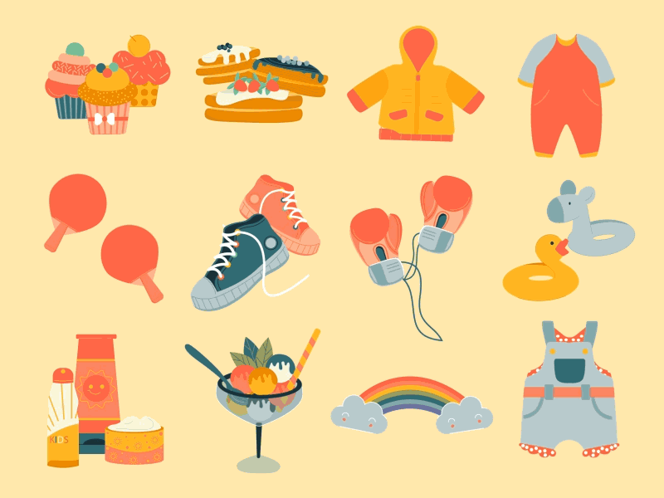



Unit 5
My clothes
Lesson 3 – Task 4,5,6

Slide 3
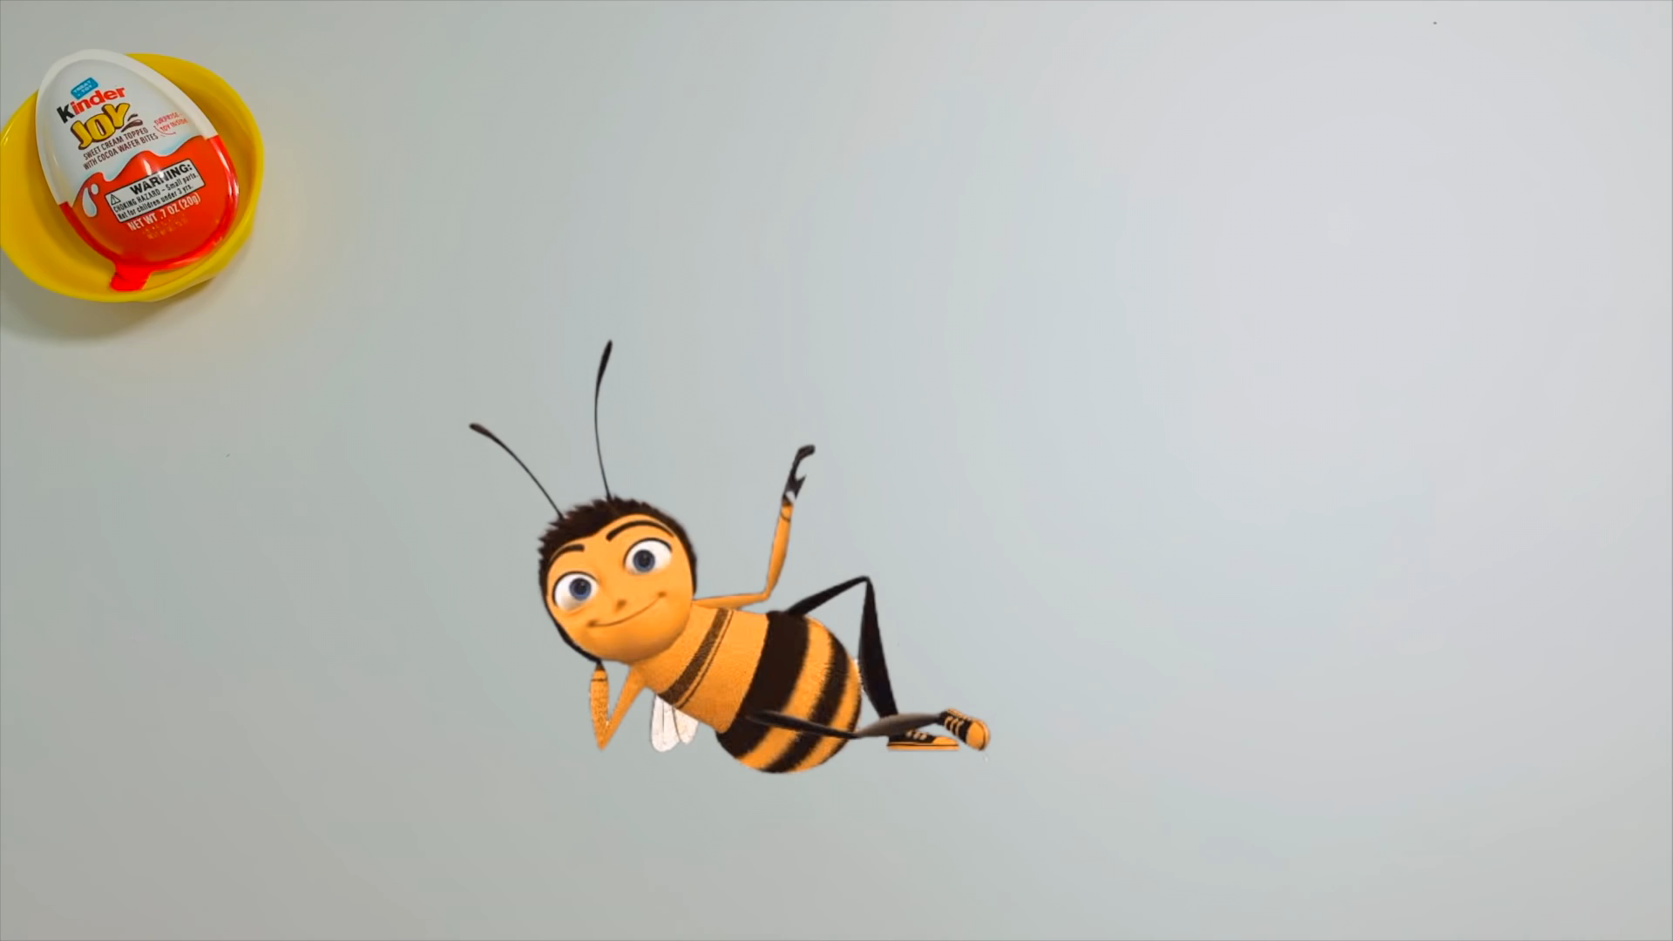

Slide 4



Start

Slide 5
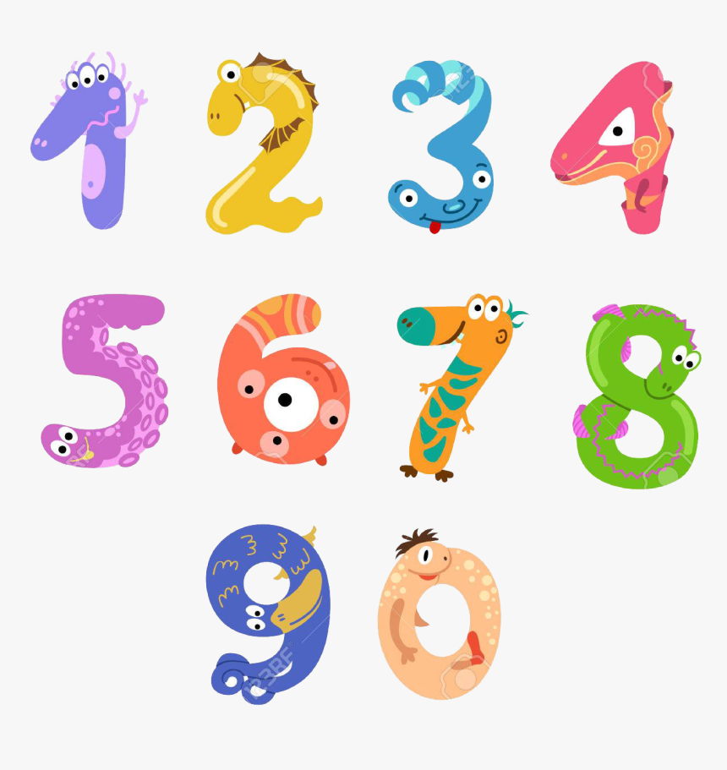
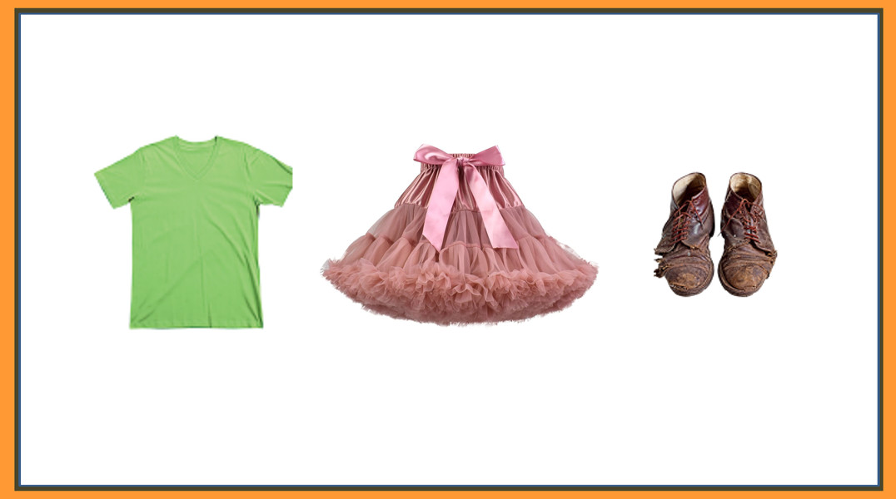
Click on the number to go to the corresponding page and continue the lesson
Next

Slide 6

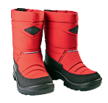
What are these?
big boots

Slide 7

What is it?
new hat

Slide 8
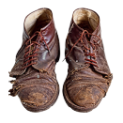
What are these?
old shoes

Slide 9
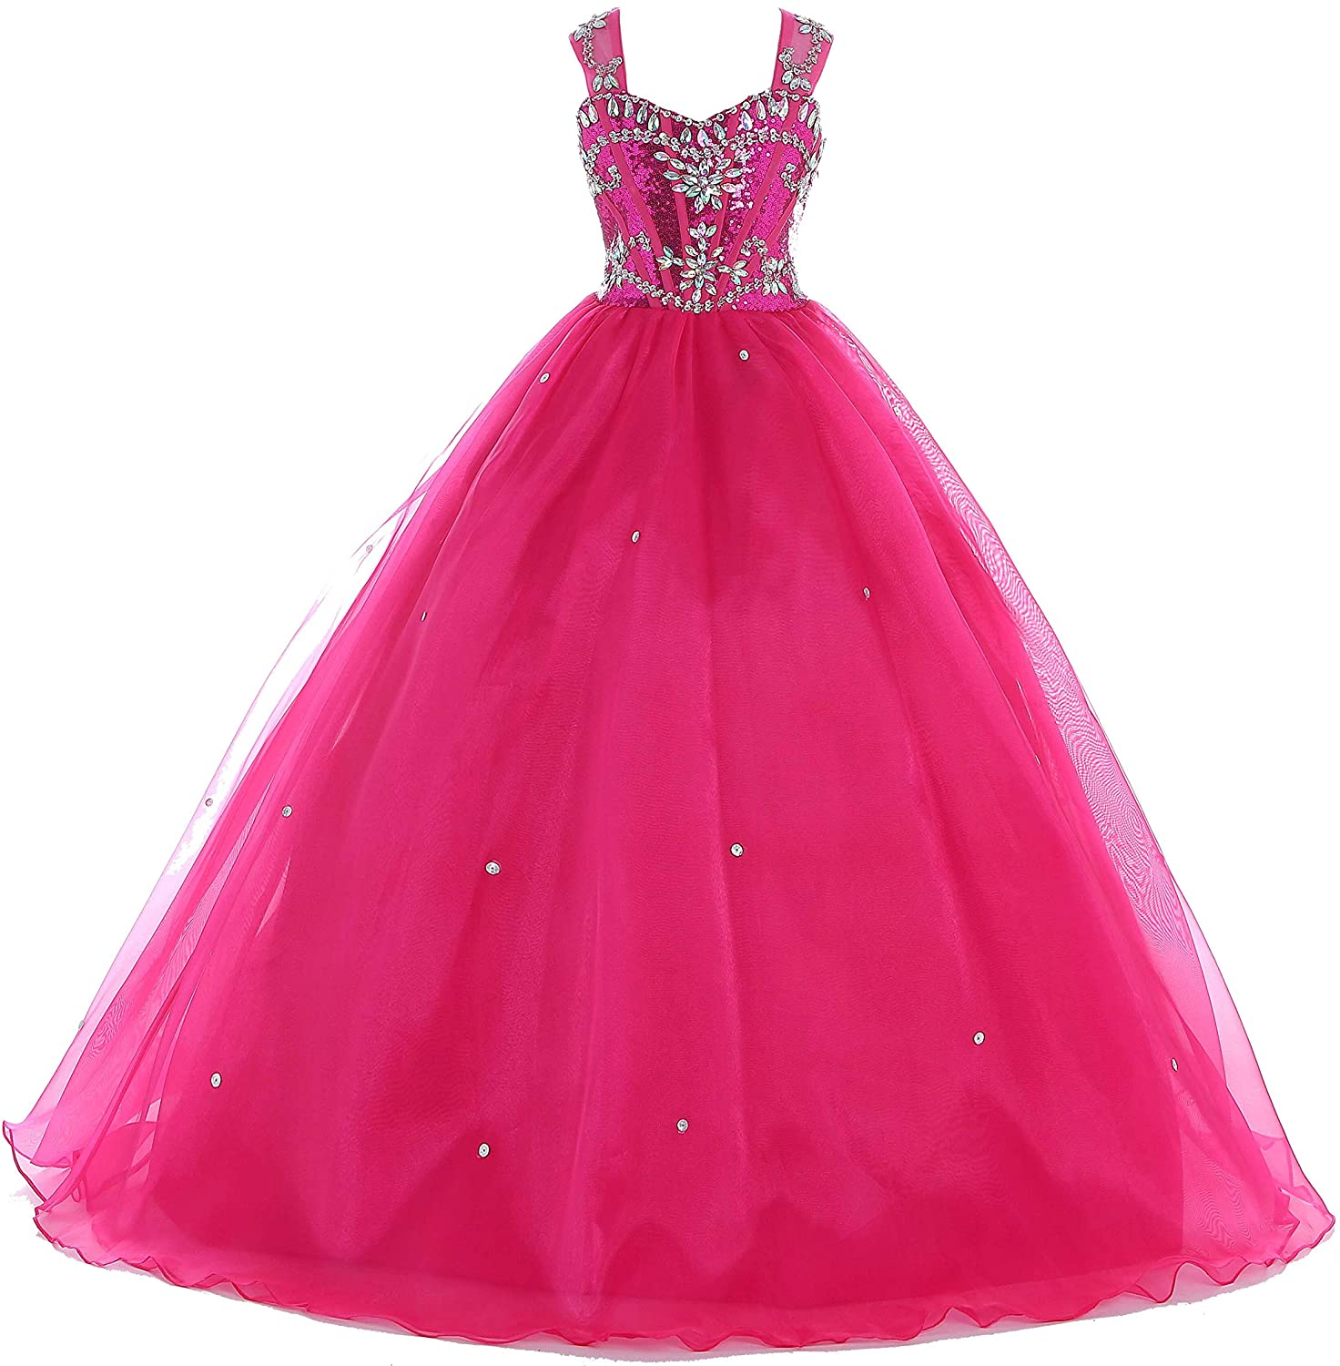
What is it?
long dress

Slide 10

What is it?
small T-shirt

Slide 11
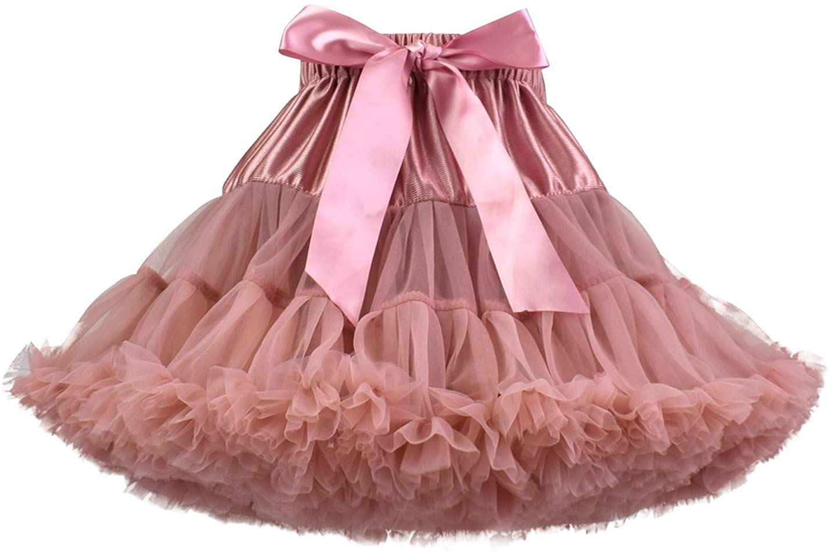
What is it?
pretty skirt

Slide 12



4.Listen and repeat.
2. She’s got a pretty skirt.
3. They’ve got old shoes.
1. I’ve got a new T-shirt.
Notes:
Bấm audio nghe
Nghe tới đâu click chuột tới đó

Slide 13
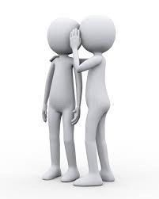
CHINESE WHISPERING GAME
2. She’s got a pretty skirt.
3. They’ve got old shoes.
1. I’ve got a new T-shirt.

Slide 14
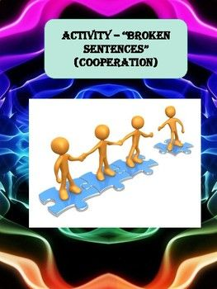
Brocken sentence

Slide 15
BROKEN SENTENCE
1. new / I’ve got / shoes.
______________________
2. nice. / Your / is / dress
______________________
3. pretty / She’s got / skirt. / a
_________________________
4. black. / Our / new / are / boots
__________________________
5. long / They’ve got / socks.
__________________________
I’ve got new shoes.
Your dress is nice.
She’s got a pretty skirt.
Our new boots are black.
They’ve got long socks.
Notes:
HOẠT ĐỘNG TƯƠNG TÁC

Slide 16
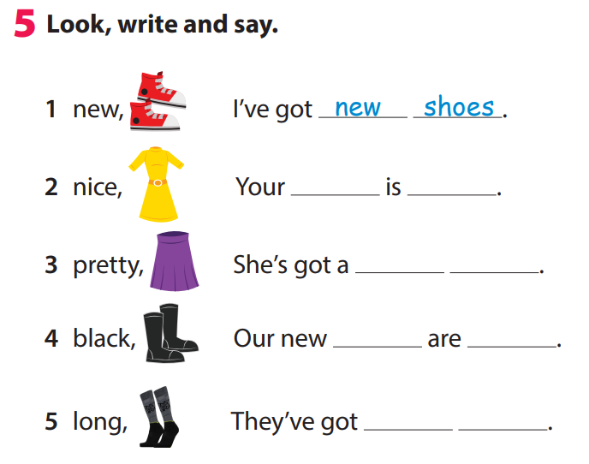
dress
nice
pretty
skirt
boots
black
long
socks

Slide 17



Slide 18
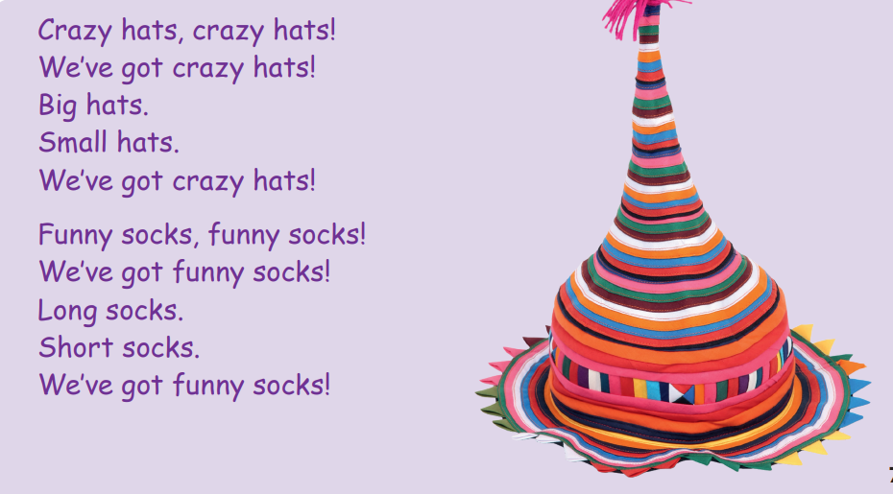

Slide 19

WONDERFUL WORLD
CONTEST

Slide 20


Slide 21
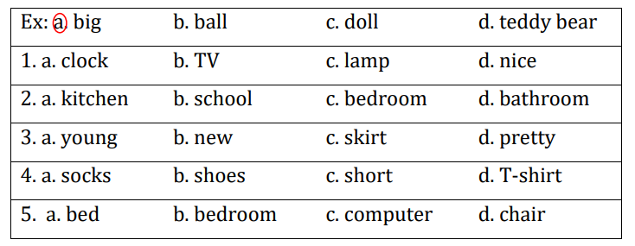
CIRCLE THE ODD ONE OUT
Notes:
HOẠT ĐỘNG TƯƠNG TÁC

Slide 22



Slide 23




Good bye.
See you again!

