Slide 1




















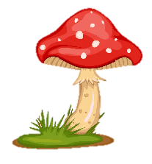
Notes:
Để nguyên trang bìa như này, chỉ thay đổi tên bài trong quá trình làm. Logo của sách Wonderful World

Slide 2
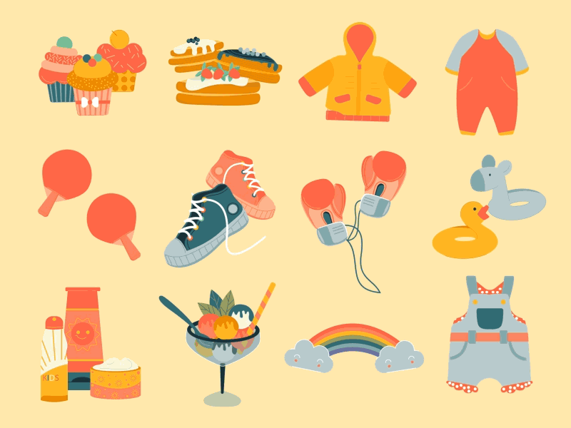



Unit 5
My clothes
Lesson 3 – Task 7,8,9

Slide 3


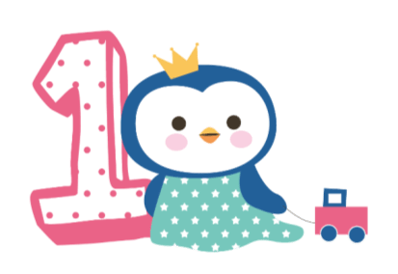



Warm up
Song: A ram sam sam

Slide 4

Sing and do

Slide 5


Slide 6
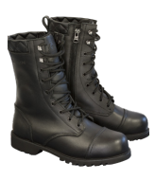

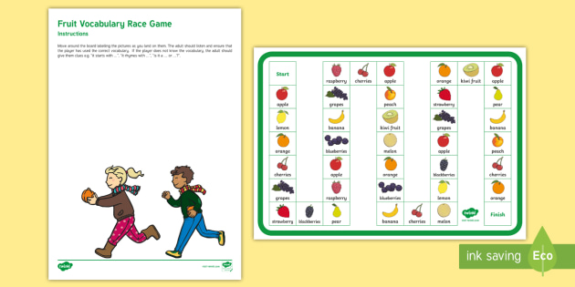


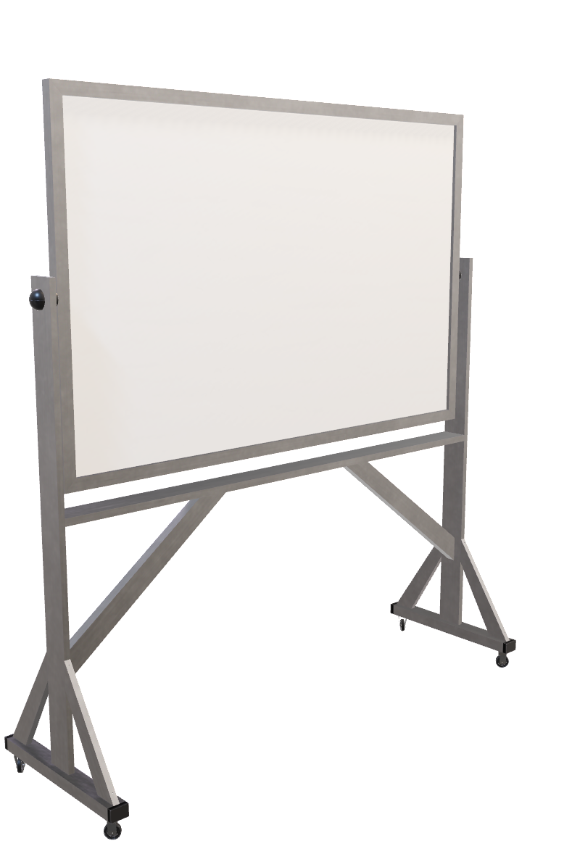
Board race
Group 1
Group 2

Slide 7

Presentation
Task 7: Listen and repeat

Slide 8
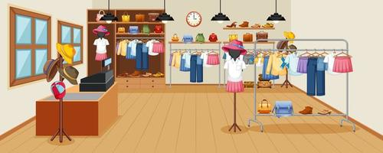
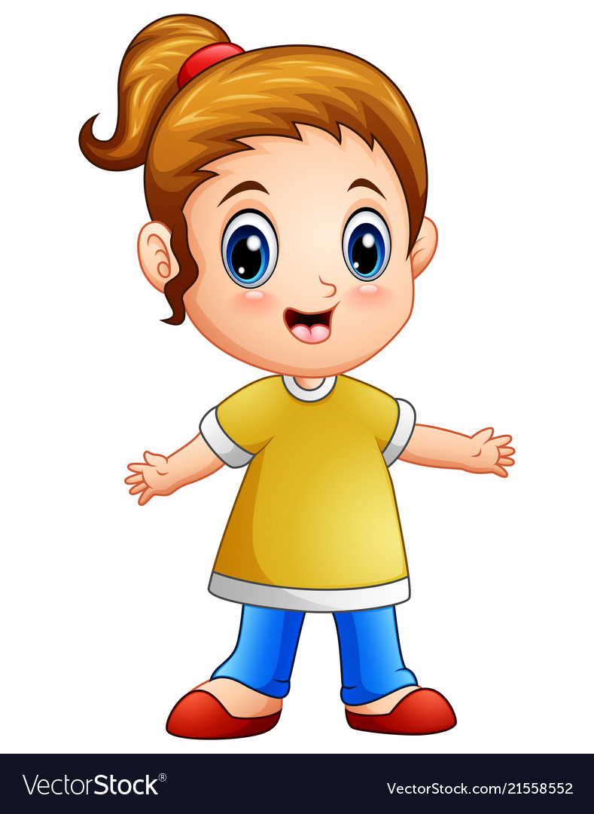

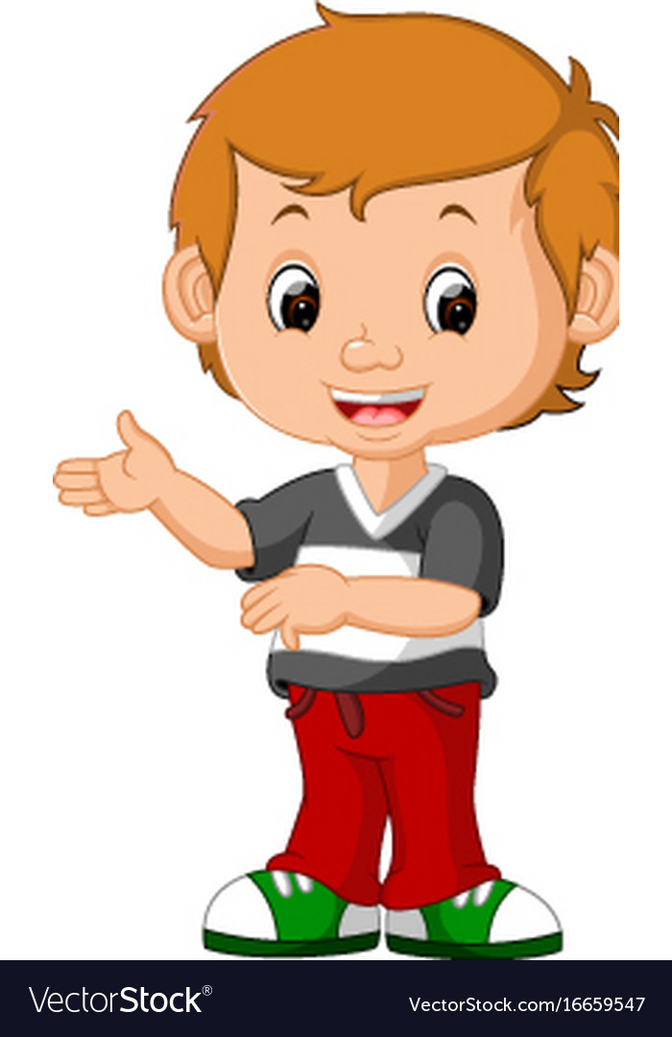
At the clothes shop
b
boots
ou
trousers
Notes:
Bấm vào audio nghe lần lượt

Slide 9
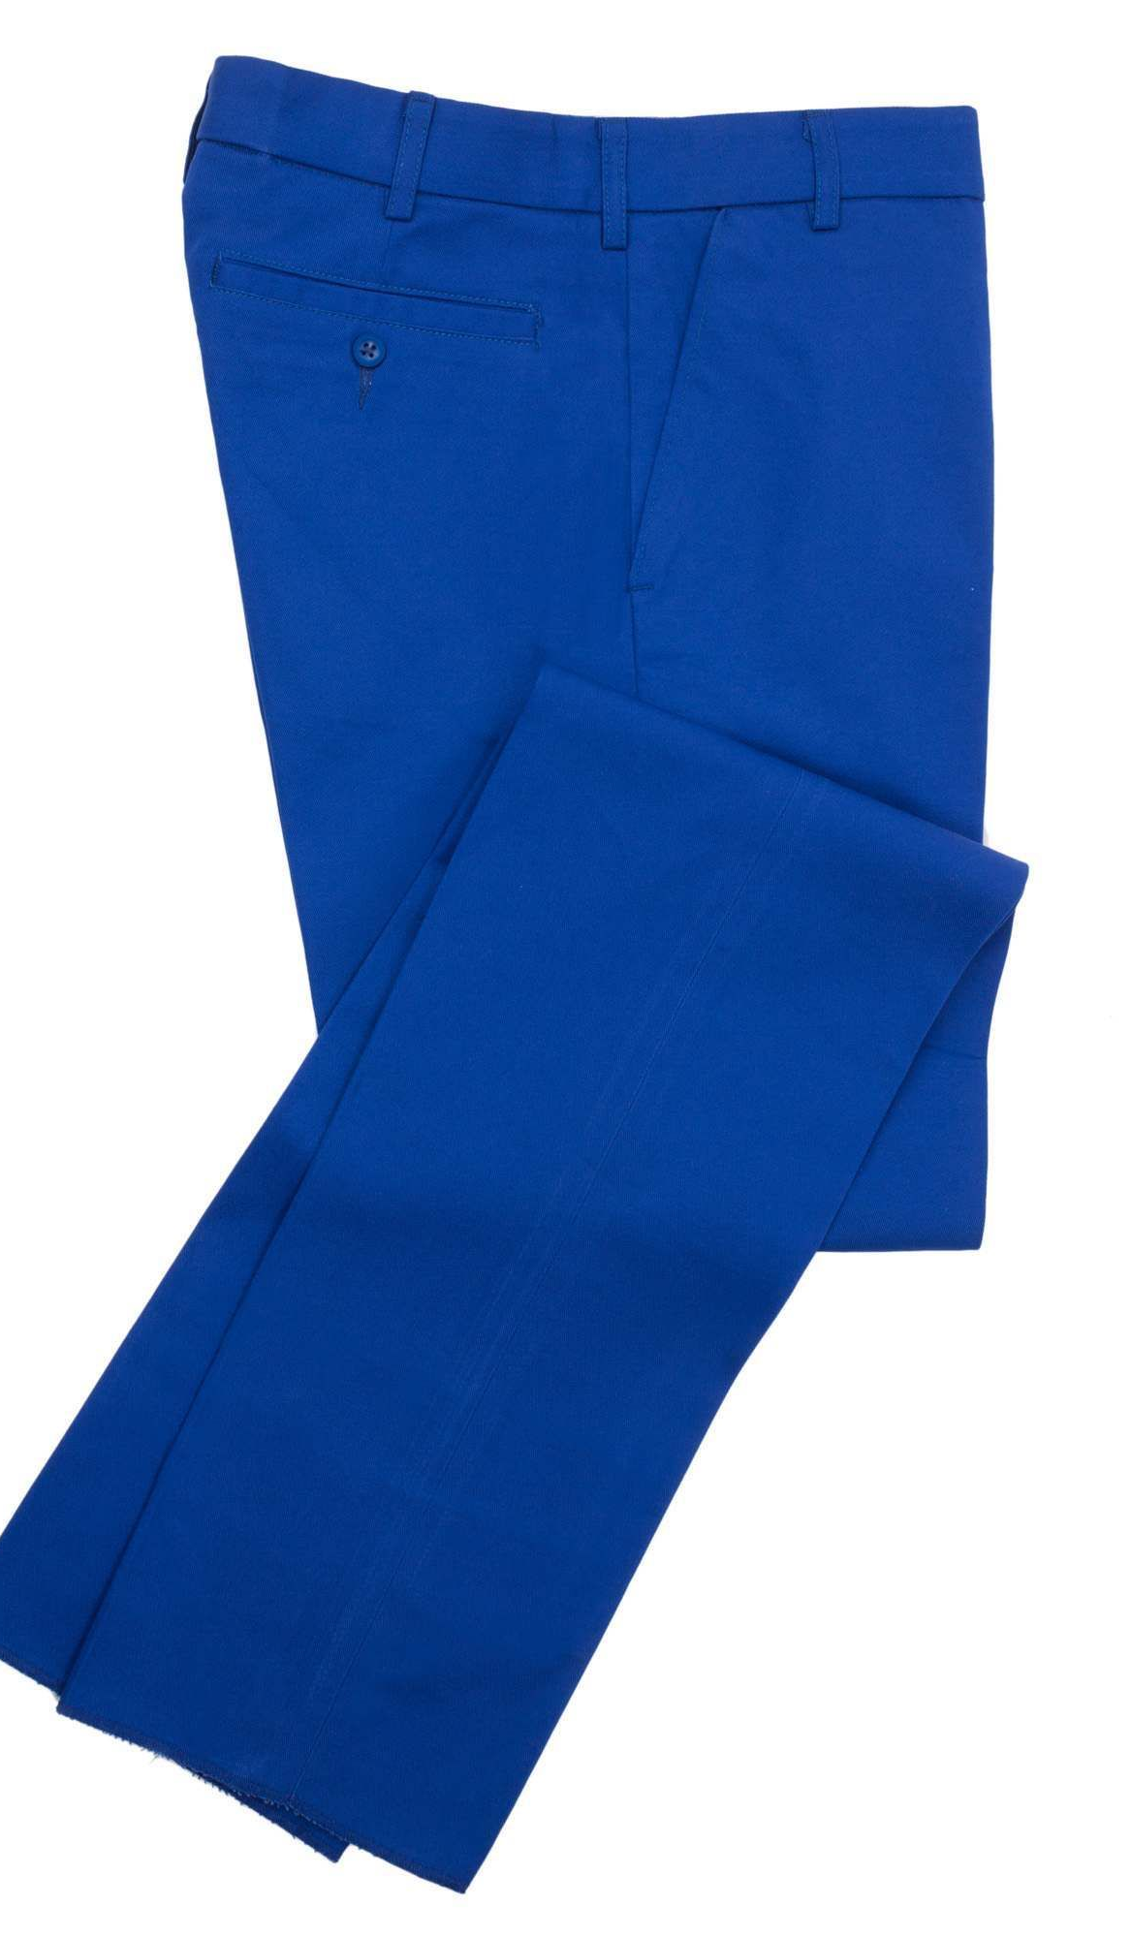
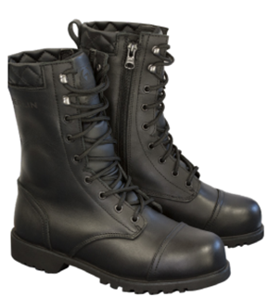
At the clothes shop
I’ve got blue trousers and black boots
Notes:
Bấm vào audio

Slide 10
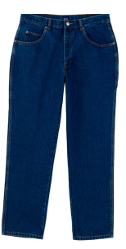

7
Listen and repeat.
trousers
boots
I’ve got blue trousers and black boots.

Slide 11
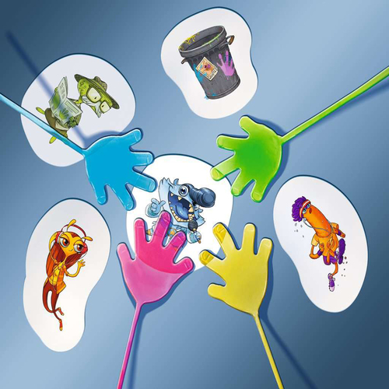
Slap the board👉

Slide 12
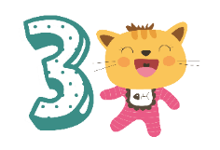
Practice
Task 8: Listen and chant

Slide 13
8
Listen and chant.
I’ve got big boots!
I’ve got trousers in my house!

Slide 14
8
Listen and chant.
B,b, b.
Big, big, big.
Boots, boots, boots!
I’ve got big boots!
Ou, ou, ou.
Trousers, trousers, trousers.
House, house, house.
I’ve got trousers in my house!

Slide 15
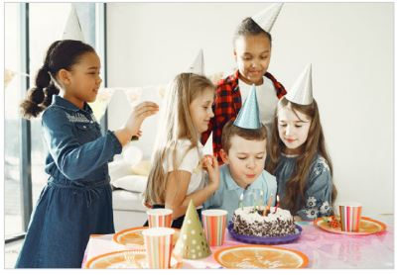
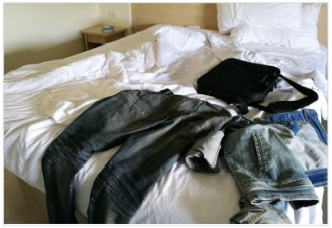
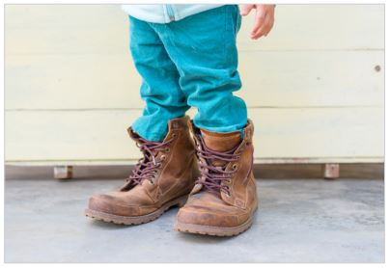
9
Say it.
Look, read and match
1
2
3
There are trousers on the bed.
We’re in the house.
It’s my birthday.
I’ve got big boots.
Notes:
HOẠT ĐỘNG TƯƠNG TÁC

Slide 16
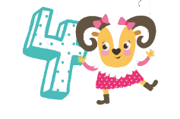
Production

Slide 17
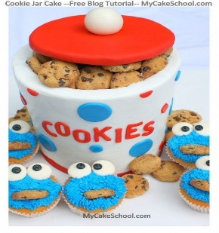
Cookies jar
Notes:
Ask sts to prepare one cookie jar for each group; they can bring some cookies or candies and put them in the jar. For each phonics lesson, they can take it out and use
- Ask sts to work in groups
- Ask them to discuss and find their own word that has the sound they have learned and collect them in a jar. Each word is correct they can take out one cookie/candy for their own
-Groups take turns to say out loud the word’s content sound. The group having the most words/ cookies wins the game.

Slide 18
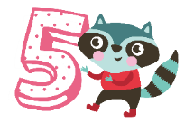
Assessment
Write the words in
correct column

Slide 19
Write the words in the correct column.
trousers / boots / house/ big/ down/ ball
/aʊ/ | /b/
trousers
boots
house
big
down
ball

Slide 20


Slide 21




Good bye.
See you again!

