Slide 1




















Notes:
Để nguyên trang bìa như này, chỉ thay đổi tên bài trong quá trình làm. Logo của sách Wonderful World

Slide 2






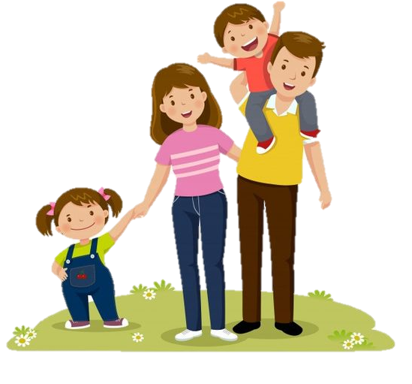
Unit 6:
Outdoor Activities
Fun time & Project

Slide 3
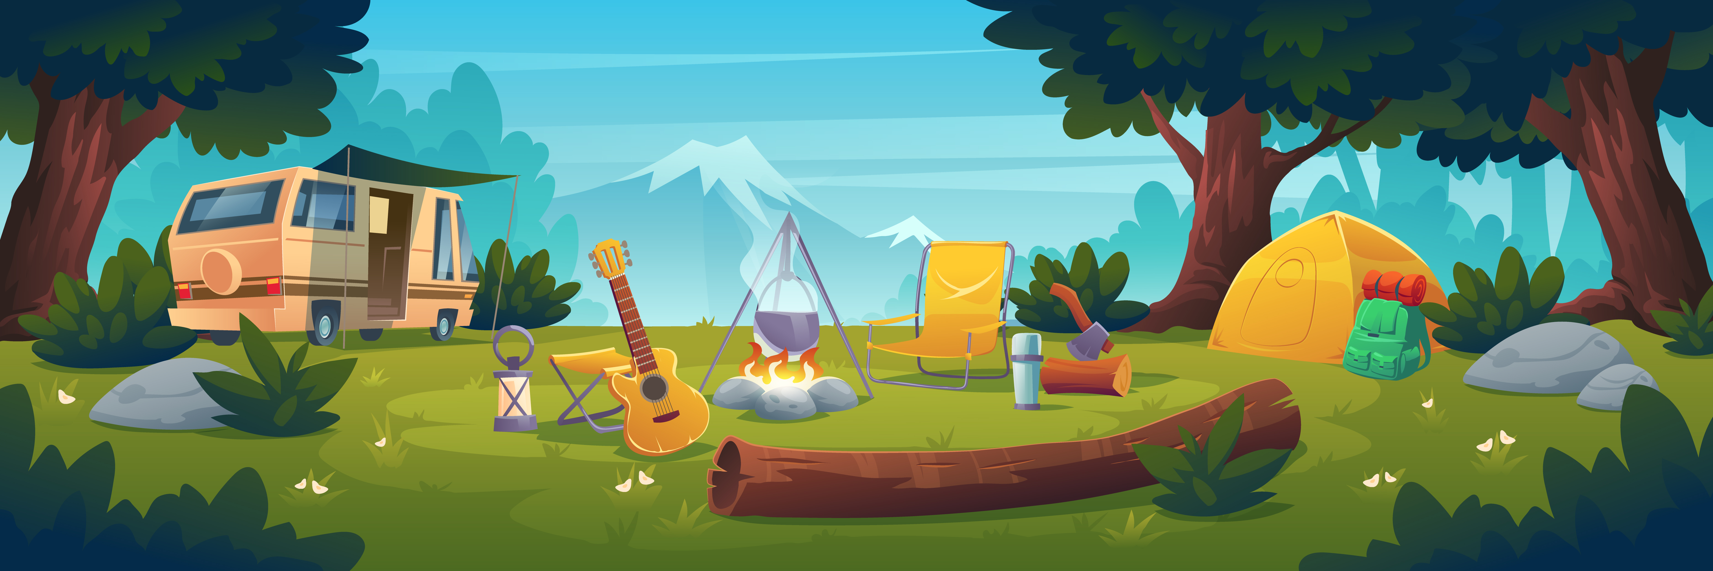
01
WARM-UP

Slide 4
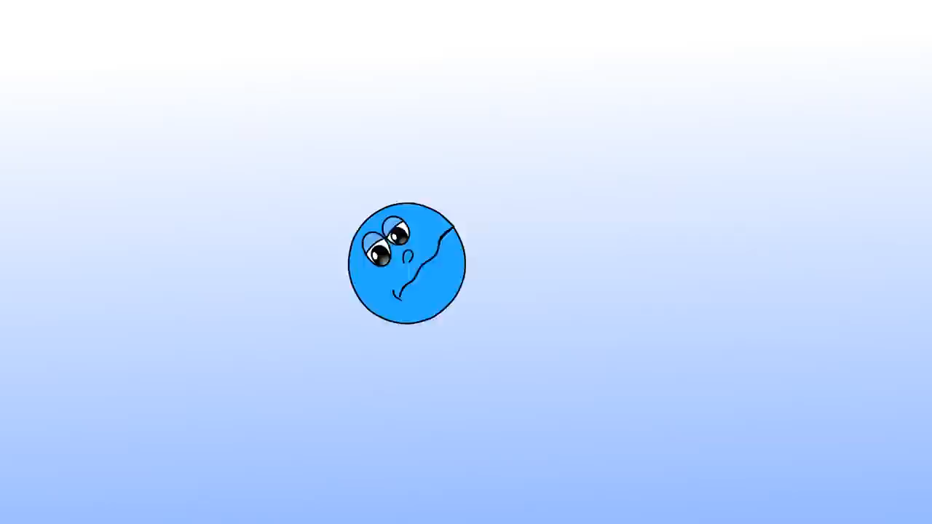
Listen and sing!

Slide 5
02
PRESENTATION

Slide 6
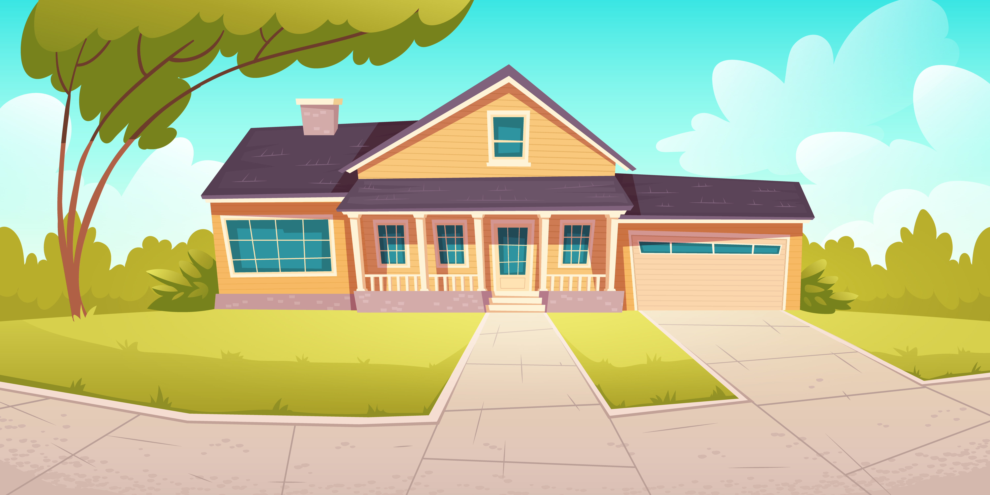
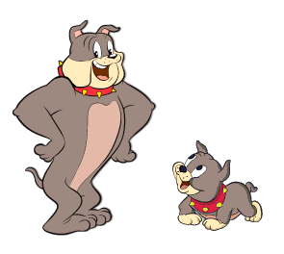
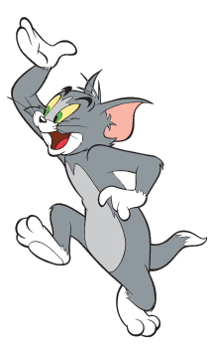
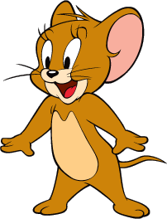
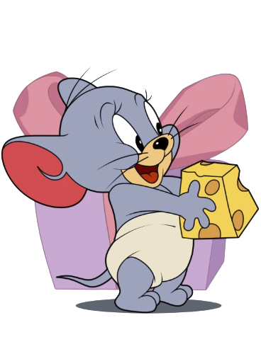
Tom and Jerry Puzzle!

Slide 7
Pick A Character!
Next

Slide 8
c i p i n c
  picnic
back

Slide 9
k h i n g i
  hiking
back

Slide 10
t i a o u m n n
  mountain
back

Slide 11
r f e m p c a i
  campfire
back

Slide 12
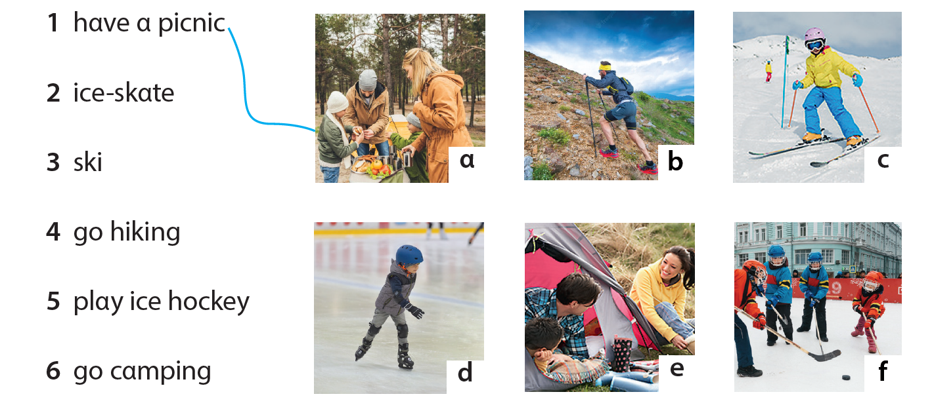
1. Match!
2
3
4
5
6

Slide 13
03
PROJECT

Slide 14
Let’s draw a camp!

Slide 15
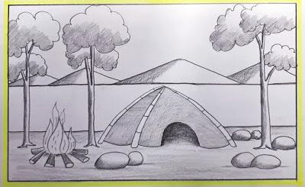
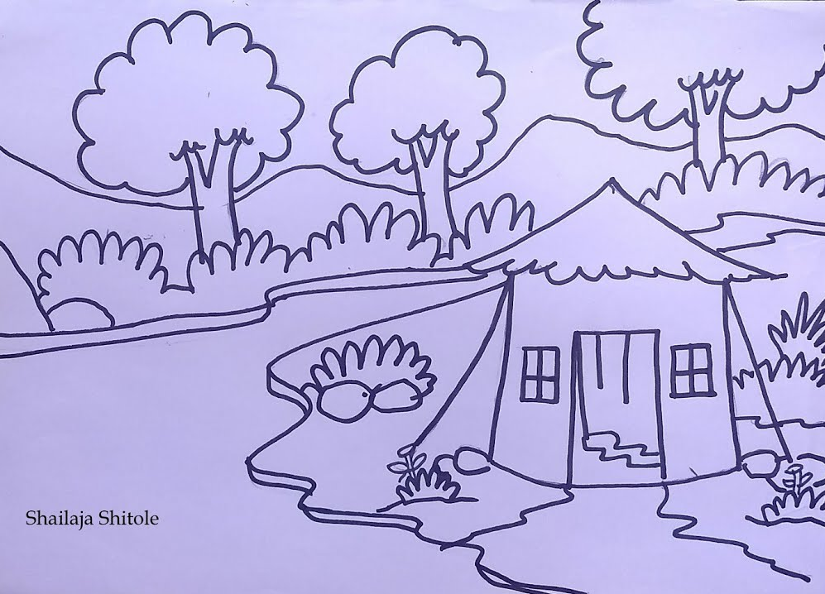
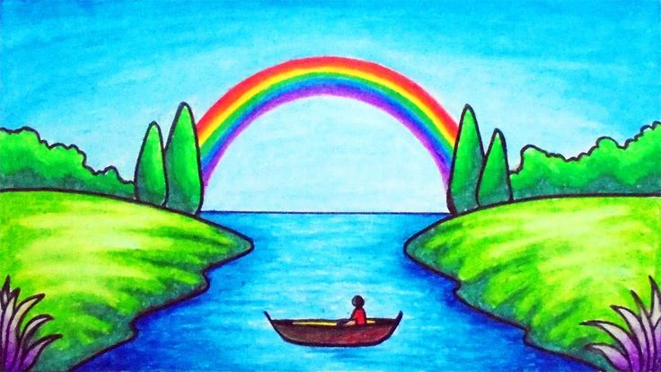
Imagine. What is your outdoor camp like?

Slide 16
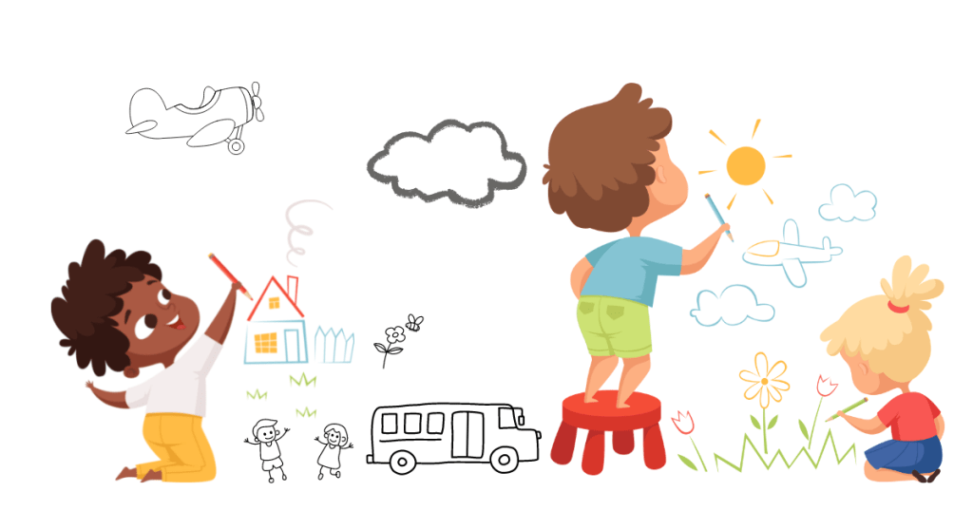
It’s time to draw!

Slide 17
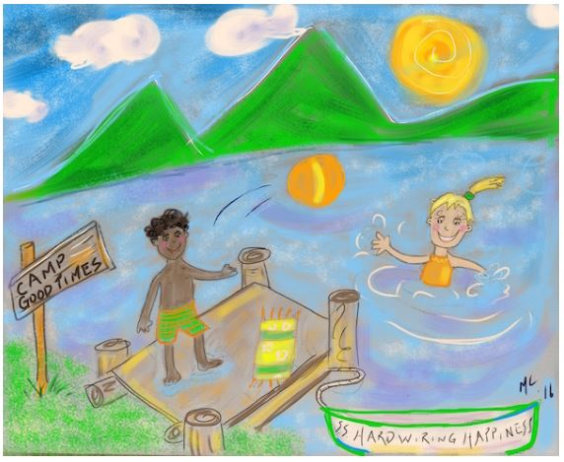
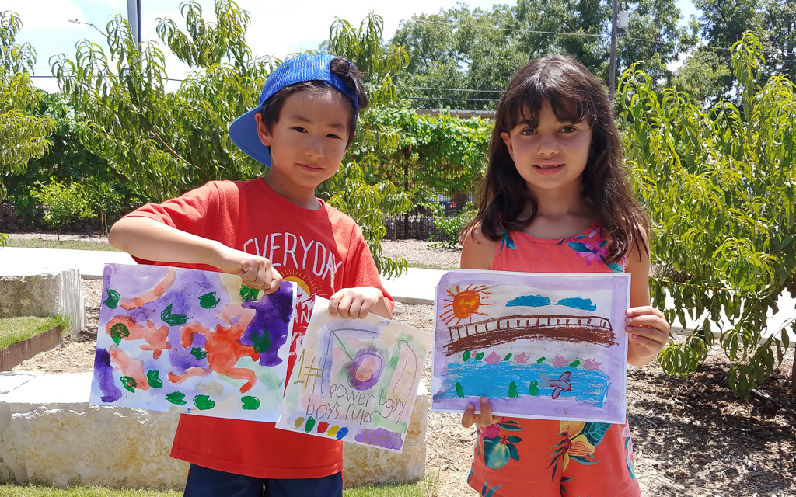
Show off your drawings!

Slide 18
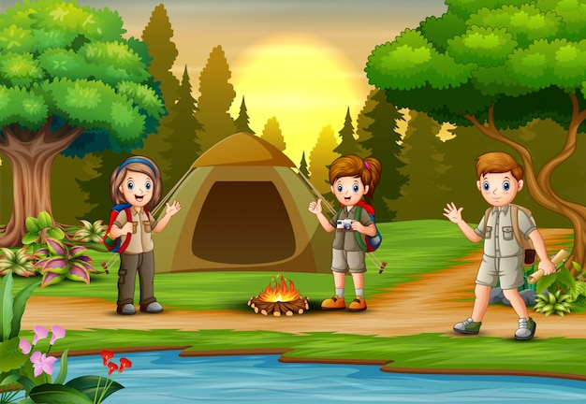
Describe your camp. What can you do?
We cαn pitch α tent αnd hαve α picnic, but we cαn't go hiking.

Slide 19
04
ASSESSMENT

Slide 20
Circle the correct answer
We can go camping … the sea.
on B. near C. at
We can’t have a picnic today because it’s ….
sunny B. warm C. rainy
3. He can go swimming … the pool.
on B. near C. in
4. They can’t play ice hockey today because it’s ….
hot B. cold C. snowy

Slide 21


Thank you
& goodbye!

