Slide 1




















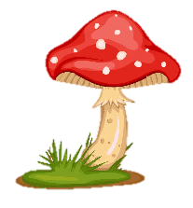
Notes:
Để nguyên trang bìa như này, chỉ thay đổi tên bài trong quá trình làm. Logo của sách Wonderful World

Slide 2
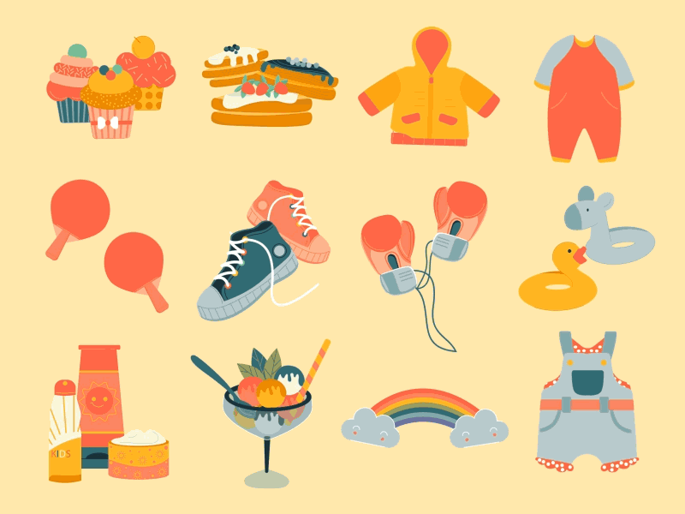



Unit 5
My clothes
Fun time

Slide 3


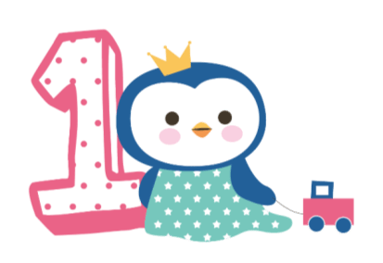



Activity 1
Fun time

Slide 4


1
Sing
a
song

Slide 5


Slide 6
2
Match

Slide 7
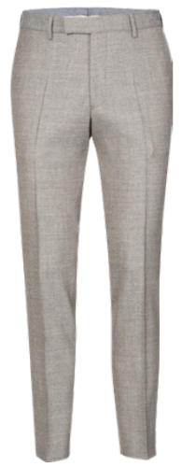
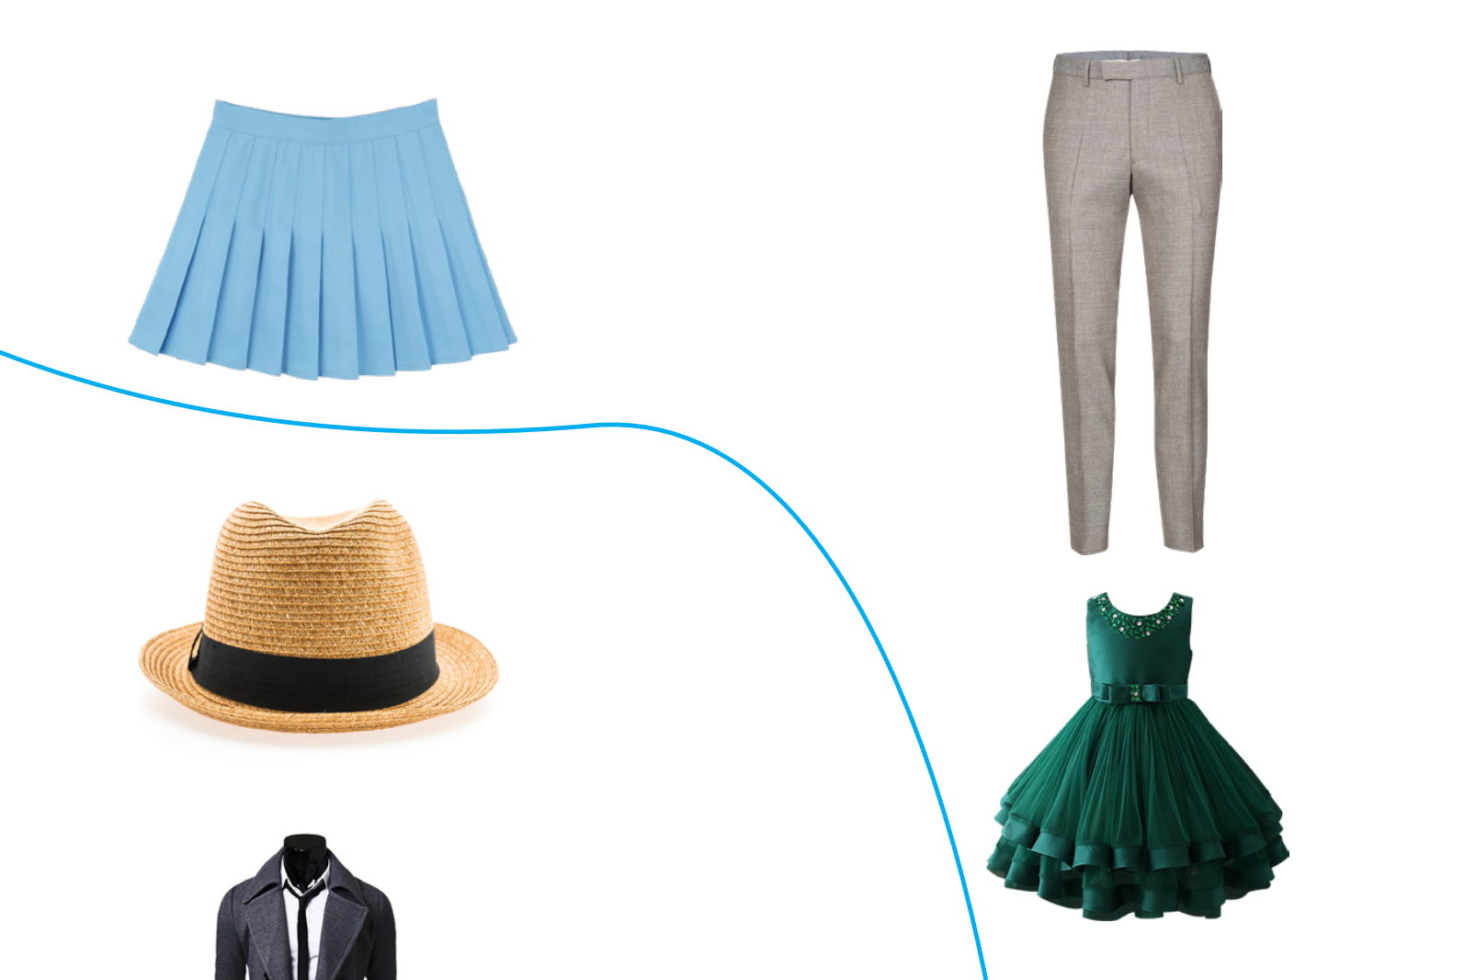
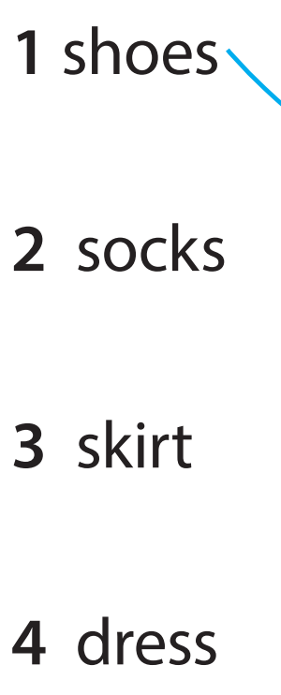
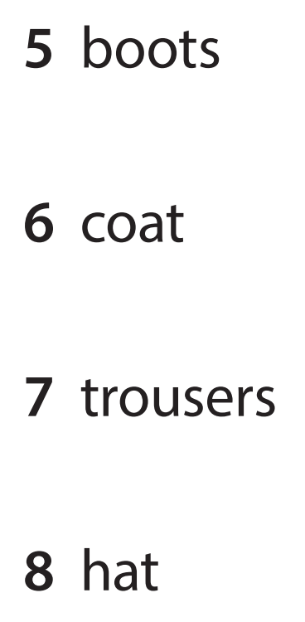
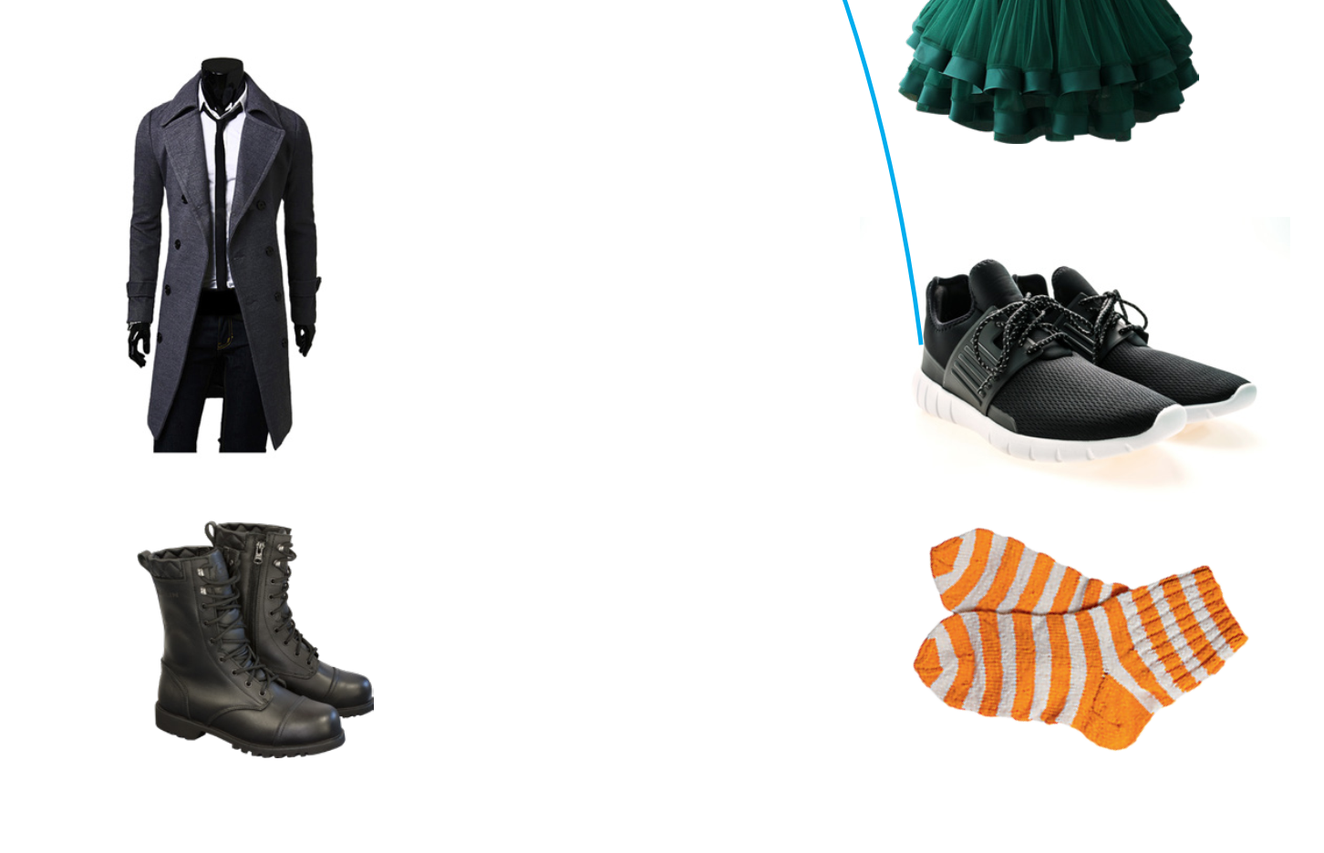
Notes:
HOẠT ĐỘNG TƯƠNG TÁC

Slide 8
3
Project

Slide 9

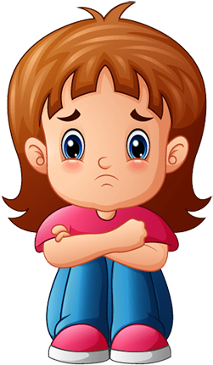
Magic Wardrobe
Lucy

Slide 10
Magic Wardrobe
She’s got a skirt.

Slide 11
Magic Wardrobe
She’s got black shoes.

Slide 12
Magic Wardrobe
She’s got a green dress.

Slide 13
Magic Wardrobe
She’s got orange socks.

Slide 14
Magic Wardrobe
She’s got old trousers.

Slide 15
Magic Wardrobe
She’s got black boots.

Slide 16
Magic Wardrobe
She’s got a new hat.

Slide 17
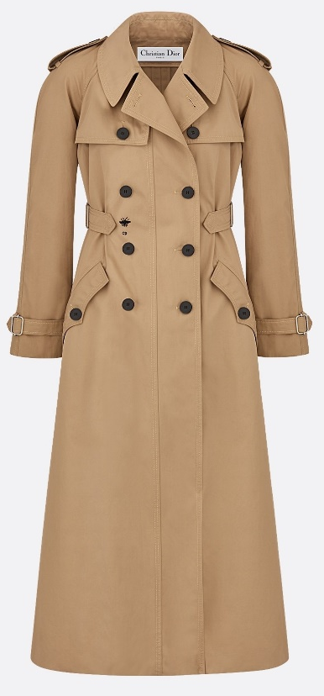
Magic Wardrobe
She’s got a long coat.

Slide 18
4
My friends

Slide 19
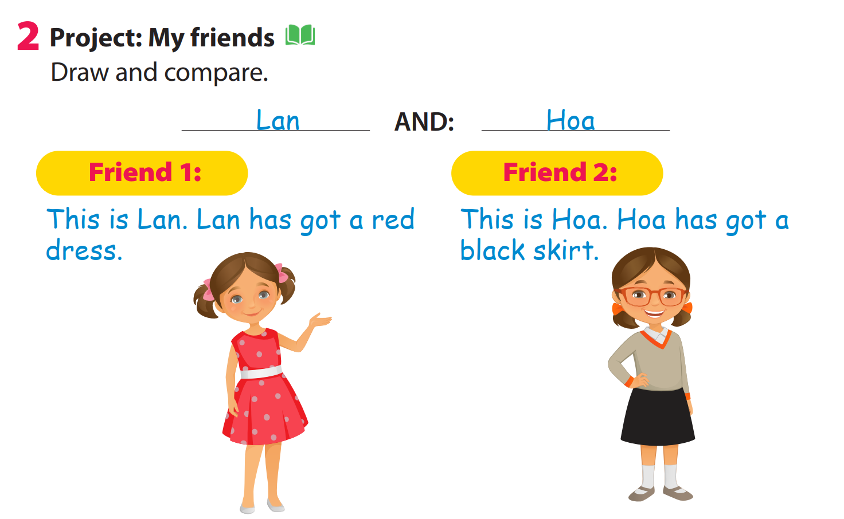
Friend 1:
Friend 2:
This is Lan.
This is Hoa.
She has got a red dress.
She has got a black skirt.

Slide 20
5
Draw

Slide 21


My friends

Slide 22




Good bye.
See you again!

