Slide 1




















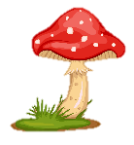
Notes:
Để nguyên trang bìa như này, chỉ thay đổi tên bài trong quá trình làm. Logo của sách Wonderful World

Slide 2





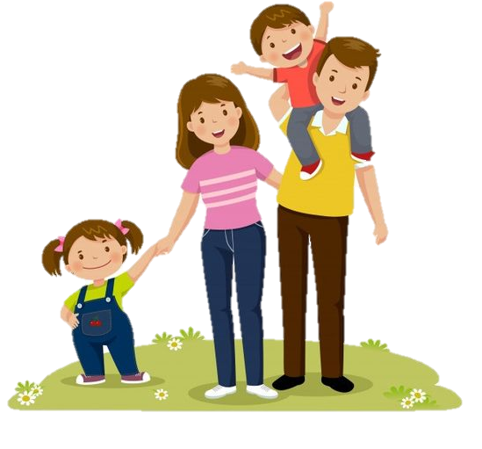
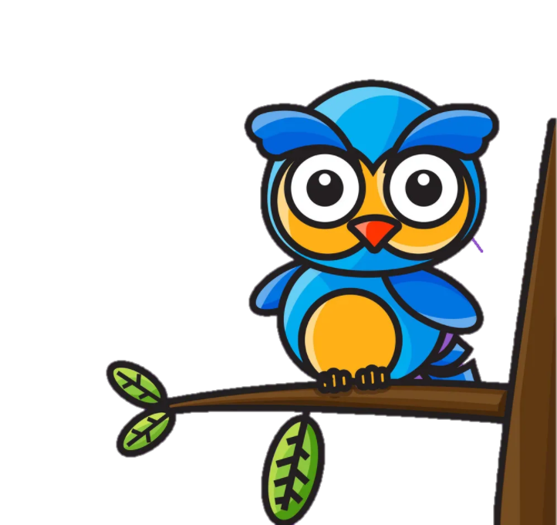


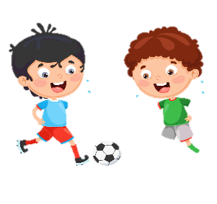


Unit 1:
MY FAMILY
AND FRIENDS
Lesson 3 – Task 4, 5, 6

Slide 3

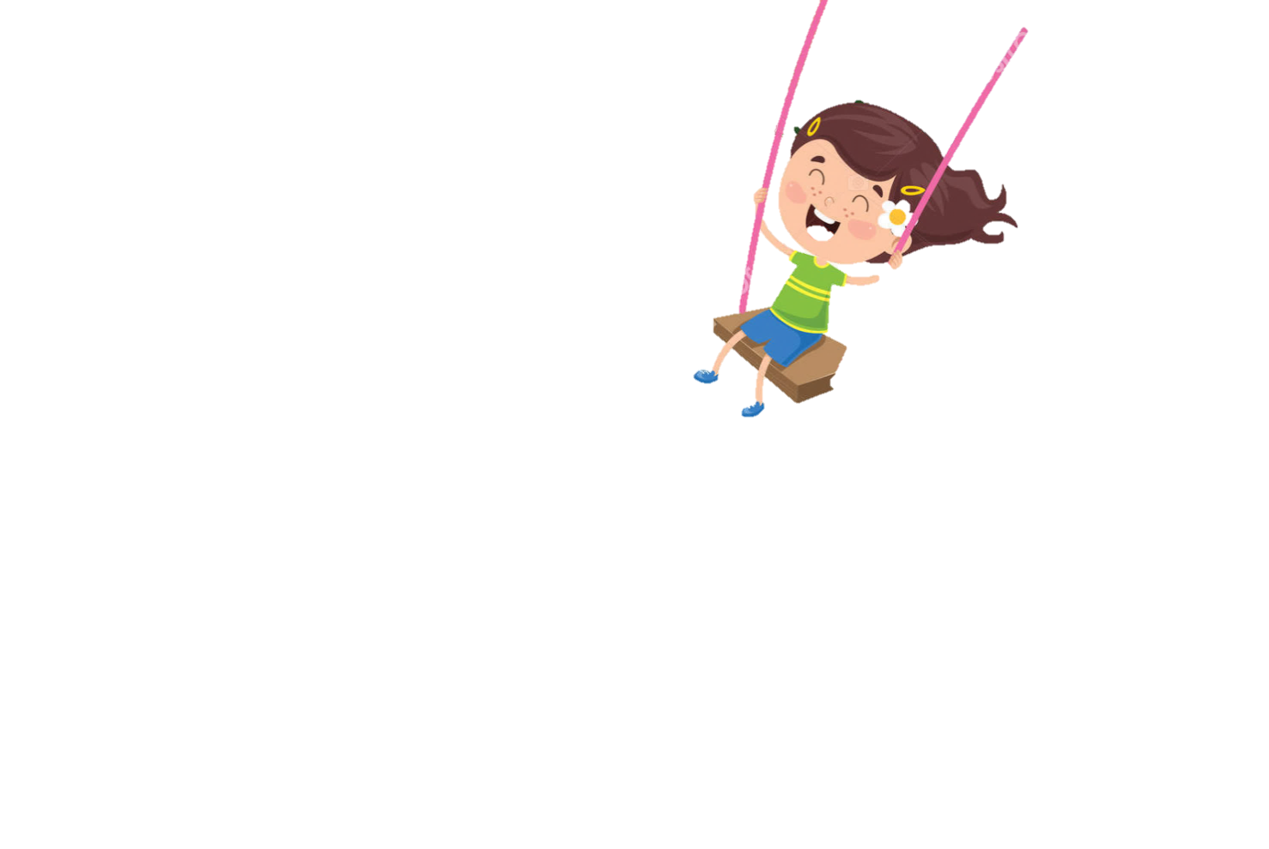
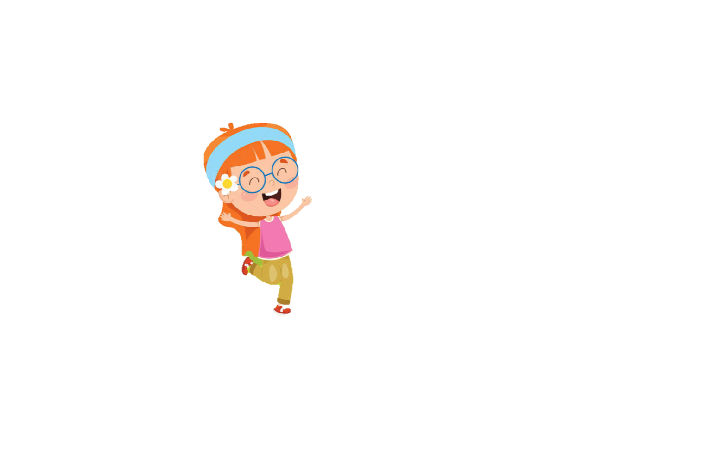

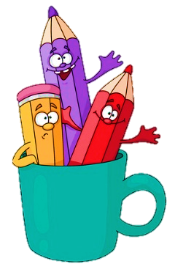
1
Warm Up

Slide 4


Presentation
2

Slide 5


little
Review
The
bee

Slide 6
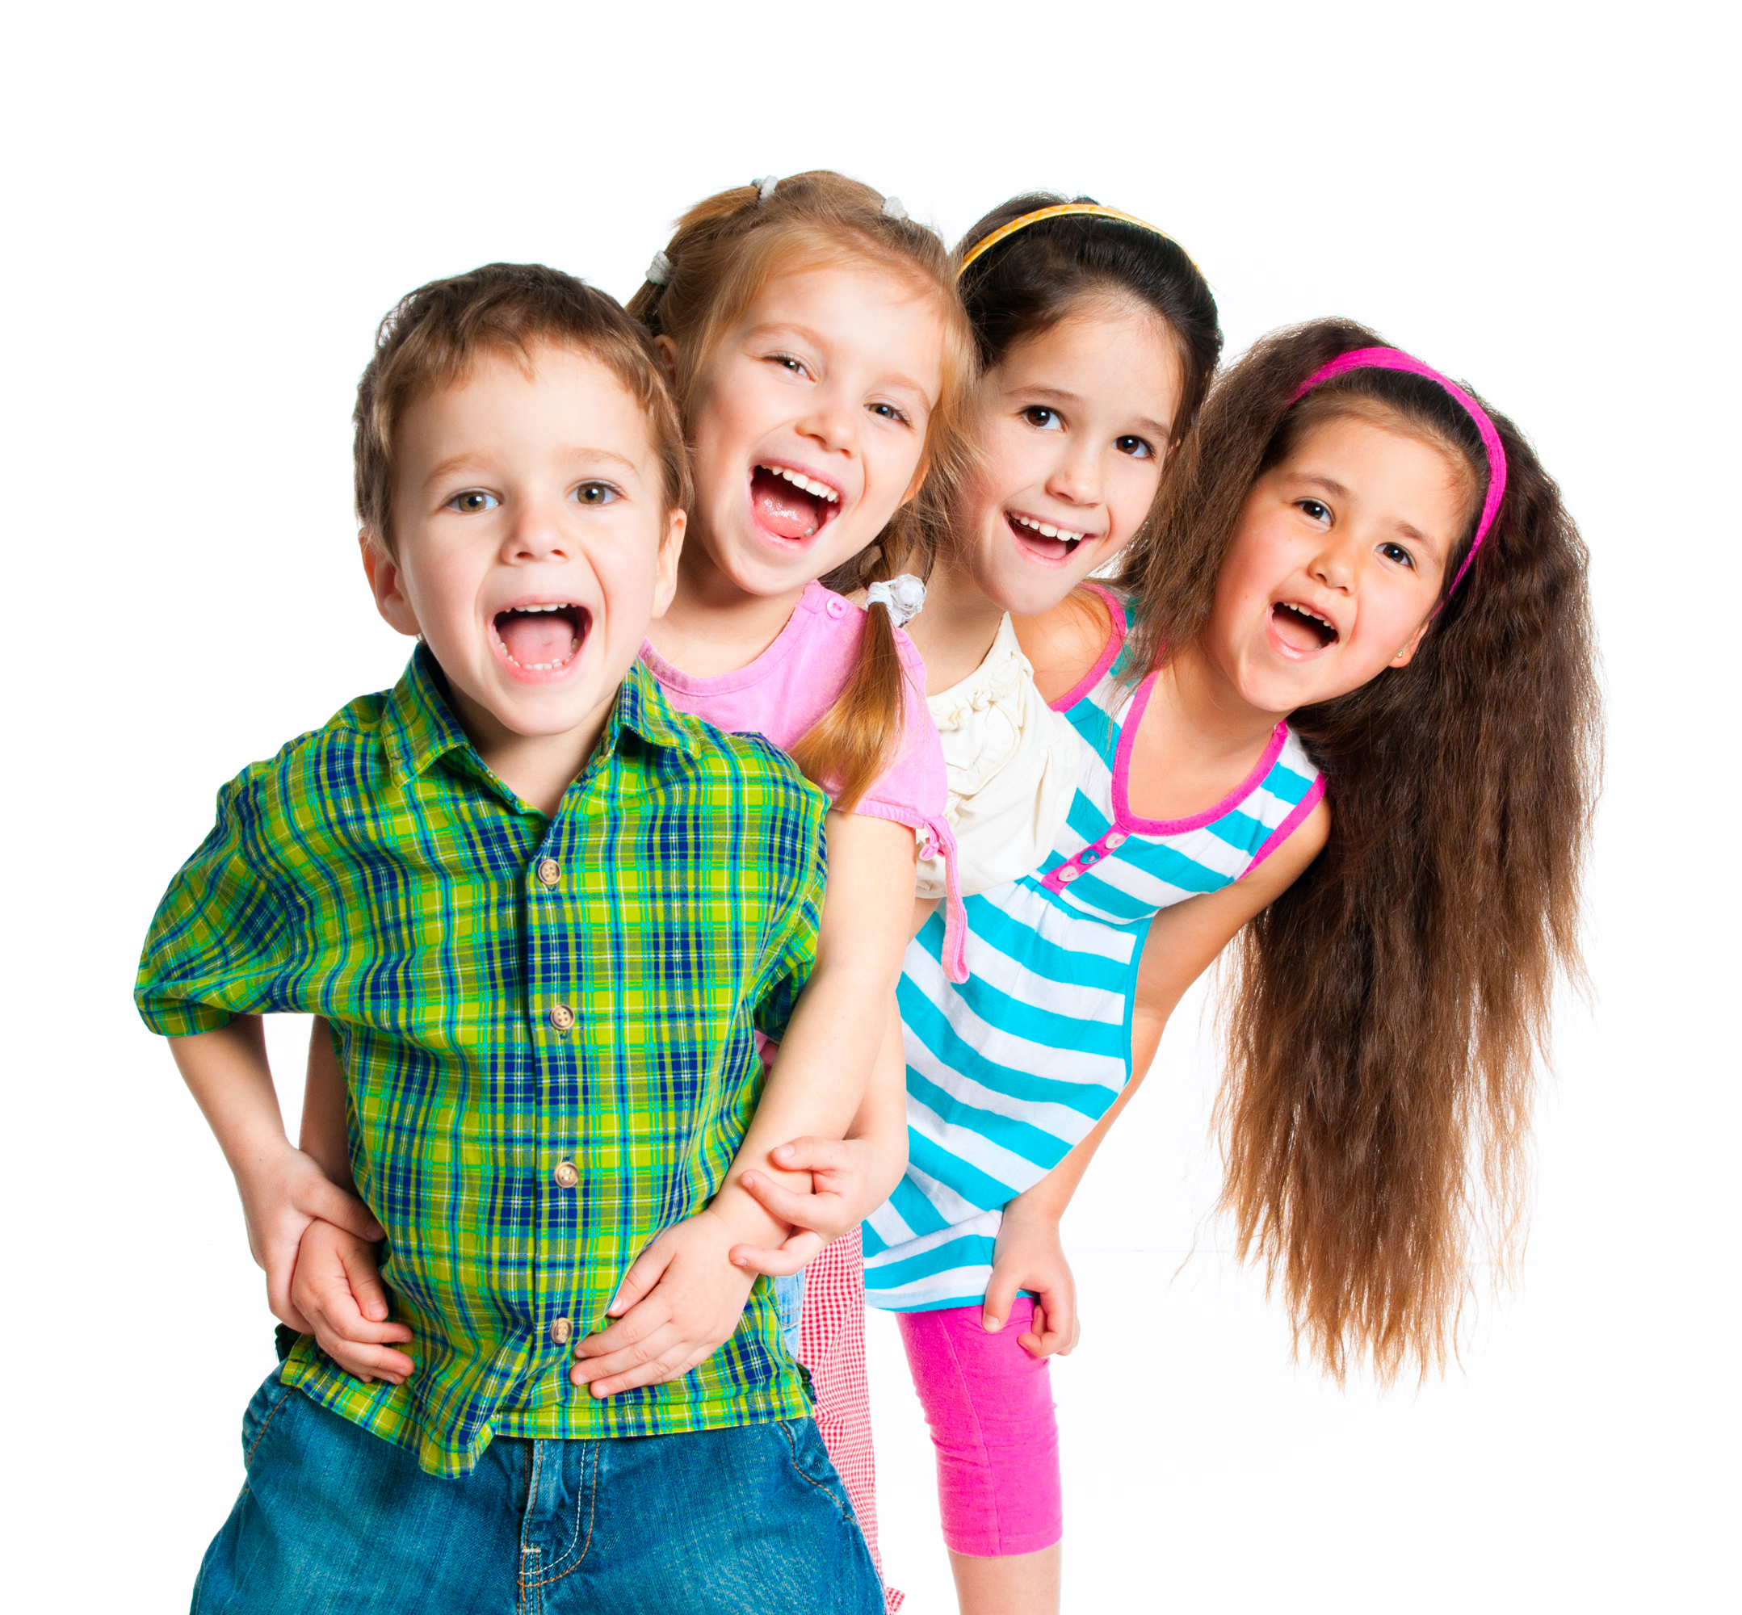
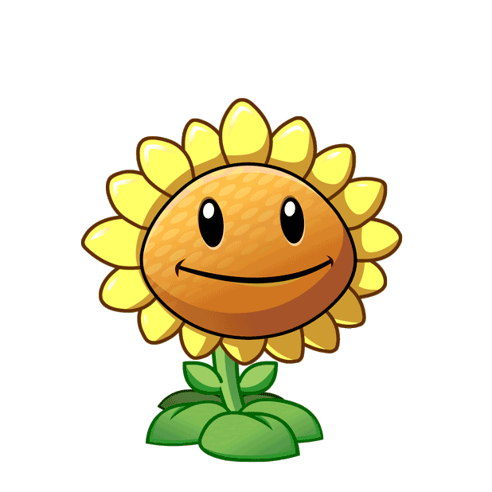
Question 1
A. cheerful
B. friendly
C. pleasant
D. hard-working

Slide 7
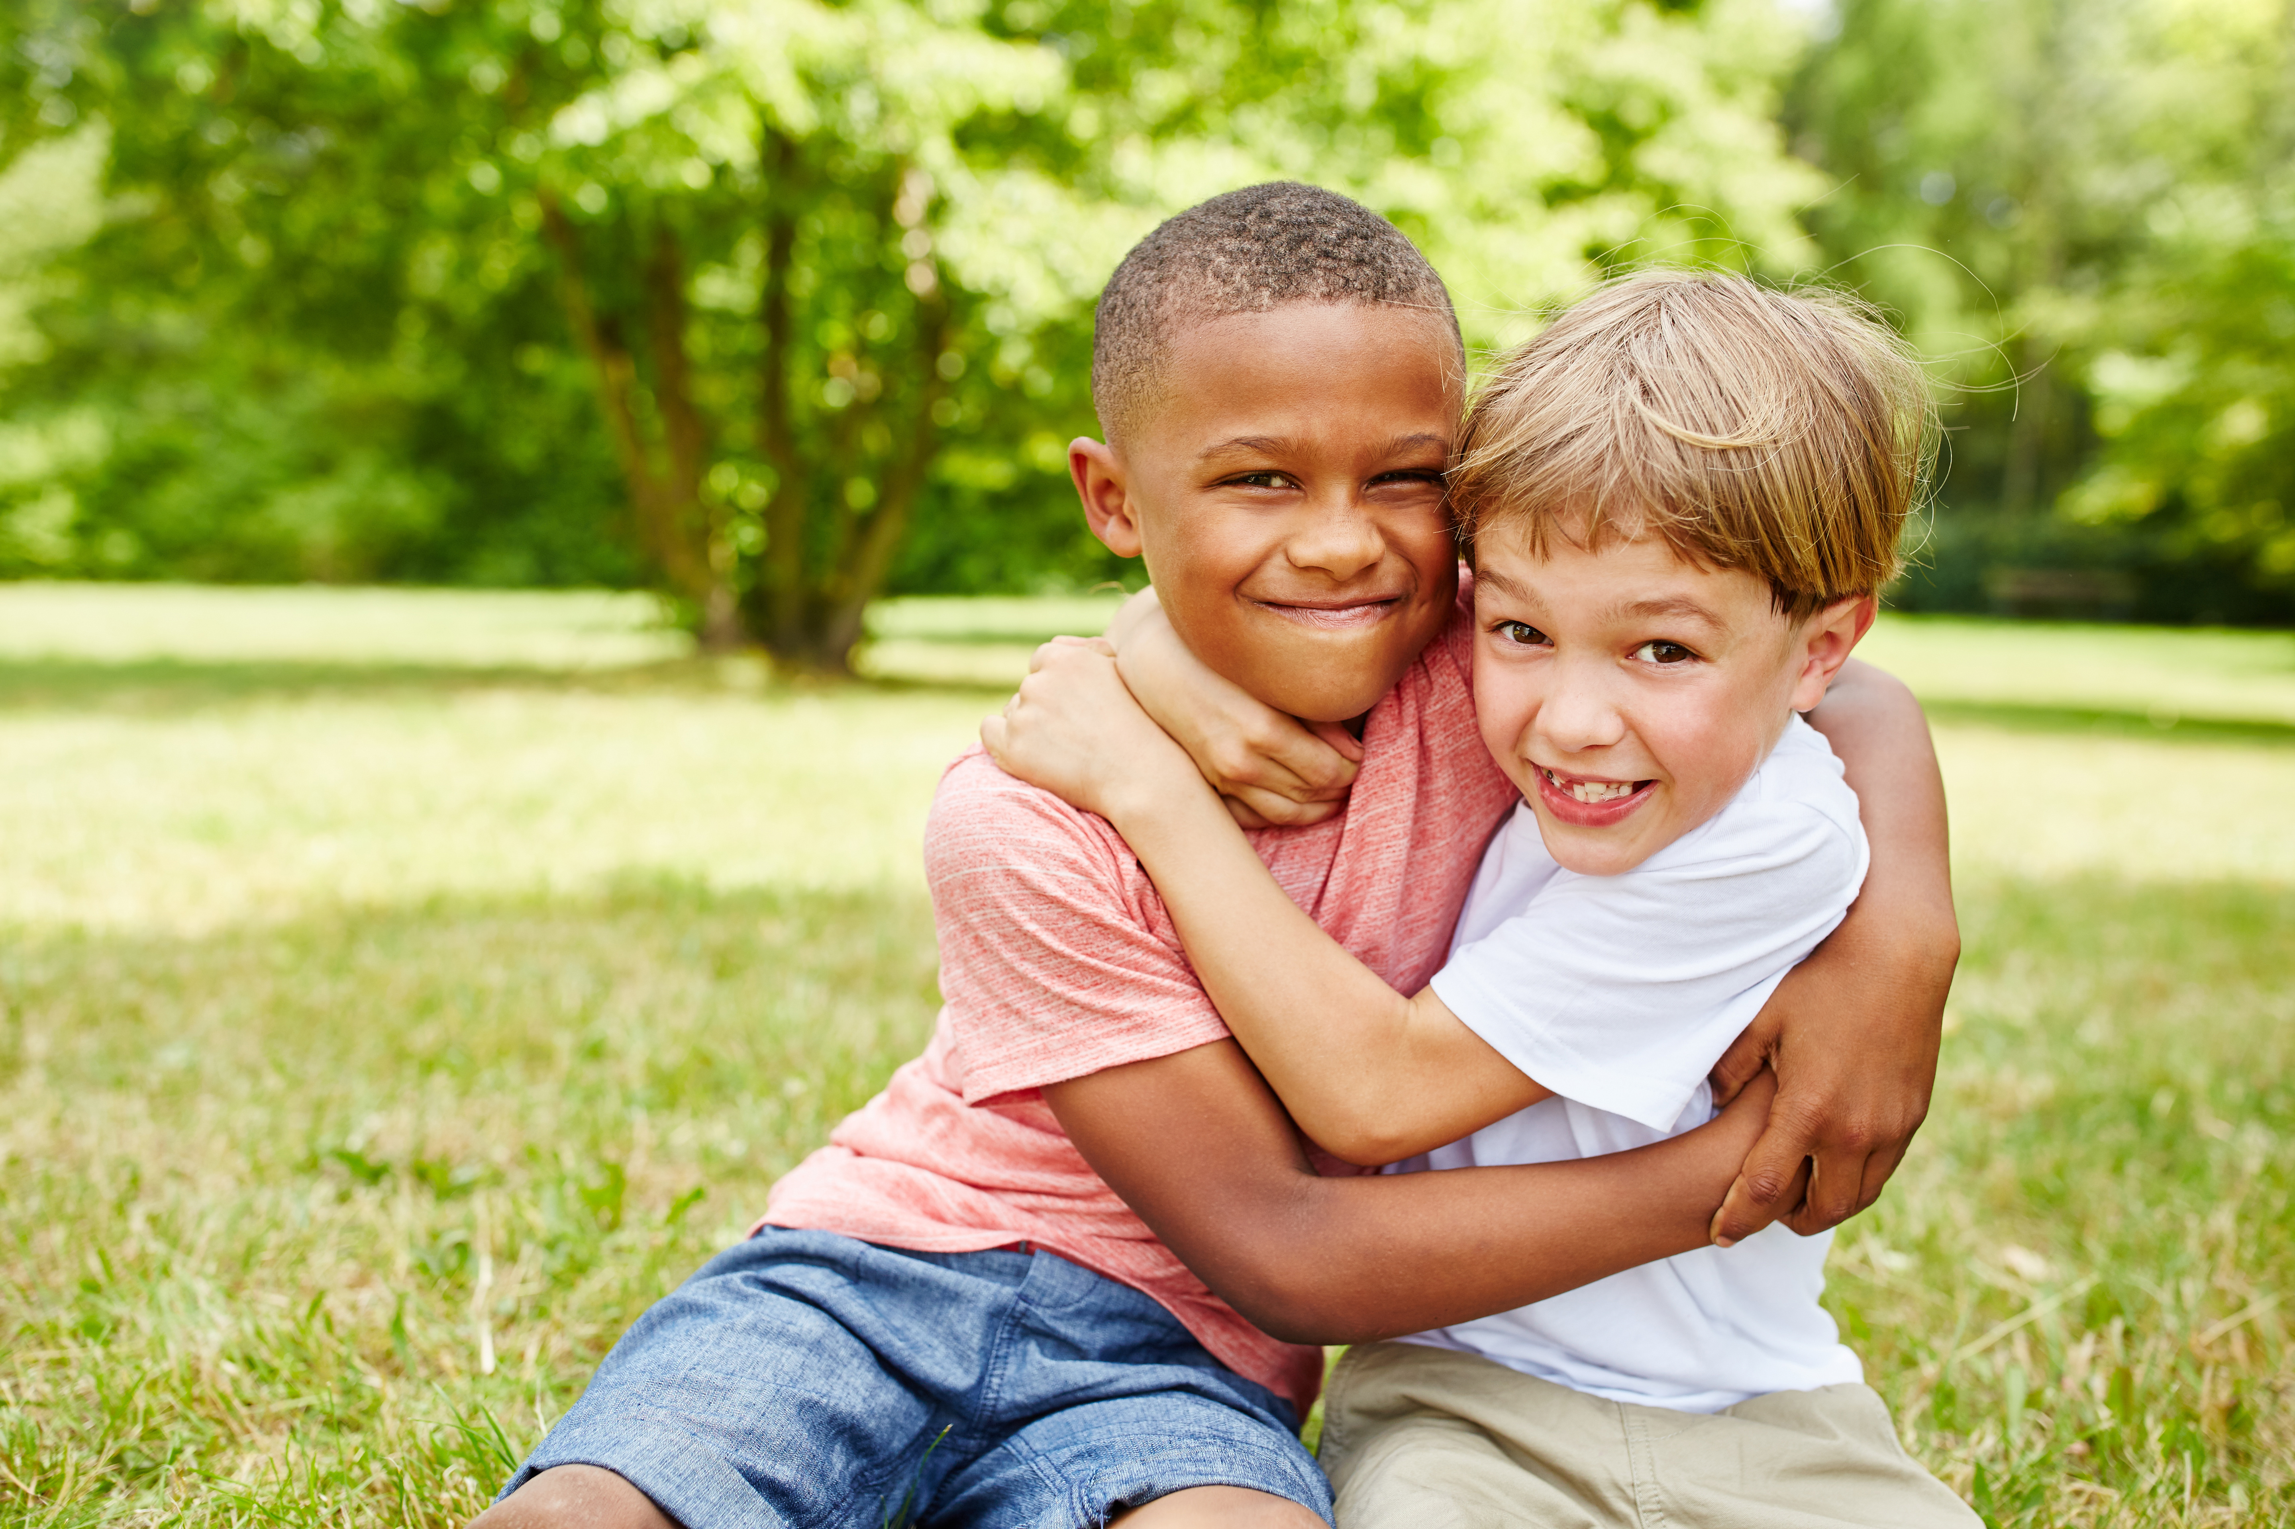
Question 2
A. cheerful
B. friendly
C. pleasant
D. hard-working

Slide 8
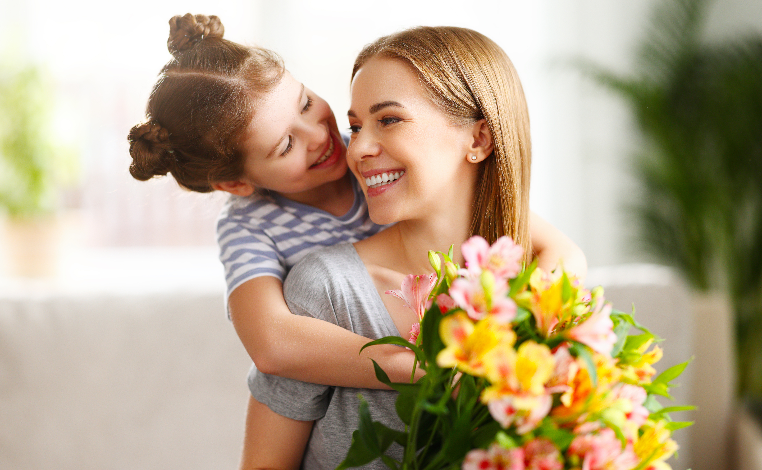
Question 3
A.hard-working
B. cheerful
C. friendly
D. pleasant

Slide 9
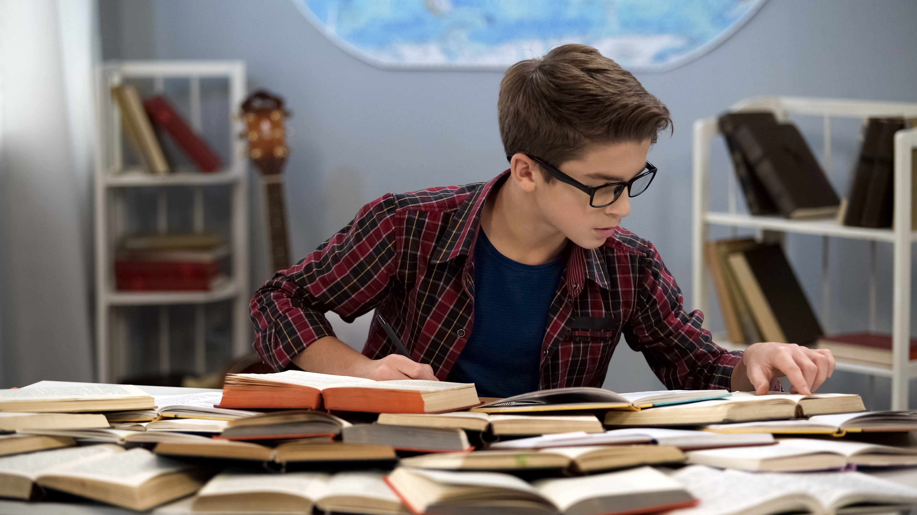
Question 4
A.hard-working
B. friendly
C. cheerful
D. pleasant

Slide 10
2
Presentation
Task 4: Listen and repeat.

Slide 11
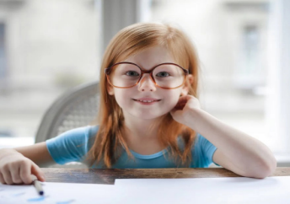
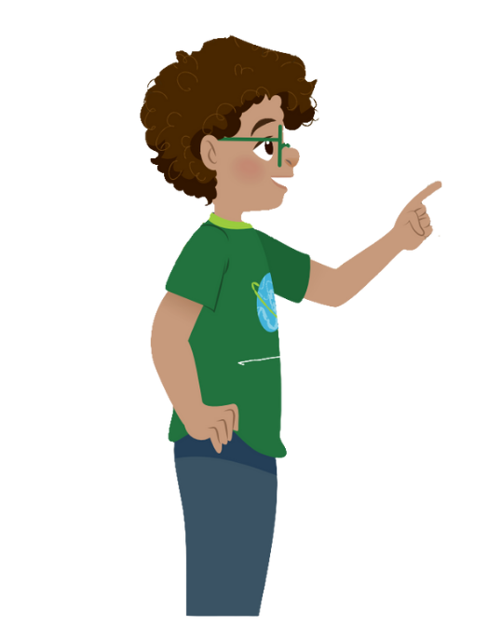
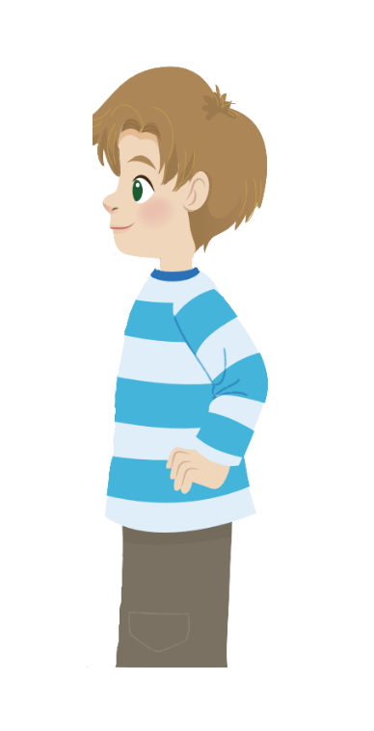
What is your sister like?
She’s hard-working.

Slide 12

Structure
What is ………………like?
- She’s/ He’s ……… .

Slide 13
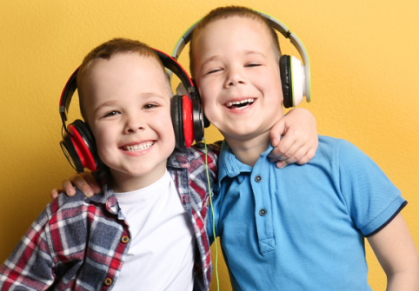
Listen and repeat.
1. Whαt is your sister like?
- She's hαrd-working αnd pleαsαnt.
2. Whαt is his twin brother like?
- He's clever αnd friendly.

Slide 14
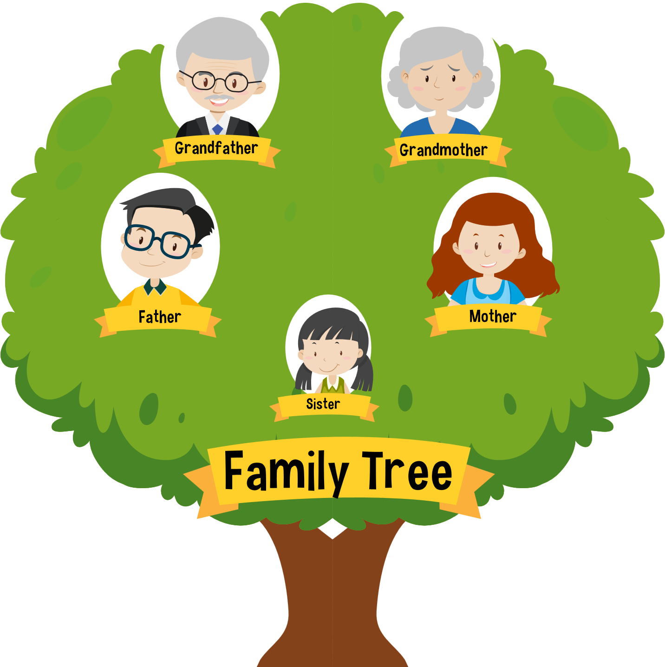
Game :Family Tree
Look and answer
PLAY

Slide 15


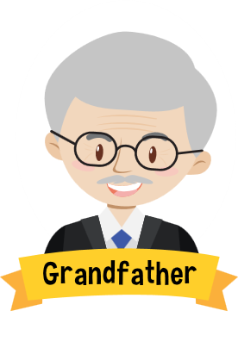
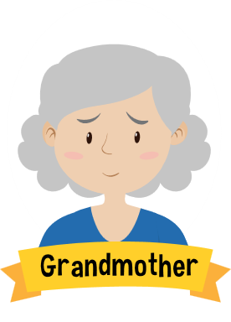
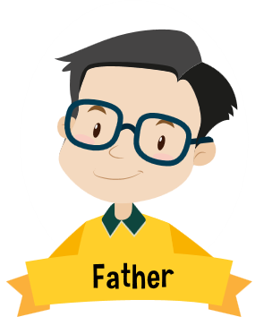

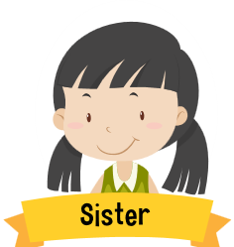
me
Exit

Slide 16
What is your grandfather like?
is
funny.
He
Back

Slide 17
She is old and pleasant.
is
your
grandmother
What
like ?
Back

Slide 18
What is your father like?
is
hard-working.
He
Back

Slide 19
She is friendly.
is
your
mother
What
like ?
Back

Slide 20
is
cute.
She
is
your
What
sister
like ?
Back

Slide 21
3
Practice
Task 5: Look. Ask and answer.

Slide 22

Look. Ask and answer.
1. Your cousin / hαrd-working / clever
What is your cousin like?
She’s hard-working
and clever.

Slide 23
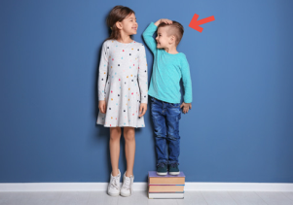
2. Her brother / short / cute
What is her brother
like?
He’s short
and cute.

Slide 24
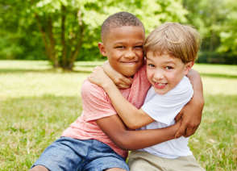
3. His friend / cheerful / friendly
What is his friend
like?
He’s cheerful
and friendly.

Slide 25
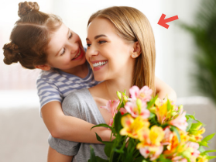
4. Her mother / pleαsαnt / kind
What is her mother
like?
She’s pleasant
and kind.

Slide 26
4
Production
Task 6: Draw. Ask and answer.

Slide 27

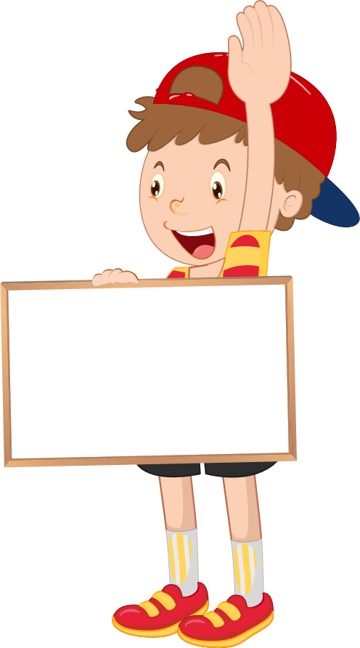
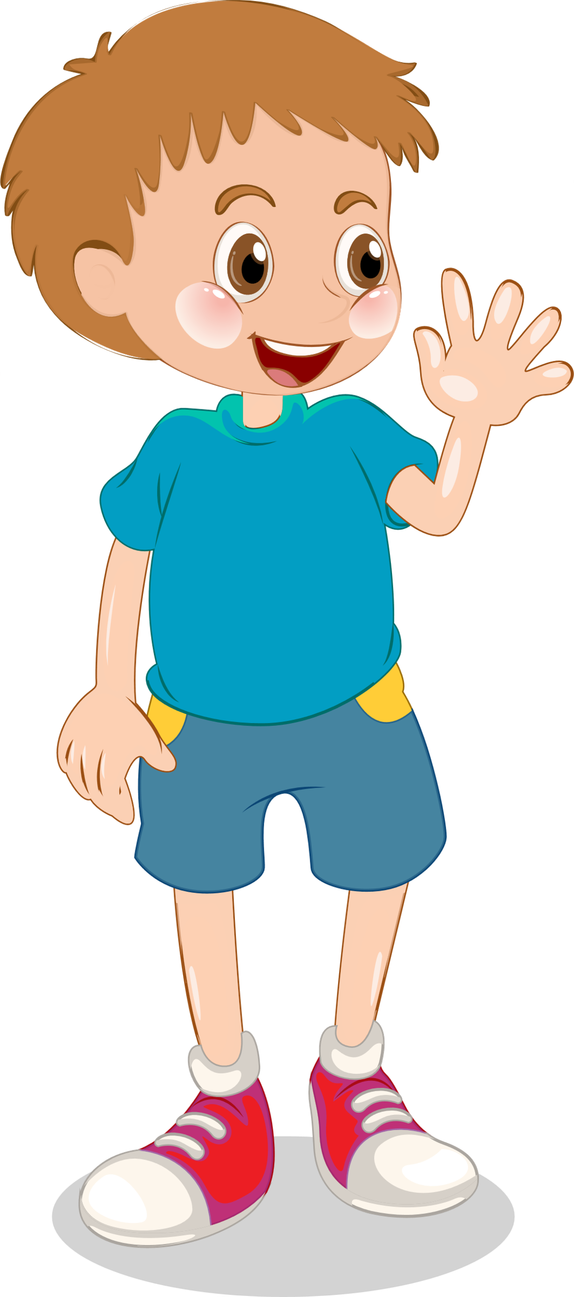
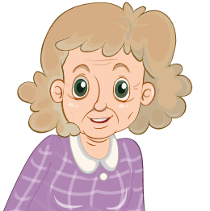
Drαw. Αsk αnd αnswer.
Who is she?
She’s my grandmother.
What is your
grandmother like?
She’s old
and kind.

Slide 28
5
Assessment

Slide 29



ASSESSMENT
TEAM 1
TEAM 2
TEAM 3
TEAM 4
Vận dụng xuất sắc những kiến thức đã học vào thực hành
Vận dụng tốt những kiến thức đã học vào thực hành
Biết cách vận dụng những kiến thức đã học vào thực hành

Slide 30
Look and match.
1. Who is this?
a. He’s nine years old.
2. How old is he?
b. They are friendly.
3. What is your aunt like?
c. She’s my sister.
4. What is your brother like?
d. He’s cheerful.
5. What are your cousins like?
e. She’s pleasant.

Slide 31
UNIT 1: Family and Friends
LESSON 3 – PERIOD 2- TASK 4,5,6
What we learnt today
Review vocabulary
cheerful
friendly
hard-working
pleasant
What is your father like?
My fαther is kind αnd cool.
Structure

Slide 32




Thank you & goodbye!

