Slide 1





















4
GO HOME
Notes:
Để nguyên trang bìa như này, chỉ thay đổi tên bài trong quá trình làm. Logo của sách Wonderful World

Slide 2



Unit 7
MY FAVOURITE
SPORT
Lesson 3. Task 4,5,6

Slide 3
01
WARM UP
Listen to the song

Slide 4
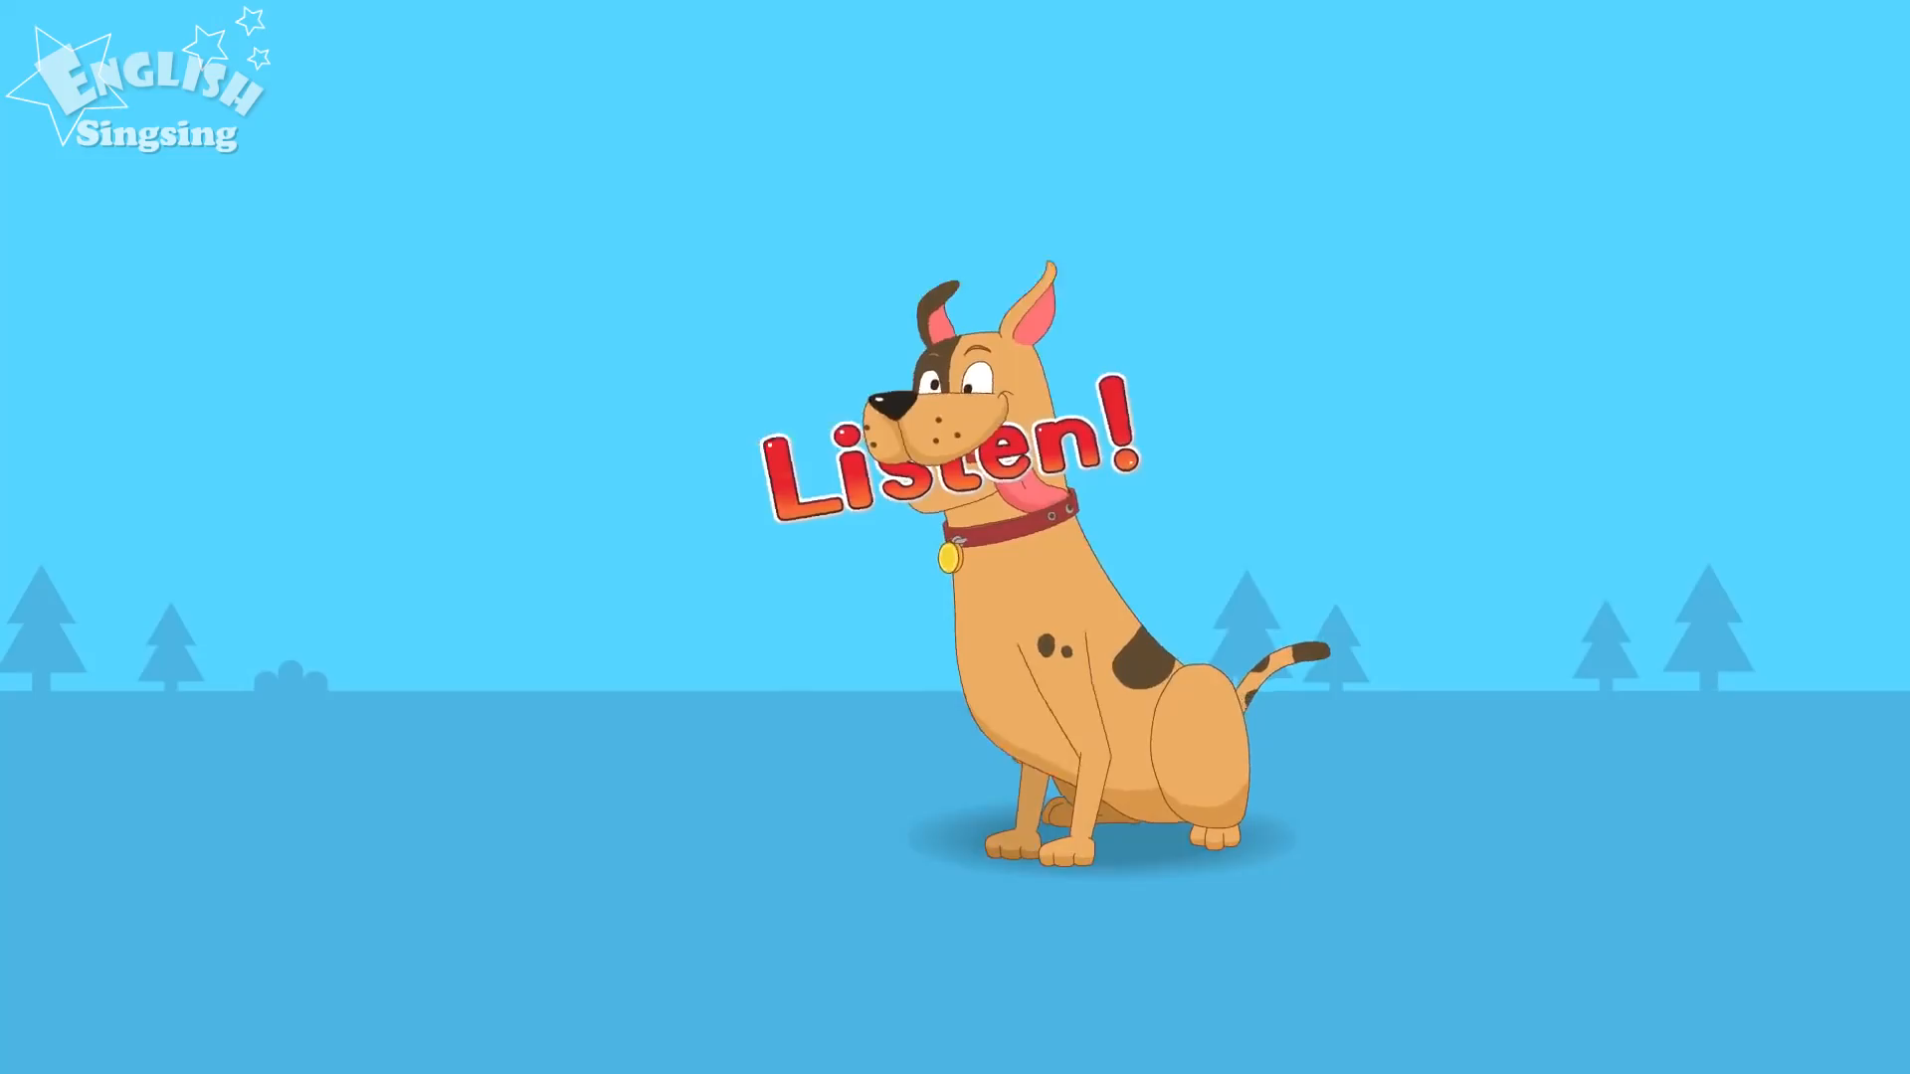

Slide 5
PRESENTATION
02

Slide 6
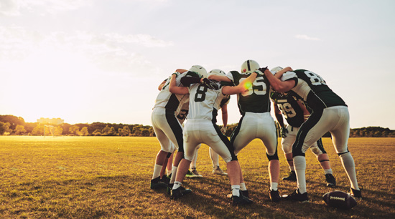
Are you playing with your team ?
- Yes, I am.

Slide 7

Is she running?
- No, she isn’t.

Slide 8
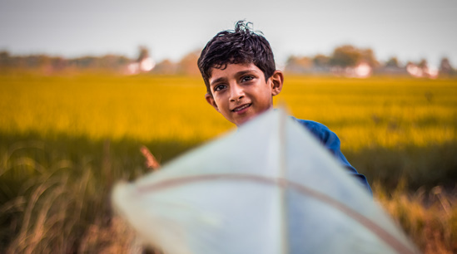
Is he flying a kite?
- Yes, he is.

Slide 9
Task 4. Listen and repeat.
Are you playing
with your team?
- Yes, I am .
Is she running?
- No, she isn’t.
- Is he flying a kite ?
- Yes, he is.

Slide 10

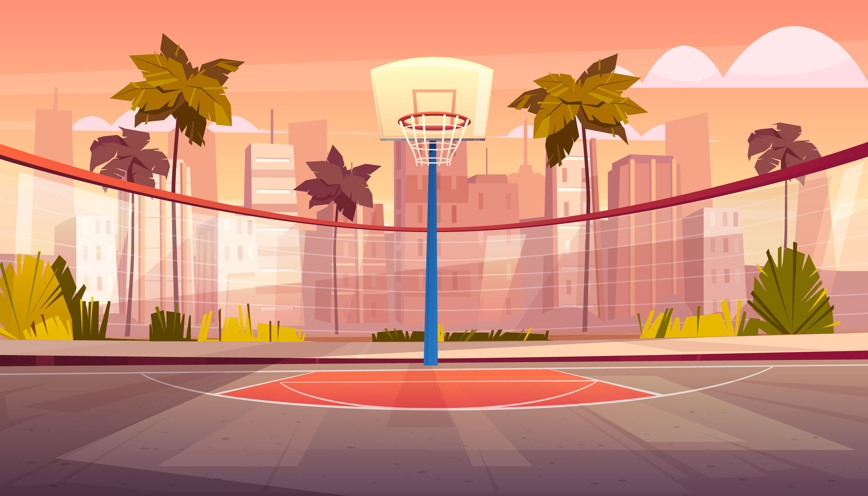

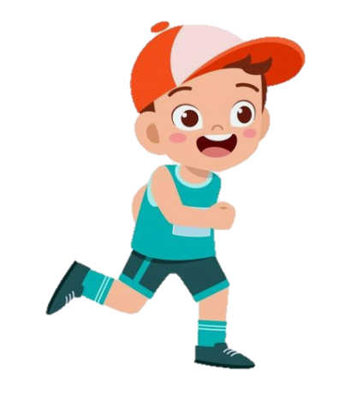


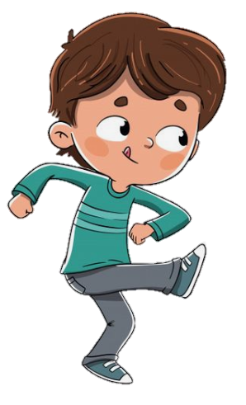
Checking Game
TPR GAME
Checking Game
Notes:
One student is doing the action what he likes . And student is standing in front of him so that he can’t see what other S is doing and then, guess and say the action. :
Is he …..? All the class has to answer yes/ no
And Sts can guese three times to find the correct action and get stars .

Slide 11

Is she running ?
No, she isn’t.

Slide 12

03
PRACTICE

Slide 13


7
8
6
10
3
2
4
1
5
9
LUCKY STAR

Slide 14


Is he playing football ?
No, he isn’t.
2
GO HOME

Slide 15


Is he flying a kite ?
Yes, he is.
A. Yes, he is.
2
B. No, he isn’t.
4
GO HOME

Slide 16

Is he swimming ?
No, he isn’t.
Yes, he is.
No, I’m not

Slide 17
Is he riding a bike ?
No, he isn’t.
4
GO HOME

Slide 18

1. she / riding a bike?
Task 5. Look and say .
Is she riding a bike ?
4
Yes, she is.
GO HOME

Slide 19
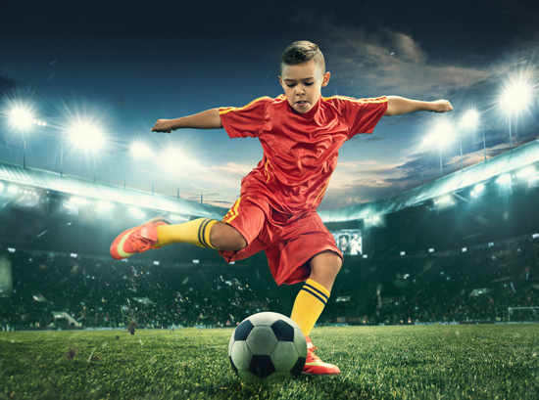
2. he / swimming?
Task 5. Look and say .
Is he swimming ?
4
No, he isn’t.
GO HOME

Slide 20
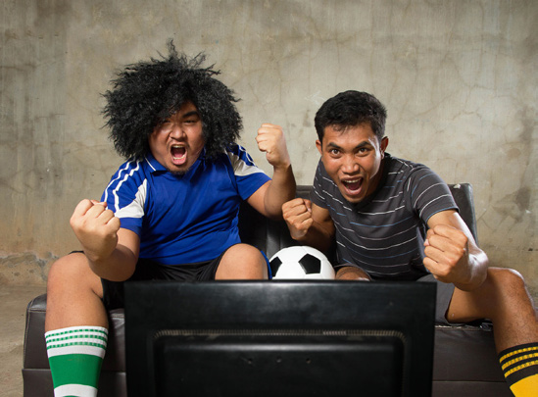
3. you / dancing?
Task 5. Look and say .
Are you dancing ?
No, I’m not.
4
GO HOME

Slide 21

4. he / flying a kite?
Task 5. Look and say .
Is he flying a kite ?
Yes, he is.
4
GO HOME

Slide 22

5. she / jumping?
Task 5. Look and say .
Is she jumping ?
No, she isn’t .
4
GO HOME

Slide 23
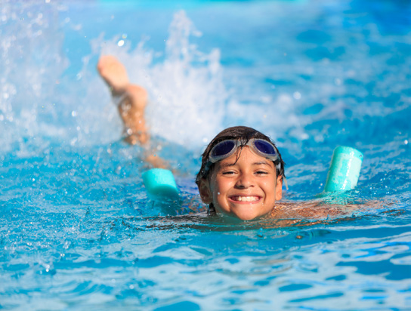
6. you / swimming?
Task 5. Look and say .
Are you swimming ?
Yes, I am.
4
GO HOME

Slide 24
04
PRODUCTION

Slide 25

HOCKEY

Slide 26


Is he playing hockey ?
Is he hitting and running?

Slide 27
Hockey is cool! Hockey is great!
Look at us now, we’re playing hockey!
We’re hitting and running.
We aren’t catching or jumping.
Come on, play hockey with us!
Task 6. Listen and sing

Slide 28
05
ASSESSMENT

Slide 29
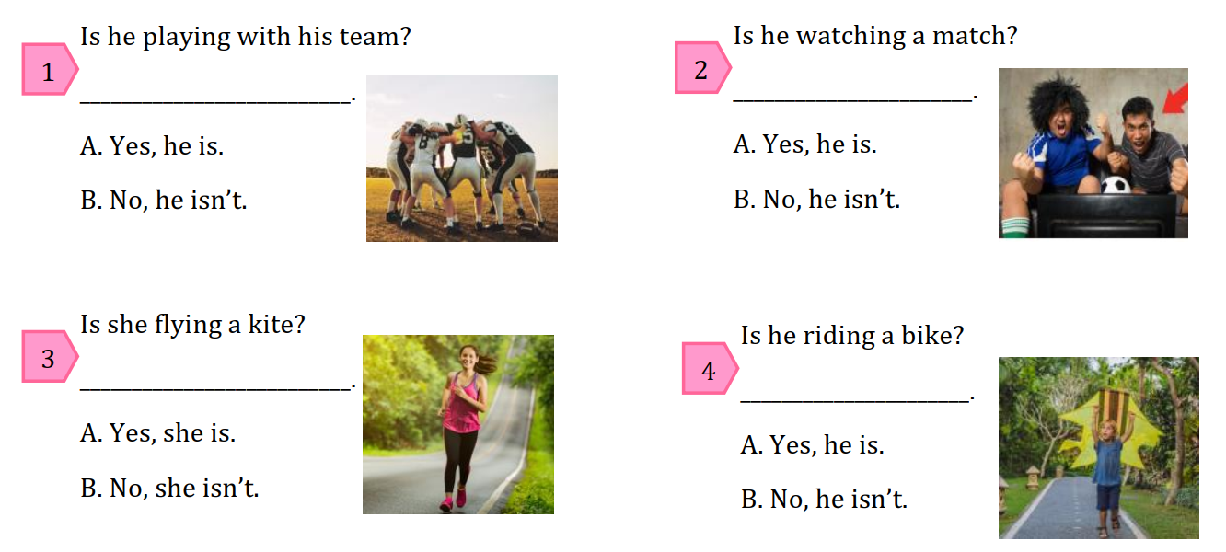
Look and circle the correct answers.
Notes:
HOẠT ĐỘNG TƯƠNG TÁC : THE BALL AND MUSIC , Sts pass the ball when the music plays. And when music stops, Sts is holding the ball who will answer the question and take the stars .

Slide 30

THANK YOU

