Slide 1

Review
Units 5-8
Page 125

Slide 2
Lesson Outline
Warm-up
Speaking
Listening
Reading & Writing
Consolidation
Wrap-up

Slide 3
Objectives
By the end of this lesson, students will be able to review the vocabulary items and the sentence structures from Unit 5 to Unit 8.
Vocabulary:
badminton, shorts, potato, shirt, tie, T-shirt, marble, bedroom, block, wardrobe, robot

Slide 4
Objectives
By the end of this lesson, students will be able to review the vocabulary items and the sentence structures from Unit 5 to Unit 8.
Structures:
May I watch TV?/ I want a red T-shirt./ What are you wearing?/ Can you play badminton?

Slide 5
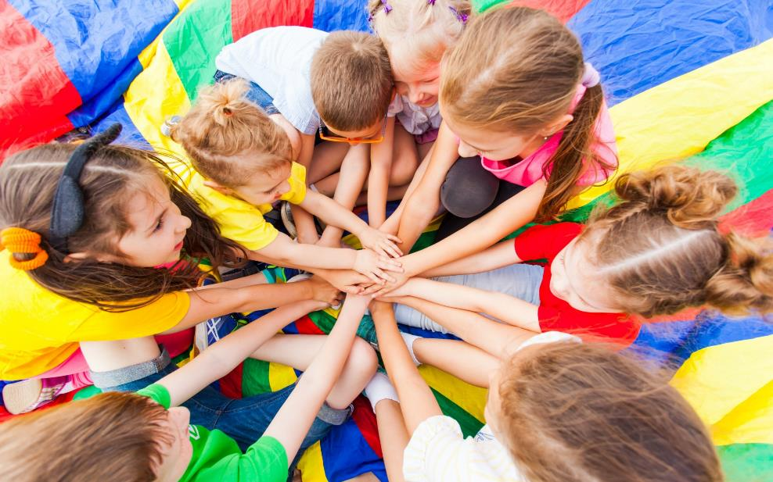
WARM UP

Slide 6
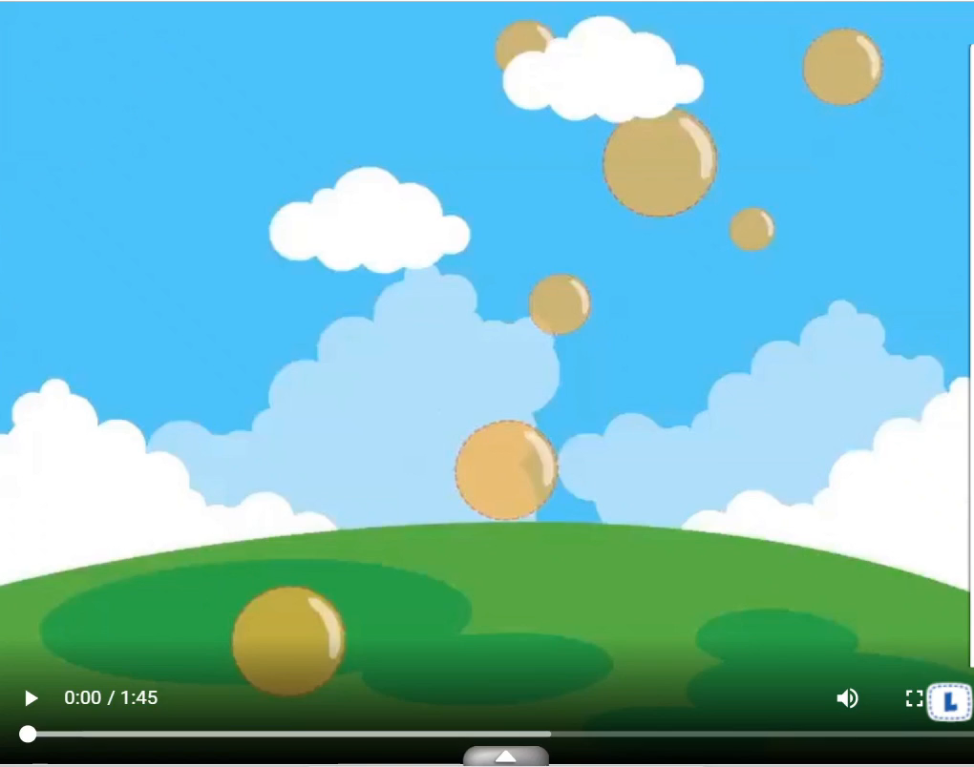

Slide 7

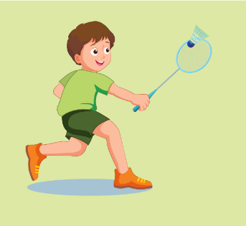
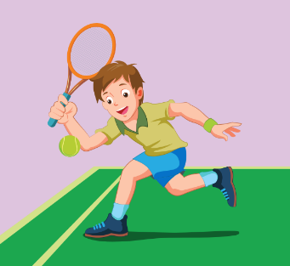
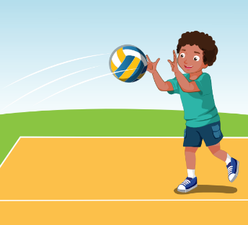
Listen and circle.
A
B
C
KEYS

Slide 8



Listen and circle.
A
B
C
KEYS

Slide 9
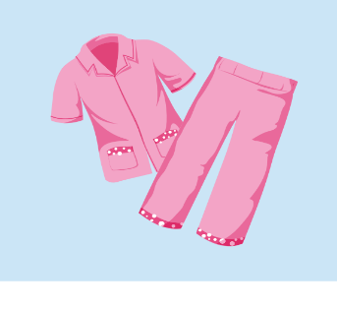
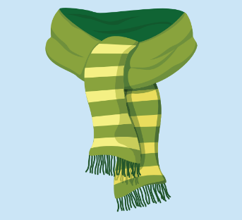
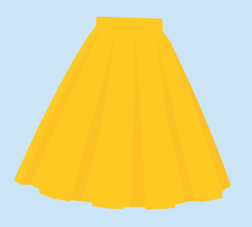
Listen and circle.
A
B
C
KEYS

Slide 10

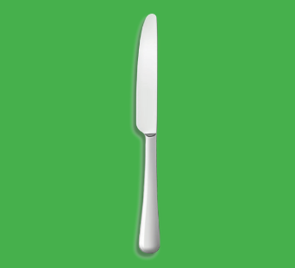

Listen and circle.
A
B
C
KEYS

Slide 11
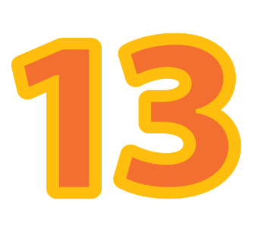


Listen and circle.
A
B
C
KEYS

Slide 12
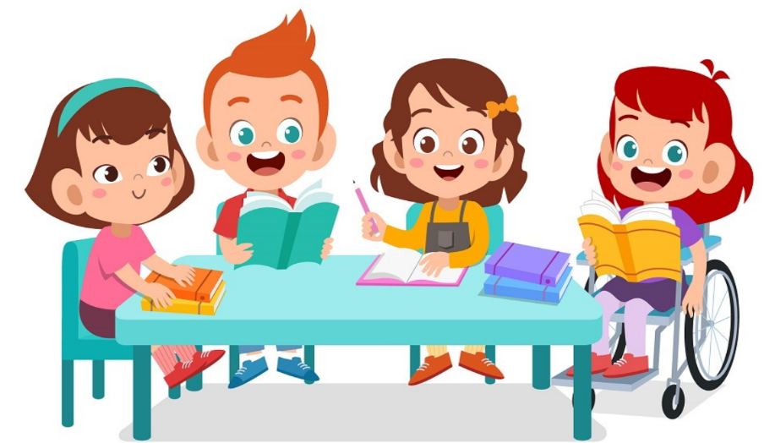
It’s time to learn …

Slide 13
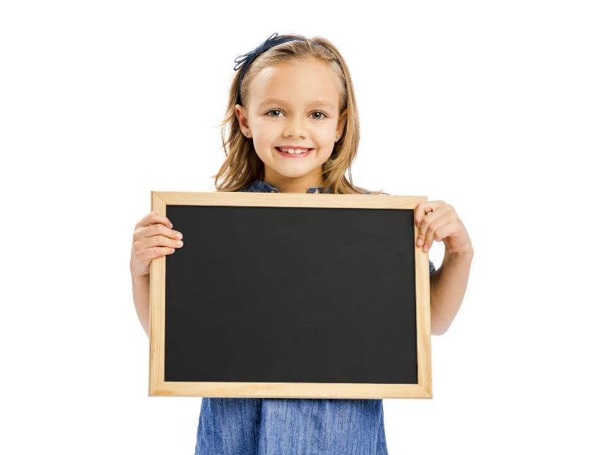
Speaking

Slide 14
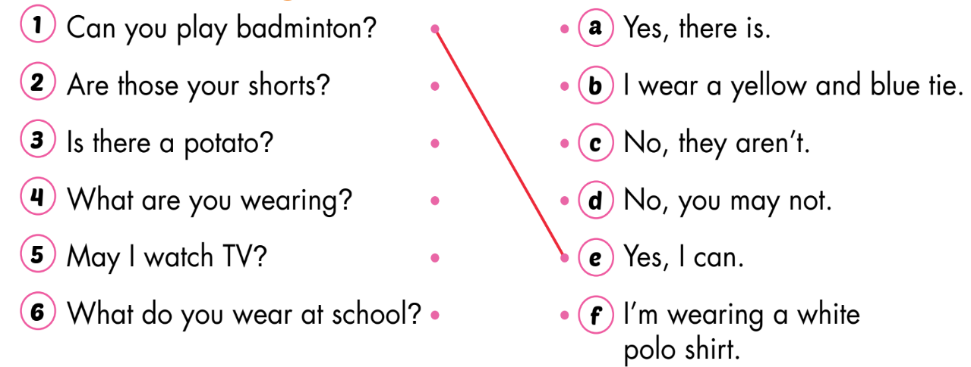
4. Read and match.

Slide 15
Listening

Slide 16
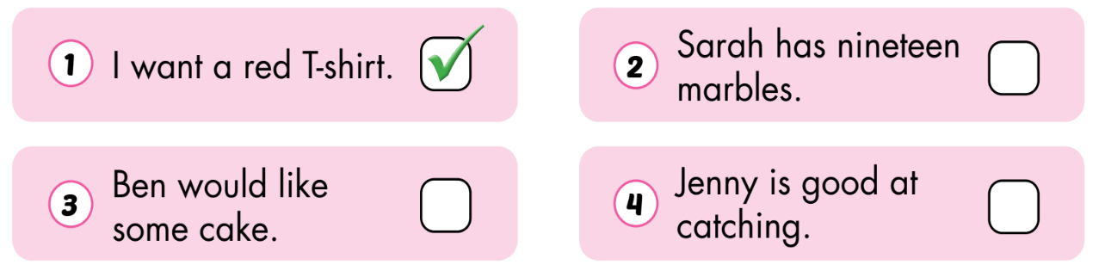
5. Listen and put a (✓) or a (✗). (CD3 Track 69)
✗
✗
✓

Slide 17
Audio scripts
Track 69
Narrator: Listen and put a tick or a cross.
1. G: What do you want?
B: I want a red T-shirt.
2. B: How many marbles do you have, Sarah?
G: I have eighteen marbles.
3. G: Would you like some cake, Ben?
B: No, thank you.
G: Would you like some ice cream?
B: Yes, please.
4. B: What are you good at, Jenny?
G: I’m good at catching.

Slide 18
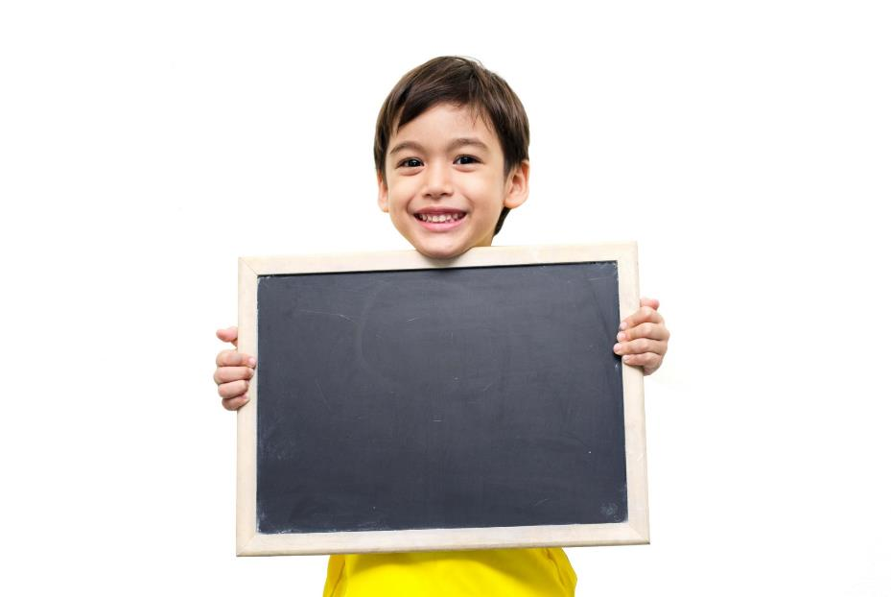
Reading
& Writing

Slide 19
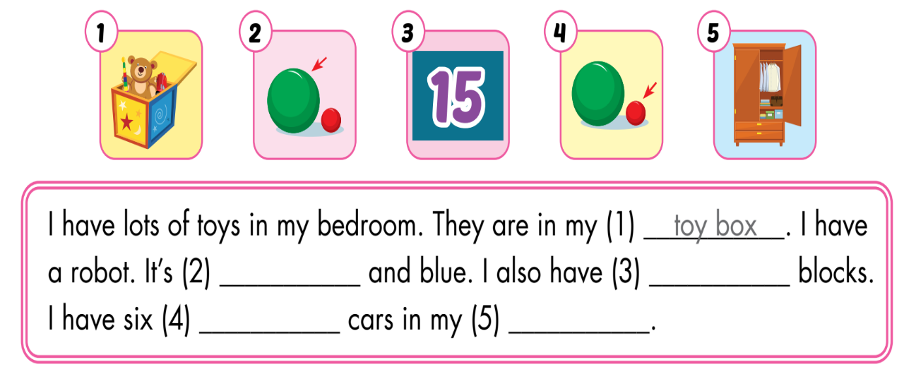
6. Look, read, and fill in the blanks.
big
fifteen
small
wardrobe

Slide 20
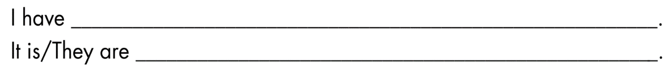
7. What do you have? Where is it? Write 10-20 words.
Sample writing
I have a big doll. It is in my bedroom. I have twenty blocks. They are in my toy box.

Slide 21
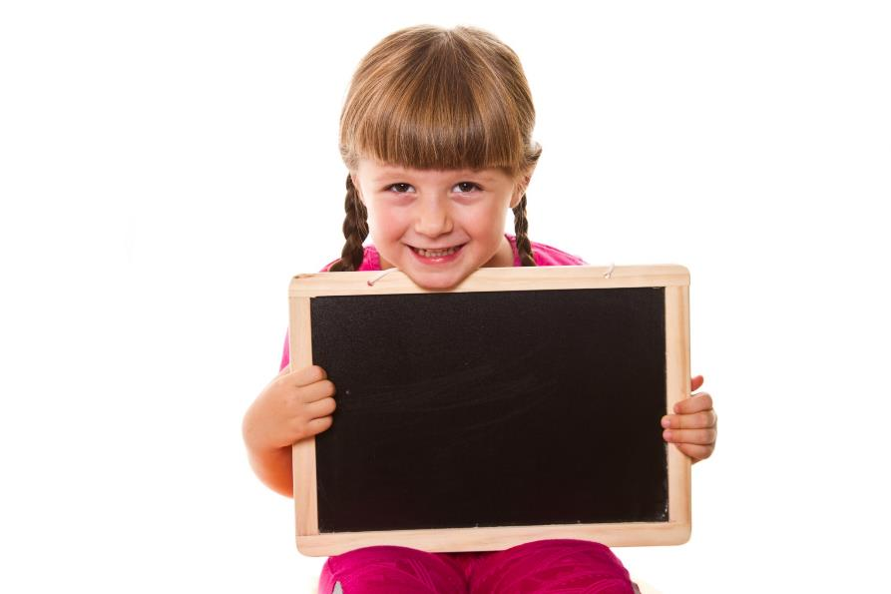
Extra Practice

Slide 22
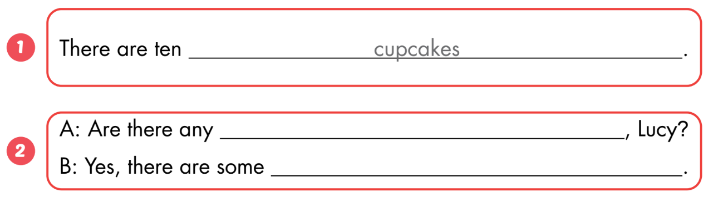
B
Listen and fill in the blanks. (WB Track 46)
eggs
eggs

Slide 23
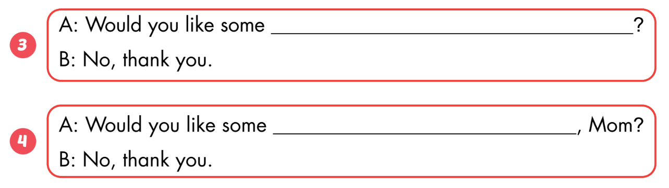
B
Listen and fill in the blanks. (WB Track 46)
cake
fries

Slide 24

Consolidation

Slide 25
1
4
6
1
SPIN
2
5
2
5
4
3
3
6
Next Part

Slide 26
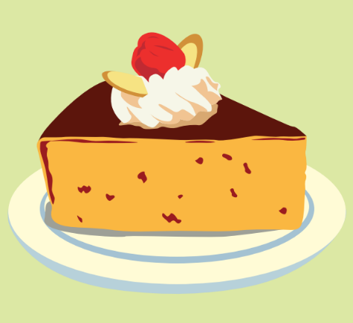
Would you like some ___?
Go back

Slide 27
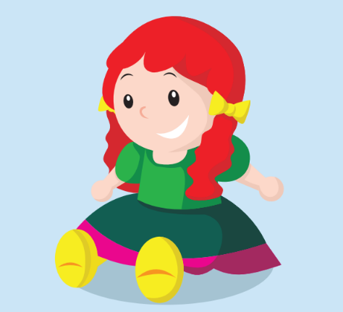
Is this your ___?
Go back

Slide 28
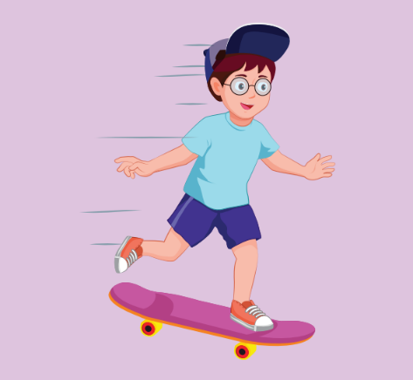
Can you ___ ___?
Go back

Slide 29
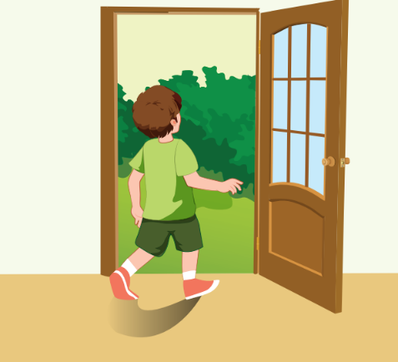
May I ___ ___?
Go back

Slide 30
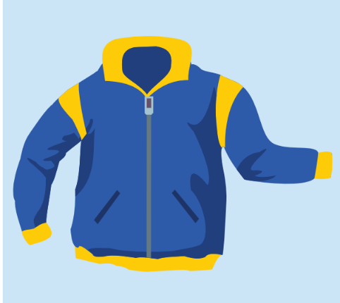
I’m wearing a ___.
Go back

Slide 31

Would you like some ___?
Go back

Slide 32
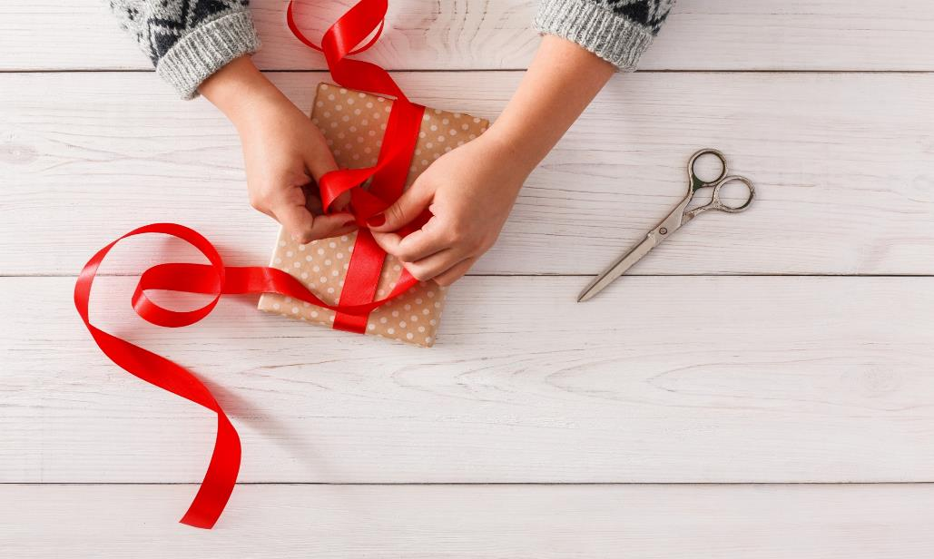
WRAP-UP

Slide 33
Today’s lesson
Vocabulary:
badminton, shorts, potato, shirt, tie, T-shirt, marble, bedroom, block, wardrobe, robot
Structures:
May I watch TV?/ I want a red T-shirt./ What are you wearing?/ Can you play badminton?

Slide 34
Homework
Practice vocabularies and structure. Make sentences using them.
Practice the vocabulary and structure in Tiếng Anh 3 i-Learn Smart Start Notebook (pages 64-65).
Play consolidation games in Tiếng Anh 3 i-Learn Smart Start DHA App on www.eduhome.com.vn

Slide 35
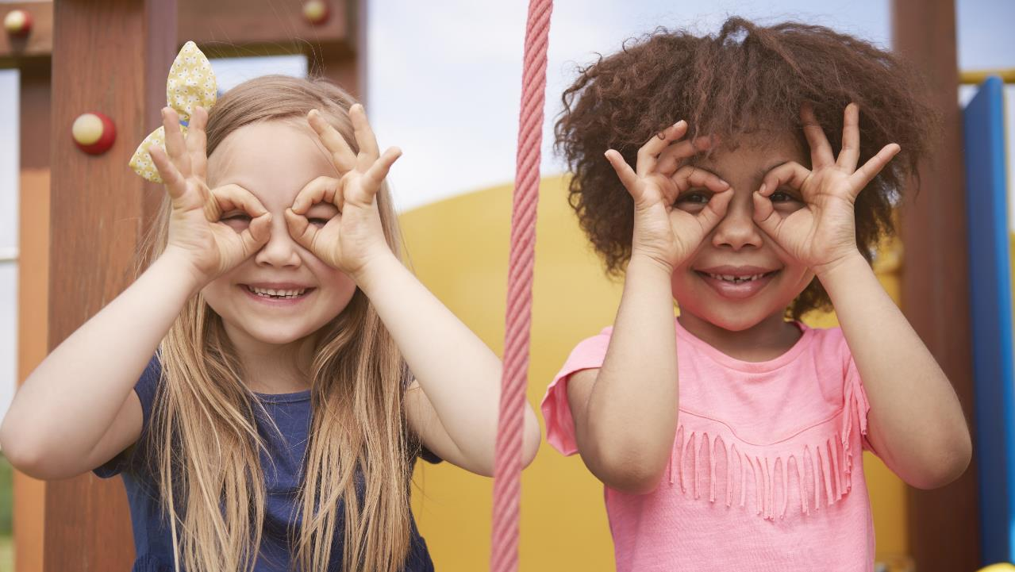
Enjoy your day!

