Slide 1

UNIT 7
MY FAMILY
LESSON: 1.1

Slide 2
Table of contents
01
02
03
Warm Up
Vocabulary
Grammar

Slide 3
01
Warm Up

Slide 4


Slide 5
02
Vocabulary

Slide 6
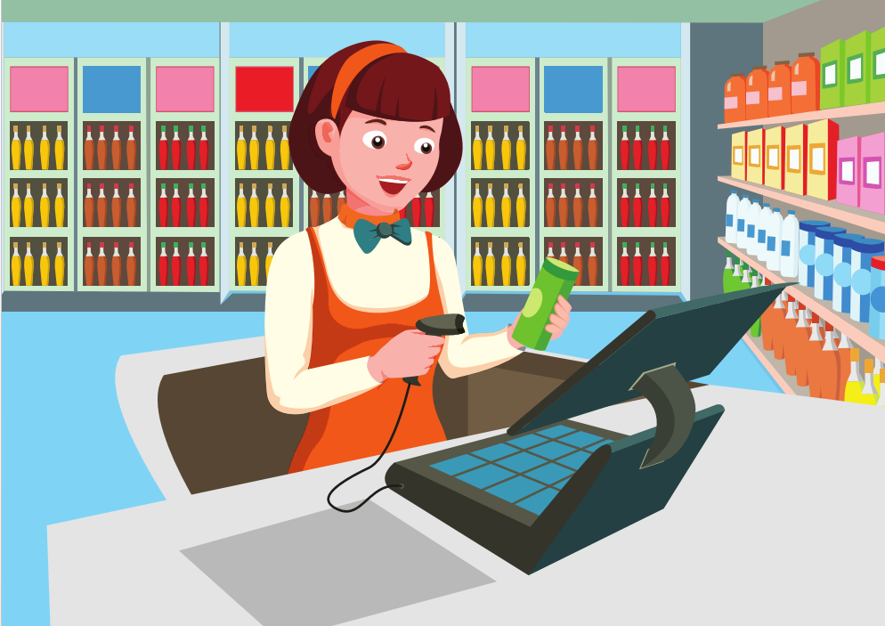

cashier

Slide 7

doctor

Slide 8

office
worker

Slide 9
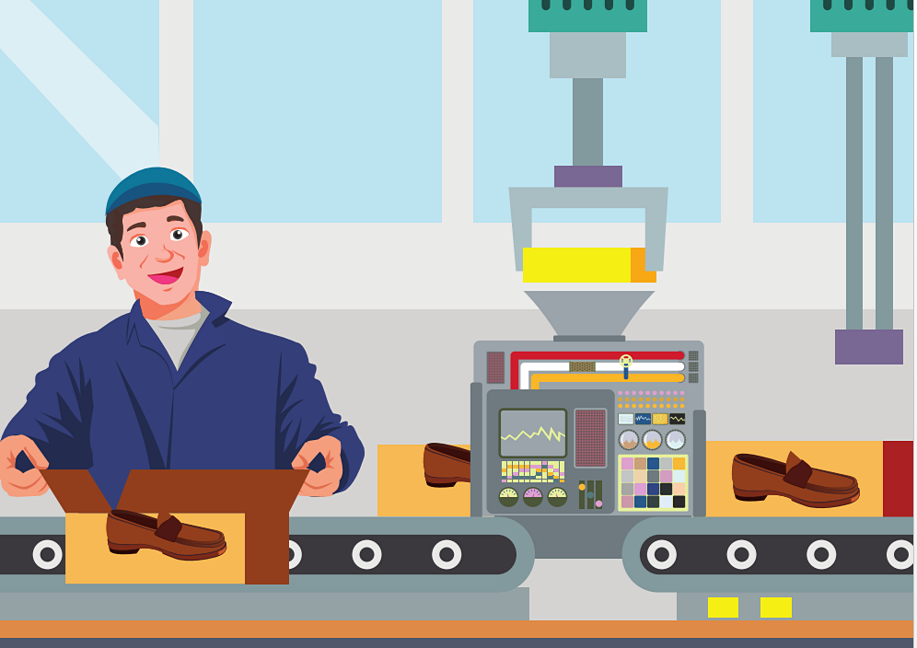
factory worker

Slide 10
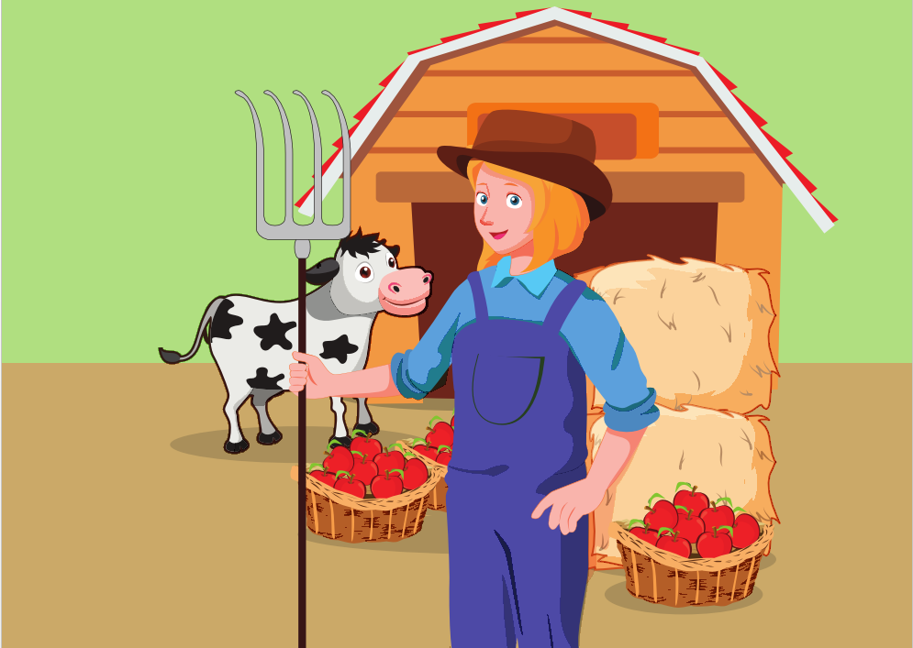
farmer

Slide 11
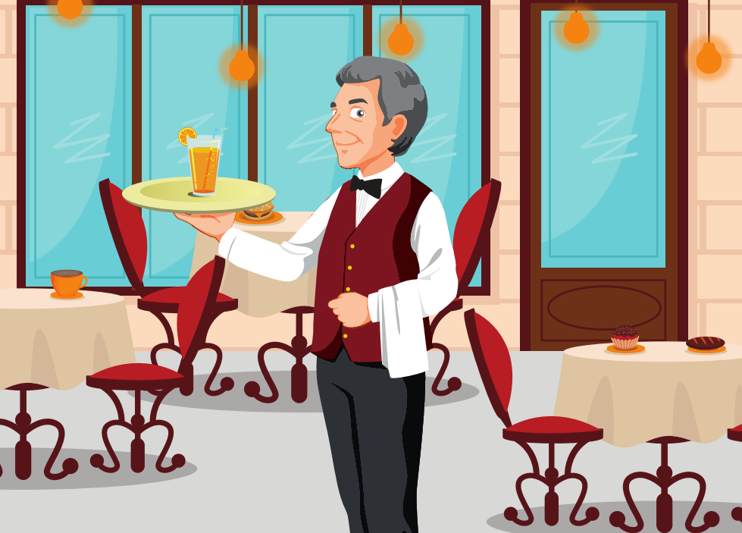
waiter

Slide 12

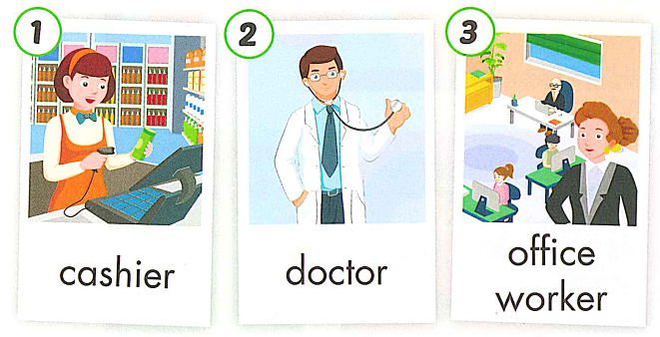
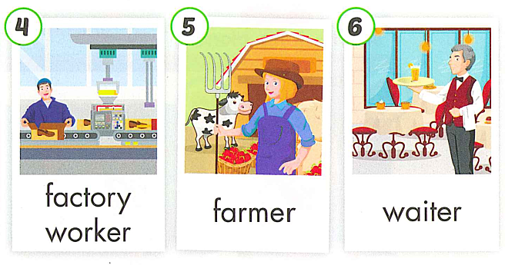

Slide 13
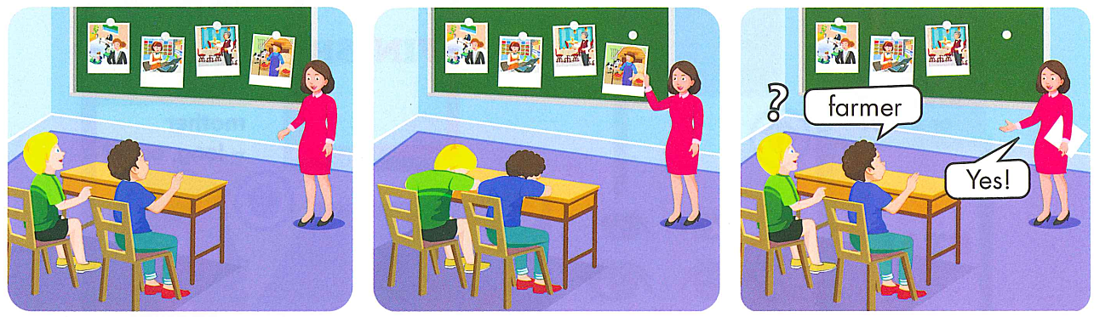

Slide 14
Review
Vocabulary

Slide 15
LETTER
RAINING
START

Slide 16
i
e
h
s
a
r
cashier
CHECK

Slide 17
r
c
o
d
o
t
doctor
CHECK

Slide 18
office worker
CHECK
er
of
ce
rk
wo
fi

Slide 19
factory worker
ry
fac
er
rk
to
wo
CHECK

Slide 20
m
farmer
f
e
r
a
r
CHECK

Slide 21
r
a
t
i
e
w
waiter
CHECK

Slide 22
03
Grammar

Slide 23

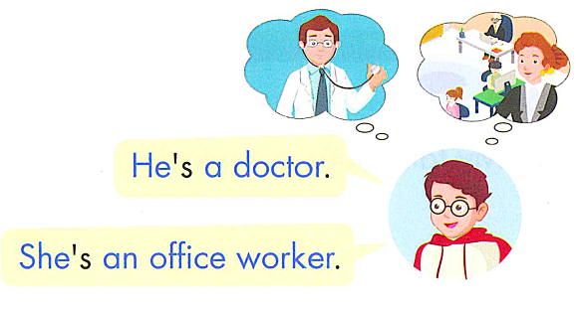
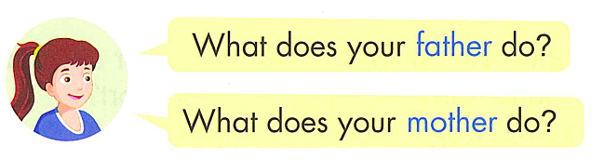

Slide 24
What + does + your +
(Noun of member family)+ do ?
He’s/She’s + a/an +job

Slide 25
Review Grammar

Slide 26
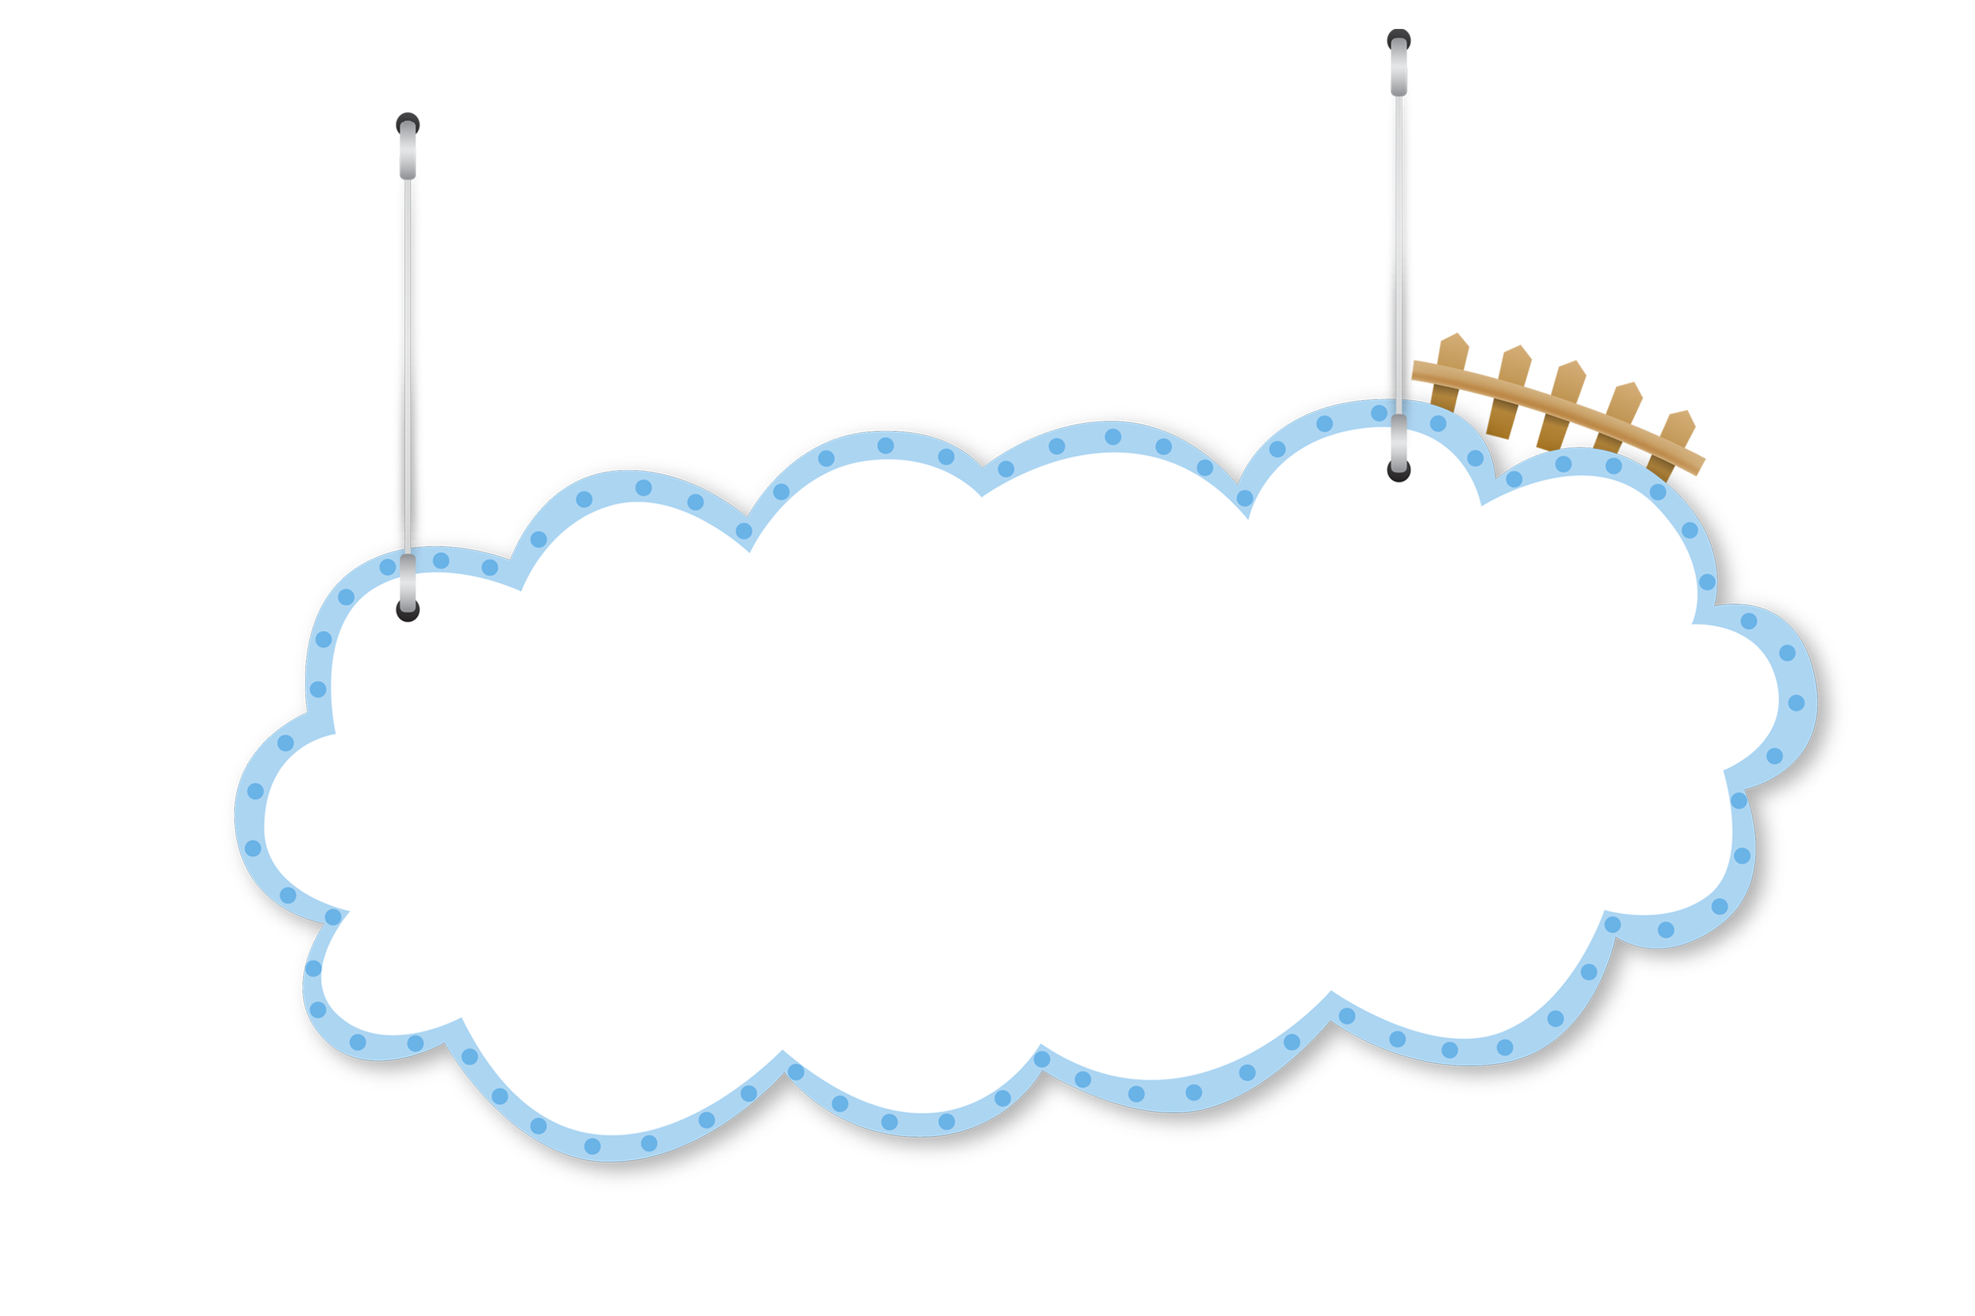
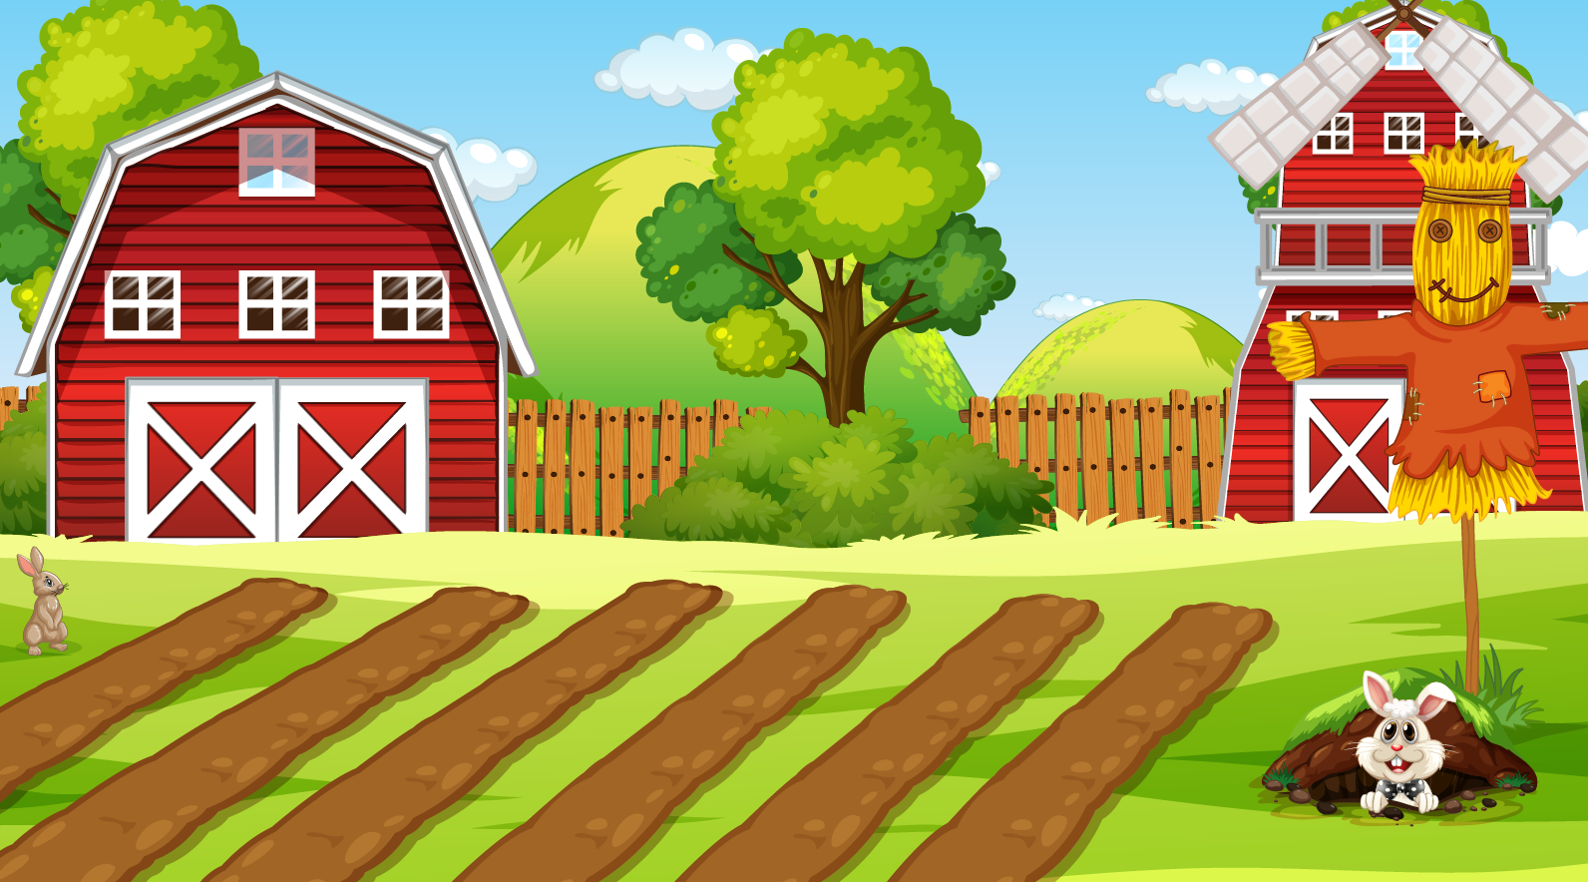
Vegetables
Harvest

Slide 27







NEXT

Slide 28




What does your mom do?
a. cashier
b. farmer
c. waiter
d. doctor

Slide 29
What does your sister do?
a. She’s a cashier.
b. She’s an office
worker.
c. She’s a farmer.
d. She’s a doctor.

Slide 30

What does your brother do?
He’s an………
a. office worker
b. waiter
c. factory worker
d. cashier

Slide 31
……………..?
My father is a waiter.
a. What is your father doing ?
b. What can your father do ?
c. What does your father do ?
d. What does your father like ?

Slide 32

My uncle is a………..
a. farmer
b. cashier
c. doctor
d. factory worker

Slide 33
My grandfather works in a hospital.
He helps sick people.
What does he do ?
a. He’s a waiter.
b. He’s a farmer.
c. He’s a doctor.
d. He’s a factory worker.

Slide 34
Practice

Slide 35


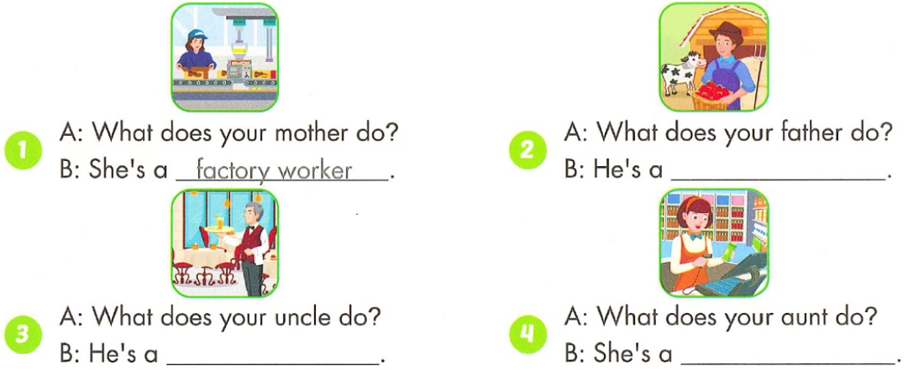
farmer
waiter
cashier

Slide 36
GOOD BYE

