Slide 1

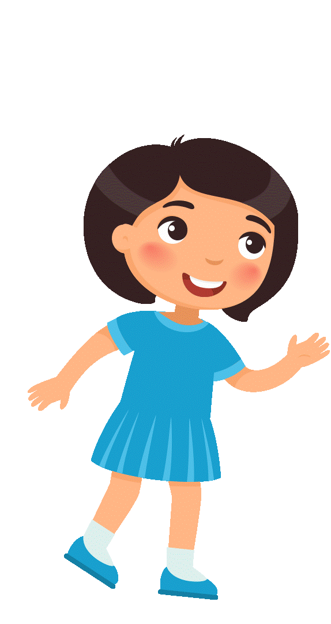



WELCOME TO OUR ENGLISH LESSON
Class 3A
Teacher: Nguyễn Thị Minh

Slide 2

Unit 2
Culture Lesson L4.2
Page 34

Slide 3
Objectives
By the end of this lesson, students will be able to talk about the family pet.
Vocabulary Revision:
dog, cat, fish, bird, pig, goat, duck, cow, rabbit
Structure:
I love my ____.

Slide 4
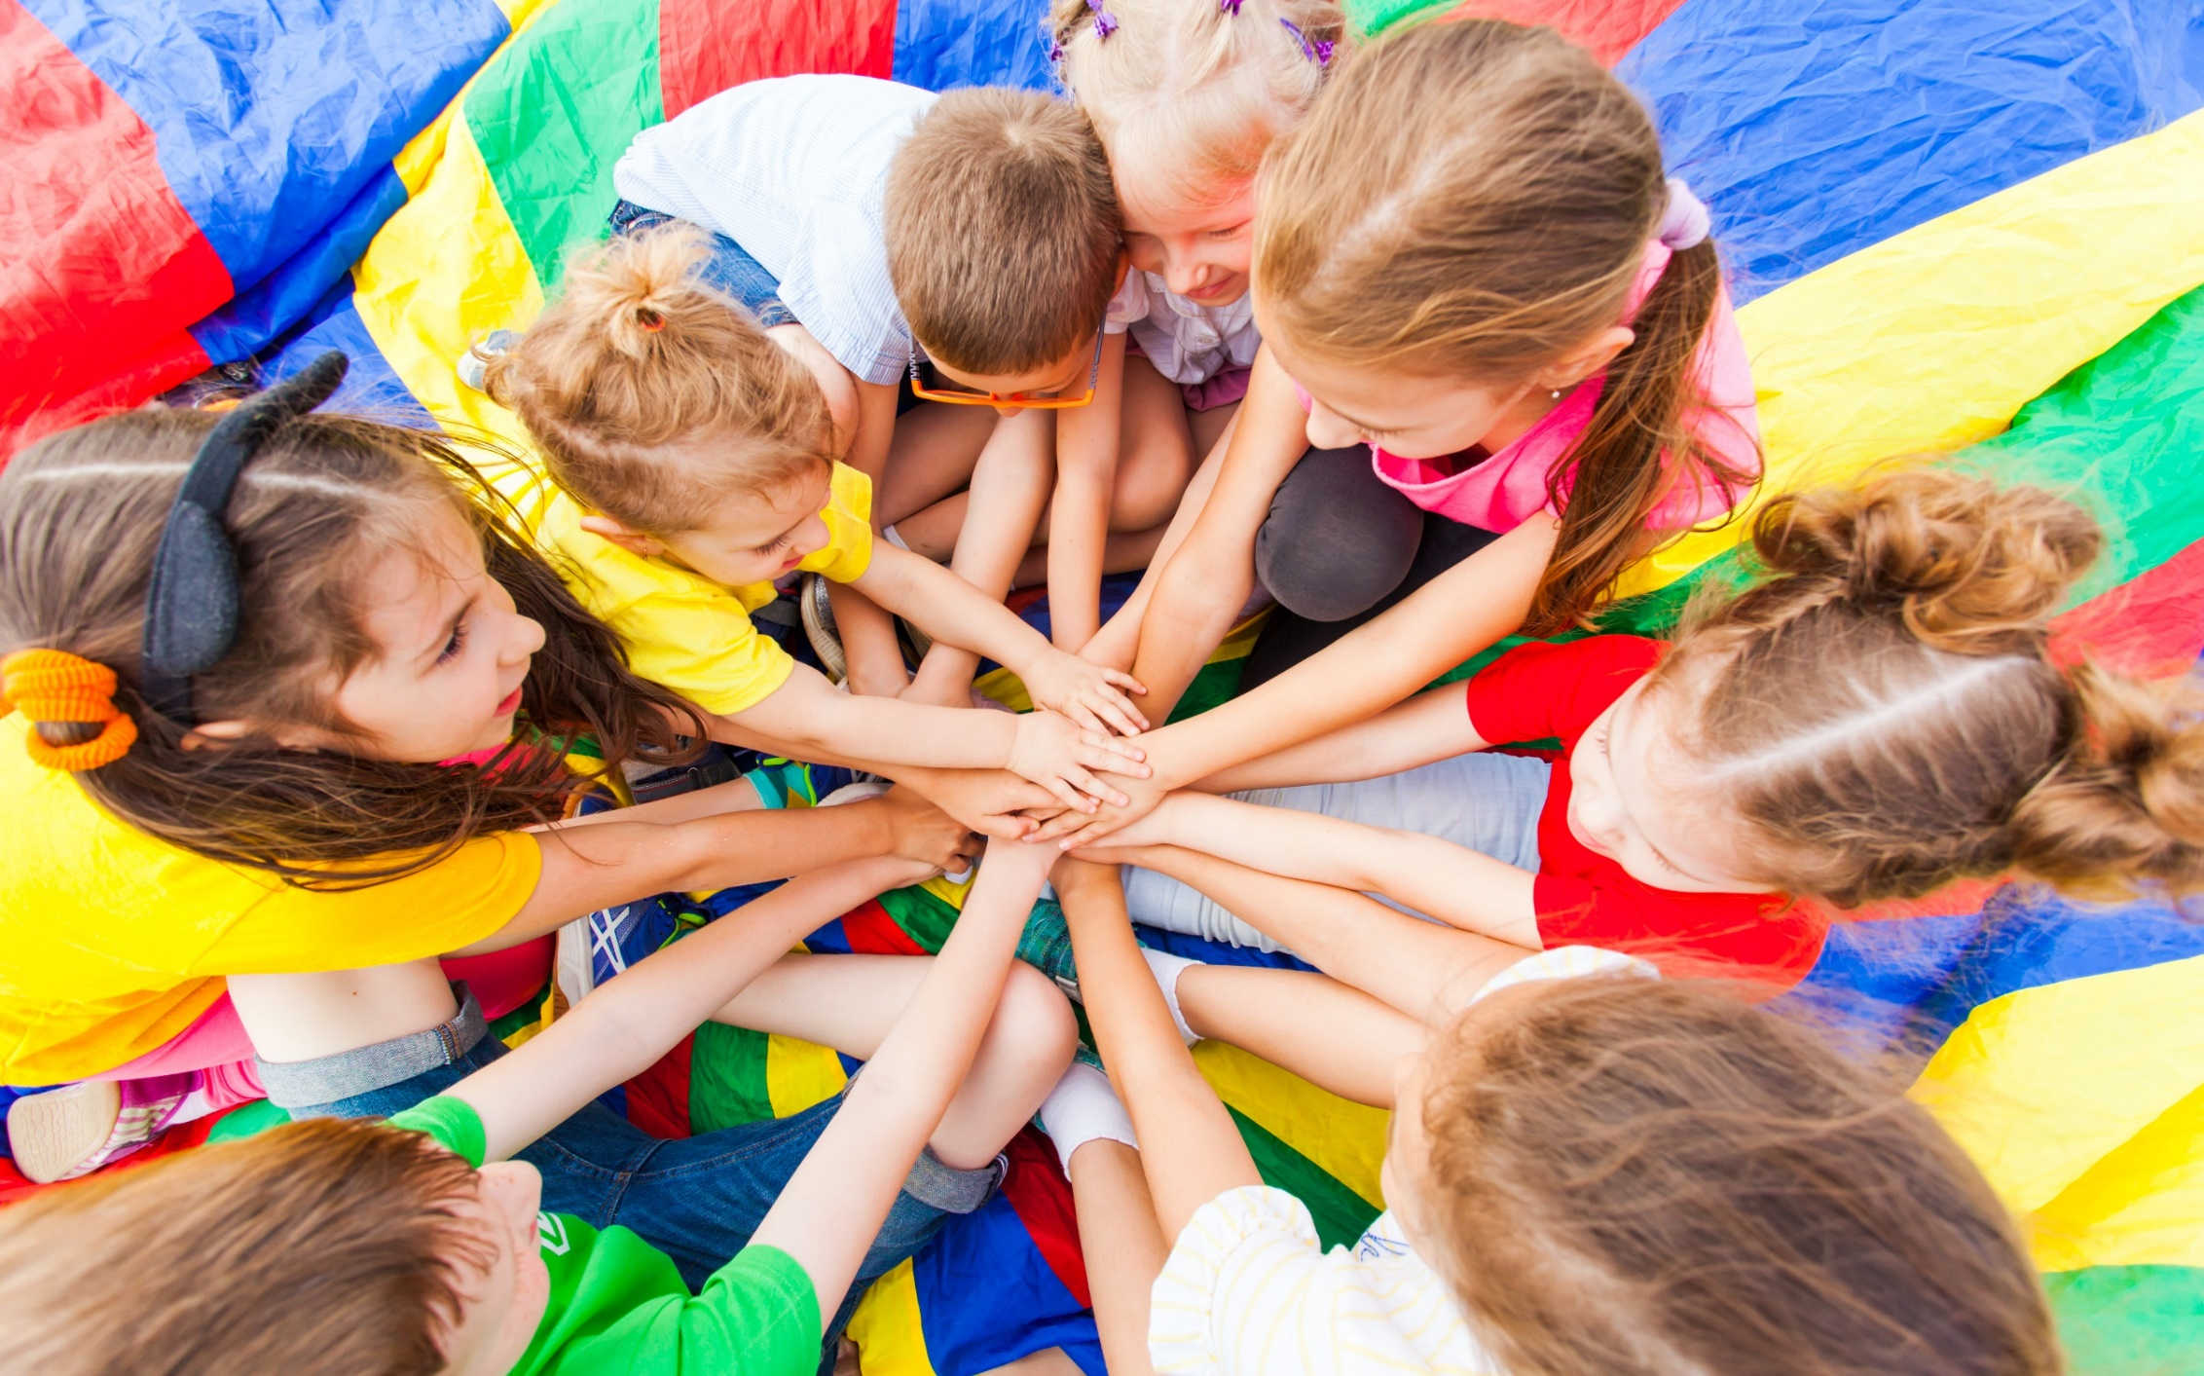
WARM UP

Slide 5
1
4
6
1
SPIN
2
5
2
5
4
3
3
6
Next Part

Slide 6
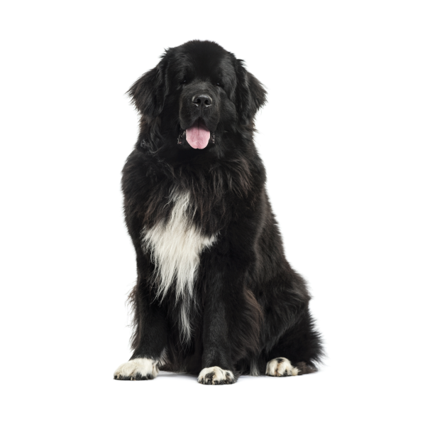
I love my ______.
Go back

Slide 7
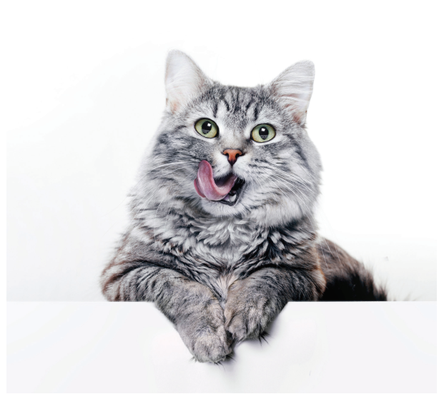
I love my ______.
Go back

Slide 8
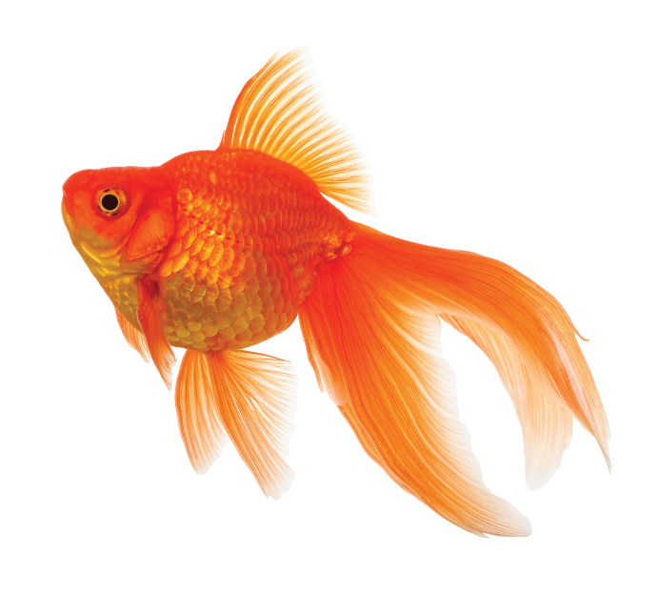
I love my ______.
Go back

Slide 9
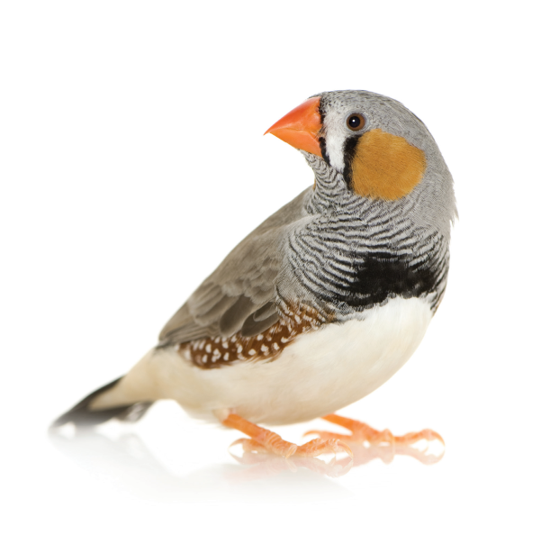
I love my ______.
Go back

Slide 10
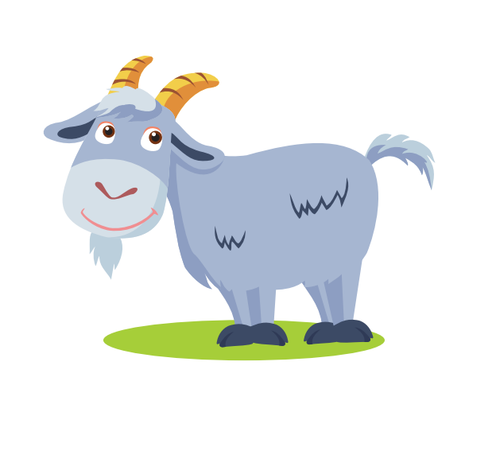
I love my ______.
Go back

Slide 11
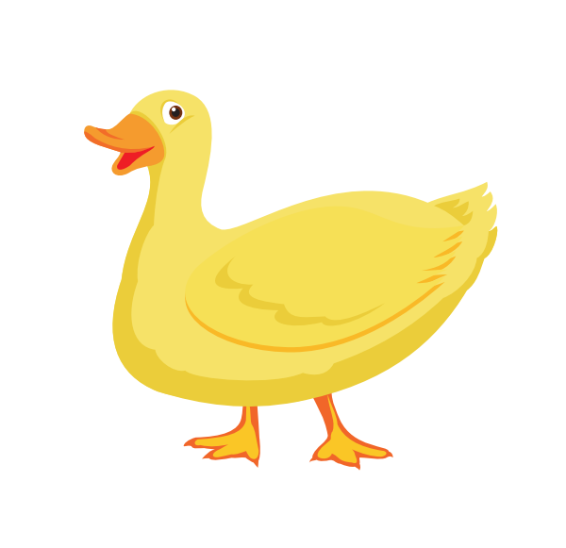
I love my ______.
Go back

Slide 12

Reading

Slide 13
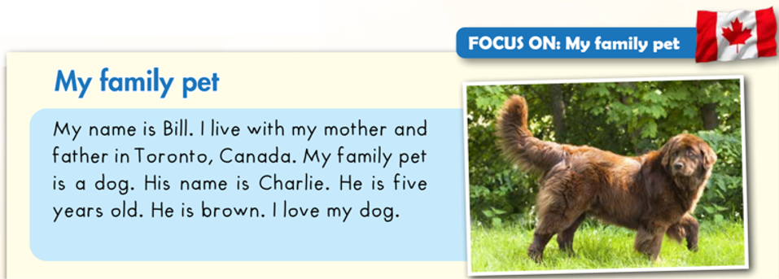
C
Read and circle.

Slide 14
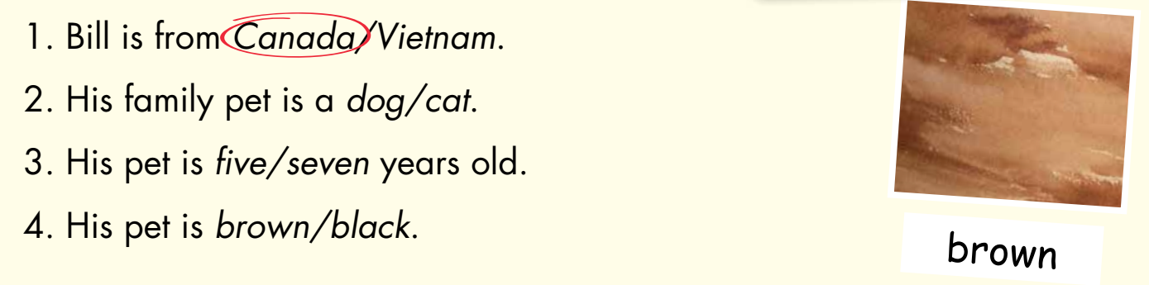
C
Read and circle.

Slide 15

Listening

Slide 16

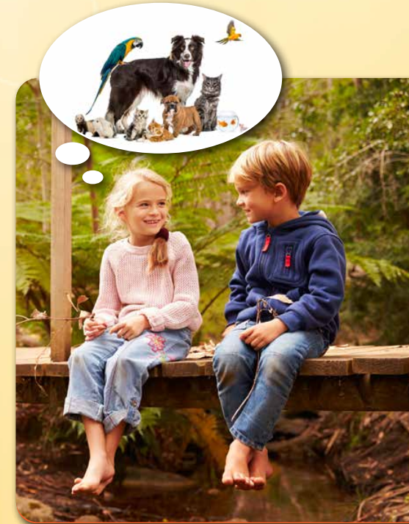
D
1. Look and listen. (CD1 Track 55)
What pets are they talking about?
The bird and cat.

Slide 17
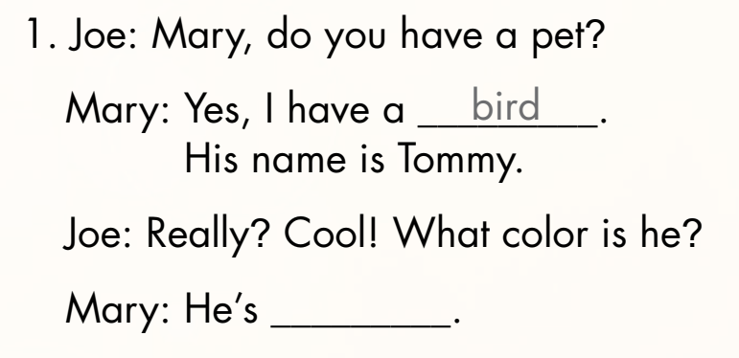
D
2. Listen and write. (CD1 Track 56)
yellow
Keys

Slide 18
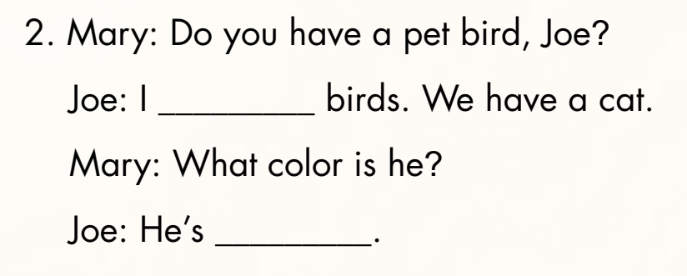
D
2. Listen and write. (CD1 Track 56)
don’t like
brown
Keys

Slide 19

Practice

Slide 20
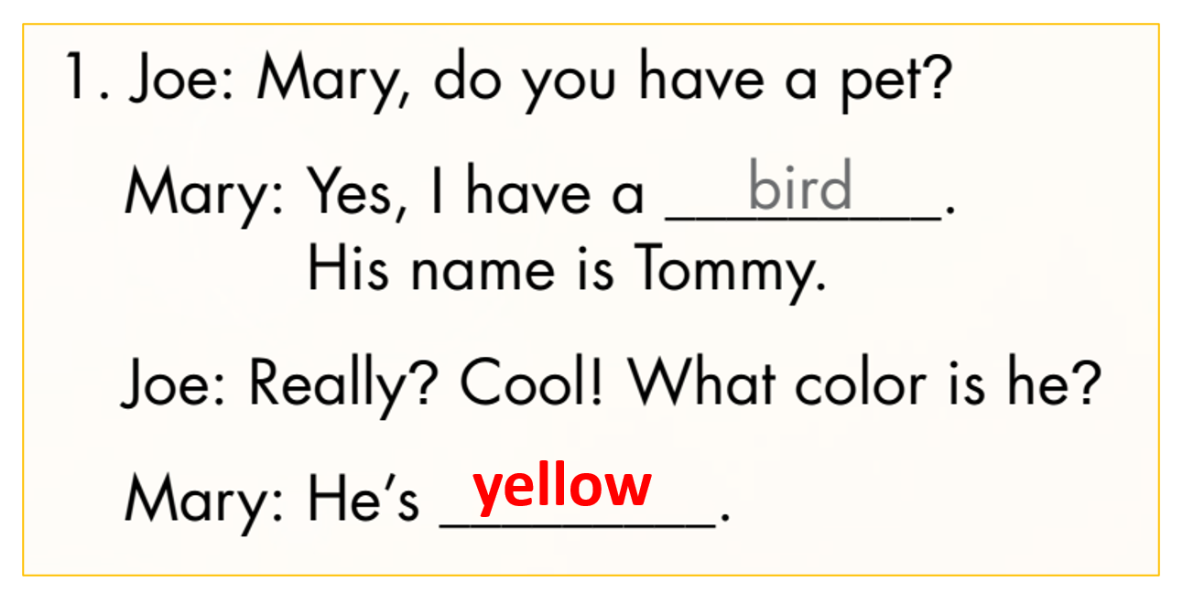
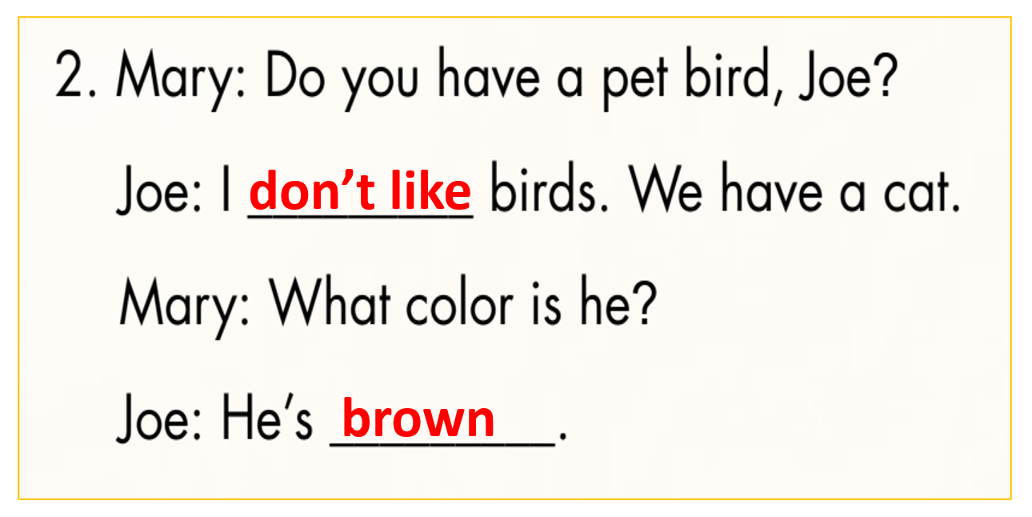
D
3. Practice with your friends.

Slide 21
Further Practice

Slide 22
Make their own conversation.
Mai: Do you have a pet ____, Linh?
Linh: Yes, I have a ____. Her name is ____.
Mai: Great! What color is she?
Linh: She’s ____.
Mai: Cool! How old is she?
Linh: She’s ____.

Slide 23
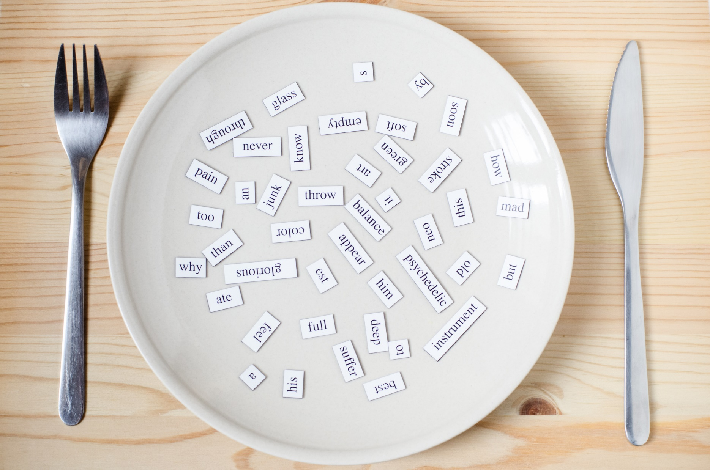
Consolidation

Slide 24
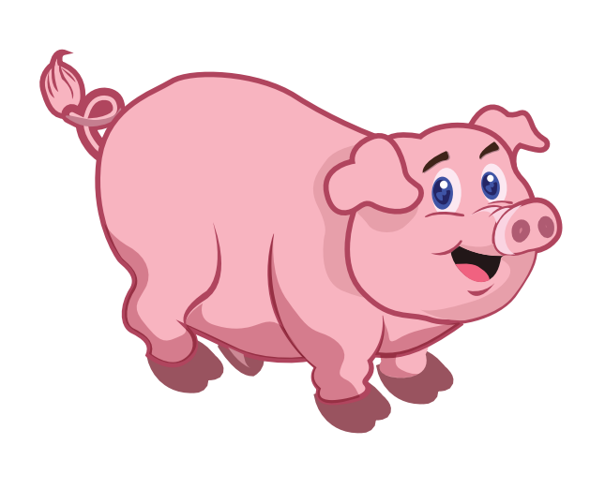
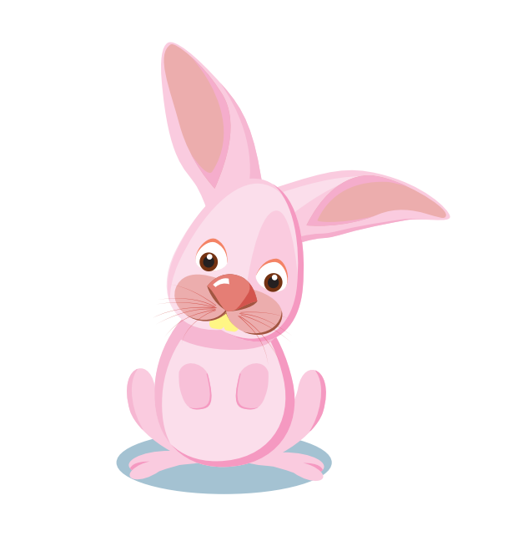
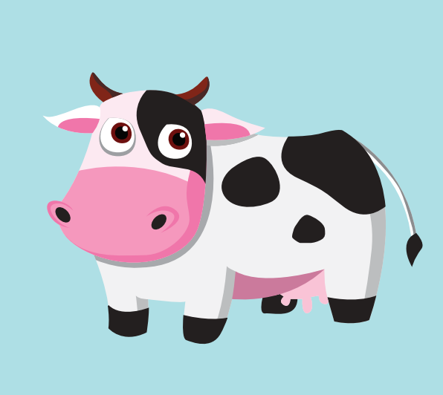
What’s missing?

Slide 25

WRAP-UP

Slide 26
Today’s lesson
Vocabulary Revision:
dog, cat, fish, bird, pig, goat, duck, cow, rabbit
Structure:
I love my ____.

Slide 27
Homework
Practice vocabularies and structure. Make sentences using them.
Do the exercises in Tiếng Anh 3 i-Learn Smart Start Workbook (page 25).
Do the exercises in Tiếng Anh 3 i-Learn Smart Start Notebook (page 19).
Play the consolidation games in Tiếng Anh 3 i-Learn Smart Start DHA App on www.eduhome.com.vn
Prepare the next lesson (page 35).

