Slide 1





WELCOME TO OUR ENGLISH LESSON
Class 3D
Teacher: Nguyễn Thị Minh

Slide 2

Unit 7: Toys
Lesson 1.1
Page 96

Slide 3
Objectives
By the end of this lesson, students will be able to…
Vocabulary: Pronounce and use the words related to the topic properly: robot, doll, big, small, car
Structure: Talk about what can they see by using:
What can you see? - I can see a big doll.
What can you see? - I can see a small robot.

Slide 4

WARM UP

Slide 5




robot
car

Slide 6
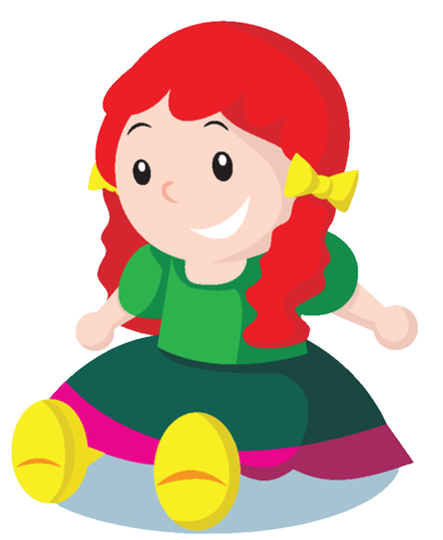
car
doll

Slide 7
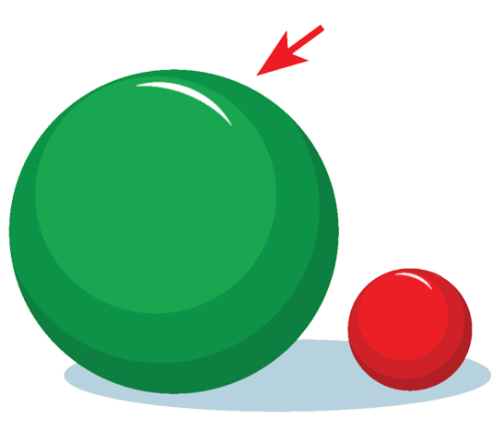
big
small

Slide 8
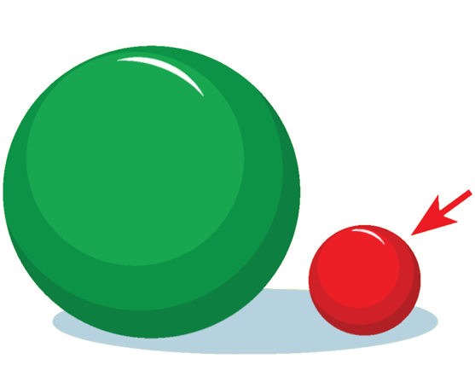
big
small

Slide 9

car
doll

Slide 10
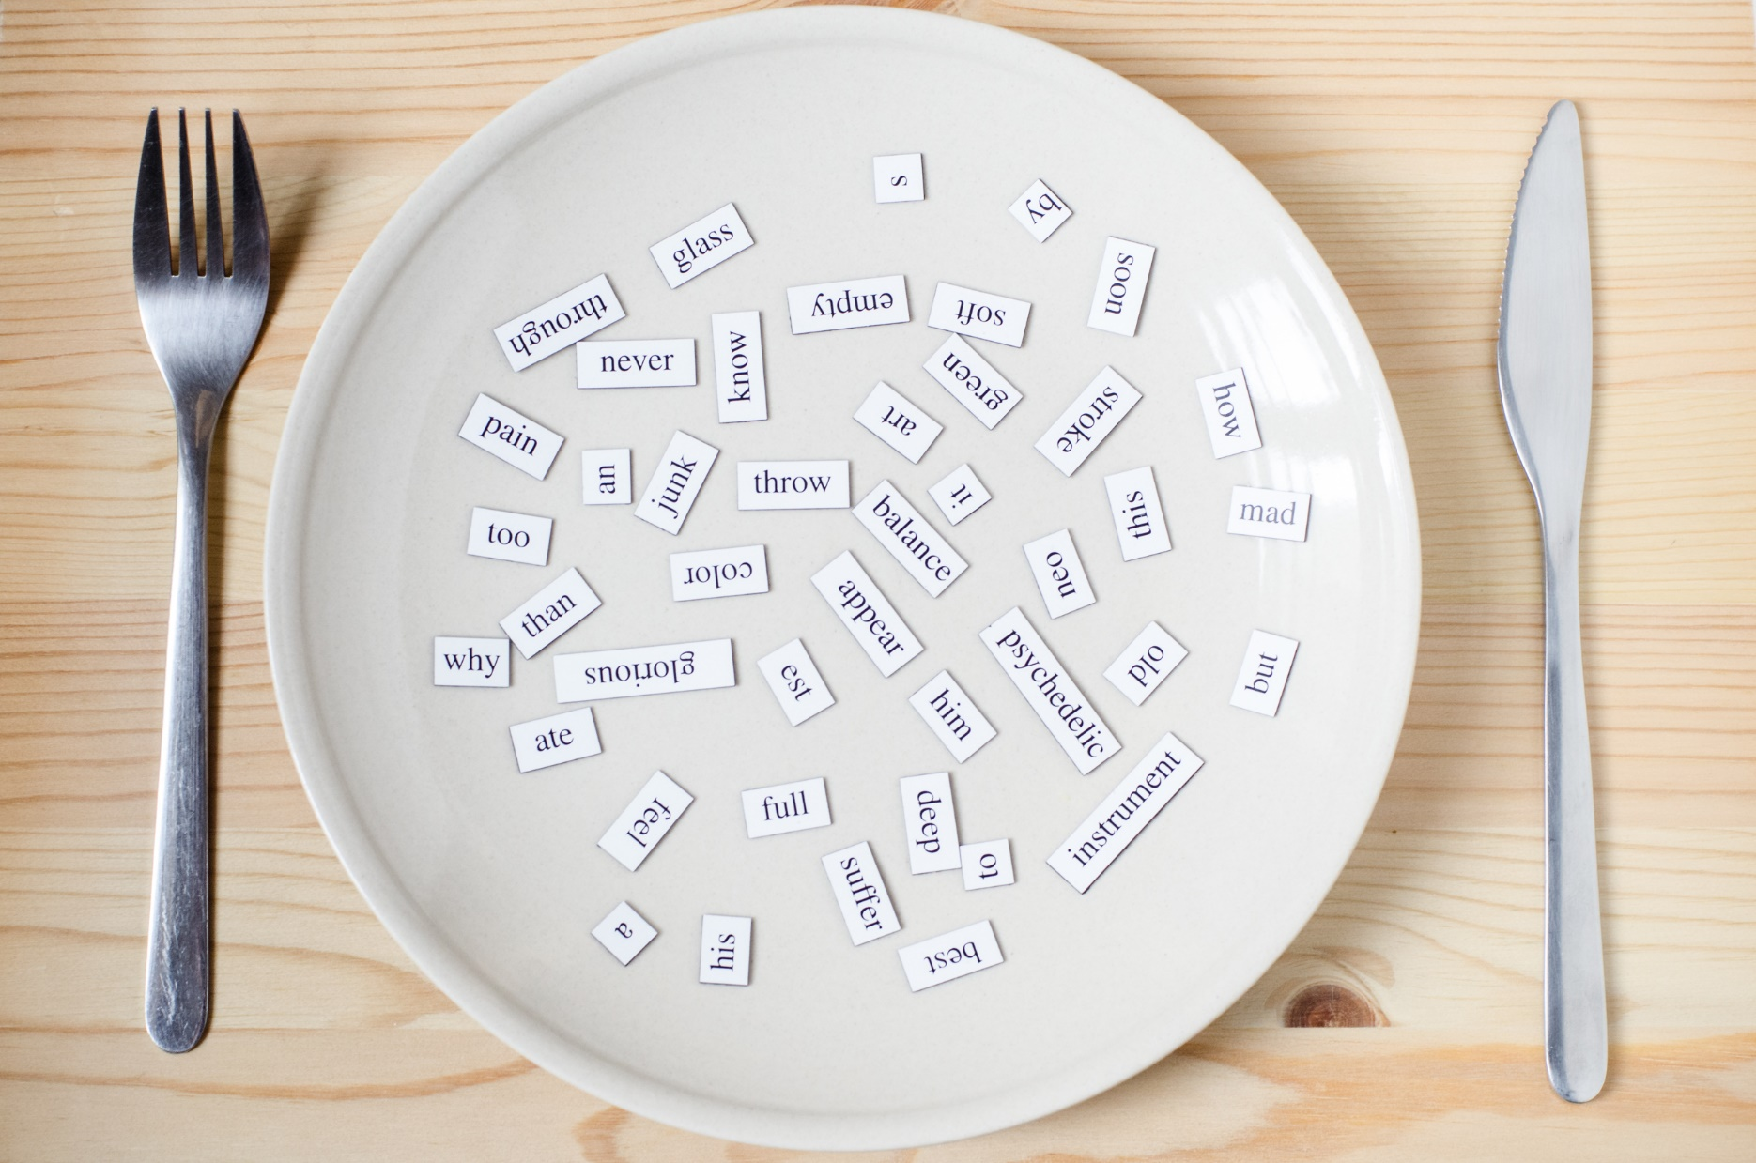
New words
robot
doll
big
small
car

Slide 11
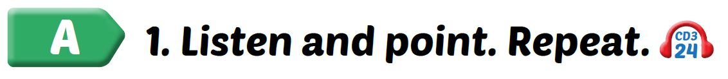

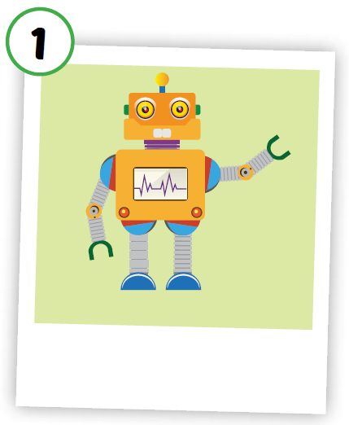
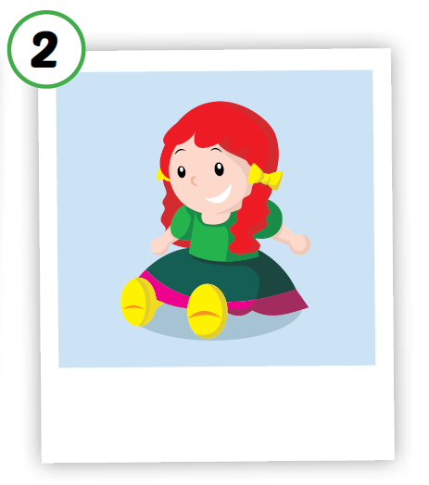
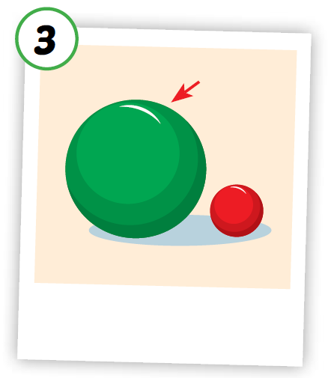
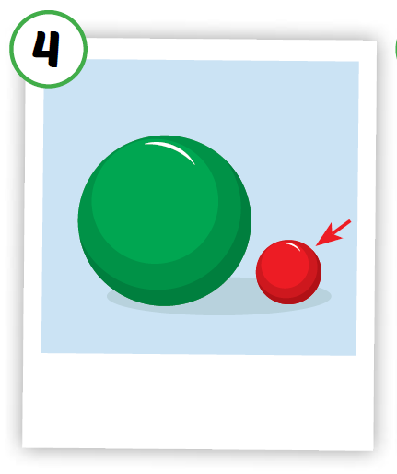
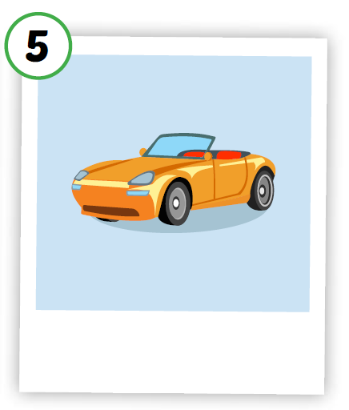





Click the icon to hear the sound
Notes:
Click vào hình A. 1. Listen and point. Repeat để cho cả audio full chạy

Slide 12
Click on each icon to hear the sound
/dɑːl/
búp bê
/bɪɡ/
to, lớn
/smɑːl/
nhỏ, bé
/kɑːr/
ô tô, xe hơi
/ˈroʊbɑːt/người máy
Notes:
Click vô hình để nghe

Slide 13
Click on the icon to hear the sound
/ˈroʊbɑːt/người máy
Notes:
Click vô hình để nghe

Slide 14
Click on the icon to hear the sound
/dɑːl/
búp bê
Notes:
Click vô hình để nghe

Slide 15
Click on the icon to hear the sound
/bɪɡ/
to, lớn
Notes:
Click vô hình để nghe

Slide 16
Click on the icon to hear the sound
/smɑːl/
nhỏ, bé
Notes:
Click vô hình để nghe

Slide 17
Click on the picture to hear the sound
/kɑːr/
ô tô, xe hơi
Notes:
Click vô hình để nghe

Slide 18
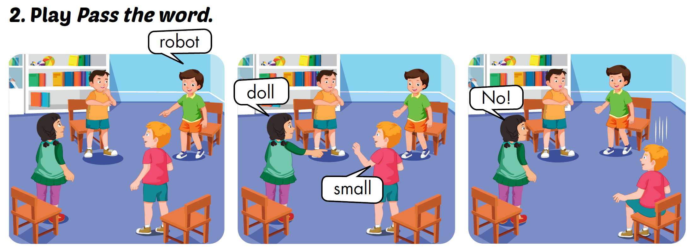

Slide 19




LOOK AND WRITE
b_g
i
_ar
c
t
robo_
d_ll
o
sm_ll
a
Notes:
Bấm vào hình ảnh để hiện đáp án

Slide 20
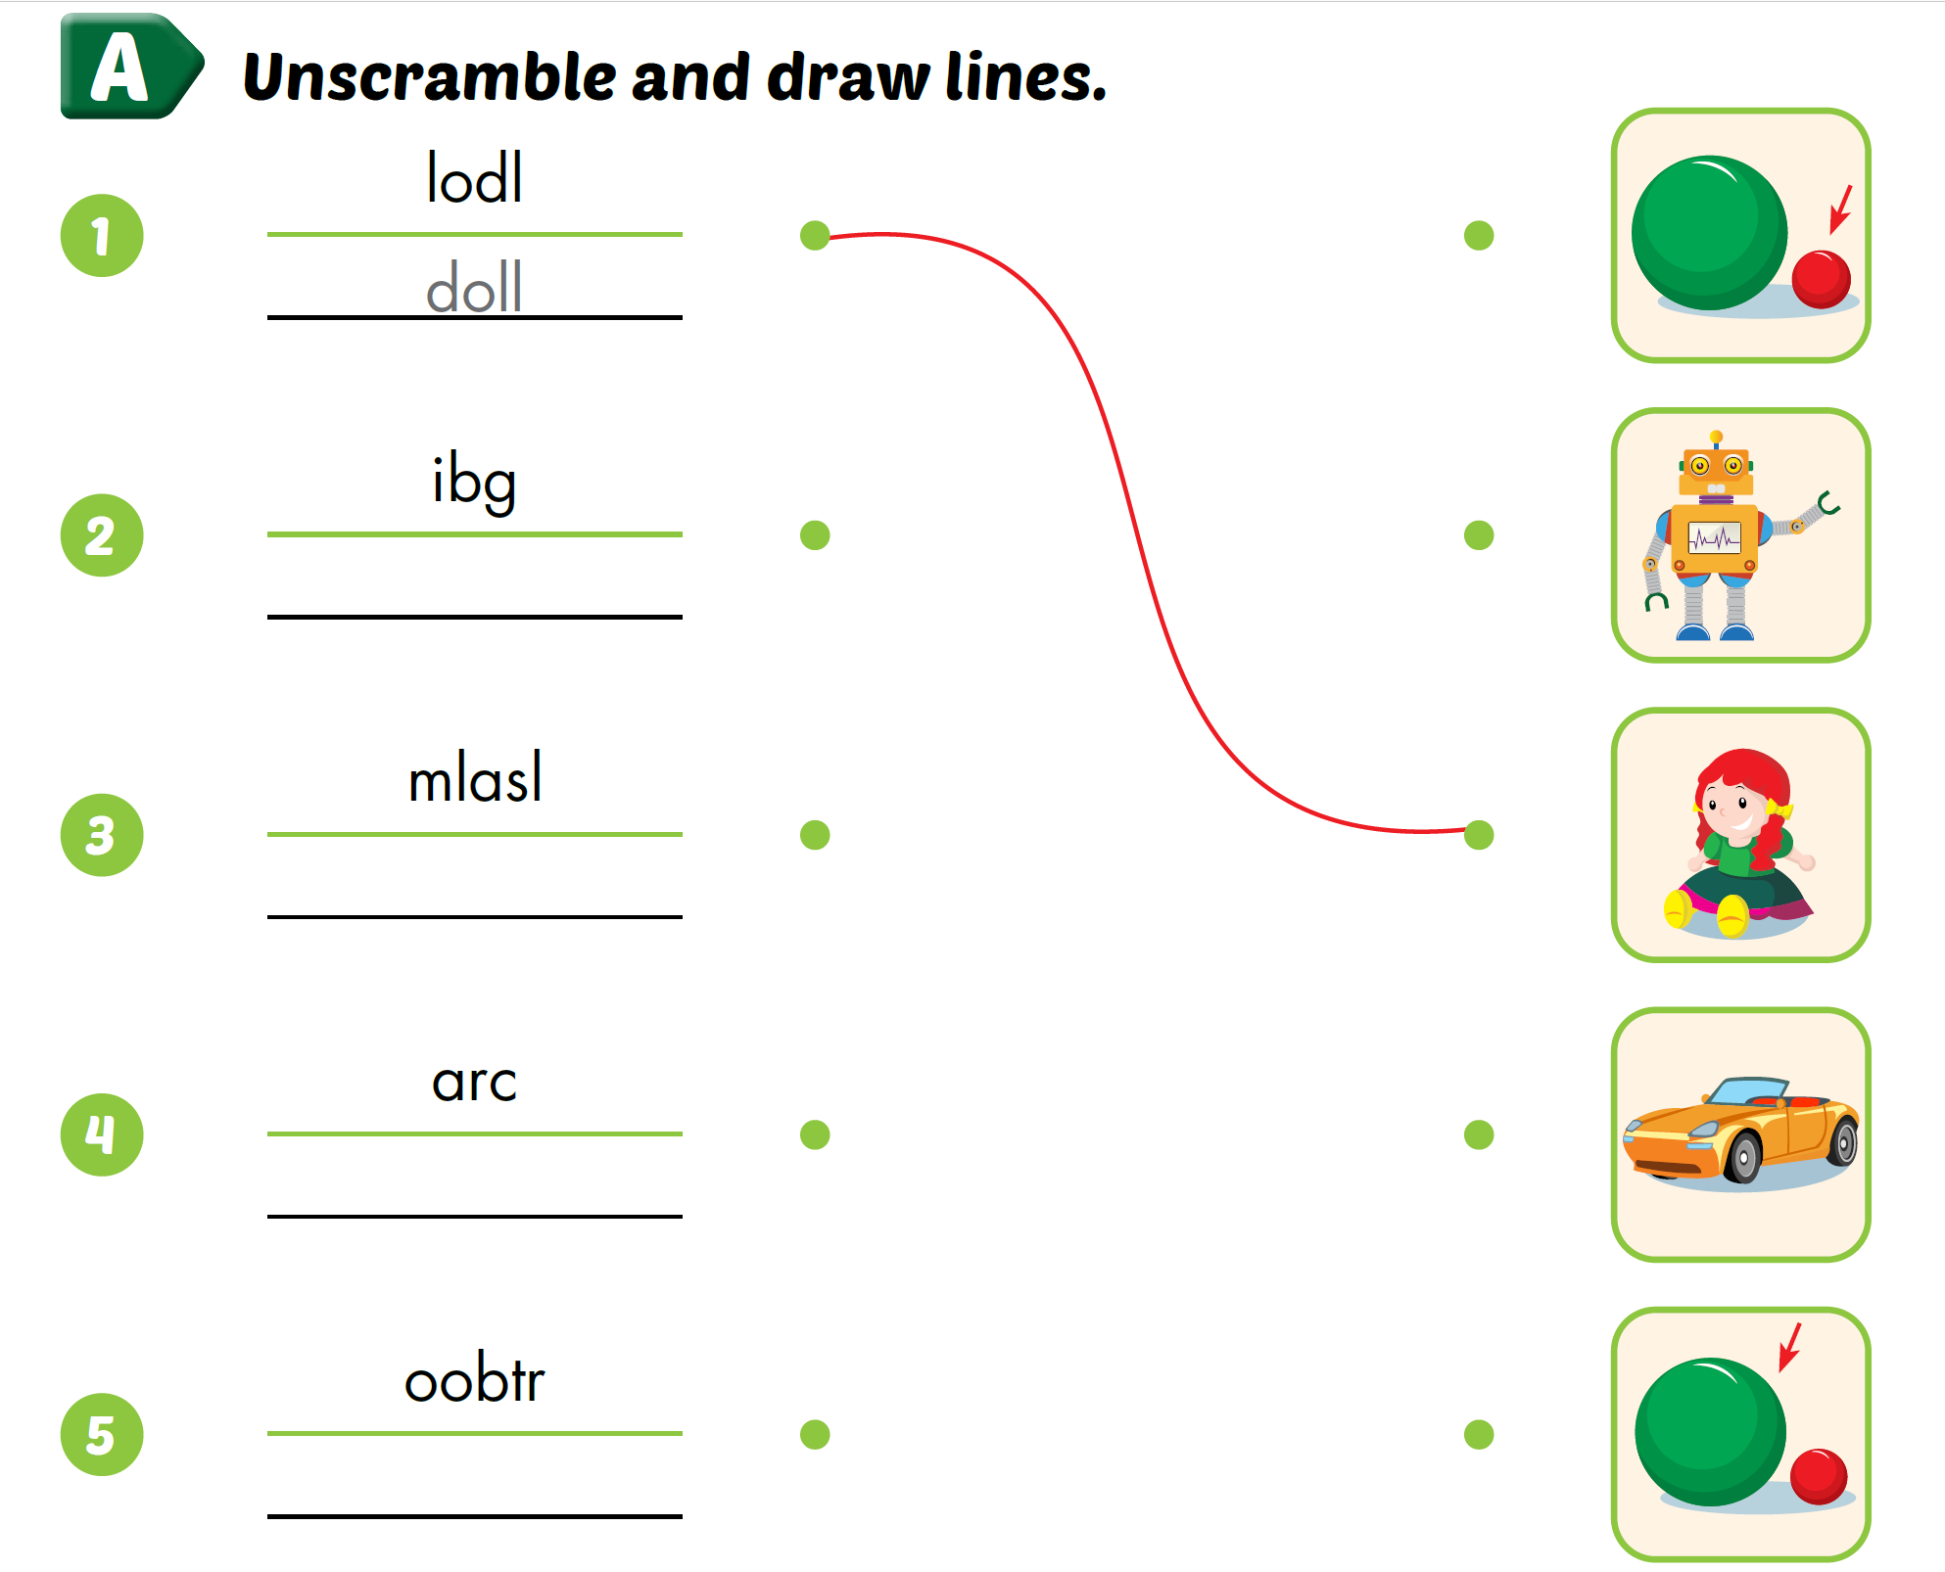
Extra Practice
WB, P. 68
big
small
car
robot
Notes:
Bấm vào từ bị đảo lộn để hiện đáp án

Slide 21
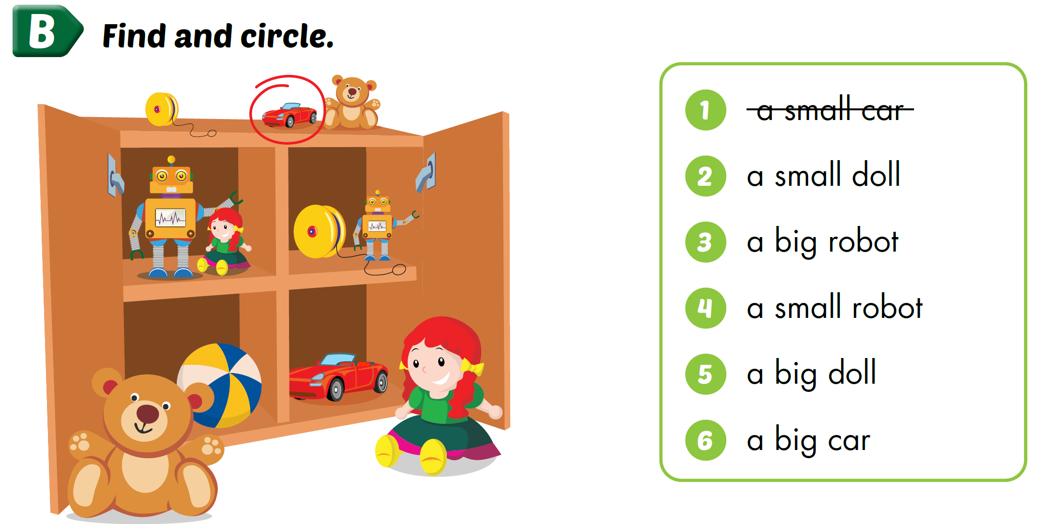
Extra Practice
WB, P. 68

Slide 22

Extra Practice
WB, P. 68

Slide 23
Extra Practice
WB, P. 68

Slide 24
Extra Practice
WB, P. 68

Slide 25
Extra Practice
WB, P. 68

Slide 26
Extra Practice
WB, P. 68

Slide 27
Structures
What can you see?
I can see a big doll.
What can you see?
I can see a small robot.

Slide 28
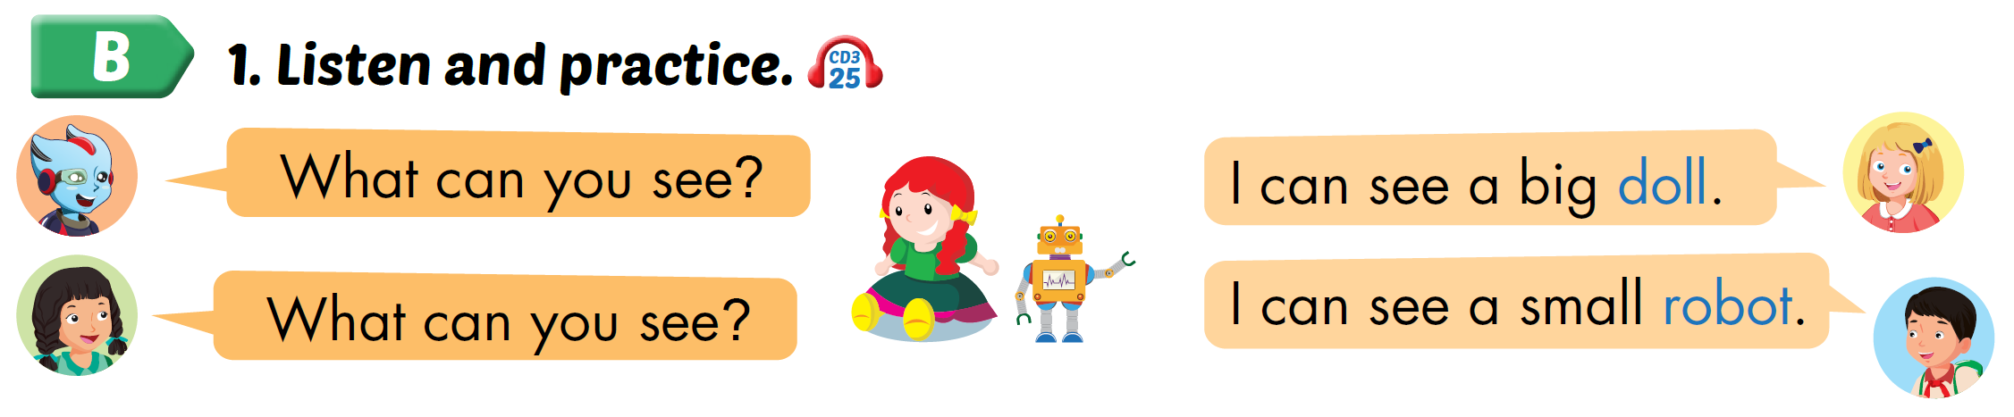
Click on the icon to hear the sound.

Slide 29
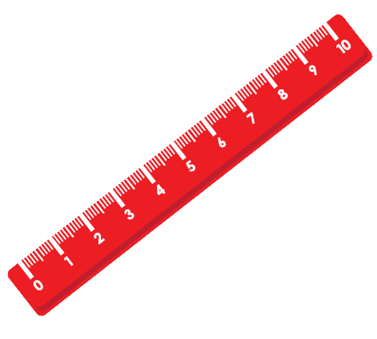
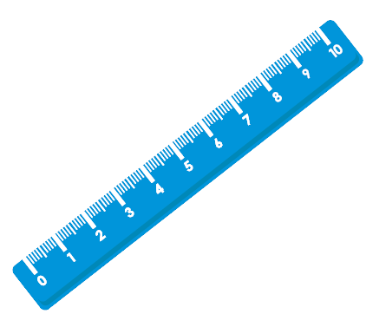
I can see a big ruler.

Slide 30

I can see a small robot.

Slide 31
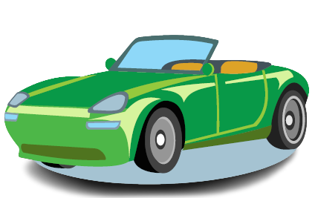
I can see a big car.

Slide 32

I can see a small doll.

Slide 33
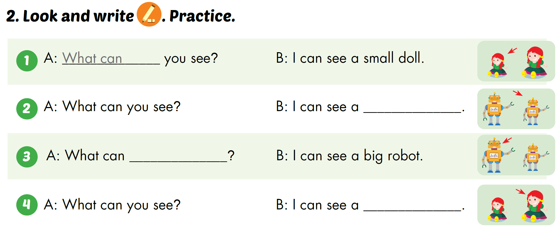
small robot
you see
big doll

Slide 34

CONSOLIDATION

Slide 35
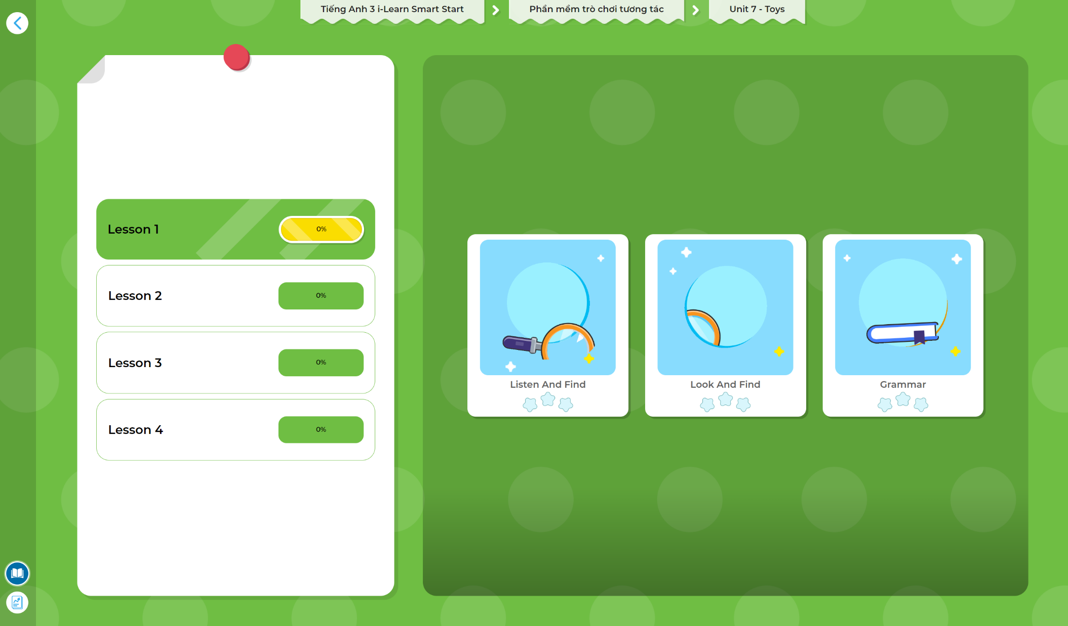
Extra Practice
DHA App
LET’S PLAY!
Click here to play the games

Slide 36
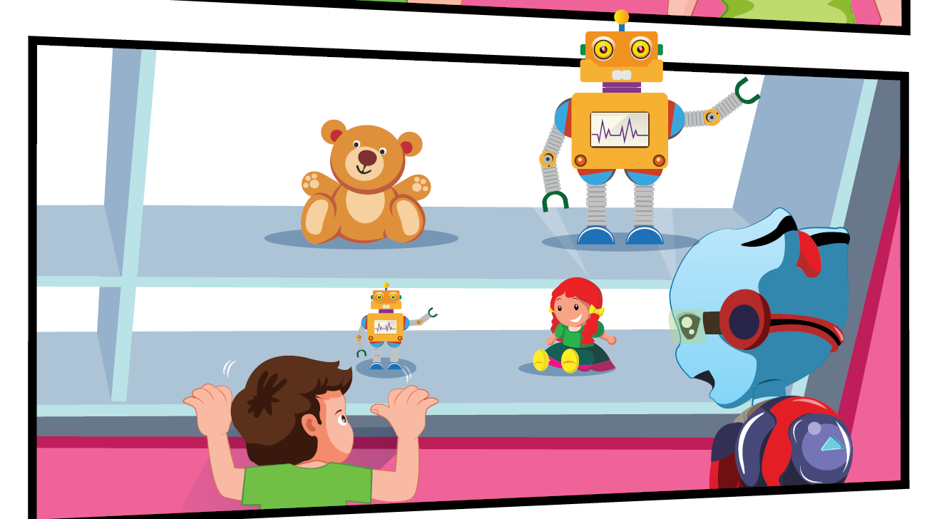
Describe the picture.

Slide 37

WRAP-UP

Slide 38
Today’s lesson
Structures/ Sentence patterns
What can you see?
I can see a big doll.
What can you see?
I can see a small robot.
Vocabulary
robot, doll, big, small, car

Slide 39
Homework
Practice vocabularies, structures, and make sentences using them
Practice the vocabulary and structure in Tiếng Anh 3 i-Learn Smart Start Notebook (page 46)
Do the exercises in Tiếng Anh 3 i-Learn Smart Start Workbook (page 68)
Play the consolidation games in Tiếng Anh 3 i-Learn Smart Start DHA App on www.eduhome.com.vn
Prepare the next lesson (page 97)

