Slide 1

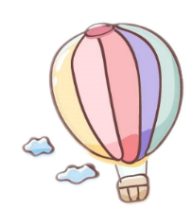


SON TAY EDUCATION AND TRAINING DEPARTMENT.
TRUNG SON TRAM PRIMARY SCHOOL
Welcome teachers to attend our class
English 4 - Class 4A1
Teacher: Nguyen Thi Thu Hien

Slide 2
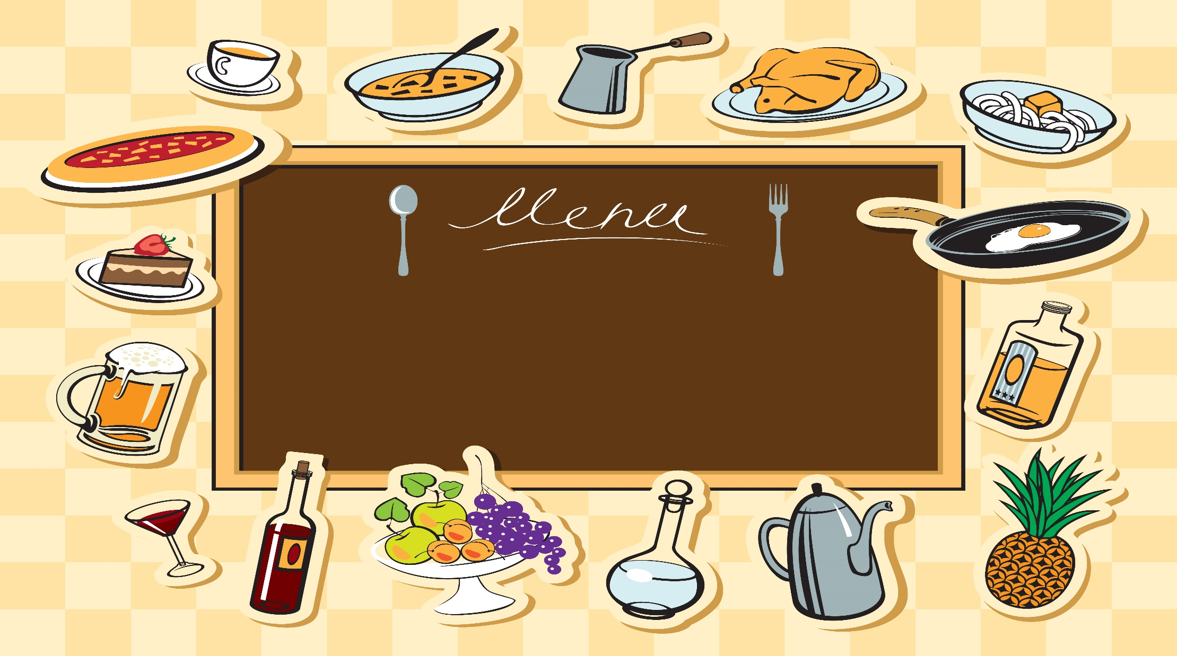

1
Warm up
Notes:
Warm-up: Play a small game “ Puzzle game”
The teacher asks SS to identify different colors and choose a color to guess the image behind the puzzles.
T calls Ss to answer and check their answers.
T asks Ss to repeat names of objects in the image.
Answer keys:
1. rope
2. horse
3. seesaw
4. hide-and-seek

Slide 3

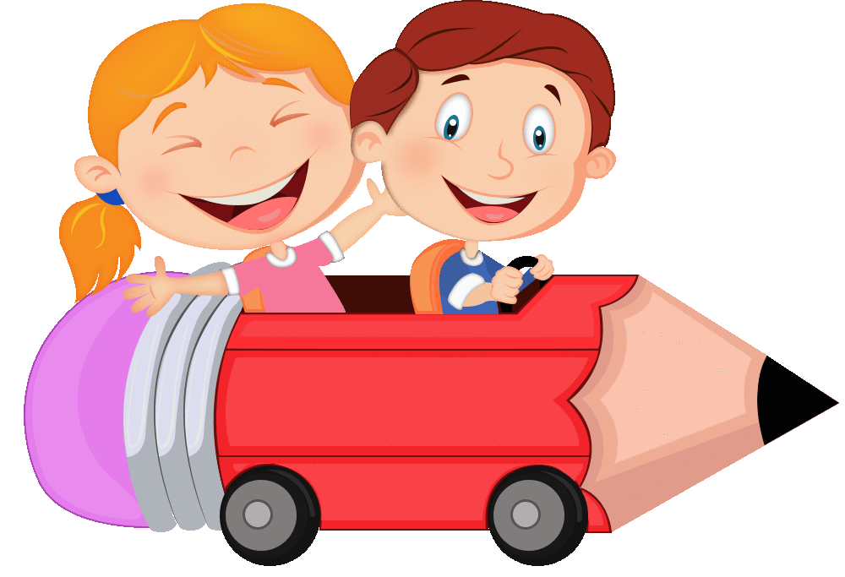
Guessing Game
Notes:
Students have to answer the questions to help the boy and the girl get the goal.

Slide 4
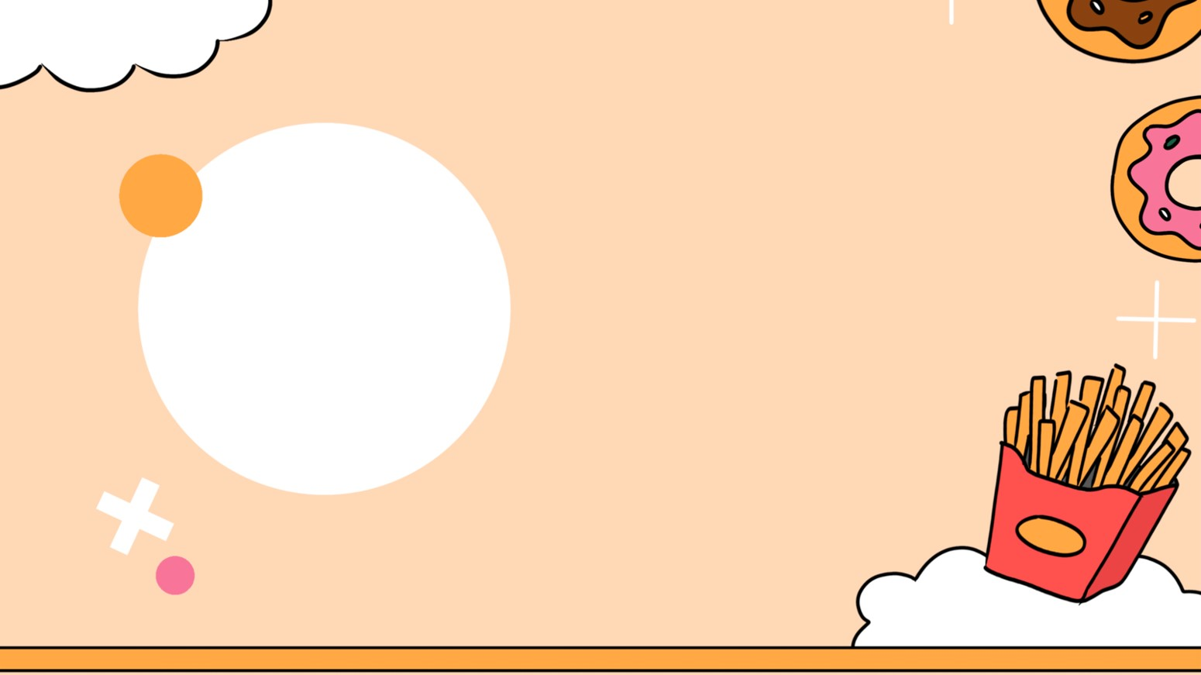


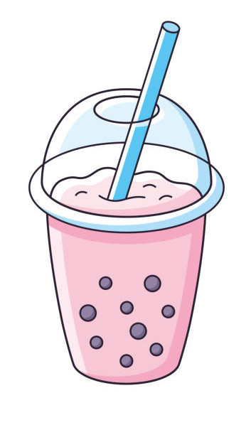
1
2
Bubble tea
4 stars
3
4

Slide 5
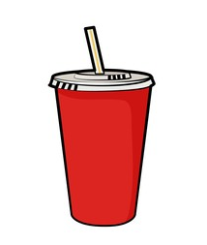
1
2
Soft drink
3 stars
3
4

Slide 6

1
2
Lemonade
3 stars
3
4

Slide 7
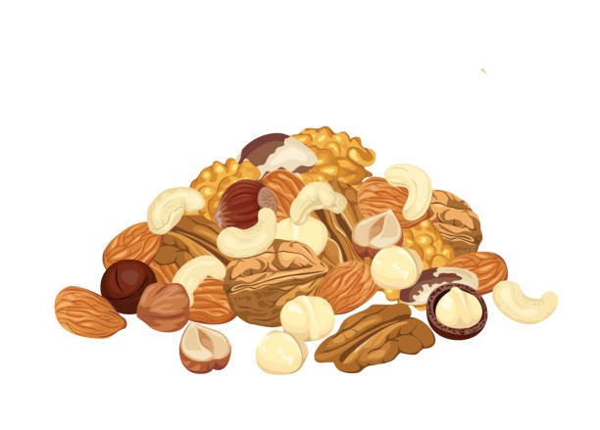
1
2
Nuts
3 stars
3
4

Slide 8

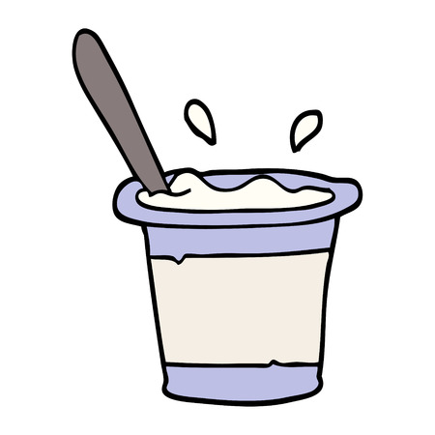
1
2
Yoghurt
3
stars
3
4

Slide 9




Let’s sing !

Slide 10


Slide 11



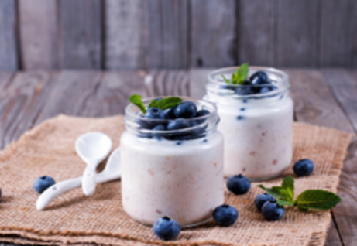
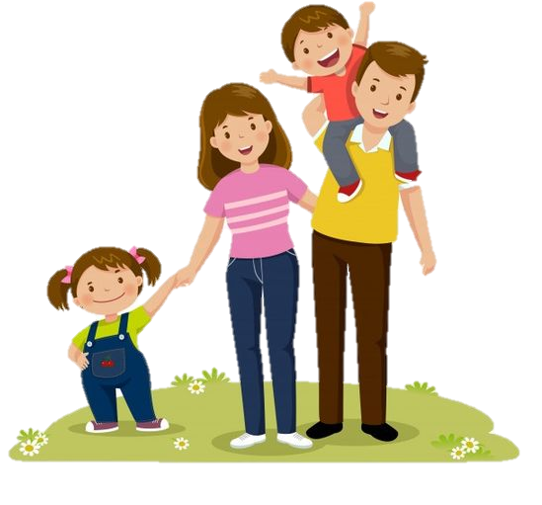

Wednesday, November 8th 2023
Unit 4: Food and Drinks
Lesson 2-Task 4, 5, 6

Slide 12
2
Presentation

Slide 13
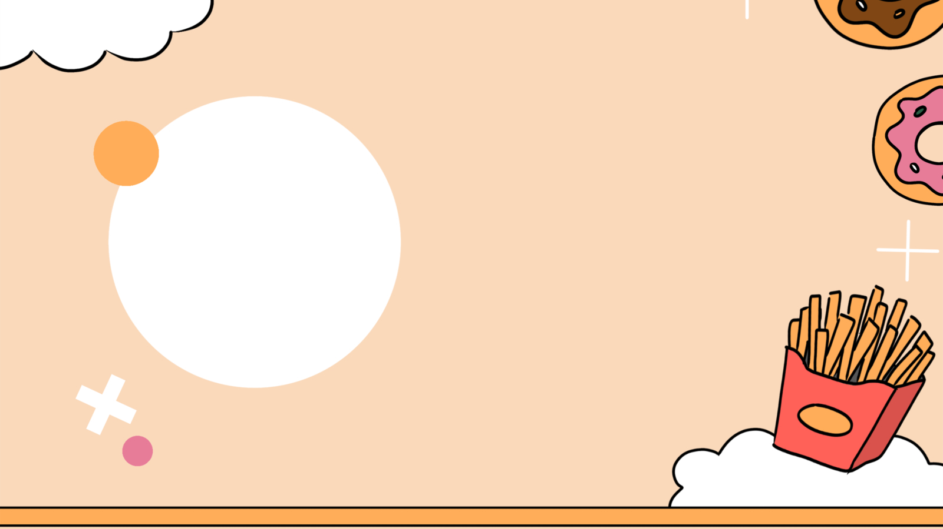
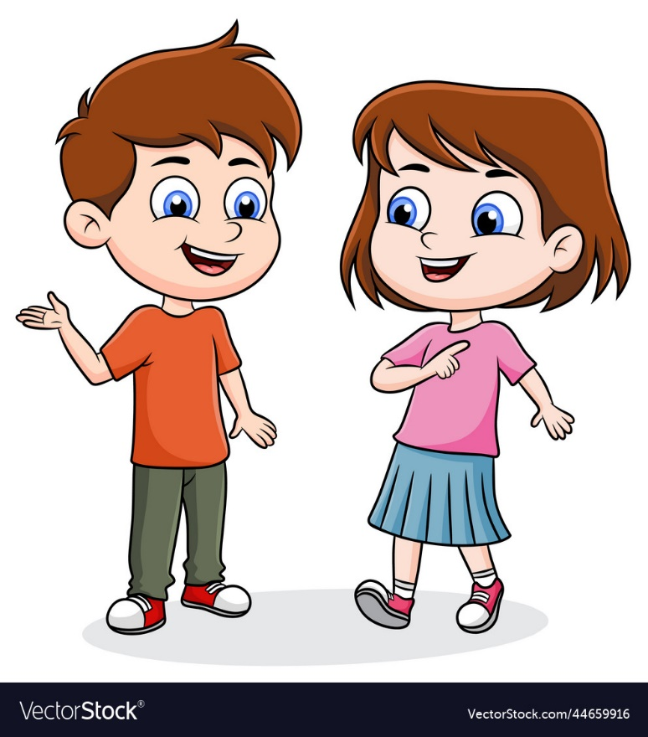


4. Listen and repeat.(track 4.11)
What’s your favourite food?
My fαvourite food is yoghurt.

Slide 14
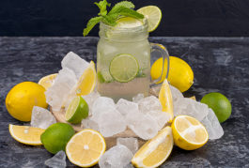
4. Listen and repeat.(track 4.11)
What’s your favourite drink?
My fαvourite drink is lemonade.

Slide 15
3
Practice

Slide 16
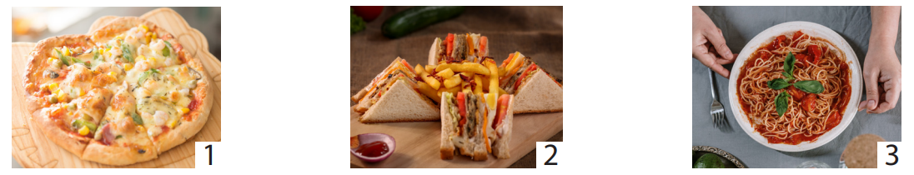
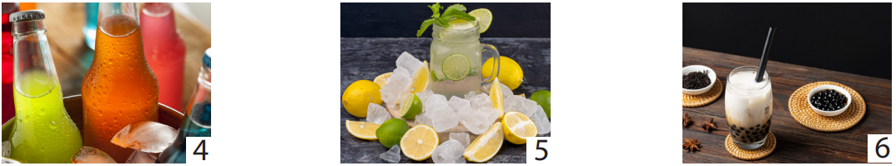
5.Look and say:
What’s your favourite food/drink?
My favourite food/ drink is….

Slide 17
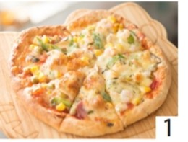
5.Look and say:
1.What’s your favourite food?
My favourite food is pizza

Slide 18
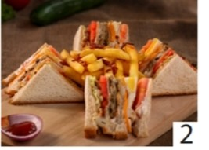
5.Look and say:
2.What’s your favourite food?
My favourite food is sandwich

Slide 19
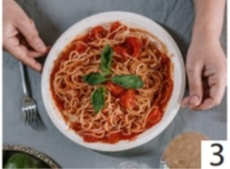
5.Look and say:
3.What’s your favourite food?
My favourite food is spaghetti

Slide 20
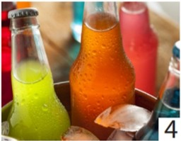
5.Look and say:
4.What’s your favourite drink?
My favourite drink is soft drink

Slide 21
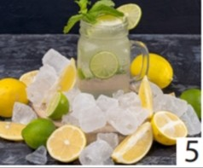
5.Look and say:
5.What’s your favourite drink?
My favourite drink is lemonade

Slide 22
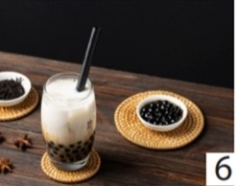
5.Look and say:
6.What’s your favourite drink?
My favourite drink is bubble tea.

Slide 23

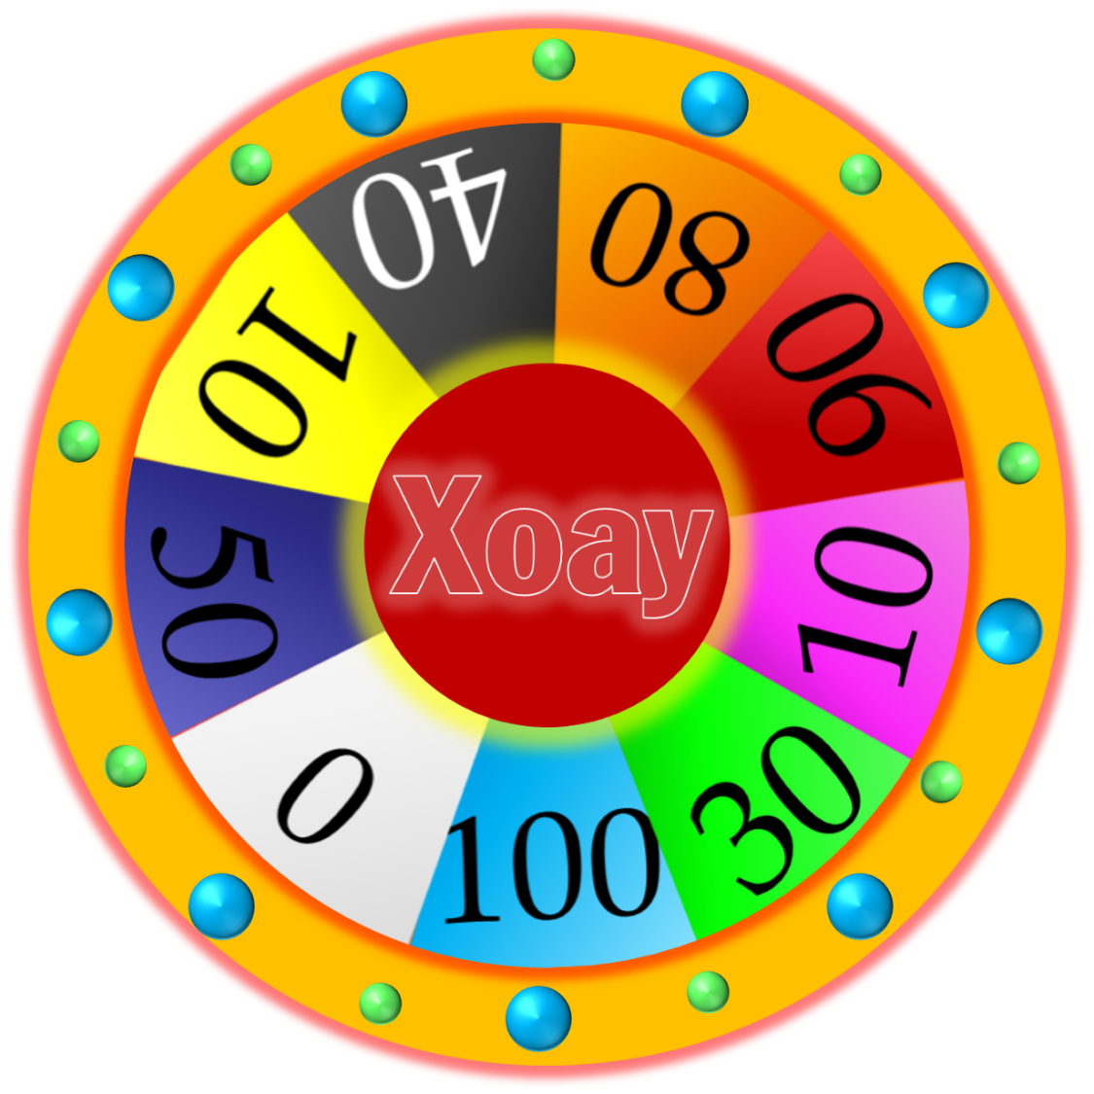

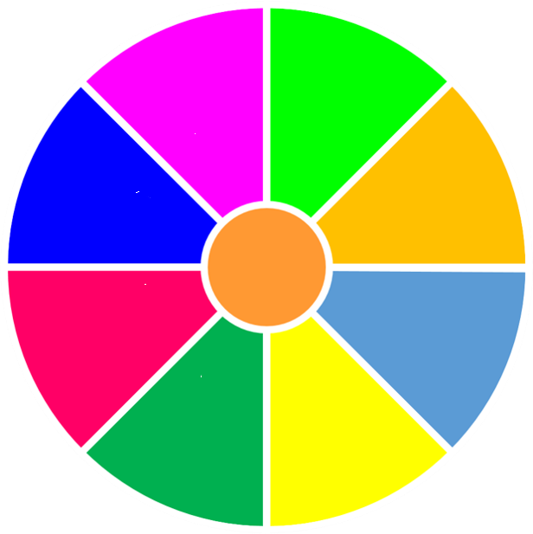



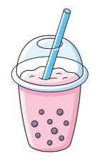
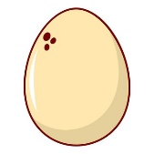


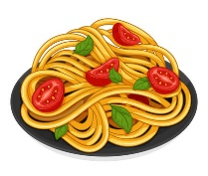


Let’s play:
What’s your favourite food/ drink?
My favourite food/ drink is….
START
STOP

Slide 24
4
Production

Slide 25
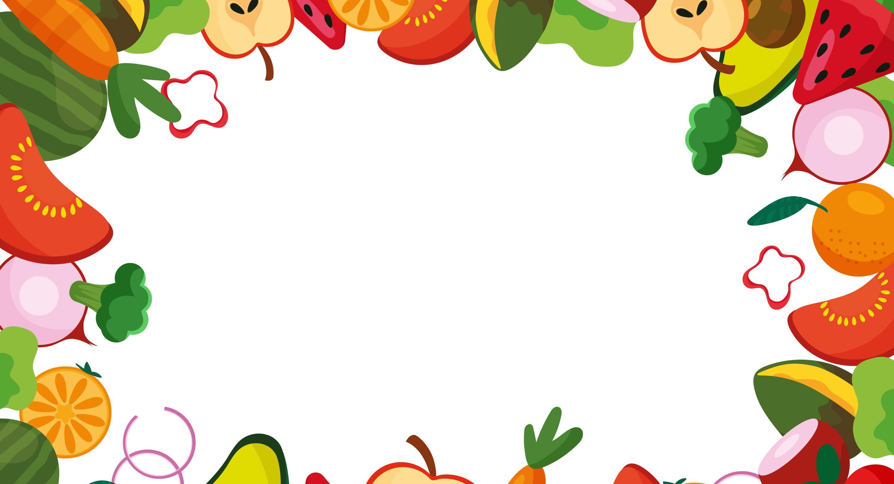

6.Drαw αnd write.Sαy:
My fαvourite food is...
And my fαvourite drink is...

Slide 26
Summary
What’s your favourite food / drink ?
My favourite food / drink is….

Slide 27
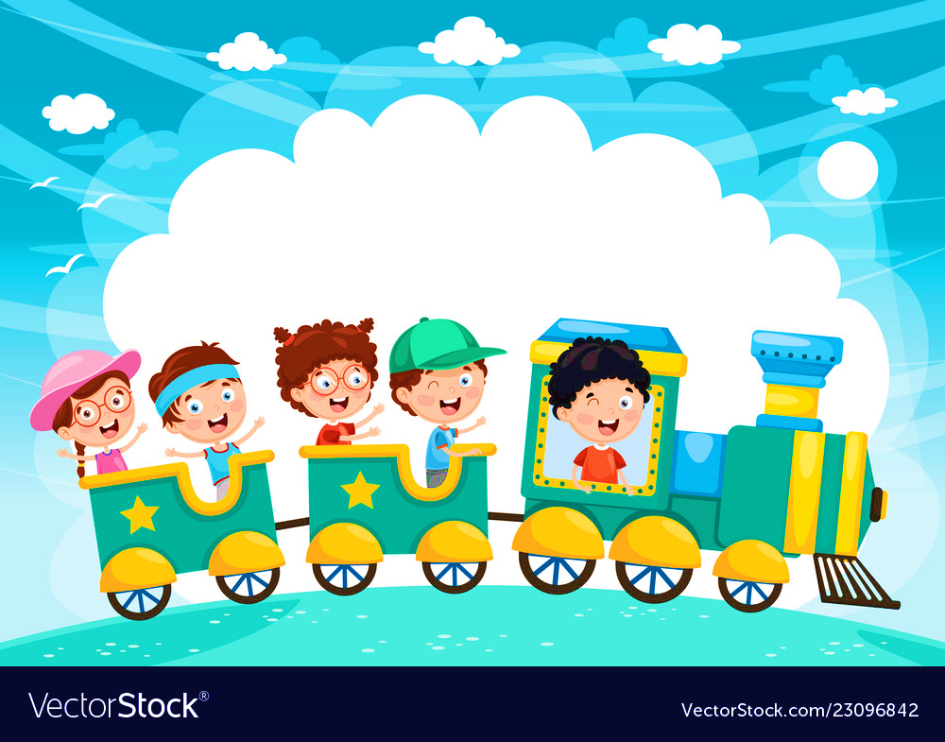







and

