Slide 1


Thursday, February 9th 2023
UNIT 12: Don’t ride your bike too fast !
Lesson 2(1,2,3)

Slide 2
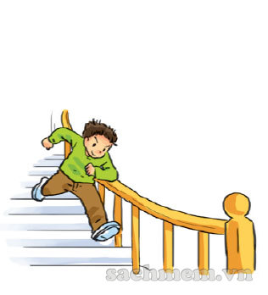
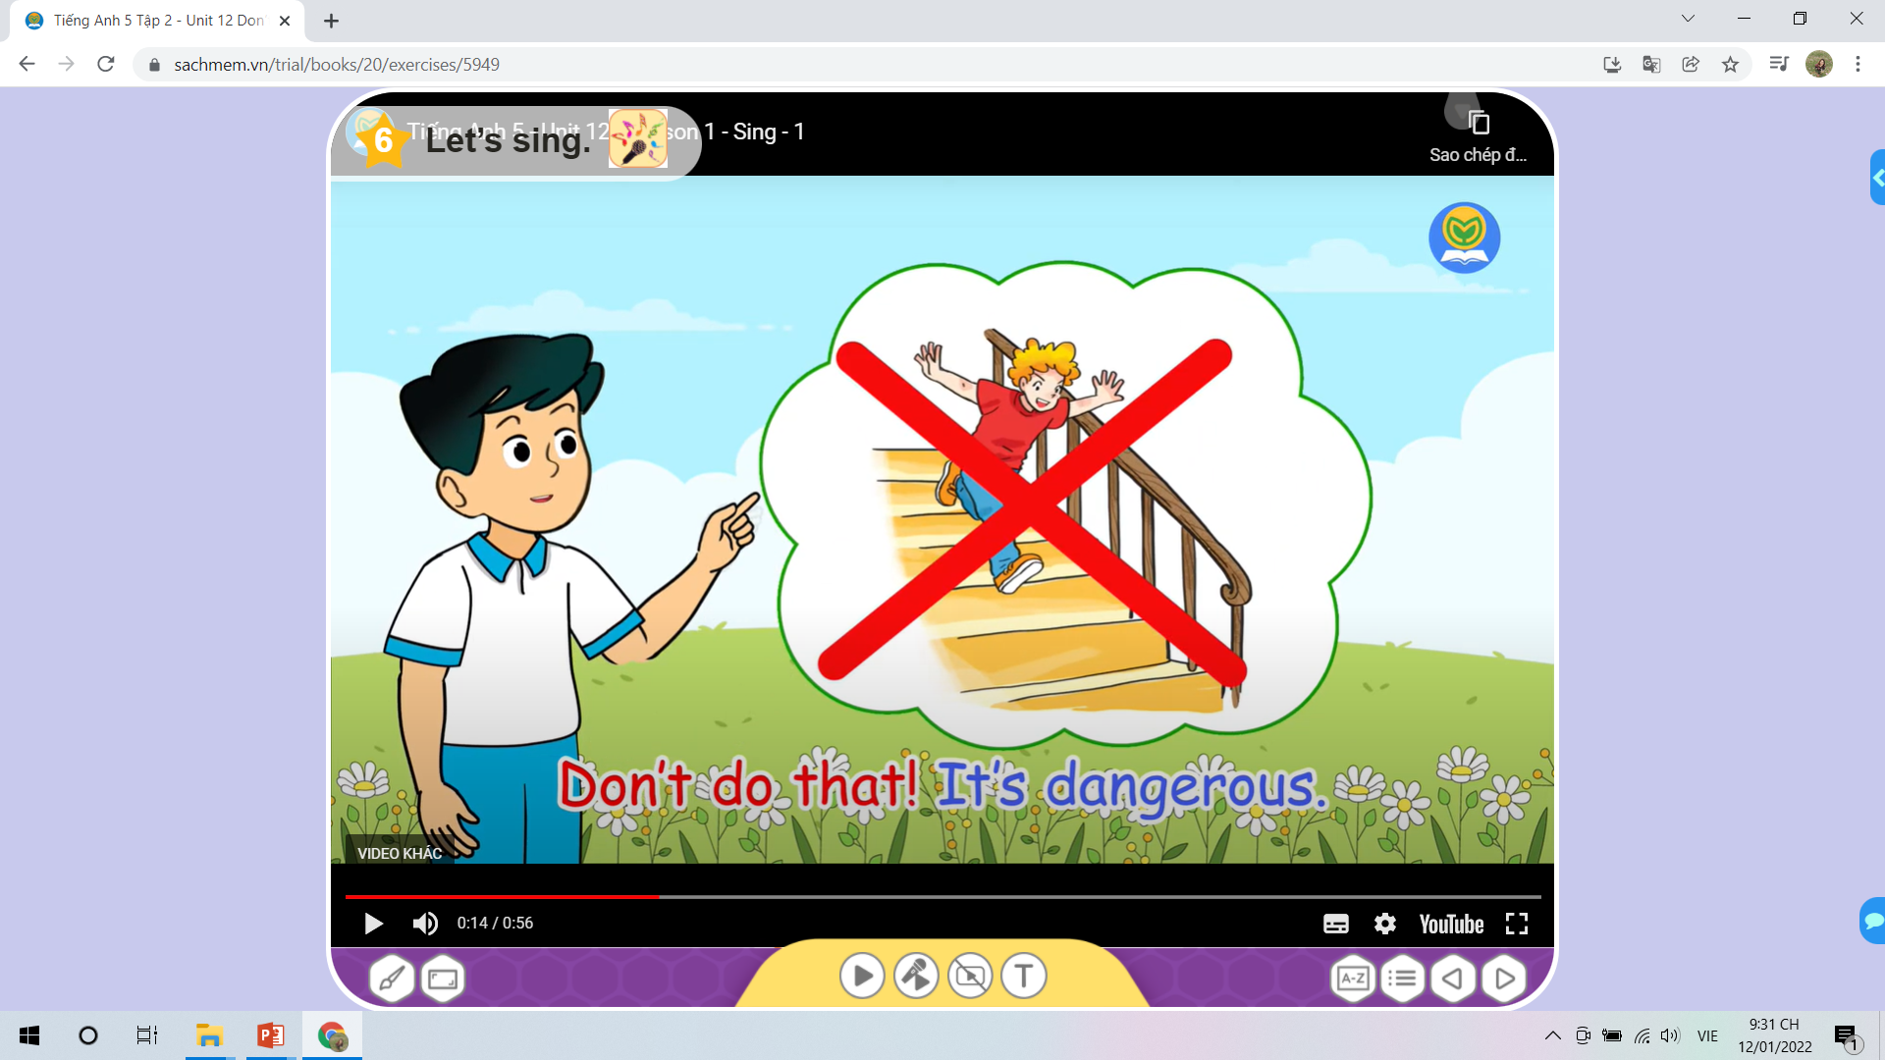


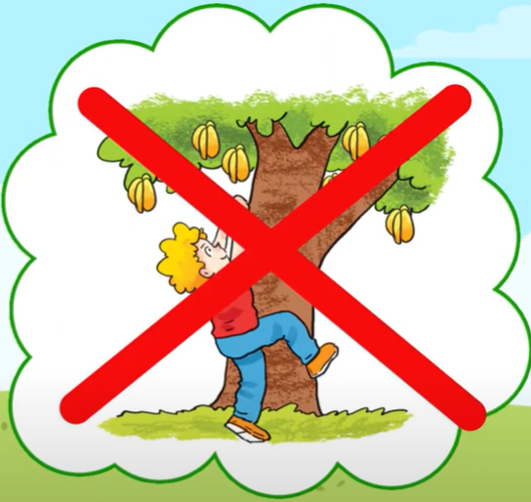
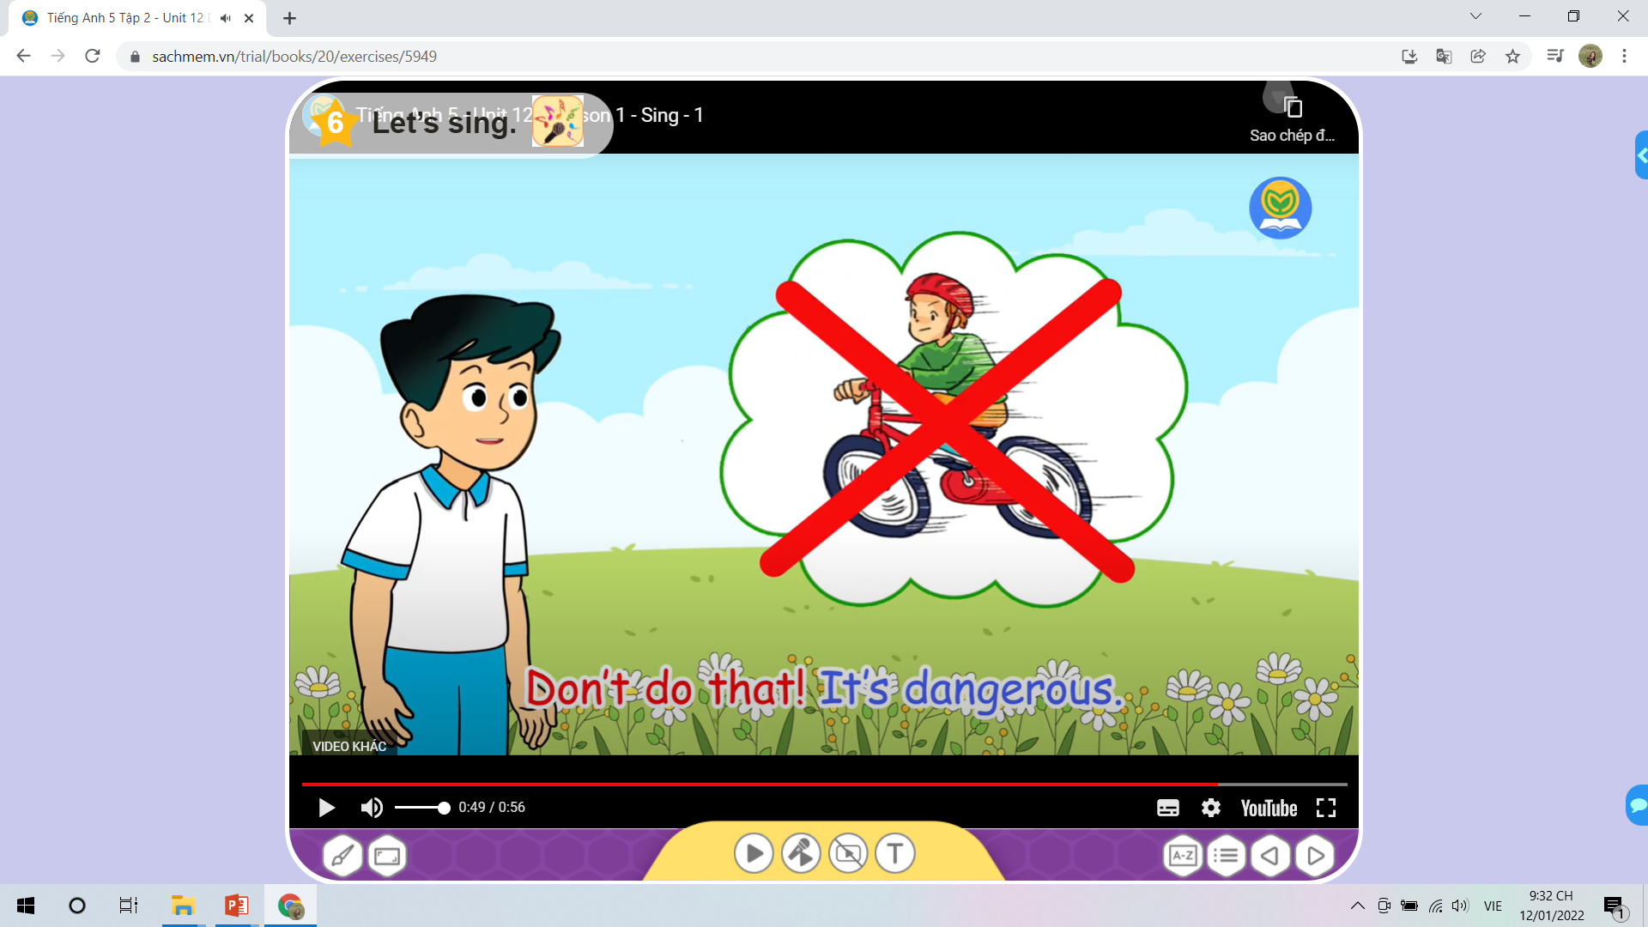

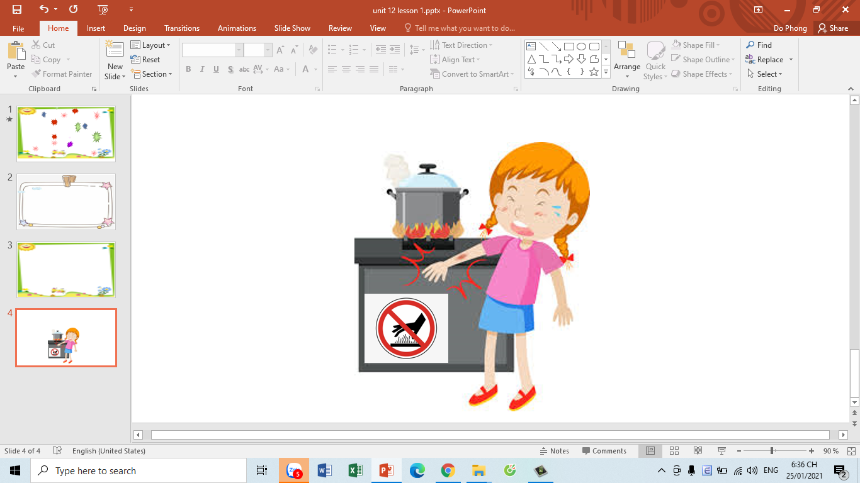

Don’t run down the stairs.
Ok, I won’t.

Slide 3
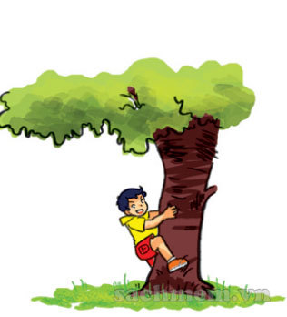
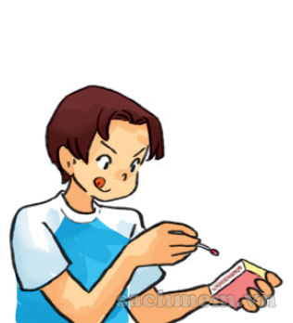
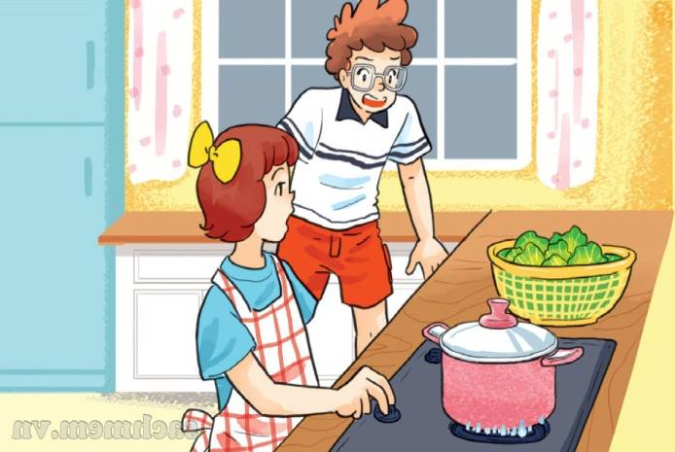
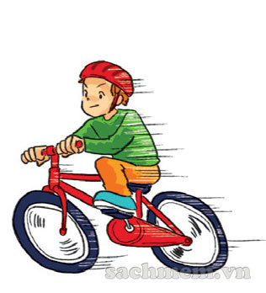
Play with the knife
Climb the tree
Play with matches
Dangerous actions
Run down the stairs
Touch the stove
Ride your bike too fast

Slide 4
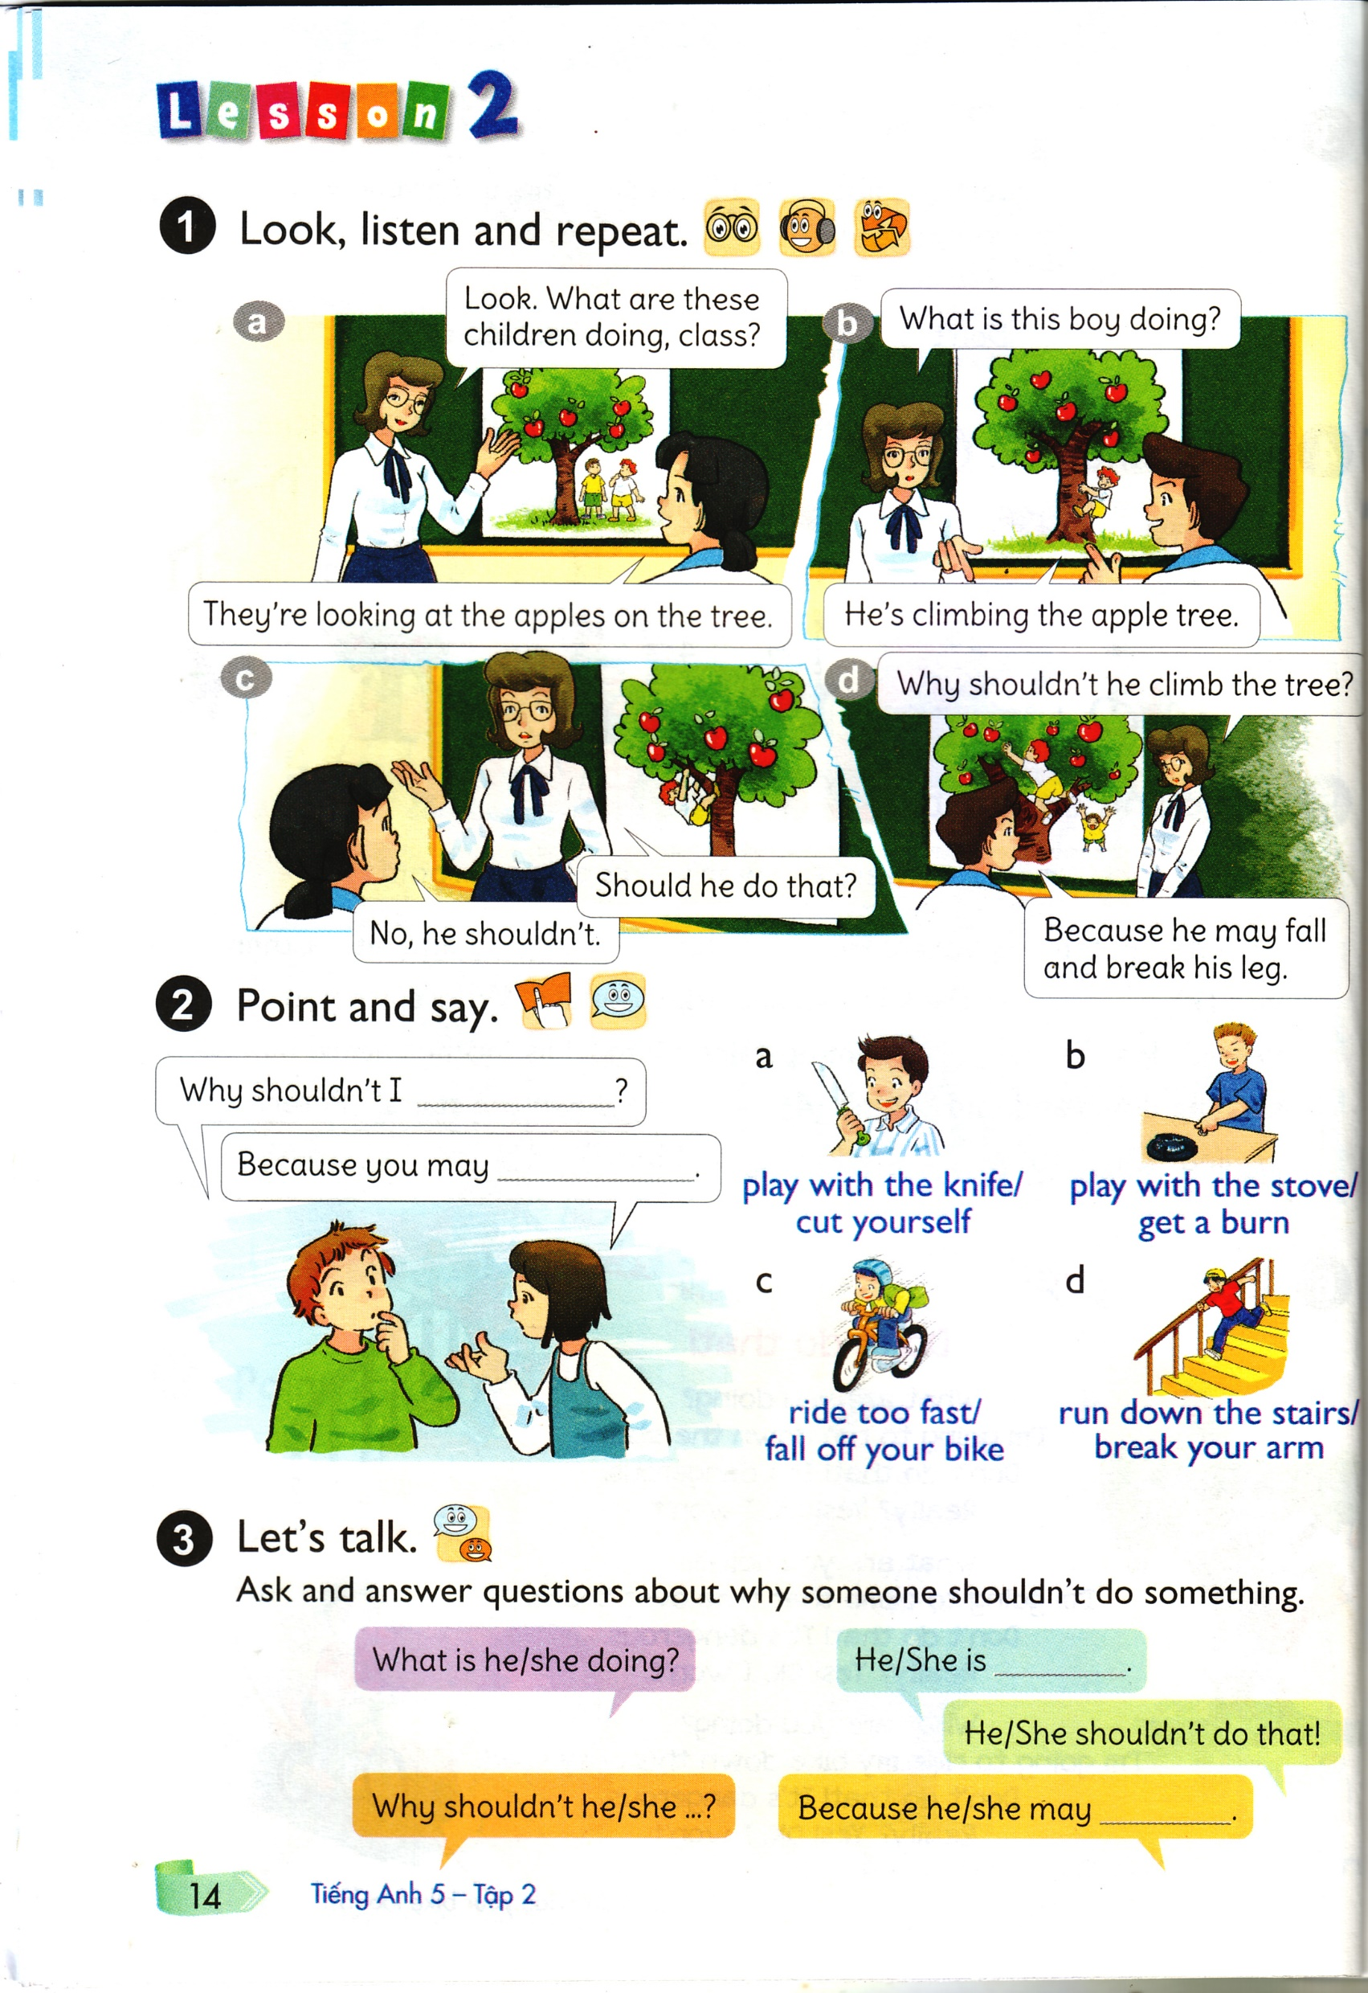


Slide 5
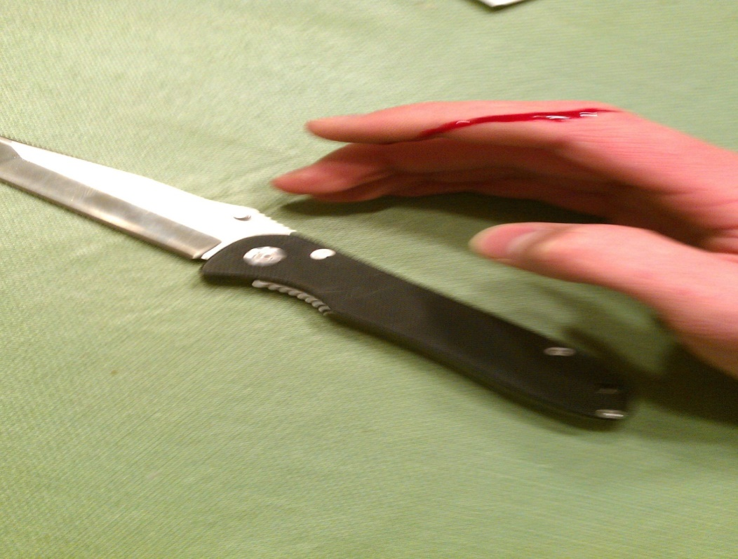
sharp: sắc nhọt

Slide 6
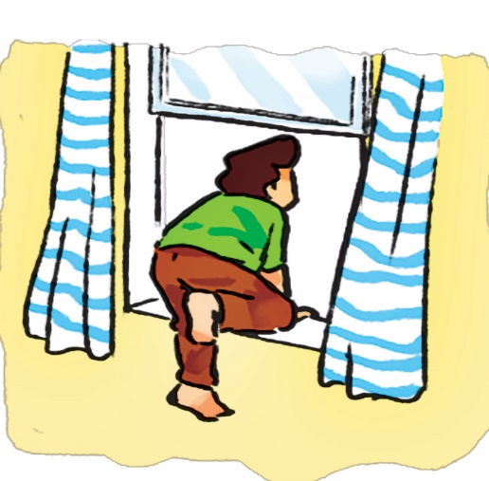
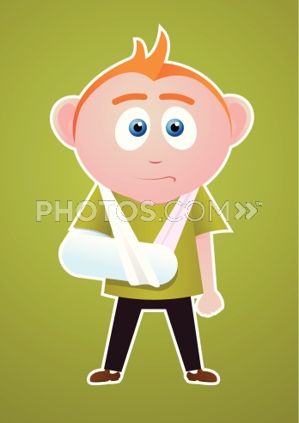
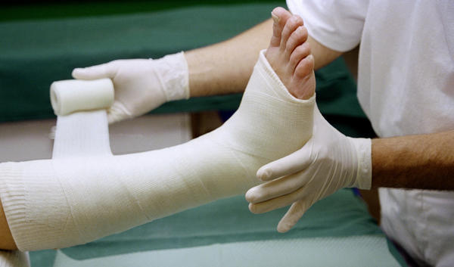
break your arm: gẫy tay
break your leg: gẫy chân

Slide 7
1.Vocabulary:
- sharp : sắc nhọn
- break your leg : gẫy chân
- break your arm : gẫy tay
- fall off your bike : ngã xe đạp

Slide 8


Slide 9
a
Why shouldn’t I play with the knife?
Because you may cut yourself.
b
Why shouldn’t I play with the stove?
Because you may get a burn.

Slide 10

c
Why shouldn’t I ride too fast?
Because you may fall of your bike.
d
Why shouldn’t I run down the stairs?
Because you may break your arm.

Slide 12
Homelink
- Học thuộc từ mới và mẫu câu.Mỗi từ viết 2 dòng.
- Hoàn thành sách bài tập trang 49,50
- Chuẩn bị Unit 12.Lesson 3

Slide 13



Thank you for your attention

