Slide 1





Unit 5: SOUND
LESSON 1:
How does the sound travel?

Slide 2



1. WARM-UP
4. APPLY AND EXTEND
5. WRAP-UP
2. PRESENT
6.HOMEWORK
3. PRACTICE

Slide 3


01
WARM - UP

Slide 4

Some sounds around us

Slide 5

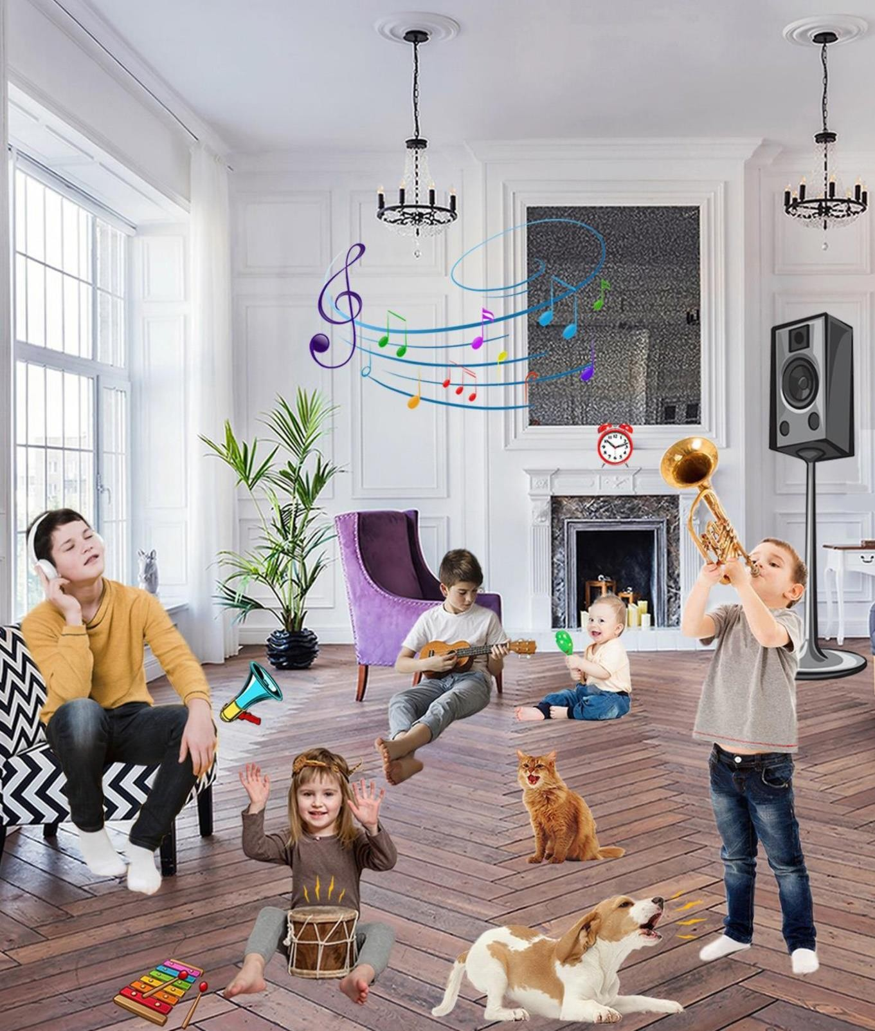
Which things in the picture make a sound?
Loudspeaker
Alarm clock
Bird
Dog
Drum

Slide 6
02
PRESENT

Slide 7

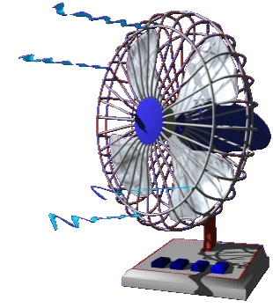

Sound

Slide 8
What is sound ?
Sound is a form of energy which is made when things move.
When a thing moves, it vibrates and makes a sound.

Slide 9




How does sound travel in air?
~ sound ~ ~ ~ ~sound ~ ~ ~

Slide 10
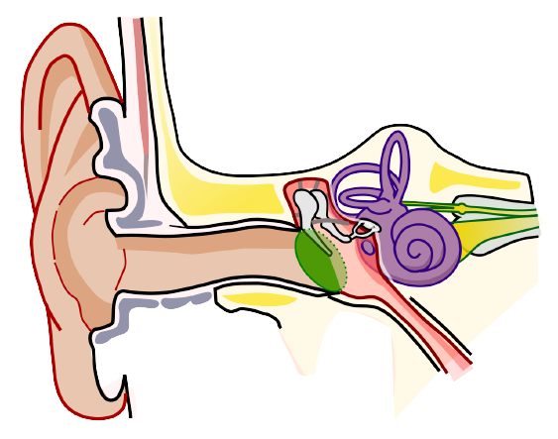

How does sound travel in air?
eardrum
~ sound ~ ~ ~ ~~~sound ~ ~
When sound vibrations spread in air and reach the ear, they will make the eardrum vibrate We can hear the sound

Slide 11
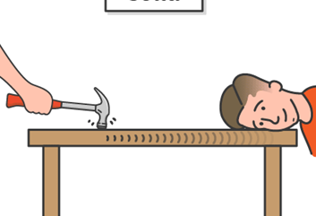
Sound can travel through
solids

Slide 12

Sound can travel through
liquids

Slide 13
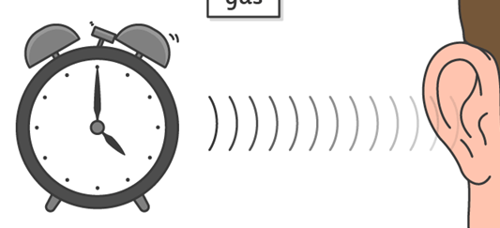
Sound can travel through
gas

Slide 14
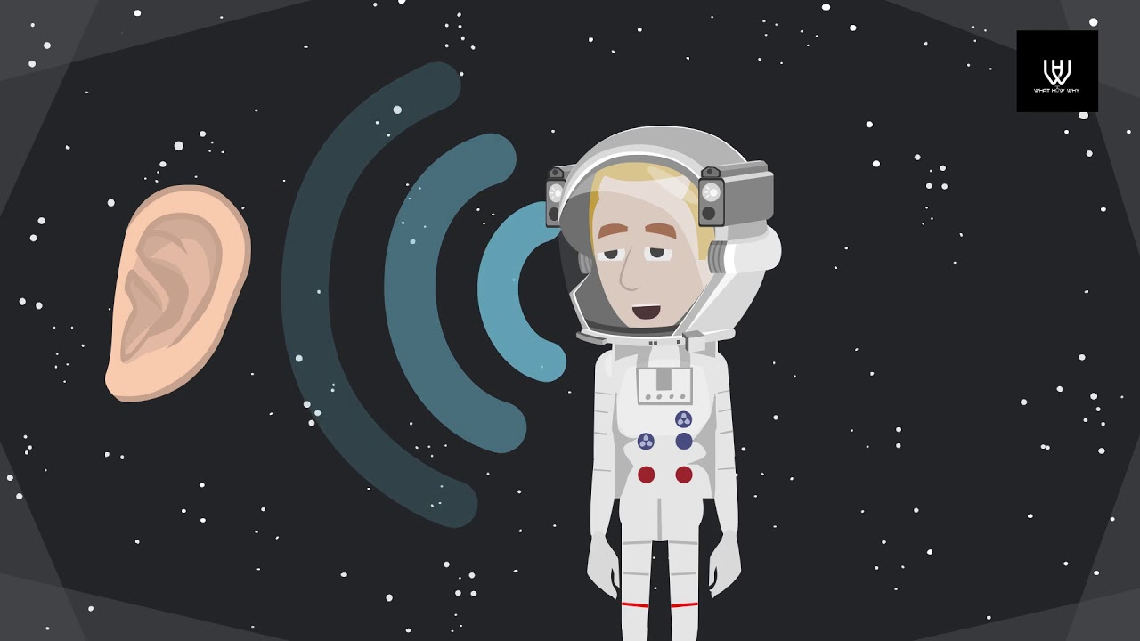
Sound can not travel through space
No air
No sound
No vibration

Slide 15
03
PRACTICE

Slide 16






FISHING GAME
GO

Slide 17


1. __________ can travel through solids, liquids and gases. Sound travels fastest
through solids, slower through liquids and slowest through gases.
Sound
Sound
Noise
Air
Sound
Eardrum

Slide 18
2. We can hear the sound when sound vibrations reach the ear and make the____________ vibrate.
eardrum
eardrum
sound
air
eardrum
noise

Slide 19
3. Sound cannot travel in space because space has no ____________ to vibrate.
air
air
air
sound
eardrum
noise

Slide 20
4. Sound is what we hear. __________ is unwanted sound.
noise
noise
sound
air
noise
eardrum

Slide 21
04
APPLY & EXTEND

Slide 22




Explore:
Which things give out loud sounds?

Slide 23

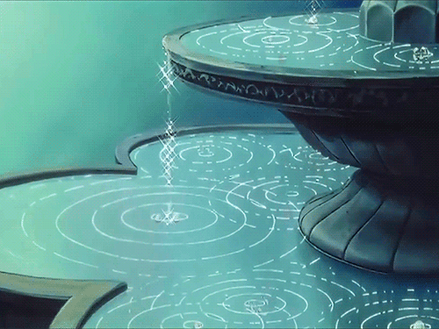

Which things give out soft sounds?
Explore:

Slide 24
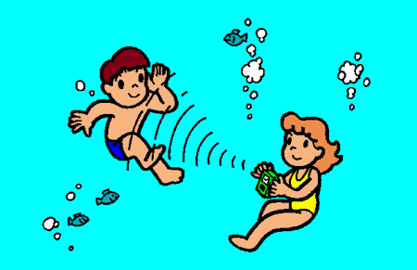
That’s cool:
✓When traveling through water, sound moves around four times faster than when it travels through air.
✓ Some vibrations are too small to see but they still make a sound.

Slide 25
05
WRAP - UP

Slide 26
What is sound ?
Sound is a form of energy which is made when things move.
When a thing moves, it vibrates and makes a sound.

Slide 27

When sound vibrations spread in air and reach the ear, they will make the eardrum vibrate We can hear the sound

Slide 28
Sound can travel through
Solid
Sound
Liquid
Gas

Slide 29
06
HOMEWORK

Slide 30
HOMEWORK
Learn by heart all vocabularies and structure sentences.
Ask and answer about sound.

Slide 31



