Slide 1




















Notes:
Để nguyên trang bìa như này, chỉ thay đổi tên bài trong quá trình làm. Logo của sách Wonderful World

Slide 2





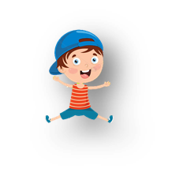





UNIT 6: OUTDOOR ACTIVITIES
Lesson 1
Period 1 – Task 1,2,3 (P.63, 64)

Slide 3
Contents
01
04
WARM-UP
03
PRODUCTION
PRACTICE
02
05
PRESENTATION
ASSESSMENT

Slide 4
01
WARM-UP

Slide 5
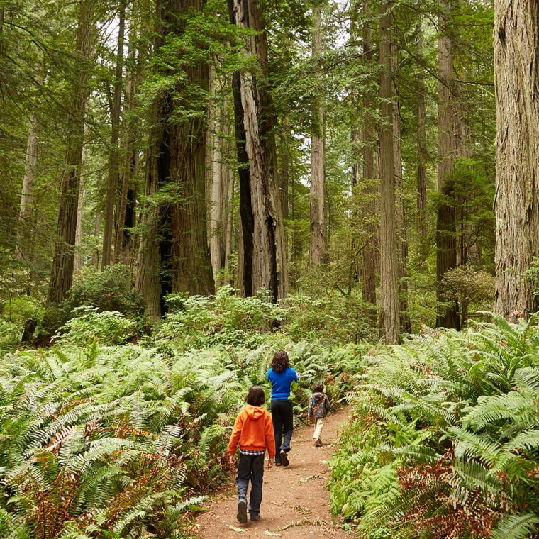
Quick Answers
1. Look at the photo. Tick what you can see.
plants
a dog
rain
trees
2. What are they doing?
3. Where are they?

Slide 6
02
PRESENTATION

Slide 7
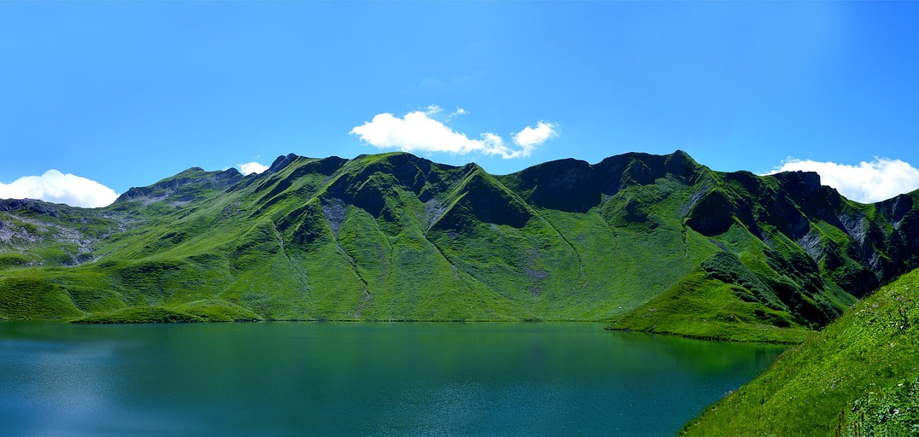
NEW WORDS
mountain

Slide 8
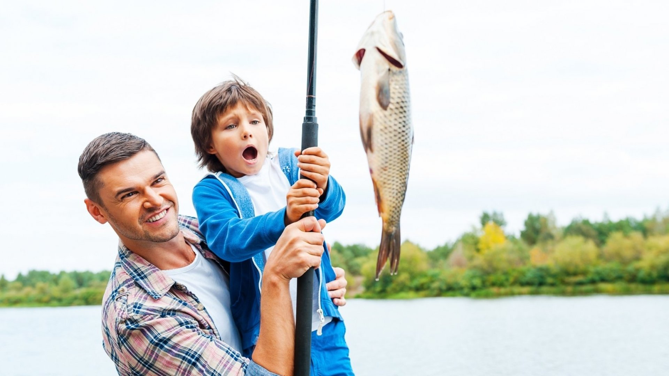
NEW WORDS
go fishing

Slide 9
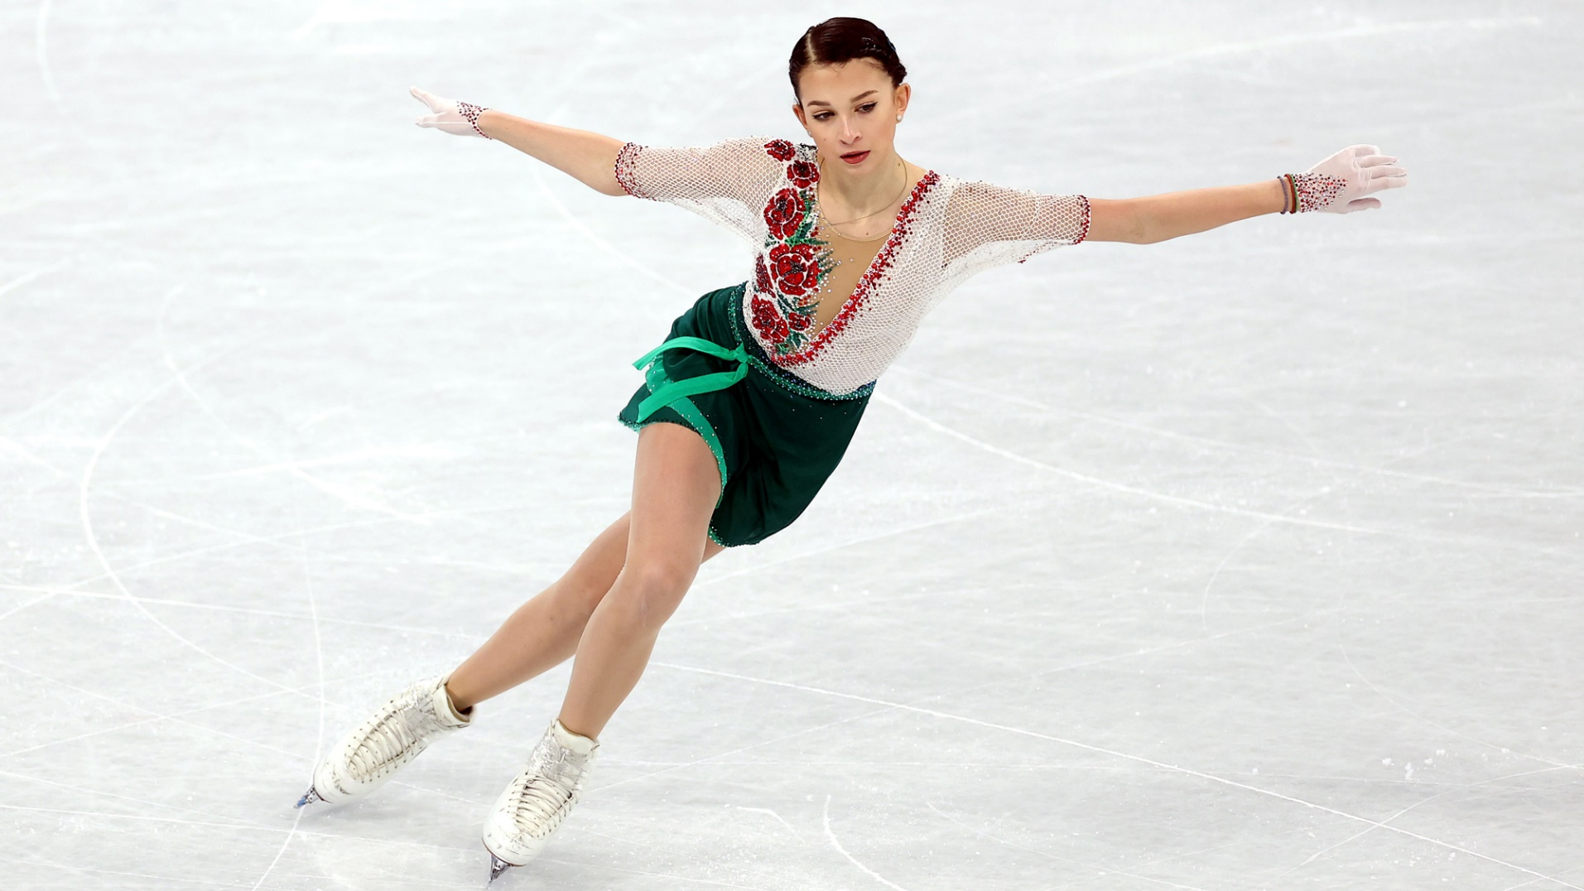
NEW WORDS
ice-skate

Slide 10
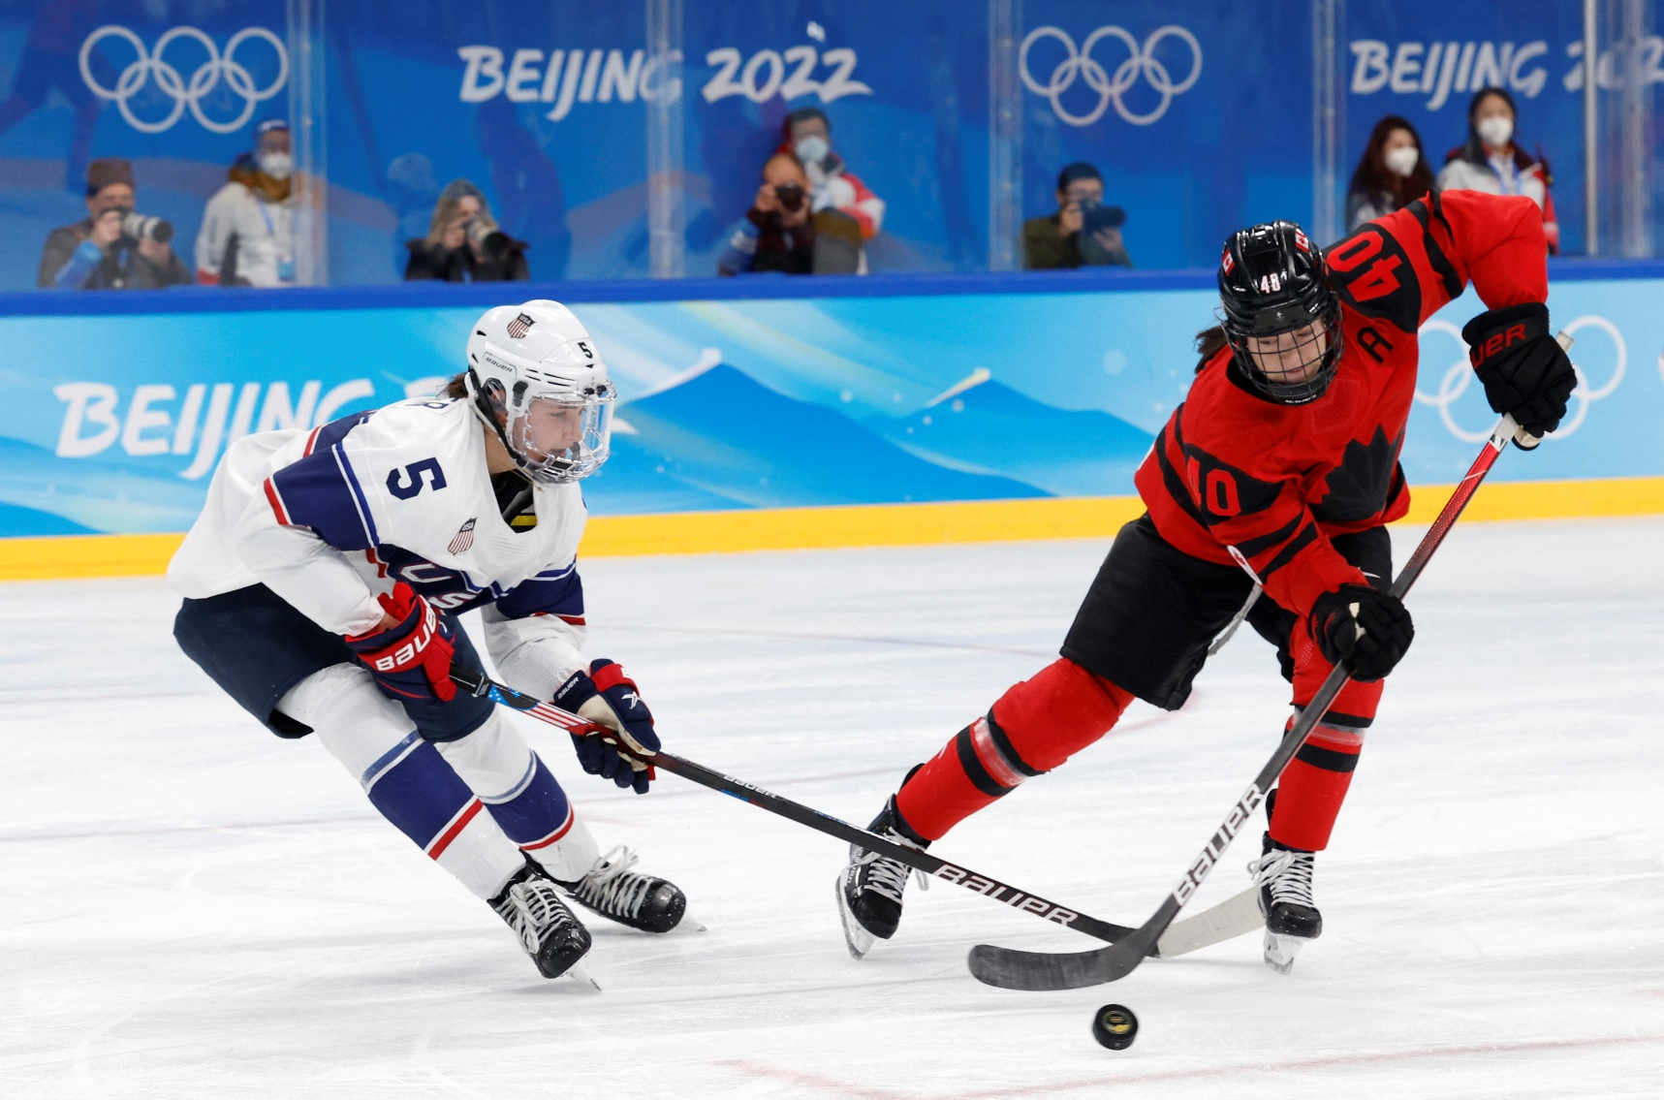
NEW WORDS
play ice hockey

Slide 11
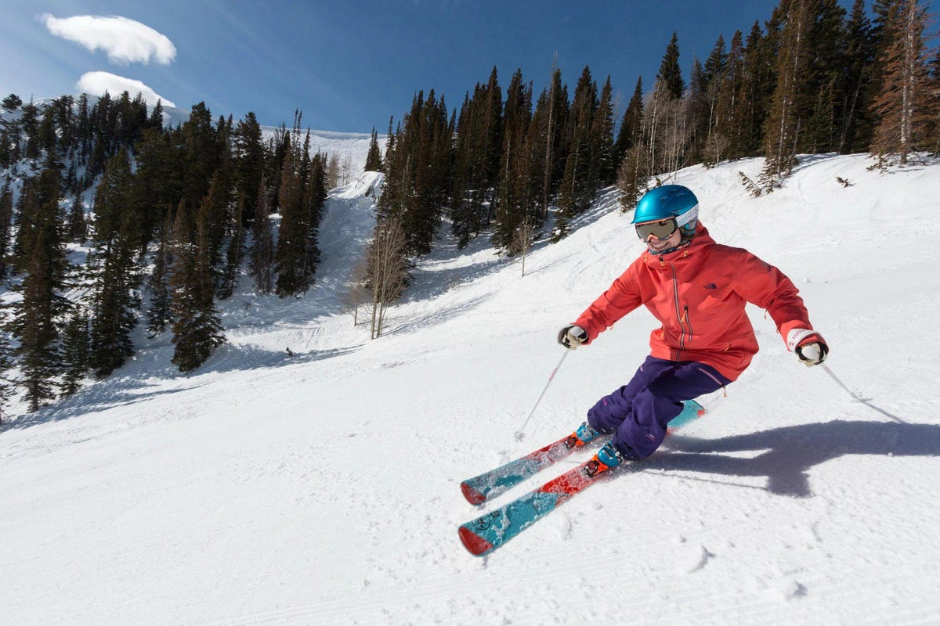
NEW WORDS
ski

Slide 12
Task 1.
Listen and point. Repeat.
Notes:
Dấu câu

Slide 13
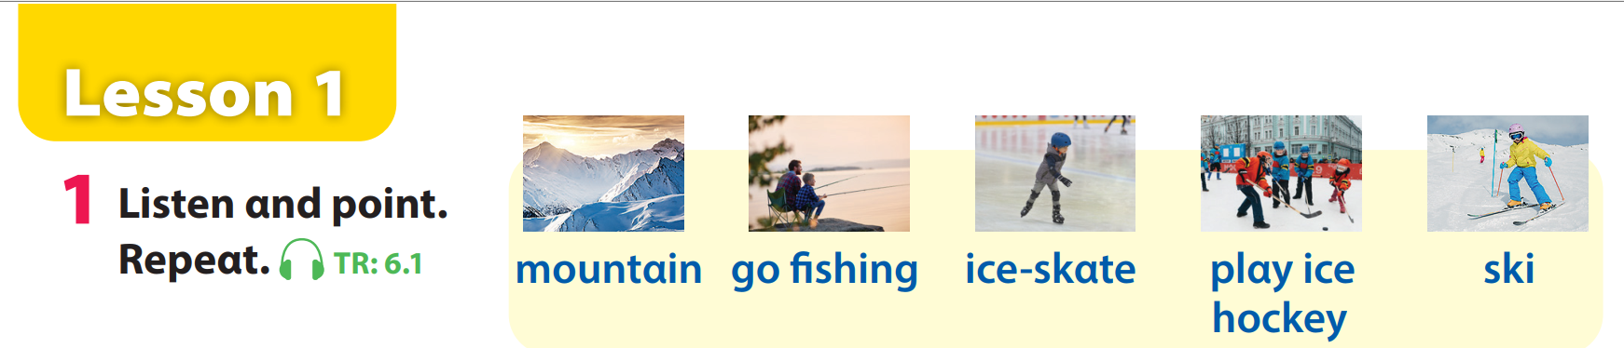
Unit 6 – Lesson 1 – Activity 1 (page 64)

Slide 14
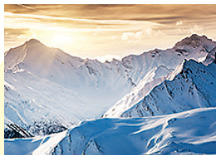
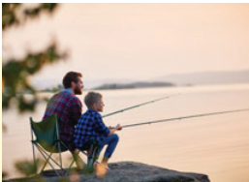
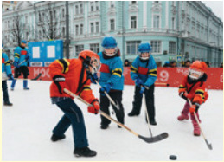
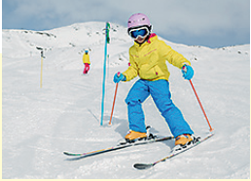
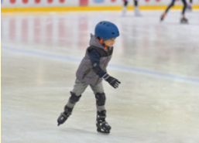
PRACTICE: MATCHING
ice-skate
mountain
go fishing
play ice hockey
ski

Slide 15
Task 2.
Listen and read. Tick.
Notes:
Dấu câu

Slide 16
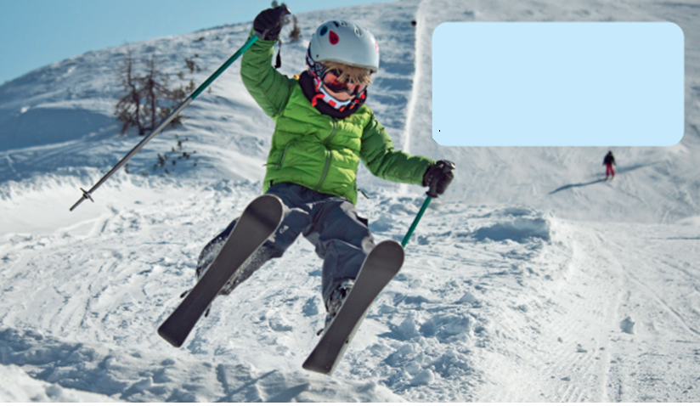
BRAINSTORMING
What is he doing?
Where is he?
What’s the weather like?

Slide 17
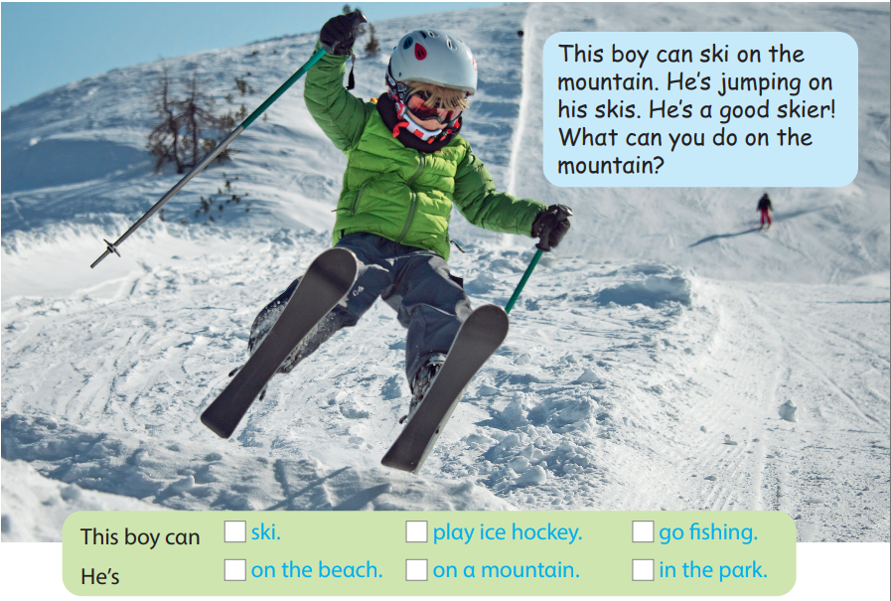

Task 2. Listen and read. Tick.
This boy can ski on the mountain.
He’s jumping on his skis.
He’s a good skier!
What can you do on the mountain?

Slide 18
03
PRACTICE

Slide 19










1
4
HELP THE POOH
2
5
3

Slide 20



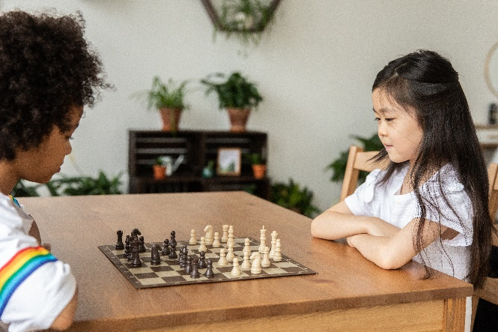


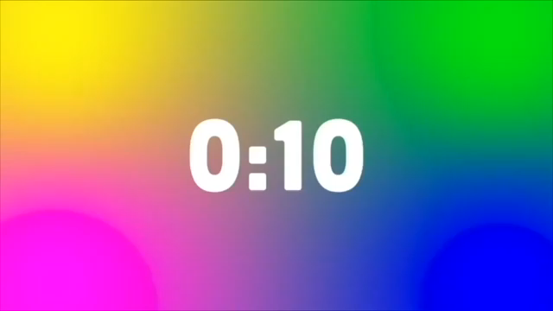



1. What are they doing?
They’re watching a film.
A
They’re playing board games.
B
They’re reading books.
C
They’re listening to music.
D
BACK

Slide 21

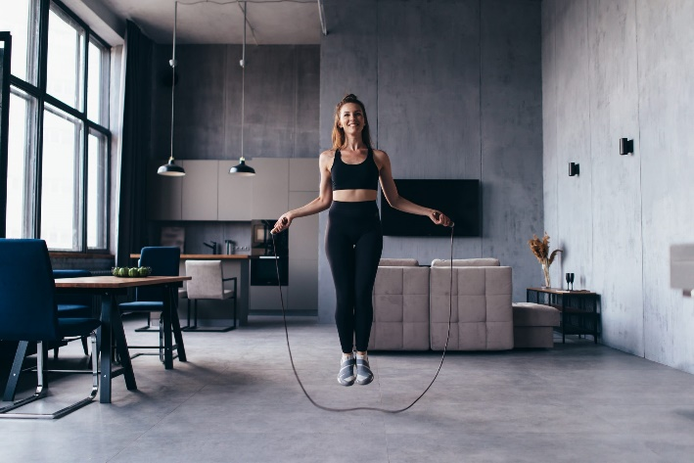

2.She is ……. rope.
A
listening
B
skiing
C
running
D
jumping
BACK

Slide 22
3. What is he doing?
A
He’s swimming.
B
He’s singing.
C
He’s skiing.
D
He’s playing football.
BACK

Slide 23
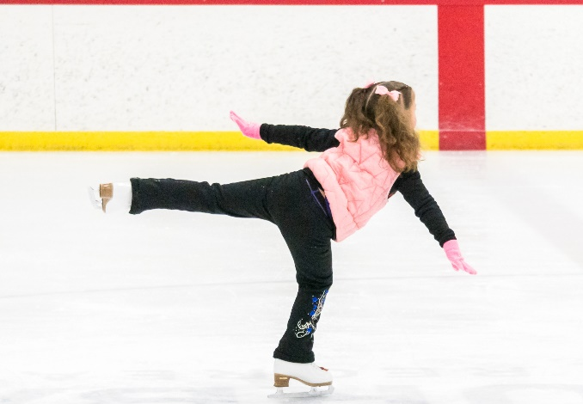
4. What is she doing?
She’s ice-skating.
A
She’s dancing.
B
He’s swimming.
C
She’s jogging.
D
BACK

Slide 24
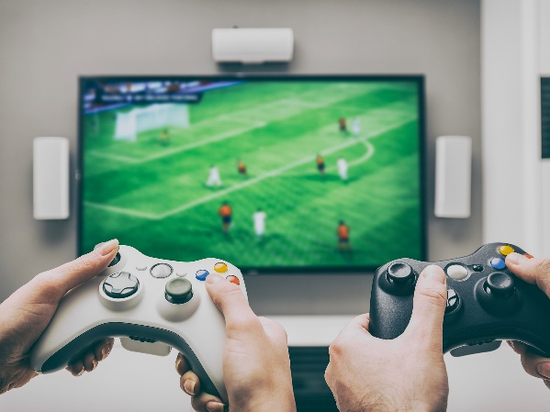
5. What are they doing?
A
They’re reading.
B
They’re playing video games.
C
No, they aren’t.
D
Yes, they can.
BACK

Slide 25
04 Production
Notes:
Dấu câu

Slide 26
Task 3.
Look and say.
Notes:
Dấu câu

Slide 27
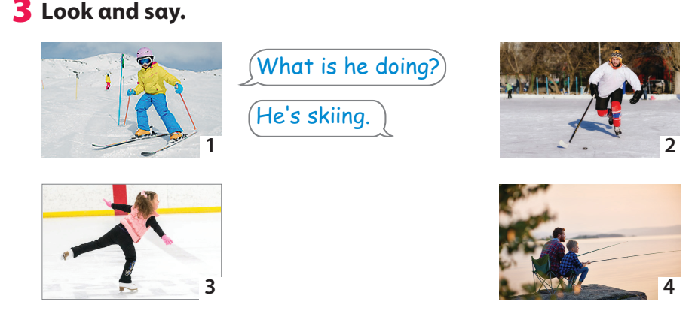
Task 3 – Look and say (page 64)
Notes:
Dấu câu

Slide 28
05 Assessment
Notes:
Đây k phải là extra, đây là hđ 3 của bài

Slide 29
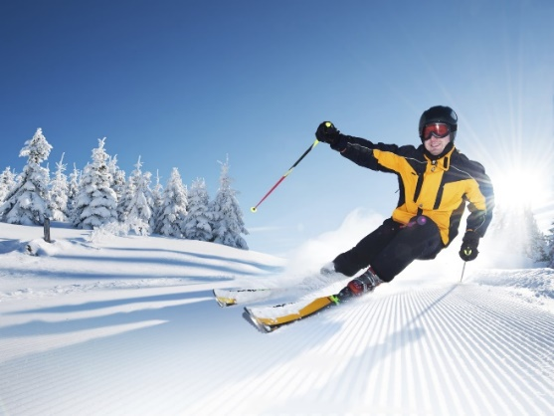
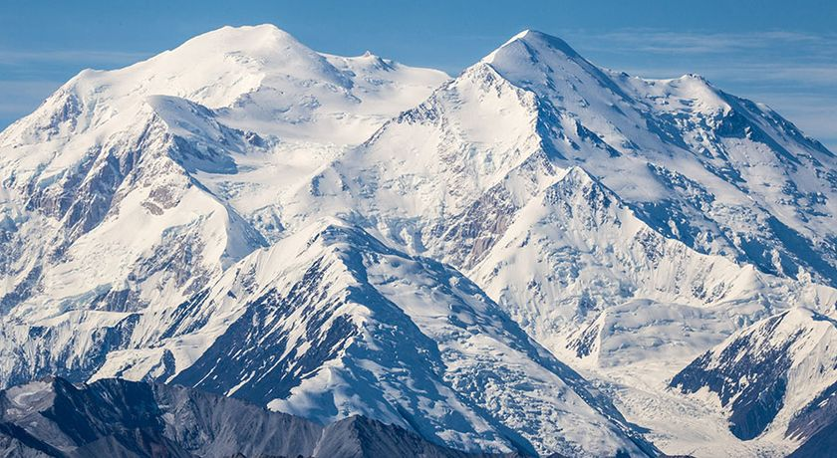
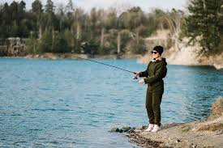
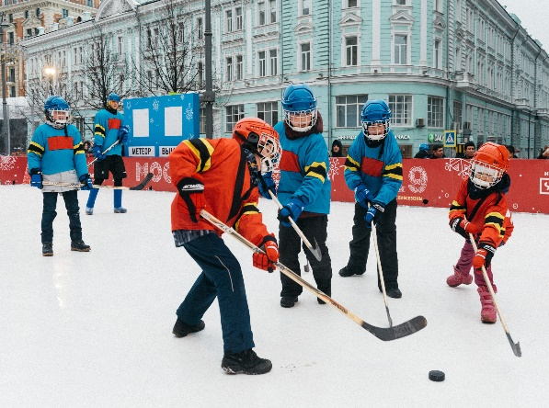
LOOK AT THE PICTURES AND
WRITE THE CORRECT ANSWERS
1
skiing
He’s ________ .
3
mountain
On the ______
4
playing ice hockey
They’re _____.
2
going fishing
She’s ______ .

Slide 30




Thank you & goodbye!

