Slide 1

Unit 3: WEATHER
Lesson 4.2
Page 44

Slide 2
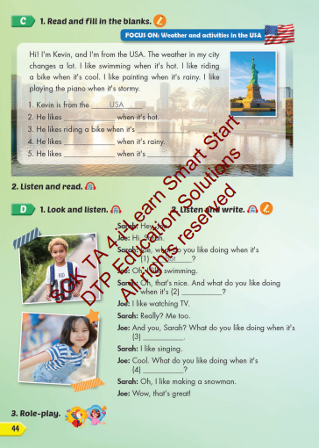
Lesson Outline
Warm-up
Listening
Consolidation
Wrap-up

Slide 3
Objectives
By the end of this lesson, students will be able to the weather like today.
Vocabulary: Cold, Hot, Warm, Freezing, Cool, Stormy
Structure: What do you like doing when it's hot?
I like swimming.

Slide 4
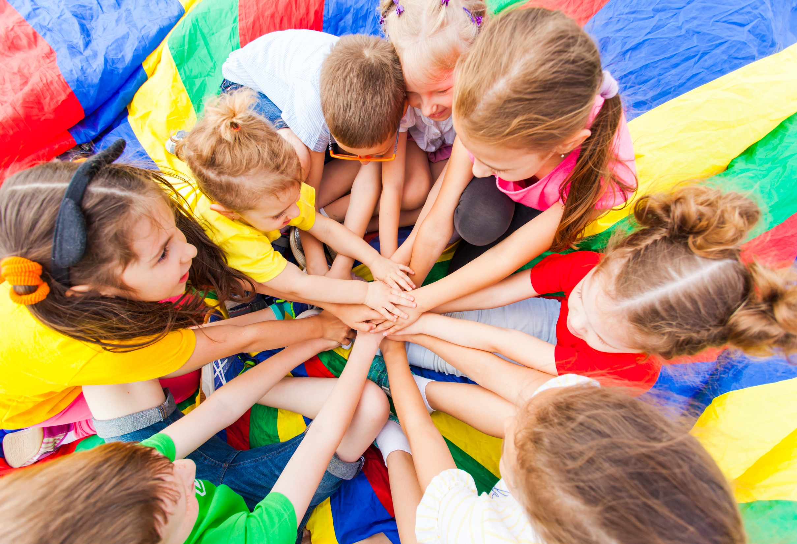
WARM UP

Slide 5
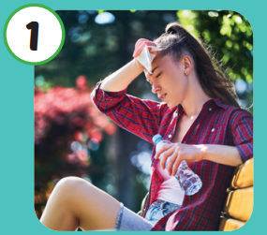



Click on the right word
Warm
Hot

Slide 6
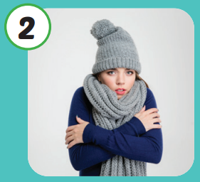
Click on the right word
Cold
Stormy

Slide 7

Click on the right word
Hot
Warm

Slide 8
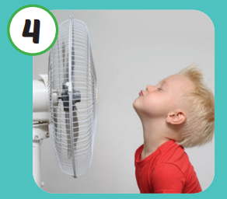
Click on the right word
Cool
Freezing

Slide 9
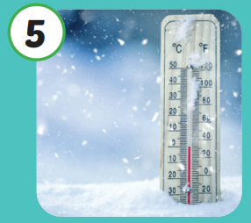
Click on the right word
Cool
Freezing

Slide 10
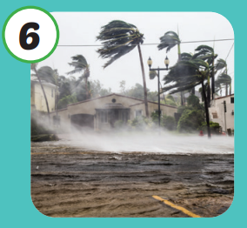
Click on the right word
Stormy
Warm

Slide 11

It’s time to learn …

Slide 12

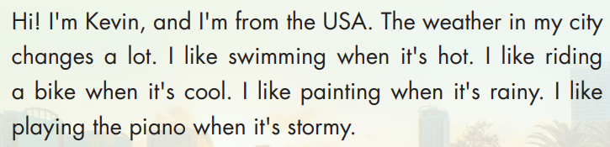
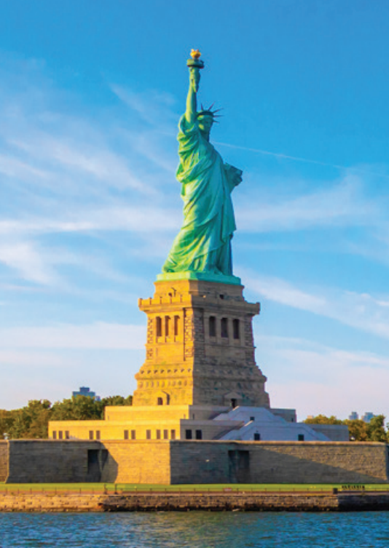
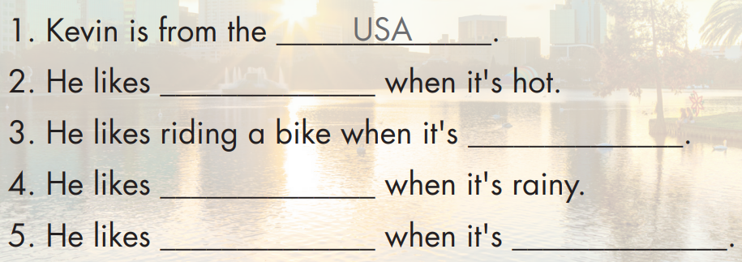
swimming
cool
painting
playing the piano
stormy

Slide 13


Hi! I’m Kevin, and I’m form the USA. The weather in my city changes a lot. I like swimming when it’s hot. I like riding a bike when it’s cool. I like painting when it’s rainy. I like playing the piano when it’s stormy.

Slide 14


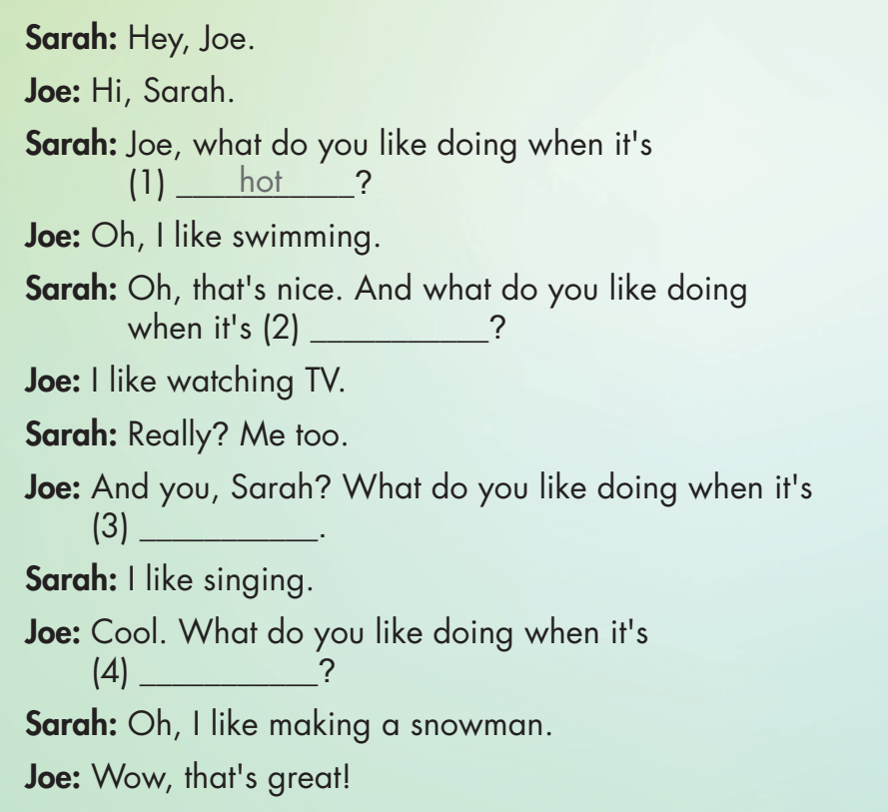

Slide 15

rainy
stormy
freezing

Slide 16

Practice

Slide 17



Hey, what do you like when it’s hot
Oh, I like swimming.
Really? Me too.

Slide 18
Hey, what do you like when it’s warm
Oh, I like go for a walk.
Really? I like playing soccer.

Slide 19
Hey, what do you like when it’s freezing
Oh, I like making a snowman.
That’s great

Slide 20
Hey, what do you like when it’s stormy
Oh, I like listening music
Cool! I like watching TV.

Slide 21
Hey, what do you like when it’s cold
Oh, I like sleeping.
That’s sound great.

Slide 22
Hey, what do you like when it’s cool
Oh, I like flying a kite
Really? Me too.

Slide 23

CONSOLIDATION

Slide 24



Look the pictures and choose
Cold
Cool
Hot

Slide 25
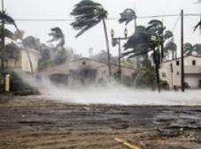

Look the pictures and choose
Stormy
Freezing
Cold

Slide 26

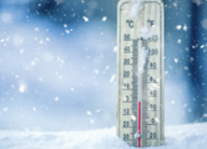

Look the pictures and choose
Freezing
Warm
Cool

Slide 27


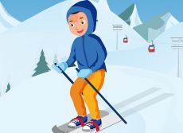
Look the pictures and choose
Hot
Warm
Cold

Slide 28
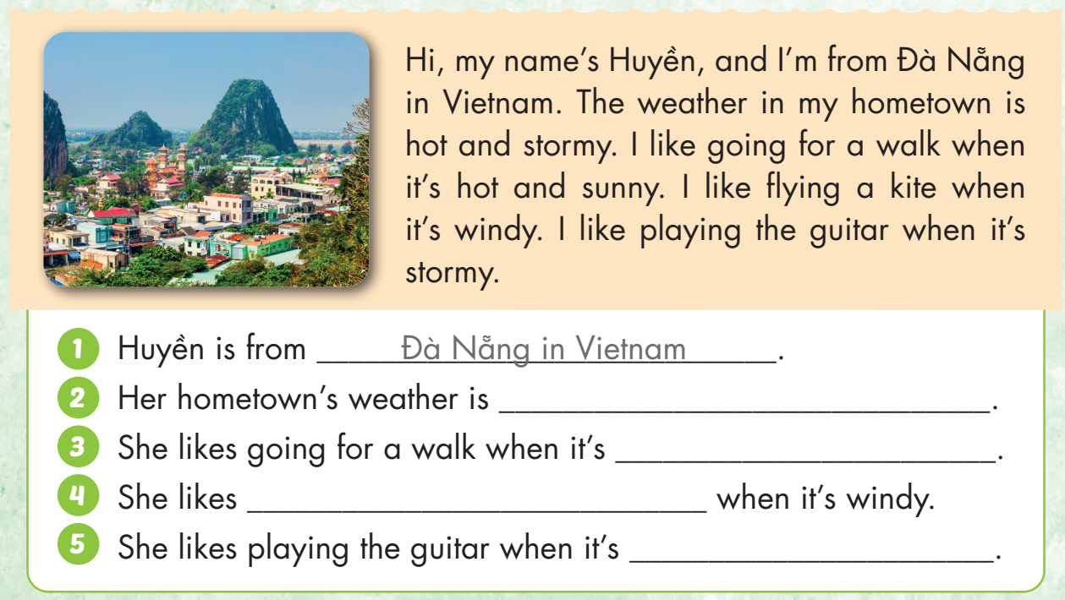
hot and stormy
hot and sunny
flying a kite
stormy

Slide 29

WRAP-UP

Slide 30
Today’s lesson
Vocabularies
Hot
Cold
Warm
Cool
Freezing
Stormy
Structures/ Sentence patterns
What do you like doing when it's hot?
I like swimming.

Slide 31
Homework
Practice the vocabularies and structure; and make sentences using them.
Do the exercises in Tiếng Anh 4 i-Learn Smart Start WB (page 29).
Do the exercises in Tiếng Anh 4 i-Learn Smart Start Notebook (page 19).
Prepare the next lesson (page 45 SB).
Play the consolidation games in Tiếng Anh 4 i-Learn Smart Start DHA App on www.eduhome.com.vn

Slide 32
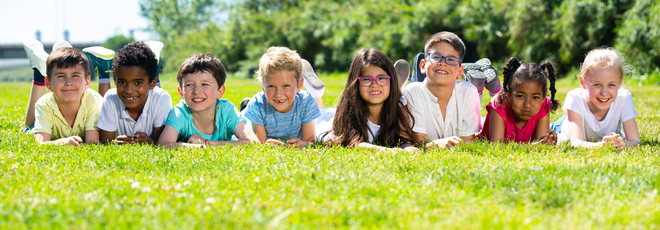
Have a nice day!

