Slide 1
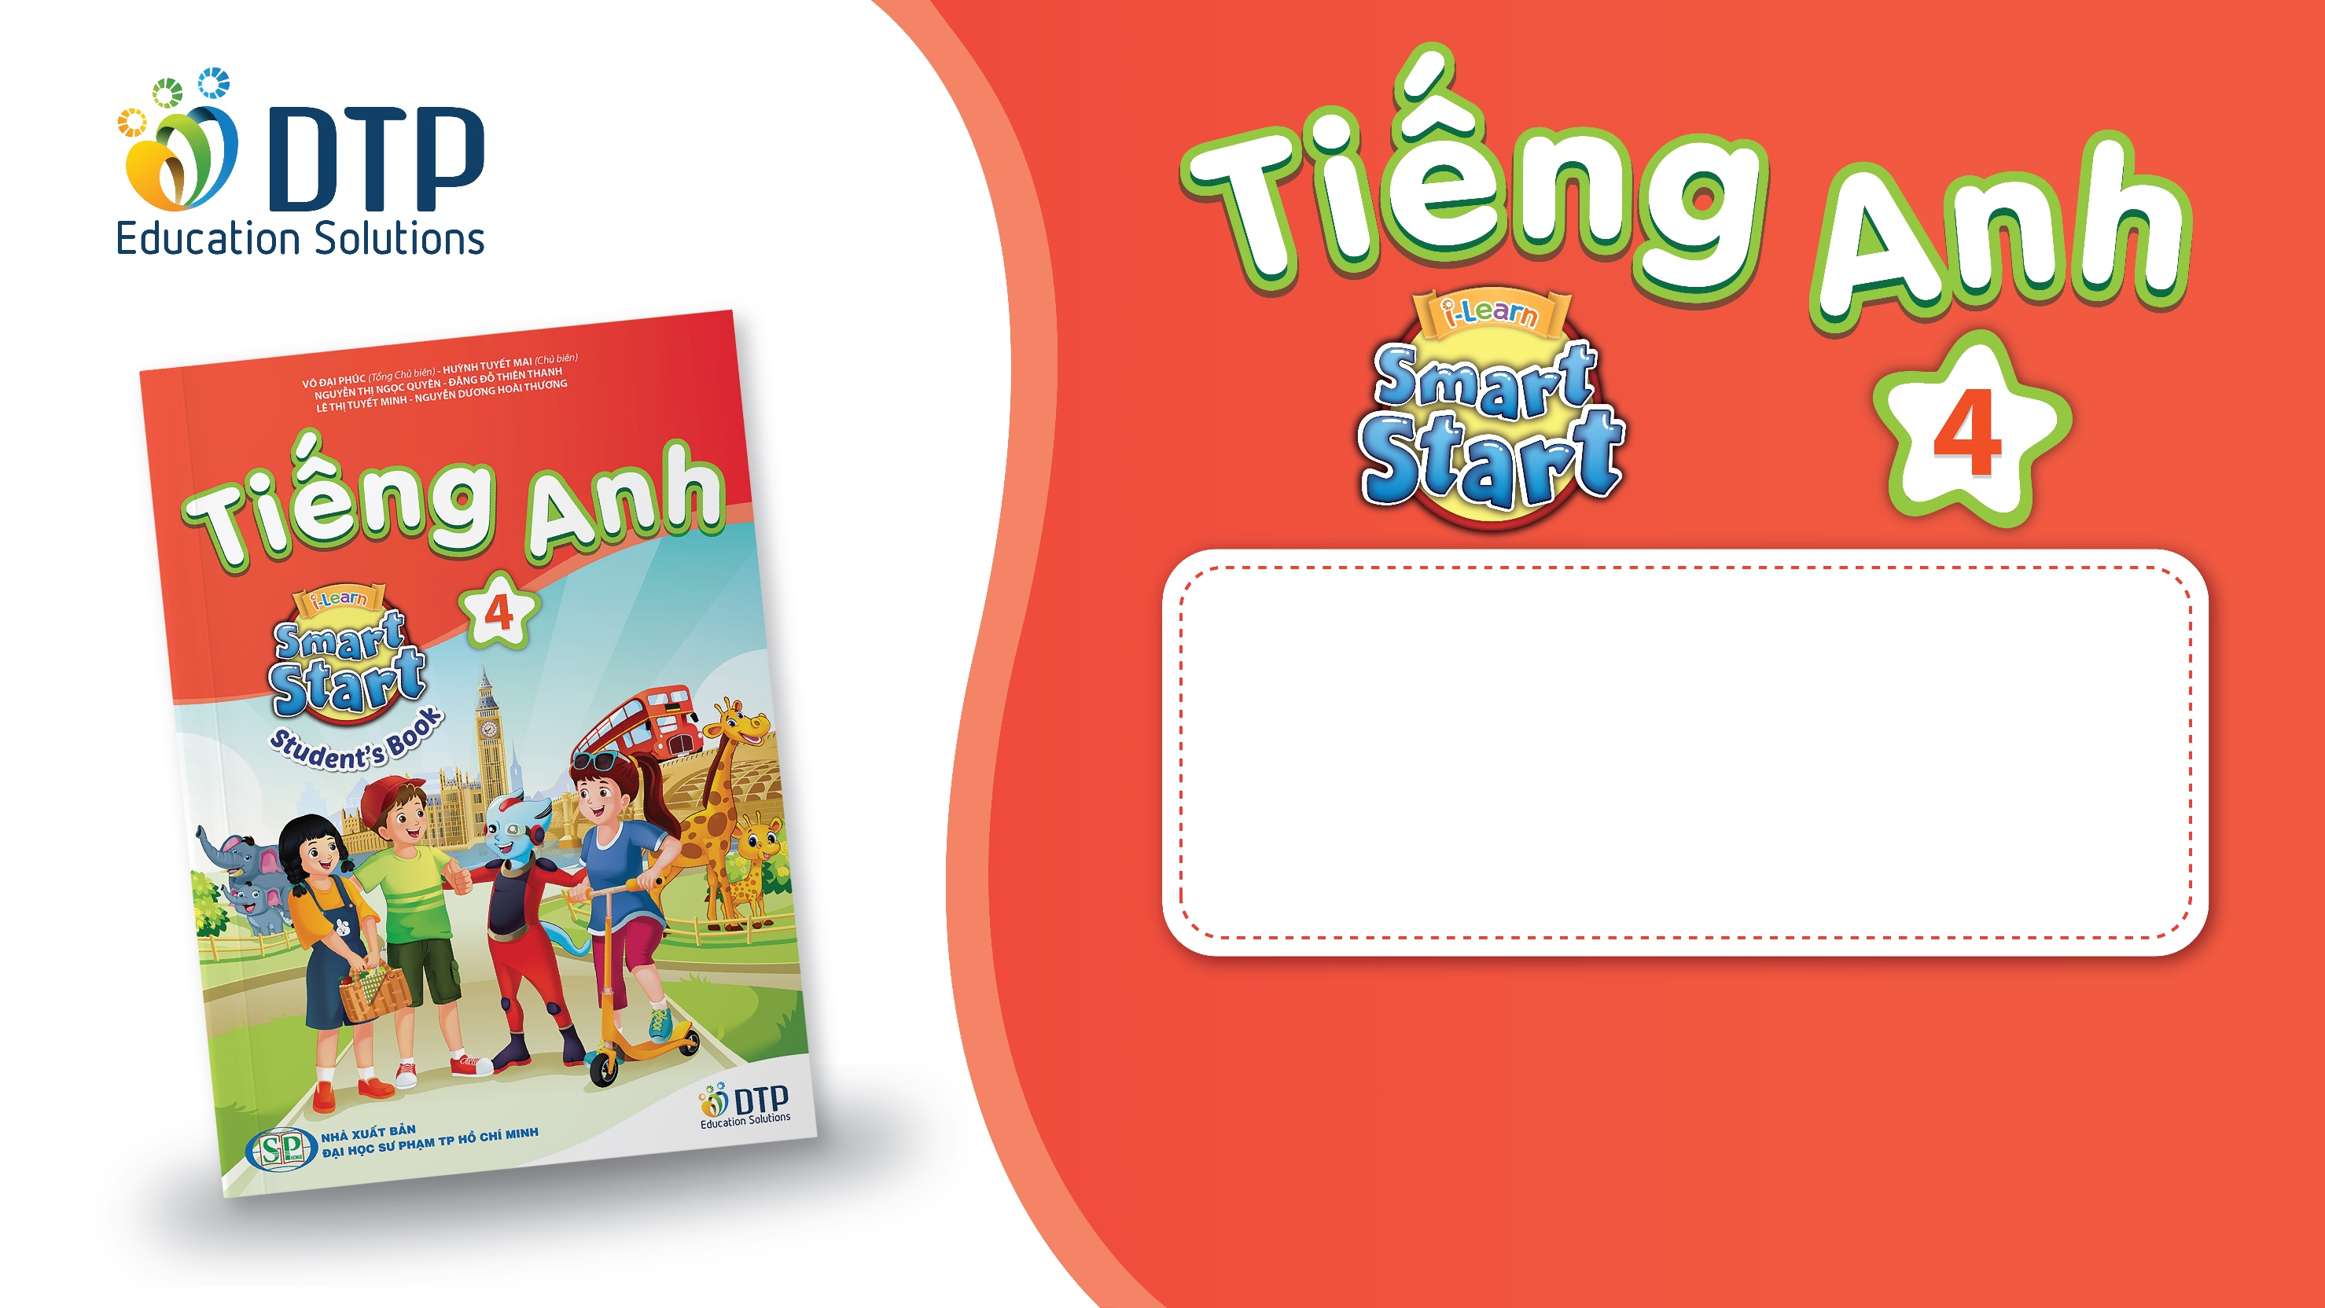
Unit 4: ACTIVITIES
Lesson 1.2
Page 49

Slide 2
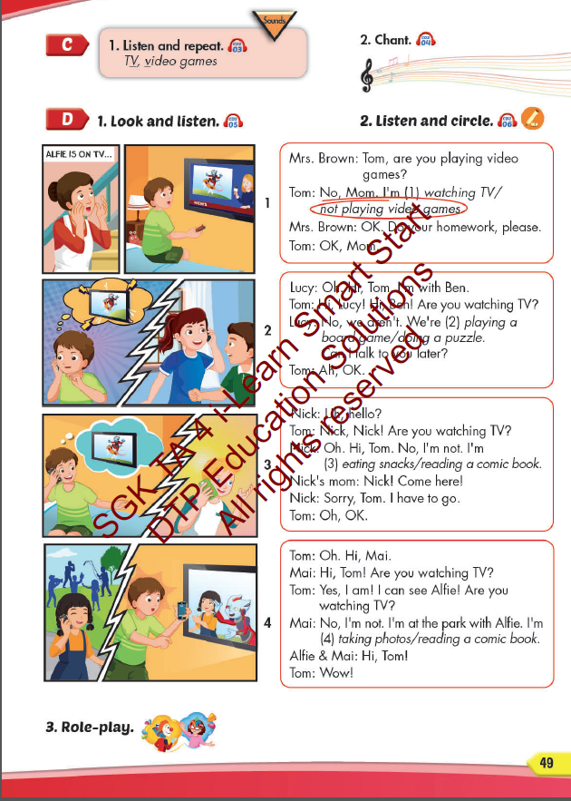
Lesson Outline
Warm-up
Listening
Consolidation
Wrap-up

Slide 3
Objectives
By the end of this lesson, students will be able to pronounce the sound /v/; and practice asking and answering what they are doing.
Vocabulary: play a board game, do a puzzle, read a comic book, eat snacks, play video games.
Structure: Are you reading a comic book?
– Yes, I am.
Are you read a comic book?
- No, we aren’t. We’re playing a board game.
Phonics: /v/, TV, video games.

Slide 4
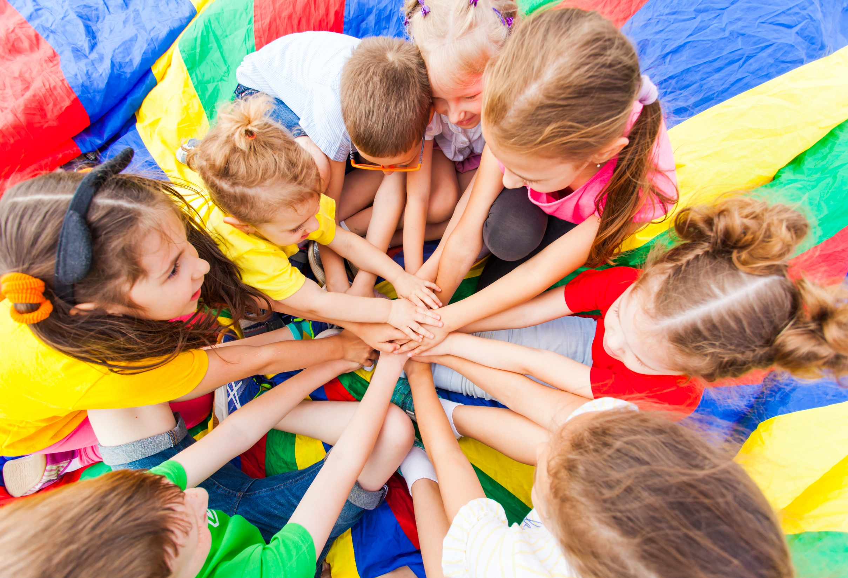
WARM UP

Slide 5


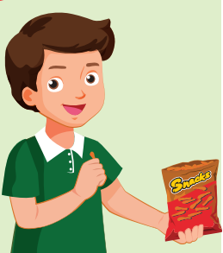

Look. Choose the correct answer.
A
play board game
B
eat snacks
C
read comic books

Slide 6
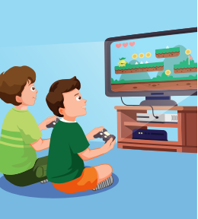
Look. Choose the correct answer.
A
take photos
B
play board game
C
play video games

Slide 7
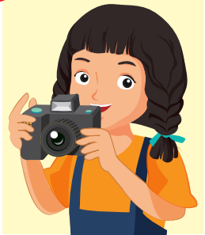

Listen. Choose the correct answer.
Click on A, B, C box to check the correct answer
A
B
C
Click on speaker icon to hear the sound

Slide 8
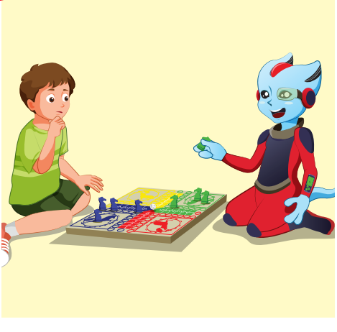
Listen. Choose the correct answer.
A
B
C

Slide 9
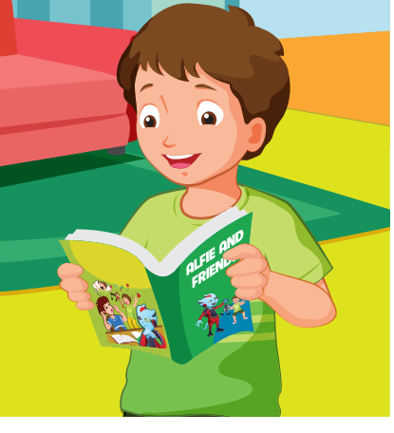
Listen. Choose the correct answer.
A
B
C

Slide 10
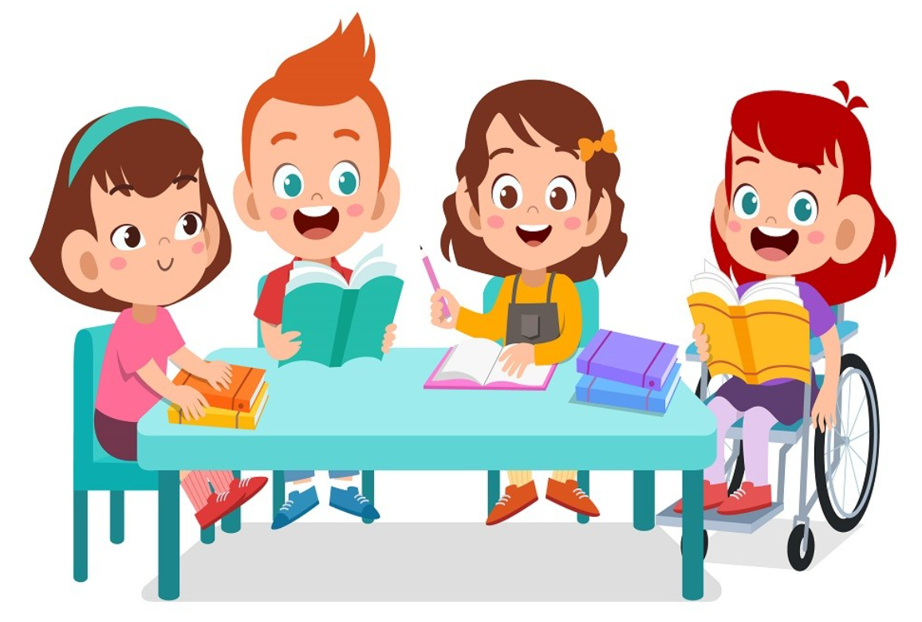
It’s time to learn …

Slide 11
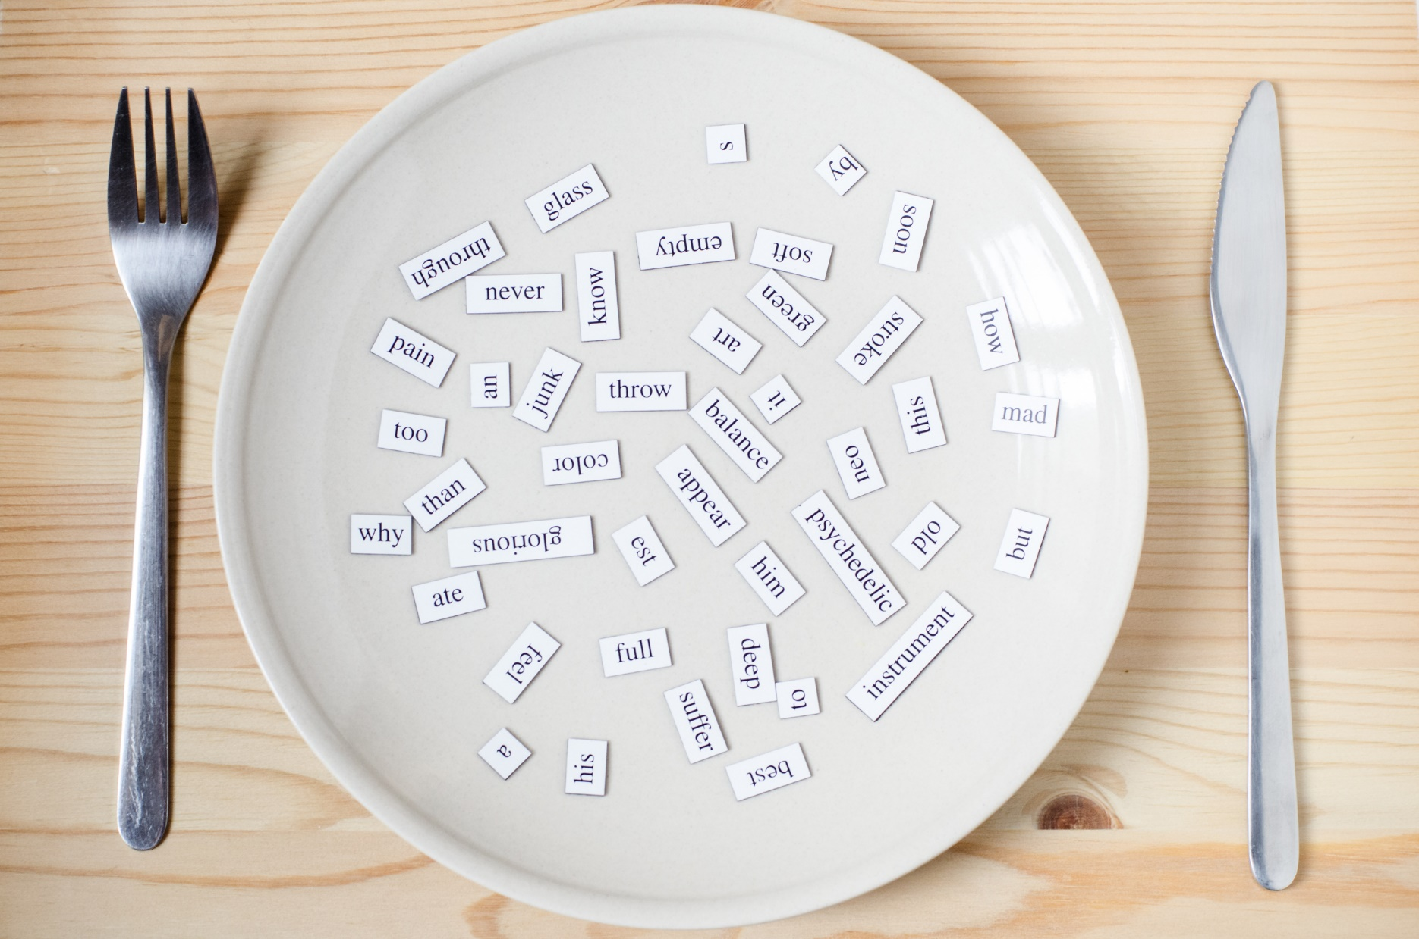
Phonics
/v/

Slide 12
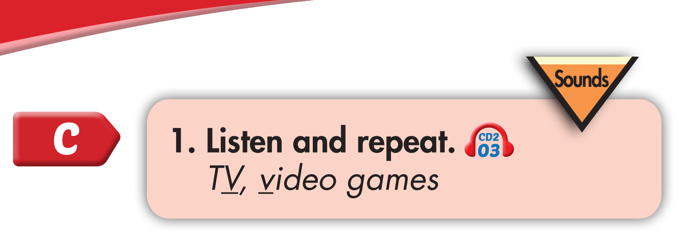
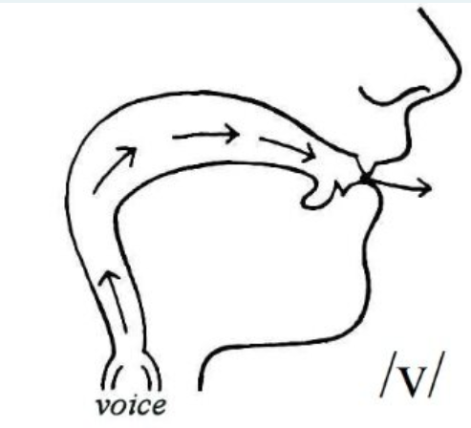
Click on the red words to hear the sound
V, v, TV
V, v, video games

Slide 13
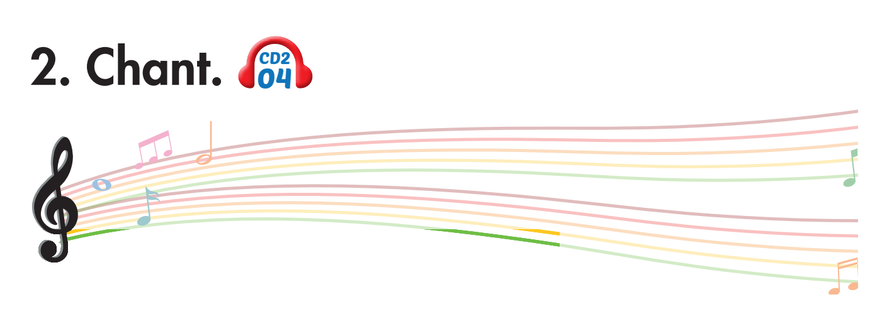
Click on the headphone icon to hear the sound
Are you watching TV?
No, I’m not. I’m not watching TV.
Are you playing video games?
Yes, I am. I’m playing video games.
Notes:
1. Listen.
2. Listen and chant.

Slide 14
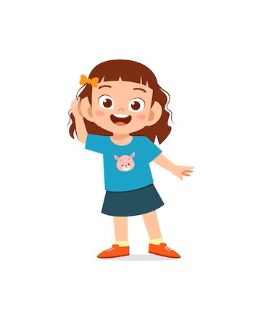
Listen. Hop and repeat when you hear /V/ sound.
Notes:
T say
Violin
Friend
Vet
Fish
Volleyball
Living room
Kitchen
Video games
TV
Dance
November

Slide 15

Listening

Slide 16
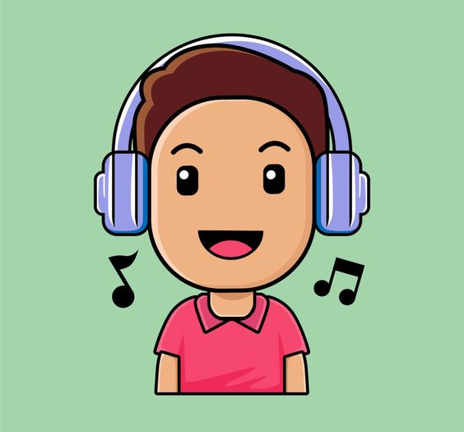
BEFORE YOU LISTEN

Slide 17
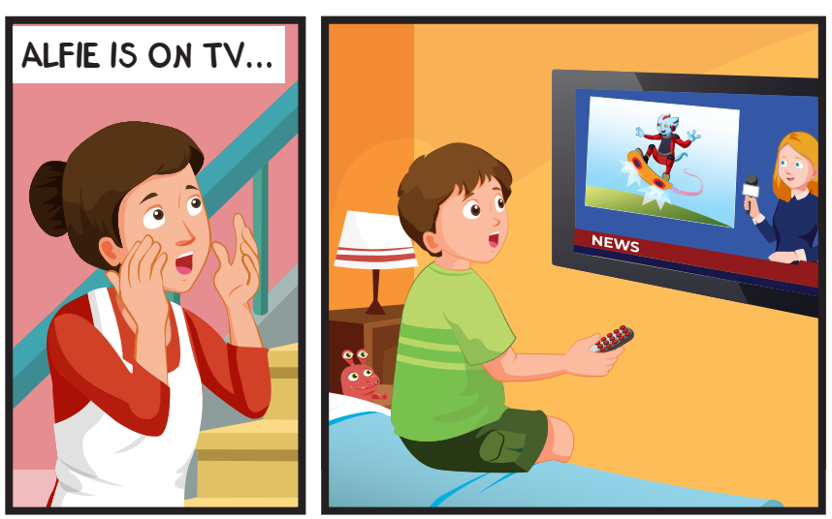
Where’s Tom?
What is Tom doing?
Notes:
Encourage Ss to guess

Slide 18
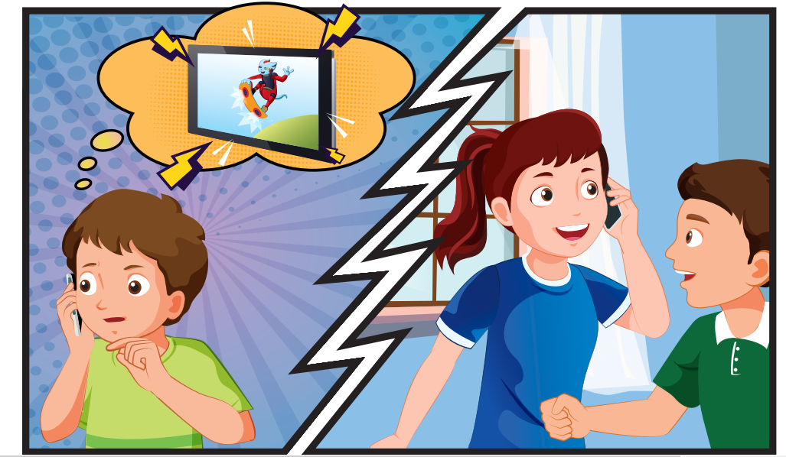
What are Lucy and Ben doing?

Slide 19
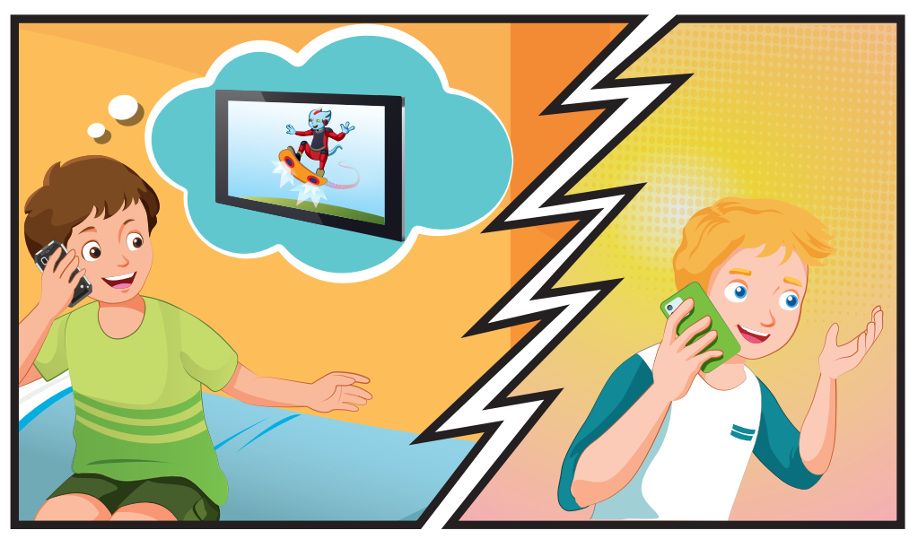
What’s Nick doing?

Slide 20
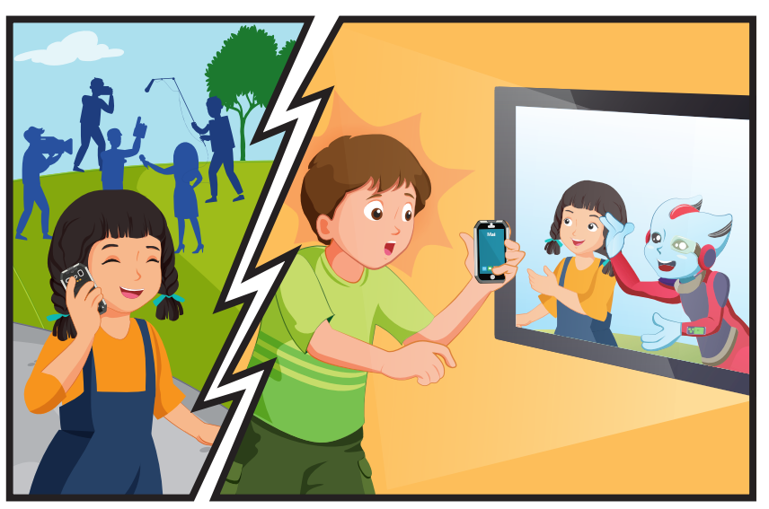
Where is Mai?
What are Mai and Alfie doing?

Slide 21

Click on the headphone icon to hear the sound

Slide 22
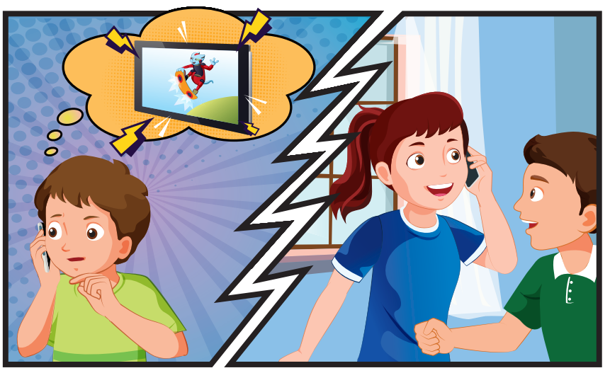
Click on the headphone icon to hear the sound

Slide 23
Click on the headphone icon to hear the sound

Slide 24
Click on the headphone icon to hear the sound

Slide 25
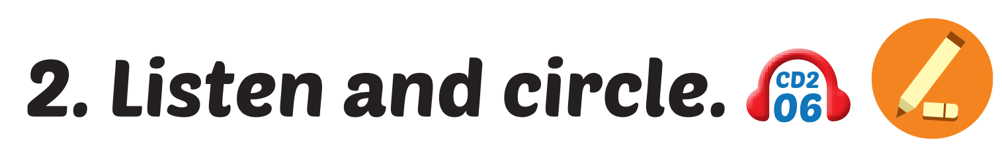
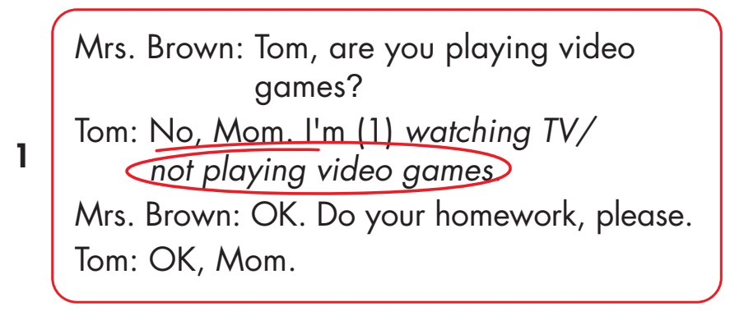
Click on the headphone icon to hear the sound.
Click on number 1
to show the answer.

Slide 26
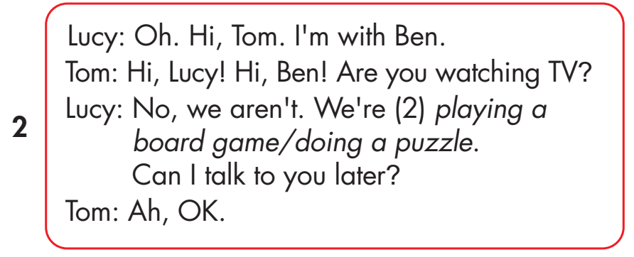
Click on the headphone icon to hear the sound.
Click on number 2
to show the answer.

Slide 27
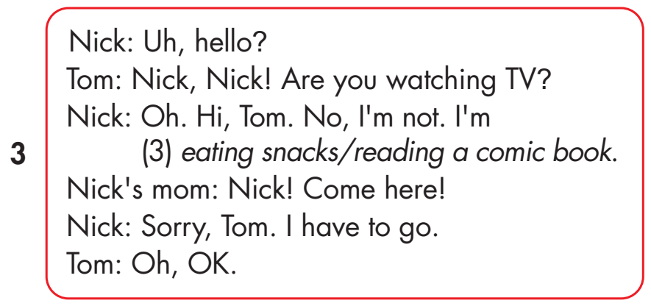
Click on the headphone icon to hear the sound.
Click on number 3
to show the answer.

Slide 28
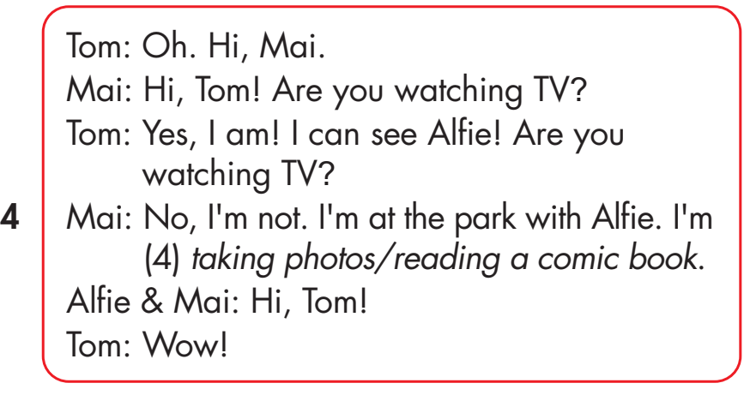
Click on the headphone icon to hear the sound.
Click on number 4
to show the answer.

Slide 29

Practice

Slide 30
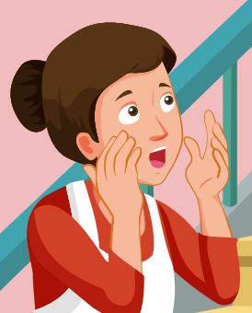
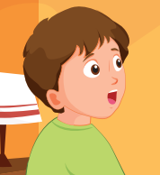
Practice with your friend.
Tom, are you playing video games?
No, Mom. I’m not playing video games.
OK. Do your homework please.
OK, Mom.

Slide 31
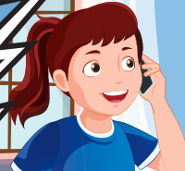
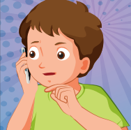
Oh, hi Tom. I’m with Ben.
Hi, Lucy! Hi, Ben! Are you watching TV?
No, we aren’t. We are playing a board game. Can I talk to you later?
Ah, OK.

Slide 32
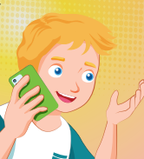
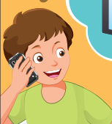
Uh? hello?
Nick, Nick! Are you watching TV?
Oh. Hi, Tom. No, I'm not. I'm eating snacks.
Nick's mom
Nick! Come here!
Sorry, Tom. I have to go.
Oh, OK

Slide 33



Oh. Hi, Mai.
Hi, Tom! Are you watching TV?
Yes, I am! I can see Alfie! Are you watching TV?
No, I'm not. I'm at the park with Alfie. I'm taking photos.
Hi, Tom!
Wow!

Slide 34
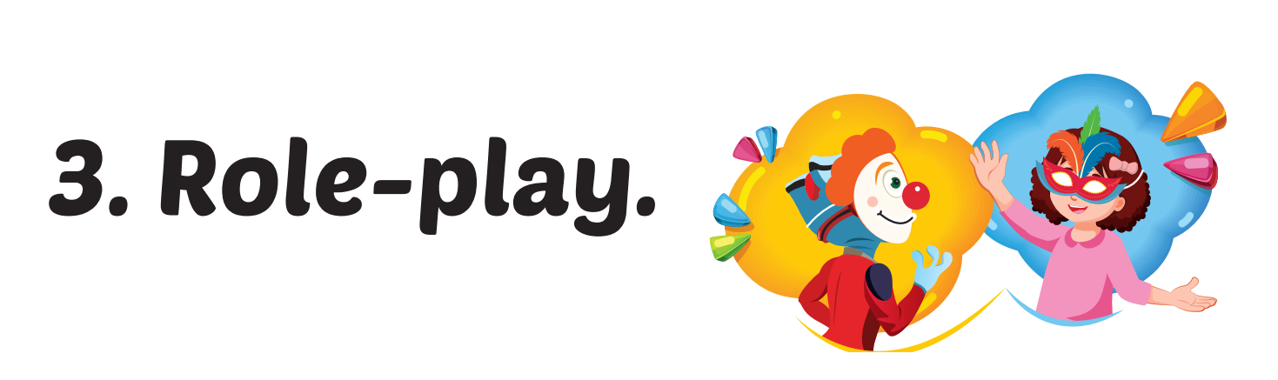

Slide 35

CONSOLIDATION

Slide 36

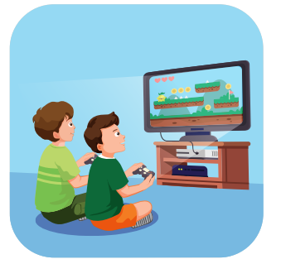
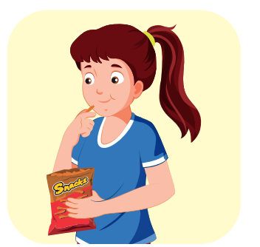
eat snacks
_____________________________
Notes:
WB page 32

Slide 37
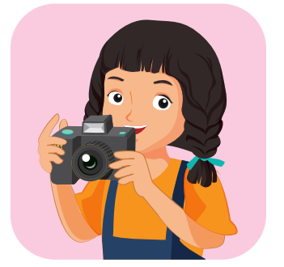
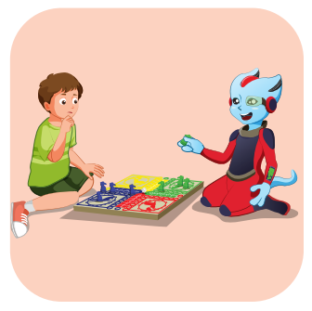
play a board game
_____________________________
Notes:
WB page 32

Slide 38
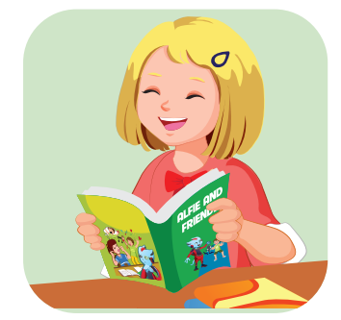
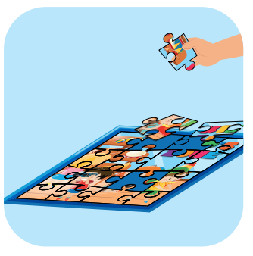
do a puzzle
_____________________________
Notes:
WB page 32

Slide 39
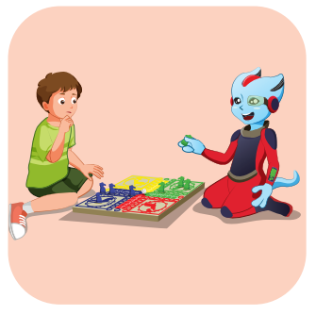
take photos
_____________________________
Notes:
WB page 32

Slide 40
play video games
_____________________________
Notes:
WB page 32

Slide 41
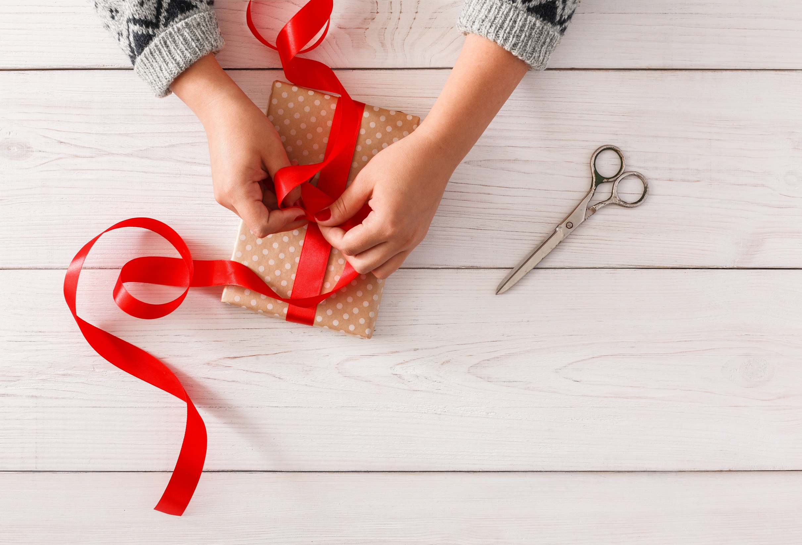
WRAP-UP

Slide 42
Today’s lesson
Vocabularies
play a board game, do a puzzle, read a comic book, eat snacks, play video games.
Structures/ Sentence patterns
Are you reading a comic book?
– Yes, I am.
Are you read a comic book?
- No, we aren’t. We’re playing a board game.

Slide 43
Homework
Practice the vocabularies and structure, and make sentences using them.
Do the exercises in Tiếng Anh 4 i-Learn Smart Start WB (page 33).
Do the exercises in Tiếng Anh 4 i-Learn Smart Start Notebook (page 23).
Prepare for the next lesson (page 50 SB).
Play the consolidation games in Tiếng Anh 4 i-Learn Smart Start DHA App on www.eduhome.com.vn

Slide 44

Lesson 3
Stay positive and have a nice day!

