Slide 1
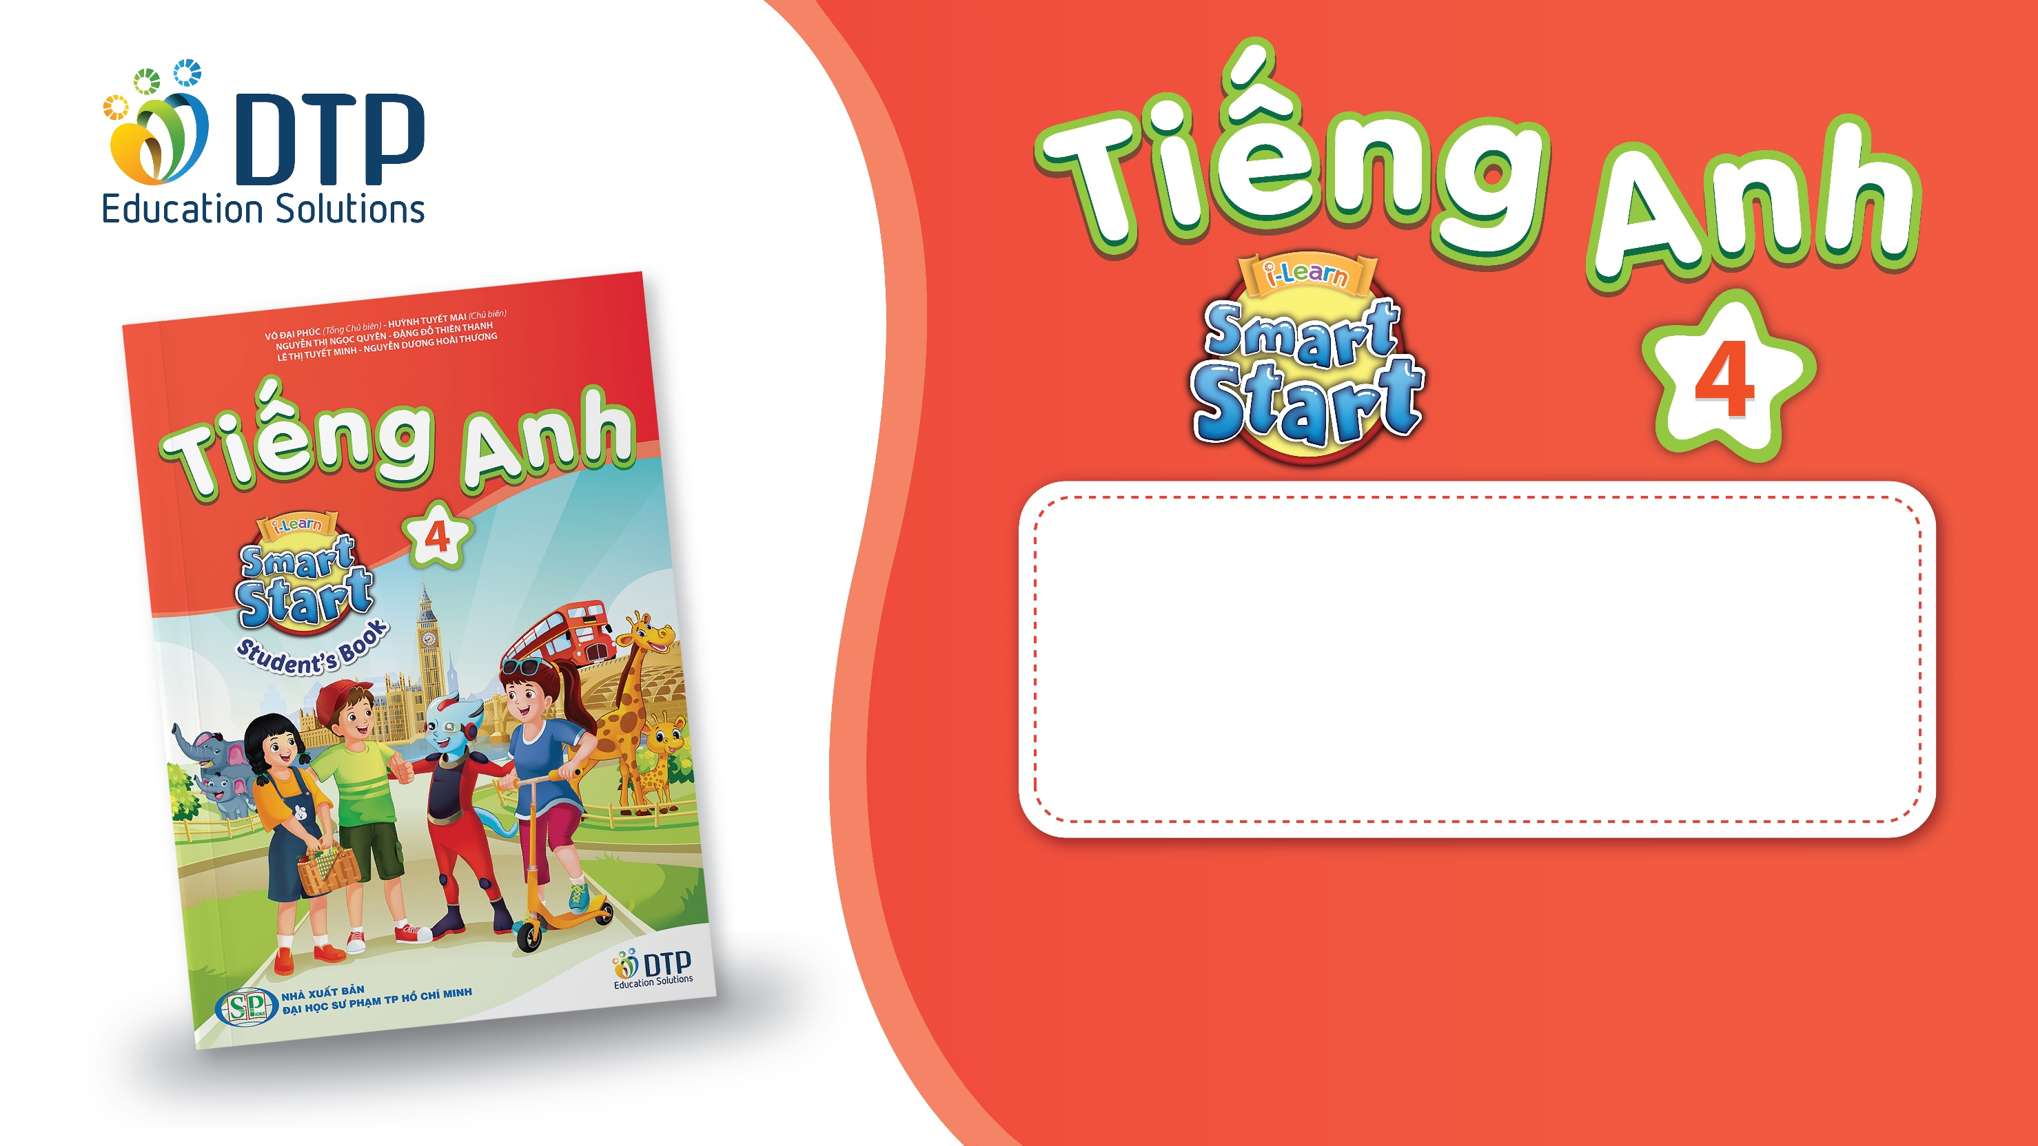
Unit 4: ACTIVITIES
Lesson 1.3
Page 50

Slide 2
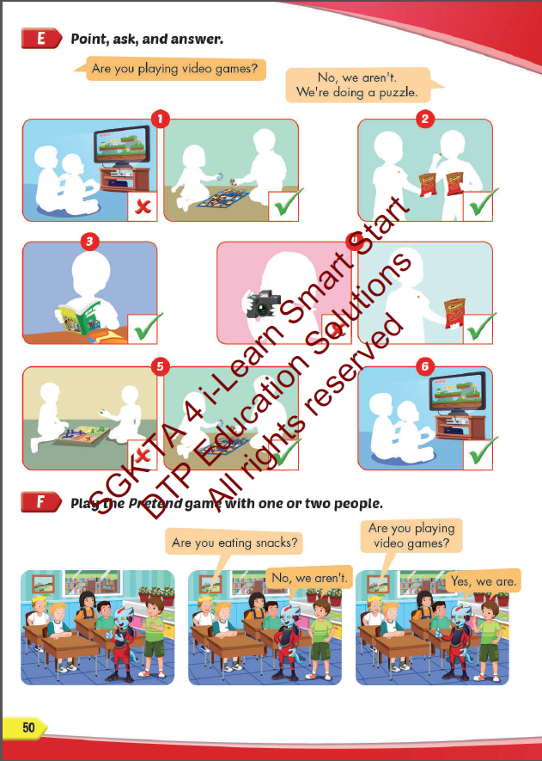
Lesson Outline
Warm-up
Practice
Speaking
Consolidation
Wrap-up

Slide 3
Objectives
By the end of this lesson, students will be able to
ask and answer what they are doing.
Vocabulary: play a board game, do a puzzle, read a comic book, eat snacks, play video games.
Structure: Are you reading a comic book?
– Yes, I am.
Are you read a comic book?
- No, we aren’t. We’re playing a board game.

Slide 4
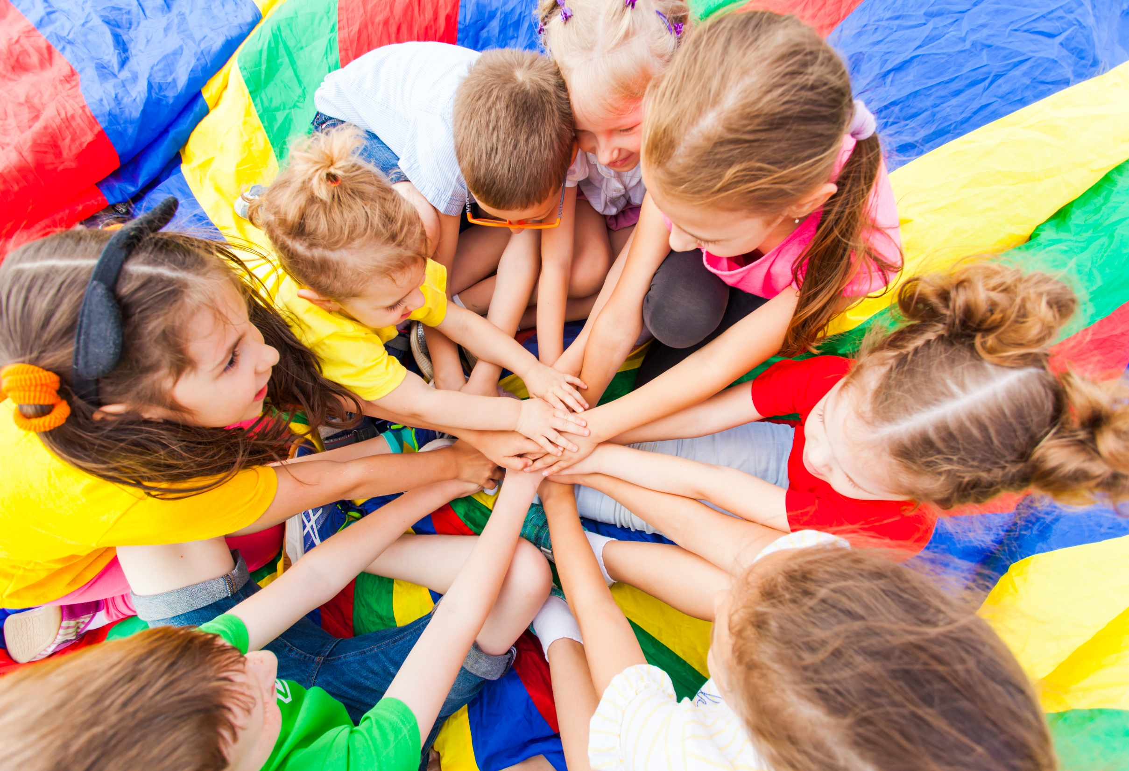
WARM UP

Slide 5

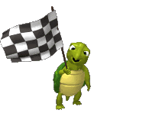



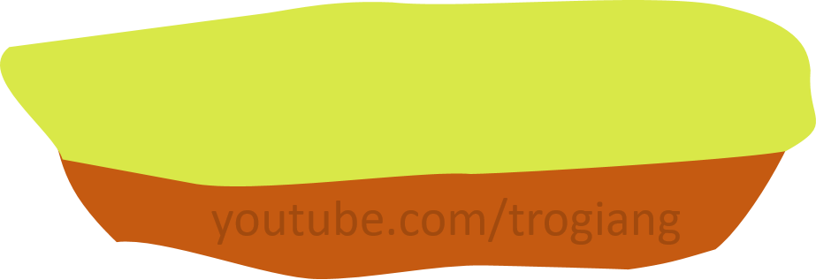

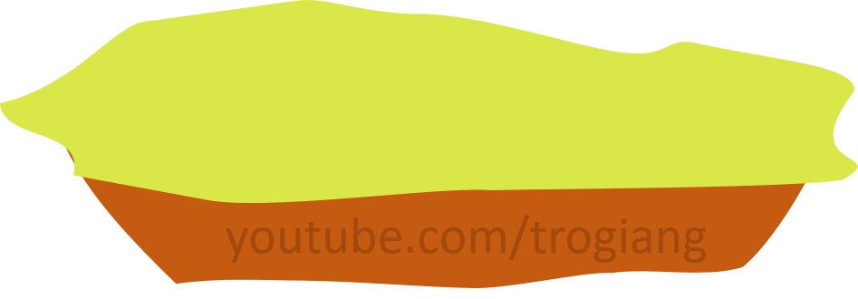
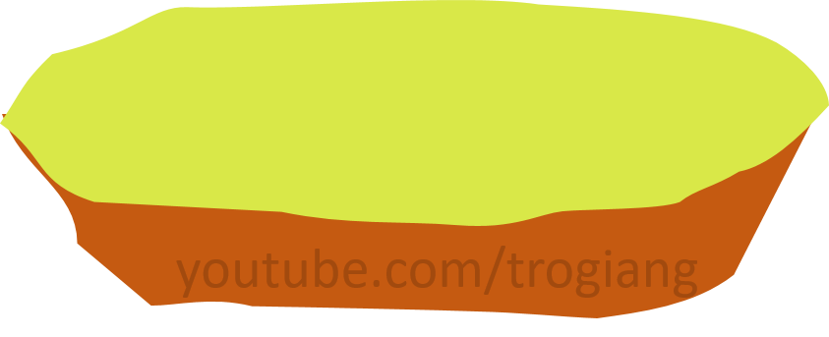

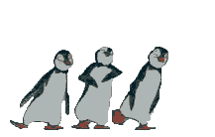


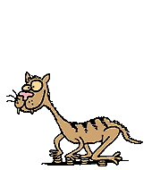
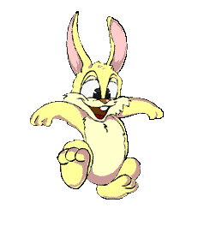




5
CONGRATULATIONS TIGER TEAM
5
CONGRATULATIONS RABBIT TEAM
4
4
3
3
2
2
overtop
1
1
Notes:
T divides Ss into 2 teams.
Each team has a leader.
Team leaders have to play Rock, Scissors, Paper for each question.
The winner will get a turn to answer the question.
Ss can step once for a correct answer.

Slide 6



Click on each sentence to check the correct answer.
Are you taking photos?
1
A
Yes, she is.
B
Yes, I am.
C
No, I’m not.

Slide 7
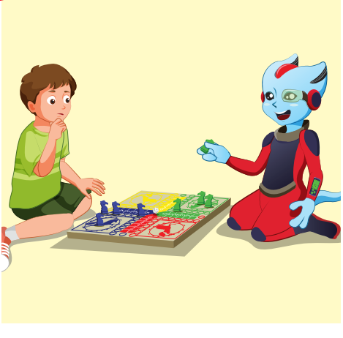
Click on each sentence to check the correct answer.
Are you playing board games?
2
A
Yes, we are.
B
Yes, we aren’t.
C
No, we aren’t.

Slide 8
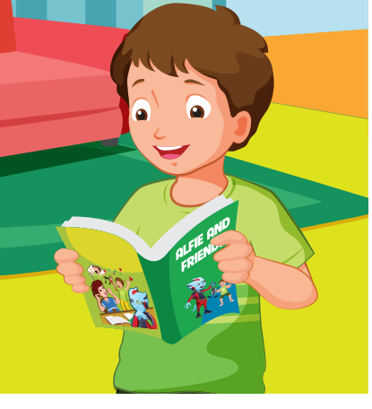
Click on each sentence to check the correct answer.
Are you playing video games?
3
A
No, he isn’t. He’s reading a comic book.
B
Yes, I am.
C
No, I’m not. I’m reading a comic book.

Slide 9
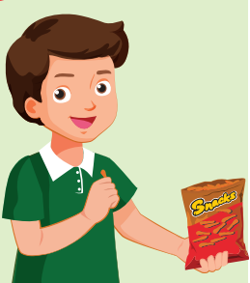
Click on each sentence to check the correct answer.
Are you eating snacks?
4
A
Yes, he is.
B
No, he isn’t.
C
Yes, I am.

Slide 10
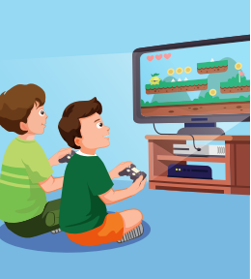
Click on each sentence to check the correct answer.
Are you doing a puzzle?
5
A
No, we aren’t. We are playing video games.
B
Yes, we are.
C
Yes, they are.

Slide 11

It’s time to learn …

Slide 12

Practice

Slide 13

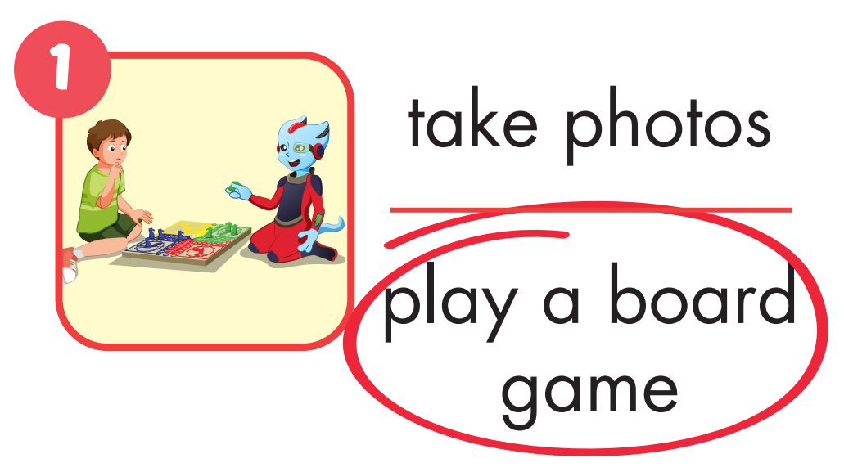
Click on the picture to check the correct answer.

Slide 14
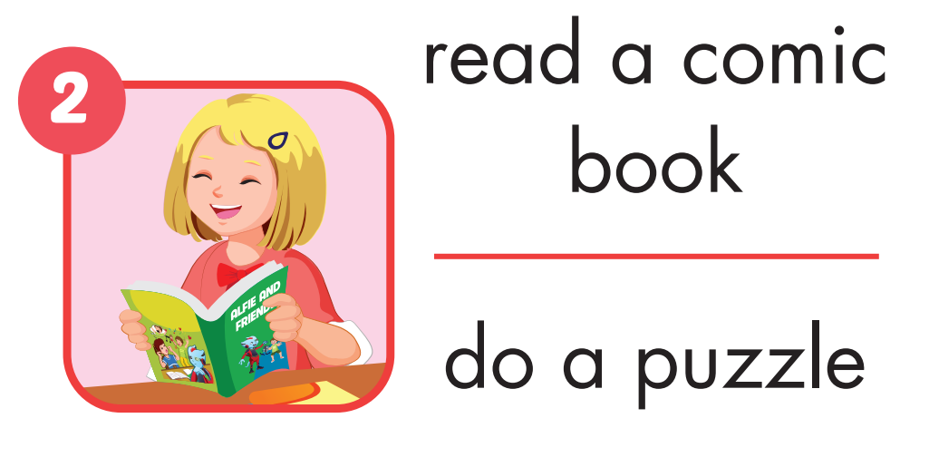

Slide 15
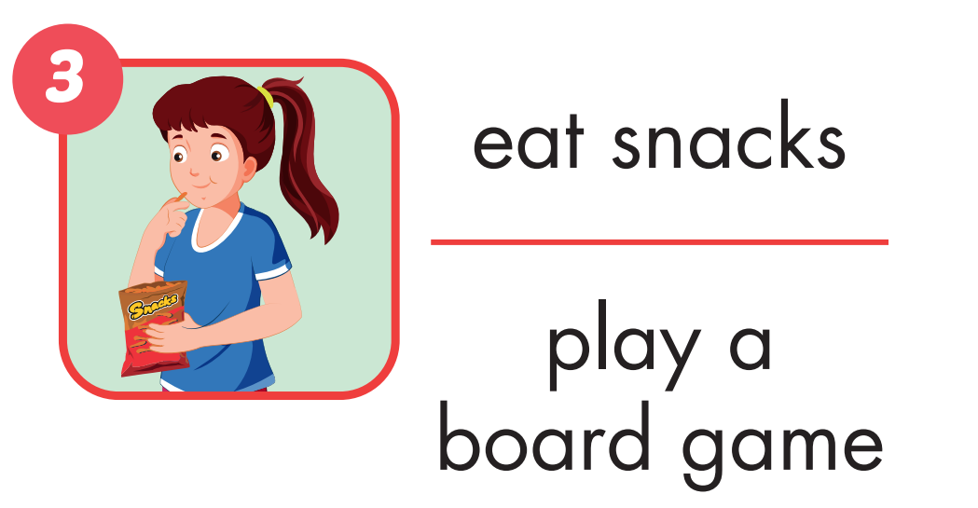
Click on the picture to check the correct answer.

Slide 16
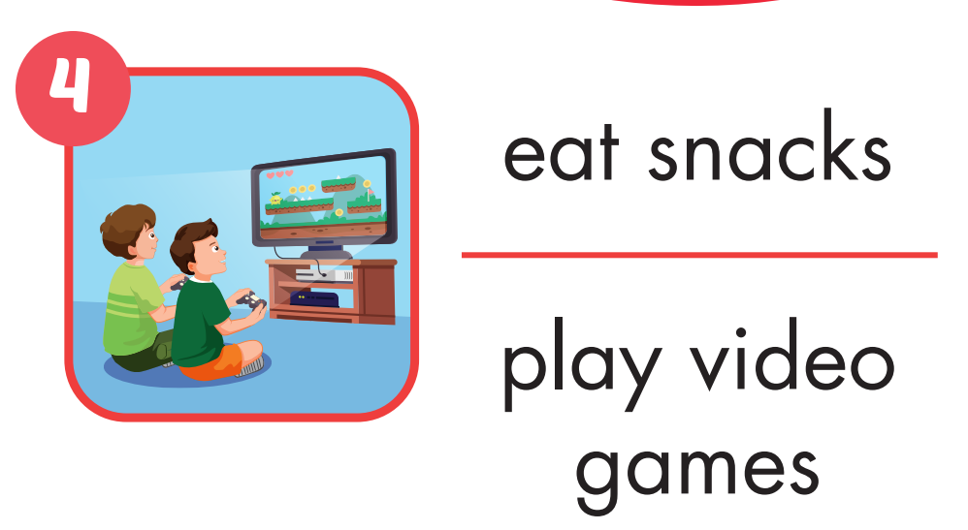
Click on the picture to check the correct answer.

Slide 17
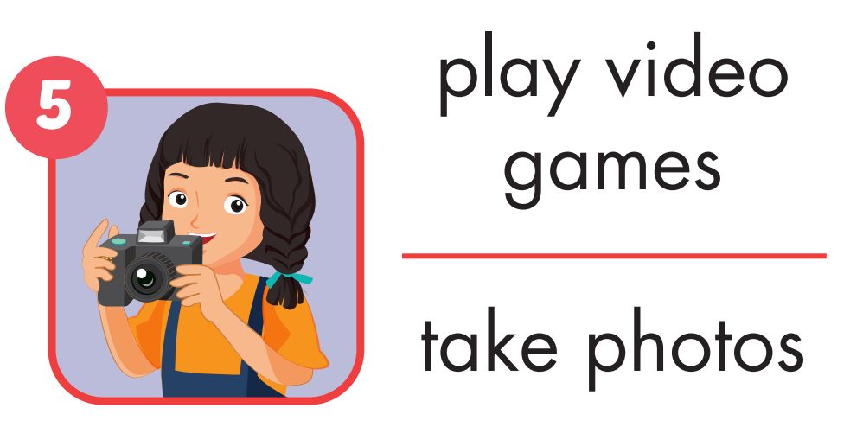
Click on the picture to check the correct answer.

Slide 18
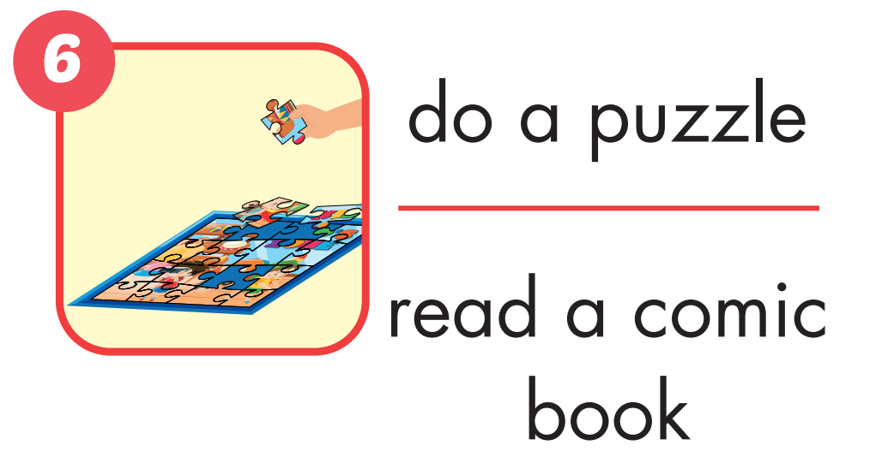
Click on the picture to check the correct answer.

Slide 19

Listening

Slide 20

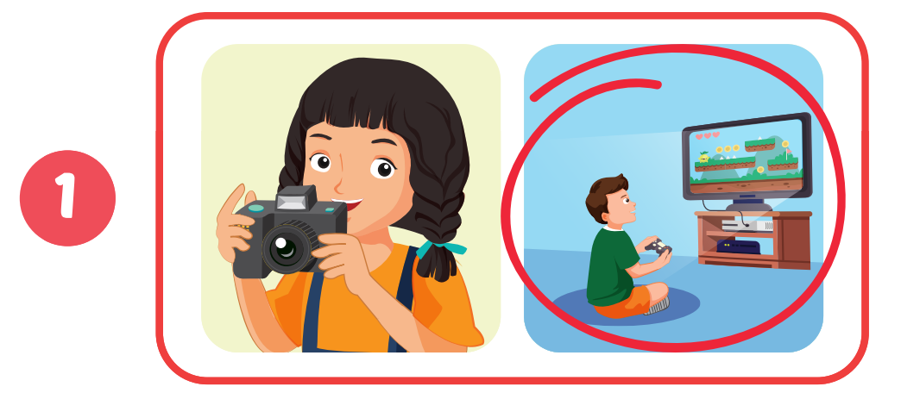
Click on the headphone icon to hear the sound.
Click on the pictures to show the correct answer.

Slide 21
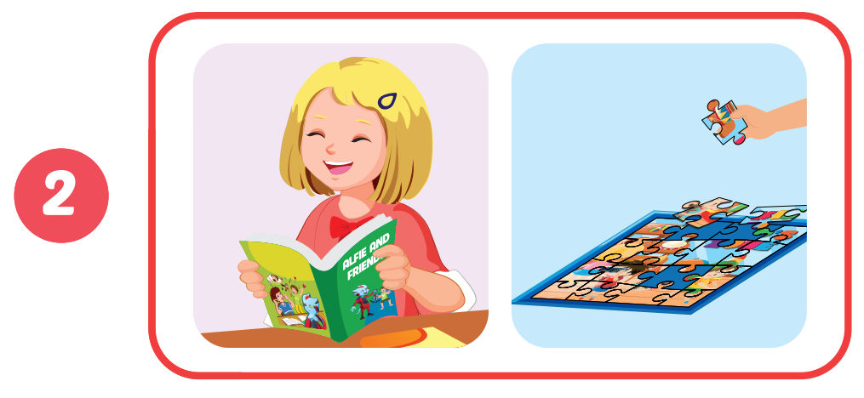

Slide 22
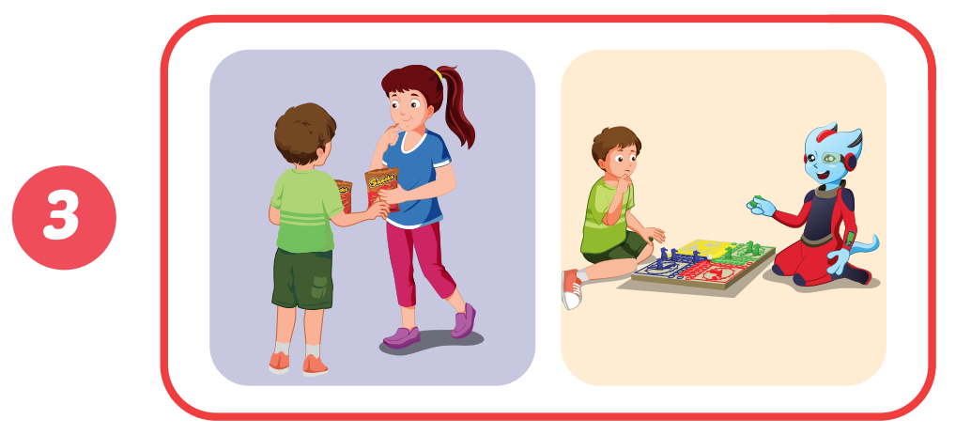

Slide 23
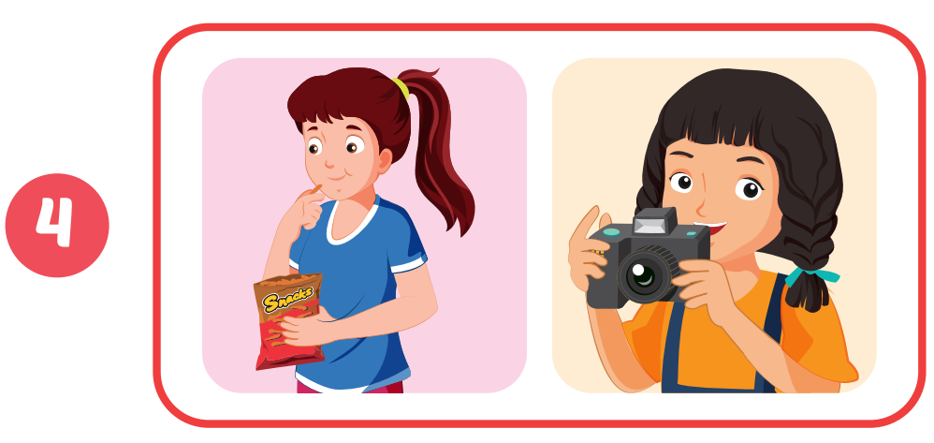

Slide 24
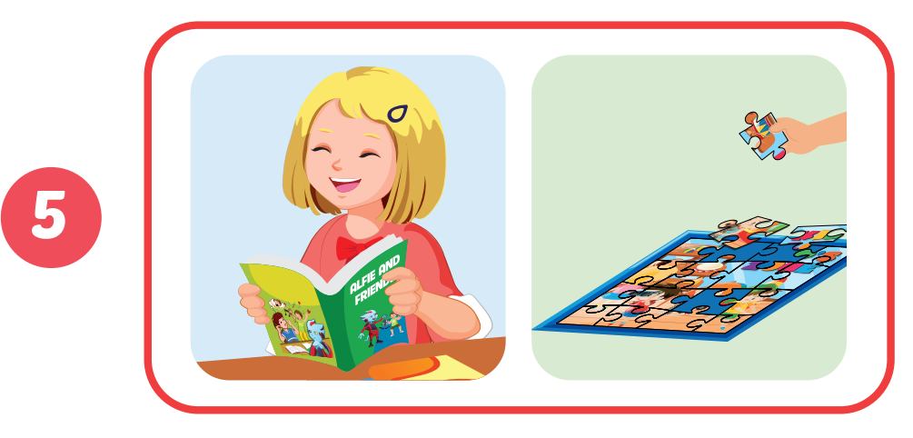

Slide 25
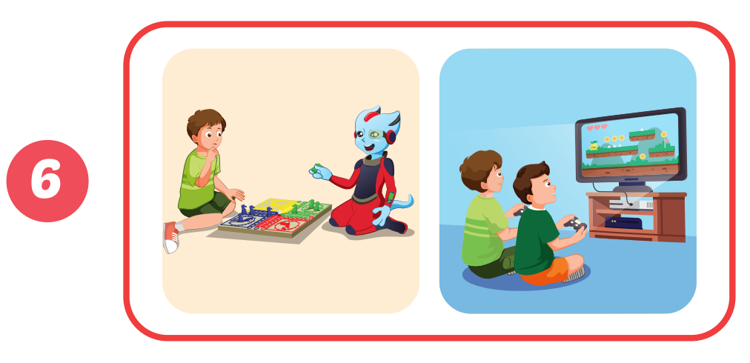

Slide 26

Speaking

Slide 27

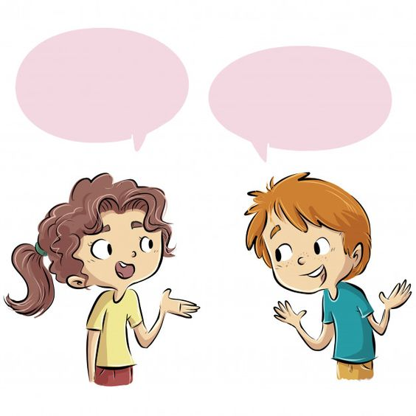
Are you playing video games?
No, we aren’t. We are doing a puzzle.

Slide 28
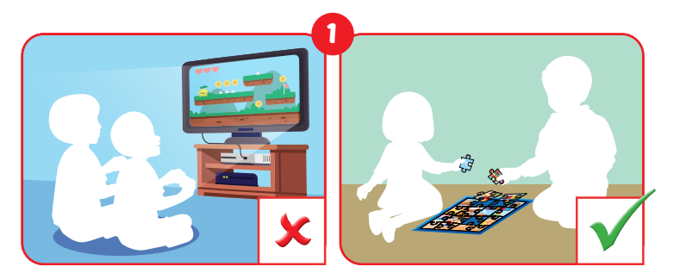
……………..?
No,………...

Slide 29
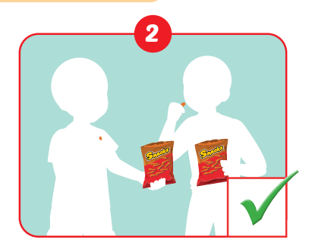
……………..?
Yes,………...

Slide 30
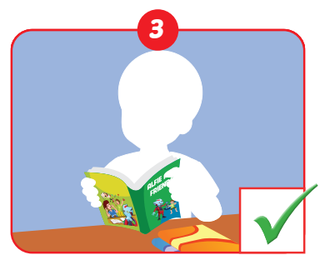
……………..?
Yes,………...

Slide 31
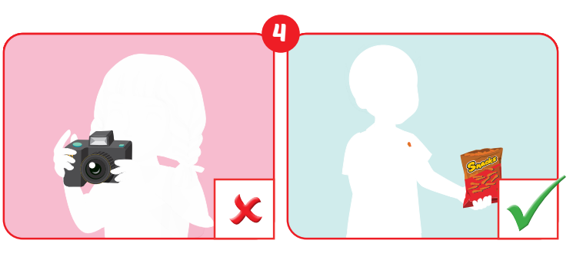
……………..?
No,………...

Slide 32
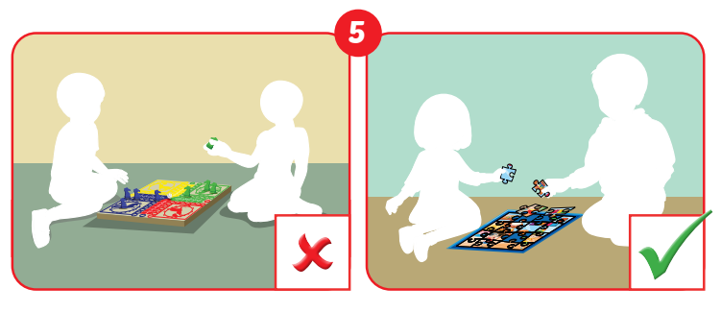
……………..?
No,………...

Slide 33
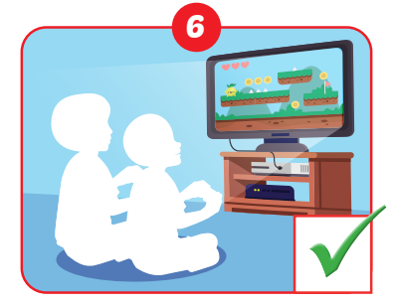
……………..?
Yes,………...

Slide 34

Production

Slide 36
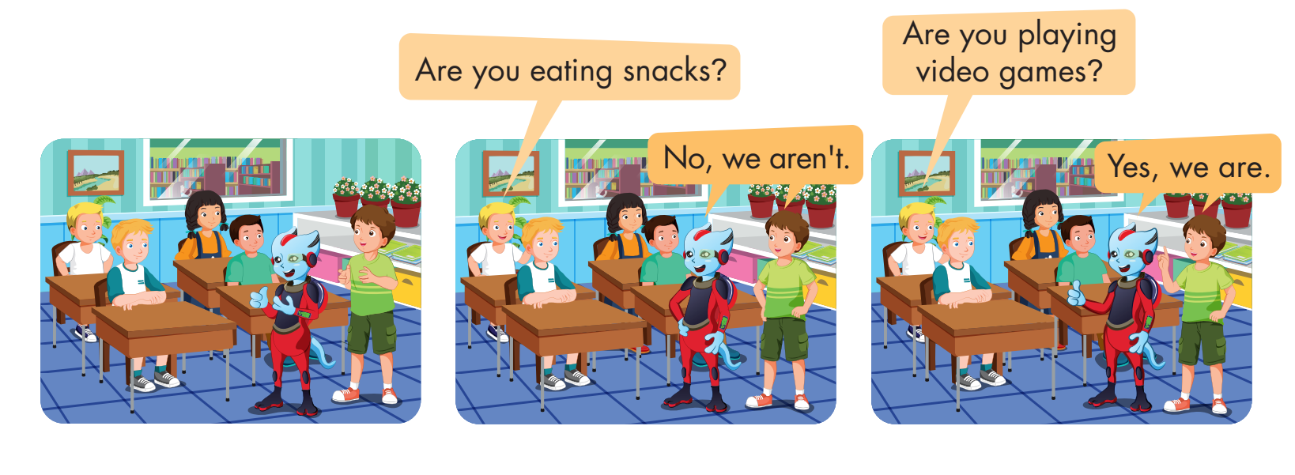

Slide 37

CONSOLIDATION

Slide 38
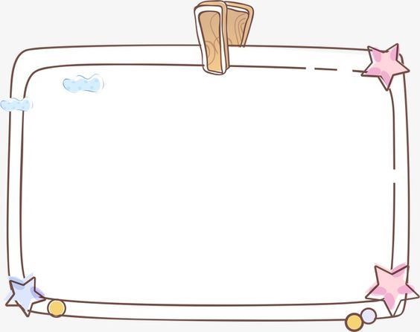

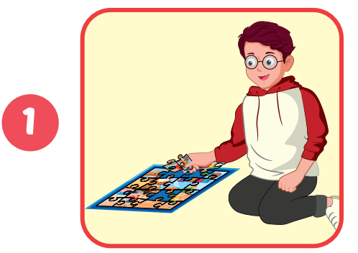
Are you ___________?
Yes, ______________.
A
playing a board game/I am
B
doing a puzzle/ I am
C
doing a puzzle/ he is

Slide 39
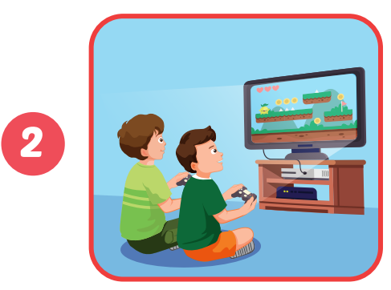
Are you reading a comic book?
No, we _____. ______________.
A
aren’t/We are playing video games.
B
aren’t/We are play video games.
C
are/We are playing video games.

Slide 40
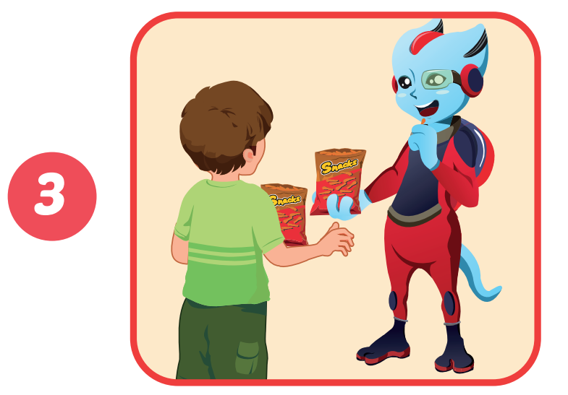
Are you ____________________?
____________.
A
eating snacks/Yes, we aren’t
B
eat snacks/Yes, we are
C
eating snacks/Yes, we are.

Slide 41
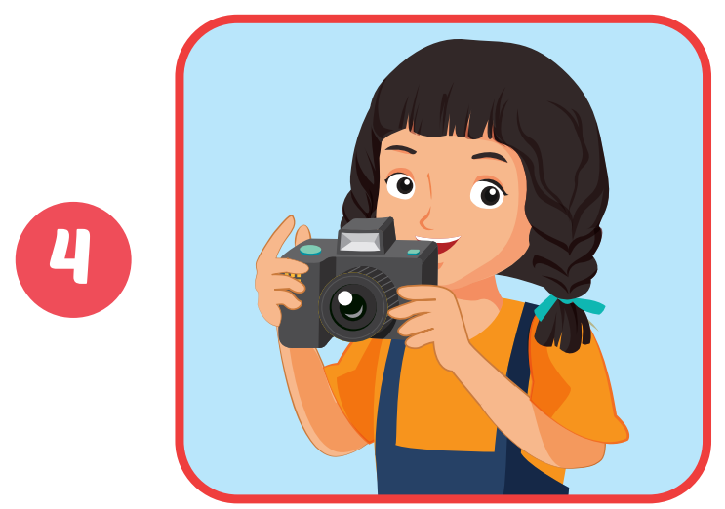
Are you ____________________?
Yes, ______.
A
take photos/we are
B
taking photos/we are
C
takes photos/we are

Slide 42

WRAP-UP

Slide 43
Today’s lesson
Vocabularies
play a board game, do a puzzle, read a comic book, eat snacks, play video games.
Structures/ Sentence patterns
Are you reading a comic book?
– Yes, I am.
Are you read a comic book?
- No, we aren’t. We’re playing a board game.

Slide 44
Homework
Practice the vocabularies and structure; and make sentences using them.
Do the exercises in Tiếng Anh 4 i-Learn Smart Start WB (page 33).
Do the exercises in Tiếng Anh 4 i-Learn Smart Start Notebook (page 22).
Prepare the next lesson (page 51 SB).
Play the consolidation games in Tiếng Anh 4 i-Learn Smart Start DHA App on www.eduhome.com.vn

Slide 45
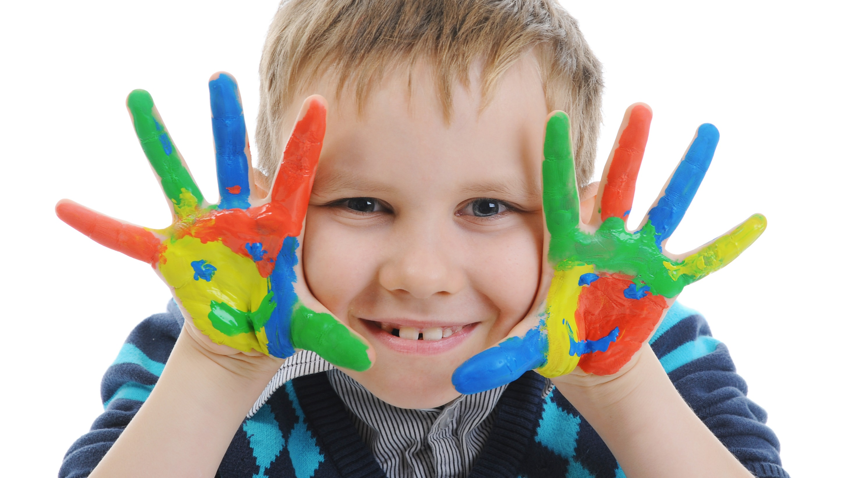
Enjoy your day!

