Slide 1

Unit 5: Getting Around
Lesson 1.1
Page 64

Slide 2
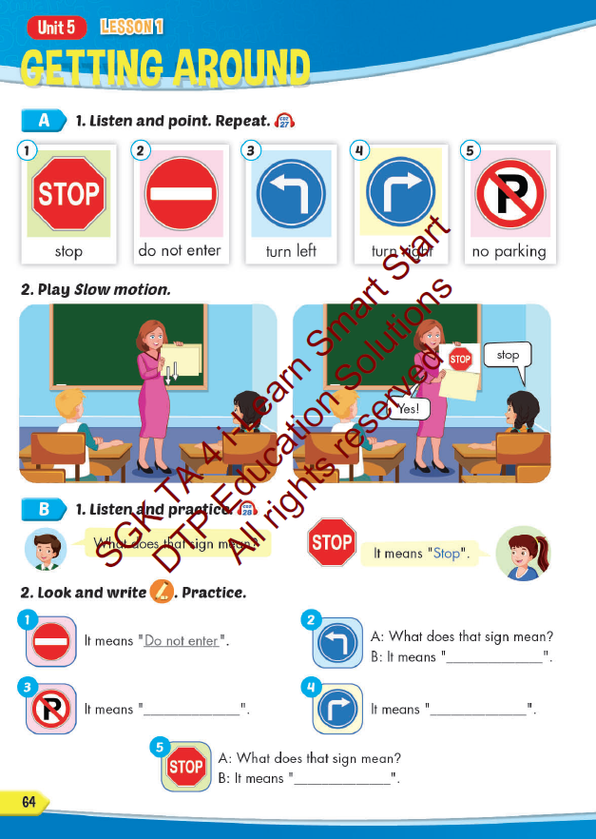
Lesson Outline
Warm-up
Vocabulary
Structure
Consolidation
Wrap-up

Slide 3
Objectives
By the end of this lesson, students will be able to…
Vocabulary: Pronounce and use the words related to the topic properly: stop, do not enter, turn left, turn right, no parking.
Structure: What does that sign mean? - It means "Stop".

Slide 4

WARM UP

Slide 5

It’s time to learn …

Slide 6

New words
stop, do not enter, turn left,
turn right, no parking.

Slide 7

Presentation

Slide 8


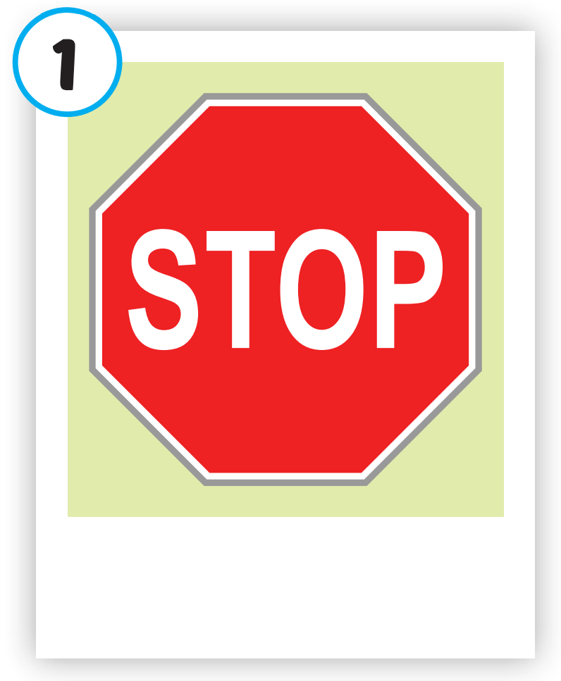
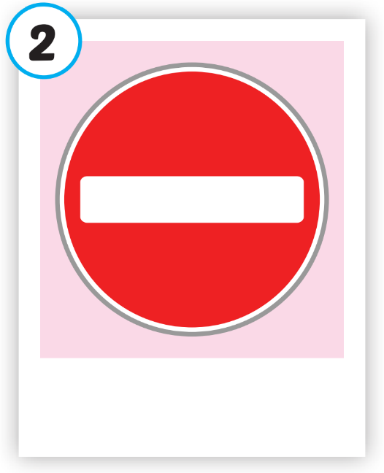
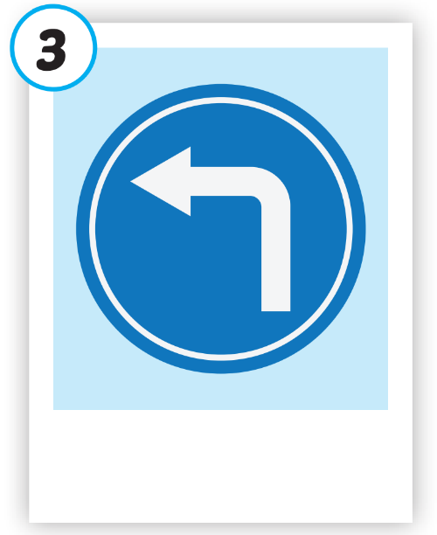
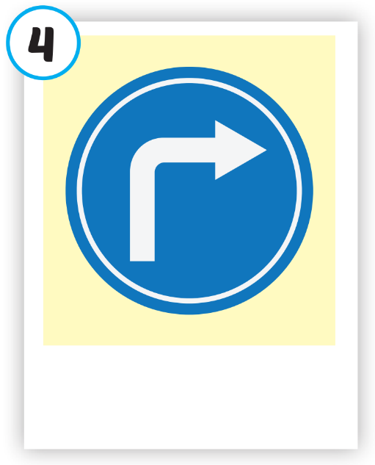
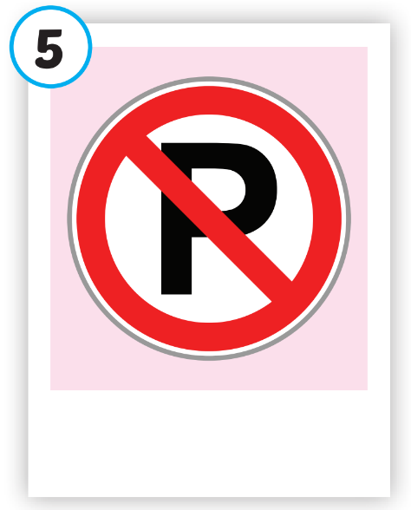





Click on each picture to hear the sound.
/stɑːp/
ngừng lại, dừng lại
/duː nɑːt ˈentər/
cấm vào
/tɜːrn left/
rẽ trái
/tɜːrn raɪt/
rẽ phải
/noʊ ˈpɑːrkɪŋ/
cấm đỗ xe

Slide 9

Click on each picture to hear the sound.
/stɑːp/
ngừng lại, dừng lại

Slide 10

Click on each picture to hear the sound.
/duː nɑːt ˈentər/
cấm vào

Slide 11

Click on each picture to hear the sound.
/tɜːrn left/
rẽ trái

Slide 12

Click on each picture to hear the sound.
/tɜːrn raɪt/
rẽ phải

Slide 13
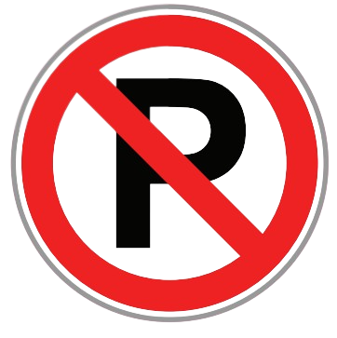
Click on each picture to hear the sound.
/noʊ ˈpɑːrkɪŋ/
cấm đỗ xe

Slide 14
Practice

Slide 15
Check your memory

Slide 16

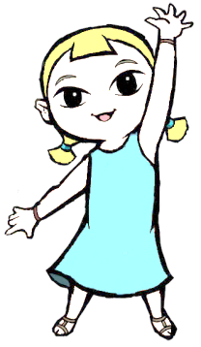

Look at the the line and say what disappears with the wind within the time limit (5 seconds)

Slide 17

What disappears?
TIME’S UP
stop

Slide 18



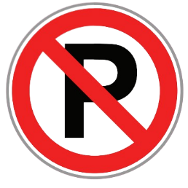
What disappears?
TIME’S UP
no parking

Slide 19




What disappears?
do not enter
TIME’S UP

Slide 20

What disappears?
turn left
TIME’S UP

Slide 21
What disappears?
turn right
TIME’S UP

Slide 22



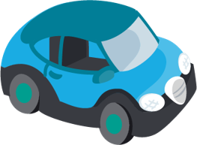

What disappears?
a teddy bear
TIME’S UP

Slide 23
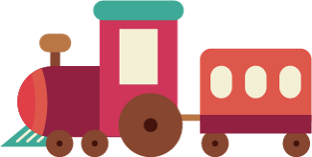
What disappears?
a train
TIME’S UP

Slide 24

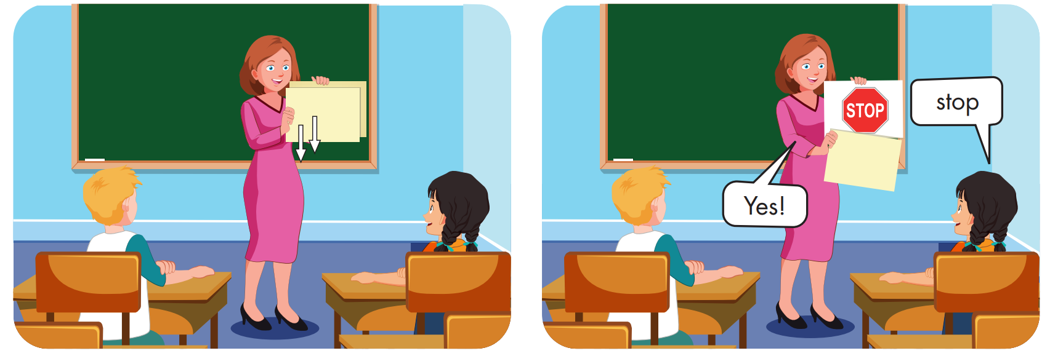

Slide 25
Structure
What does that sign mean?
It means "Stop".

Slide 26
Presentation

Slide 27


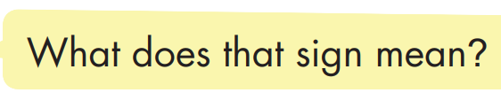
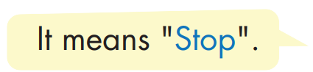

Structure

Slide 28

Practice

Slide 29


Slide 30

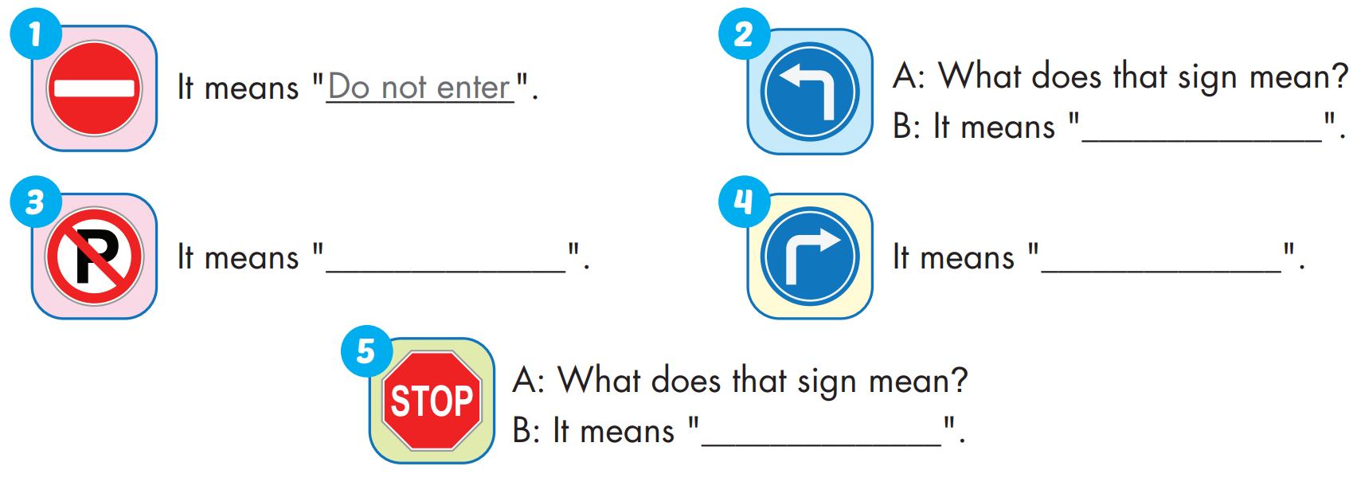
turn left
no parking
turn right
stop

Slide 31

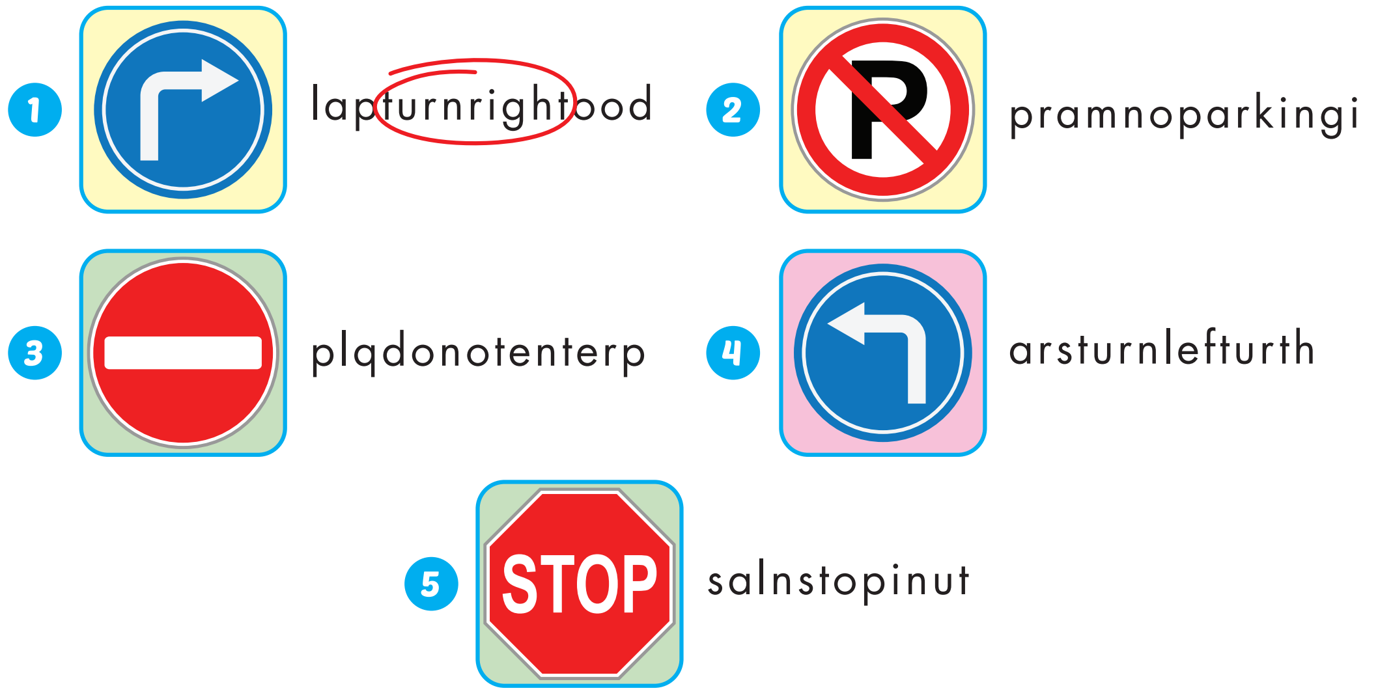
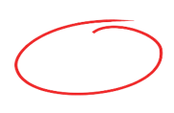
Extra Practice
WB, page 42

Slide 32

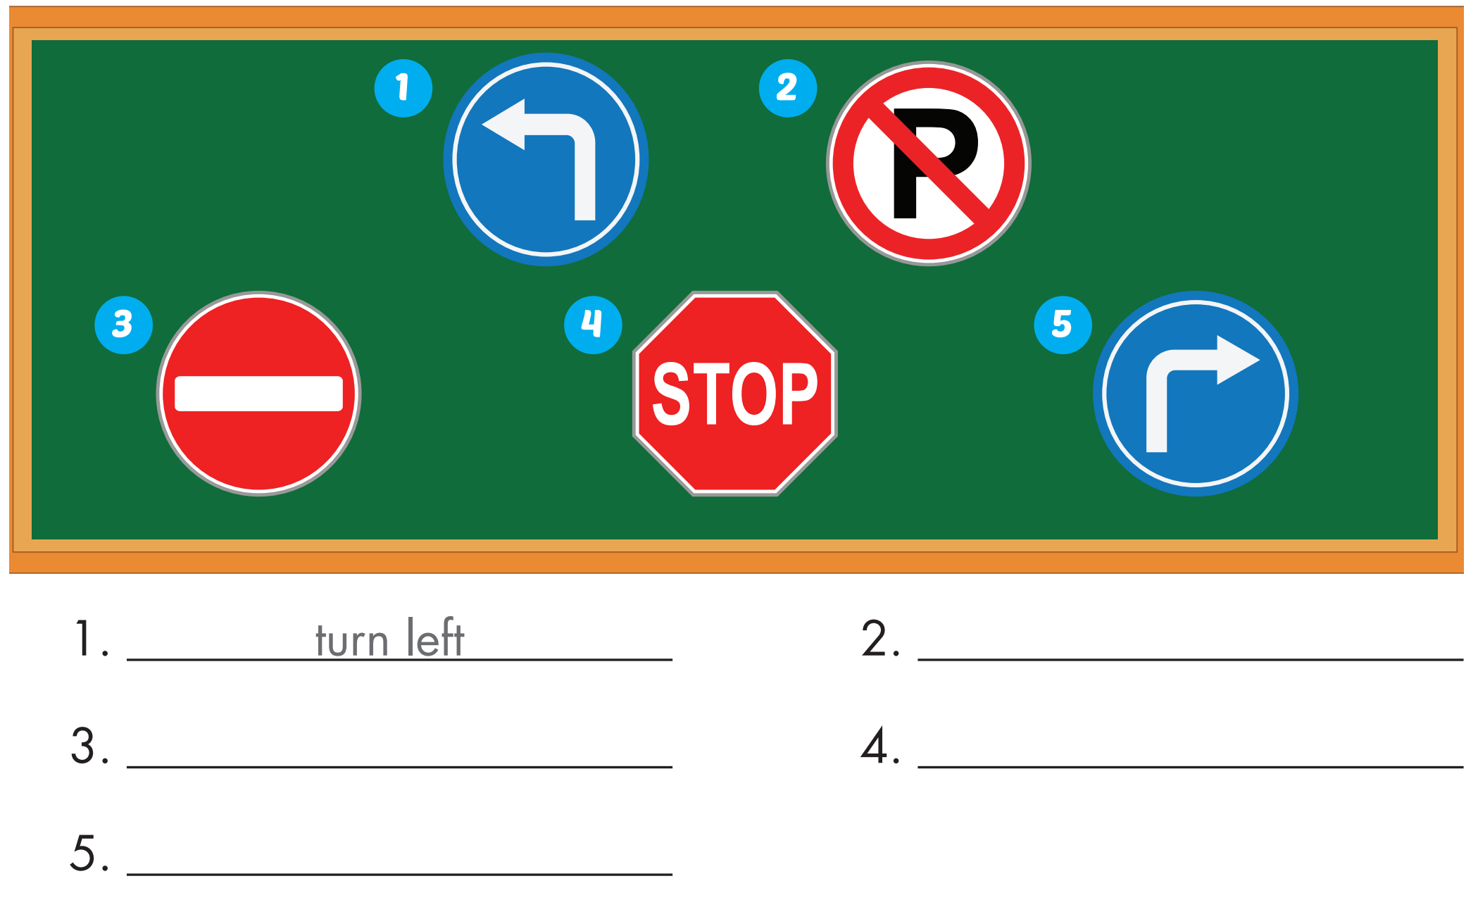
Extra Practice
WB, page 42
no parking
do not enter
stop
turn right

Slide 33

Production

Slide 34

CONSOLIDATION

Slide 35

WRAP-UP

Slide 36
Today’s lesson
Vocabularies
stop, do not enter, turn left, turn right, no parking.
Structures/ Sentence patterns
What does that sign mean?
- It means "Stop".

Slide 37
Homework
Practice the vocabularies and structure; and make sentences using them.
Do the exercises in Tiếng Anh 4 i-Learn Smart Start WB (page 42).
Do the exercises in Tiếng Anh 4 i-Learn Smart Start Notebook (page 28).
Prepare the next lesson (page 65 SB).
Play the consolidation games in Tiếng Anh 4 i-Learn Smart Start DHA App on www.eduhome.com.vn

Slide 38
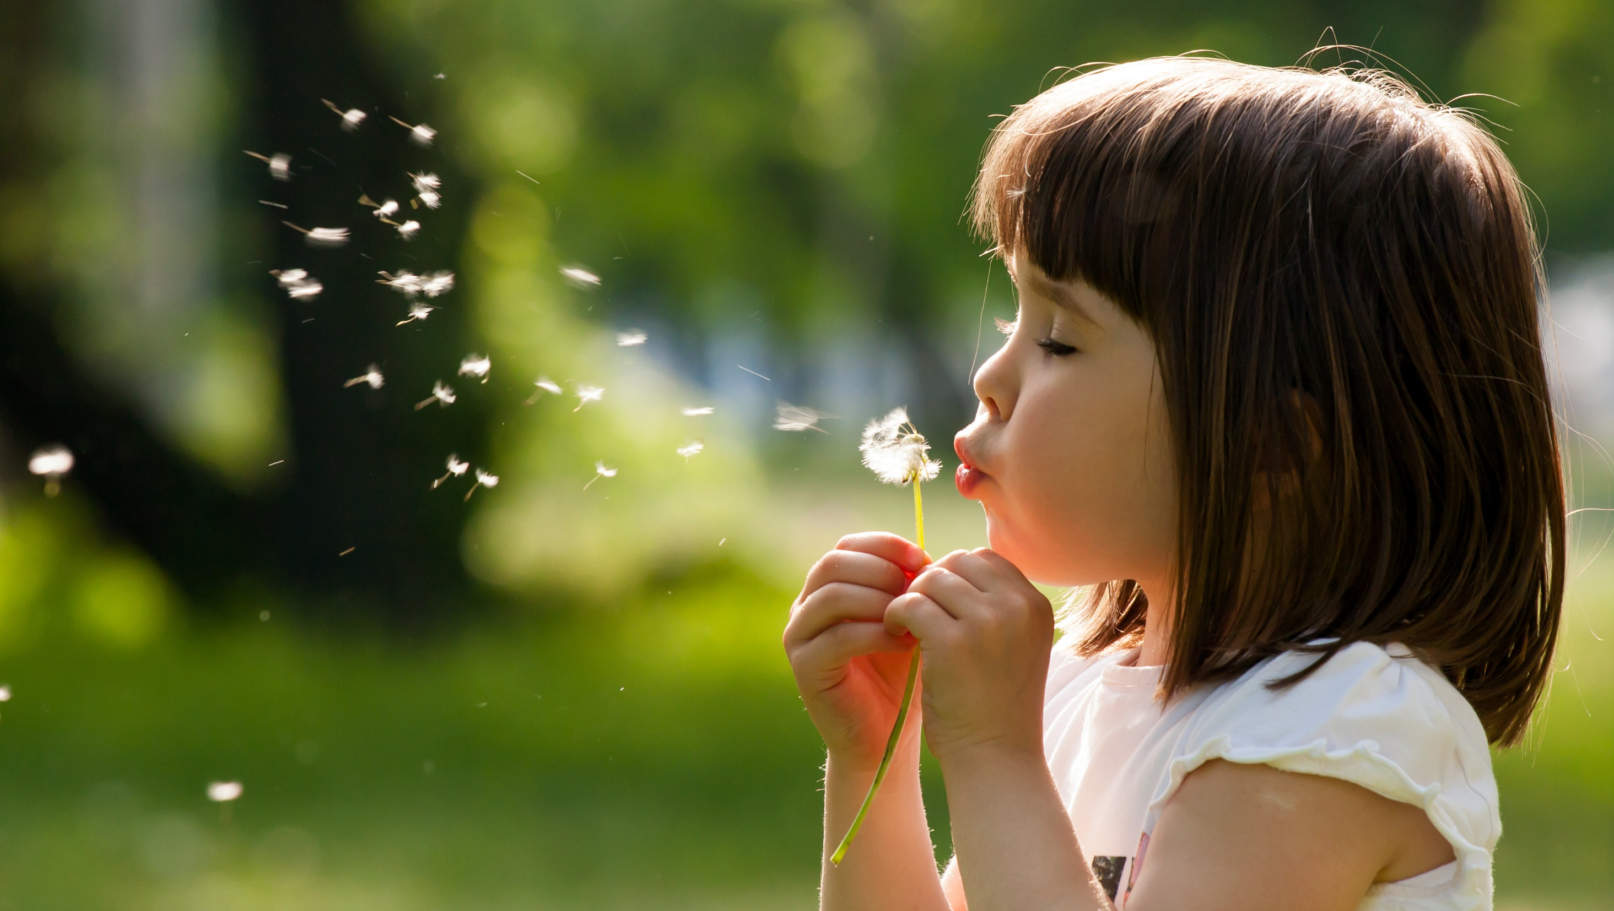
Enjoy your day!

