Slide 1

Unit 5: Getting Around
Lesson 4.1 Culture
Page 73

Slide 2
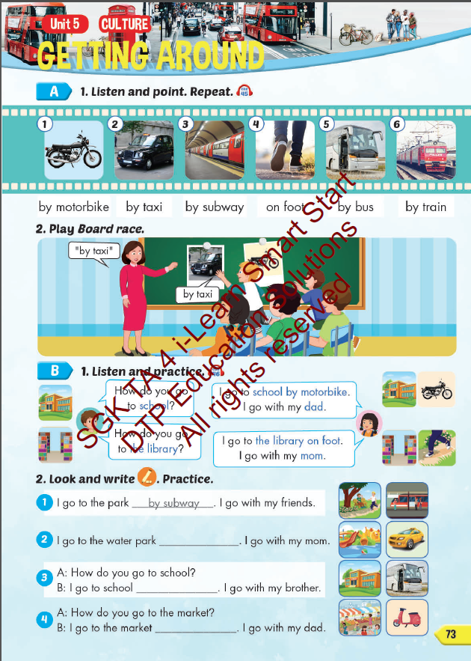
Lesson Outline
Warm-up
Vocabulary
Structure
Consolidation
Wrap-up

Slide 3
Objectives
By the end of this lesson, students will be able to…
Vocabulary: Pronounce and use the words related to the topic properly: by motorbike, by taxi, by subway, on foot, by bus, by train.
Structure: How do you go to school?
- I go to school by motorbike. I go with my dad.
How do you go to the library?
- I go to the library on foot. I go with my mom.

Slide 4

WARM UP

Slide 5










Slide 6


Guess what’s behind the wall
by removing the bricks.

Slide 7
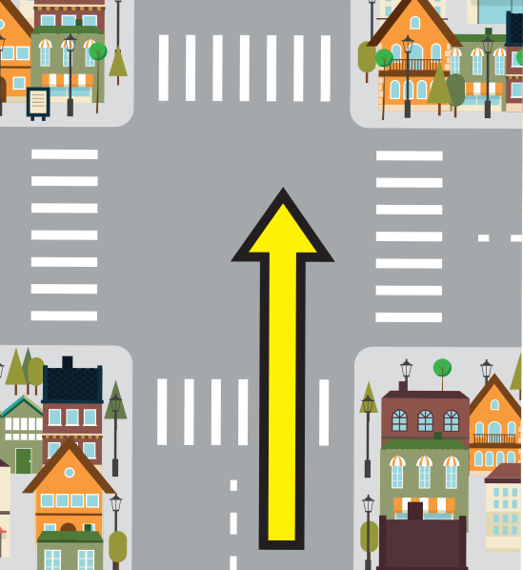
Click on the bricks
go straight
NEXT
CHECK

Slide 8

go over
Click on the bricks
NEXT
CHECK

Slide 9

traffic lights
Click on the bricks
NEXT
CHECK

Slide 10
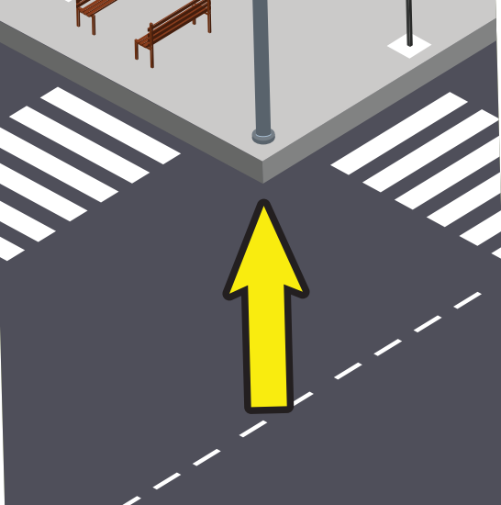
corner
Click on the bricks
NEXT
CHECK

Slide 11

bridge
Click on the bricks
NEXT
CHECK

Slide 12
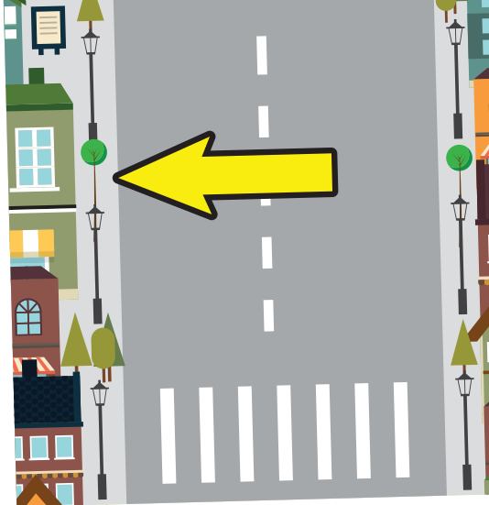
on the left
Click on the bricks
NEXT
CHECK

Slide 13
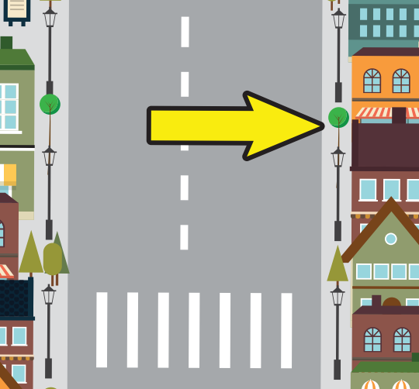
on the right
Click on the bricks
NEXT
CHECK

Slide 14

hide-and-seek
Click on the bricks
NEXT
CHECK

Slide 15

It’s time to learn …

Slide 16

New words
by motorbike, by taxi,
by subway, on foot,
by bus, by train.

Slide 17

Presentation

Slide 18



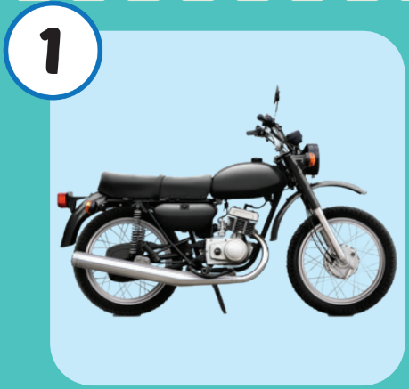
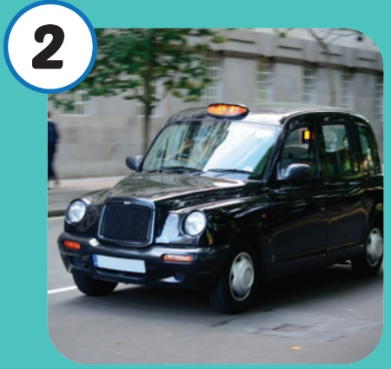
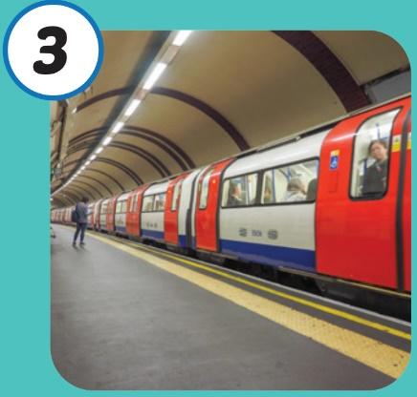
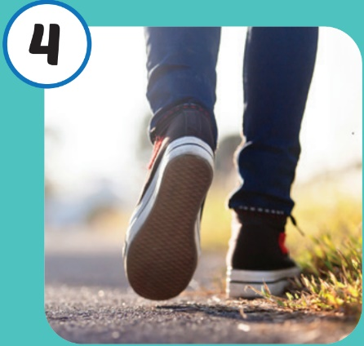
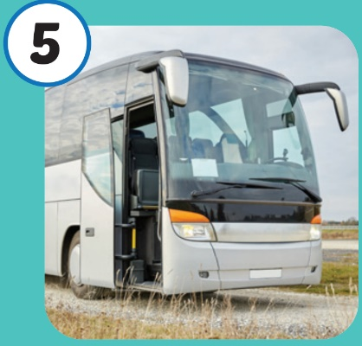
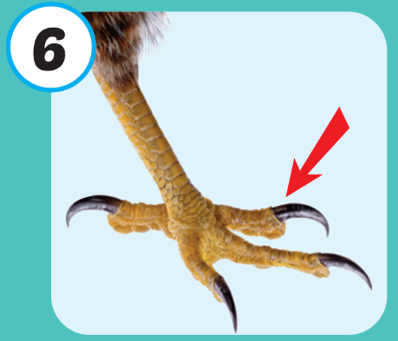
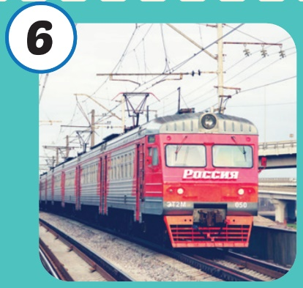







Click on each picture to hear the sound.
/baɪ ˈmoʊtərbaɪk
đi bằng
xe gắn máy
/baɪ ˈtæksi/
đi bằng
xe taxi
/baɪ ˈsʌbweɪ/
đi bằng
tàu điện ngầm
/baɪ bʌs/
đi bằng
xe buýt
/baɪ treɪn/
đi bằng
tàu hỏa
/ɑːn fʊt/
đi bộ

Slide 19

Click on each picture to hear the sound.
/baɪ ˈmoʊtərbaɪk/
đi bằng
xe gắn máy

Slide 20
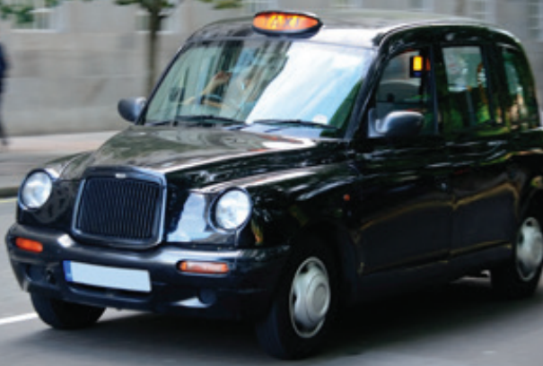
Click on each picture to hear the sound.
/baɪ ˈtæksi/
đi bằng
xe taxi

Slide 21
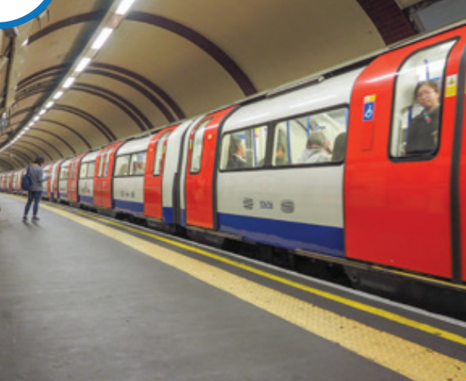
Click on each picture to hear the sound.
/baɪ ˈsʌbweɪ/
đi bằng
tàu điện ngầm

Slide 22

Click on each picture to hear the sound.
/ɑːn fʊt/
đi bộ

Slide 23
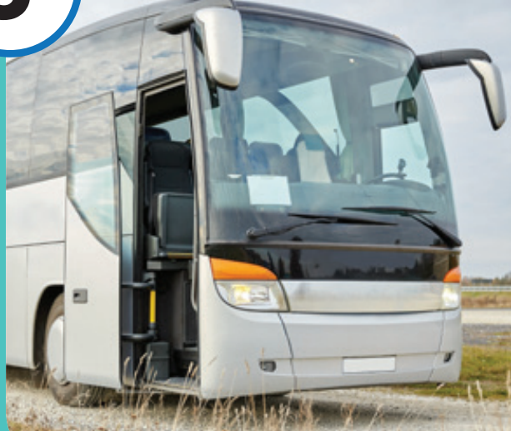
Click on each picture to hear the sound.
/baɪ bʌs/
đi bằng
xe buýt

Slide 24
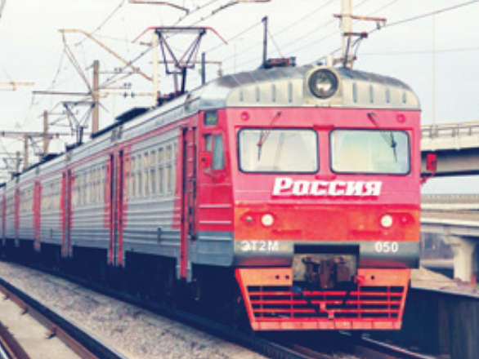
Click on each picture to hear the sound.
/baɪ treɪn/
đi bằng
tàu hỏa

Slide 25

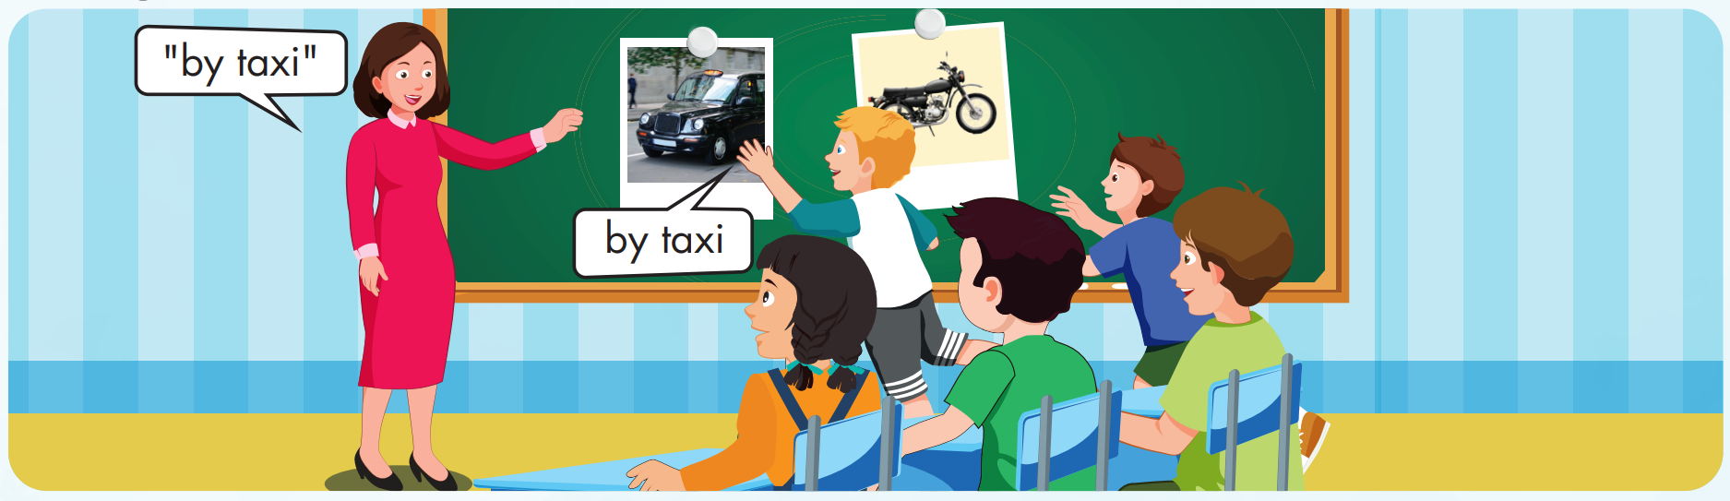

Slide 26
Check your memory

Slide 27




Slide 28






_______________.
by motorbike
on foot
by motorbike
by taxi
by train

Slide 29

_______________.
by taxi
by taxi
by subway
by bus
on foot

Slide 30
_______________.
by subway
by taxi
by train
by subway
on foot

Slide 31
_______________.
on foot
by taxi
by train
by subway
on foot

Slide 32

_______________.
by taxi
by bus
by subway
by taxi
on foot

Slide 33
_______________.
by subway
by taxi
by subway
by train
on foot

Slide 34
Structure
How do you go to school?
- I go to school by motorbike. I go with my dad.
How do you go to the library?
- I go to the library on foot. I go with my mom.

Slide 35

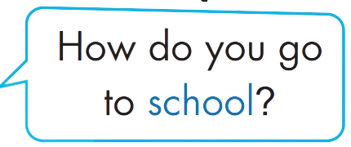
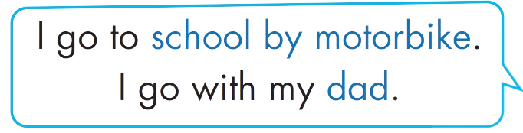





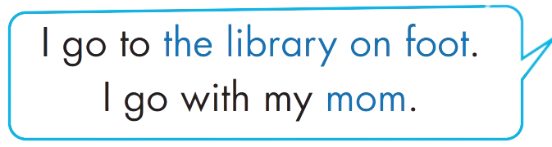

Structure

Slide 36

Practice

Slide 37


Slide 38

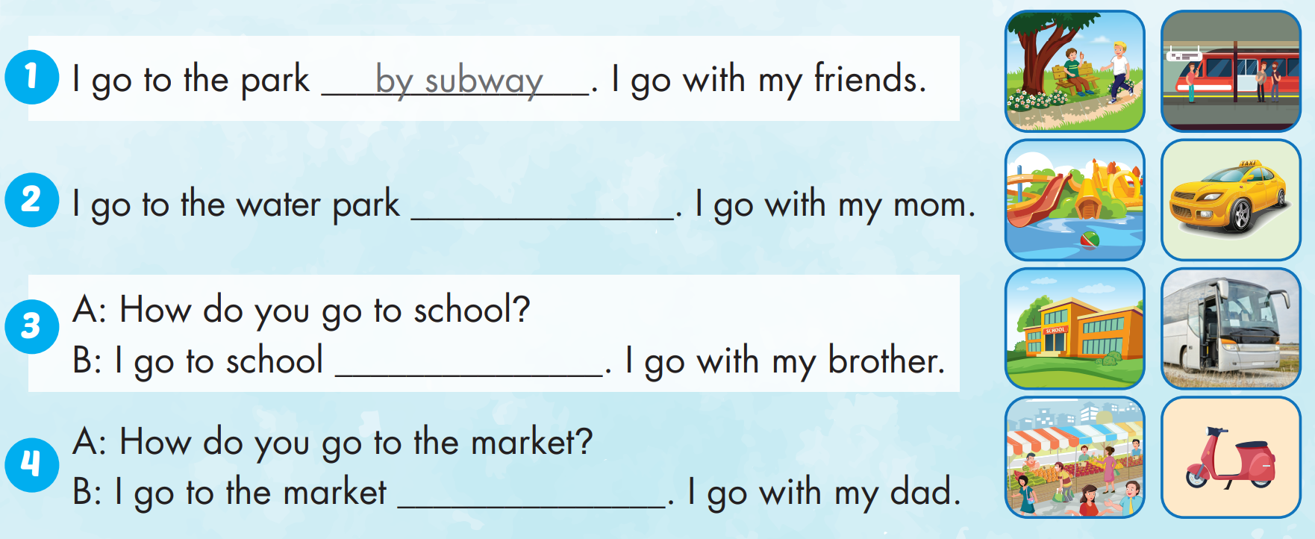
by taxi
by bus
by motorbike

Slide 39

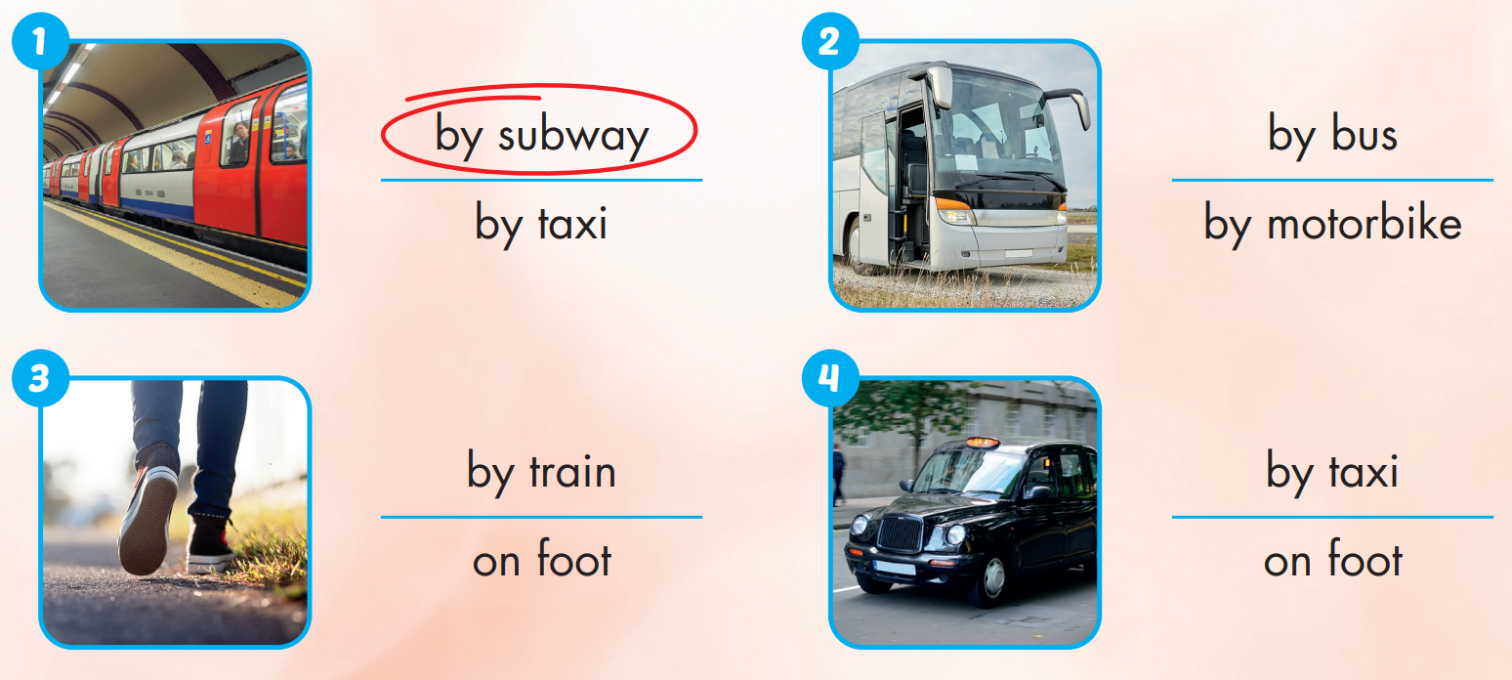

Extra Practice
WB, page 48

Slide 40

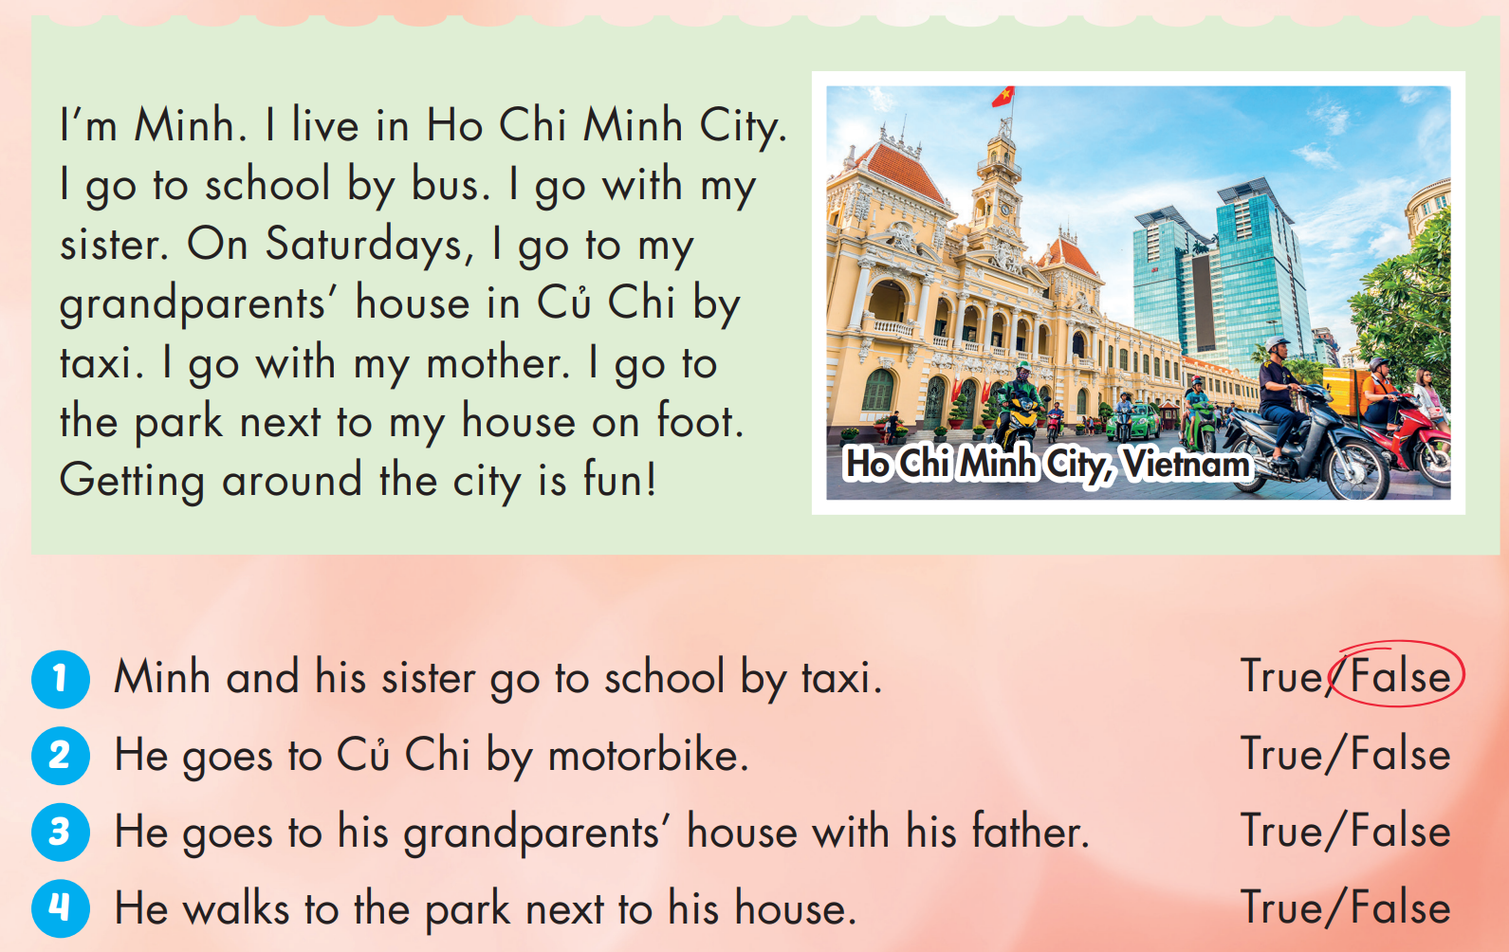
Extra Practice
WB, page 48

Slide 41

Production

Slide 42

CONSOLIDATION

Slide 43

WRAP-UP

Slide 44
Today’s lesson
Structures/ Sentence patterns
How do you go to school?
- I go to school by motorbike. I go with my dad.
How do you go to the library?
- I go to the library on foot. I go with my mom.
Vocabularies
by motorbike, by taxi, by subway, on foot, by bus, by train.

Slide 45
Homework
Practice the vocabularies and structure; and make sentences using them.
Do the exercises in Tiếng Anh 4 i-Learn Smart Start WB (page 48).
Do the exercises in Tiếng Anh 4 i-Learn Smart Start Notebook (page 31).
Prepare the next lesson (page 74 SB).
Play the consolidation games in Tiếng Anh 4 i-Learn Smart Start DHA App on www.eduhome.com.vn

Slide 46

Enjoy your day!

