Slide 1

Unit 5: Getting Around
Lesson 3.2
Page 71

Slide 2
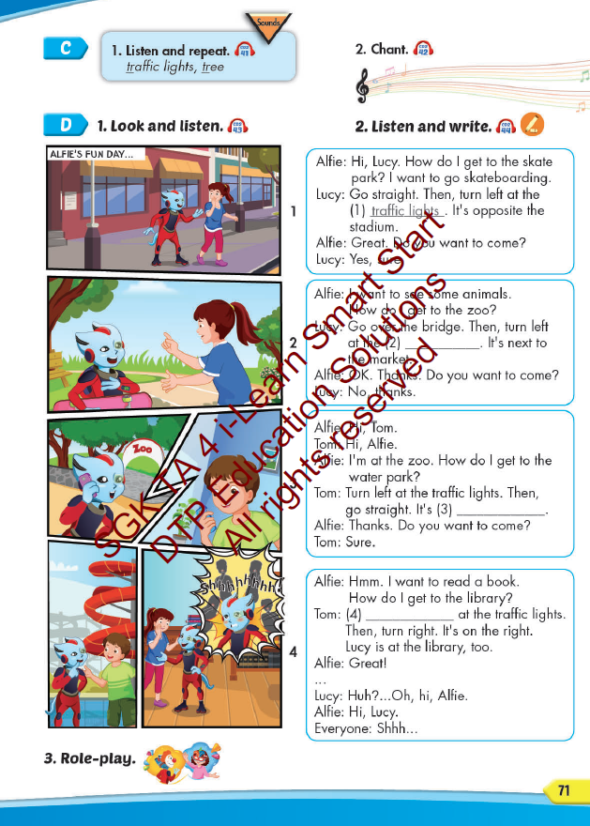
Lesson Outline
Warm-up
Listening
Consolidation
Wrap-up

Slide 3
Objectives
By the end of this lesson, students will be able to…
Vocabulary: Pronounce and use the words related to the topic properly: go straight, go over, traffic lights, corner, bridge, on the left, on the right.
Structure: How do I get to the swimming pool?
Go straight. Then, turn left. It's on the right.
Phonics: Identify the /tr/ sound. and practice the conversations.

Slide 4
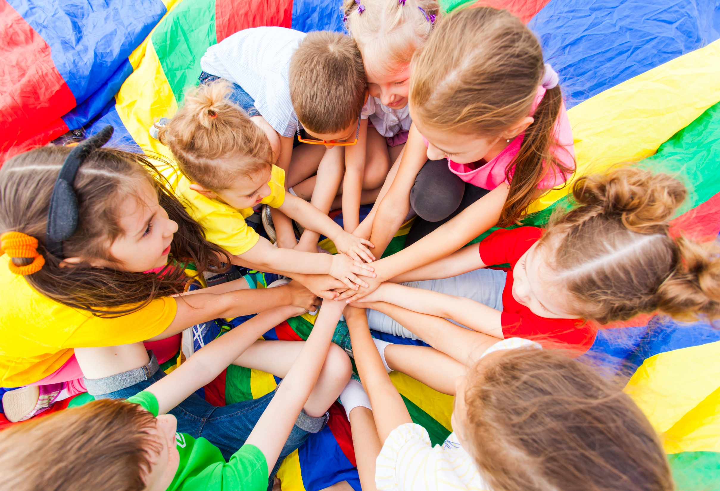
WARM UP

Slide 5



Slide 6
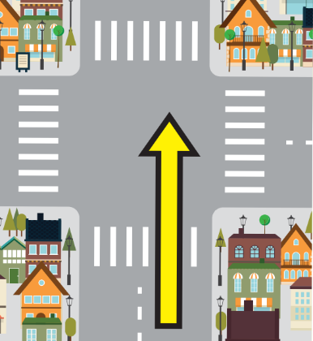
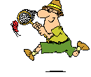

Click on the odd-one-out
go straight
go ahed
go over

Slide 7
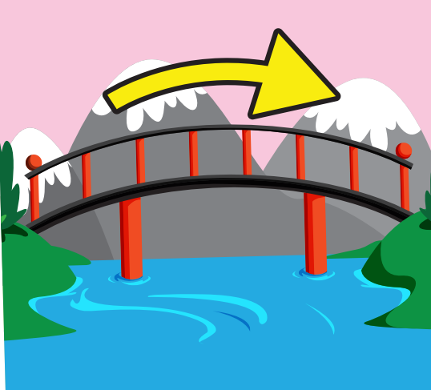
Click on the odd-one-out
go over
go straight
go around

Slide 8

Click on the odd-one-out
corner
go over
traffic lights

Slide 9
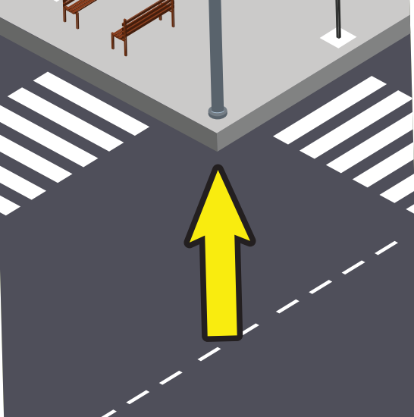
Click on the odd-one-out
corner
traffic lights
bridge

Slide 10

Click on the odd-one-out
bridge
go straight
on the left

Slide 11
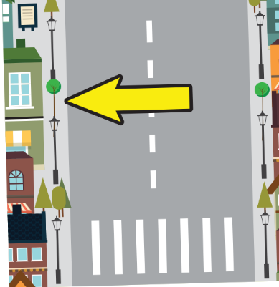
Click on the odd-one-out
on the right
corner
on the left

Slide 12

It’s time to learn …

Slide 13
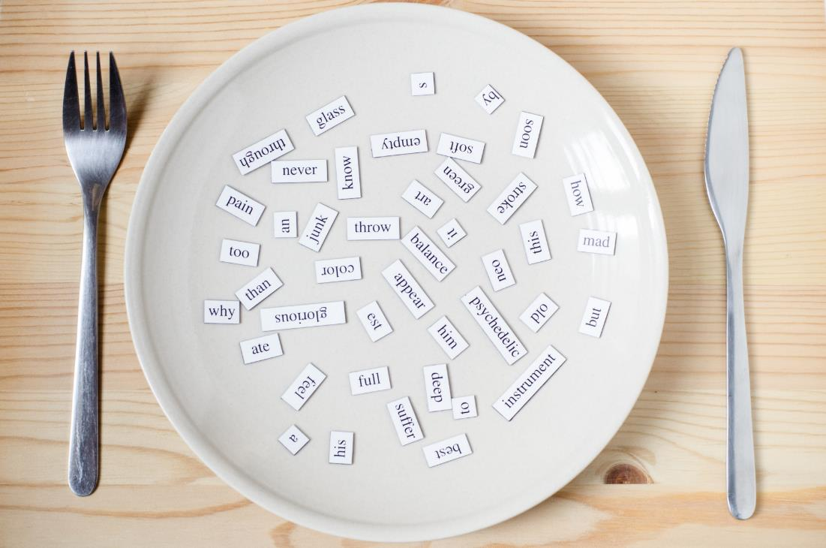
Phonics
/tr/

Slide 14
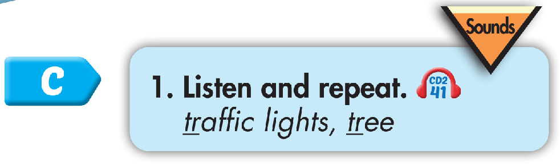

Click CD1 track 10 to hear the sound.
tr tr traffic lights
tr tr tree

Slide 15
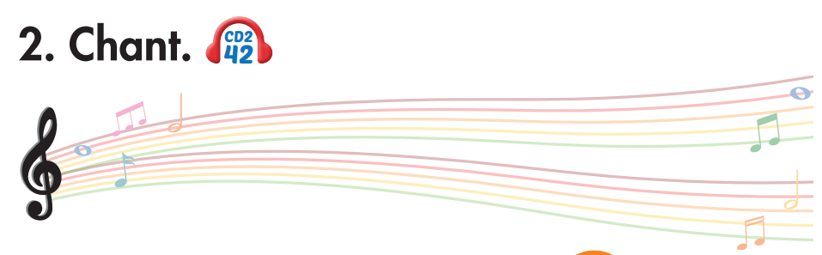
Track 42
Which way is Green Street?
Which way is Green Street?
Turn right at the traffic lights.
Turn right at the traffic lights.
Which way is Orange Street?
Which way is Orange Street?
Go straight at the traffic lights.
Go straight at the traffic lights.
Click on the music note to hear the sound.

Slide 16

train
trouble
List the words with the same sound /tr/. Practice saying them with a partner.
truck
trend
travel
trade
trick
tradition

Slide 17

Listening

Slide 18
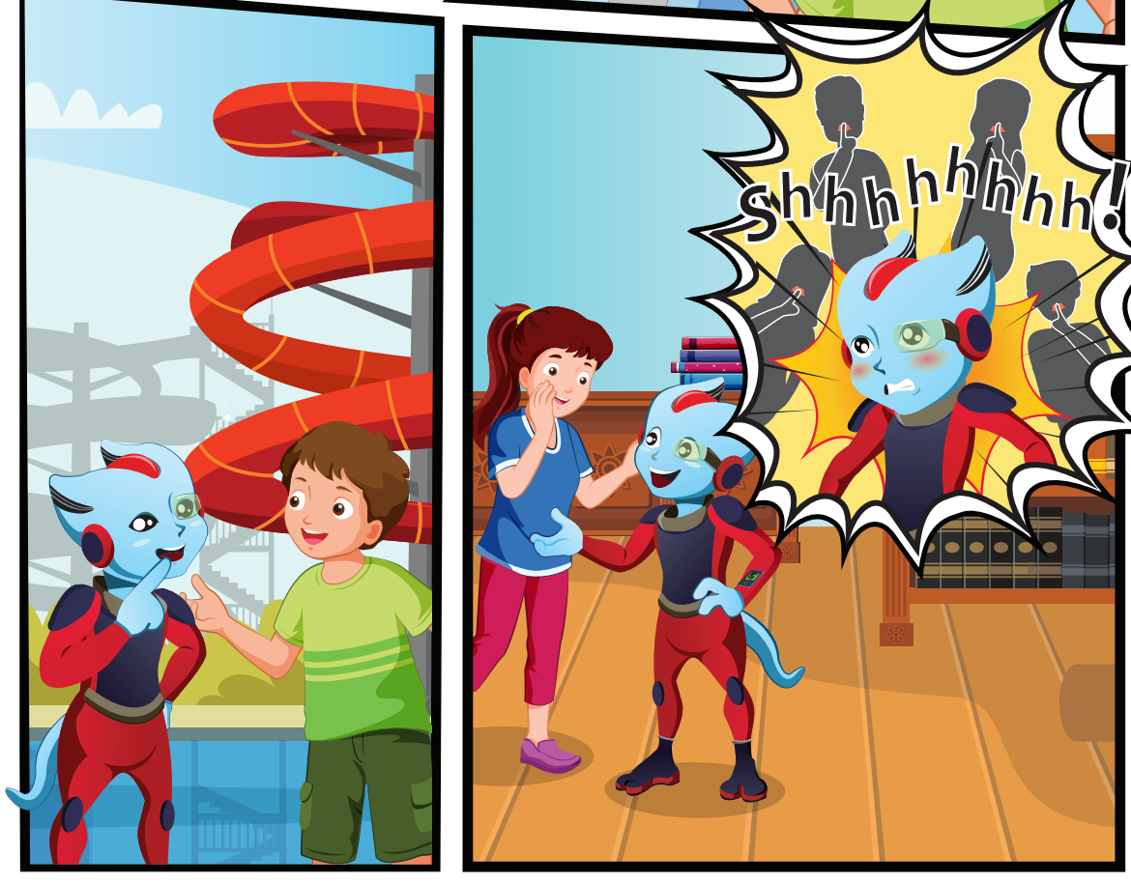
Look at the picture and answer.
Pre Listening
Who can you see?
Lucy, Alfie and Tom.

Slide 19
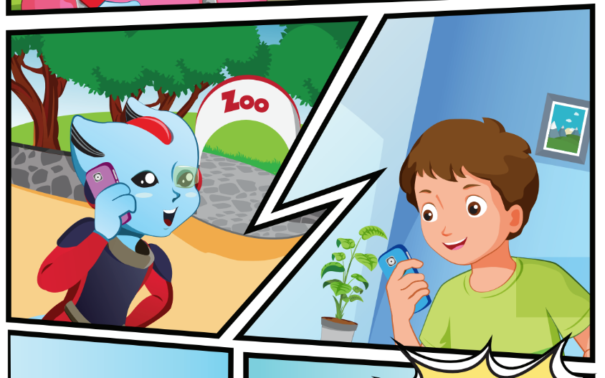
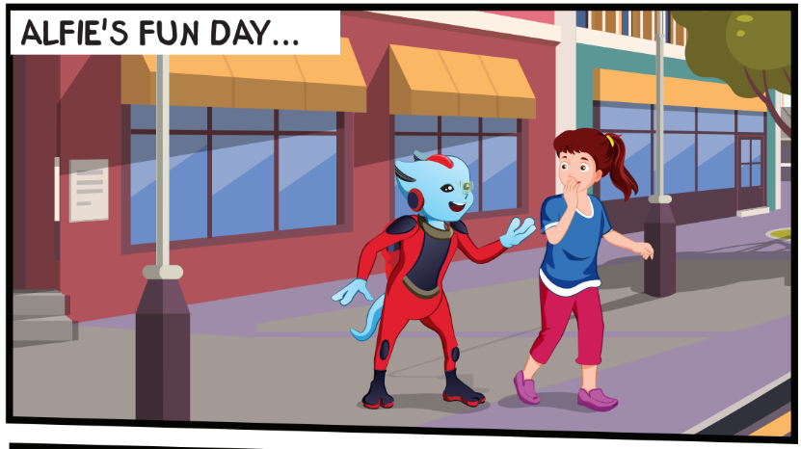

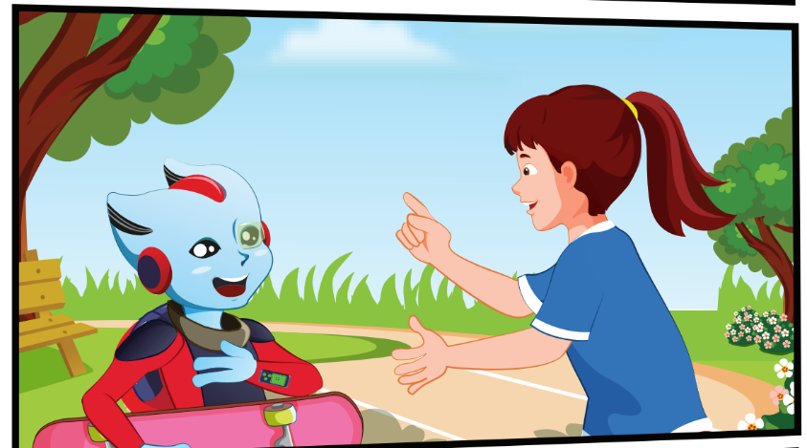
Look at the picture and answer.
Pre Listening
Where are they?
They're on the street, at the park, at the zoo,
at the water park.

Slide 20
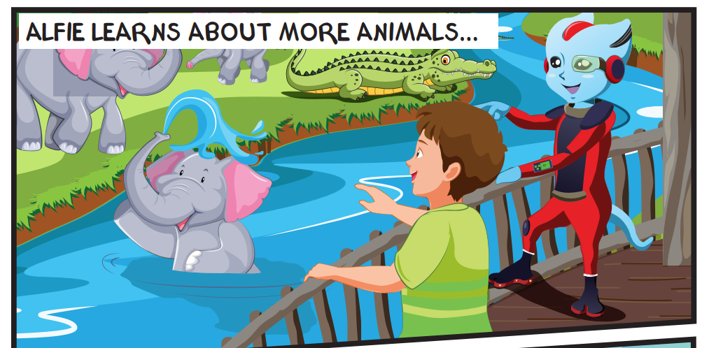
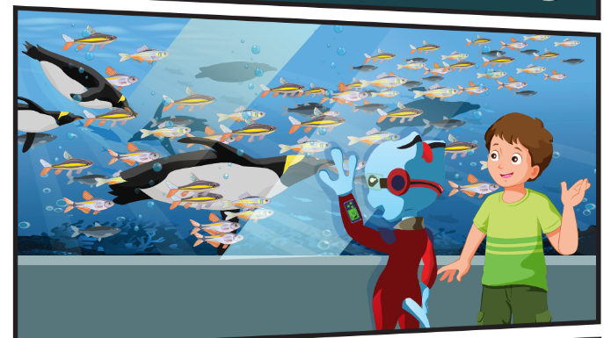
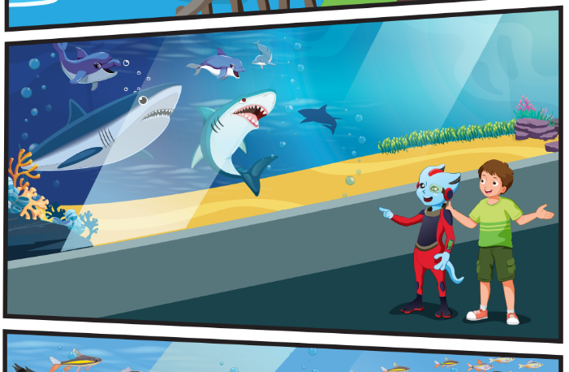
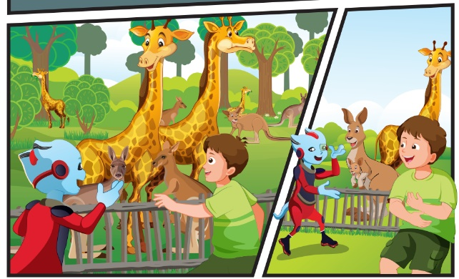
Look at the picture and answer.
Pre Listening
What can you see?
I can see sharks, dolphins, elephants, crocodiles,
penguins, fish, kangaroos, giraffes.

Slide 21

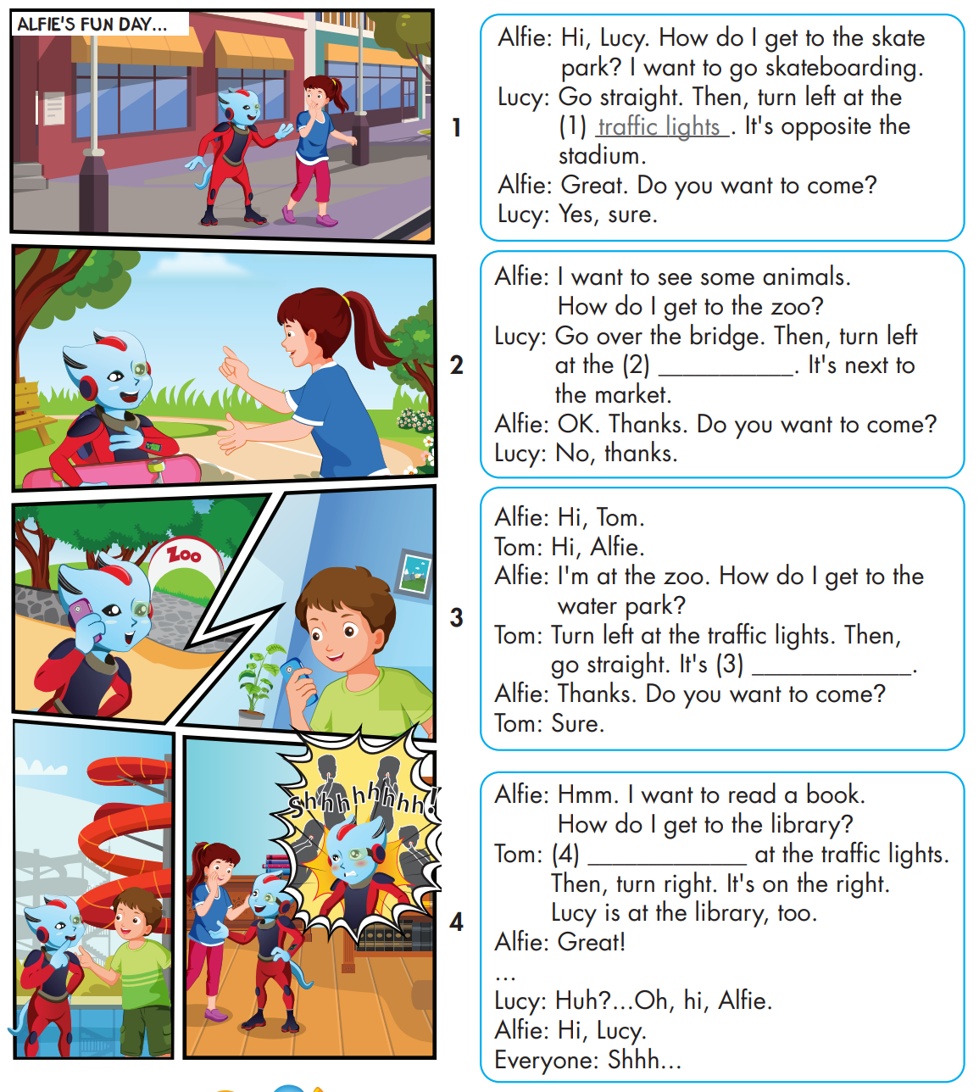
While Listening

Slide 22

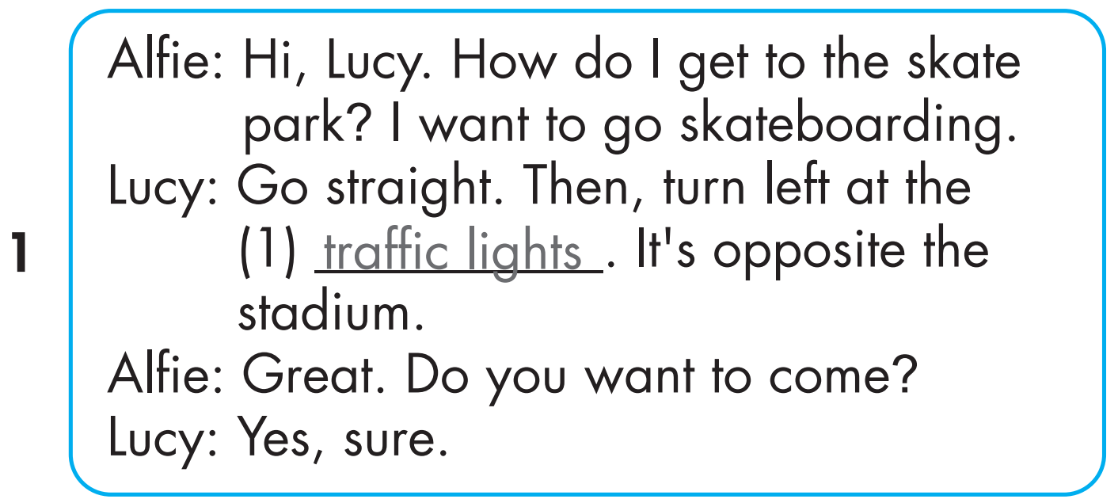
While Listening

Slide 23

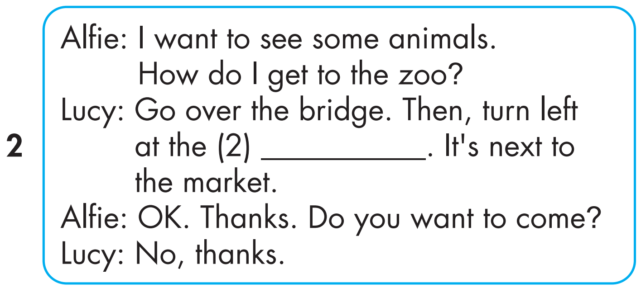
While Listening

Slide 24

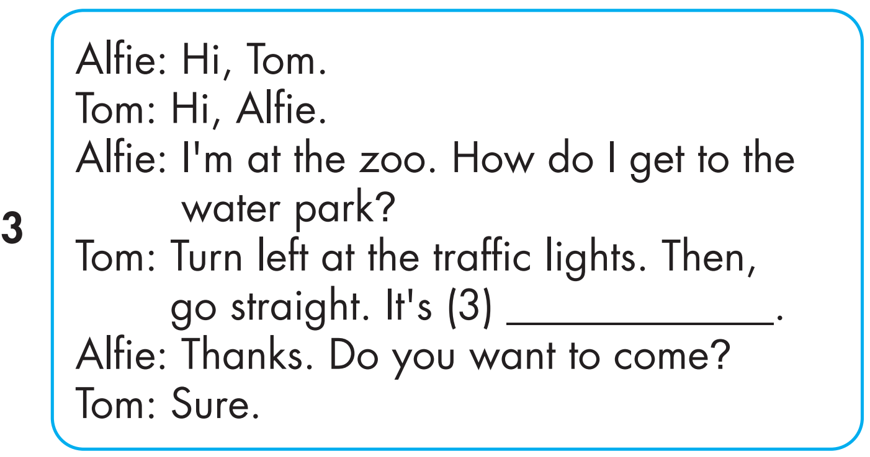
While Listening

Slide 25
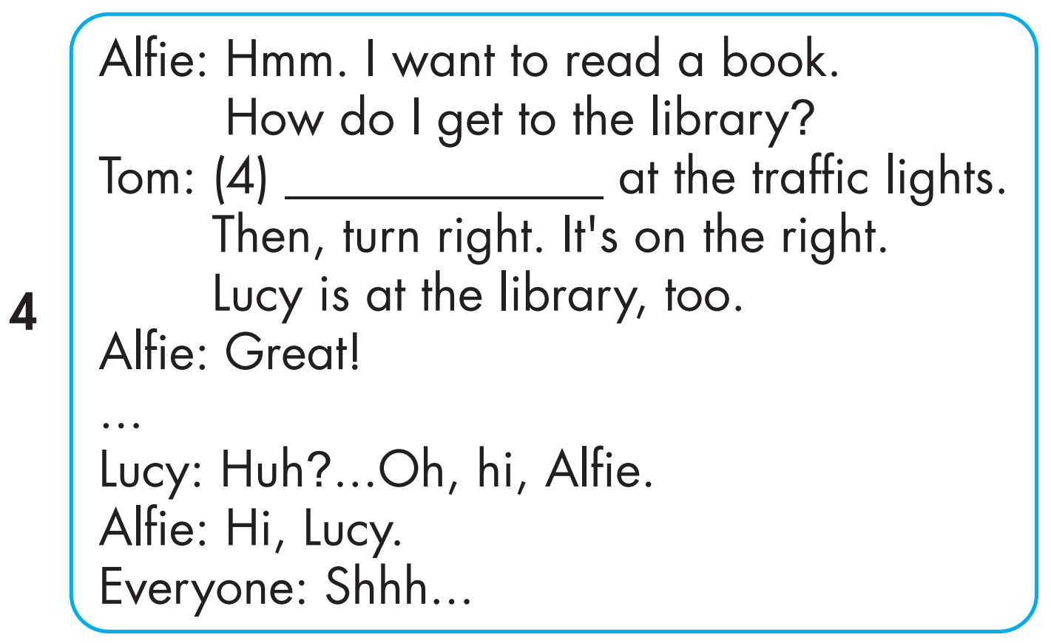
While Listening

Slide 26

Click on 4 numbers to hear each sentence.
While Listening
3
1
on the right
Go straight
4
2
corner

Slide 27

Post Listening

Slide 28

3
1
on the right
Go straight
4
2
corner

Slide 29

Production

Slide 30


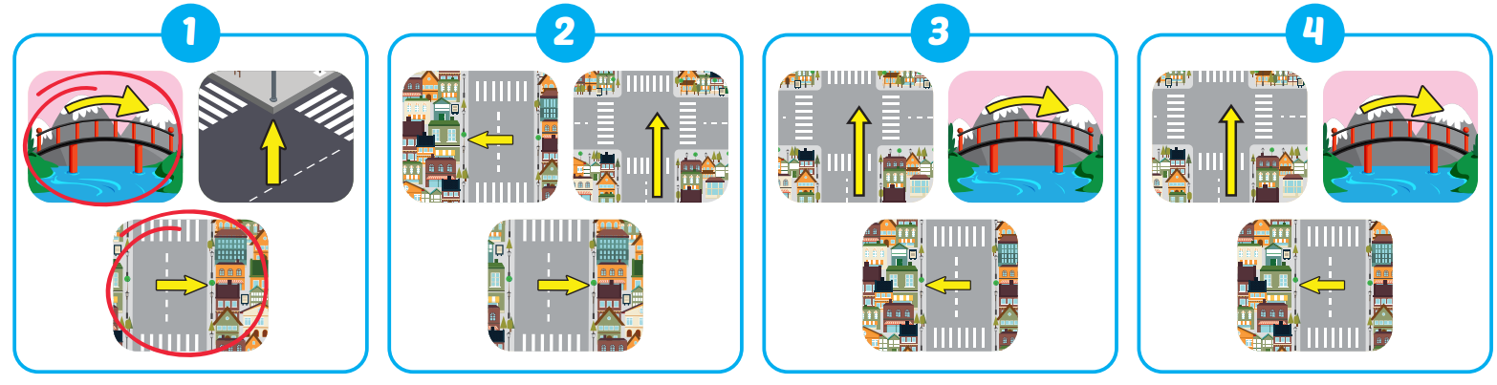
Extra Practice
WB, P. 47

Slide 31

WRAP-UP

Slide 32
Today’s lesson
Vocabularies
go straight, go over, traffic lights, corner, bridge, on the left, on the right.
Structures/ Sentence patterns
How do I get to the swimming pool? Go straight. Then, turn left. It's on the right.
Phonics
Phonics: Identify the /tr/ sound. and practice the conversations.

Slide 33
Homework
Practice the vocabularies and structure; and make sentences using them.
Do the exercises in Tiếng Anh 4 i-Learn Smart Start WB (page 47).
Do the exercises in Tiếng Anh 4 i-Learn Smart Start Notebook (page 30).
Prepare the next lesson (page 72 SB).
Play the consolidation games in Tiếng Anh 4 i-Learn Smart Start DHA App on www.eduhome.com.vn

Slide 34
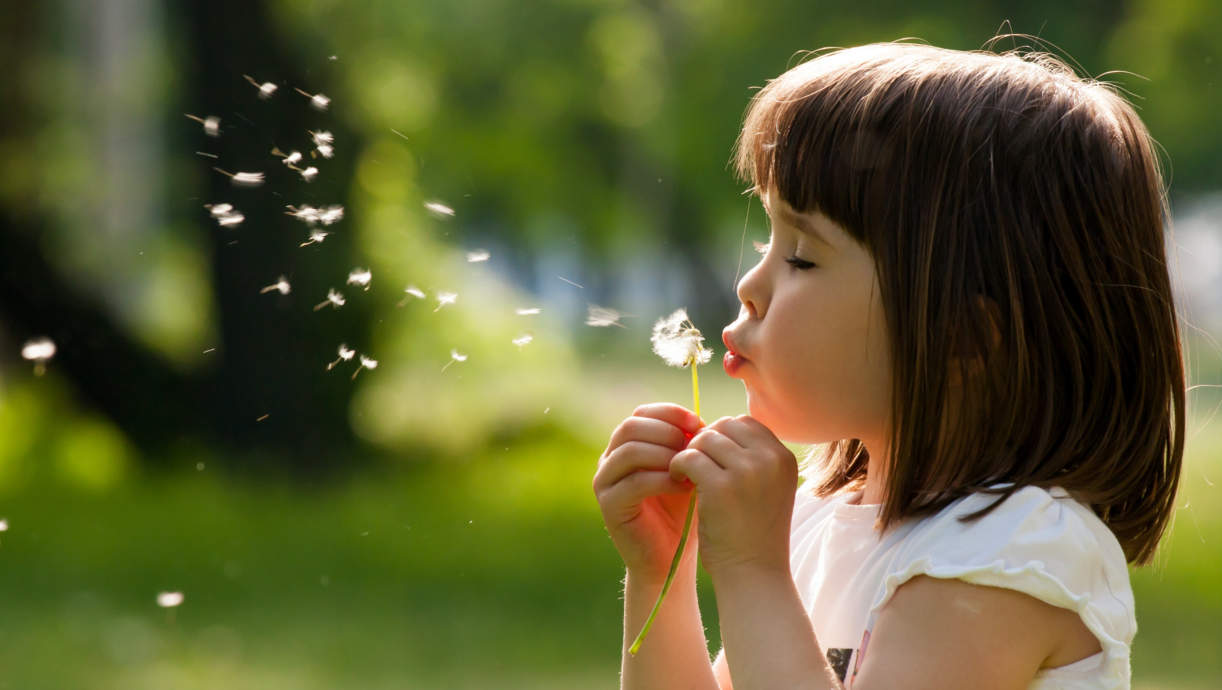
Enjoy your day!

