Slide 1
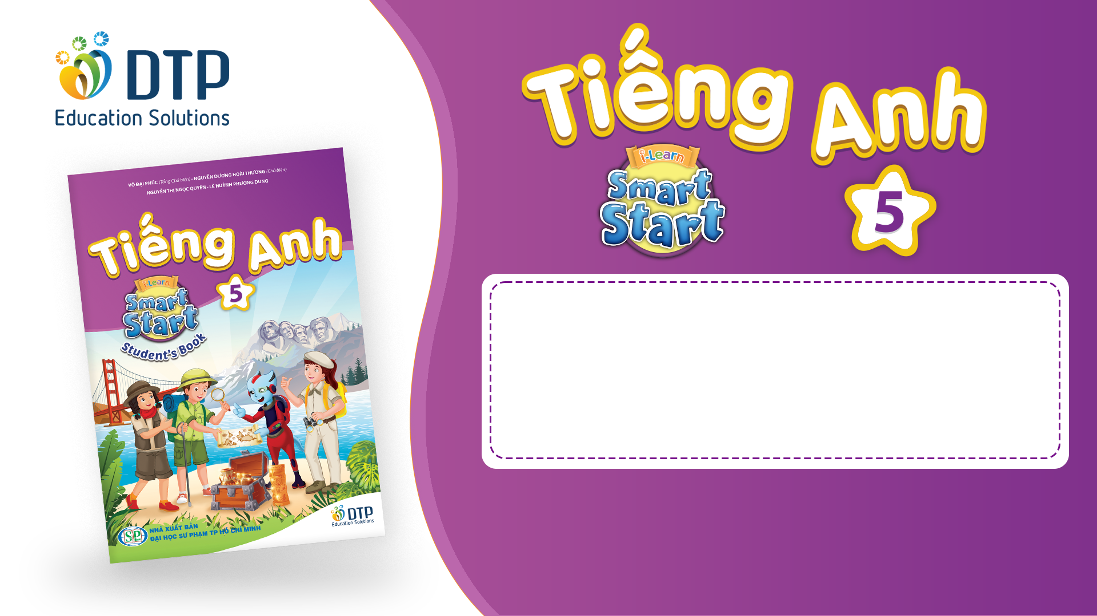
Unit 2: Holidays
Lesson 2.1
Page 23

Slide 2
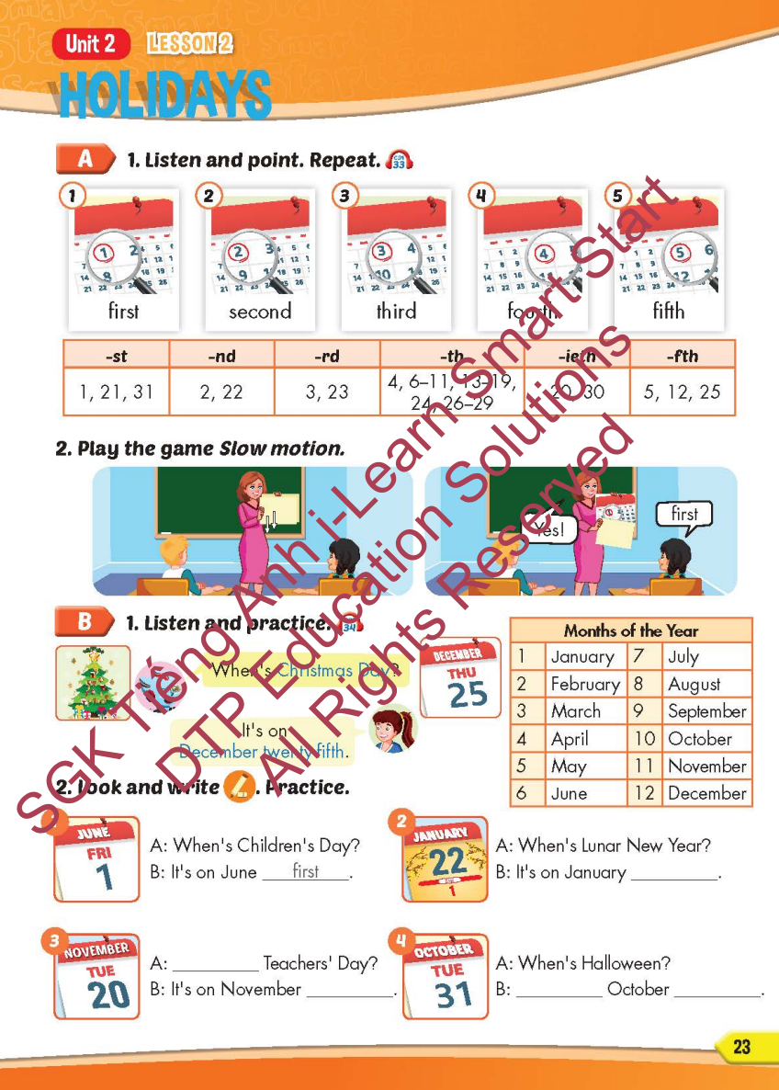
Lesson Outline
Warm-up
Vocabulary
Structure
Consolidation
Wrap-up

Slide 3
Objectives
By the end of this lesson, students will be able to…
Vocabulary: Pronounce and identify the words related to the topic properly: first, second, third, fourth, fifth
Structure: When's Christmas Day?
- It's on December twenty-fifth.

Slide 4
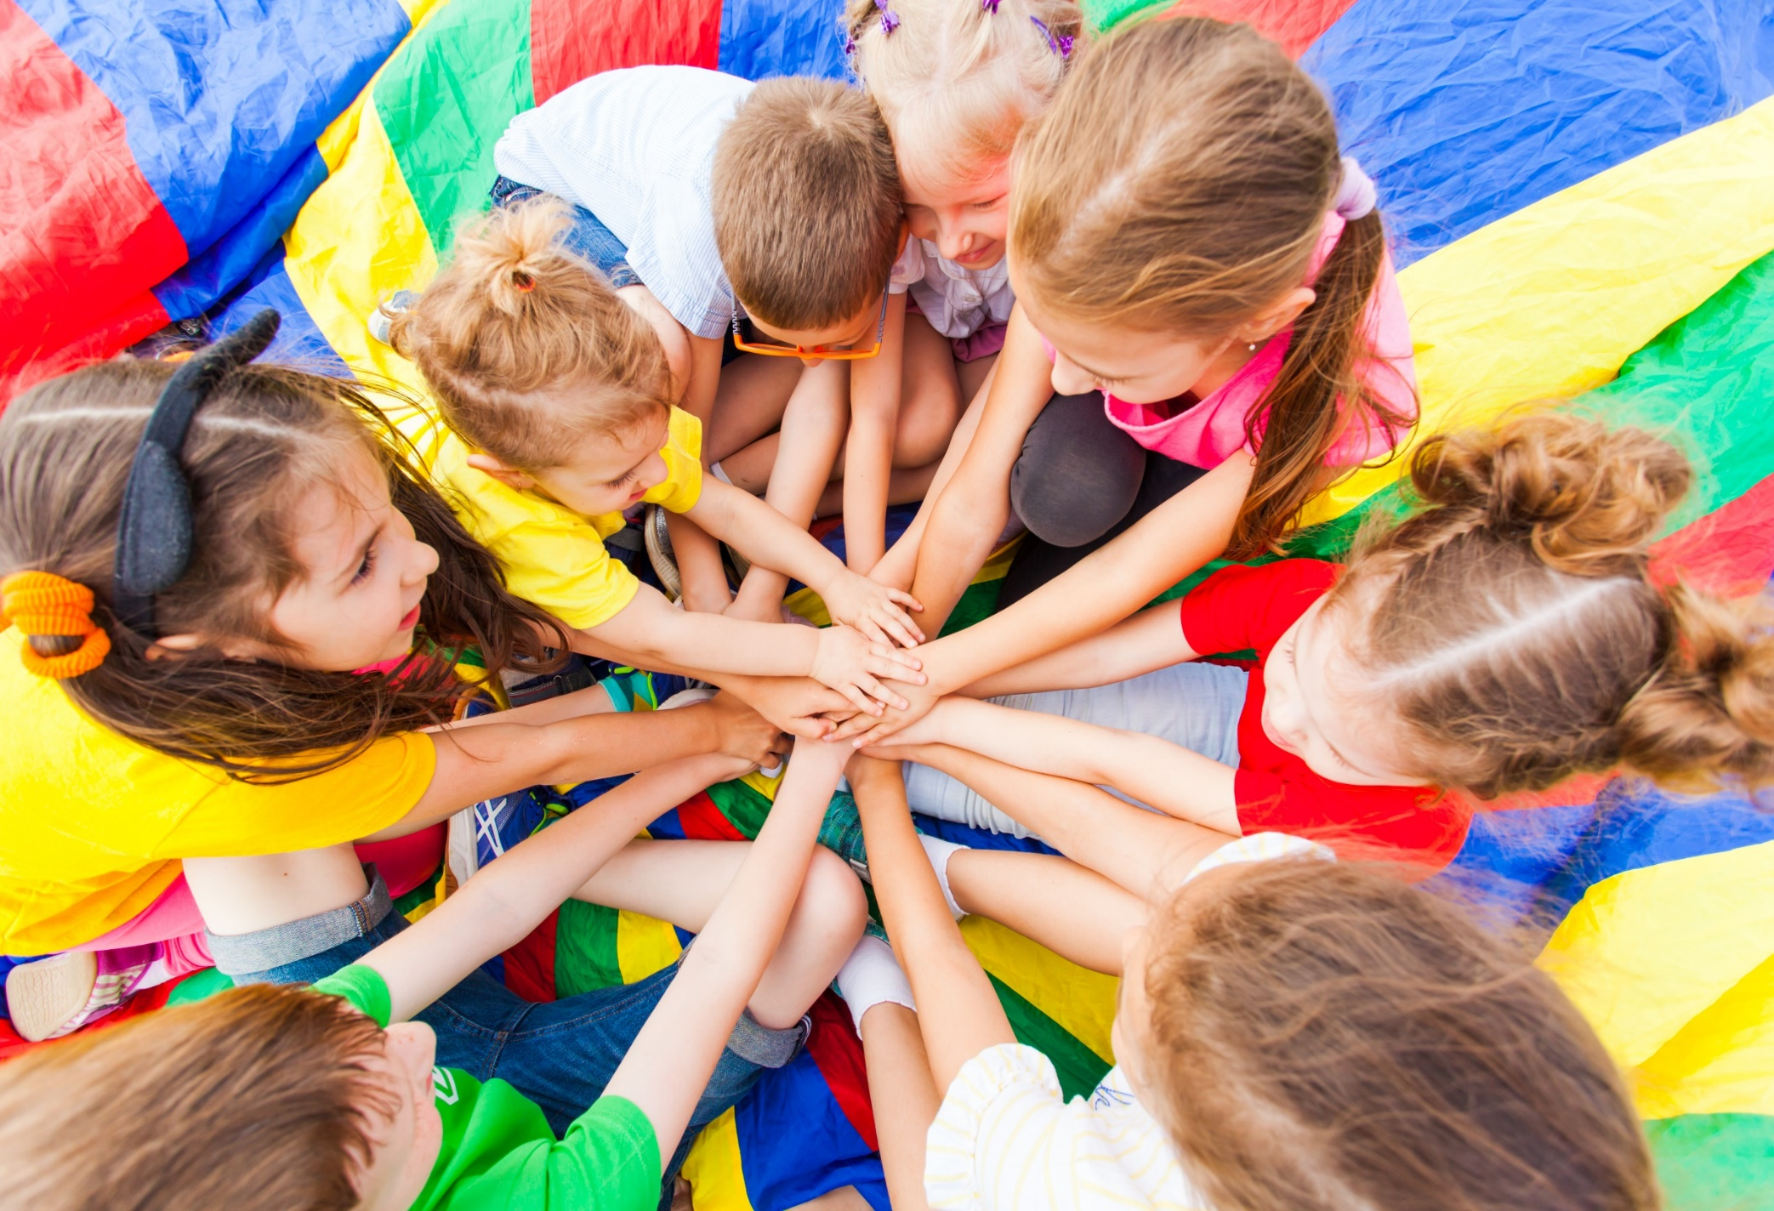
WARM-UP

Slide 5


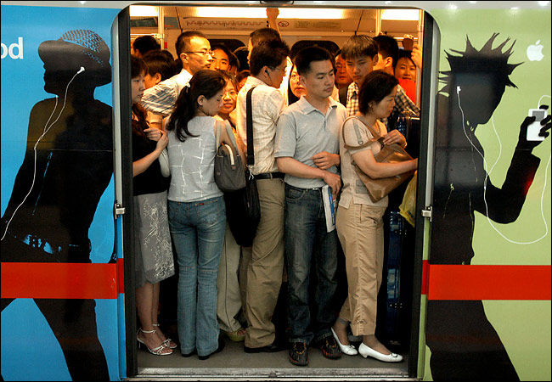
0
ORDINAL
NUMBERS

Slide 6
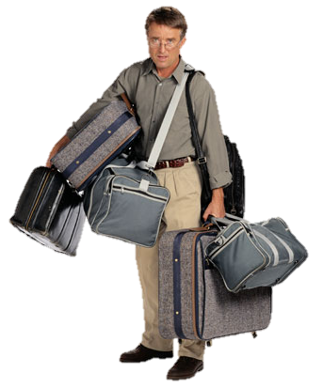
1 st
FIRST

Slide 7

2 nd
SECOND

Slide 8

3 rd
THIRD

Slide 9
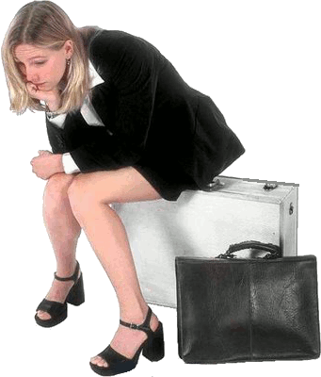
4 th
FOURTH

Slide 10

5 th
FIFTH

Slide 11

6 th
SIXTH

Slide 12

7 th
SEVENTH

Slide 13
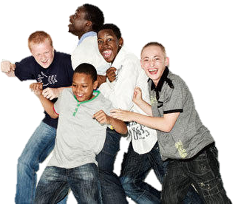
8 th
EIGHTH

Slide 14
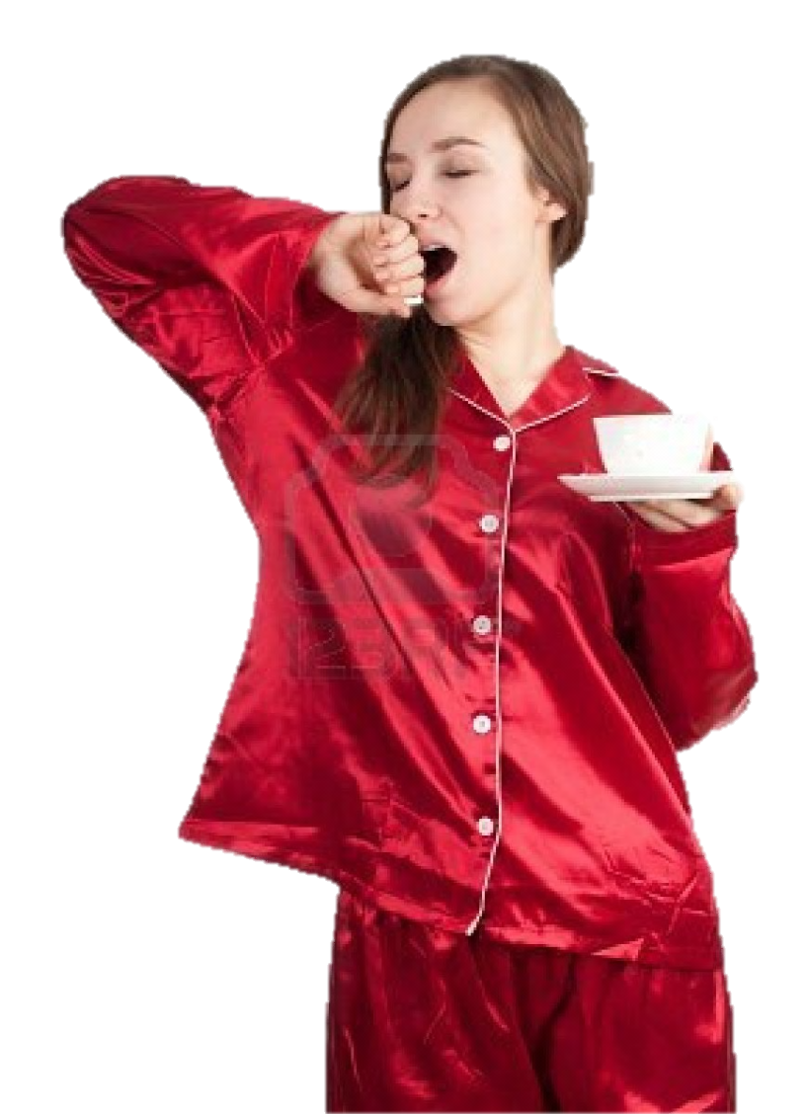
9 th
NINTH

Slide 15

10 th
TENTH

Slide 16

It’s time to learn …

Slide 17

New words
first, second, third,
fourth, fifth

Slide 18

Presentation

Slide 19


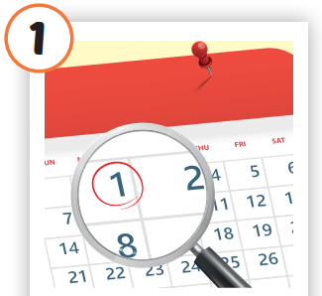
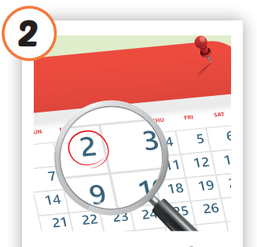
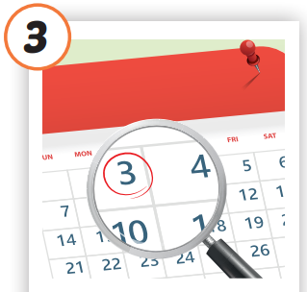
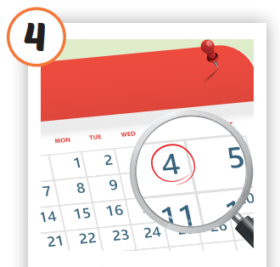
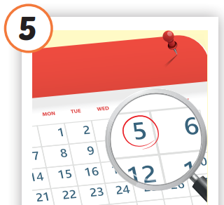


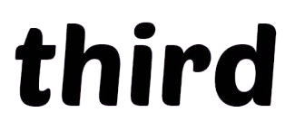


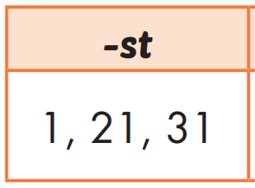
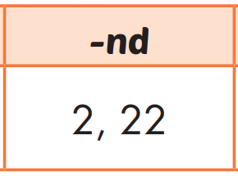
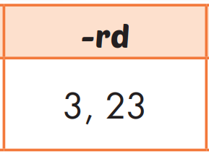
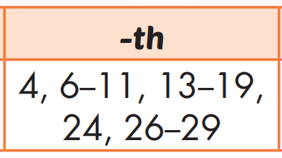
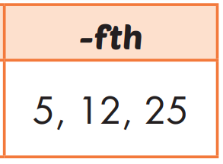
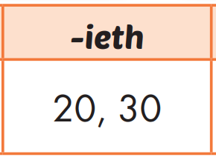
Click on each picture to hear the sound.
/fɜːrst/
thứ nhất
/fɔːrθ/
thứ tư
/fɪfθ/
thứ năm
/ˈsekənd/
thứ hai
/θɜːrd/
thứ ba
Notes:
Click vào hình A. 1. Listen and point. Repeat để cho cả audio full chạy

Slide 20

/fɜːrst/
thứ nhất

Slide 21

/ˈsekənd/
thứ hai

Slide 22

/θɜːrd/
thứ ba

Slide 23

/fɔːrθ/
thứ tư

Slide 24
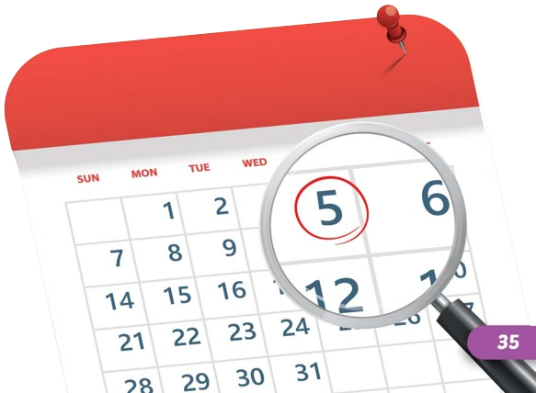
/fɪfθ/
thứ năm

Slide 25
Practice

Slide 26
Check your memory

Slide 27



Help me, please! I’m going to the third floor
11
12
9
10
7
8
5
6
3
4
1
2

Slide 28
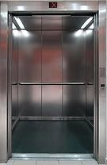
3 rd
third
Thank you!

Slide 29
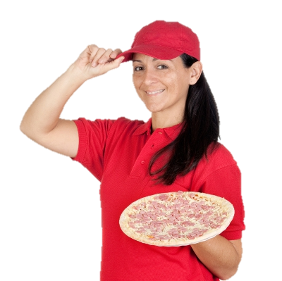
I’m going to the fifth floor
11
12
9
10
7
8
5
6
3
4
1
2

Slide 30

5 th
fifth
Thank you!

Slide 31

I’m going to the ninth floor
11
12
9
10
7
8
5
6
3
4
1
2

Slide 32
9 th
ninth
Thank you!

Slide 33
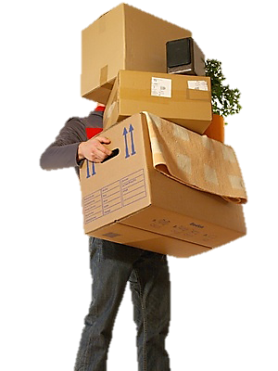
I’m going to the second floor
11
12
9
10
7
8
5
6
3
4
1
2

Slide 34
2 nd
second
Thank you!

Slide 35
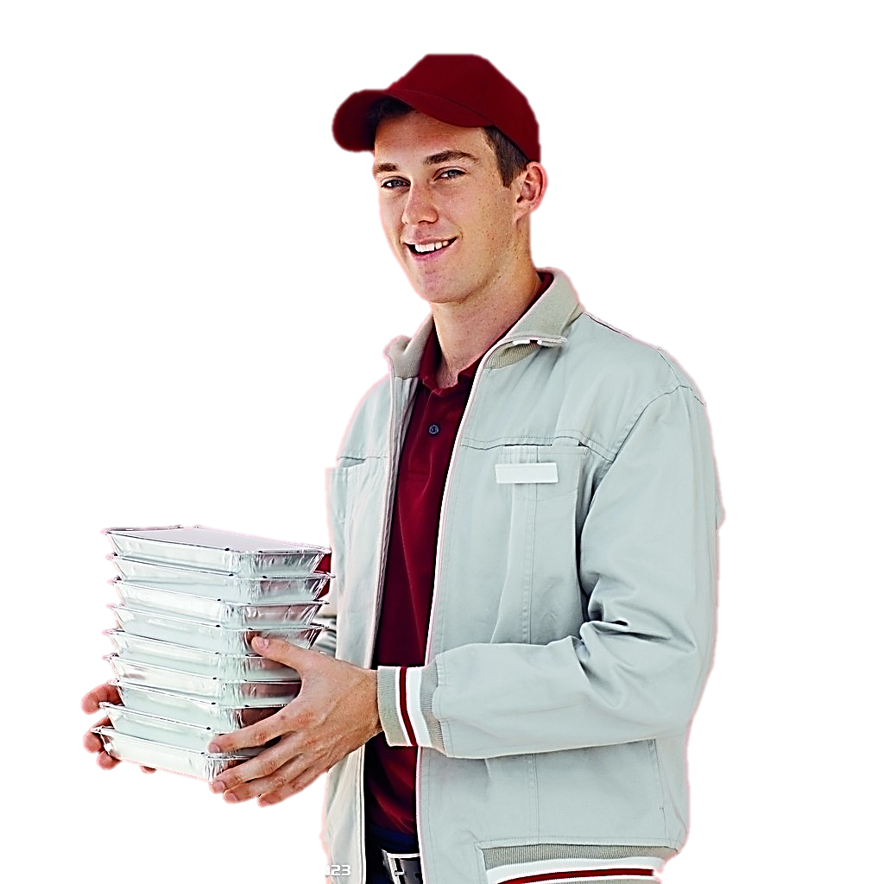
I’m going to the first floor
11
12
9
10
7
8
5
6
3
4
1
2

Slide 36
1 st
first
Thank you!

Slide 37
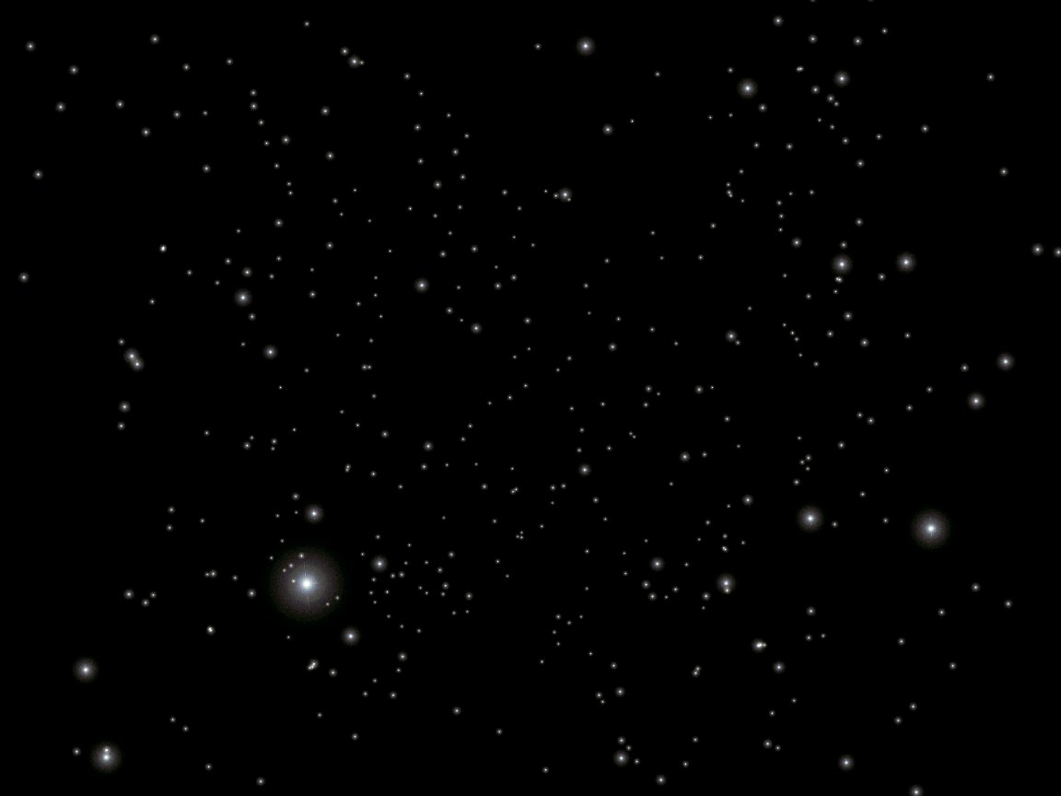
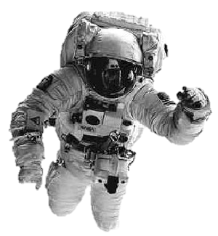
What floor are we on?
?

Slide 38
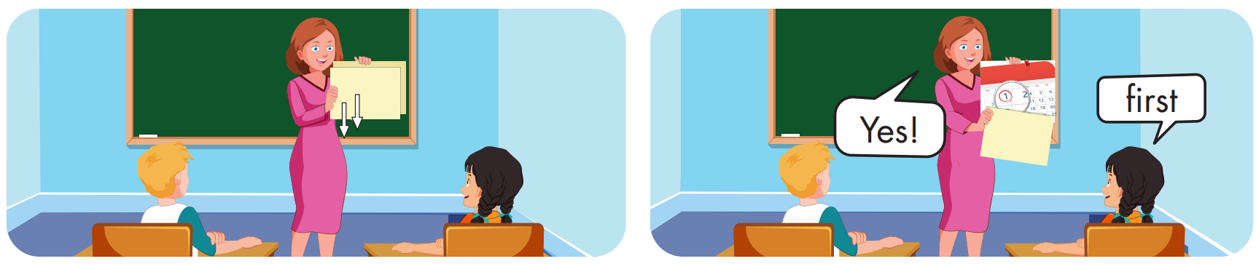

Slide 39
Structure
When's Christmas Day?
- It's on December twenty-fifth.

Slide 40
Presentation

Slide 41
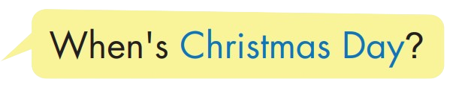
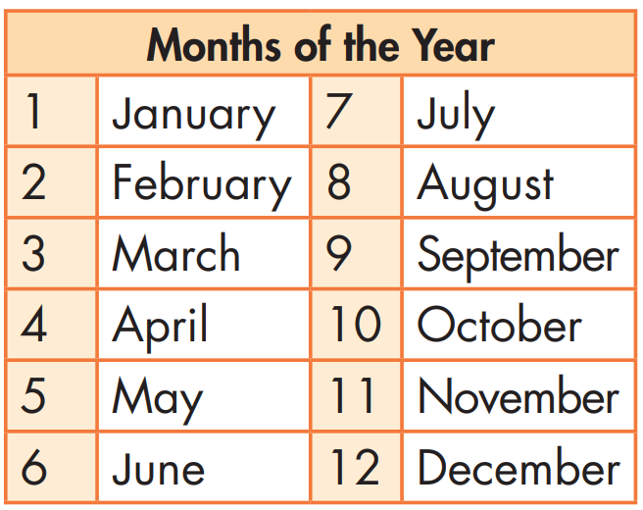



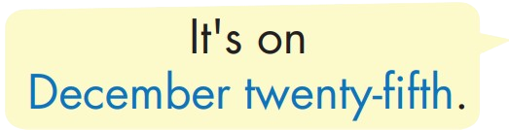

Structure

Slide 42

Practice

Slide 43


Slide 44
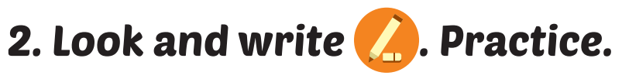
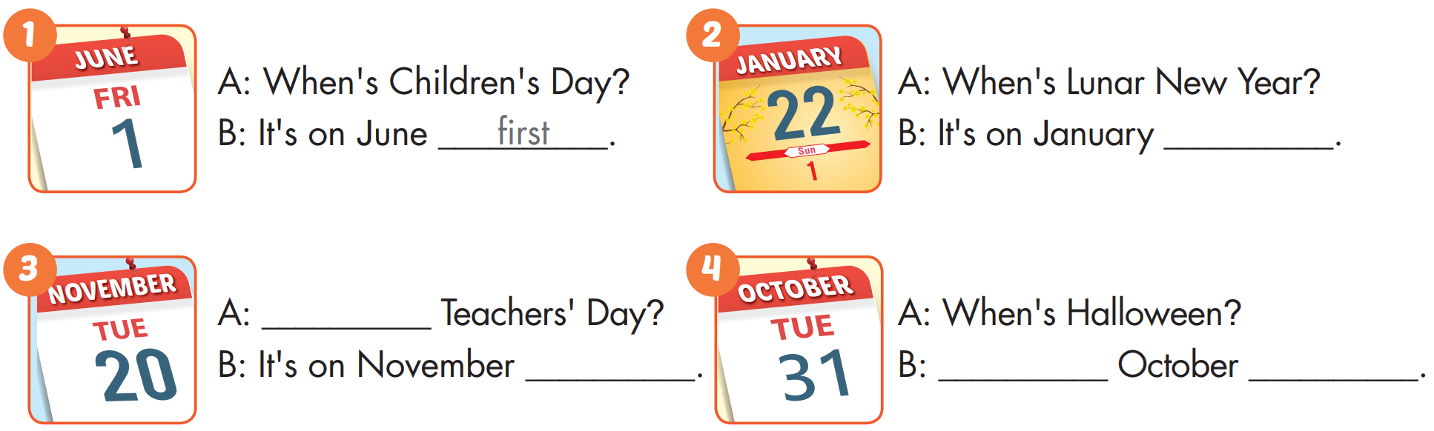
twenty-second
When's
twentieth
It's on
thirty-first

Slide 45

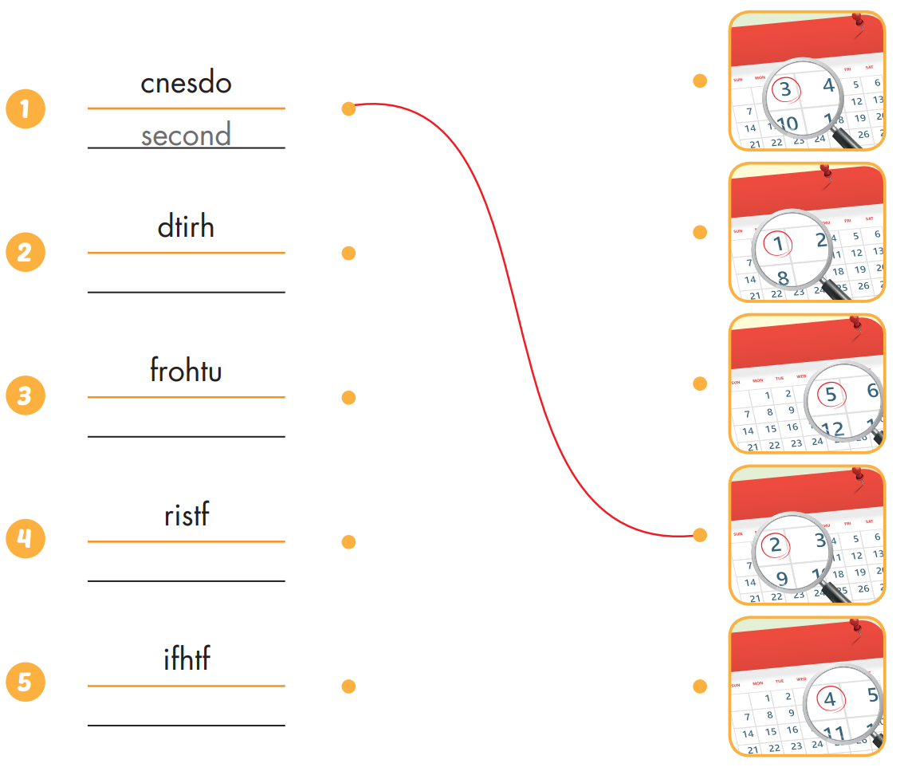
Extra Practice
WB, page 14
third
fourth
first
fifth

Slide 46

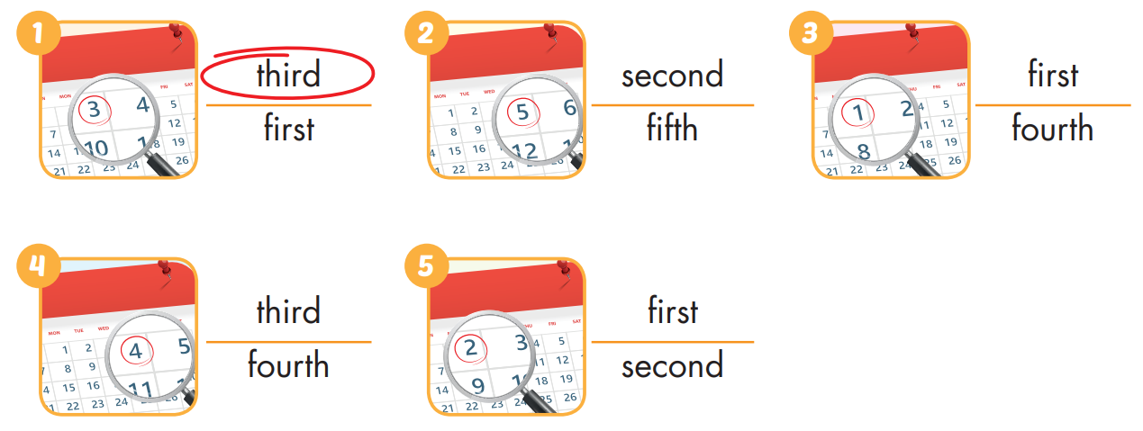
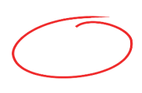
Extra Practice
WB, page 14

Slide 47

Production

Slide 48

CONSOLIDATION

Slide 49

WRAP-UP

Slide 50
Today’s lesson
Vocabularies
first, second, third, fourth, fifth
Structures/ Sentence patterns
When's Christmas Day?
- It's on December twenty-fifth.

Slide 51
Homework
Practice the vocabularies and structure, and make sentences using them.
Do the exercises in Tiếng Anh 5 i-Learn Smart Start WB (page 14)
Do the exercises in Tiếng Anh 5 i-Learn Smart Start Notebook (page 11)
Prepare the next lesson (page 24 SB)
Play the consolidation games in Tiếng Anh 5 i-Learn Smart Start DHA App on www.eduhome.com.vn

Slide 52
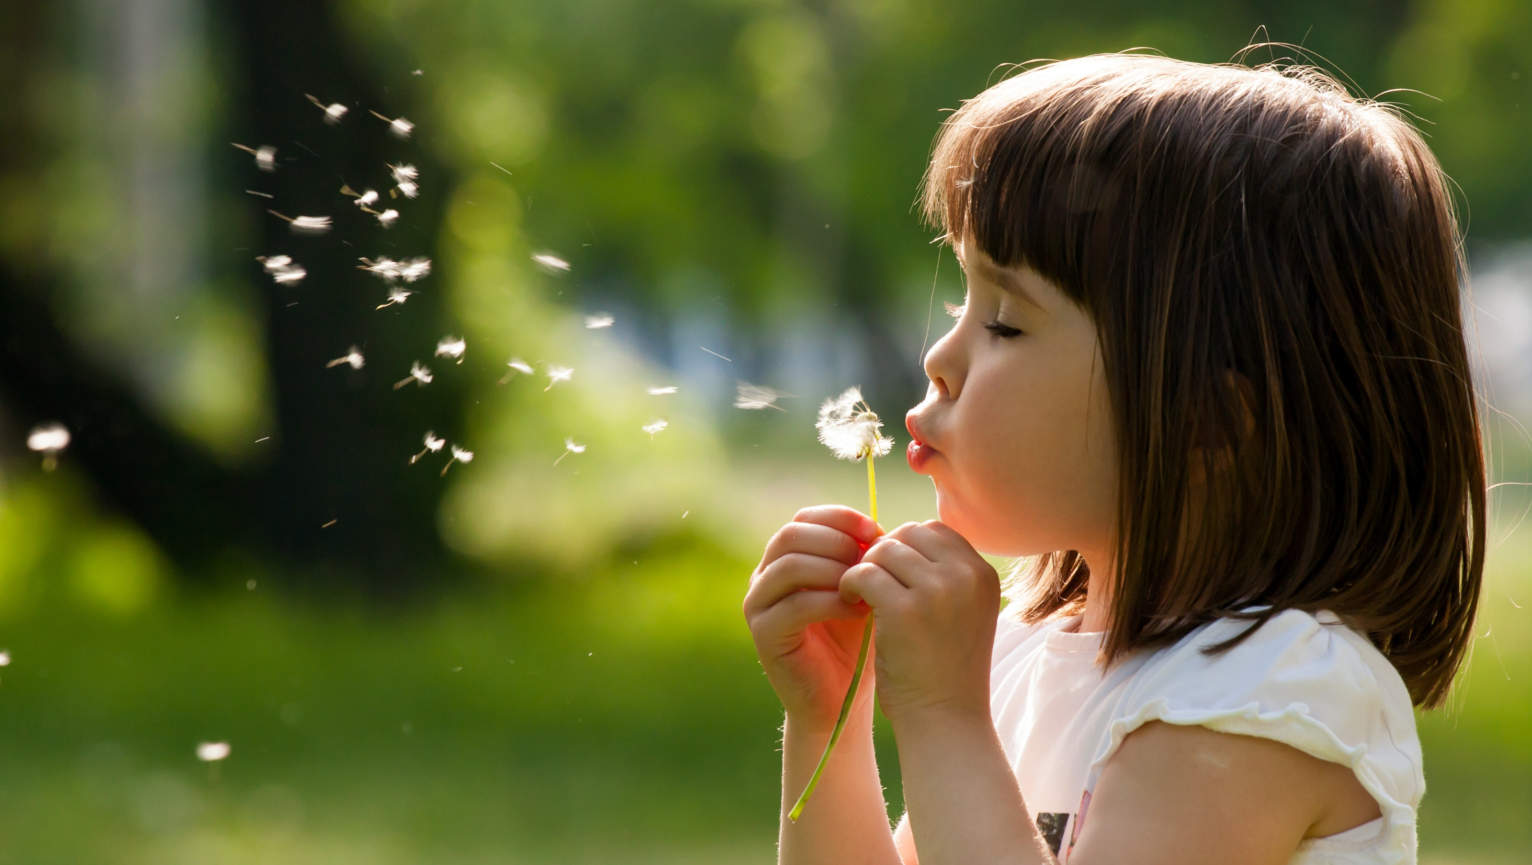
Enjoy your day!

Slide 53

Lesson 3
Stay positive and have a nice day!

