Slide 1
Welcome to my class

Slide 2
Tuesday, 13th December 2022
Unit 9: What did you see
at the zoo?
Lesson 3

Slide 3
Check the last words

Slide 4

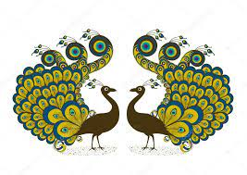


What did you see at the zoo?
I saw ………..
peacocks
pythons
a peacock

Slide 5

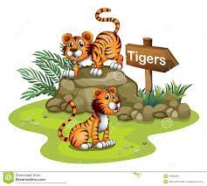
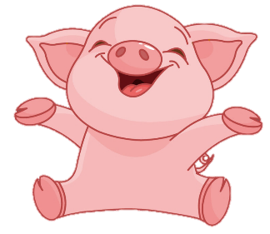
What did the ……… do when you were there?
Back
tigers
lions
tiger

Slide 6
I saw pandas at the zoo.
They ate ……… .
Back
fast
beautifully
slowly

Slide 7
I ……… the pythons yesterday.
see
sees
saw

Slide 8
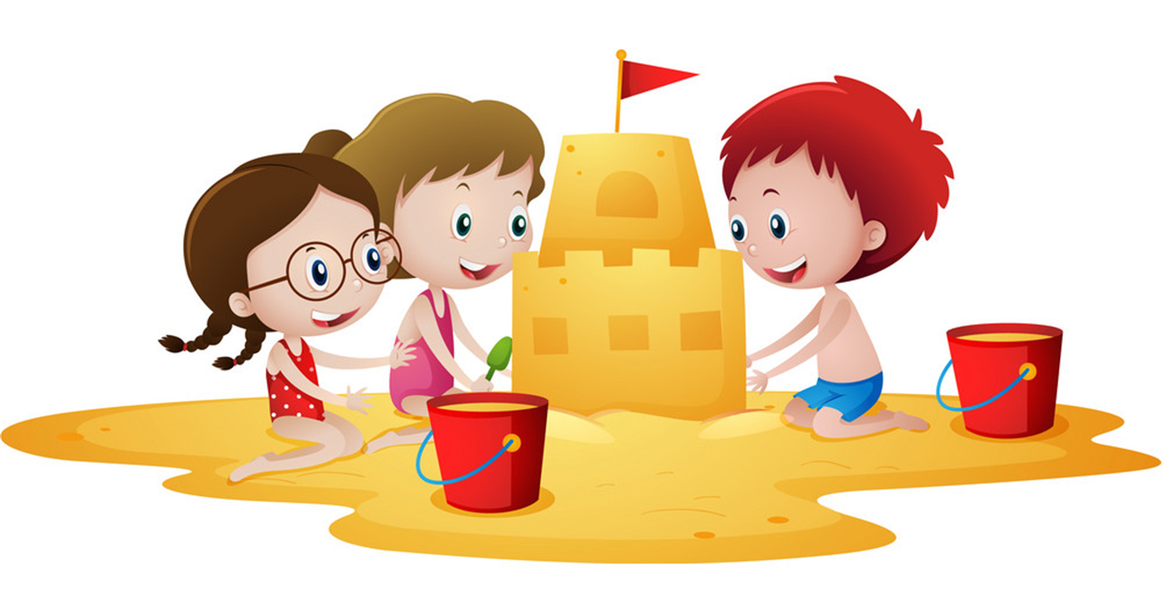
What are your favourite animals?
They are ……. .
Back
pandas
peacock
lion

Slide 9
PRONUNCIATION

Slide 10

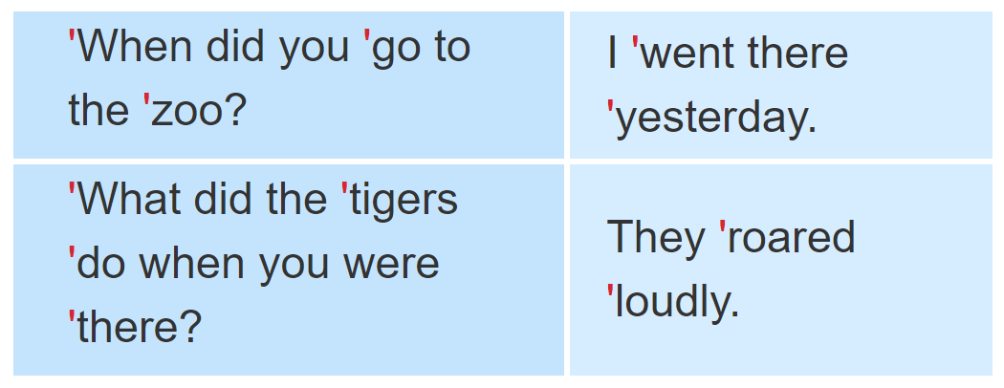
1. Listen and repeat.

Slide 11
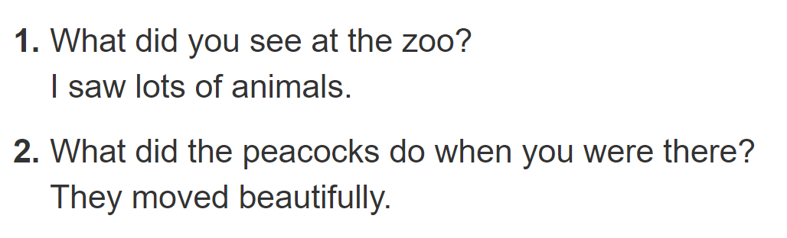

2. Listen and underline the stressed words. Then say the sentences aloud.

Slide 12
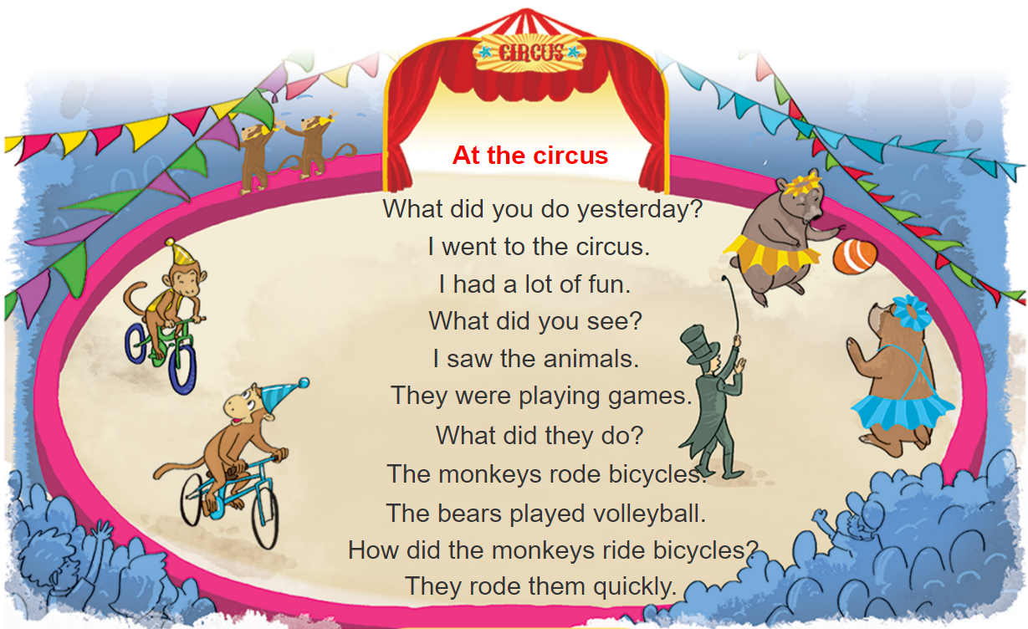



3. Let’s chant

Slide 13
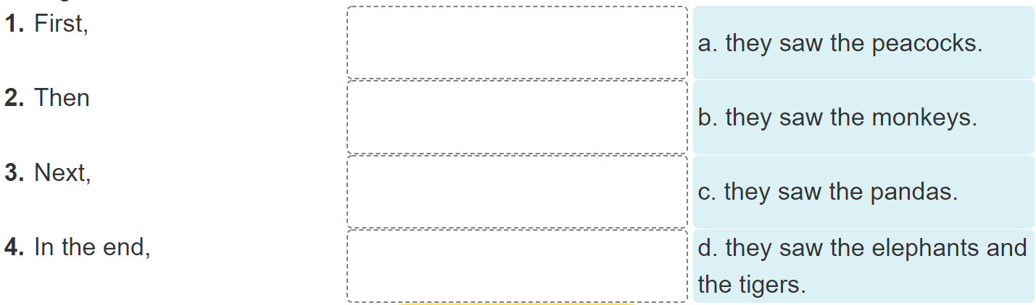
4. Read and complete

Slide 14
4. Read and complete
Dear Tuan,
I went to the zoo with my classmates last Friday. First, we saw the monkeys. They were fun to watch because they jumped up and down quickly. Then we went to see the elephants. They moved slowly and quietly. We also saw the tigers. I liked them very much because they were fast. Next, we saw the peacocks. My classmates liked them because they moved beautifully. In the end, we saw the pandas. They were very cute and did everything slowly. I had a really good time at the zoo.
See you soon.
Best wishes,
Phong

Slide 15
4. Read and complete

Slide 16
5. Write about your last visit to the zoo
I went to the zoo with_________last _________.
At the zoo, I saw ________________________.
The _________ and the _________.
I think the animals at the zoo are ____________.

Slide 17
6. Project
Draw your dream zoo.

Slide 18
I
7, Homework
Read again part 1.
Do exercise in the workbook.
Prepare the next lesson.

