Slide 1
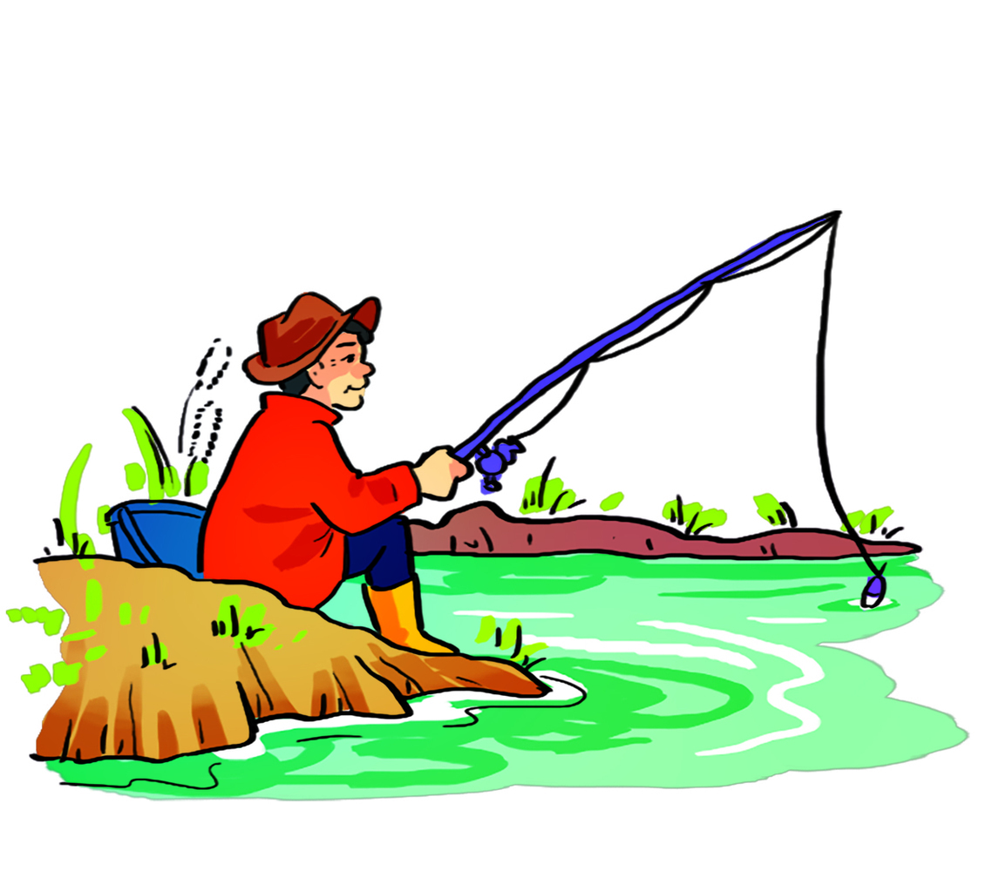
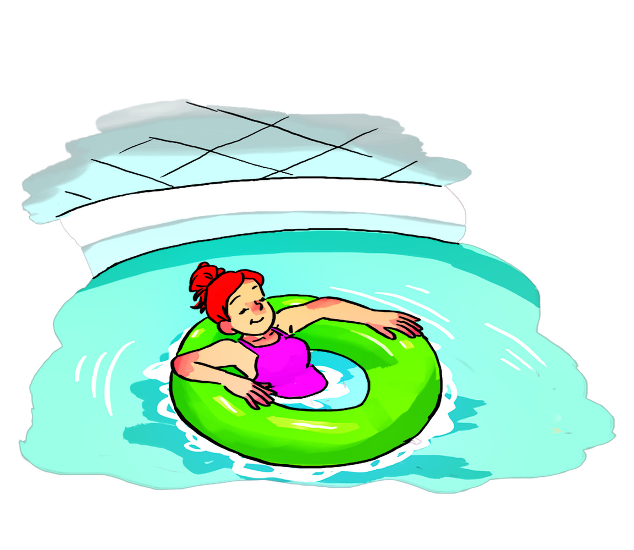
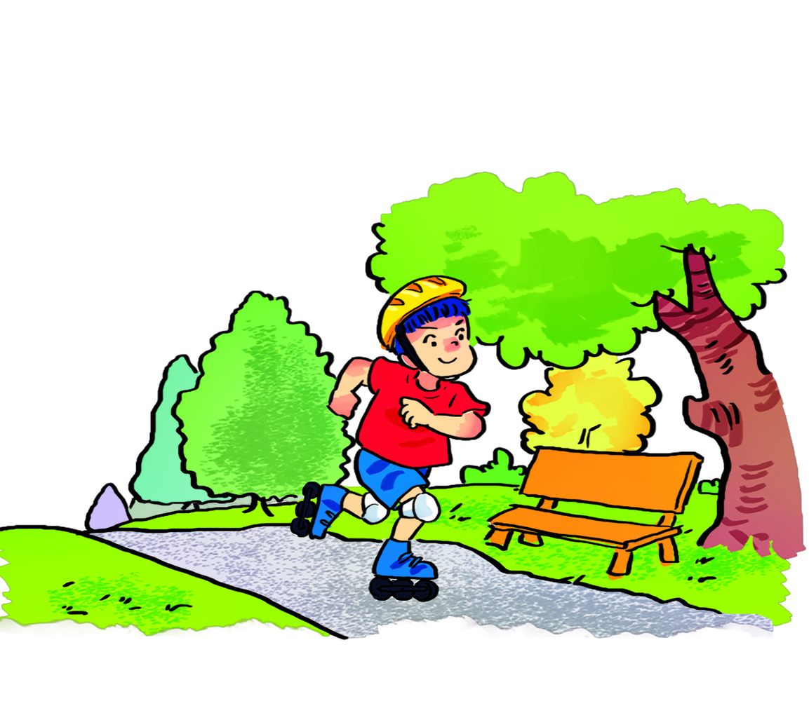
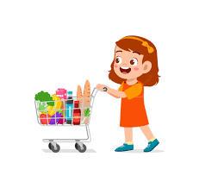

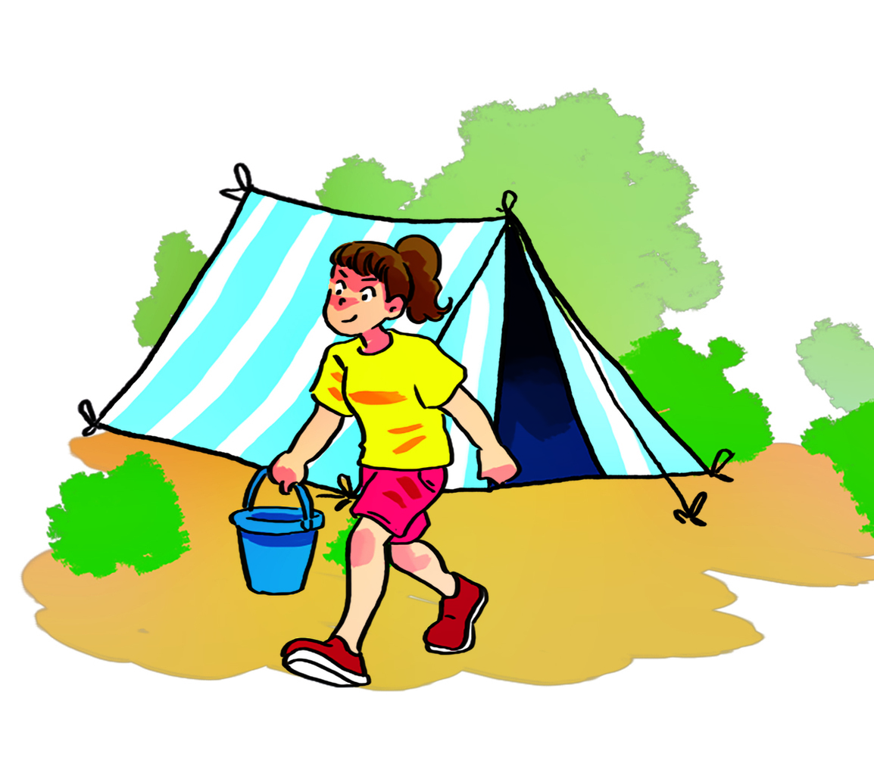
Check the last words
go fishing
go swimming
go skating
go camping
go shopping
questions

Slide 2
Monday, 20th February 2023
Unit 13 WHAT DO YOU DO
IN YOUR FREE TIME?
Lesson 3

Slide 3
I. Pronounciation

Slide 4

1. Listen and repeat
1. | What do you do in your free time? ↷ I surf the Internet. ↷
2. | What does he do in his free time? ↷ He listens to music. ↷
3. | What does she do in her free time? ↷ She goes shopping. ↷
4. | What do they do in their free time? ↷ They go camping. ↷

Slide 5


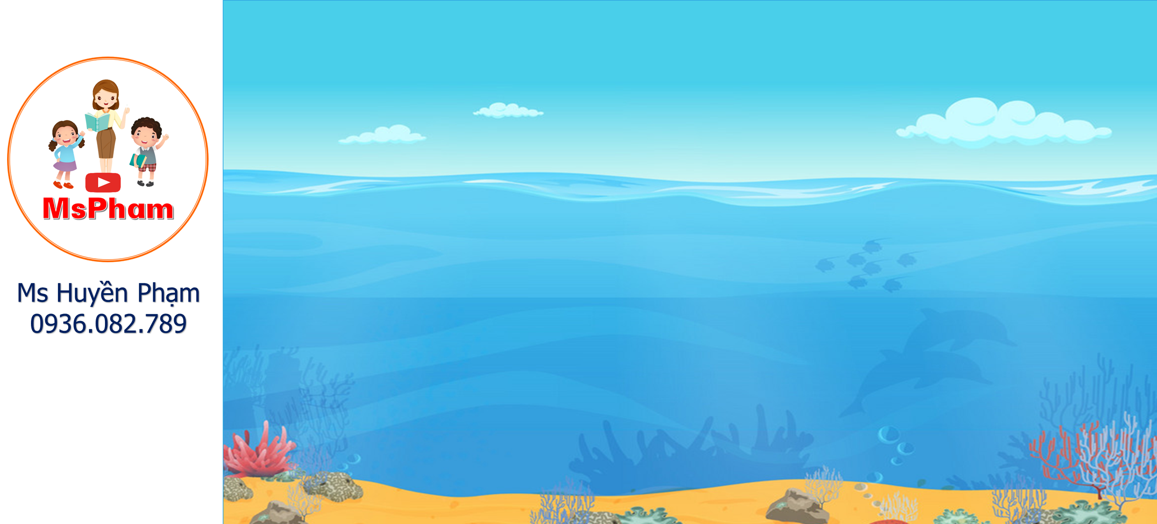
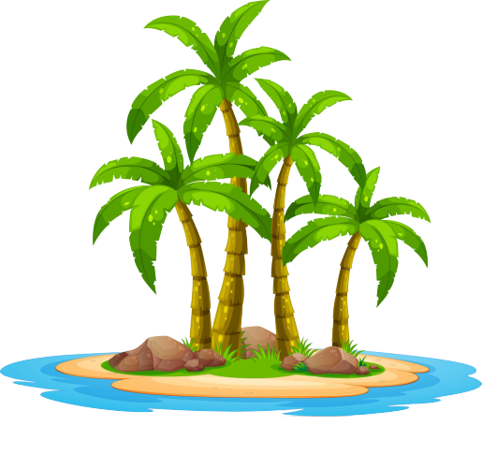
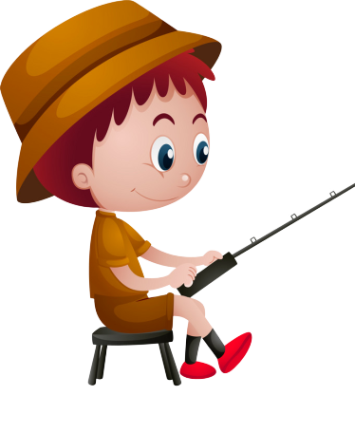
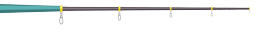

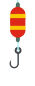
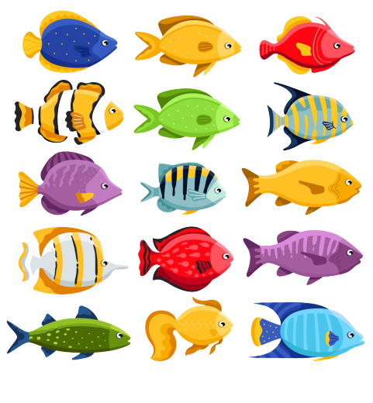
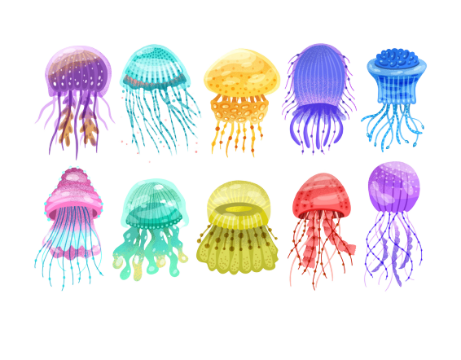

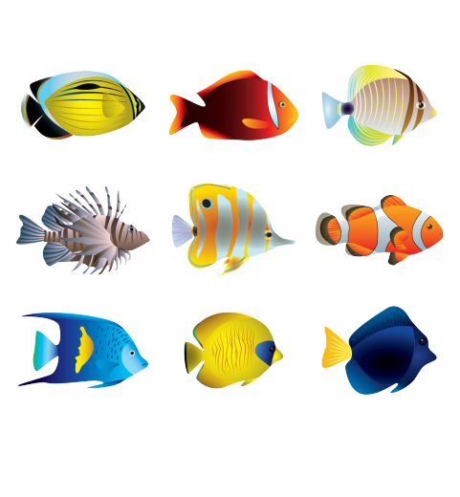

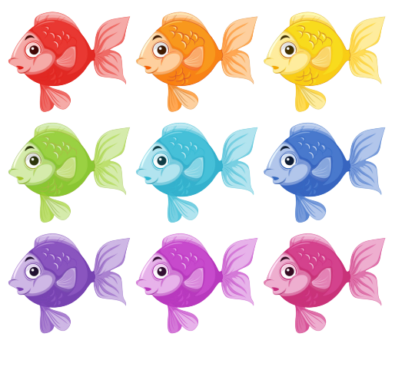
GO FISHING
Game
PLAY
EXIT

Slide 6


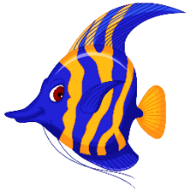
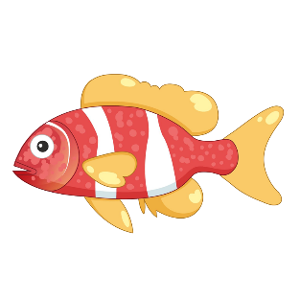






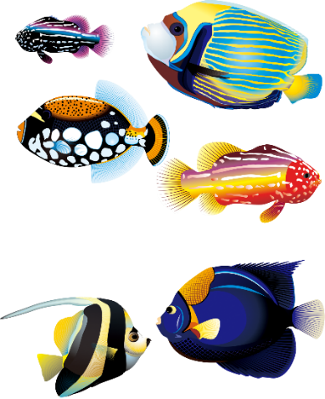
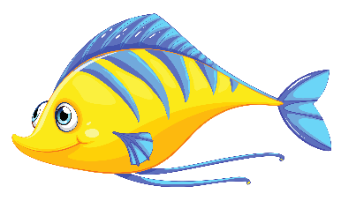
0
Score:
13
12
EXIT
11
14
7
8
15
1
6
9
2
5
3
10
4

Slide 7

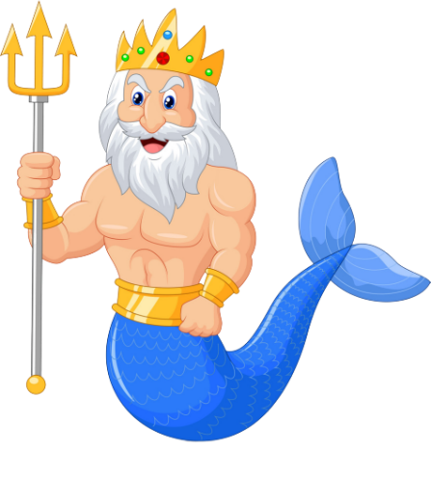


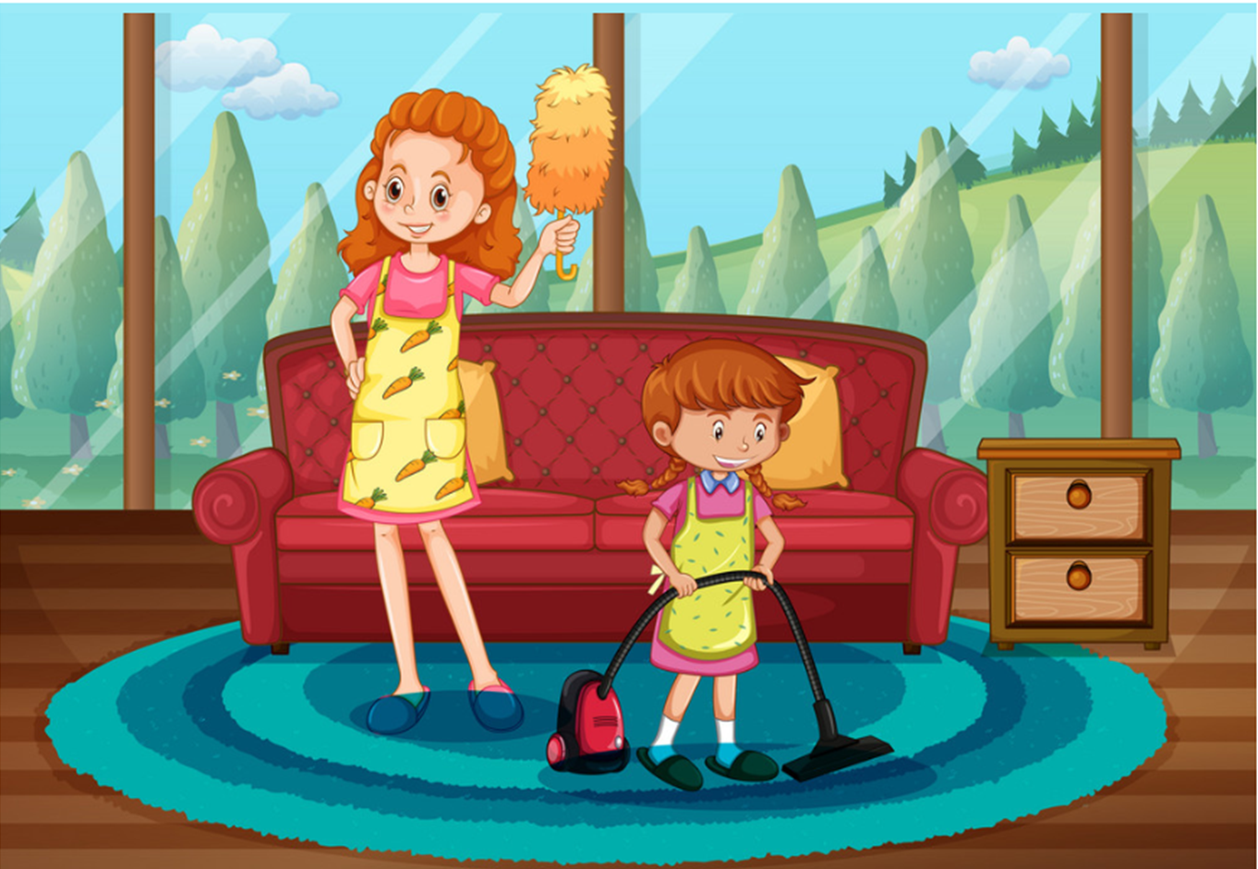
A
I cleans my house.
What do you do in your free time?
B
I cleanes my house.
C
I clean my house.
D
You clean my house.

Slide 8
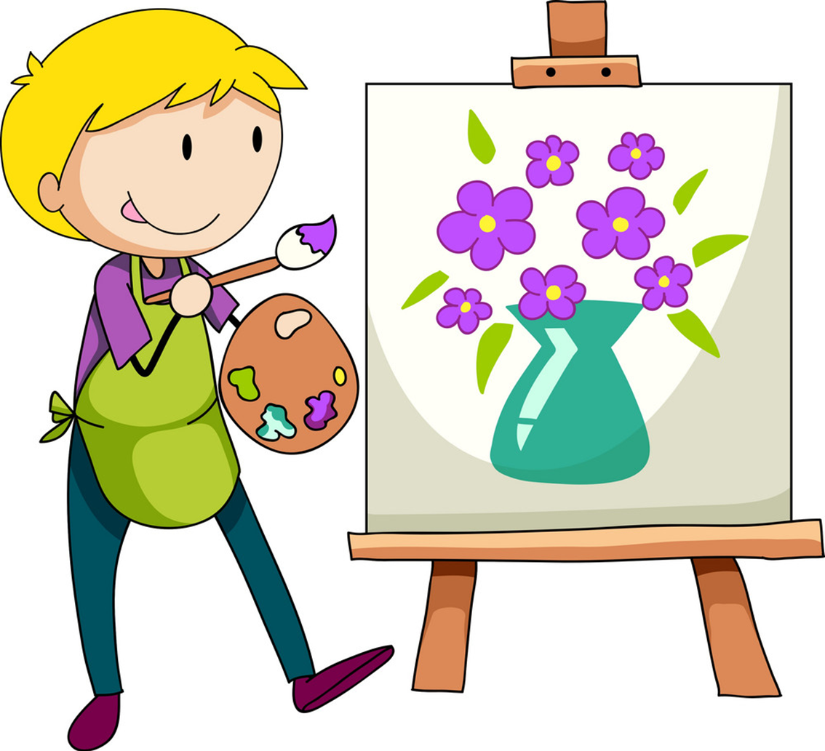
A
What do he do
_____________ in his free time?
He draws pictures.
B
What does he do
C
What do she do
D
What does she do

Slide 9
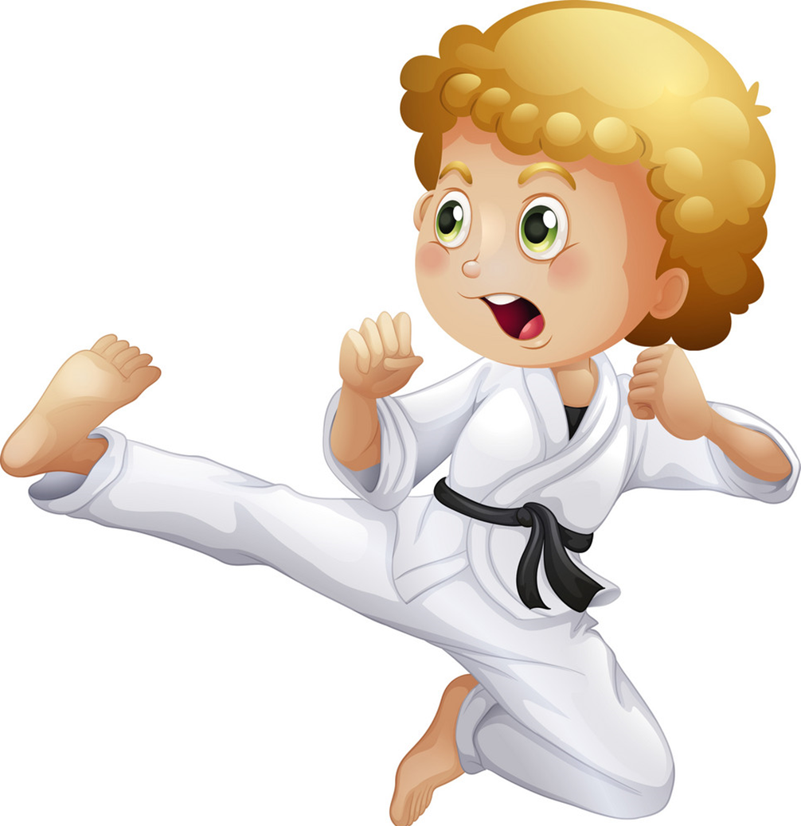
A
does karate
What do you do in your free time?
I _____________.
B
do karate
C
dos karate
D
deos karate

Slide 10
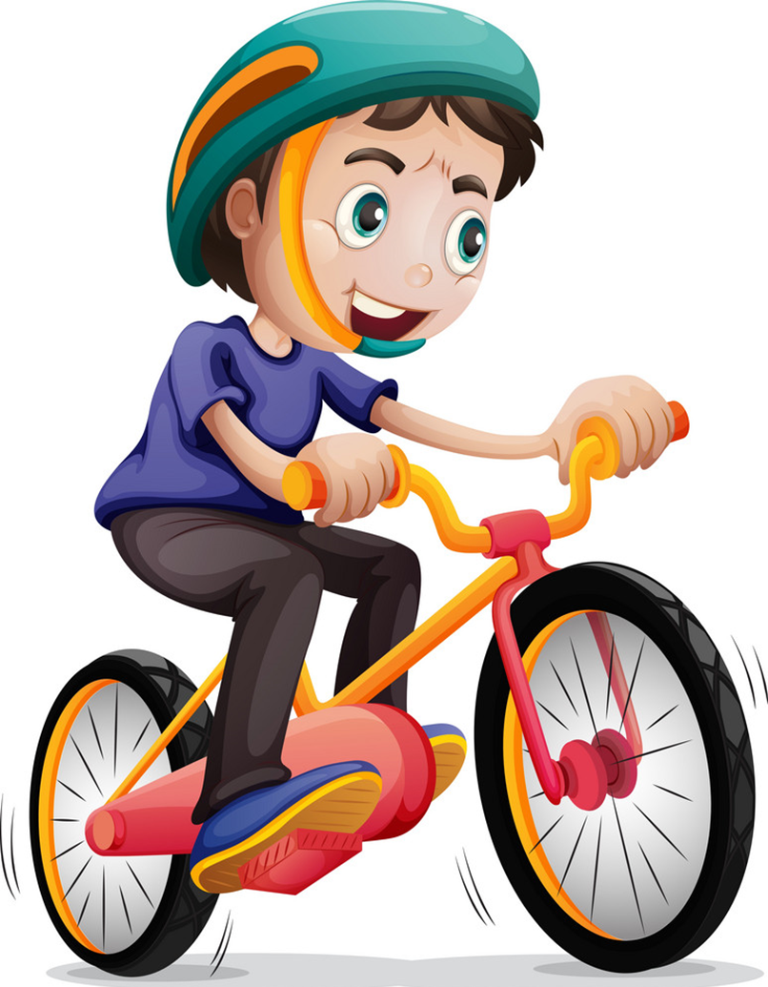
A
What do you do
in your
______________ free time?
He rides his bike.
B
What do you do
in his
C
What do he do
in his
D
What does he do
in his

Slide 11

A
surf the Internet
What does you brother do
in his free time?
- He_______________.
B
surfes the Internet
C
surf the Internets
D
surfs the Internet

Slide 12
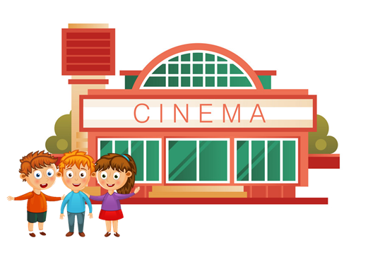
What does your friend do
in her free time?
- She goes to the cinema.
A
True
B
False
C
By
D
Next to

Slide 13
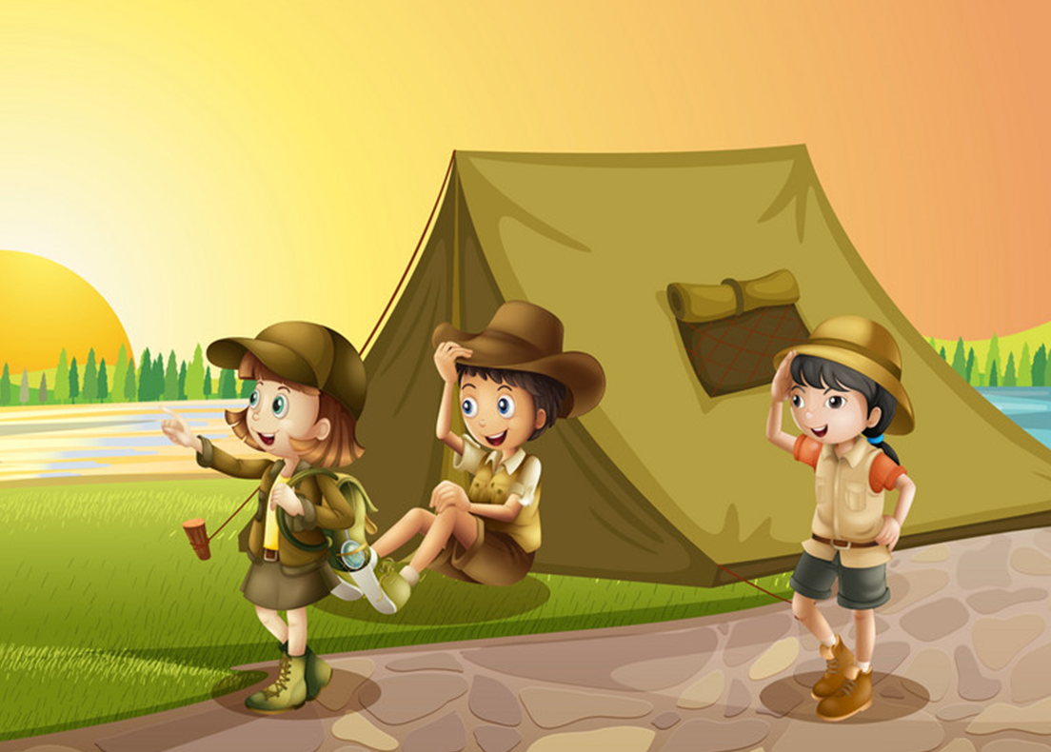
What do you do in your
free time?
- I go camping.
A
True
B
False
C
Should
D
May

Slide 14
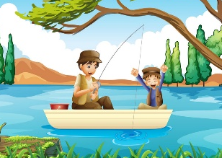
What do your father do
in his free time?
- He goes fishing.
A
True
B
False
C
Play
D
Watch

Slide 15
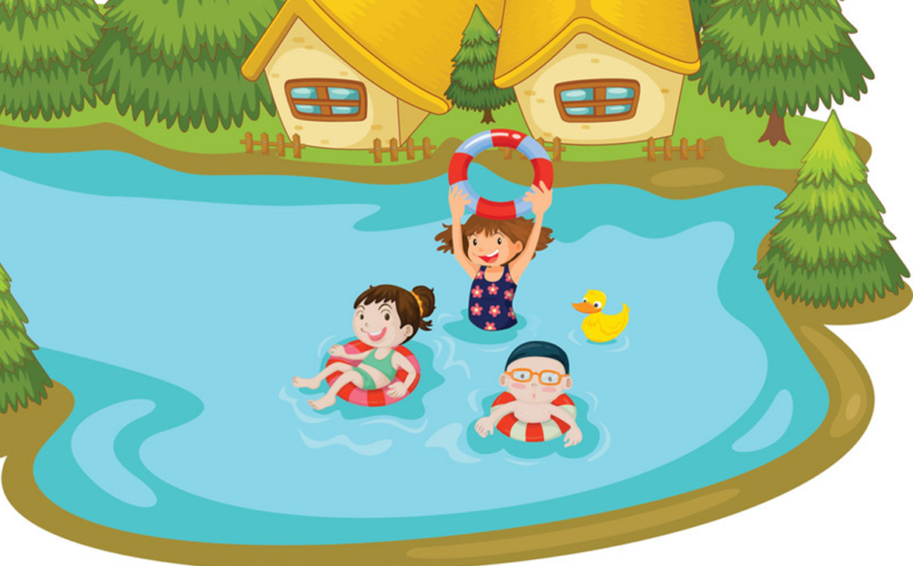
What does your sister do
in her free time?
- She go swimming.
A
True
B
False
C
Play
D
Watch

Slide 16
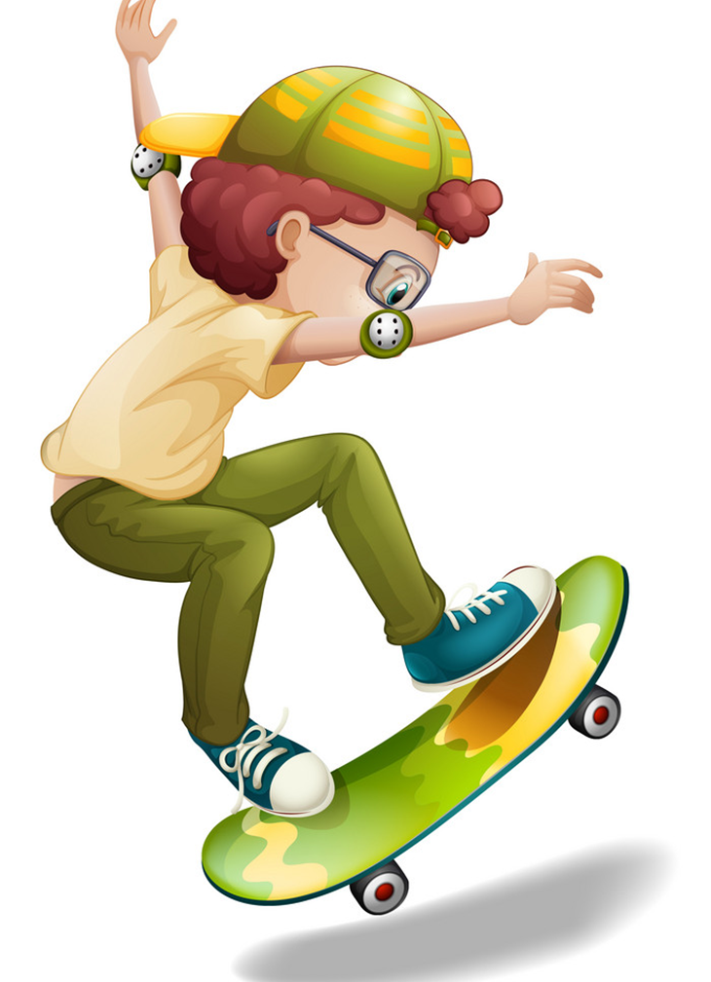
_____ two black cats.
What does you brother do
in his free time?
- He goes skating.
A
True
A
There is
B
False
B
There are
C
Should
C
Play
D
May
D
Watch

Slide 17
2. Listen and circle a or b. Then say the sentences aloud.
1. What do you do in your free time? I ________.
a. clean the house b. watch cartoons
2. What does she do in her free time? She ______.
a. goes skating b. goes fishing
3. What does he do in his free time? He ________.
a. does karate b. goes to the cinema
4. What do they do in their free time? They ________.
a. work in the garden b. go shopping

Slide 18
II. Practise

Slide 19
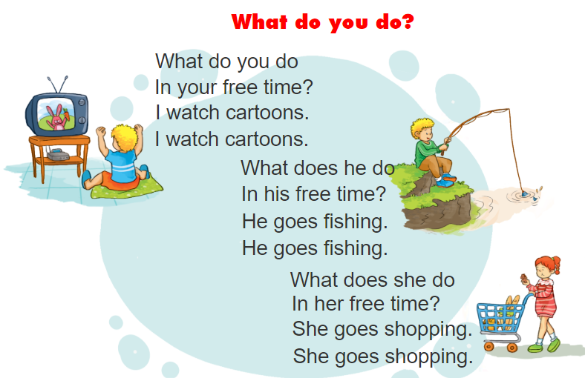


3. Let’s chant

Slide 20
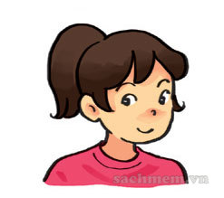
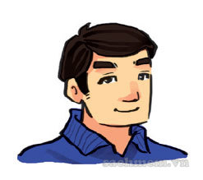
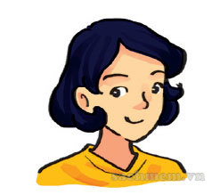

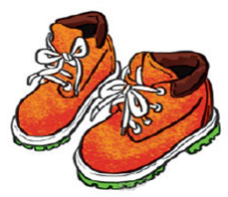
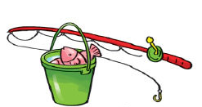
4. Read and draw lines to match.
My name is Lien. In my free time, I often go camping with my family. The camp is in the forest near the Red River. We go there by bus in the morning. My father likes fishing in the river. My mother likes drawing. She often draws pictures of the camp. I often go hiking in the forest because I like sports. We return home late in the evening. We enjoy camping very much.
1
2
3
a
b
c

Slide 21
III. Homework
1, Learn by heart all the new words and the model sentences again.
2, Do exercise 5,6 in the Studentbook (page 23)
3, Do exercises A and F in the workbook.

Slide 22
THANK YOU!

