Slide 1


Unit 6
Folk Tales
Period 49: Lesson7 Looking back

Slide 2
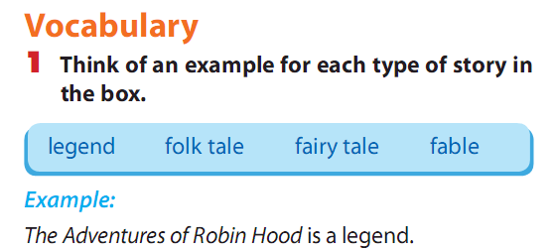
The Startfruit Tree and The Tortoise and the Hare are Fable
Thanh Giong is Legend
Chung Cakes ,Day Cakes is Fokl tale

Slide 3
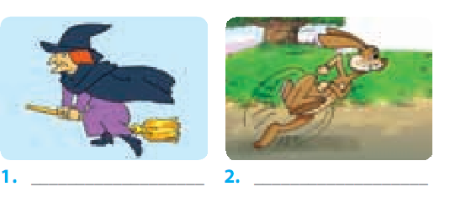
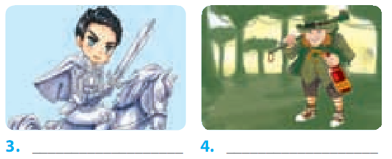
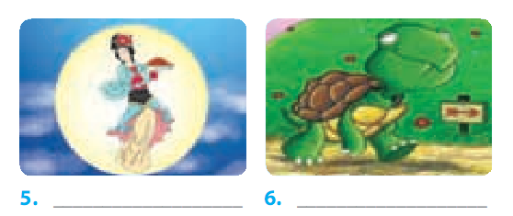
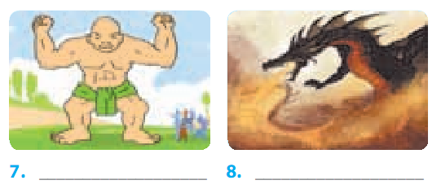
4
witch
hare
knight
ogre
fairy
tortoise
giaint
dragon

Slide 4
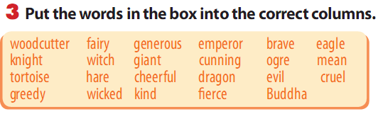

witch | kind
dragon | generous
fairy | mean
giant | wicked
hare | cheerful
emperor | fierce
ortoise | evil
knight | cunning
ogre | brave
eagle | greedy
Buddha

Slide 5
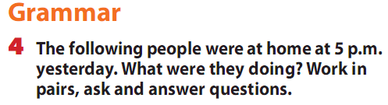
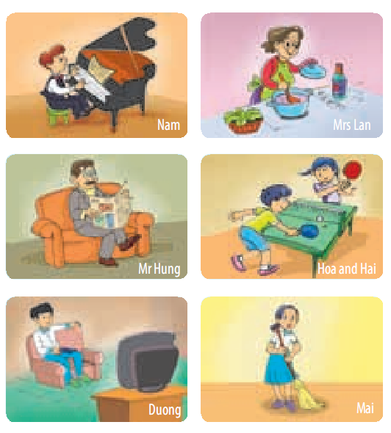

Slide 6
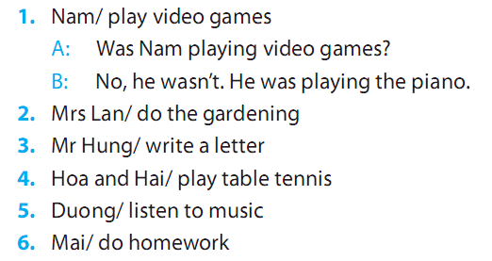

Slide 7
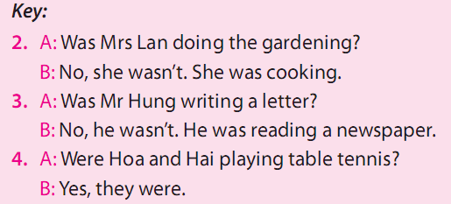
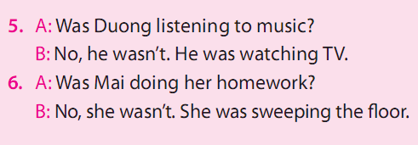

Slide 8

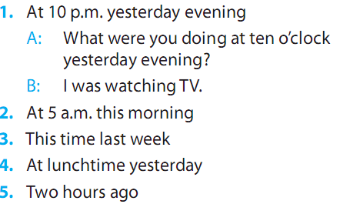

Slide 9
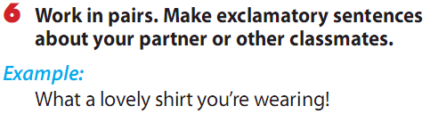

Slide 10
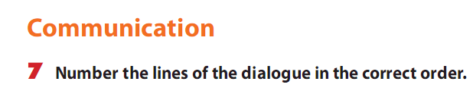
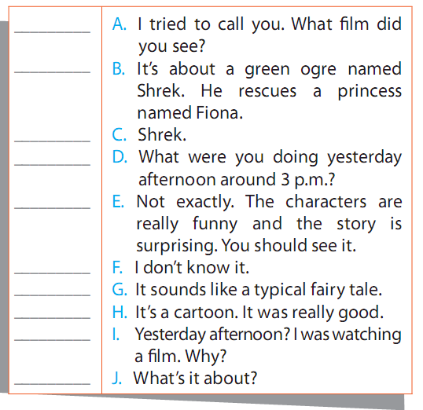
=>Key:
1.D 2.I 3. A 4. C 5. F
6. H 7. J 8. B 9. G 10. E

Slide 11
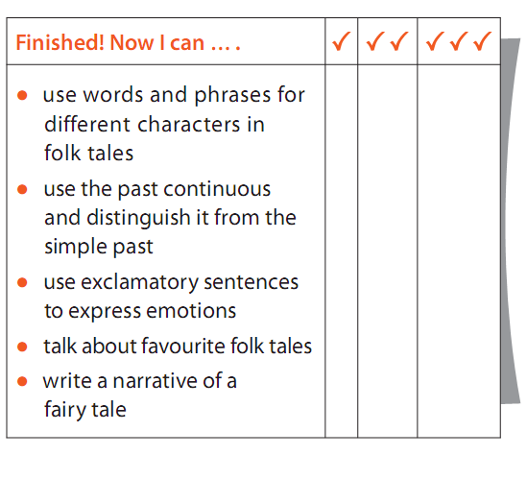

Slide 12
Homework :
Learn by heart new grammar
-Write the exercises in your notebooks
Prepare: Review

