Slide 1
Every morning, I get up at 6. ………., I brush my teeth. …………, I have breakfast. …………….., I get dressed.
……………., I go to school.
(1)
First
(2)
Second
(3)
After that
(4)
Finally
-First ( adv):
đầu tiên
-Second ( adv):
thứ hai
-After that ( adv):
sau đó
-Finally ( adv):
cuối cùng

Slide 2
UNIT 4: My Neighbourhood.
Period 29
Lesson 4: Communication.
(P. 43)

Slide 3
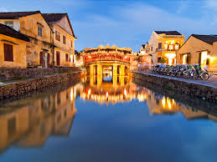
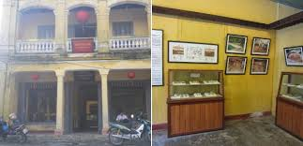

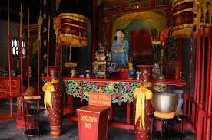
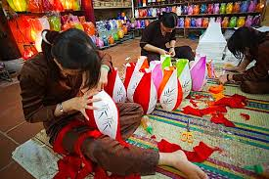
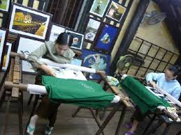
Hoi An
Museum of Sa Huynh Culture (n):
viện bảo tàng văn hóa Sa Huỳnh.
Quan Cong Temple (n):
đền thờ Quận Công.
Hoa Nhap Workshop (n):
xưởng Hòa Nhập.

Slide 4
I.Vocabulary:
-Museum of Sa Huynh Culture (n):
Viện bảo tàng văn hóa Sa Huỳnh.
-Quan Cong Temple (n):
Đền thờ Quan Công.
-Hoa Nhap Workshop (n):
Xưởng Hòa Nhập.
-First ( adv):
Đầu tiên
-Second ( adv):
Thứ hai
-After that ( adv):
Sau đó
-Finally ( adv):
Cuối cùng

Slide 5

City Tours !
Welcome to Hoi An ! Hoi An is famous for its (1) _______ buildings, shops, pagodas and houses. They’re older than in other cities in Viet Nam. The streets are very narrow so it is more (2) ___________ to walk there.
Ok. Let’s start our tour! First, go to Quan Cong Temple. To get there, walk (3)_________ for 5 minutes. The temple is on your left. (4) _______go to the Museum of Sa Huynh Culture. Take the second (5) _____. Turn right and it’s on your (6) _____. Then, have lunch at Cafe 96 . It’s ‘ cao Lau’ and ‘ banh vac’ are very good. Turn left and take the (7)______ turning on your right . Finally, go to Hoa Nhap Workshop to buy presents for your friends. Turn left, then turn right. The workshop is ( 8) _______Tan Ky House.
historic
convenient
straight
Second
left
right
second
next to

Slide 6
City Tours !
Welcome to Hoi An ! Hoi An is famous for its historic buildings, shops, pagodas and houses. They’re older than in other cities in Viet Nam. The streets are very narrow so it is more convenient to walk there.
Ok. Let’s start our tour! First, go to Quan Cong Temple. To get there, walk straight for 5 minutes. The temple is on your left. Second go to the Museum of Sa Huynh Culture. Take the second left. Turn right and it’s on your right. Then, have lunch at Cafe 96 . It’s ‘ cao Lau’ and ‘ banh vac’ are very good. Turn left and take the second turning on your right . Finally, go to Hoa Nhap Workshop to buy presents for your friends. Turn left, then turn right. The workshop is next to Tan Ky House.

Slide 7
2/ Choose one of the cities below. Creative an audio guide for your city.
Remember to:
Include some comparisions with other cities
Give directions to difirent places, and link your instructions using first, then, after that and finally.

Slide 8
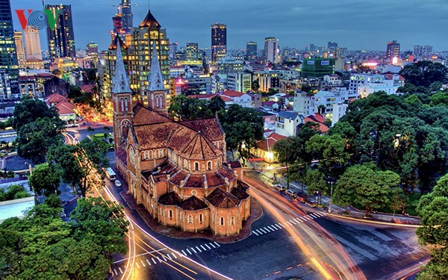
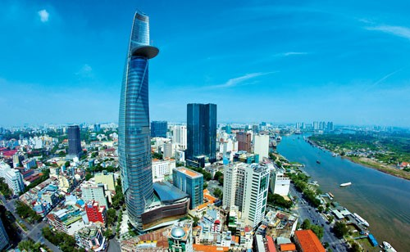
Ho Chi Minh city

Slide 9
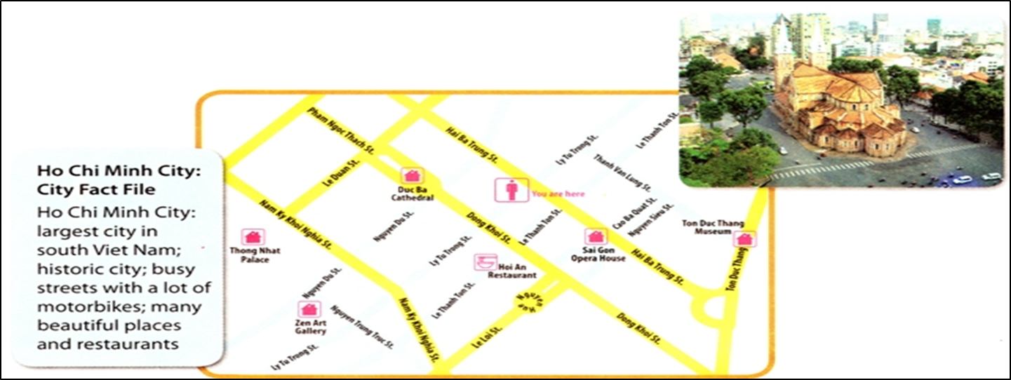

Slide 10
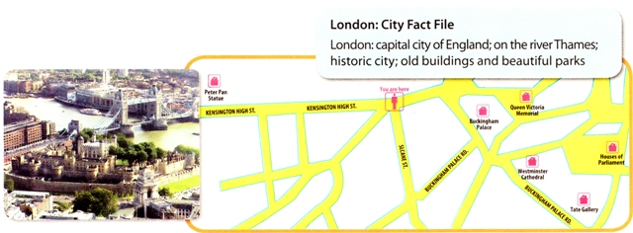

Slide 11
Ho Chi Minh City
Welcome to Ho Chi Minh City ! Ho Chi Minh City is the largest city in South Viet Nam. It is a historic city and has many busy streets with a lot of motorbikes. It has many beautiful places and restaurants .
Well. Let’s start our tour! First, go to Duc Ba Cathedral. To get there, go straight ahead then turn right on the Dong Khoi street, keep straight on. The Cathedral in front of you. Second, go to Thong Nhat palace. Go a long Nguyen Du street , turn right on Nam Ky Khoi Nghia street. It’s on your left . And then, go to Zen Art Gallary on the corner between Nguyen Du street and Nguyen Trung Truc street.

Slide 12
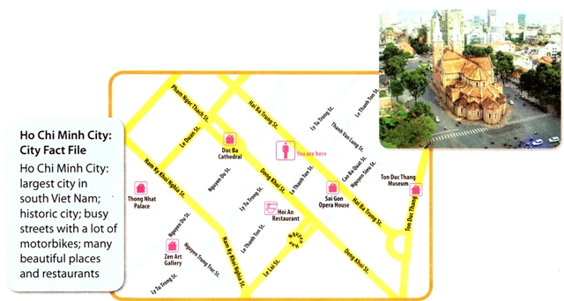
Welcome to Ho Chi Minh City ! Ho Chi Minh City is the largest city in South Viet Nam. It is a historic city and has many busy streets with a lot of motorbikes. It has many beautiful places and restaurants .
Well. Let’s start our tour! First, go to Duc Ba Cathedral. To get there, go straight ahead then turn right on the Dong Khoi street, keep straight on. The Cathedral in front of you. Second, go to Thong Nhat palace. Go a long Nguyen Du street , turn right on Nam Ky Khoi Nghia street. It’s on your left . And then, go to Zen Art Gallary on the corner between Nguyen Du street and Nguyen Trung Truc street.

Slide 13





