Slide 1
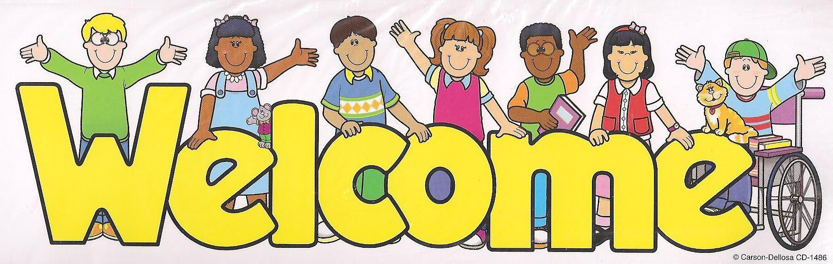

Slide 2

ENGLISH 9
UNIT 2: CITY LIFE
Lesson 2: Getting started

Slide 3

GAME:CROSSWORD
1
C
R
A
F
T
1
2
2
C
O
N
I
C
A
L
3
L
A
N
T
E
R
N
3
S
4
S
A
Y
4
5
5
M
O
U
L
D
6
H
I
S
T
O
R
Y
6
7
F
A
M
O
U
S
7
8
I
N
T
E
R
E
S
T
8
The … village of Bat Trang lies on the bank of the Red river.
Some people….. that a place of interest should be a well- known site
This kind of …... hat is made in Chuong village.
In Hoi An you can see colorful ….. Hanging in the streets.
This village is ….. for its wood- carving craft
The children can ….. the clay into many shapes
The ….... of Ha Noi began over a thousand years ago.

Slide 4

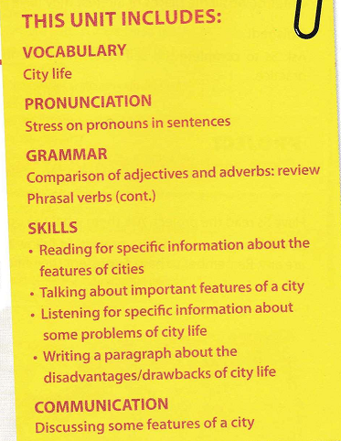
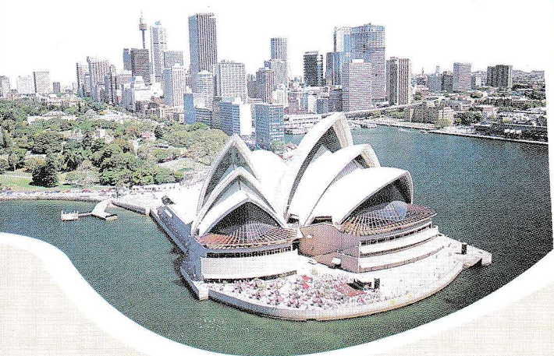

Slide 5
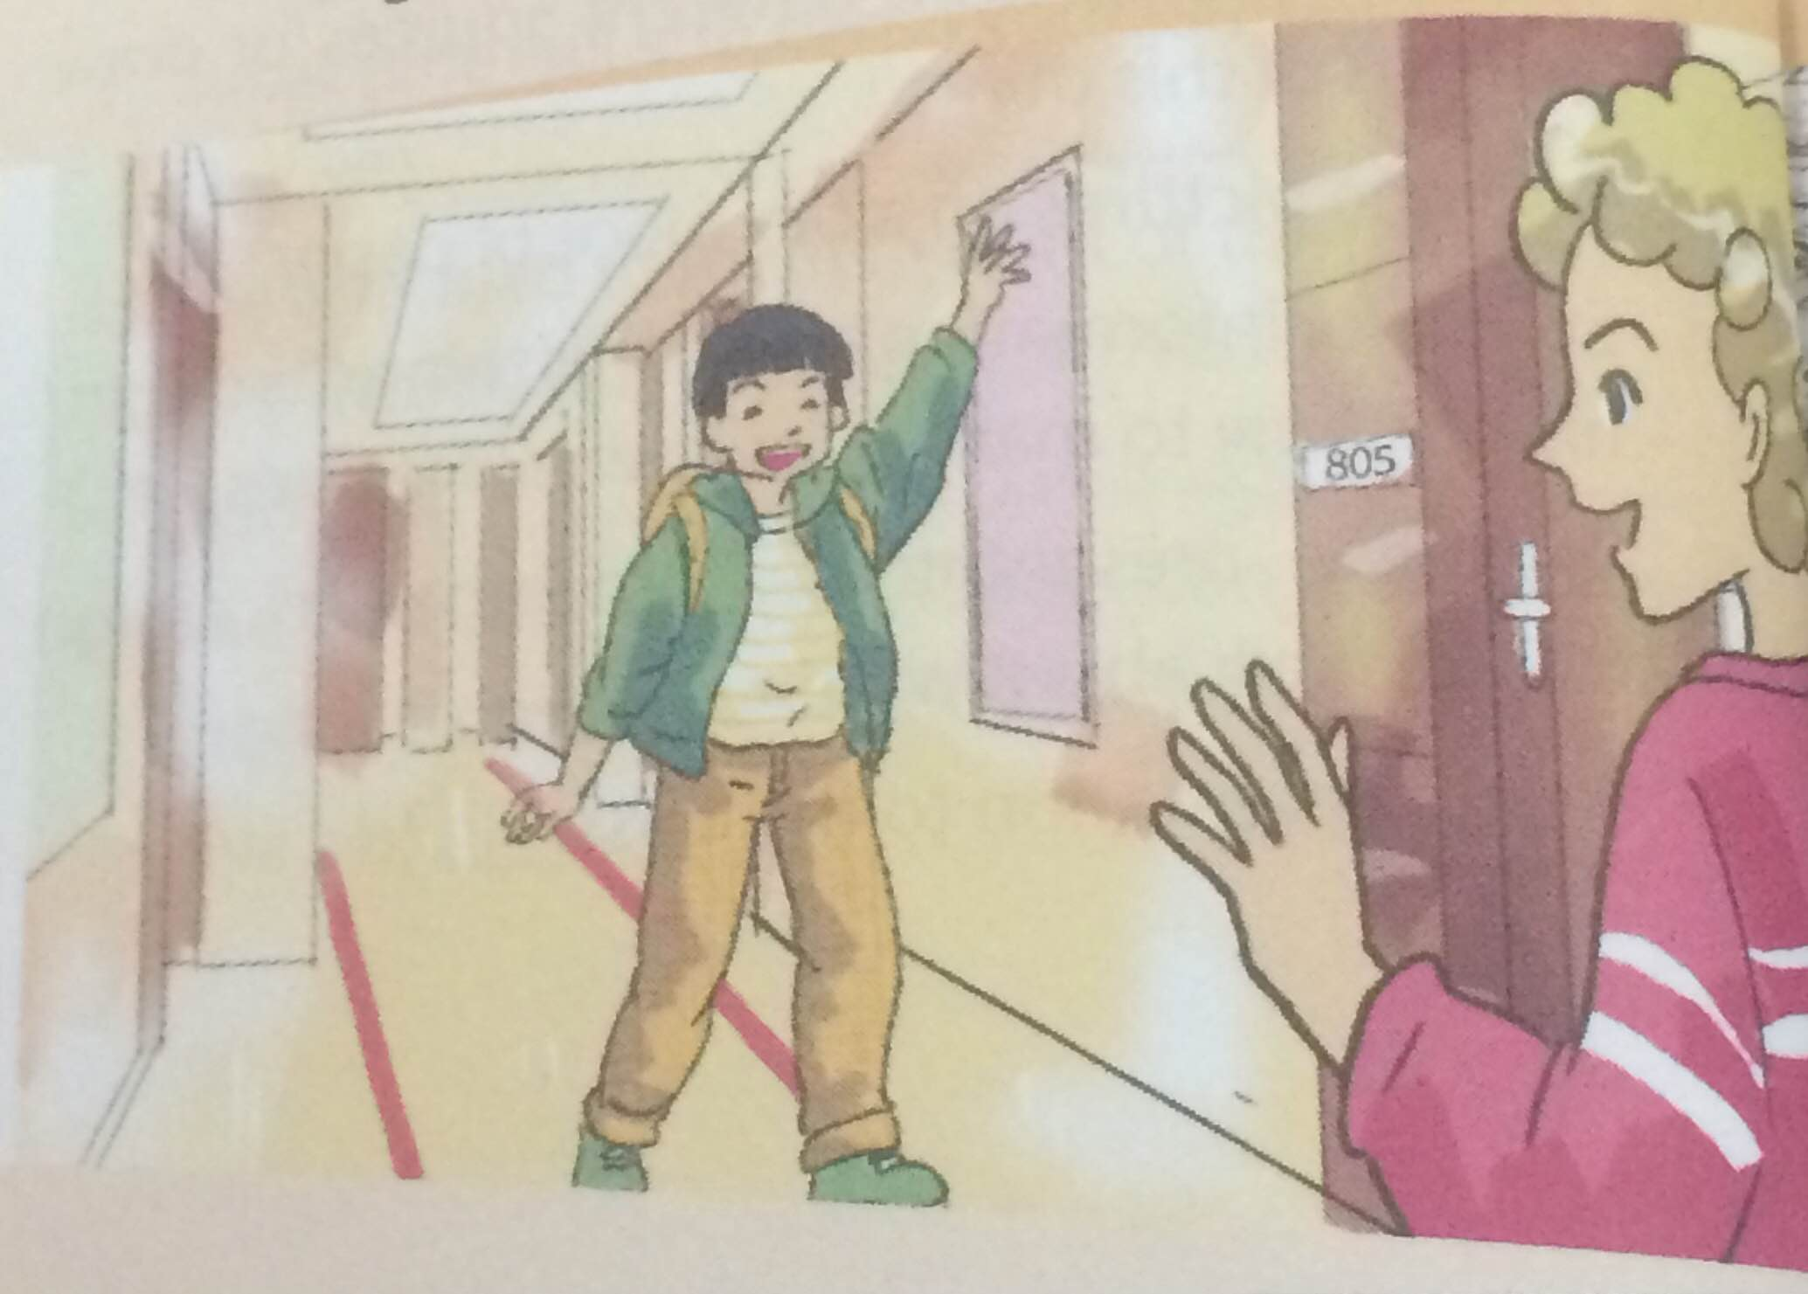
Answer the following questions.
1. What can you see in the picture?
2. Do you know these two boys?
3. Where are they now?
4. What are they talking about?

Slide 6

1. Listen and read
Duong: Hey, Paul! Over here!
Paul: Hi, Duong! How's it going? Getting over the jet lag?
Duong: Yes, I slept pretty well last night. Hey, thanks so much for showing me around today.
Paul: No worries, it'll be good fun.
Duong : So, are you from around here?
Paul: Me? Yes, I was born and grew up here. Sydney's my hometown.
Duong :It's fabulous. Is it an ancient city?
Paul: No, it's not very old, but it's Australia's biggest city, and the history of our country began here.
Duong : Wow! So what are the greatest attractions in Sydney?
Paul: Well, its natural features include Sydney Harbour, the Royal National Park, and Bondi Beach. Man-made attractions such as the Royal Botanic Gardens, Sydney Opera House, and the Harbour Bridge are also well known to visitors.

Slide 7
1. Listen and read
Duong : What about transport?
Paul: Public transport here is convenient and reliable: you can go by bus, by train, or light rail. Taxis are more expensive, of course.
Duong : And is Sydney good for shopping?
Paul: Of course! You know, Sydney's a metropolitan and multicultural city, so we have a great variety of things and foods from different countries. I'll take you to Paddington Market later,
if you like.
Duong : Wonderful. What about education? Are there many universities?
Paul: Sydney has five big universities and some smaller ones. The oldest of them was set up in 1850, I believe.
Duong : Oh, it sounds like a good place to get higher education. I like this town!

Slide 8
a. Complete the sentences with information from the conversation.
visit
1. It is Duong's first _________ to Sydney.
2. In Paul's opinion, Sydney is not _________ an city.
3. Sydney Harbour is a _________ attraction of Sydney.
4. The shopping is good because of the ________ of things.
5. Duong thinks Sydney may be a good place to _________.
ancient
natural
variety
study

Slide 9
b. Find the word in the conversation to match these definitions.
1. tiredness from traveling across different tome zones
2. an attraction
3. that can be trusted
4. belonging to a very large city
5. including people of different races, religons, languages, and traditions
jet lag
a feature
reliable
metropolitan
multicultural

Slide 10
c. Answer the questions.
Where did Paul grow up?
2. What is the biggest city in Australia?
3. How is the public transport in Sydney?
4. Why is,there a great variety of things and foods in Sydney?
5. When was the first university built in Sydney?

Slide 11

Lucky Number Game

Slide 12
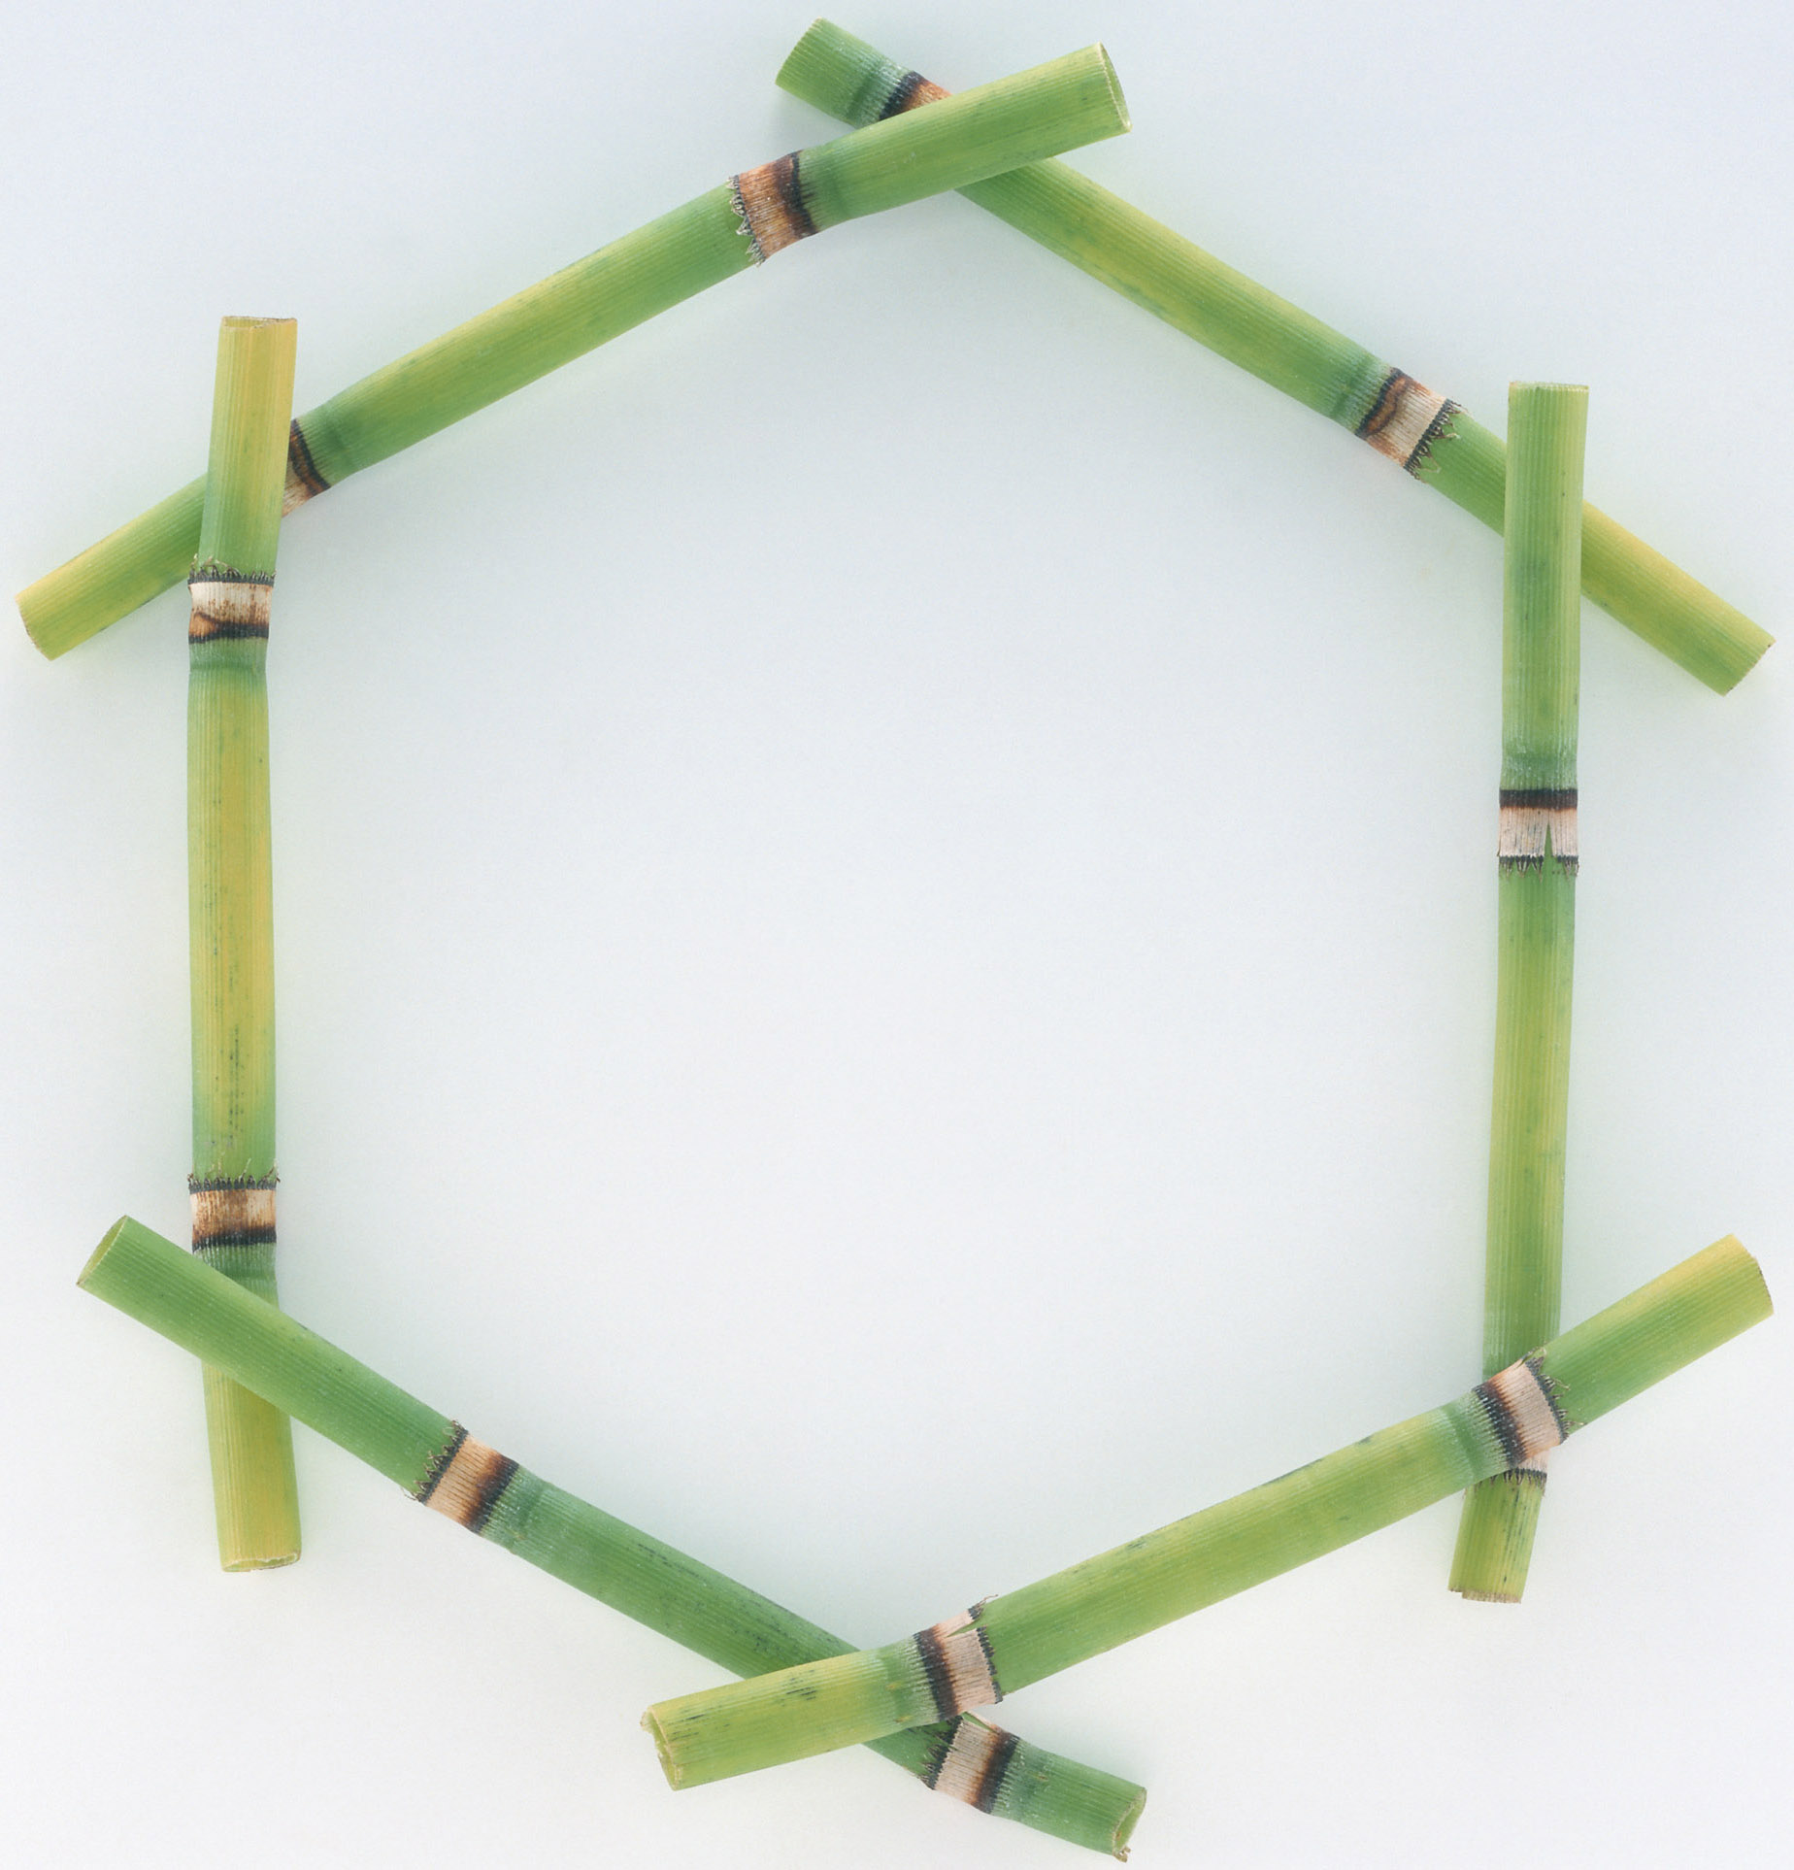

❶ | ❷ | ❸
❹ | ❺ | ❻

Slide 13




Lucky number.
Congratulation !

Slide 14


1. Where did Paul grow up?
- He grew up in Sydney.

Slide 15
2. What is the biggest city in Australia?
- Sydney is

Slide 16
3. How is the public transport in Sydney?
- It is convenient and reliable.

Slide 17
4. Why is there a great variety of things and foods in Sydney?
- Because it is a metropolitan and multicultural city.

Slide 18
5. When was the first university built in Sydney?
- In 1850.

Slide 19
c. Answer the questions.
Where did Paul grow up?
2. What is the biggest city in Australia?
3. How is the public transport in Sydney?
4. Why is there a great variety of things and foods in Sydney?
5. When was the first university built in Sydney?
- He grew up in Sydney.
- Sydney is.
- It is convenient and reliable.
- Because it is a metropolitan and multicultural city.
- In 1850.

Slide 20
d. Think of other ways to say these expressions from the conversation.
1. "How's it going?"
2. "Getting over the jet lag?"
3. "I slept pretty well"
4. "No worries"

Slide 21
d. Think of other ways to say these expressions from the conversation.
Suggested answer
1. "How's it going?"/ How are you going? / How are the things”
2. "Getting over the jet lag?“/ Are you recovering from the jet lag?
3. "I slept pretty well“/ I slept quite well/ I slept tight.
4. "No worries"/ That’s OK/ It’s not a problem/ It’s my pleasure.

Slide 22
2. Replace the word(s) in italics with one of the words from the box.
crowded – international – local – urban – neighbouring
1. There is not a lot of world news in this
newspaper.
2. I do my shopping in the neighbourhood shops, not in the town centre.
3. At weekends the city centre is always packed with people.
4. My friend's family has just moved to a nearby town.
5. There is far too much pollution nowadays in city areas.
international
local
crowded
neighbouring
urban

Slide 23
3. Work in pairs to do the quiz.
CITY QUIZ
1. Which city is the oldest?
Ha Noi B. Hue C. Can Tho
2. Which city is in Oceania?
Baghdad B. Amsterdam C. Canberra
3. Which city is the best-known city in North America?
Chicago B. Vancouver C. New York
4. Which city is in Africa?
Luanda B. Athens C. Buenos Aires
5. Which city has the World Heritage status?
Bac Giang B. Vinh C. Hoi An
6. Which is a capital city?
A. Rio B. Moscow C. Osaka

Slide 24
Complete the summary of the dialogue between Duong and Paul
This is the ______ time Duong has been to Sydney, the biggest city in Australia. Through the trip, he has learnt that Sydney’s a metropolitan and ______ city. There are many great ______ there such as: Sydney harbour, the Royal National park, Bondi beach,… Public transport here is convenient and ______. Sydney has ______ big universities and some smaller ones. The oldest of them was set up in ______. He likes this city very much.

Slide 25
Complete the summary of the dialogue between Duong and Paul
This is the first time Duong has been to Sydney, the biggest city in Australia. Through the trip, he has learnt that Sydney’s a metropolitan and multicultural city. There are many great attractions there such as: Sydney harbor, the Royal National park, Bondi beach,… Public transport here is convenient and reliable . Sydney has five big universities and some smaller ones. The oldest of them was set up in 1850 . He likes this city very much.

Slide 26

III. Home assignments
  Write a short paragraph (60-80 words) about one of your trips to a famous city.

