Slide 1


Slide 2

UNIT 2: CITY LIFE
Lesson 5: Skills 1

Slide 3

I.VOCABULARY
-determine (v) : quyết định
-conﬂict (n) : sự xung đột
-index (n) : chỉ số
-factor (n) : yếu tố
-rank (v) : phân loại, liệt vào hạng
-urban sprawl (n) : sự phát triển đô thị

Slide 4
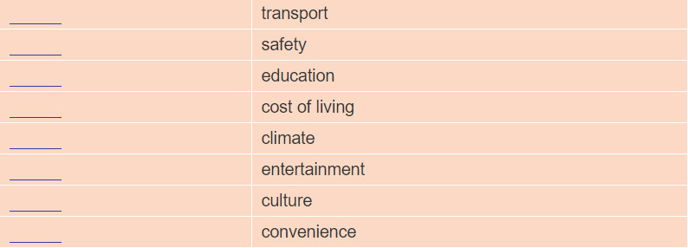
READING
1. Work in pairs. What features are important to you in a city? Put the following in order 1-8 (1 is the most important).

Slide 5
READING
2. Read the passage quickly and find the information to fill the blanks.
1.The name of the organisation doing the survey:
The Economist Intelligence Unit (EIU)
2. The year of the survey:
2014
3. The names of the best city and the worst cities:
The best city: Melbourne

Slide 6
READING
3. Read the passage again and answer questions.
What factors are used by EIU to range the world cities?
Climate, transport, education, safety, and recreational facilities in cities (are used).
2. Where were some famous cities on the list?
Among the top 20.
3. Why were Dhaka, Tripoli and Douala ranked among the worst cities?
Because the living conditions there were the most difficult or dangerous.
4. Which was the most “liveable” city in Asia?
Osaka was.
5. What are some factors that should be added to the index?
They are a city's green space, urban sprawl, natural features, cultural attractions,
convenience, and pollution.

Slide 7
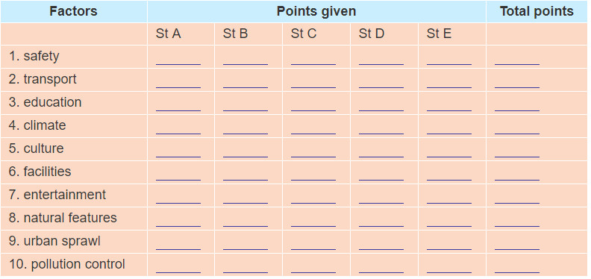
SPEAKING
4a. Work in groups of five or six. Conduct a survey to rank your own town/city or a town city you know. Give from 10 points (the best to 1 point (the worst) to each factor.
Ask each student in your group the question: "How many points do you give to factor 1 - safety? "
Then write the points in the table.

Slide 8

SPEAKING
b, Work out the final result of your group. Then present it to the class. Is your group's result the same or different from that of other groups?

Slide 9
HOMEWORK
-Learn by heart the new words
-Prepare : Skills 2

Slide 10


