Slide 1


8
UNIT
English speaking countries
Getting started
THUHA X NGOCLINH X MAILY X YENVY

Slide 2


1. Listen and read
Nick: How’s your international summer camp going, Phong?
Phong: Awesome, just awesome.
Nick: You sound so happy. What do you like about it?
Phong: It’s hard to say. Everything’s wonderful: the friends I’ve made, the places I’ve visited, the activities....
Nick: Oh...Your English has improved a lot!
Phong: Absolutely. I use English everyday, with people from different countries.
Nick: Where are they from?
Phong: Everywhere! Places like India, Canada... English is also an official language here in Singapore.
Nick: Right. Have you made any friends from English speaking countries?
Phong: I’m in a team with two boys from Australia and a girl from the USA.
Nick: Do you have difficulty understanding them?
Phong: I found it difficult to understand them at first. Perhaps it’s because of their accent, but it’s OK now.
Nick: It’s great that you can practise English with native speakers. When are you back?
Phong: Our camp closes on July 15th and I take the night flight home the same day.
Nick: Looking forward to seeing you then. Enjoy!
Phong: I will. Thanks. Bye.

Slide 3
a. Find a word or an expression from the conversation which you use when you....
1. think something is wonderful
Awesome, just awesome!
2. agree with somebody
Absolutely/Right
3. cannot decide
It’s hard to say.
4. are not sure about something
Perhaps

Slide 4
b. Read the conversation again and answer the questions
1. Where is Phong now?
-> He is at an international summer camp in Singapore.
2. Where do the campers come from?
-> They come from different countries.
-> They come from all over the world.
3. What has Phong done so far?
-> He has made new friends, visited places, and taken part in diﬀerent activities.
4. Why has he been able to improve his English?
-> Because he uses English everyday with people from different countries.
5. Who are in the same team with Phong?
-> Two boys from Australia and a girl from the USA.
6. When can Nick see Phong?
-> After July 15th.

Slide 5
2. Complete the sentences with words/ phrases from the box.
native speakers
the USA
official language
summer camp
English speaking countries
accents
1. Last year I had a wonderful time at a ____________ in Britain.
2. The USA, thu United Kingdom and New Zealand are all ________________________.
3. Australians are ________________ of English because they use it as their mother tongue.
4. _________ is in the mid-north of America.
5. Usually, people from different parts of a country speak their language with different __________.
6. English is an _________________ in countries like India, Malaysia and Singapore.

Slide 6

GAME
ABOUT ENGLISH SPEAKING COUNTRIES
LET’S PLAY!!

Slide 7
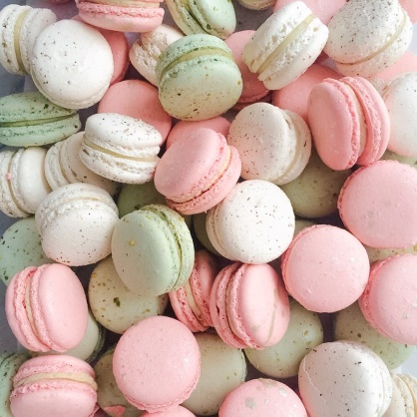
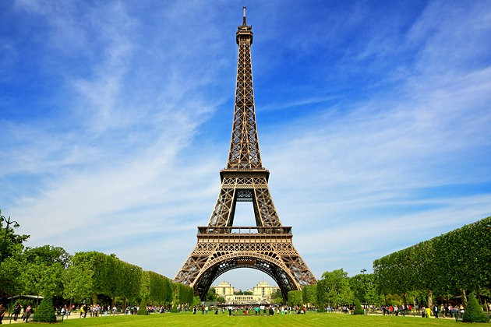
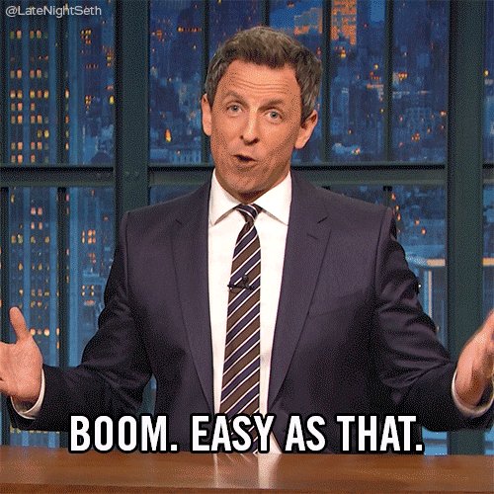
Which countries is this?
macaron
FRANCE

Slide 8
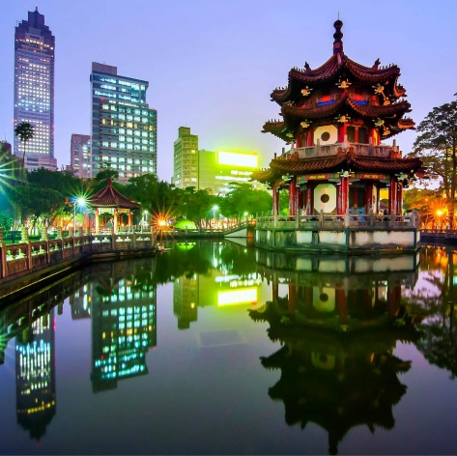
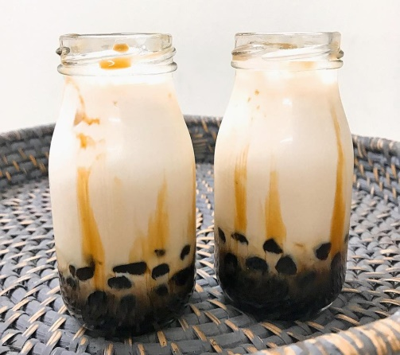
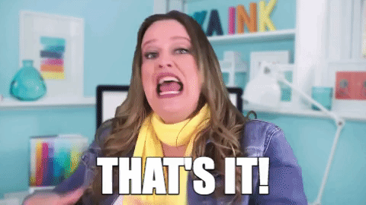
Which countries is this?
TAIWAN

Slide 9
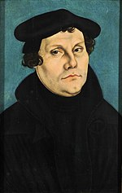
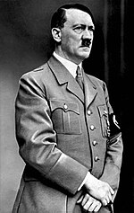
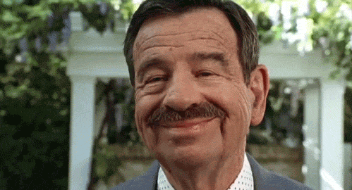
Which countries is this?
GERMANY

Slide 10
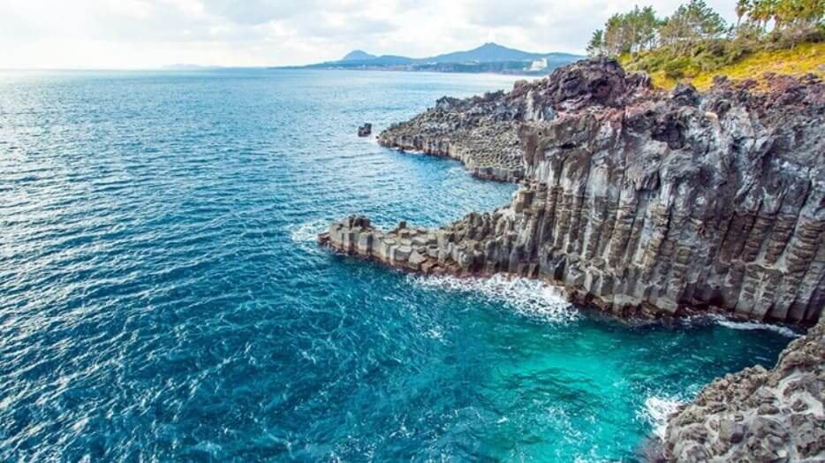
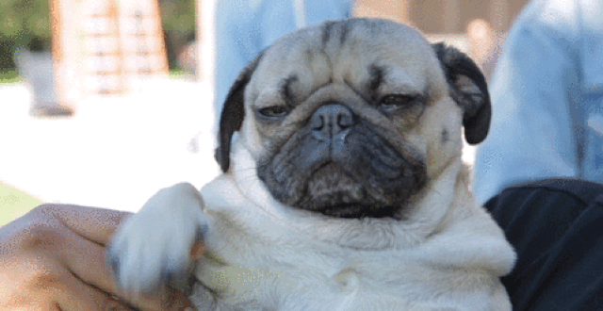
Which countries is this?
KOREA

Slide 11
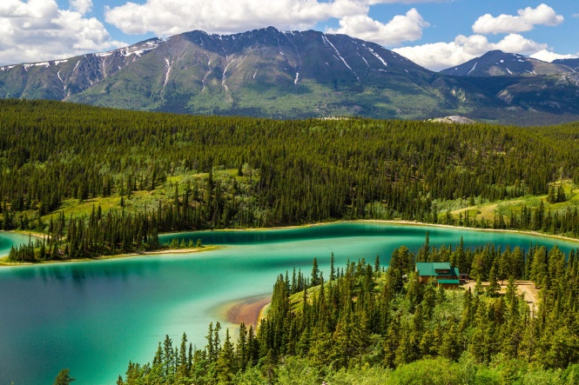


Which countries is this?
CANADA

Slide 12
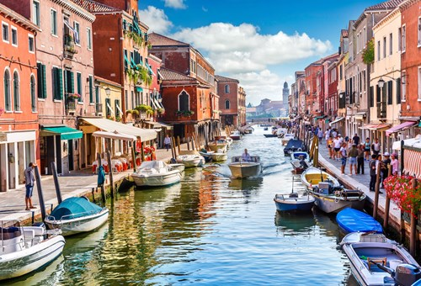
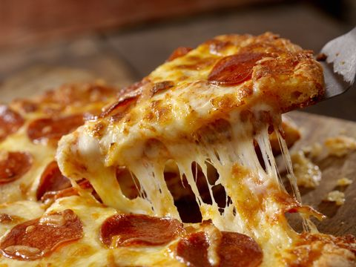

Which countries is this?
ITALY

Slide 13
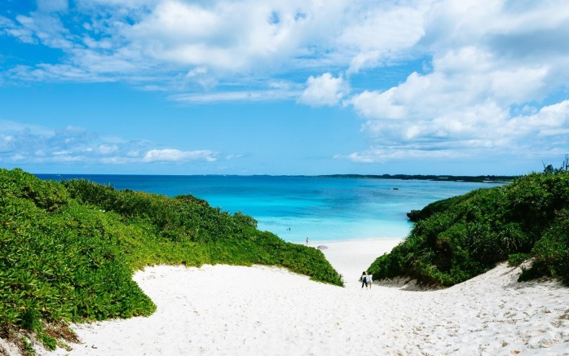

Which countries is this?
JAPAN

Slide 14
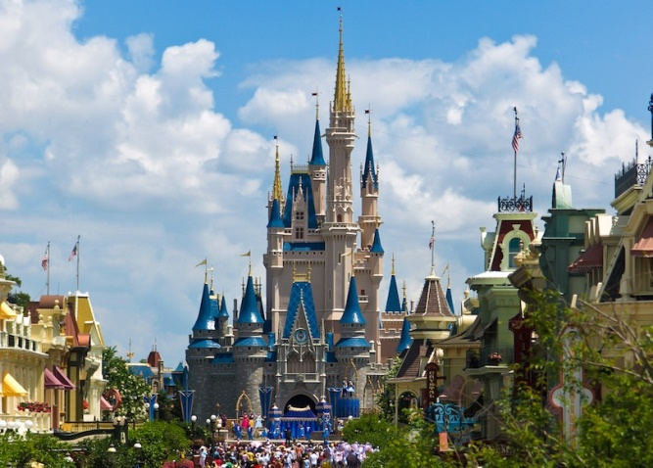
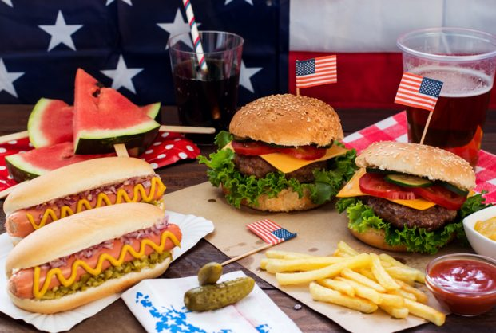
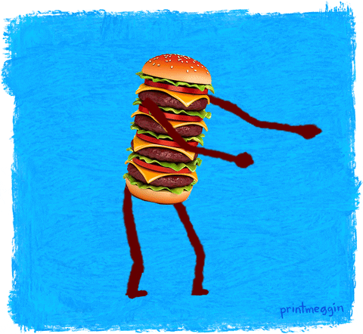
Which countries is this?
THE USA

Slide 15
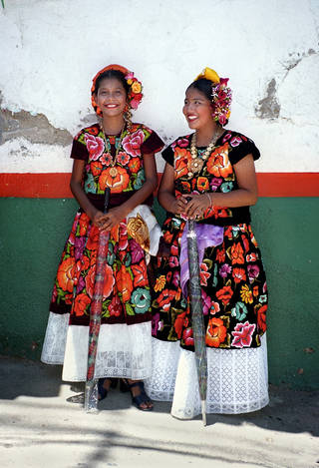
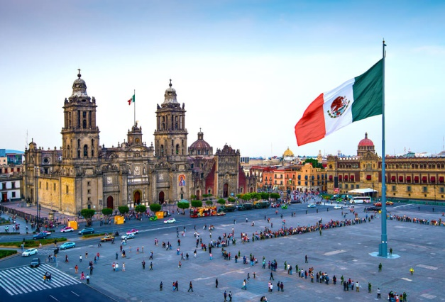
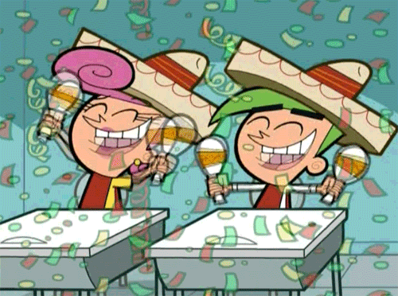
Which countries is this?
MEXICO

Slide 16
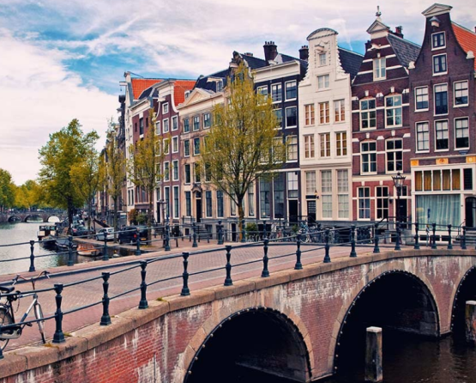
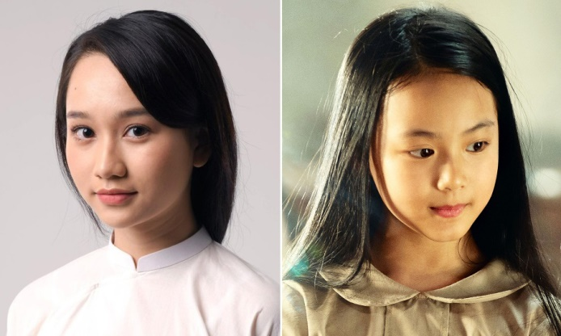
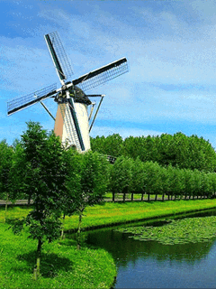
Which countries is this?
NETHERLAND

Slide 17
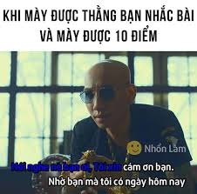
THANKS FOR LISTENING .....

