Slide 1

WARM UP !!!

Slide 2

Unit 8: English speaking countries
Skills 1
A collaboration between : Double Chou x Diệu x Hạnh x Bird

Slide 3
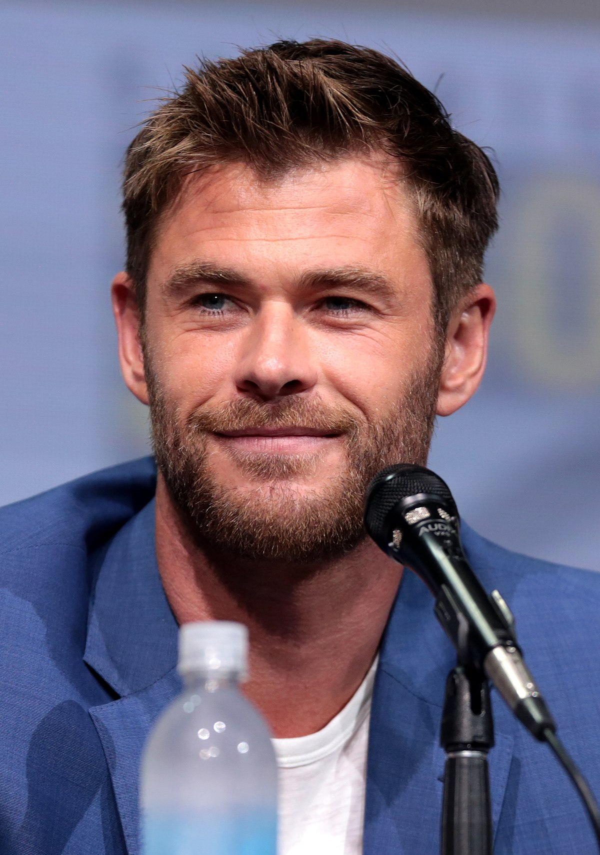
Where does he come from ???
Australia

Slide 4
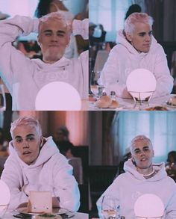
Where is he from ?
Canada

Slide 5
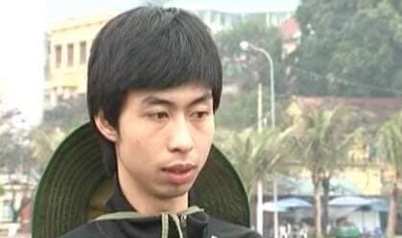
Who is he ?
Đen Vâu
Dìa dia

Slide 6
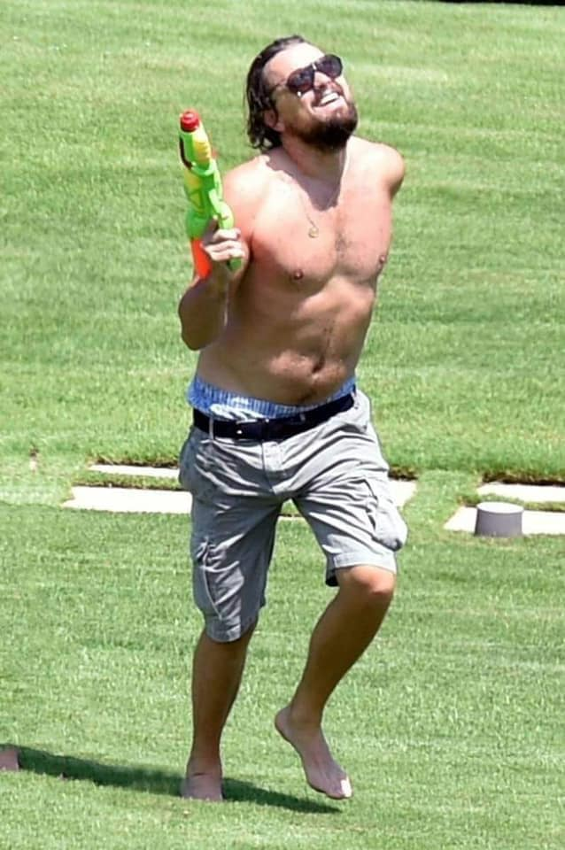
What is the most famous film he starred in?
TITANIC

Slide 7
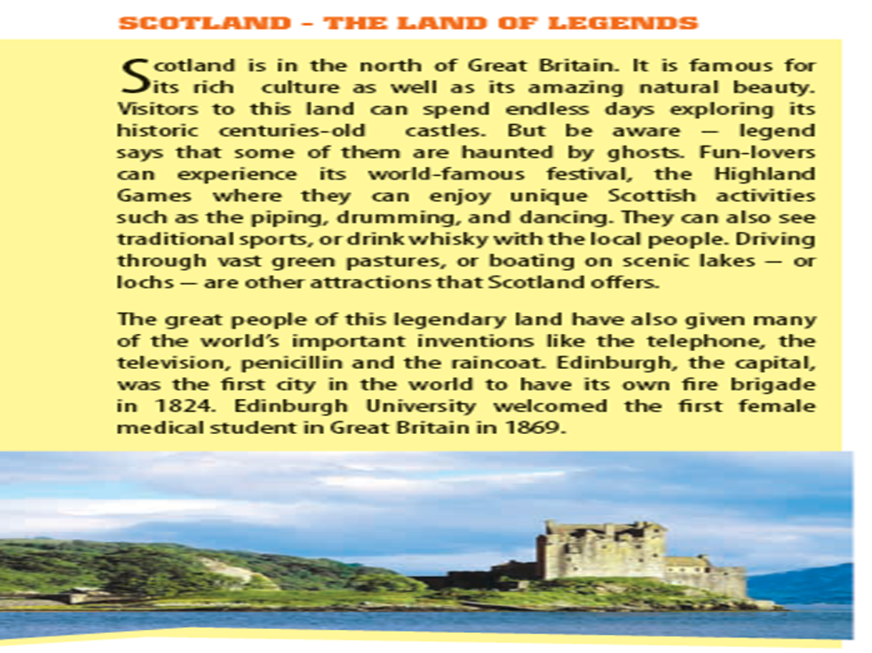

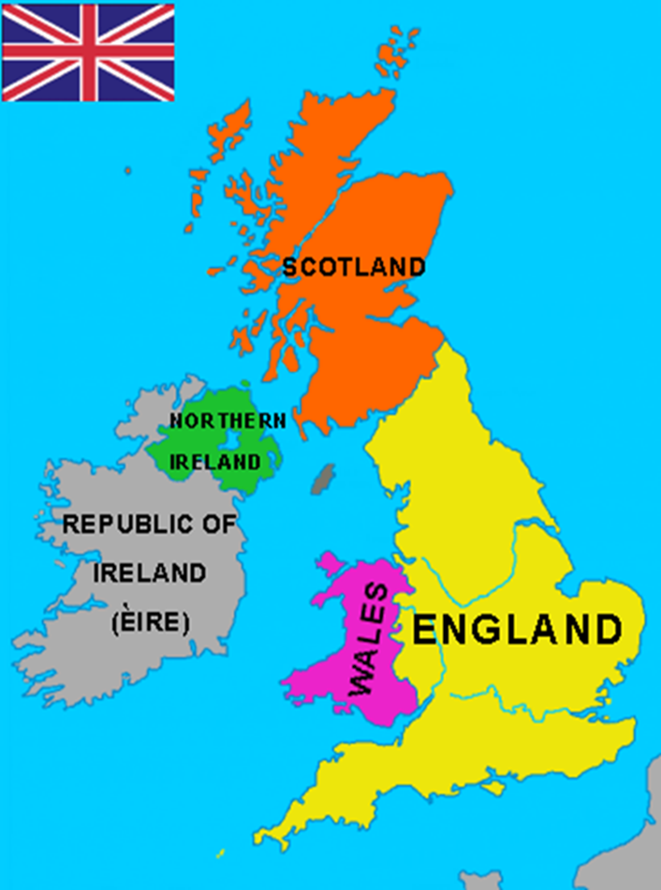
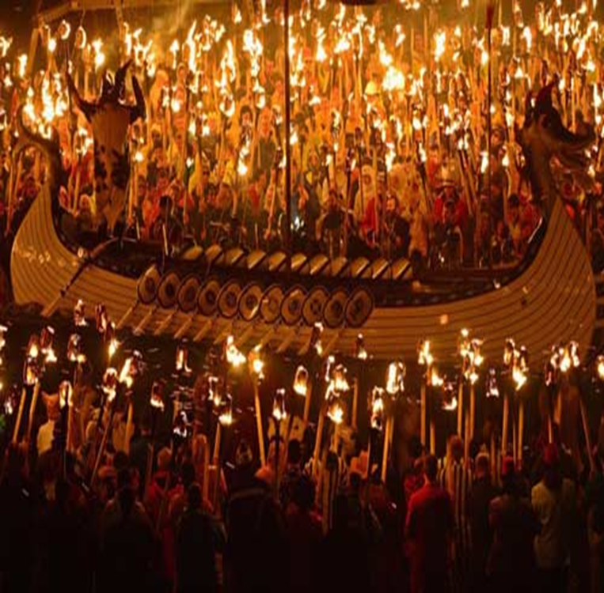
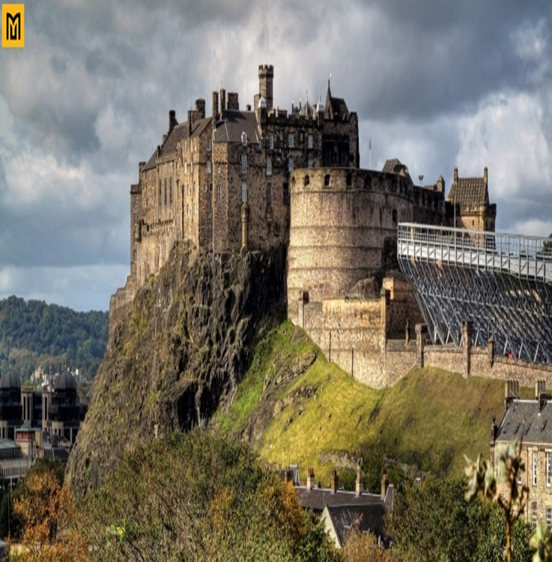

1. Discuss the questions. Then read the passage
1.Where is Scotland?
Scotland is in the north of Great Britain.
2.What is this land famous for ?
It’s famour for its rich culture as well as its amazing natural beauty, historic castles, traditional festival and whisky

Slide 8
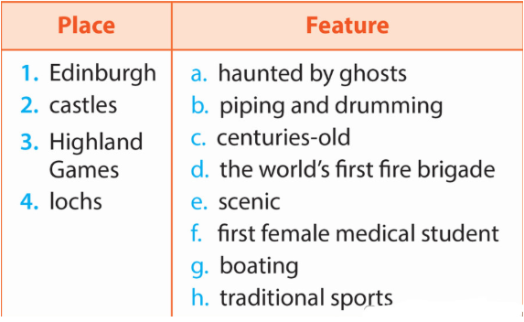
2 Match each place or event with its two features
Answers: 1(D,F);2 (A,C);3(B,H);4(B,G)

Slide 9
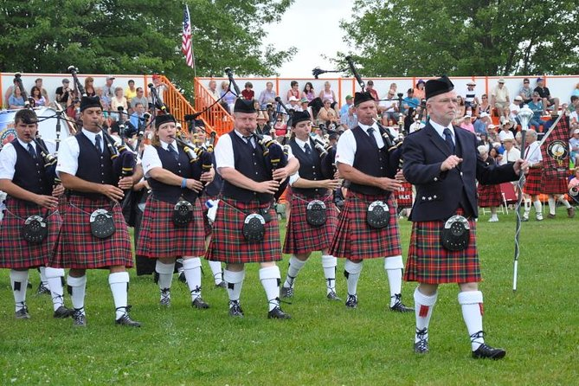
3. Read the passage again and answer the questions.
Is Scotland famous for its rich culture?
- Yes, it is.
2. What might you see while you are exploring a castle?
- I might see a ghost while I am exploring a castle.
3. What are some activities you can see at the Scottish Highland Games?
- I can see piping, drumming and dancing at the Scottish Highland Games.
4. What were some of the things invented by the Scots?
- The television, telephone, penicillin and the raincoat were invented by the Scots.
5. When was the first fire brigade in the world created?
- The first fire brigade in the world created in 1824.

Slide 10
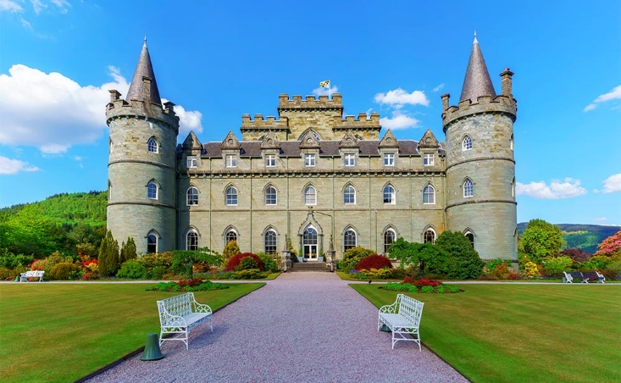
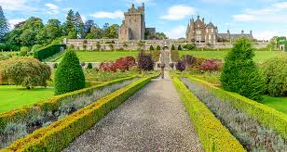
Speaking
4. Work in pairs. Talk about the thing(s) you like most about Scotland. Give reasons.
Example:
-What do you like about Scotland?
-I like the castles.
-Why?
-Because I want to see a ghost!

Slide 11
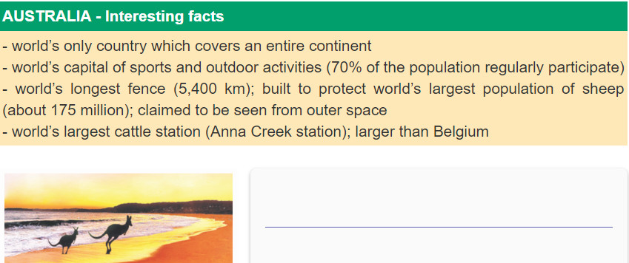
5 Work in groups. Find interesting facts about Australia then present it to the class.

Slide 12

Game on !!!

Slide 13
Normal
Special
Super hard

Slide 14


Slide 15


What is the name of this film ?
+2 points

Slide 16
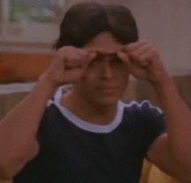
+ 10 points for u babe

Slide 17
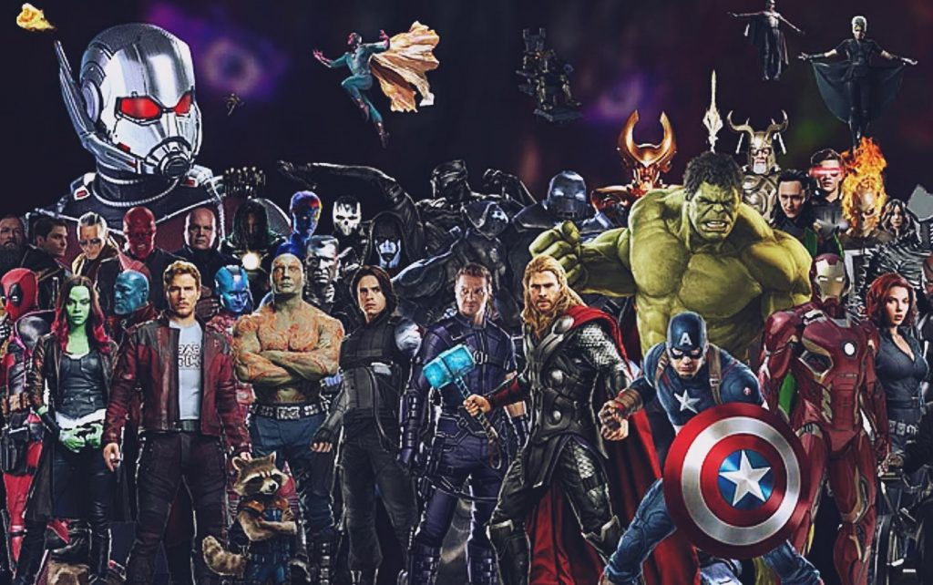
Name 5 Marvel actors/actresses
+5 points

Slide 18
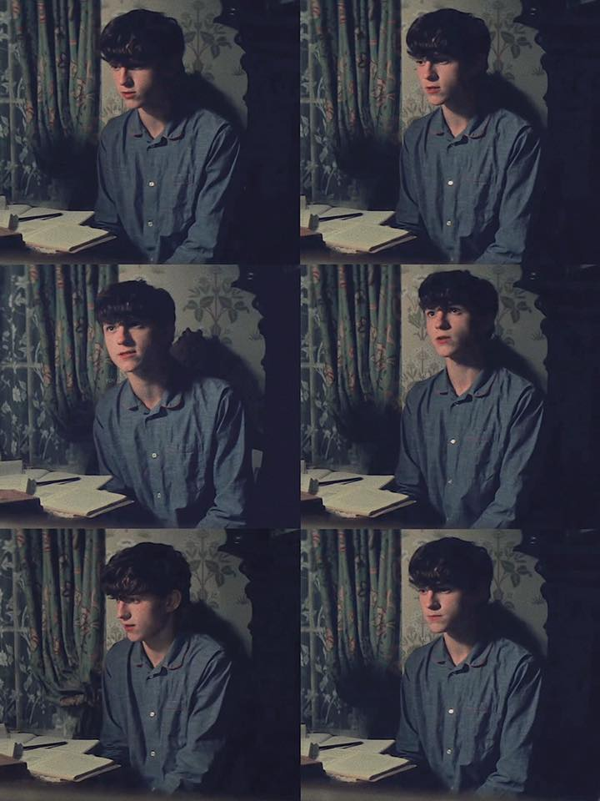
What is Tom Holland’s father name ???
If you could answer this question, your team would win

Slide 19
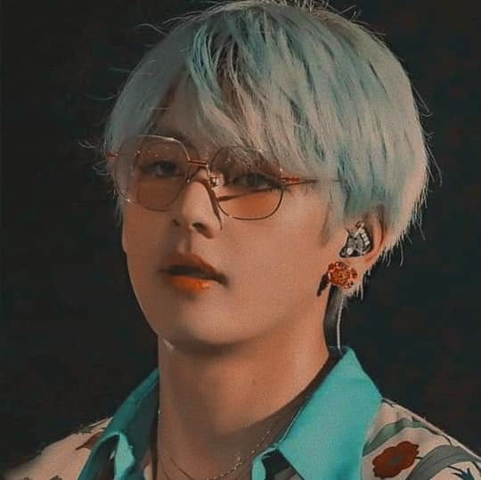
Where is his hometown ?
Daegu
-6

Slide 20
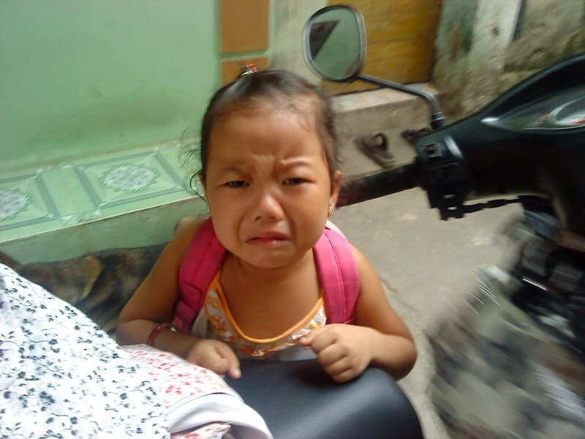
Lose all points
Sorry Hà ☹

Slide 21
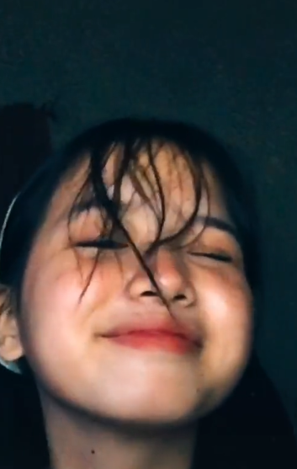
Where does this girl come from ?
Philippines
- 2

Slide 22
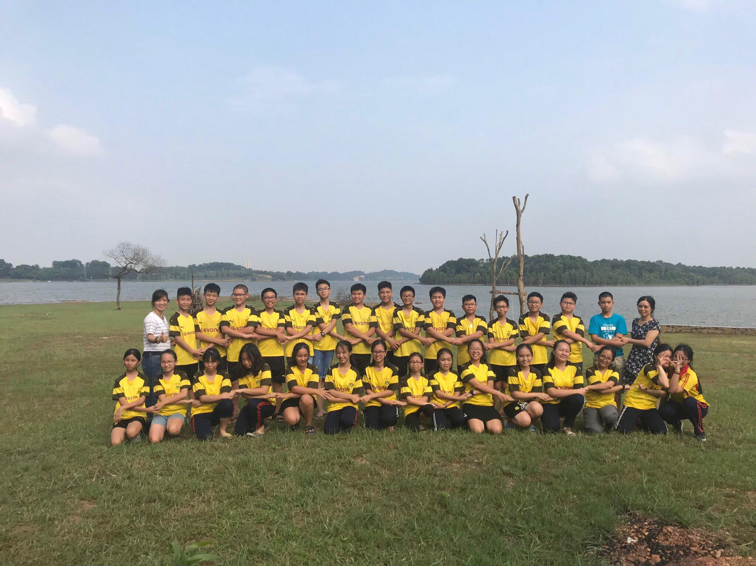
Where did we go last summer holiday?
BA VÌ
+3

Slide 23
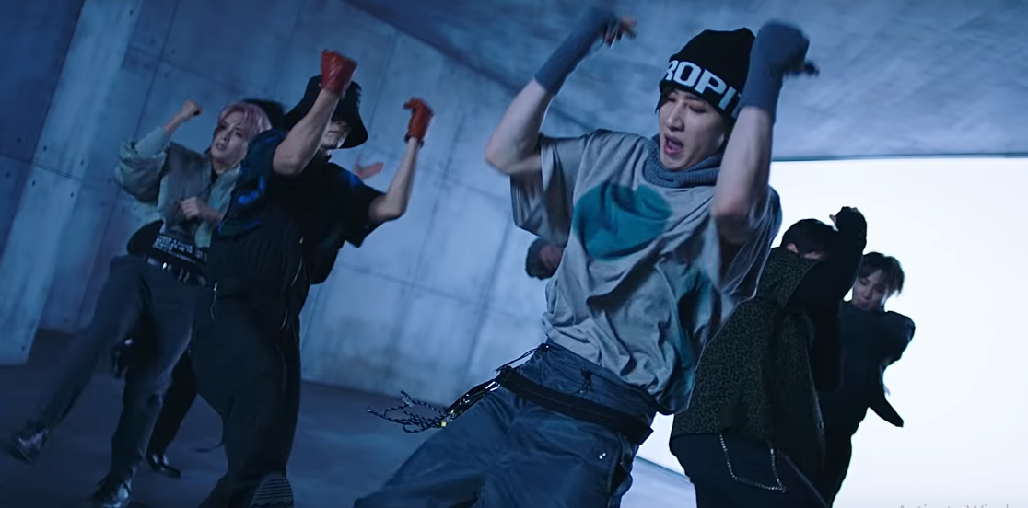
The name of the song ?
+1
'2YA2YAO!‘_Suju

Slide 24
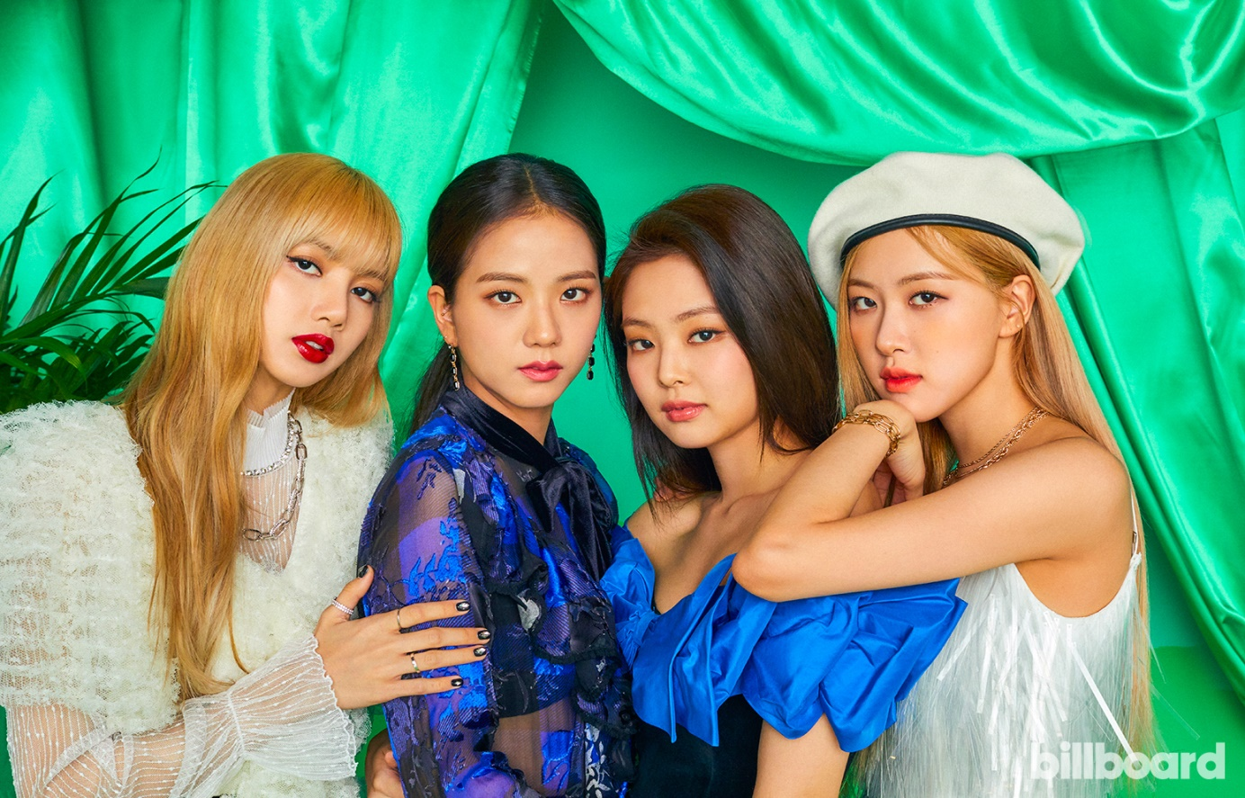
Who are the representatives of Adidas and Samsung in Korea ?
+4

Slide 25
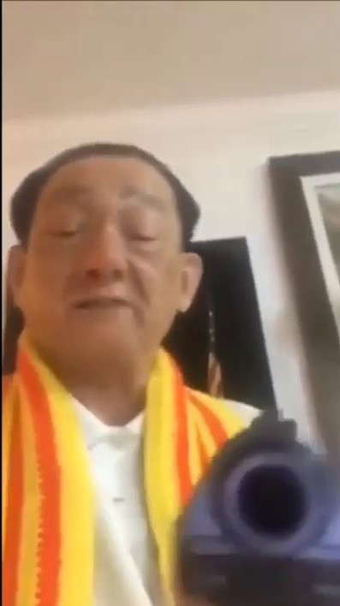
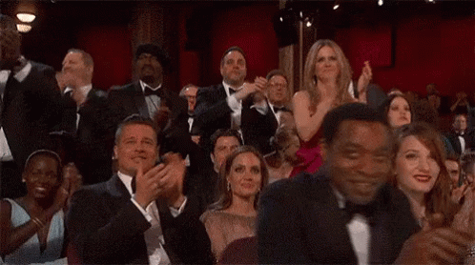
Applause or this old man will shoot you !

