Slide 1

UNIT 5: NATURAL WONDERS OF THE WORLD
Lesson 1: Getting started
By Mrs Snow

Slide 2
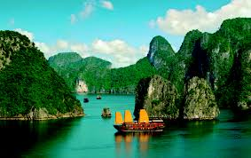
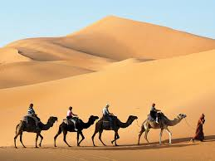
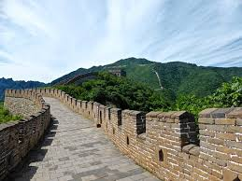
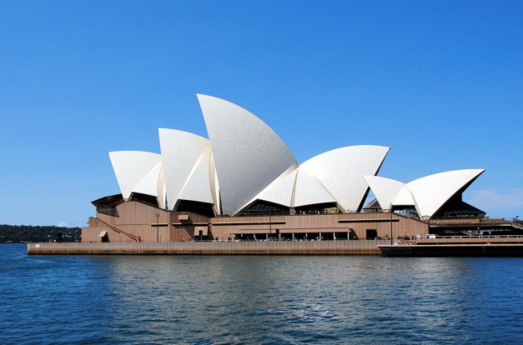
Matching the names of the pictures
Sydney Opera House
Sahara Desert
Ha Long Bay
Great Wall of China
NATURAL WONDERS OF THE WORLD

Slide 3
Unit 5
NATURAL WONDERS OF THE WORLD
Lesson 1
GETTING STARTED
Geography club

Slide 4
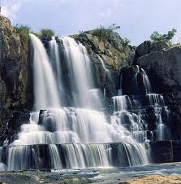
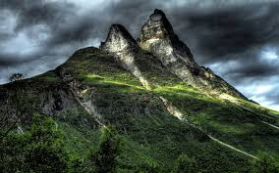
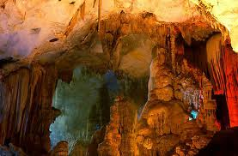
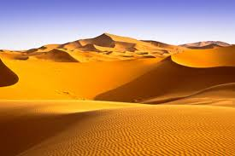
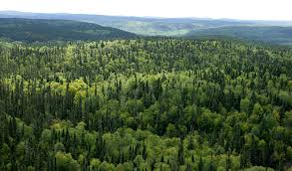
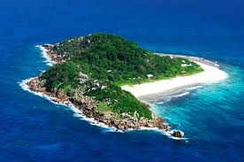
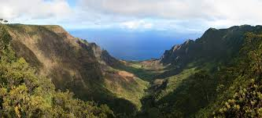
I. VOCABULARY:
- mountain (n) ['maʊntin] :
núi
- desert (n) ['dezət] :
sa mạc
- waterfall ( n ) ['wɔ:təfɔ:l]:
thác nước
- forest (n ) ['fɔrist] :
rừng
- island (n ) [‘ailənd] :
đảo
- cave (n ) [keiv] :
hang động
- valley (n ) [‘væli] :
thung lũng
- incredible (adj) :
đáng kinh ngạc

Slide 5
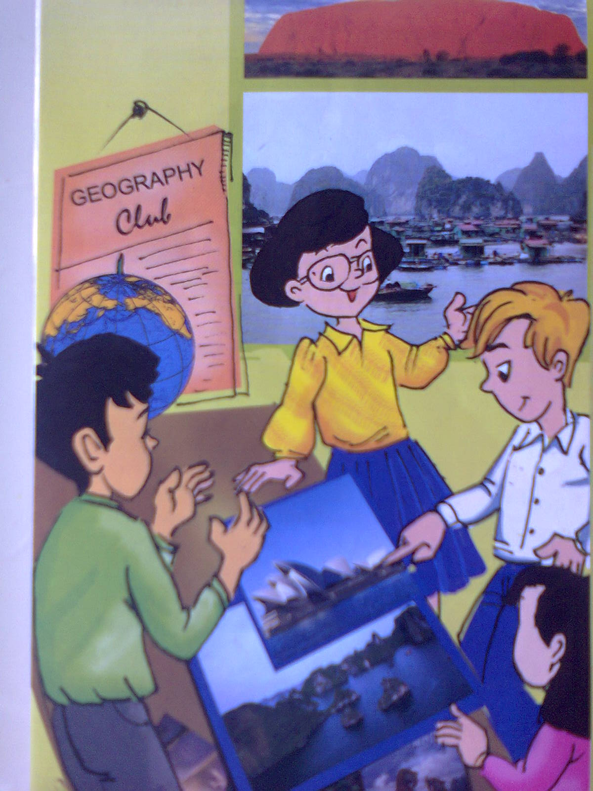

II. Listen and read:
What are they talking about?
a. Their houses
b. Their schools
c. Natural wonders

Slide 6
Vy: Hello, welcome to Geography Club. (Knock at door)
Mai: Sorry! Can I come in? I went to the wrong room.
Vy: No problem, we are just starting now. Today I’m going to introduce some natural wonders of the world to you.
Nick: Great! What’s that in the first picture? It looks incredible.
Mai: Yes! Is it a red mountain?
Vy: Well, that’s Ayers Rock. It’s in the middle of Australia. Local people call it Uluru.
Nick: Can you spell that, please?
Vy: Sure, it’s U-L-U-R-U.
Nick: Thank you.
Vy: It’s not the highest mountain in Australia, but it’s the most beautiful! Its colour changes at different times of the day. People think it’s best in the evening when it is red.
Phuc: I want to visit Ayers Rock one day.
Nick: Picture 2 is Ha Long Bay, isn’t it?
Vy: Well done Nick, that’s right. What else do you know?
Nick: It’s in Viet Nam, of course! Ha ha.
Vy: Yes, it is!There are many islands there.
This picture shows Tuan Chau. It’s one of the largest islands.
Phuc: How about picture 3 …

Slide 7
1a. Answer the following questions.
1. Who is the leader of Geography Club?
2. Why is Mai late?
3. What is the other name of Ayres Rock?
4. Which country would Phuc like to visit?
5. What is Tuan Chau?
6. Is Tuan Chau in Ha Long, Viet Nam?

Slide 8


Game: Spin a wheel
20
25
5
15
10
1
0
20
4
5
25
1
5
2
10
15
5
6
3

Slide 9

1. Who is the leader of Geography Club?
- Vy is the leader of Geography Club.

Slide 10
2. Why is Mai late?
- Because she went to the wrong room.

Slide 11
3. What is the other name of Ayres Rock?
- It is Uluru.

Slide 12
4. Which country would Phuc like to visit?
- Australia.

Slide 13
5. What is Tuan Chau?
- An island.

Slide 14
6. Is Tuan Chau in Ha Long, Viet Nam?
- Yes, it is.

Slide 15
* Choose the correct answer:
1/ Who is the leader of Geography Club?
a. Phuc
b. Mai
c. Vy
2/ Why is Mai late?
a. She went to the wrong room.
b. She was lost.
c. She got up late.
3/ What is the other name of Ayers Rock?
a. Club
b. Uluru
c. Tuan Chau
4/ Which country would Phuc like to visit?
a. Australia
b. Laos
c. Singapore
5/ What is Tuan Chau?
a. a mountain
b. an island
c. a lake

Slide 16
1. b. Put the words in the correct order
1. spell / you / that / please / can
Can you spell that, please?
2. repeat / you / that / please / can
Can you repeat that, please?
3. come / I / can / in
Can I come in?

Slide 17
Vy: Hello, welcome to Geography Club. (Knock at door)
Mai: Sorry! Can I come in? I went to the wrong room.
Vy: No problem, we are just starting now. Today I’m going to introduce some natural wonders of the world to you.
Nick: Great! What’s that in the first picture? It looks incredible.
Mai: Yes! Is it a red mountain?
Vy: Well, that’s Ayers Rock. It’s in the middle of Australia. Local people call it Uluru.
Nick: Can you spell that, please?
Vy: Sure, it’s U-L-U-R-U.
Nick: Thank you.
Vy: It’s not the highest mountain in Australia, but it’s the most beautiful! Its colour changes at different times of the day. People think it’s best in the evening when it is red.
Phuc: I want to visit Ayers Rock one day.
Nick: Picture 2 is Ha Long Bay, isn’t it?
Vy: Well done Nick, that’s right. What else do you know?
Nick: It’s in Viet Nam, of course! Ha ha.
Vy: Yes, it is!There are many islands there.
This picture shows Tuan Chau. It’s one of the largest islands.
Phuc: How about picture 3 …

Slide 18
c. Making request:
Example:
You may need to spell your name when you order take – away pizza by phone.
A: Hi, can I order a cheese and a meat pizza, please?
B: Sure. What’s your name, please?
A: It’s Nick.
B: Can you spell that, please?
A: Yes, it’s N – I – C – K.

Slide 19
* Role –play:
1. You want to join English club
2. You want to enroll the library card at your school
3. You want to order a uniform at the school
A: Hi, can I.............................................., please?
B: Sure. What’s your name, please?
A: It’s .......................................
B: Can you spell that, please?
A: Yes, it’s .............................................

Slide 20
2. Listen and repeat the following words.
1. mountain
2. river
3. waterfall
4. forest
5. cave
6. desert
7. lake
8. beach
9. island
10. valley

Slide 21


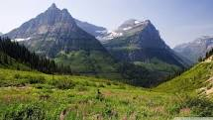
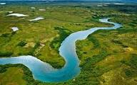
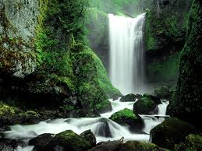
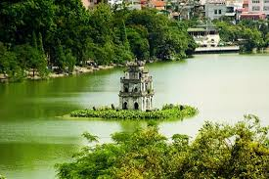
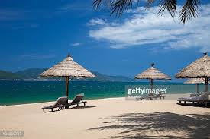
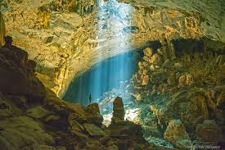
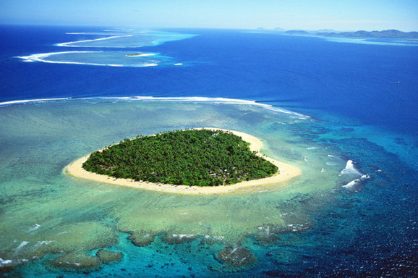
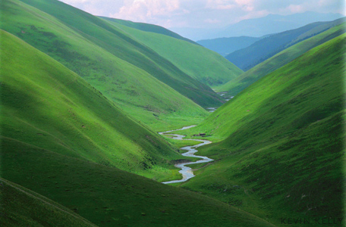
3. Now label the pictures
a. waterfall
b. mountain
c. desert
d. lake
e. river
f. beach
g. forest
h. island
i. valley
j. cave
1.
2.
3.
4.
6.
7.
8.
5.
9.
10.

Slide 22
Vy: Hello, welcome to Geography Club. (Knock at door)
Mai: Sorry! Can I come in? I went to the wrong room.
Vy: No problem, we are just starting now. Today I’m going to introduce some natural wonders of the world to you.
Nick: Great! What’s that in the first picture? It looks incredible.
Mai: Yes! Is it a red mountain?
Vy: Well, that’s Ayers Rock. It’s in the middle of Australia. Local people call it Uluru.
Nick: Can you spell that, please?
Vy: Sure, it’s U-L-U-R-U.
Nick: Thank you.
Vy: It’s not the highest mountain in Australia, but it’s the most beautiful! Its colour changes at different times of the day. People think it’s best in the evening when it is red.
Phuc: I want to visit Ayers Rock one day.
Nick: Picture 2 is Ha Long Bay, isn’t it?
Vy: Well done Nick, that’s right. What else do you know?
Nick: It’s in Viet Nam, of course! Ha ha.
Vy: Yes, it is!There are many islands there.
This picture shows Tuan Chau. It’s one of the largest islands.
Phuc: How about picture 3 …

Slide 23
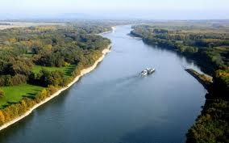
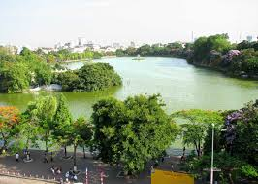
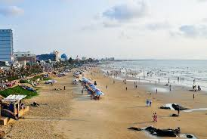
4. Read the conversation in 1. Tick the words you can find.
✓
1. mountain
2. river
3. waterfall
4. forest
5. cave
6. desert
7. lake
8. beach
9. island
✓
10. valley

Slide 24
* HOMEWORK
Learn by heart all new words.
Prepare for the new lesson: Unit 5: A closer look 1
+ Vocabulary: travel items
+ Pronunciation: /t/ and /st/

Slide 25


Thanks for
your
attendance

