Slide 1








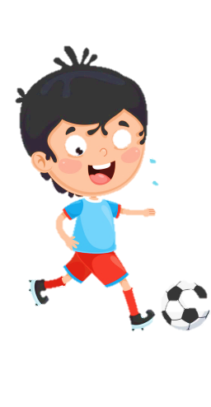

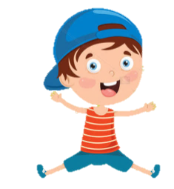





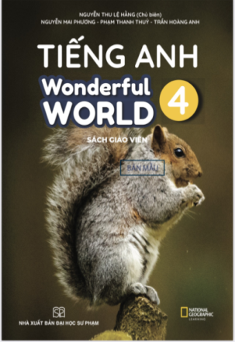



Slide 2



Unit 2 - My House
Lesson 2 – Period 2

Slide 3
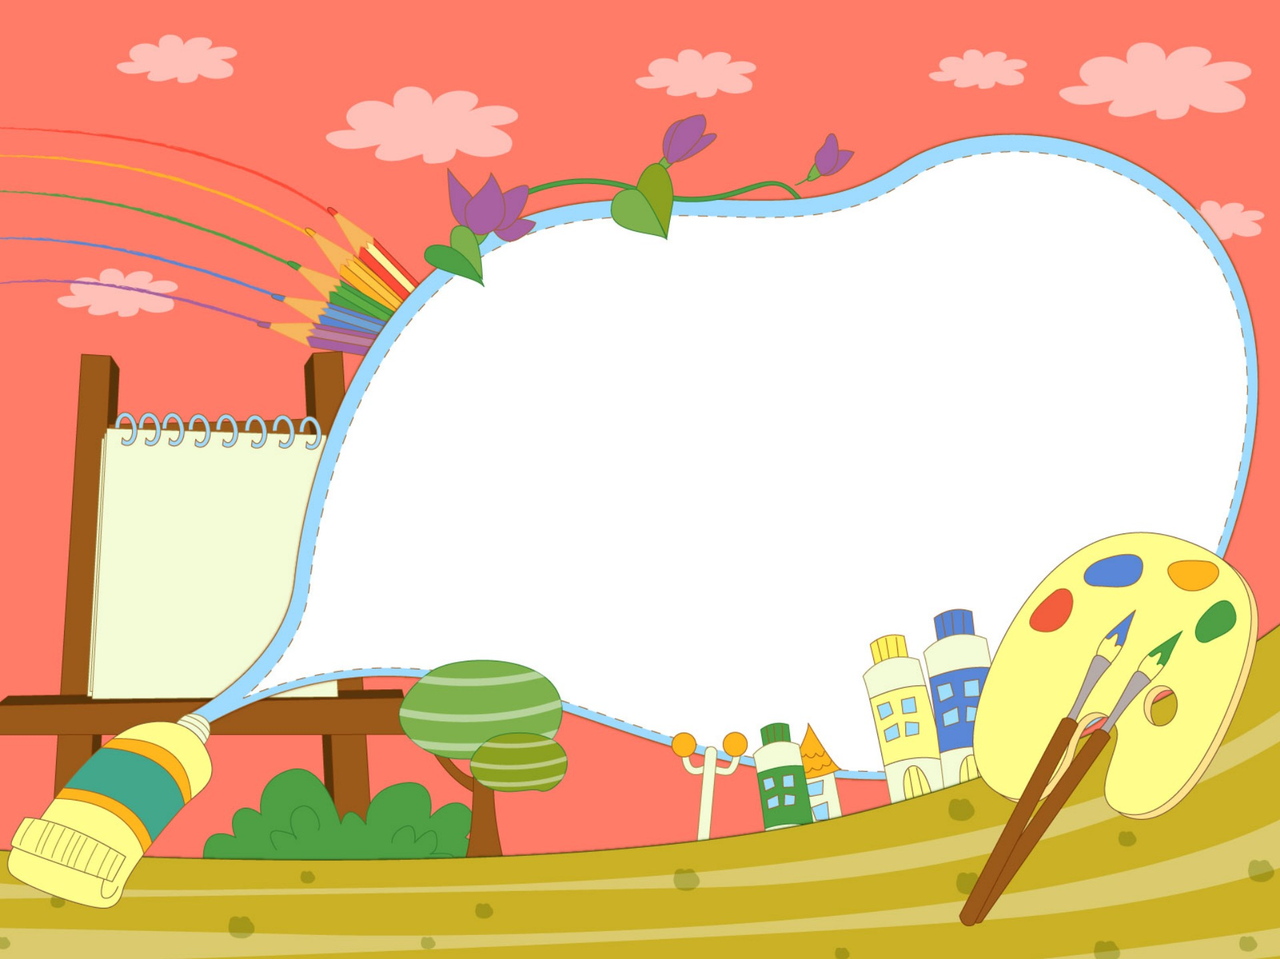

1.Warm up
Matching Time

Slide 4


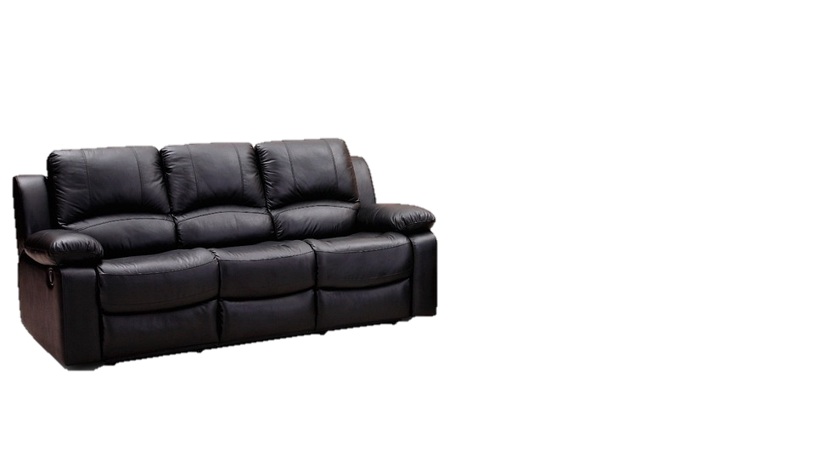

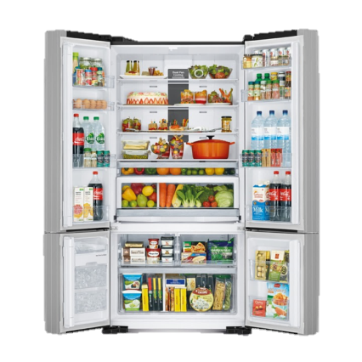
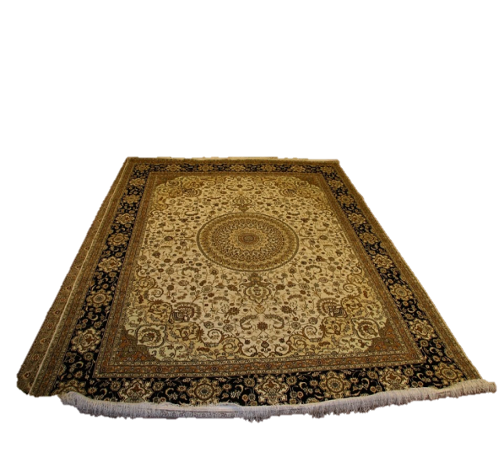
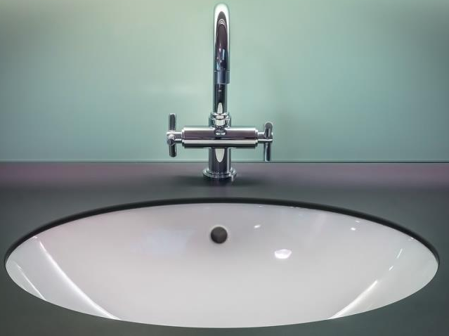
fridge
sink
rug
sofa

Slide 5

Presentation
4
Listen and repeat.

Slide 6

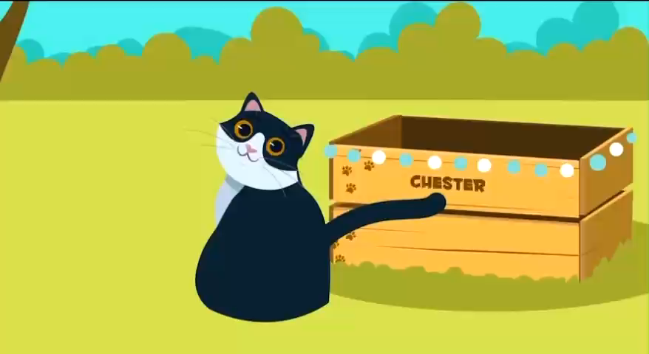

Slide 7

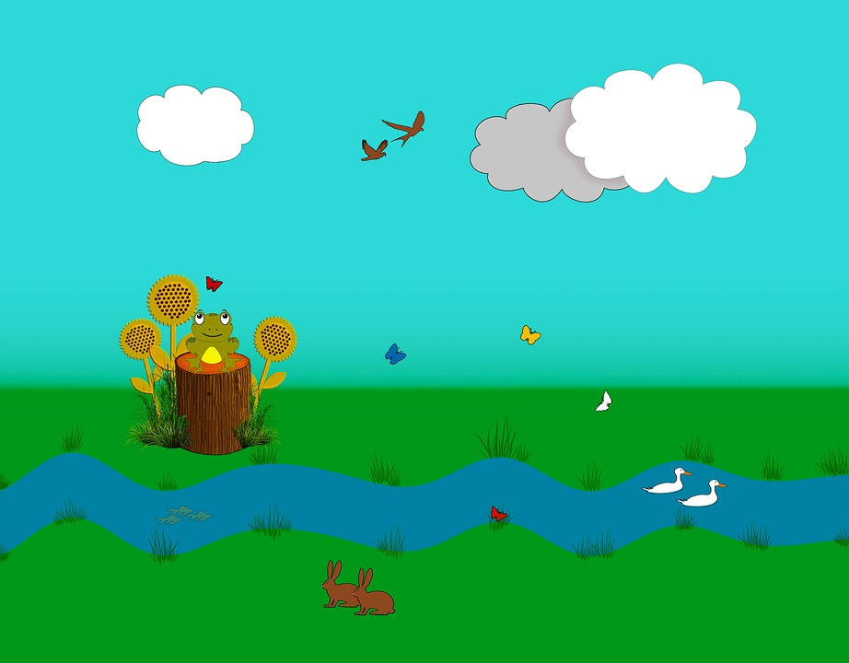

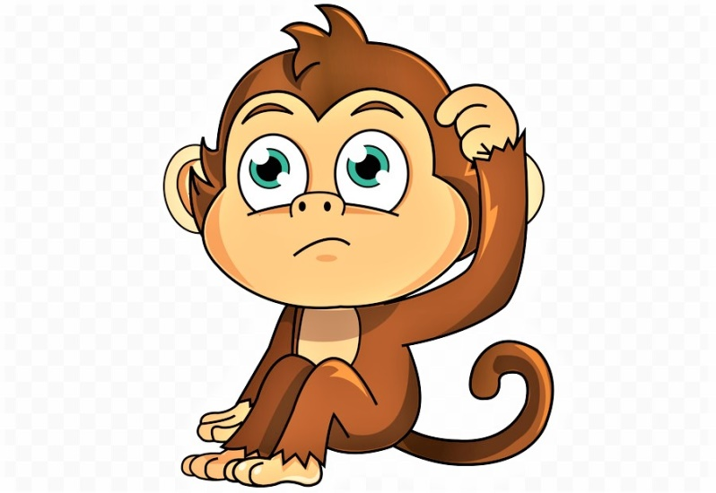
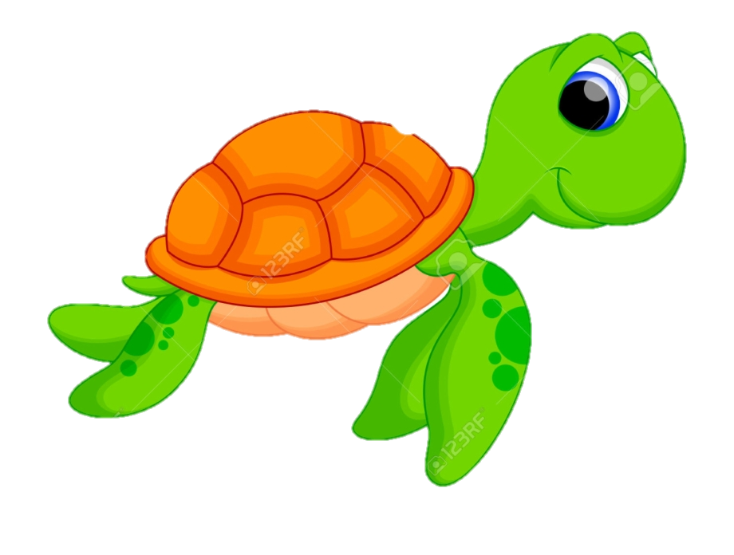
help the monkey

Slide 8

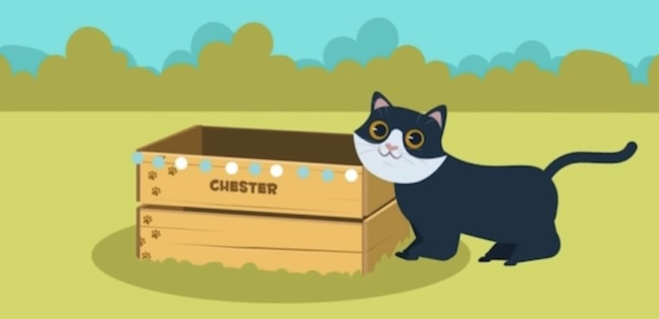
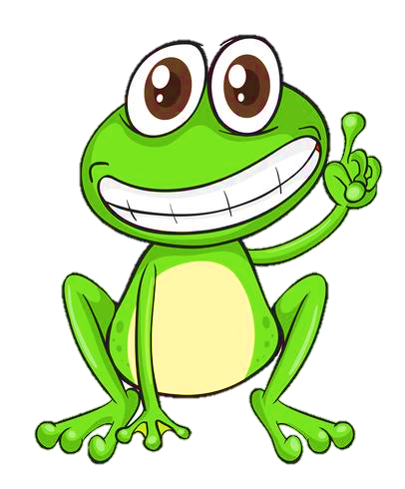

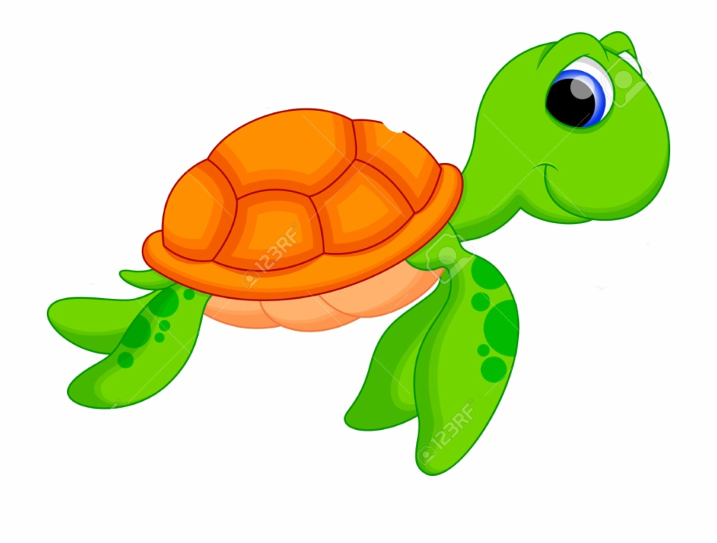
Question 1
The cat is ____ the box.
4 stars
Next to
on
next to
Notes:
Ấn vào con ếch/ chim cánh cụt có đáp án đúng để xem điểm

Slide 9
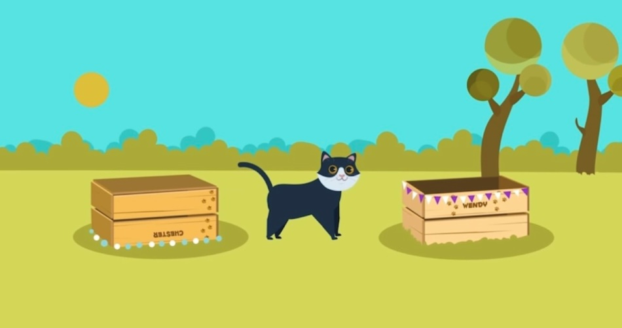


Question 2
It’s ____ the boxes.
behind
between
7 stars

Slide 10
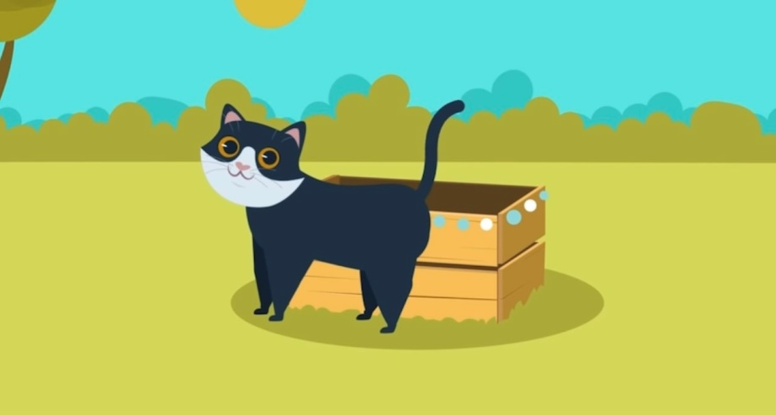
Question 3
The cat is ____ the box.
6 stars
Next to
in
in front
of

Slide 11
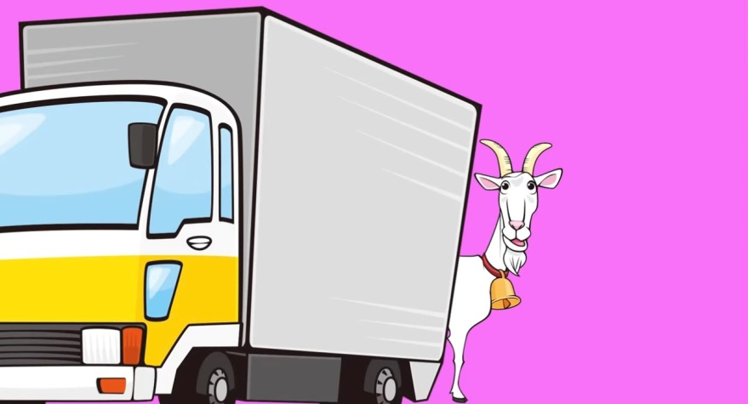
Question 4
The goat is ___ the truck.
under
behind
5 stars

Slide 12

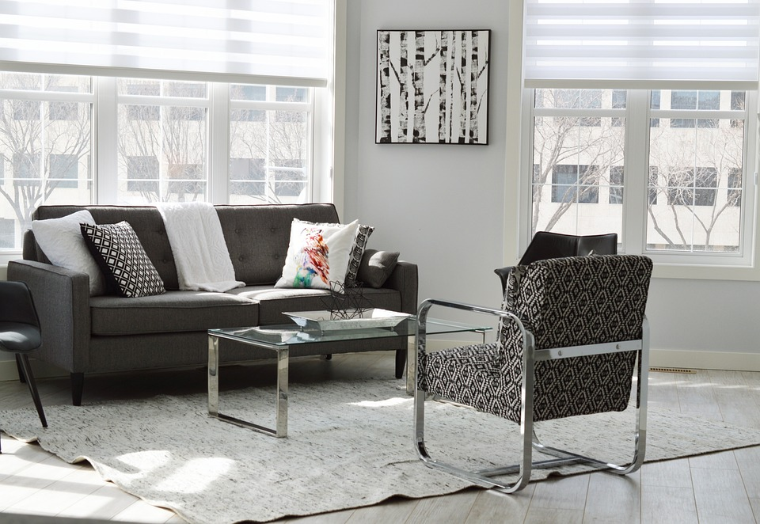
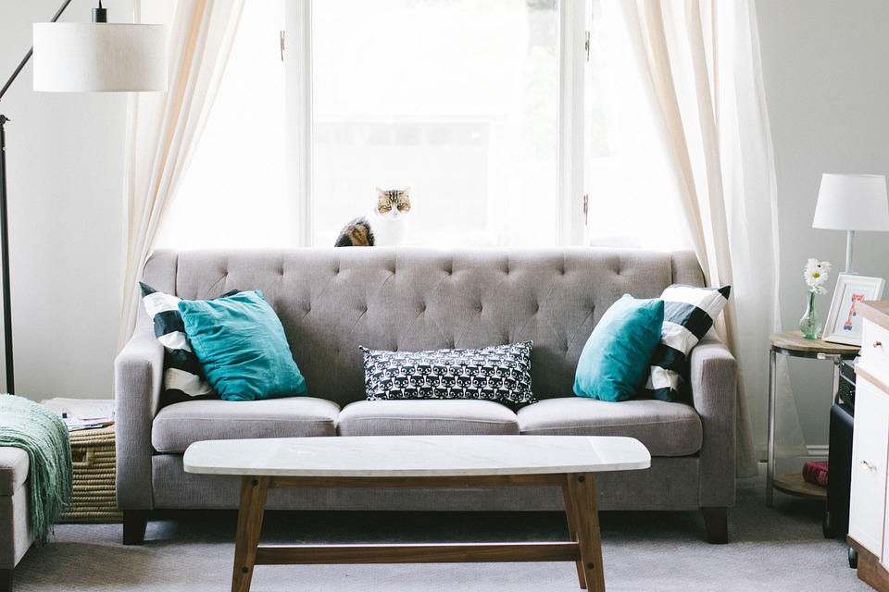
4
Listen and repeat.
2. Where is the sofa?
-It’s between two lamps.
1. Where is the rug?
-It’s in front of the sofa.

Slide 13
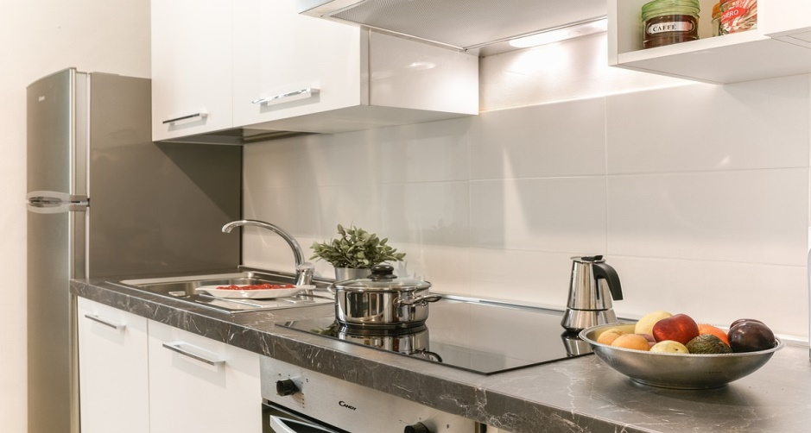
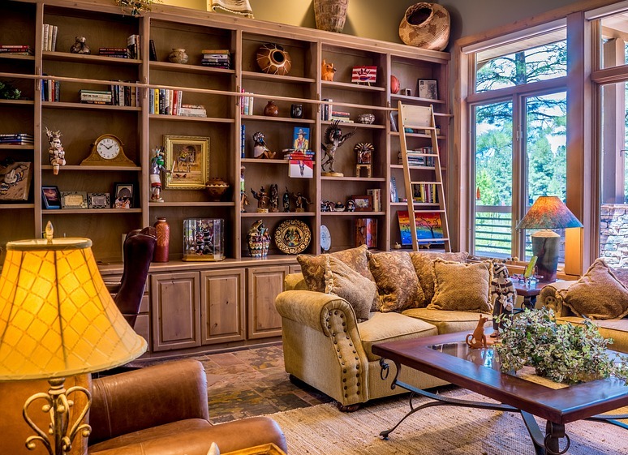
3. Where is the fridge?
4. Where are the books?
-It’s next to the sink.
- They’re behind the sofa.

Slide 14

Practice
5
Look and say.

Slide 15


Yes or No

Slide 16
1. Is this a rug?
2. Is the rug behind the table?
Yes
No
Yes
No
No, it isn’t.
It’s under the table.

Slide 17
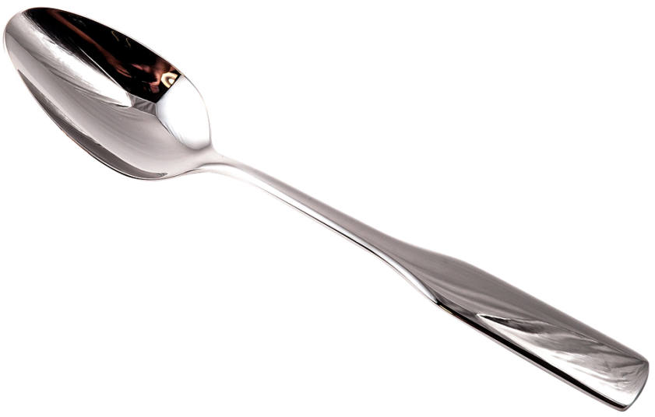
3. Are they two plates?
4. Is the sofa behind the table?
Yes
No
Yes
No
No, they aren’t.
They are spoons.

Slide 18

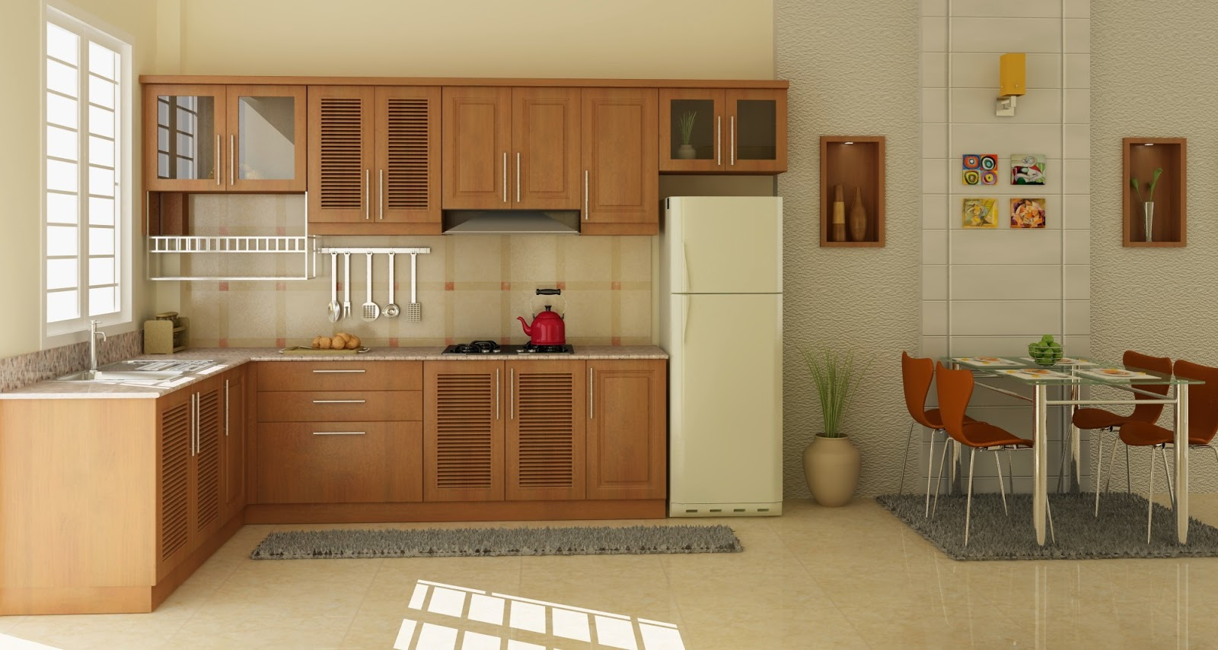


5
Look and say.
The rug/ in front of/ the fridge
Where is the rug?
The rug is in front of the fridge.

Slide 19


The sofa/ behind/ the table
Where is the sofa?
The sofa is behind the table.

Slide 20
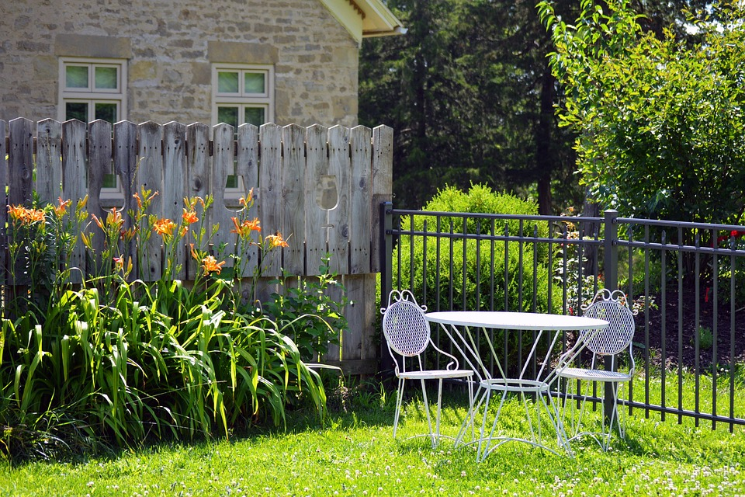
The table/ between/ two chairs
Where is the table?
The table is between two chairs.

Slide 21

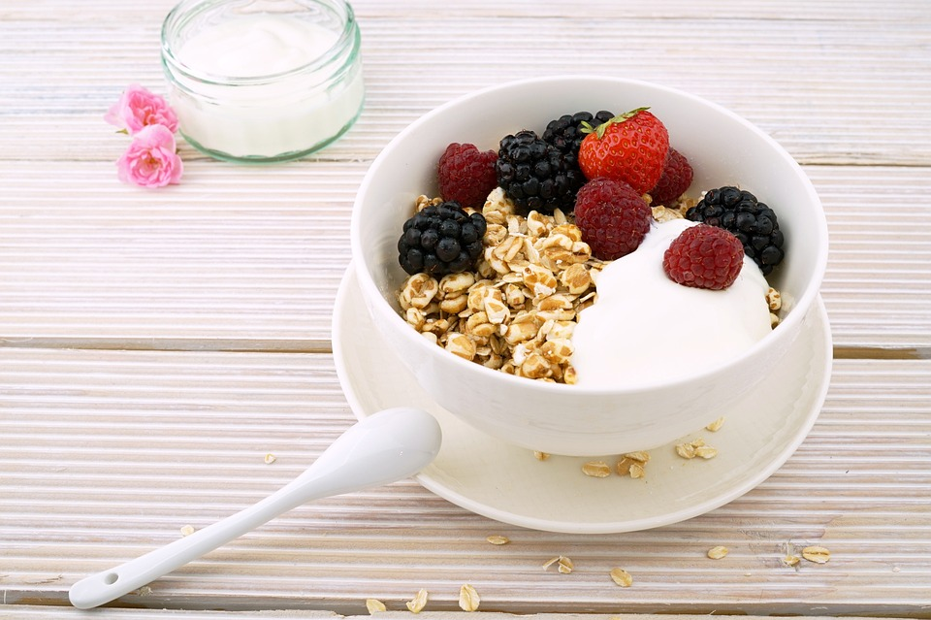
The bowl/ next to/ the spoon
Where is the bowl?
The bowl is next to the spoon.

Slide 22

Production
6
Listen and chant.

Slide 23

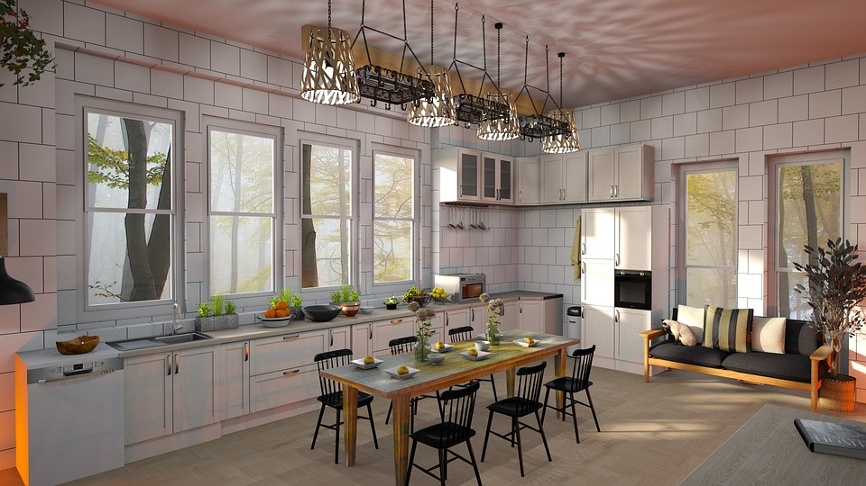
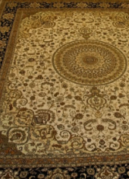
What do you see in the picture?

Slide 24
What do you see in the picture?
big fridge
small sink
brown table
black chairs
colorful rug
some bowls
………………

Slide 25


6
Listen and chant.
This is our kitchen,
our lovely kitchen.
There’s a fridge, a big, big fridge.
There’s a sink,
a small, small sink.
There are some rugs colourful, colourful rugs.
Come and see
our lovely kitchen!
Notes:
Hs nghe bài chant

Slide 26
6
Listen and chant.
This is our kitchen,
our lovely kitchen.
There’s a fridge, a big, big fridge.
There’s a sink,
a small, small sink.
There are some rugs colourful, colourful rugs.
Come and see
our lovely kitchen!
Notes:
Hs học chant từng câu

Slide 27

Let’s chant.
There’s a sink,
a small, small sink.
This is our kitchen,
our lovely kitchen.
There are some rugs colourful, colourful rugs.
There’s a fridge, a big, big fridge.
Come and see
our lovely kitchen!
Notes:
Hs tự hát

Slide 28

Assessment

Slide 29
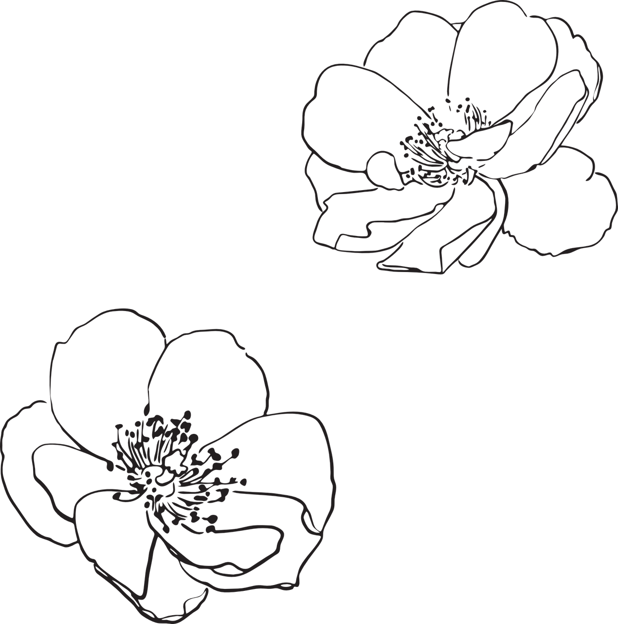
Order the words to make complete sentences
1. This/ our/ is/ kitchen/ lovely.
This is our lovely kitchen.
__________________
2. The/ between/ is/ table/ chairs/ two.
The table is between two chairs.
_________________________
3. Three/ next to/ are/ bowls/ plate/ the.
Three bowls are next to the plate.
_________________________
4. Where/ the/ rug/ is/ ?
Where is the rug?
_____________

Slide 30

Wrap up
Notes:
Đây k phải là extra, đây là hđ 3 của bài

Slide 31
REMEMBER
VOCABULARY:
Behind
Under
Next to
Between
In front of
STRUCTURE:
Where is the rug?
- The rug is in front of the fridge.
31

Slide 32




Thank you & goodbye!

