Slide 1





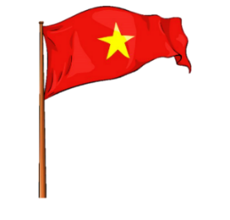





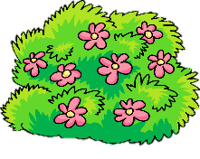
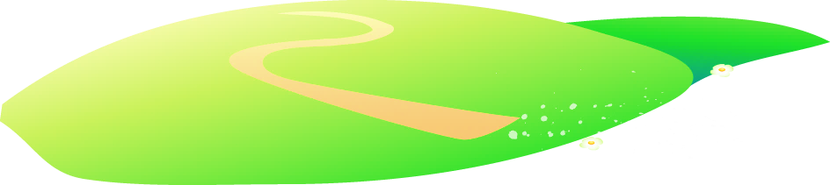


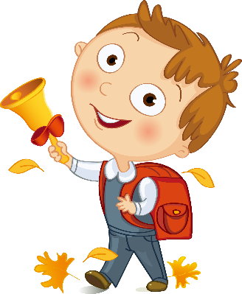
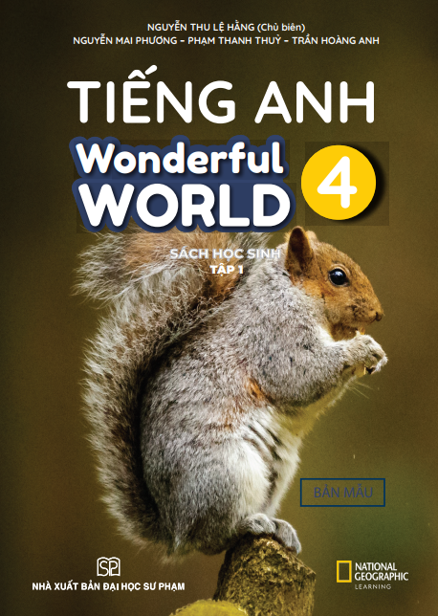


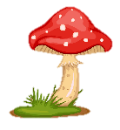
Notes:
Để nguyên trang bìa như này, chỉ thay đổi tên bài trong quá trình làm. Logo của sách Wonderful World

Slide 2
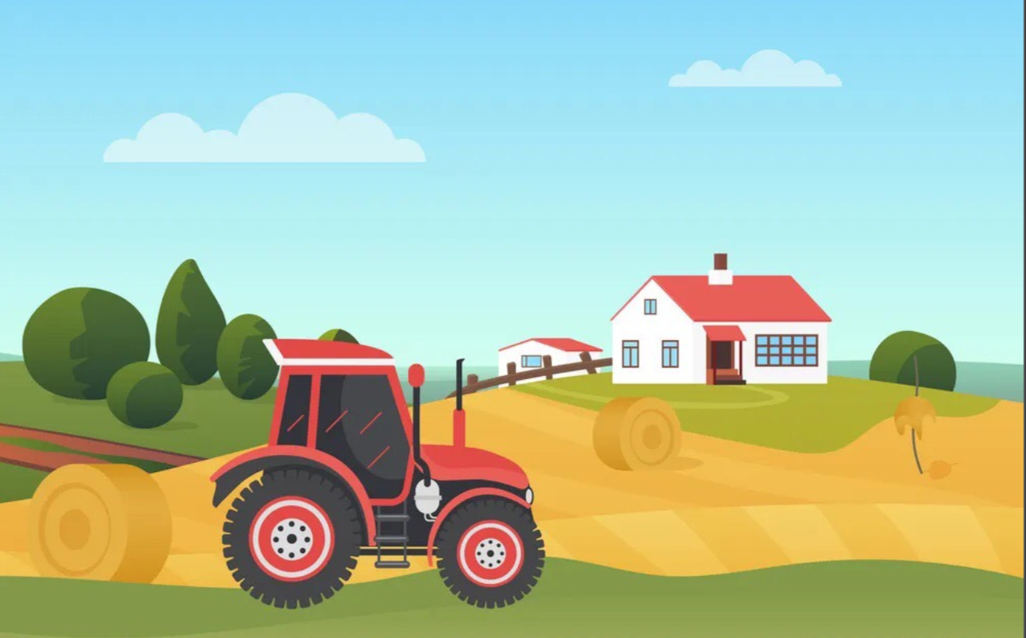

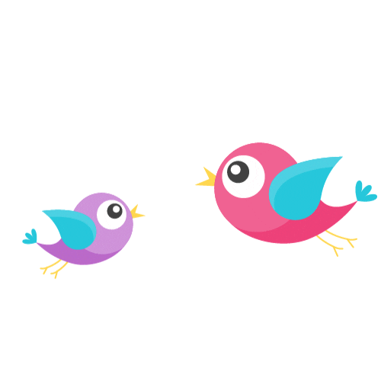
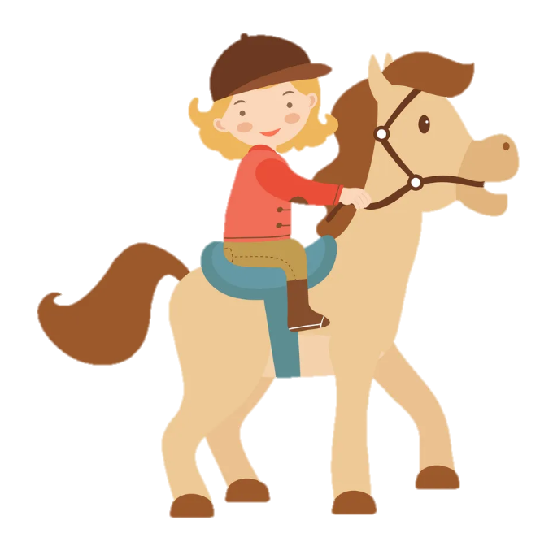
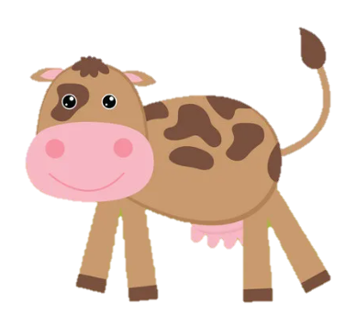
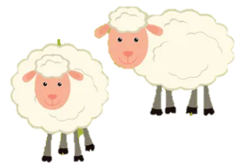
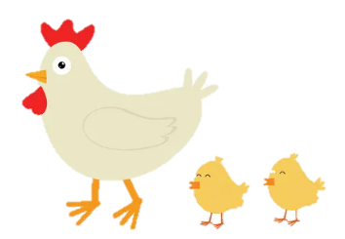
Unit 3: On the farm
Lesson 3. Task 4 5 6

Slide 3
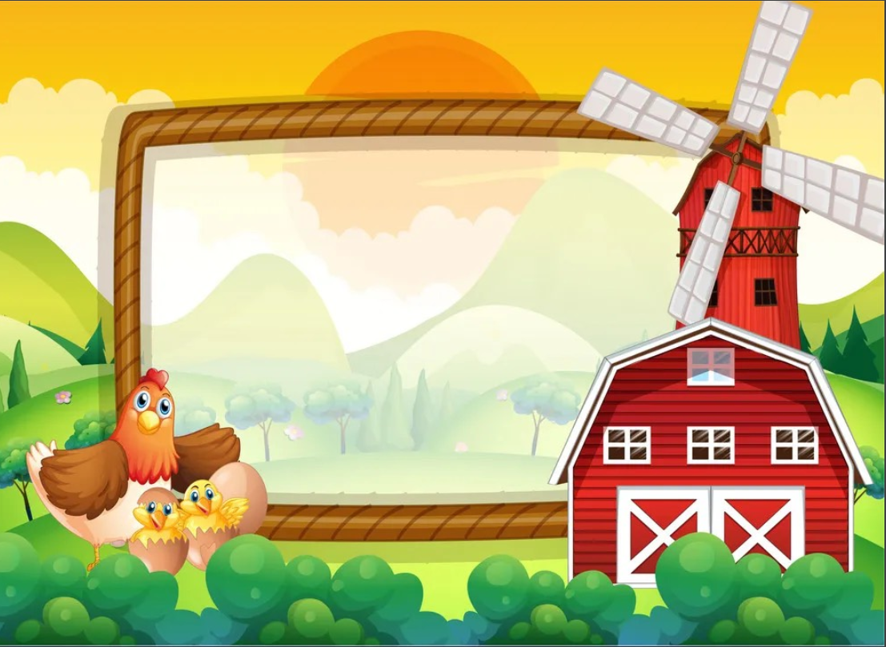
1
Warm Up

Slide 4
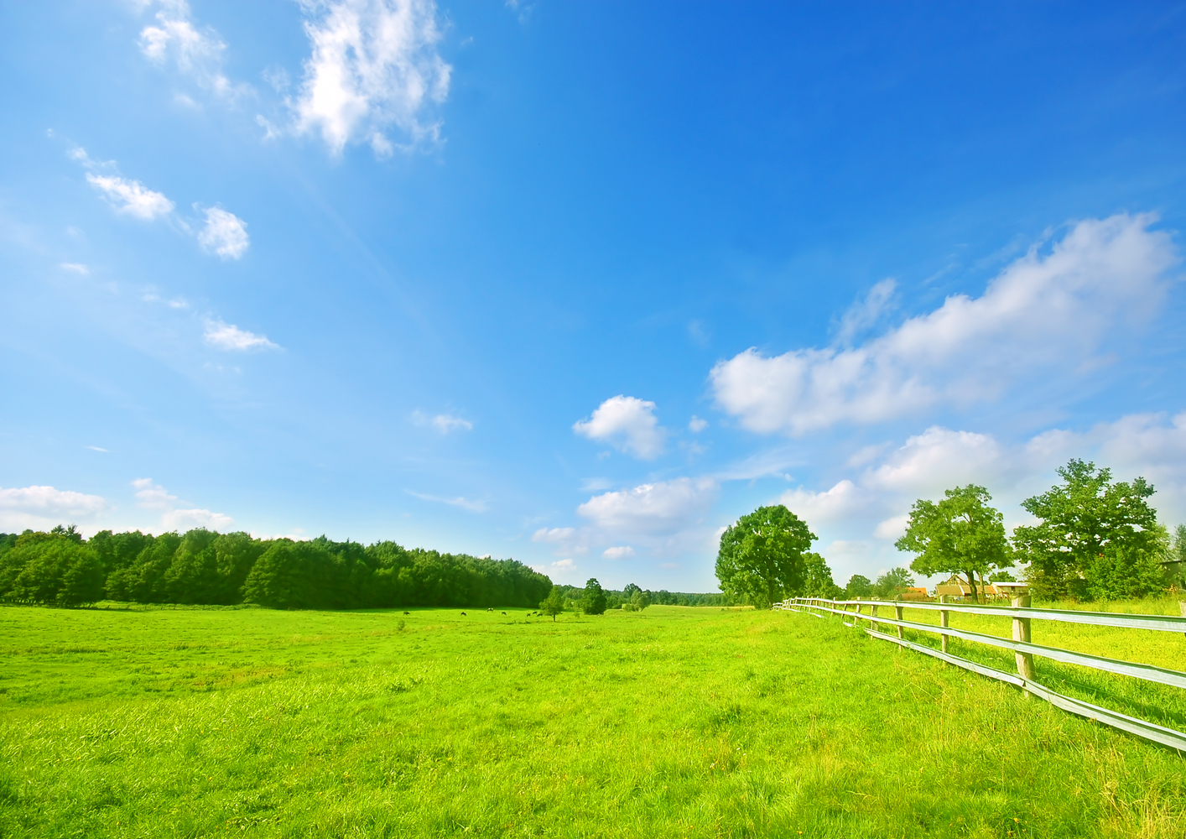
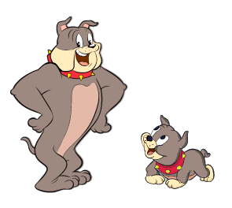
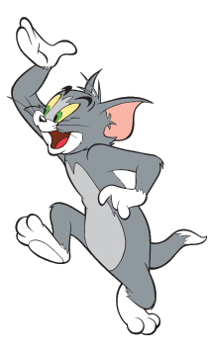
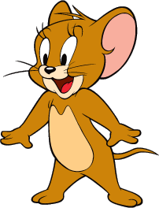
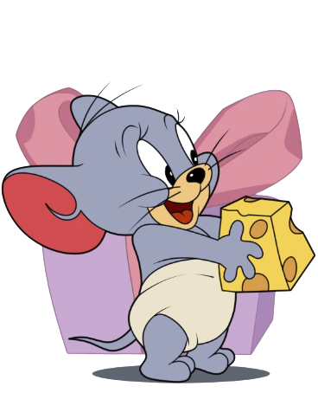
Tom and Jerry Puzzle!

Slide 5
Pick A Character!
Next

Slide 6
m s l a n i a
  animals
back

Slide 7
s a p t l n
  plants
back

Slide 8
f e d i s l
  fields
back

Slide 9
t s i r u f
  fruits
back

Slide 10
2
Presentation

Slide 11
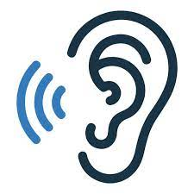

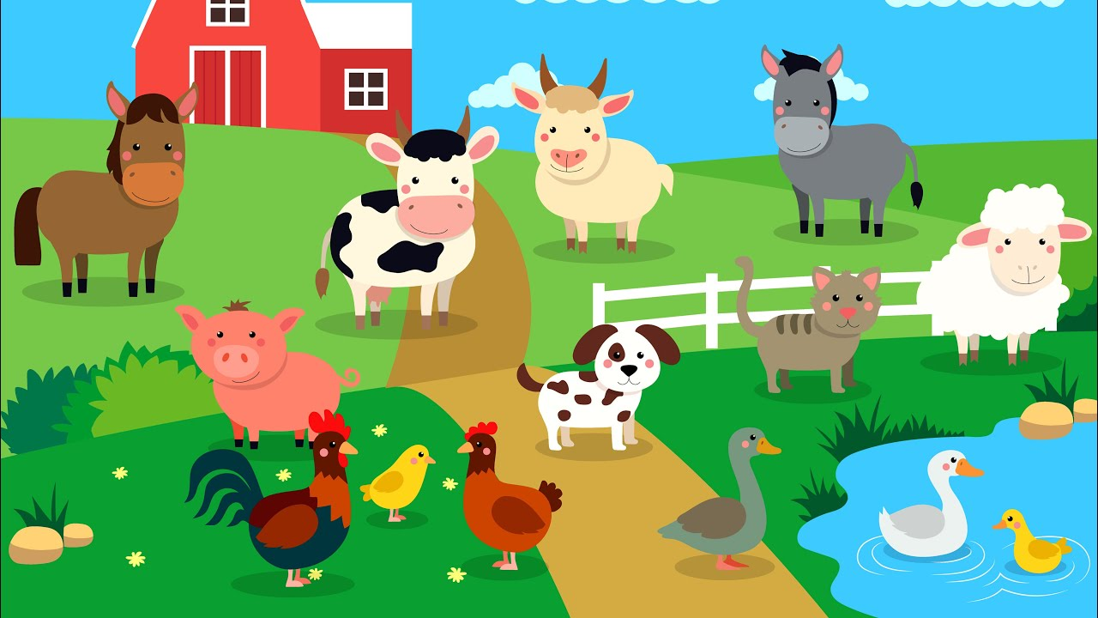
4. Listen and repeat.
- Have you got animals on the farm?
- Yes, we have.

Slide 12
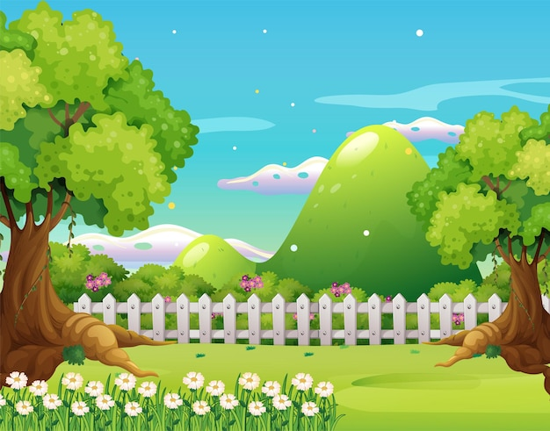
1 Listen and repeat.
- Have you got fruit trees in the field?
- No, we haven’t.

Slide 13
✘
Remember!
hαven’t = hαve not

Slide 14
3
Practice

Slide 15
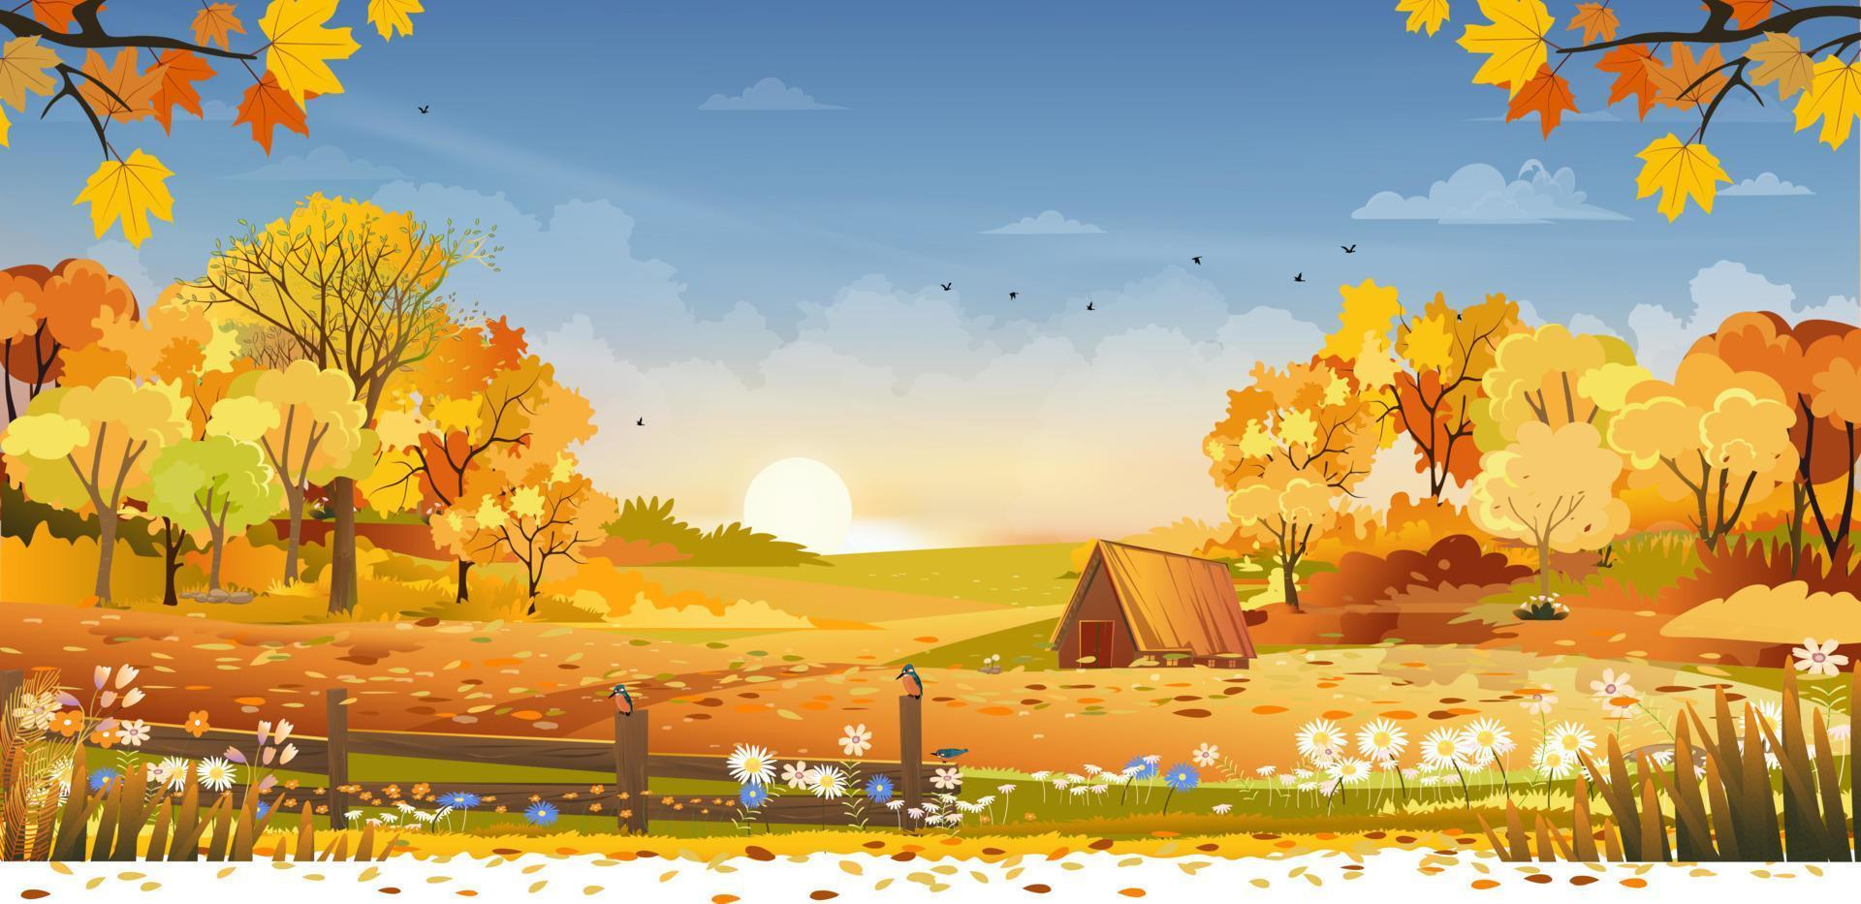
5. Choose and say!
Fruit trees
Chickens
next
Horses
Sheep
Cows

Slide 16
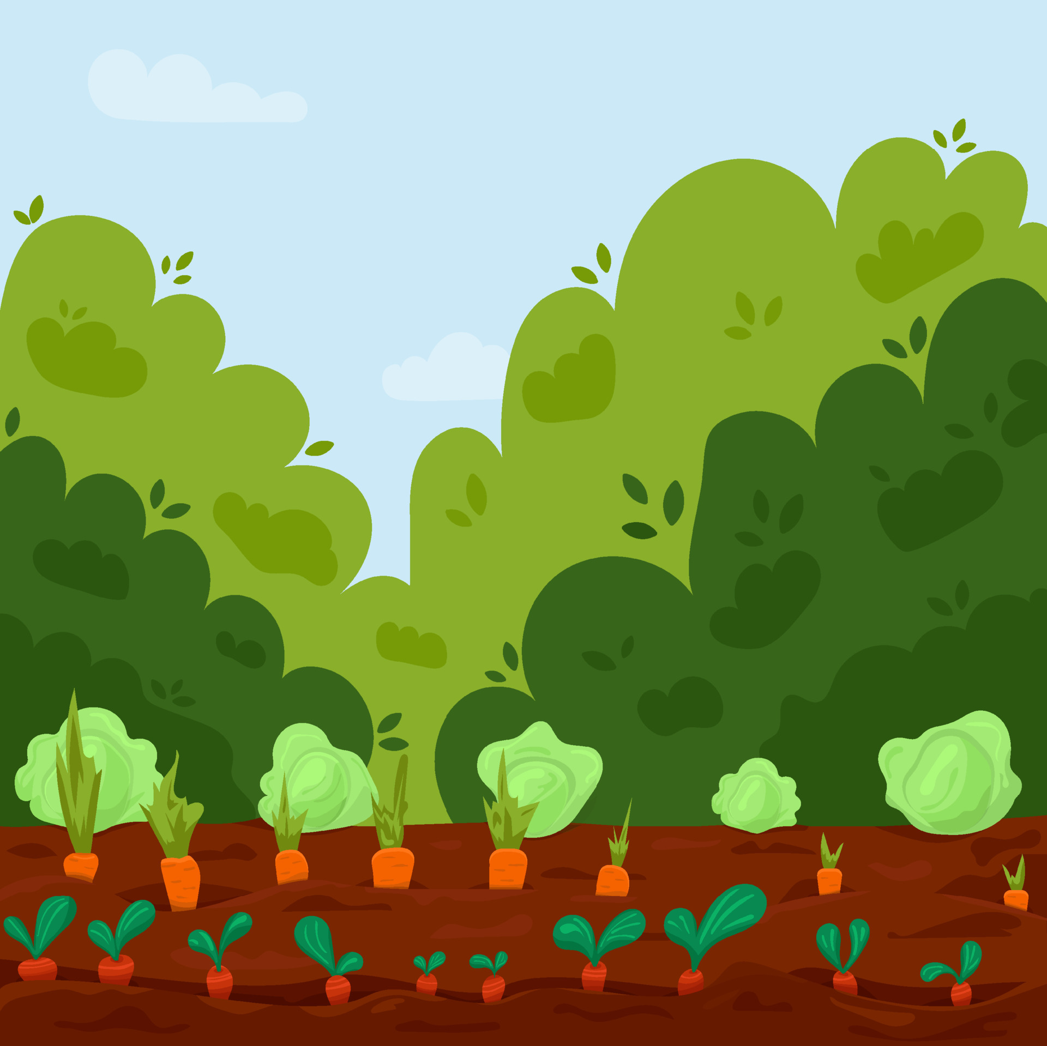
5. Look and Say
Have you got plants on the farm?
Yes, we have!
Home

Slide 17
5. Look and Say
Have you got chickens on the farm?
No, we haven’t.
Home

Slide 18
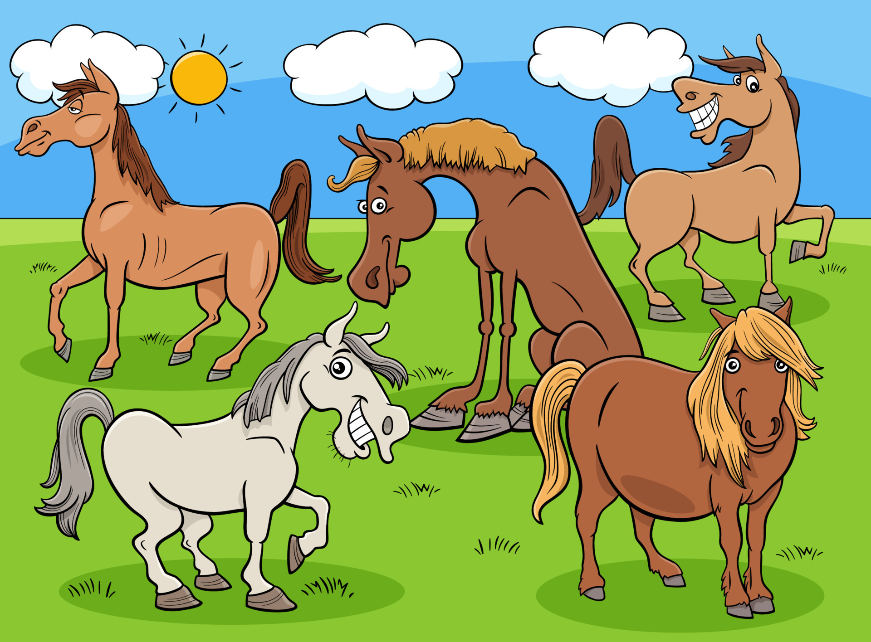
5. Look and Say
Have you got horses on the farm?
Yes, we have!
Home

Slide 19
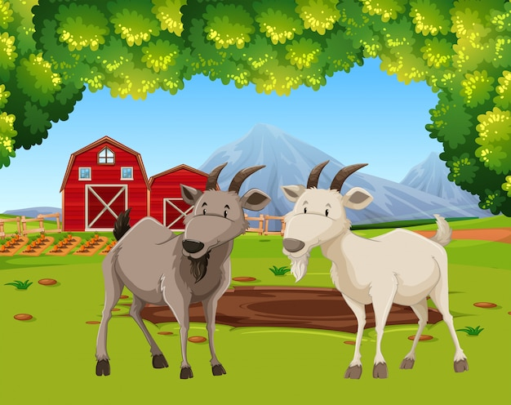
5. Look and Say
Have you got sheeps on the farm?
No, we haven’t!
Home

Slide 20
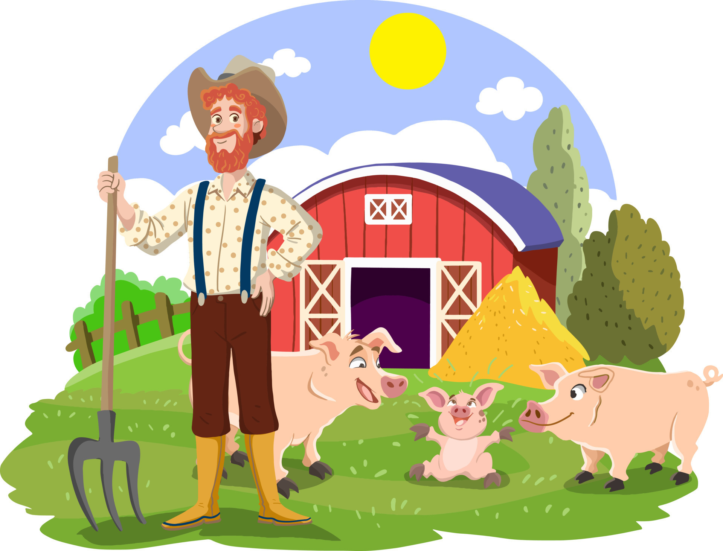
5. Look and Say
Have you got cows on the farm?
No, we haven’t!
Home

Slide 21
6. Let’s talk!
Have you got cows on the farm?
Yes, we have!

Slide 22
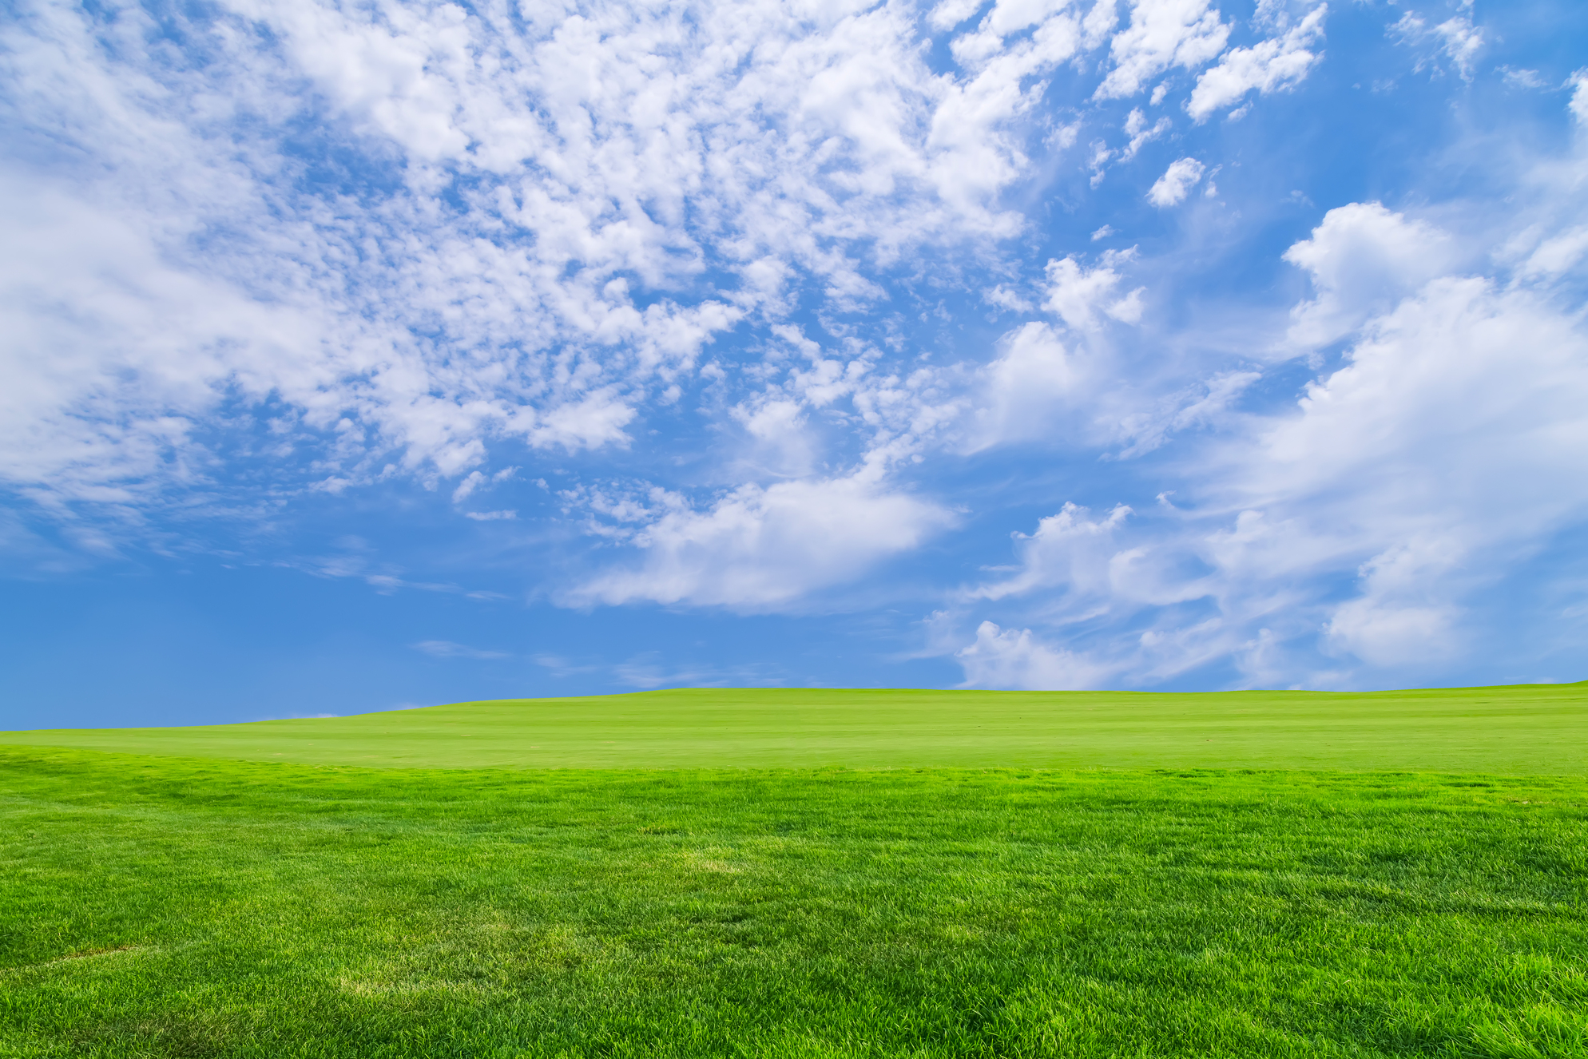
6. Let’s talk!
Have you got animals on the farm?
No, we haven’t!

Slide 23
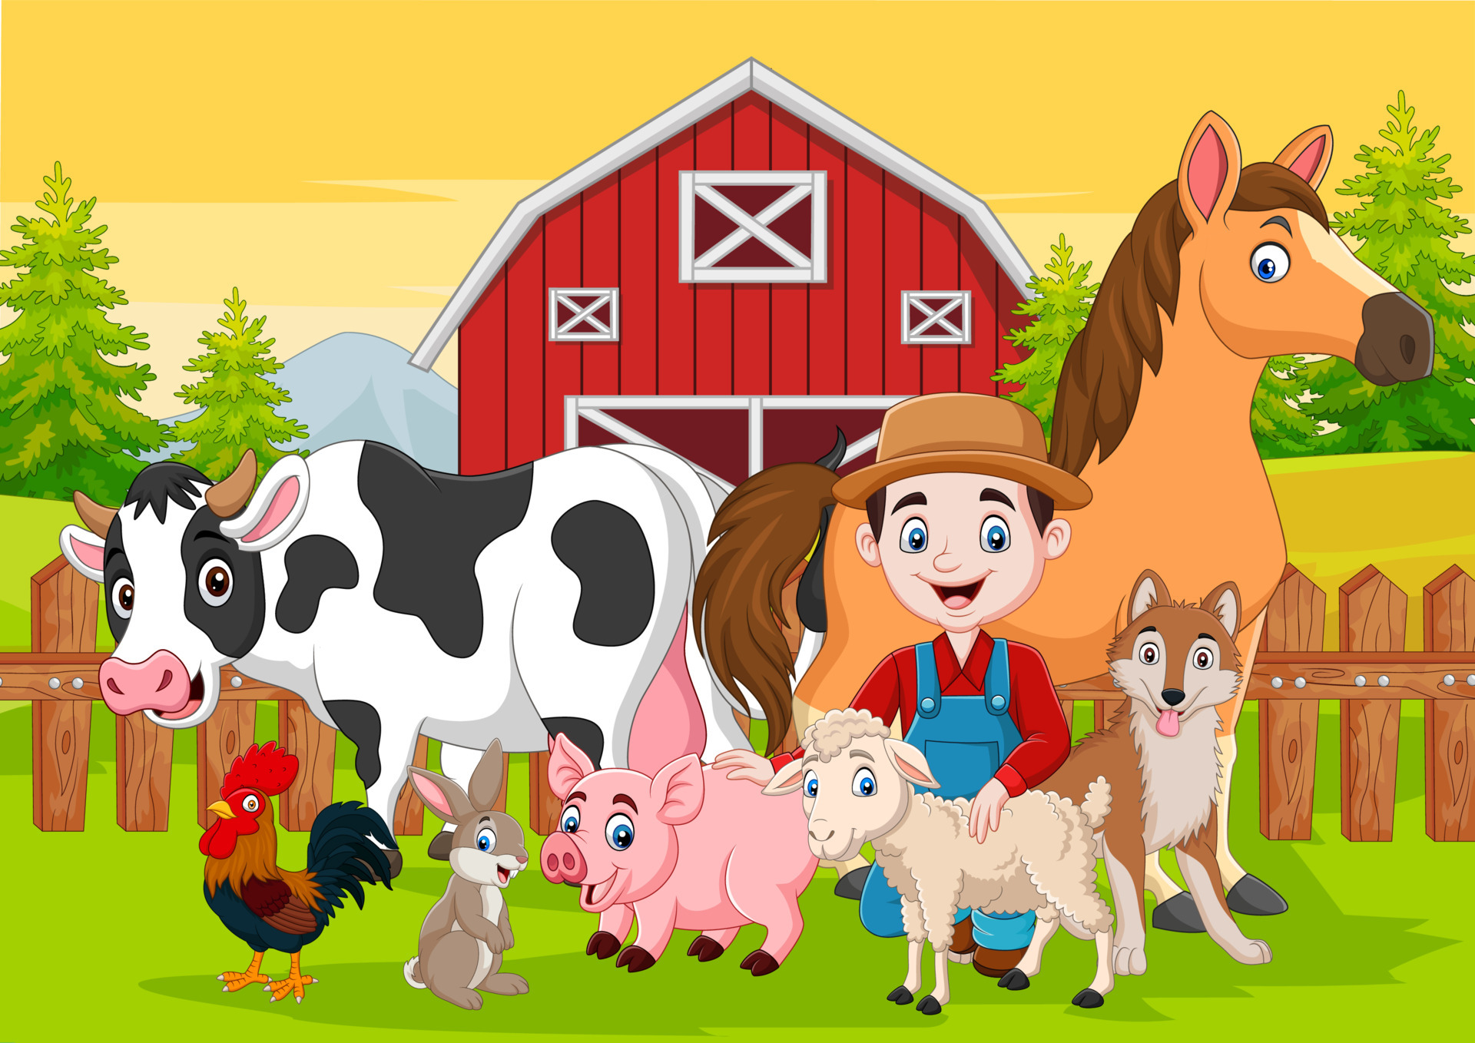
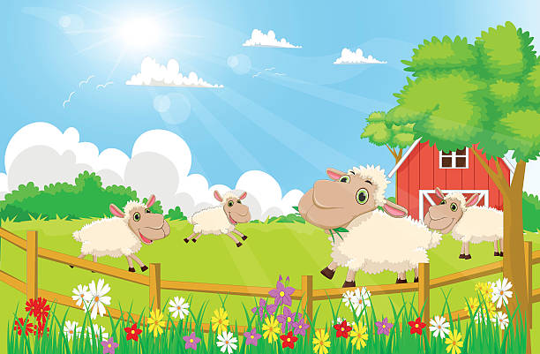
6. Let’s talk!

Slide 24
4
Production

Slide 25
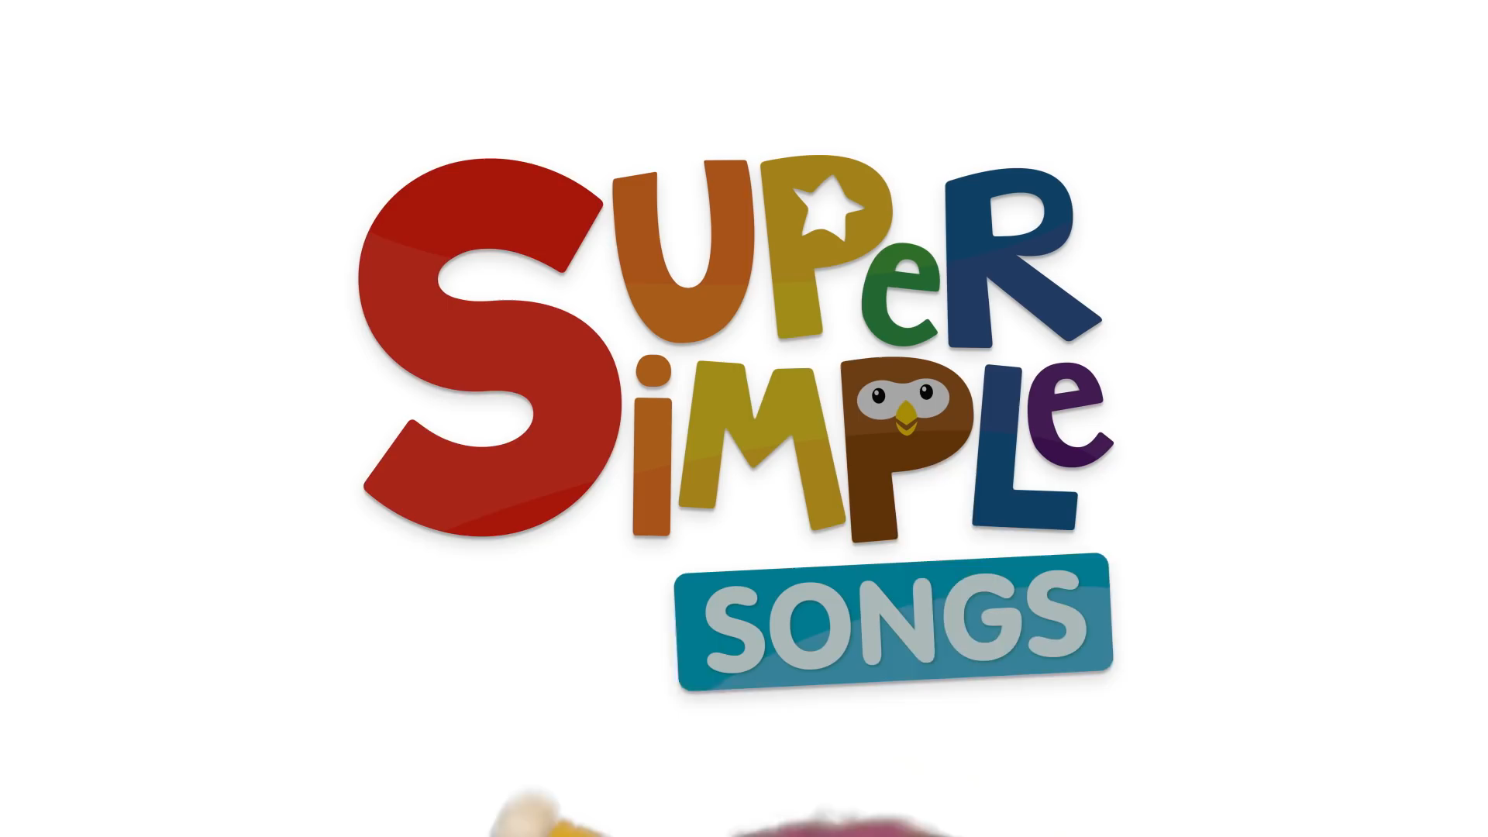
Listen and sing!

Slide 26
Sing along!
The farmer in the dell.
The farmer in the dell.
Hi-ho, the derry-o
The farmer in the dell.
The farmer milks the cow.
The farmer milks the cow.
Hi-ho, the derry-o
The farmer milks the cow.
The farmer feeds the pigs.
The farmer feeds the pigs.
Hi-ho, the derry-o
The farmer feeds the pigs.
The farmer gathers eggs.
The farmer gathers eggs.
Hi-ho, the derry-o
The farmer gathers eggs.
The farmer plants the seeds.
The farmer plants the seeds.
Hi-ho, the derry-o
The farmer plants the seeds.
The farmer picks the corn.
The farmer picks the corn.
Hi-ho, the derry-o
The farmer picks the corn.
The farmer in the dell.
The farmer in the dell.
Hi-ho, the derry-o
The farmer in the dell.

Slide 27
5
Assessment

Slide 28
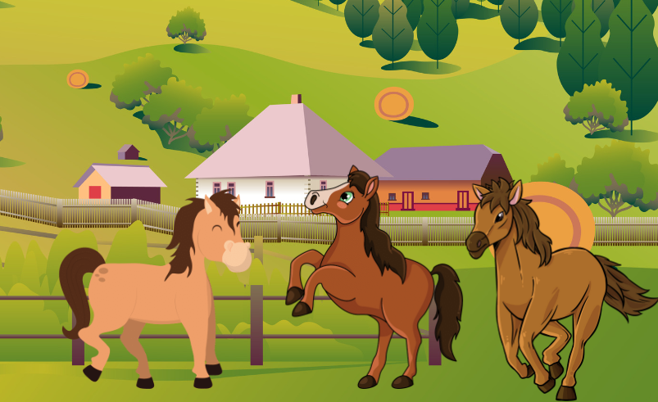
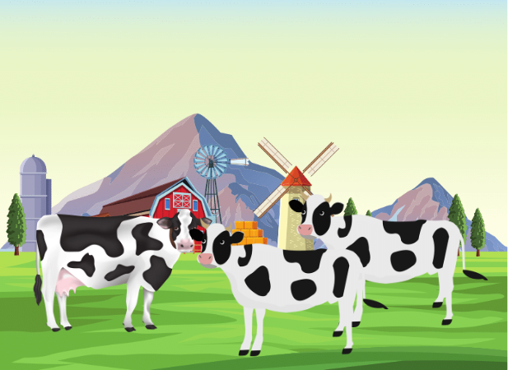
Tick the correct answer
✓
The horses haven’t got any wings .
The horses have got wings.
The cows haven’t got any tails.
✓
The cows have got tails.

Slide 29
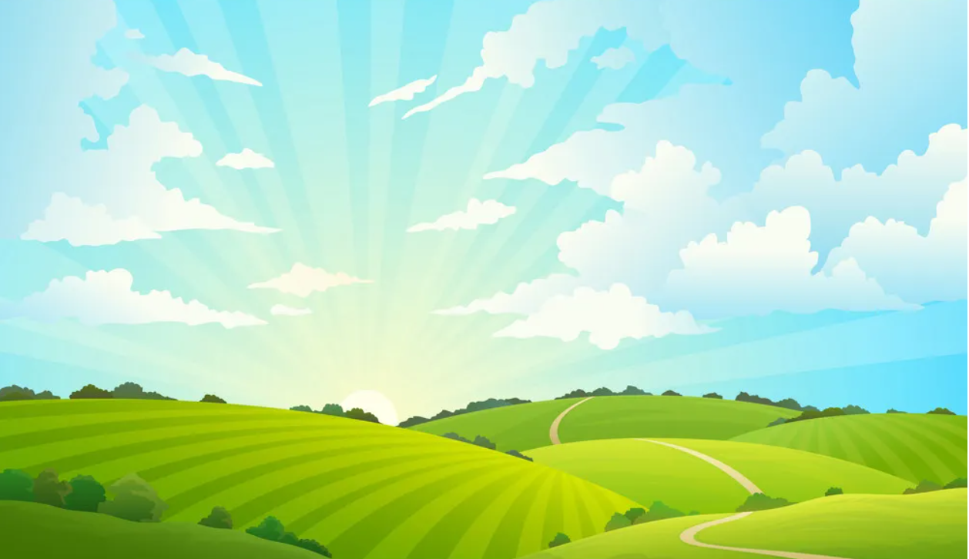
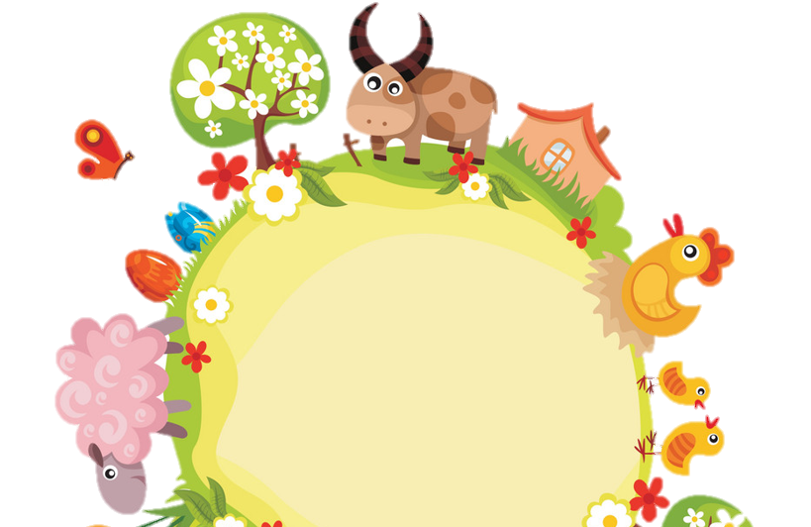
Thank you
& goodbye!

