Slide 1









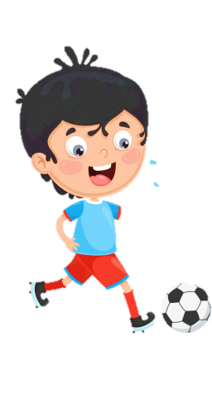
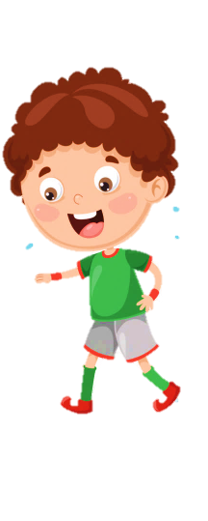

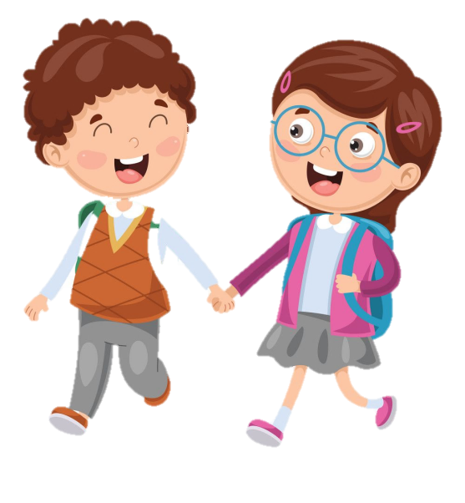



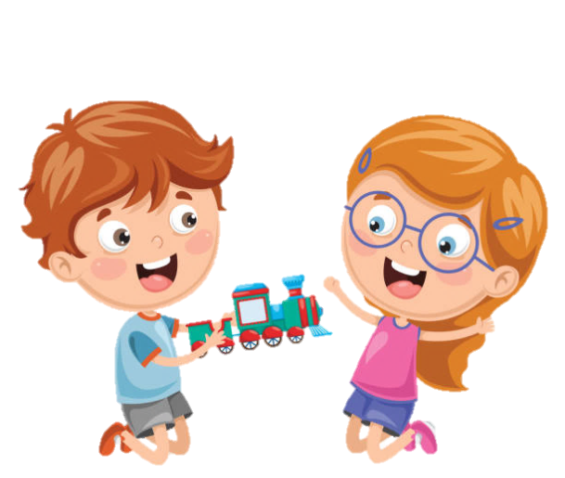


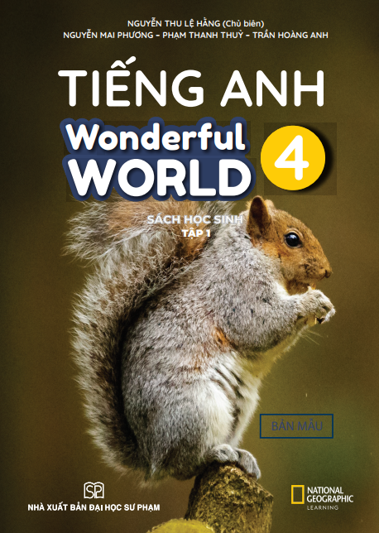

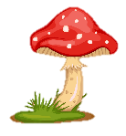

Slide 2
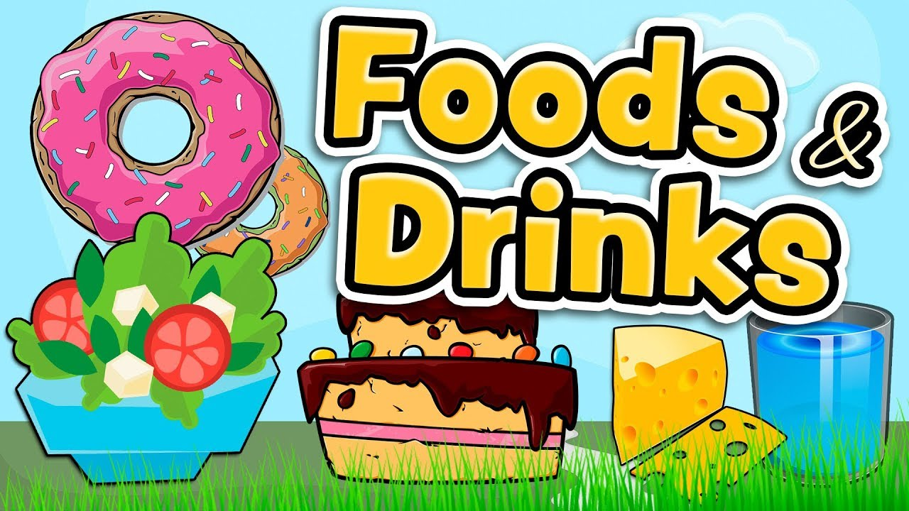
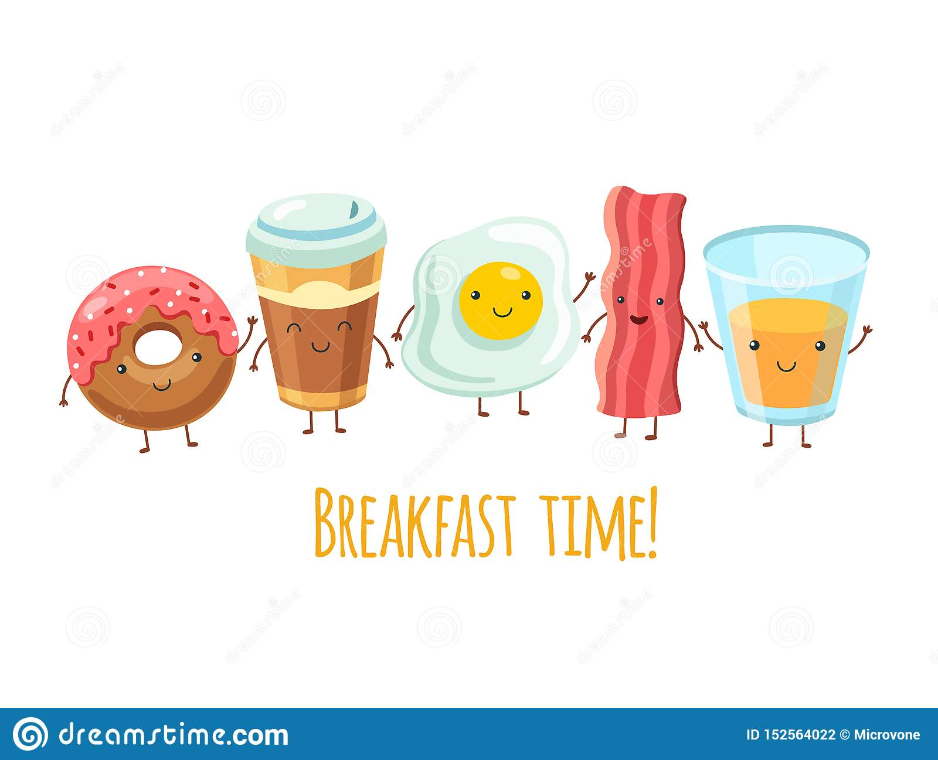
Unit 4:
Lesson 1 – Task 1, 2, 3

Slide 3
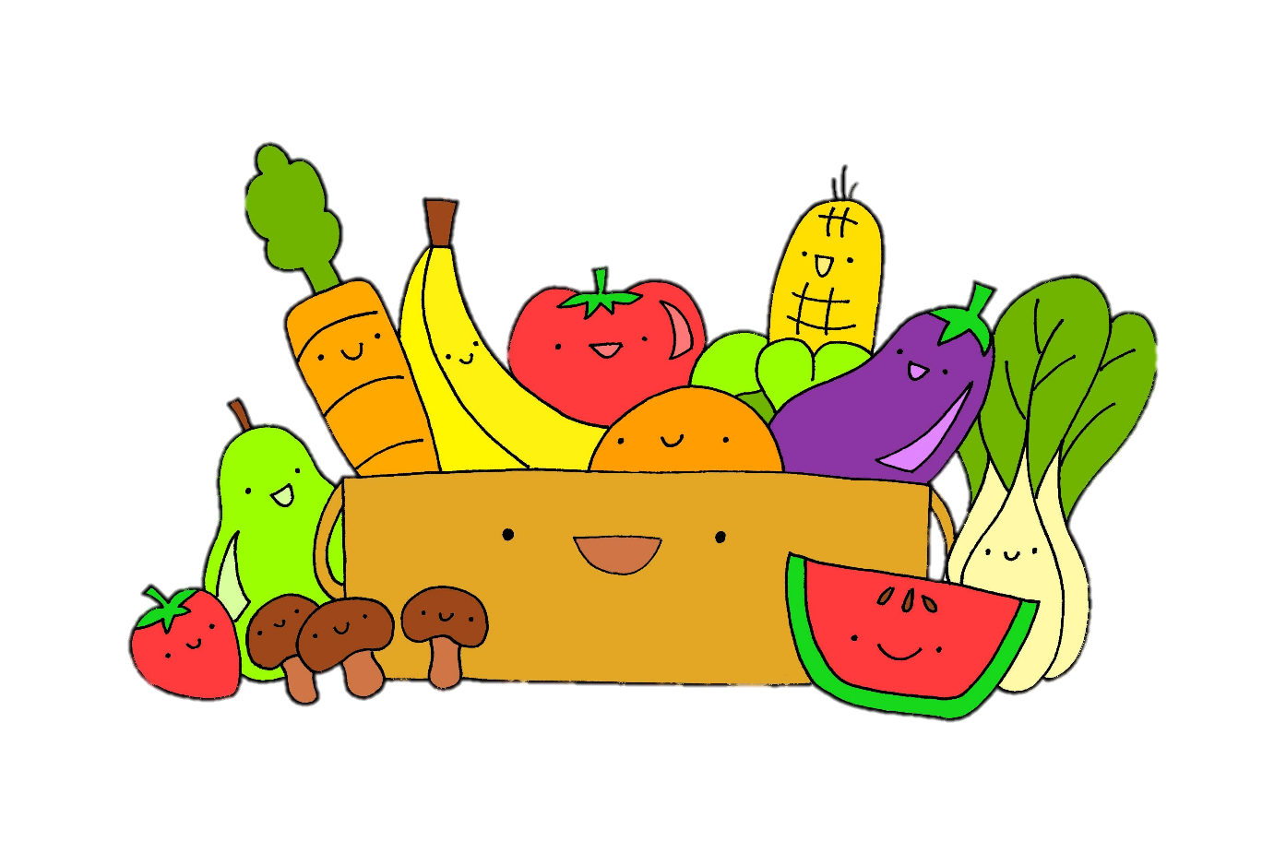
1 WARM UP
Listen and sing along.

Slide 4


Slide 5
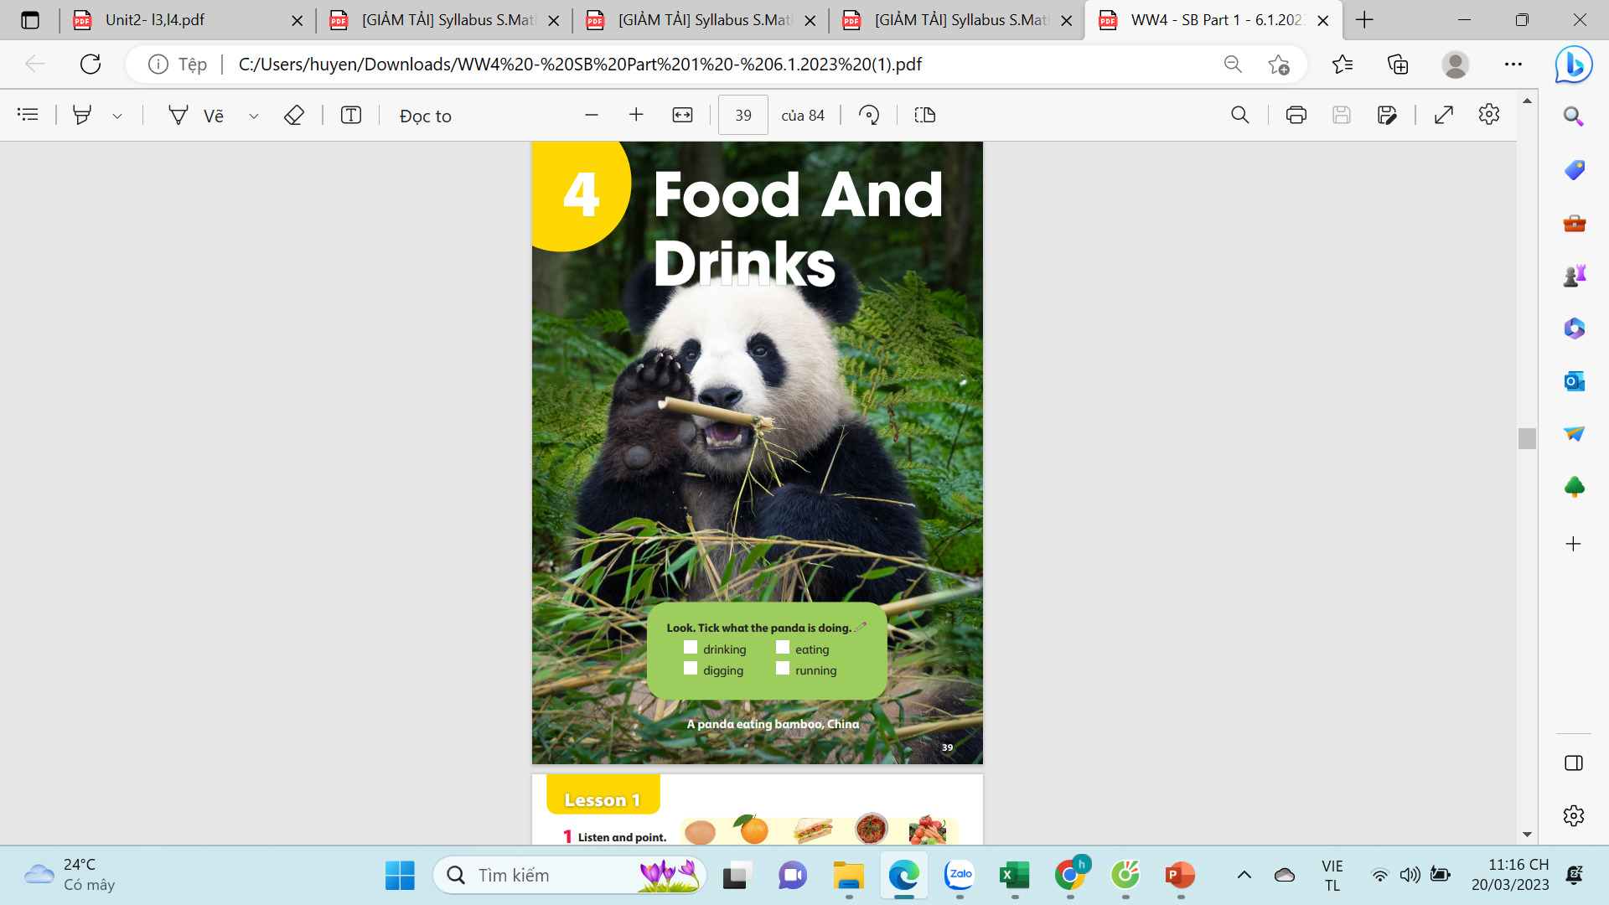
Look. Tick what the panda is doing?.
drinking
eating
digging
running
A panda eating bamboo, China
Notes:
Ko hiện lên dc dấu tick

Slide 6




2 PRESENTATION
Task 1 Listen and point. Repeat.

Slide 7
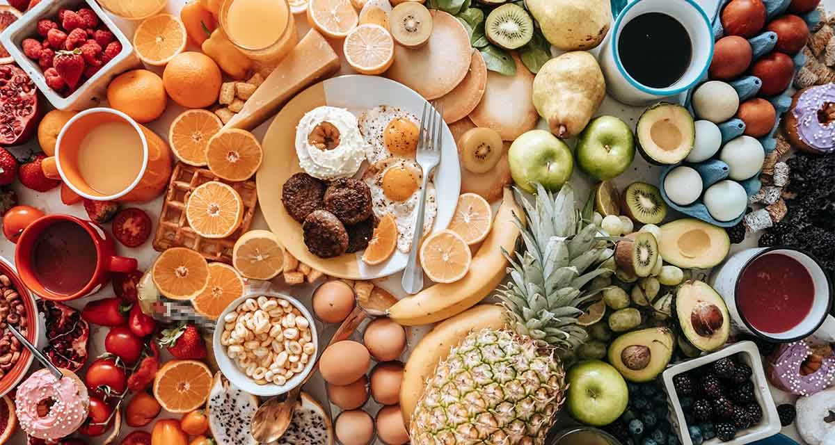

Slide 8
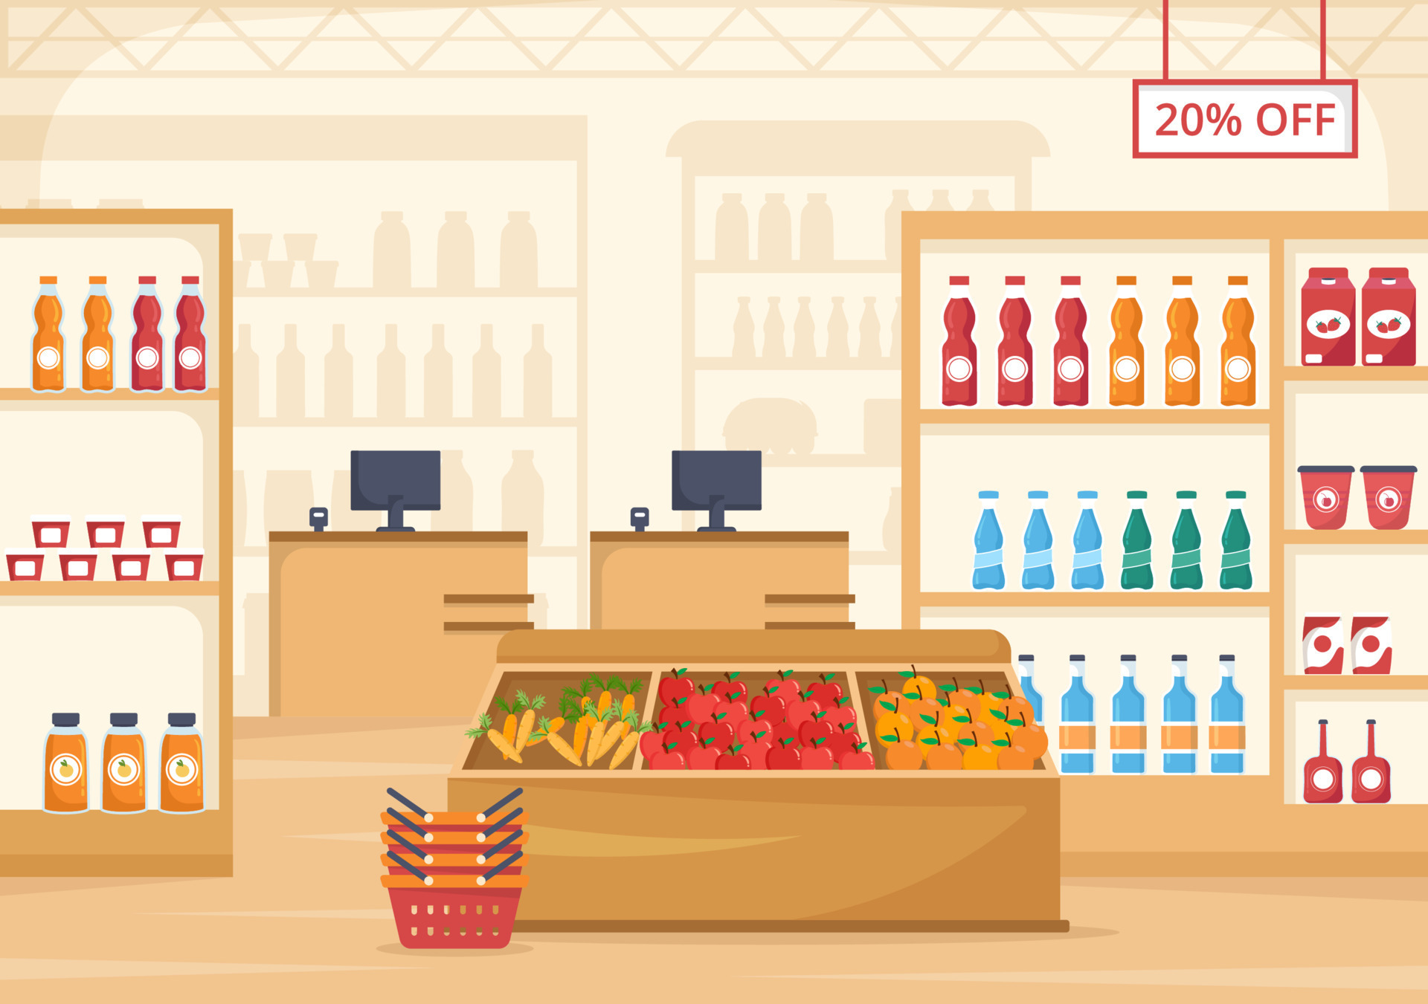
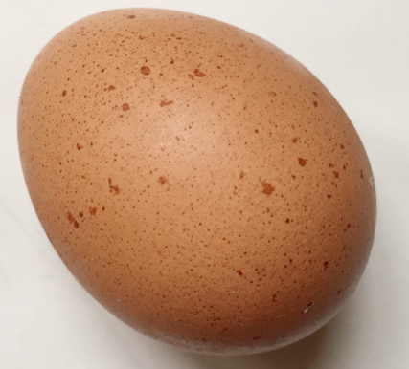
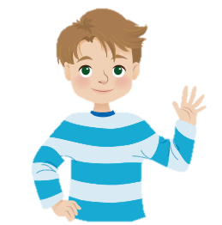
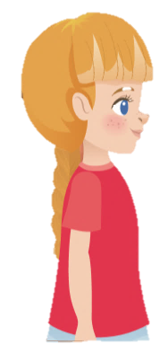
New words
an egg
Sophie
Alex

Slide 9
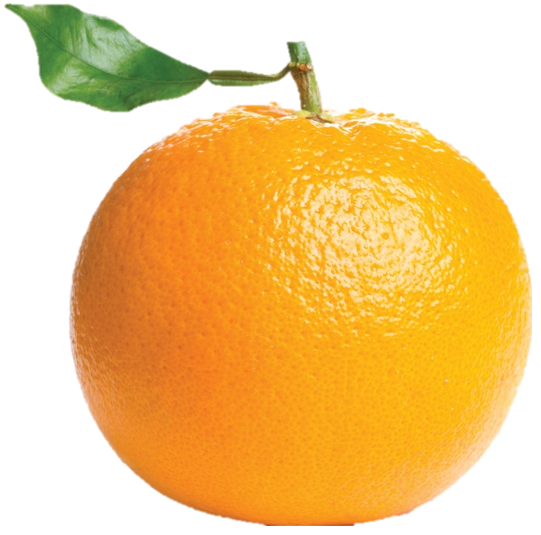
New words
an orange
Sophie
Alex

Slide 10
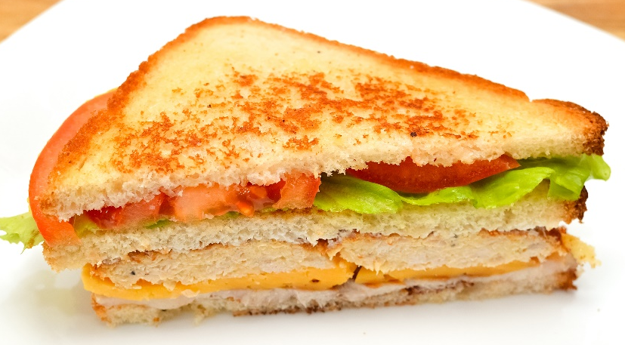
New words
a sandwich
Sophie
Alex

Slide 11
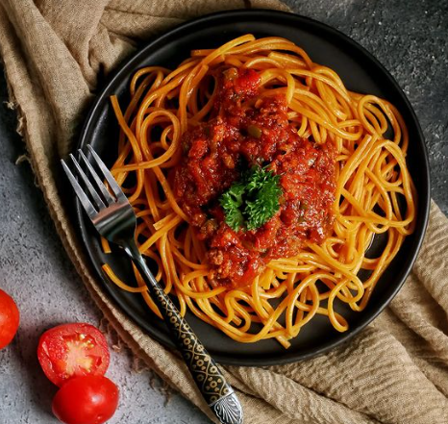
New words
spaghetti
Sophie
Alex

Slide 12
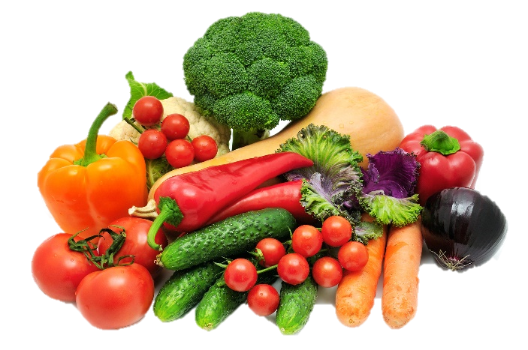
New words
vegetables
Sophie
Alex

Slide 13

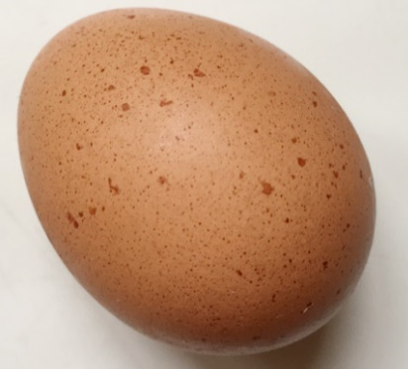



Listen and point. Repeat.
an egg
an orange
sandwich
spaghetti
vegetables

Slide 14


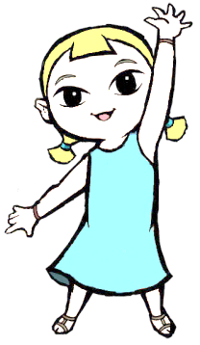
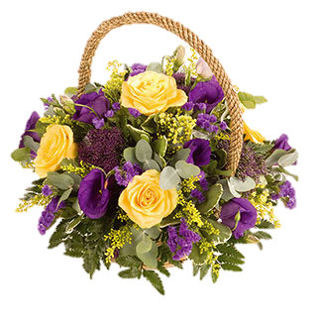

Look at the the line and say what’s disappeared with the wind within the time limit (5 seconds)

Slide 15
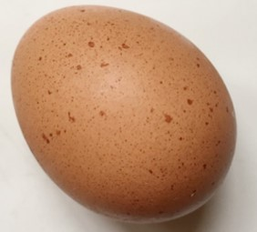
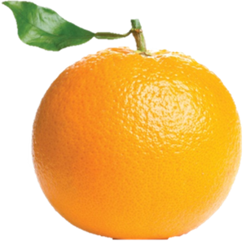

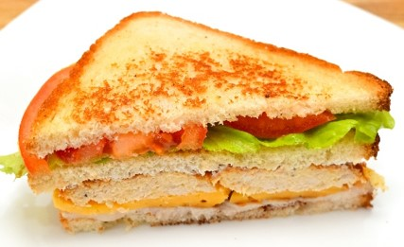
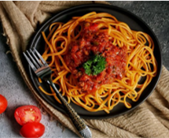
What’s disappeared?
vegetables
TIME’S UP

Slide 16
What’s disappeared?
orange
TIME’S UP

Slide 17
What’s disappeared?
spaghetti
TIME’S UP

Slide 18
What’s disappeared?
vegetables
TIME’S UP

Slide 19
What’s disappeared?
sandwich
TIME’S UP

Slide 20
What’s disappeared?
egg
TIME’S UP

Slide 21
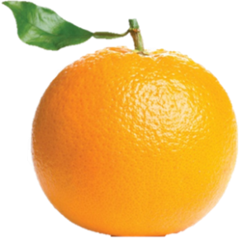
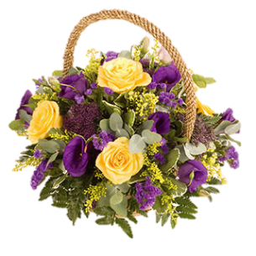
What are disappeared?
orange
TIME’S UP
sandwich

Slide 22
What are disappeared?
egg
TIME’S UP
sandwich

Slide 23
What are disappeared?
spaghetti
TIME’S UP
vegetables

Slide 24

3 PRACTICE
Task 2 Listen and read. Write.

Slide 25
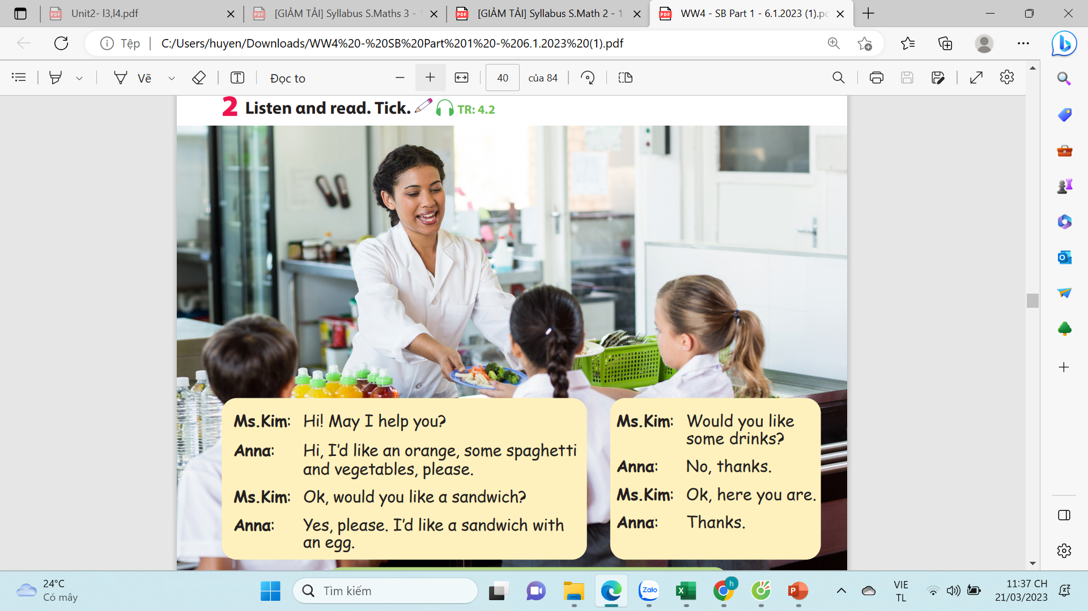
2.Listen and read. Write.
Would you like some drinks?
Hi! May I help you?
Ok, would you like a sandwich?
Ok, here you are.
Thanks.
No, thanks.
Yes, please. I’d like a sandwich with an egg.
Hi! I’d like an orange, some spaghetti and vegetables, please.

Slide 26
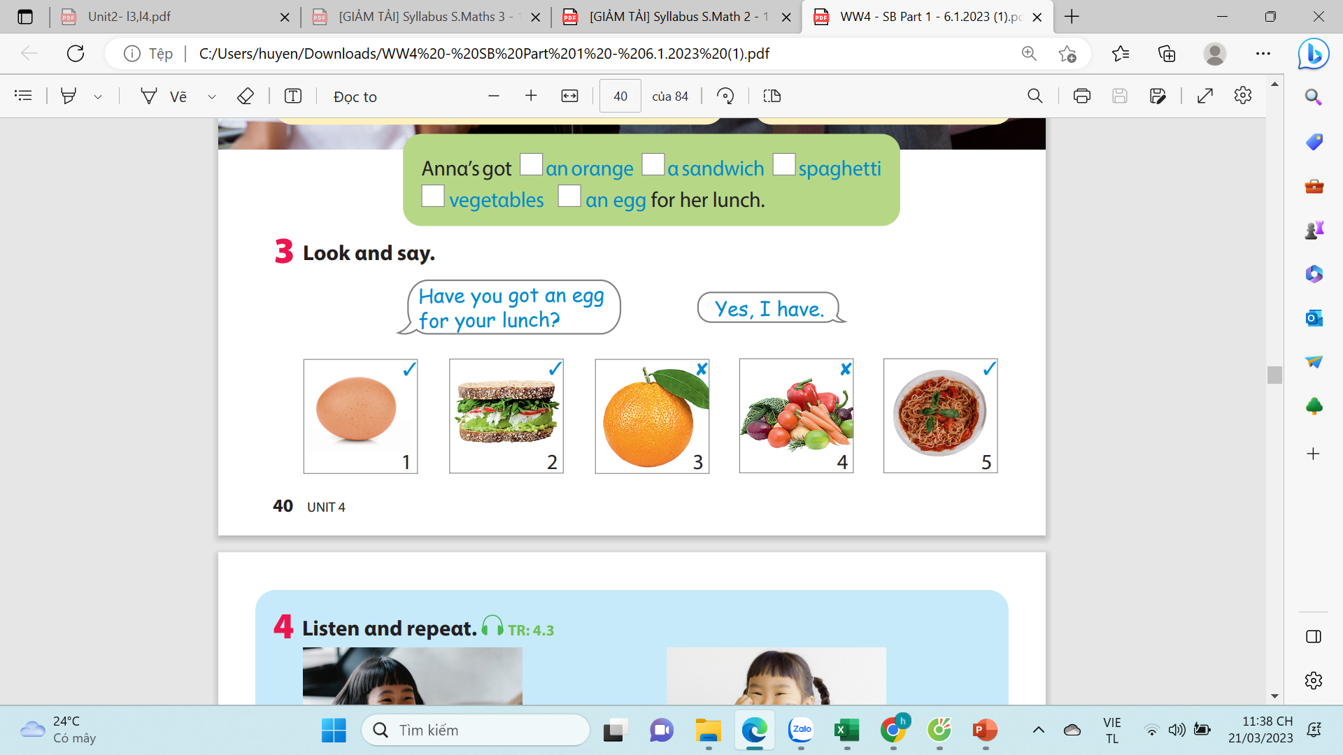
2.Listen and read. Write.
✔
✔
✔
✔
✔

Slide 27
Listen and check.

Slide 28

4.PRODUCTION
Task 3 Look and say.
Notes:
- Introduce and set game rules
- Do a demo
- Play several rounds.

Slide 29
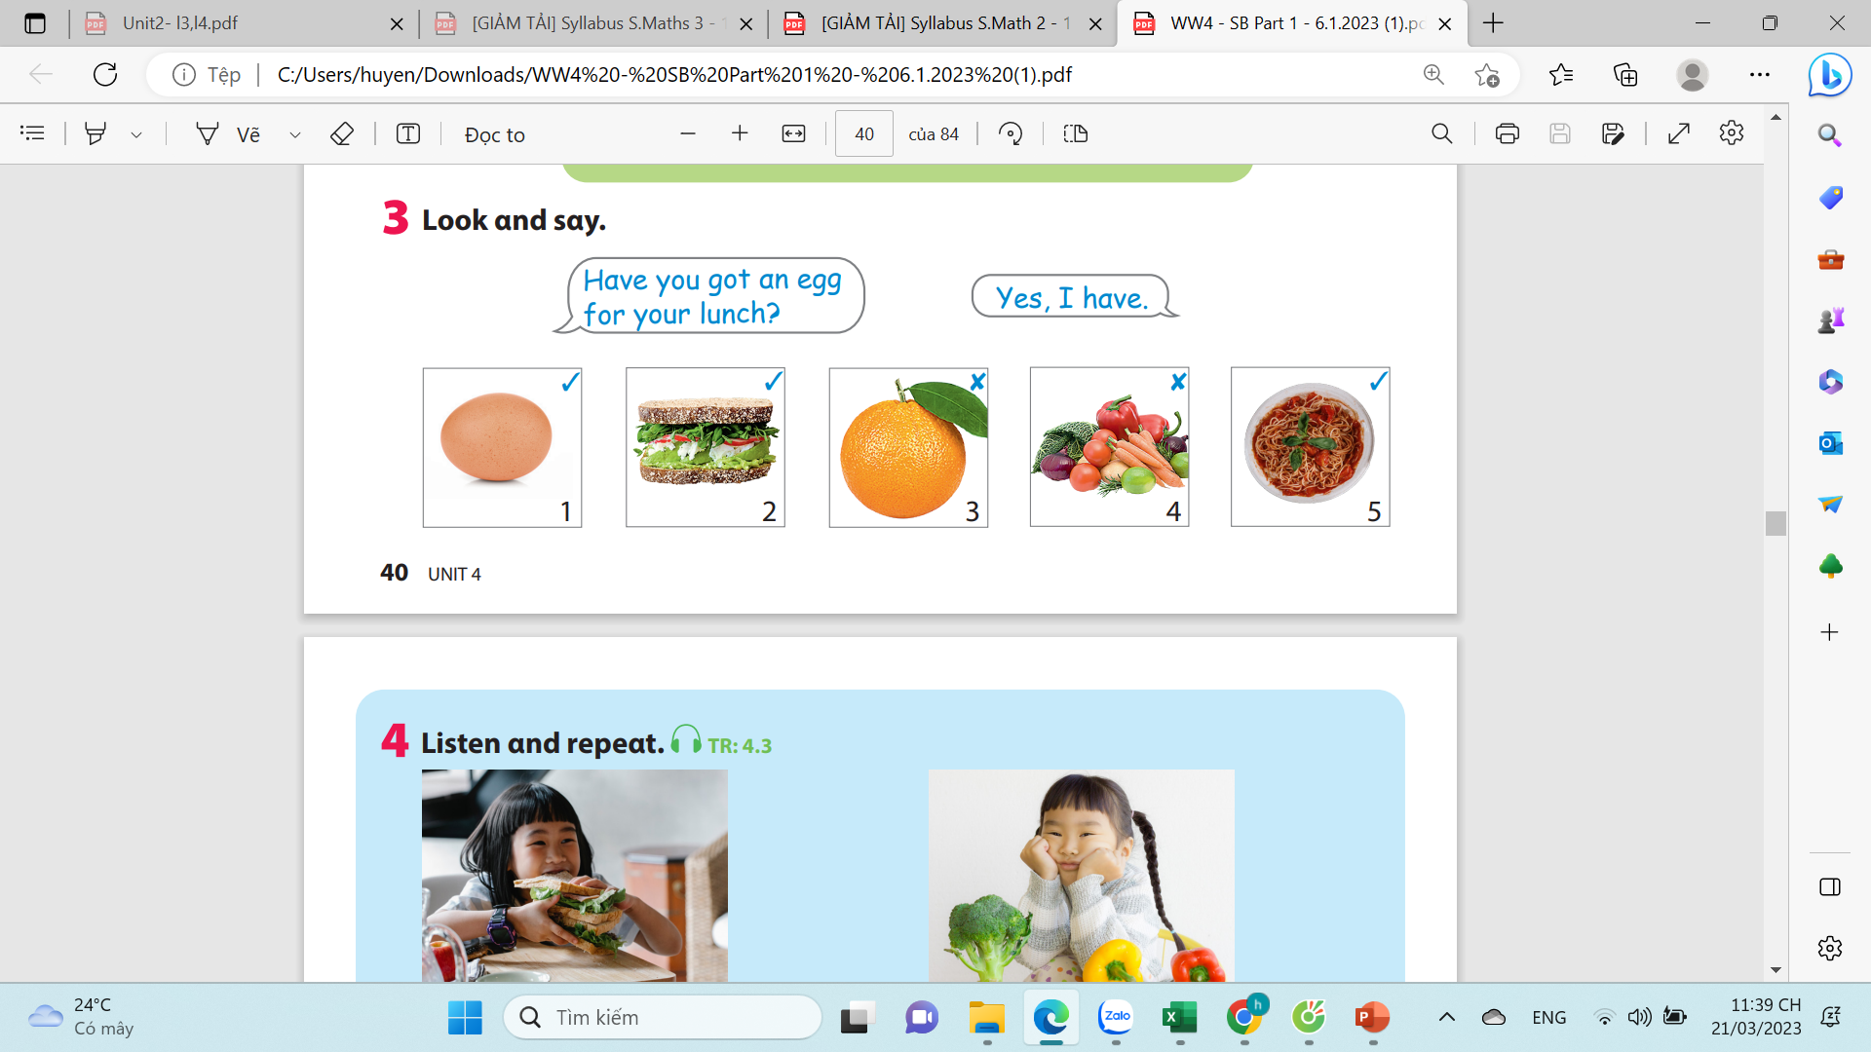

Slide 30

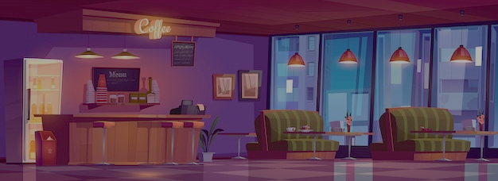
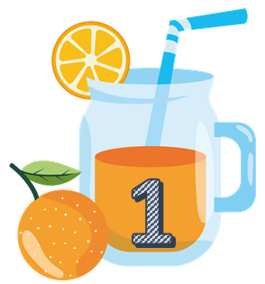








Team A
Team B
Notes:
Divide the class into 2 teams to play “ Fruit Juice”.
Each team choose one jar of juice to go to the question.
Have pupils look, read and choose the right option.
Back to the menu for pupils to choose another question.
Pupils continue their turn until there are not any jars of juice left.
The one who gets most points is the winner.

Slide 31
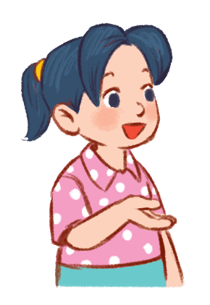
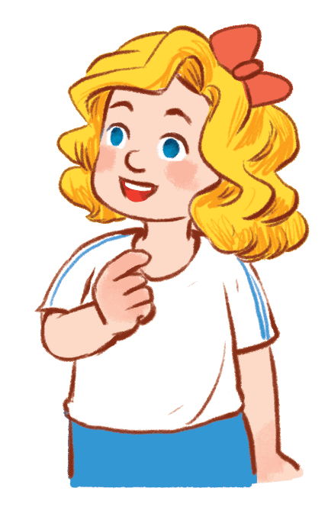

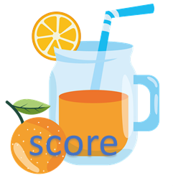
Have you got an egg for lunch?
…………………
✔
40
No, I have
Yes, I have
Yes, I do

Slide 32
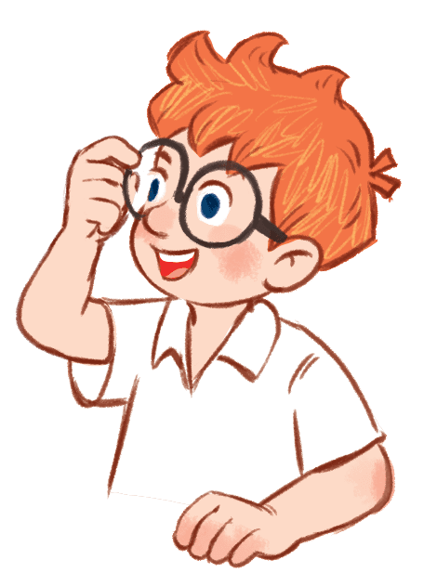
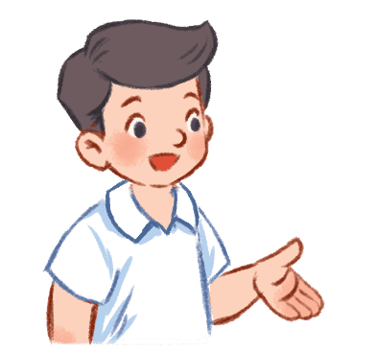
Have you got an orange for lunch?
………………...
✘
30
No, I haven’t.
No, I don’t
Yes, I do

Slide 33
Have you got a sandwich for lunch?
………………..
✔
20
Yes, I am
Yes, I do
Yes, I have.

Slide 34
Have you got vegetable for lunch?
………………..
✘
60
Yes, I am
No, I haven’t.
No, I don’t.

Slide 35
Have you got spaghetti for lunch?
………………..
✔
40
Yes, I am
Yes, I have
No, I haven’t

Slide 36
Have you got an orange for lunch?
………………...
✘
20
No, I haven’t.
No, I don’t
Yes, I do

Slide 37
Have you got vegetable for lunch?
………………..
✘
50
Yes, I am
No, I haven’t.
No, I don’t.

Slide 38
Have you got spaghetti for lunch?
………………..
✔
30
Yes, I am
Yes, I have
No, I haven’t

Slide 39

5.ASSESSMENT

Slide 40
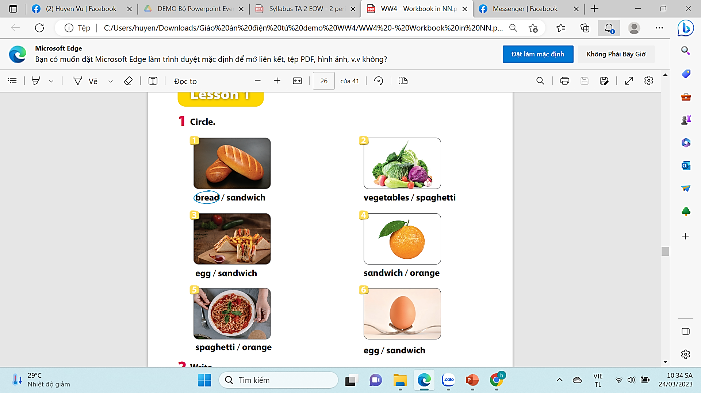

Slide 41




6. Wrap-up
Egg, orange, spaghetti, sandwich, vegetable.

Slide 42


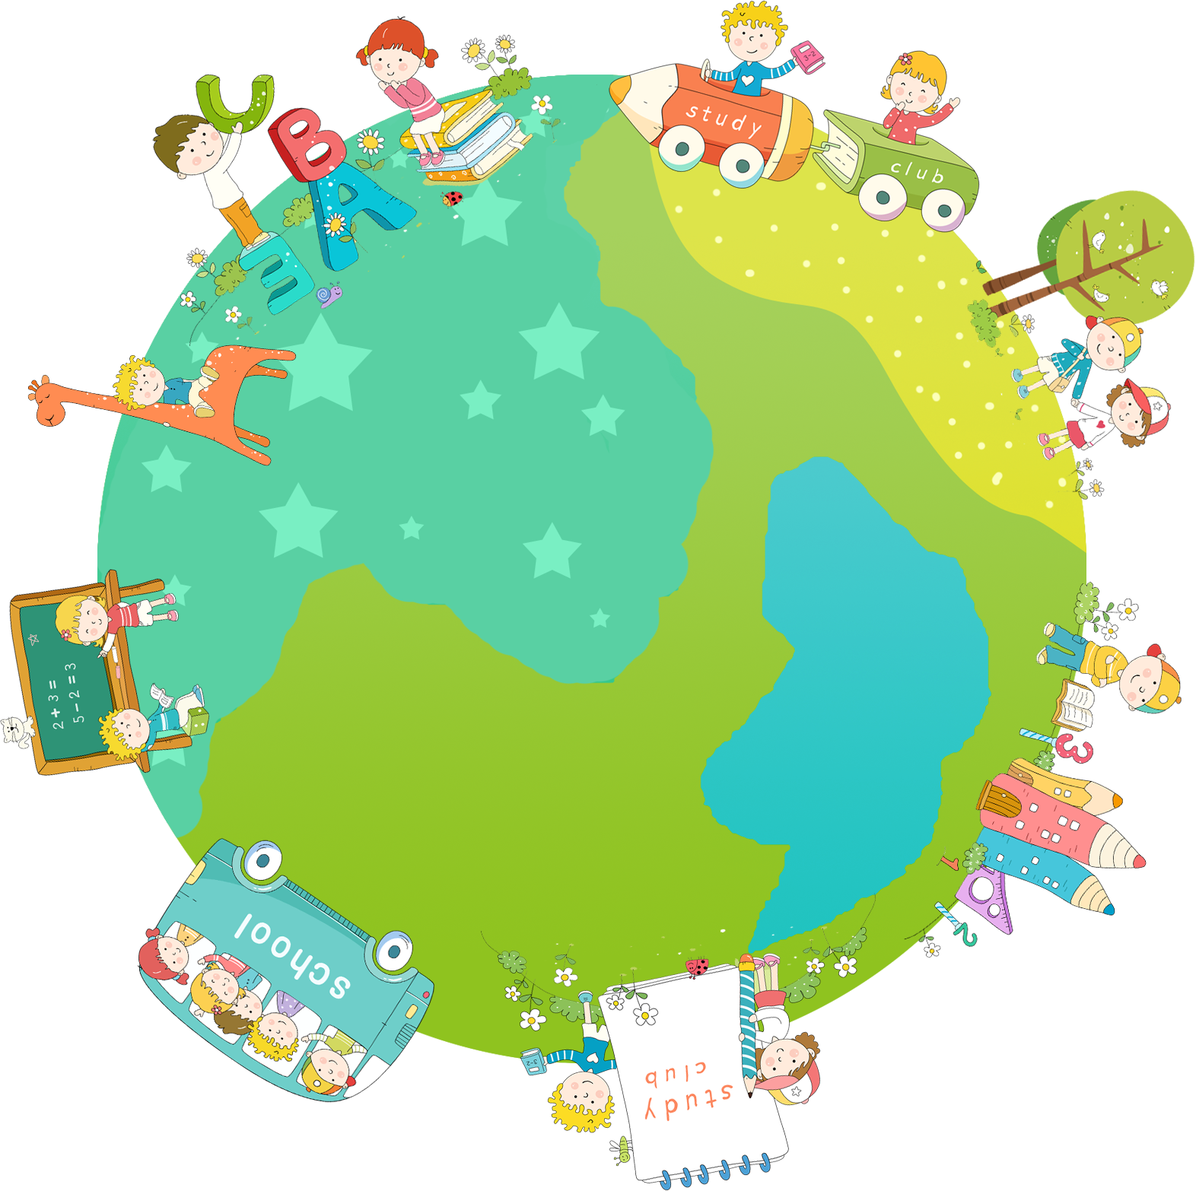

Thank you & goodbye!

