Slide 1


Slide 2







Unit
6. Listen and repeat.
7. Let’s talk.
8. Let’s sing.

Slide 3

Warm-up

Slide 4



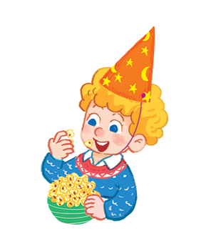

Listen and repeat.
The popcorn is yummy.
The popcorn is yummy.
The popcorn is yummy.
The popcorn is yummy.

Slide 5



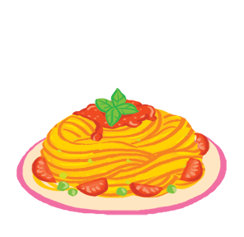

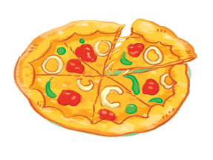
Let’s talk.
The is yummy.
a
b
c

Slide 6
The is yummy.
a

Slide 7
The is yummy.
b

Slide 8
The is yummy.
c

Slide 9
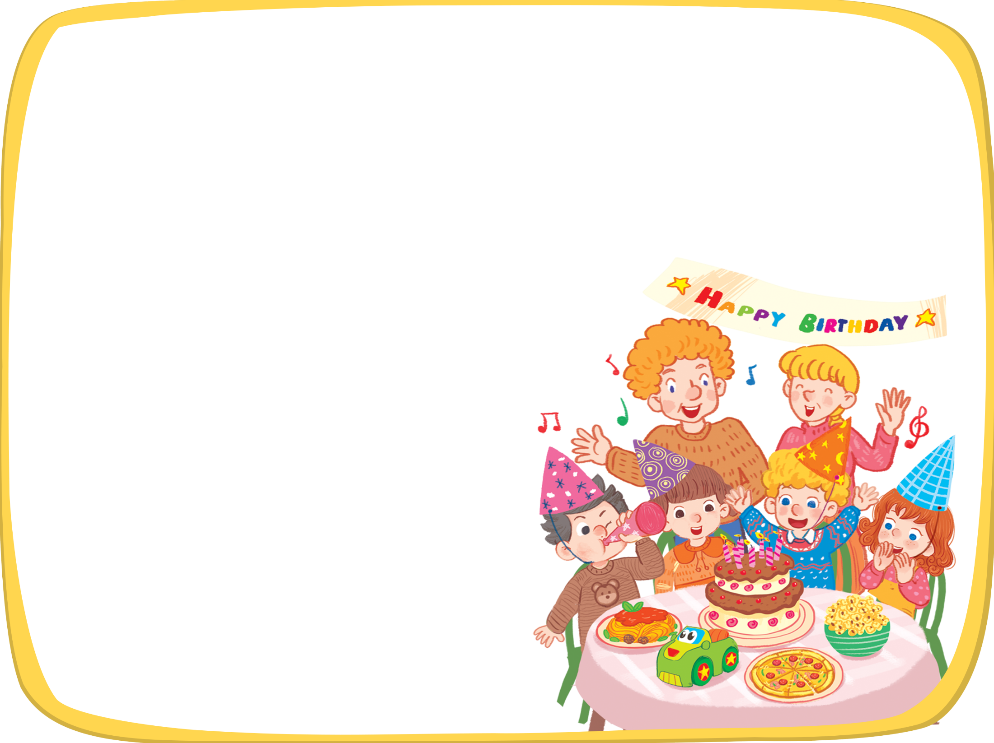


Let’s sing!
It’s my birthday party.
It’s my birthday party.
It’s my birthday party.
It’s my birthday party.
I like pasta.
I like pasta.
I like pasta.
I like pasta.
The pasta is yummy.
The pasta is yummy.
The pasta is yummy.
The pasta is yummy.
I like pizza.
I like pizza.
I like pizza.
I like pizza.
The pizza is yummy.
The pizza is yummy.
The pizza is yummy.
The pizza is yummy.
I like popcorn.
I like popcorn.
I like popcorn.
I like popcorn.
The popcorn is yummy.
The popcorn is yummy.
The popcorn is yummy.
The popcorn is yummy.

Slide 10





