Slide 1

UNIT 3
FRIENDS

Slide 2
LESSON 2

Slide 3

WARM-UP

Slide 4


Divide class into group of four. Listen to a song twice and in two minutes list all the verbs that they can hear in the song.
sleeping
running
eating
drawing
walking

Slide 5
GRAMMAR

Slide 6
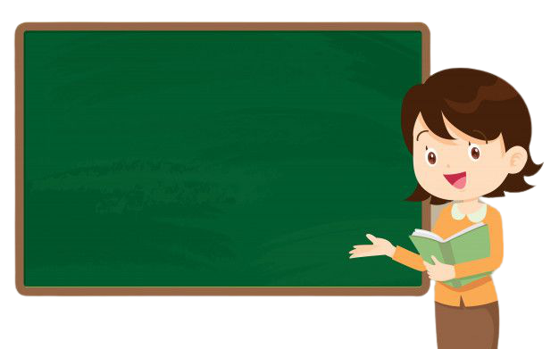
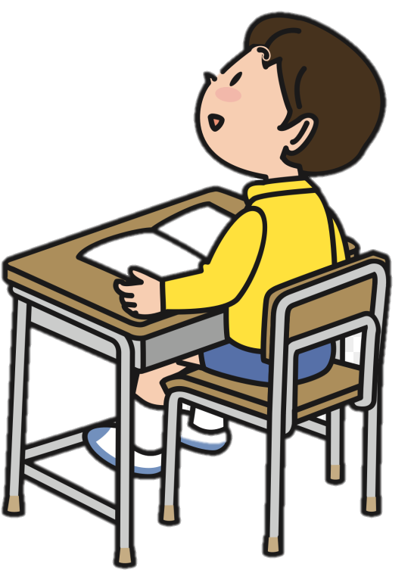
PRESENT CONTINUOUS
GRAMMAR
We are studying English.

Slide 7
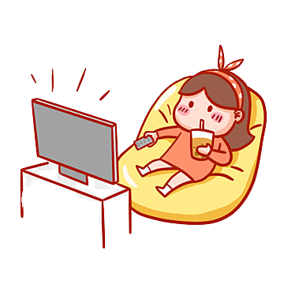

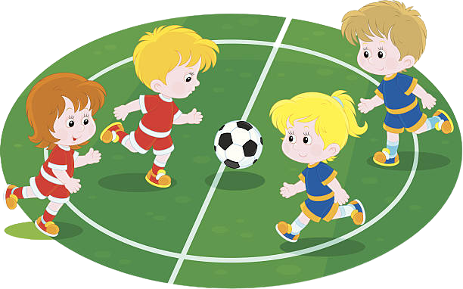
Example 1
She is watching TV now
( Diễn tả hành động đang xảy ra tại thời điểm nói)
They are playing football at the moment.

Slide 8

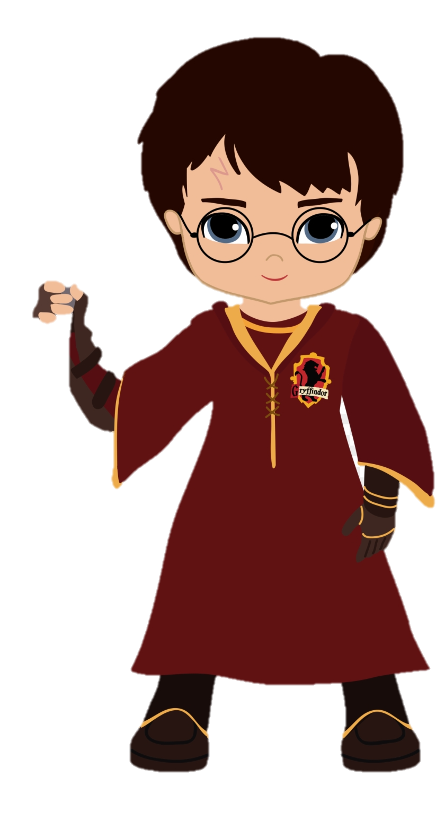
Example 2
Diễn tả hành động đang diễn ra tại thời điểm hiện tại nhưng không nhất thiết phải xảy ra tại thời điểm nói
He is working in London.
I am reading Harry Potter.

Slide 9


Example 3
She drinks coffee every day.
Diễn tả hành động khác với thói quen ở hiện tại.
But today, she is drinking tea.

Slide 10
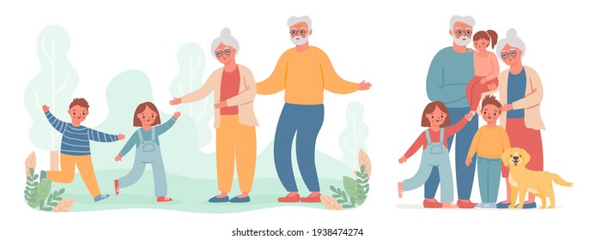
Example 4
Diễn tả một hành động sẽ làm trong tương lai có kế hoạch dự định trước.
We are visiting our grandma this weekend.

Slide 11
1
Diễn tả hành động đang xảy ra tại thời điểm nói
2
  Diễn tả hành động đang xảy ra nhưng không nhất thiết phải ở thời điểm nói.
USAGE
3
  Diễn tả hành động trái với thói quen ở hiện tại
Cách sử dụng
4
  Diễn tả hành động sẽ làm có dự định trước

Slide 12
Work in pair. Read the examples again and give the structure of the present continuous. Pay attention to the underline words.
1. We are studying English.
2. She is watching TV now
3. I am reading Harry Potter
4. He is working in London.
5. They are playing football at the moment.

Slide 13

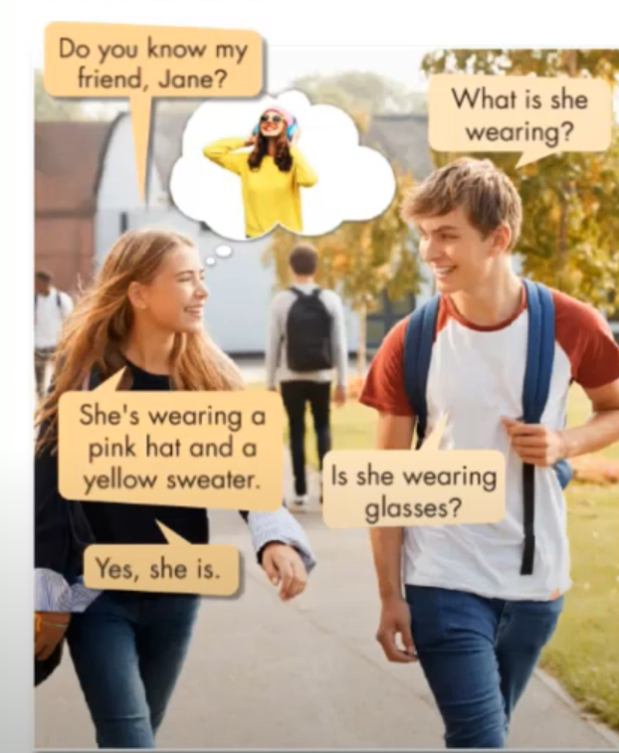
Listen the conversation and repeat. Pay attention to the present continuous tense.
Do you know my friend , Jane?
What is she wearing?
I am wearing a green dress.
You/we/they are wearing blue shoes
He/She/It is wearing a yellow shirt.
What is she wearing?
What are you wearing?
Is she wearing glasses? ( Yes, she is/ No, she isn’t)
She’s wearing a pink hat and a yellow sweater
Is she wearing glasses?
Yes, she is

Slide 14



STRUCTURE
I am + V-ing
He/she/it/S(số ít) + is + V-ing
You/We/They + are + V-ing
POSITIVE
I am = I’m
He is = He’s
They are = They’re
I am not + V-ing
He/she/it/S(số ít) + is not + V-ing
You/We/They + are not + V-ing
NEGATIVE
Is not = isn’t
are not = aren’t
Answer
(Wh) Am I + V-ing…?
(Wh) + Is + He/she/it/S(số ít) + V-ing ?
(Wh) + Are + You/We/They +are + V-ing ?
- Yes, I am/ No, I am not
QUESTION
- Yes, he is/ No, he isn’t
- Yes, they are/ no, they aren’t

Slide 15
REVIEW :Cách thêm “ ing” vào động từ
RULES ( Quy tắc) | EXAMPLE ( Ví dụ)
Động từ kết thúc là “ e” : bỏ e thêm ‘ing”
Động từ 1 âm tiết ở giữa là 1 nguyên âm ( u,e,o,a,i) – gấp đôi phụ âm cuối.
Nhưng không cần gấp đôi với các từ tận cùng là “ y, x,w)
Động từ kết thúc bằng “ ie” chuyển thành y+ing
Make – making take - taking
Run – running sit - sitting
Play – playing say - saying
Lie – lying die - dying

Slide 16
EXPRESSIONS WITH PRESENT CONTINUOUS
EXPRESSIONS | EXAMPLE
At the moment ( bây giờ)
We are studying English at the moment.
At present ( bây giờ)
She is working in London at present.
Right now( bây giờ)
They are doing their homework right now.
now( bây giờ)
I am cooking dinner now.
Những từ mệnh lệnh
( listen! Look! , be quiet , keep silent!
Look! the car is coming.
Tonight, today, next week……
We are visiting our grandma next week.
Diễn tả kế hoạch sẽ làm có dự định trước)

Slide 17
Những động từ không dùng với hiện tại tiếp diễn
Suy nghĩ , nhận thức
Believe ( tin) , consider ( xem xét) , know ( biết) , think ( nghĩ rằng) , understand ( hiểu) , doubt ( nghi ngờ)
Tồn tại, sở hữu
Be, exist ( tồn tại) , have ( có) , belong ( thuộc về)
Cảm xúc , mong muốn
Like , love , hate , dislike , want , need …….
Chỉ dùng với hiện tại đơn

Slide 18
PRACTICE
Circle the correct words
Are/Am you wearing brown pants?
He are/is wearing green shorts.
They are/is wearing blue T-shirts.
I am/are wear/wearing glasses
You am/are wearing glasses.
Are/Is they wearing black caps ?

Slide 19
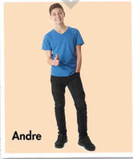
Look at the photo and write Simon’s answers.
Simon : Do you know my friend? Andre?
Marie: Is he wearing glasses?
Simon: (1) ______________________
Marie: Is he wearing a cap?
Simon: (2)________________________
Marie: What else is he wearing?
Simon: He’s (3)_______________________
and (4)________________________
No, he isn’t
No, he isn’t
wearing a blue T-shirt
black pants
Now, practice the conversation with your partner.

Slide 20
GAMES REVIEW

Slide 21
Present simple vs. present continuous
START

Slide 22

1. She never _____ his homework.
She is too lazy for that!
does
is doing
does
doing
do

Slide 23
2. ____ You have a job?
Do
do
Is
does
am

Slide 24
3.Where is Peter?
He __________computer games in his room.
is playing
plays
play
Is playing
is plaing

Slide 25
4. I ___________ENGLISH at all!
don’t speak
doesn’t speak
am not speak
don’t speak
isn’t speaking

Slide 26
5. Jack and Jill often ___ their grandparents.
visit
are visiting
visits
visiting
visit

Slide 27
5. Be quiet!
We _____________!
are working
work
works
am working
are working

Slide 28
7. Can I turn the TV off?
Yes, I ________.
am not watching
am not watching
don’t watch
aren’t watch
not watching

Slide 29
8. What time ___ you
usually have dinner?
do
do
does
are
am

Slide 30
9. Why ___ You _______?
are
smiling
is, smile
are, smiling
is, smiling
Is, smiles

Slide 31
10. My best friend rarely _____new films!
watches
is watching
watch
watchs
watches

Slide 32
11. What ___ you _______?
- I’m working!
doing
are
does
Is, doing
do
Are, doing

Slide 33
12. My sister _____ a cute cat!
has
has
Is having
have
haves

Slide 34
13. My father doesn’t ___ Japanese food!
like
likes
like
Is like
Is liking

Slide 35

14. Sometimes my friends and I ___ to the cinema on Fridays.
go
goes
go
are going
are go

Slide 36
15. Look! Somebody ___________
in the river!
is swimming
swims
swim
is swimming
are swimming

Slide 37
16. I know that your brother ____ classical music!
hates
hate
Is hating
hates
hating

Slide 38
17.Look at them! They ___ working! They ___ listening to music!
aren’t
are
aren’t, are
isn’t, are
are, are
aren’t, am

Slide 39
18. Alice _________have a car.
So, she usually ______a bus.
doesn’t
takes
don’t, takes
doesn’t, takes
don’t, take
doesn’t, take

Slide 40
19. Are you happy?
Yes, I ___.
am
are
do
have
am

Slide 41
20.___ mark and Jill live in France?
Do
Does
Are
Do
Doing

Slide 42
21. IS your mum a doctor?
No, she______. She ___ a teacher.
isn’t
is
Is, isn’t
Aren’t, is
Isn’t, is
isn’t, isn’t

Slide 43
22. Today I __________a new car!
am buying
buys
buy
am buing
Am buying

Slide 44
23. I ________to wake up early! I am a night owl.
don’t like
doesn’t like
am not liking
don’t like
don’t likes

Slide 45
24. I don’t want to go to the park. It _________!
is raining
rains
raining
Is raining
Doesn’t rain

Slide 46
25. We often ______ essays at school.
write
write
are writing
writes
writing

Slide 47
26. My cats____________ . They are eating!
aren’t sleeping
don’t sleep
aren’t sleeping
sleep
are sleeping

Slide 48
27. Tony and Jake often ___ basketball after school.
play
plays
play
are play
are playing

Slide 49
28. It’s so cold outside! I ______ home tonight.
am staying
stay
staying
am staying
don’t stay

Slide 50
29. Where ___ you live?
do
do
are
does
am

Slide 51
30. I _____________home tomorrow. Meet me at the train station!
am coming
come
coming
am coming
comes

Slide 52
WRAP- UP
The Present Continuous tense:
Form: S + am / is / are (not) + V-ing
Question: Am / Is / Are + S + V-ing?
*Usage: talk about ongoing actions
Examples: What is he wearing?
à He’s wearing a blue T-shirt

Slide 53
HOMEWORK
- Make 3 sentences to describe one of your classmates, using present continuous.
- Review vocabularies about clothes.
- Do exercises in Workbook: Lesson 1 - Grammar (page 15).
- Prepare: Lesson 1 – Pronunciation and Speaking (page 24 – SB).

Slide 54



BÀI GIẢNG THUỘC QUYỀN SỞ HỮU TRÍ TUỆ CỦA E-TEACHERS. NGHIÊM CẤM MỌI HÀNH VI SAO CHÉP, PHÁT TÁN CHIA SẺ , MUA ĐI BÁN LẠI KHI CHƯA ĐƯỢC SỰ ĐỒNG Ý CỦA E-TEACHERS
PHONE /ZALO: 0966765064
https://www.facebook.com/maiphuongdo.dhnn/
SỬ DỤNG TÀI LIỆU CHÍNH CHỦ BẠN SẼ NHẬN ĐƯỢC SỰ TẬN TÂM VÀ CHÚNG TÔI SẼ PHỤC VỤ CÁC BẠN TẬN TÌNH.
TÀI LIỆU ĐƯỢC UPDATE VÀO MAIL CÁ NHÂN NGAY KHI UPDATE VÀ ĐƯỢC GIẢI ĐÁP MỌI THẮC MẮC VỀ KỸ THUẬT HOẶC CHUYÊN MÔN MỘT CÁCH KỊP THỜI NHẤT
TK: 3614689 ĐỖ MAI PHƯƠNG
NGÂN HÀNG VPBAK VIÊT NAM THỊNH VƯỢNG CHI NHÁNH HÀ NỘI.

