Slide 1
WELCOME ALL TEACHERS
TO CLASS 7A3
7TH GRADE
Phu Yen
Secondary school

Slide 2
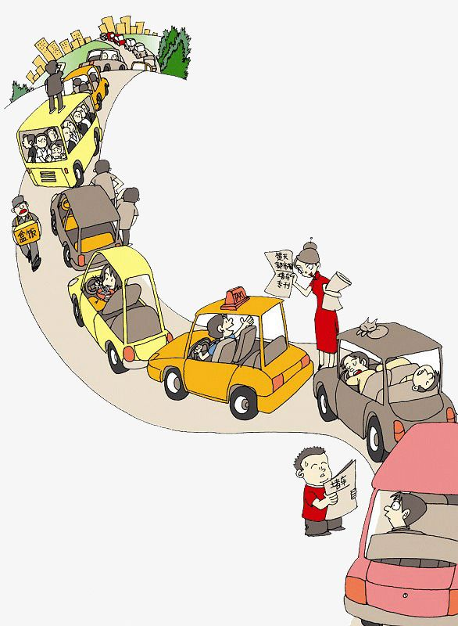
WARM-UP
Memorizing game
- Watch a video clip about TRAFFIC PROBLEMS
- Try to remember them
- Write them on the board in ONE minute

Slide 3


Slide 4
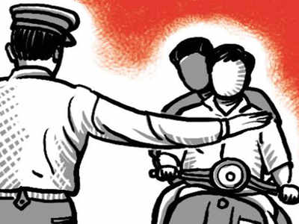
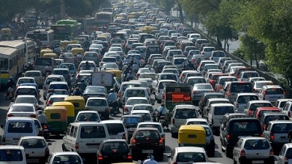
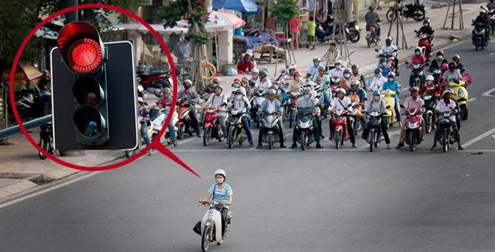
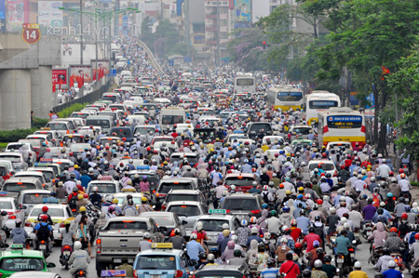
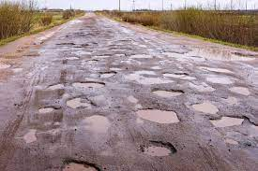
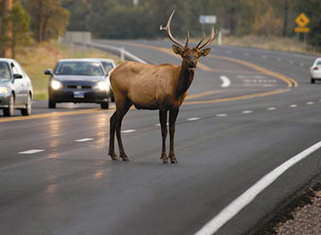
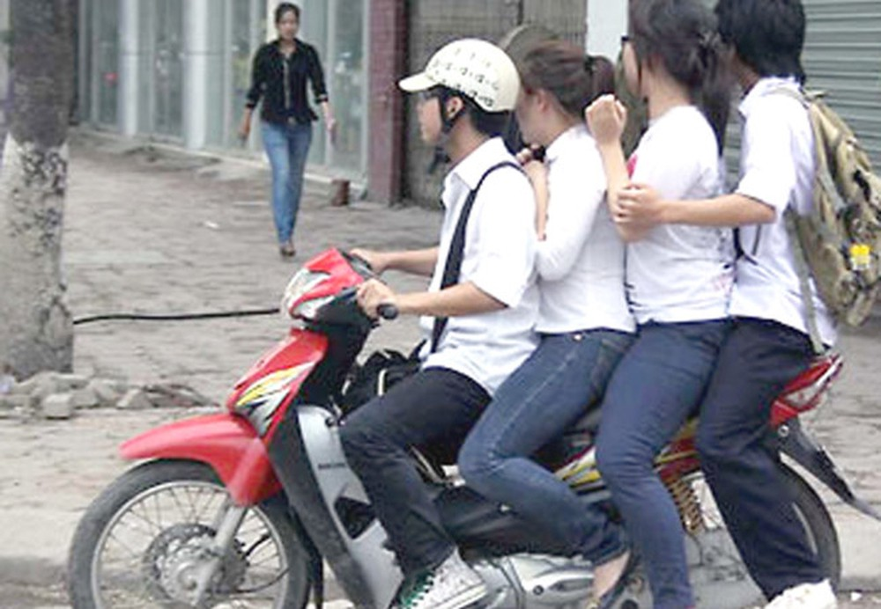
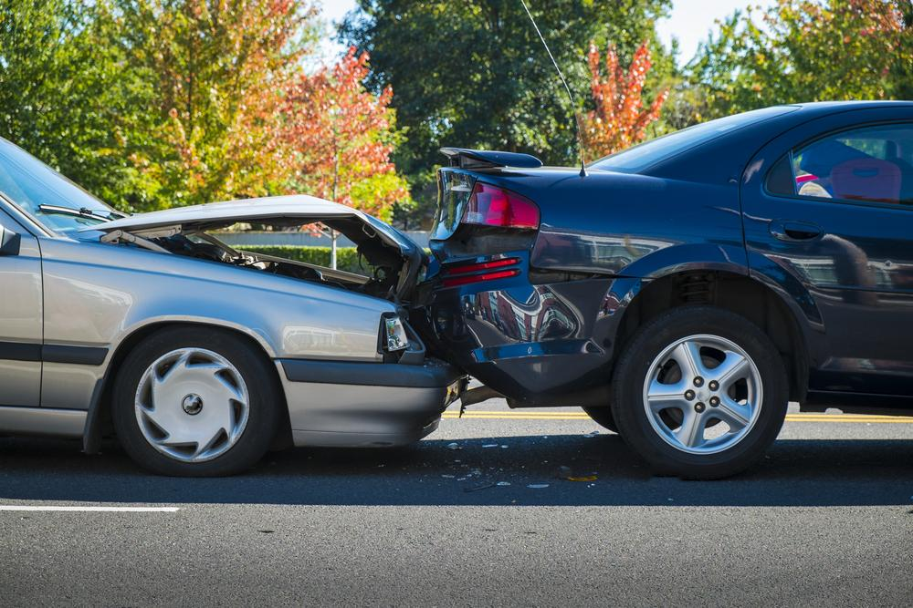
Not obeying the traffic rules
Jumping the traffic lights
Too many vehicles
TRAFFIC PROBLEMS
Traffic jams
Bumpy/narrow roads
Animals on the roads
Too many people in a vehicle
Traffic accidents

Slide 5

UNIT 7:
TRAFFIC
Lesson 6: Skills 2

Slide 6
NEW WORDS

Slide 7
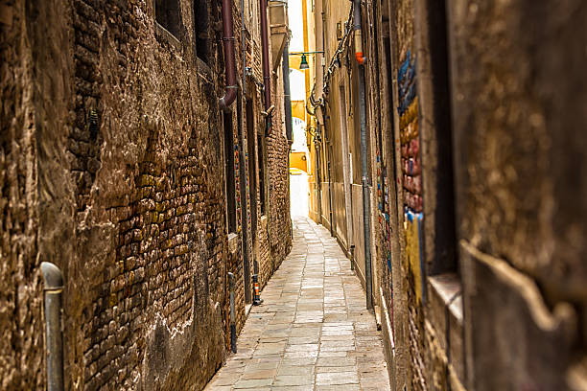
NEW WORDS
Narrow (adj)
/ˈnærəʊ/
Chật hẹp

Slide 8
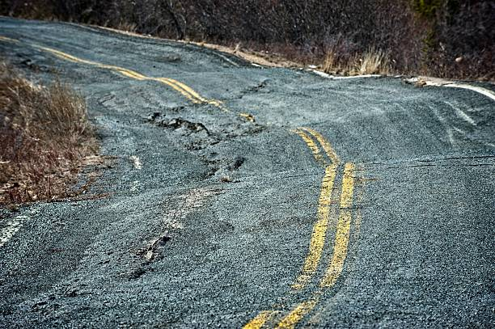
NEW WORDS
bumpy (adj)
/ˈbʌmpi/
Gập ghềnh

Slide 9
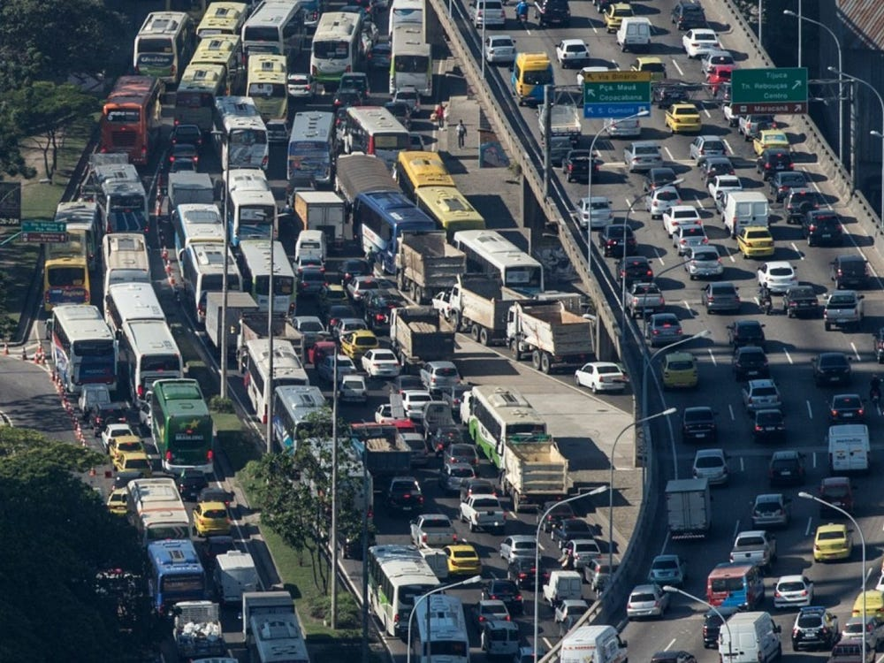
NEW WORDS
congested (adj)
/kənˈdʒestɪd/
Đông nghịt, chặt ních

Slide 10
NEW WORDS
be in good condition
(V-phr)
Trong tình trạng tốt

Slide 11
NEW WORDS
1. narrow (adj)
Chật hẹp
2. bumpy (adj)
Gập ghềnh
3. congested (adj)
Đông nghịt, chặt ních
4. be in good condition
Trong tình trạng tốt

Slide 12
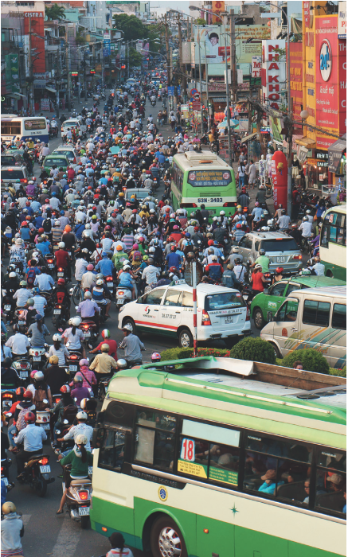

I. LISTENING
1
What can you see in this picture? What is special about it?

Slide 13
LISTENING
1
What can you see in this picture? What is special about it?
In the picture, there are numerous vehicles running on the road: motorbikes, cars, and buses. They seem to be caught up the a traffic jam.

Slide 14
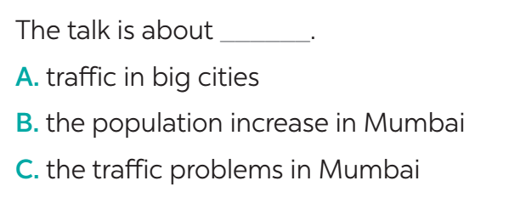
LISTENING
2
Listen to the recording and choose the correct answer A, B, or C.

Slide 15
LISTENING
3
Listen again and write ONE word or number in each gap.
n
1. Traffic _______ happen nearly every day in Mumbai.
2. One reason for the traffic ______________ is the increase of the population.
3. Mumbai has nearly ________ million people.
4. The ________ in Mumbai are narrow.
5. Many road users do not ________ the traffic rules.
n
number
n
V

Slide 16
LISTENING
3
Listen again and write ONE word or number in each gap.
jams
1. Traffic _______ happen nearly every day in Mumbai.
2. One reason for the traffic ______________ is the increase of the population.
3. Mumbai has nearly ________ million people.
4. The ________ in Mumbai are narrow.
5. Many road users do not ________ the traffic rules.
problem / jams
twenty
roads
obey

Slide 17
LISTENING
Big cities around the world have traffic problems. Mumbai in India is one of them. Mumbai is one of the most congested cities in the world. Traffic jams happen nearly every day, so drivers have to spend a lot of time on the road.
There are several reasons for traffic jams in this city. One reason is its increase in population. With nearly 20 million, Mumbai has too many people on the road. Another reason is that the roads in Mumbai are narrow, and many are not in good condition. Also, many road users do not obey the traffic rules. As a result, this problem is getting worse and worse.

Slide 18
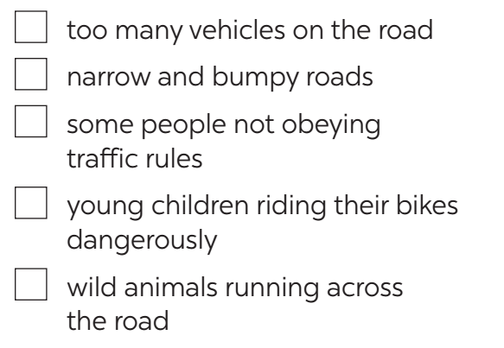





II. WRITING
4
Tick the traffic problems in big cities in Viet Nam.
$$$$
$$$$
$$$$
$$$$

Slide 19
Rearrange the words to make meaningful sentences.
1. too many/ traffic problems/ One of the/ people/ in our big cities/ using the roads./ is that
____________________________________________________________________________
2. too many/ on the road/ There are/ vehicles
____________________________________________________________________________
3. are/ bumpy and narrow/ Many roads
____________________________________________________________________________
4. accidents/ everyday./ There are/ traffic
____________________________________________________________________________
5. young children/ dangerously./ ride/ Many/ their bikes
____________________________________________________________________________
6. do not/ people/ the traffic rules./ Some/ obey
____________________________________________________________________________
7. are not/ Some roads/ good/ condition/ in
____________________________________________________________________________

Slide 20
Rearrange the words to make meaningful sentences.
1. One of the traffic problems in our big cities is that there are too many people using the roads.
2. There are too many vehicles on the road.
3. Many roads are narrow and bumpy.
4. There are traffic accidents everyday.
5. Many young children ride their bikes dangerously.
6. Some people do not obey the traffic rules.
7. Some roads are not in good condition.

Slide 21
II. WRITING
5
Write a paragraph of about 70 words about the traffic problems in your town / city.
OUTLINE
Introduction:
There are many traffic problems in my city/ town
Body:
- Problem 1: Firstly,/ The first problem is …
- Problem 2: Secondly/ Next/ Besides/…
- Problem 3: Finally/ Lastly/…
Conclusion:
(reason or suggestion)
In conclusion,…

Slide 22

II. WRITING
PEER CHECK AND CROSS CHECK
Students can:
go and see other’s work
give comments to each other

Slide 23

CONSOLIDATION
1
WRAP-UP
In this lesson, we have learnt to:
use the lexical items related to the topic Traffic
listen for main ideas and specific information about traffic problems in Mumbai
write about traffic problems in your area.

Slide 24

CONSOLIDATION
2
HOMEWORK
Prepare for the next lesson: Looking back & Project
Rewrite the passage on the notebook.
Do exercises in the workbook.

Slide 25
THANK YOU
FOR YOUR ATTENTION!
7TH GRADE
Phu Yen
Secondary school

