Slide 1
Warm up
Do the crossword puzzle
1
C
O
U
N
T
C
R
Y
2
U
U
N
I
Q
U
E
3
H
O
R
S
E
S
4
A
N
C
E
S
T
S
T
O
R
5
O
I
T
E
B
A
M
B
O
O
M
S
Y
M
6
L
U
C
K
M
O
N
E
Y
S
T
I
C
K
7
S
Y
1
2
3
4
5
6
7
8
9
10
11
12
13
14
15
16
17
18
19
20
CUSTOMS
Column

Slide 2
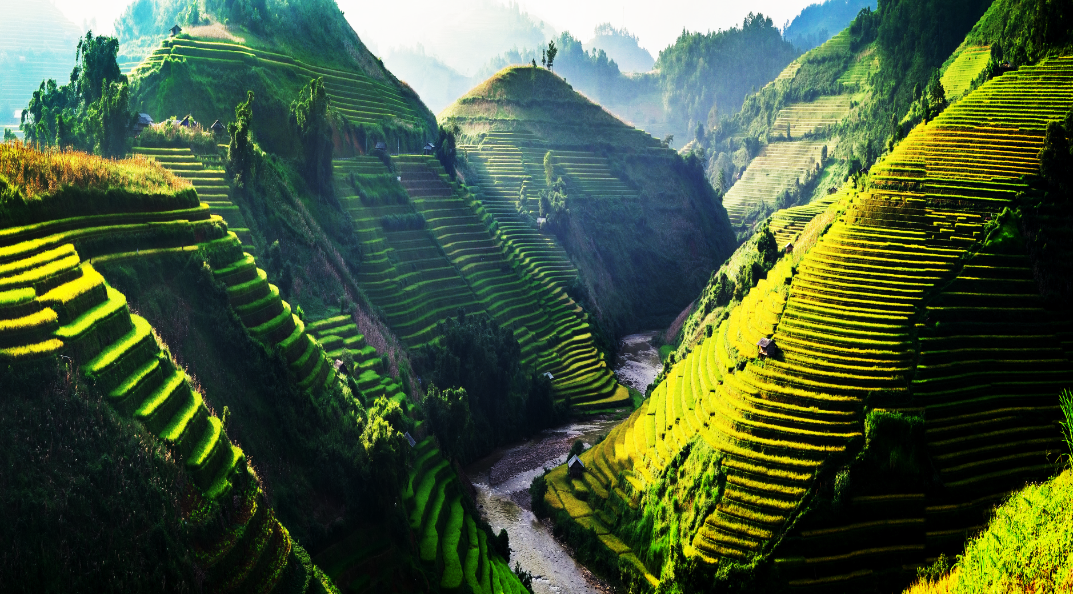
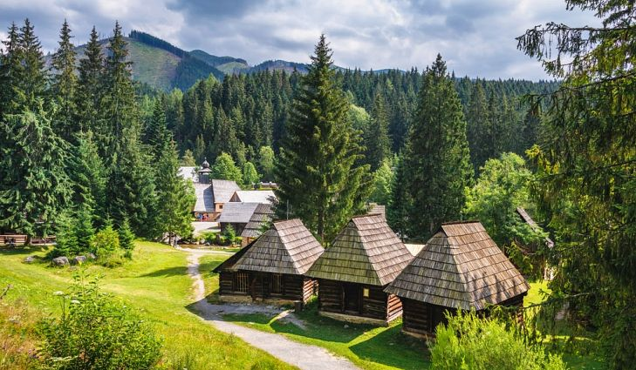
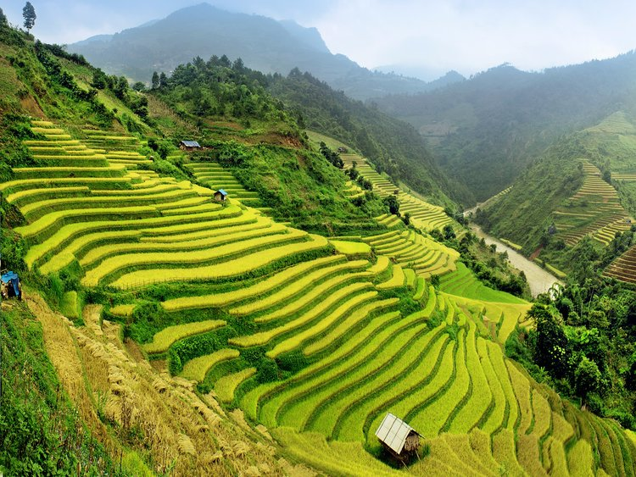
Fill in the blank
country
1. Vietnam is an amazing _______.

Slide 3
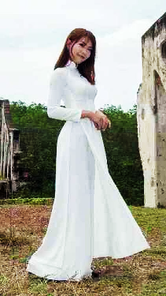
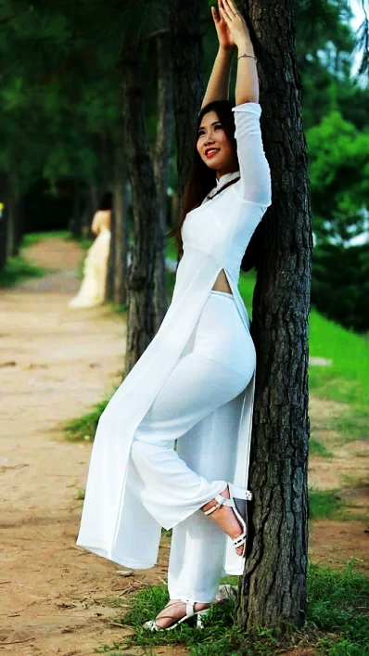
Complete the sentence
2. Vietnamese women look very beautiful and charming in the Ao dai. This costume is really _______.
unique

Slide 4
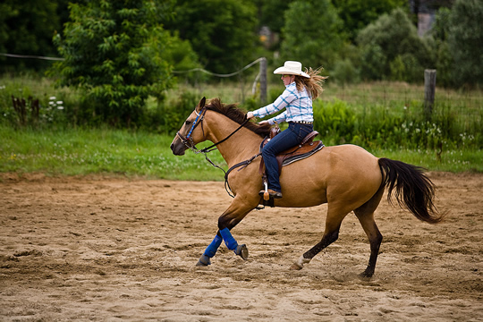
Complete the sentences
3. Have you ever ridden a ______? You have to be brave to do it.
horse

Slide 5
Complete the sentence
4. King Hungs are our _________.
ancestors

Slide 6
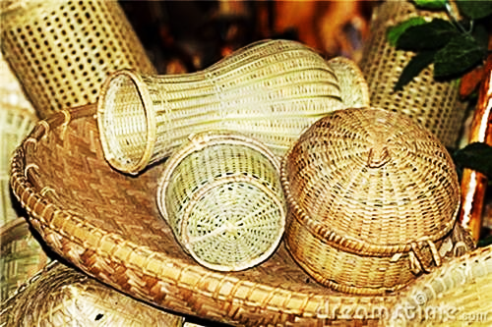
Complete the sentences
5. Vietnamese can make very beautiful ____________ from bamboo trees.
bamboo items

Slide 7
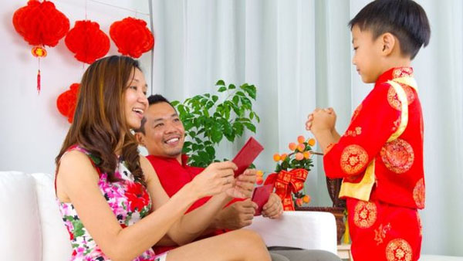
Complete the sentence
lucky money
6. At Tet, children usually get ___________ from parents and adults.

Slide 8
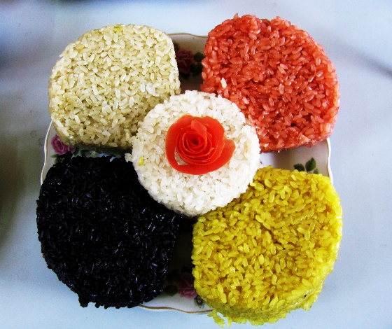
Complete the sentence
6. Vietnamese often make five-coloured _____ rice when they have guests.
sticky

Slide 9
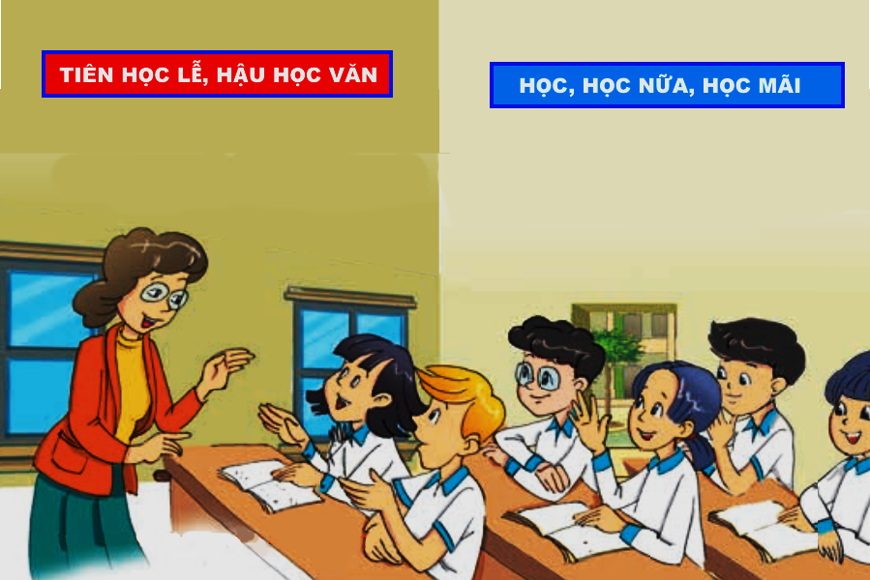
Teacher
Phong
Nick
Mi
Mai

Slide 10
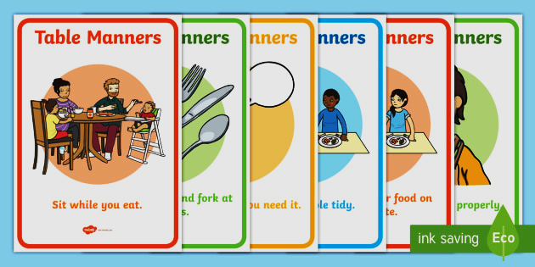

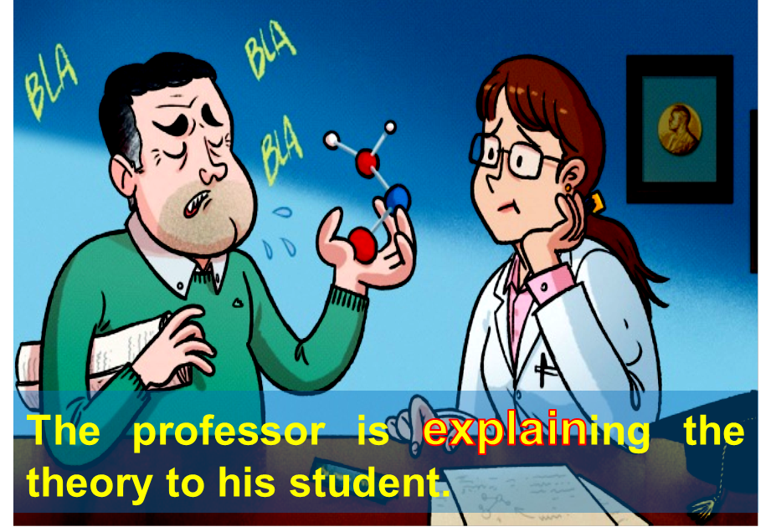
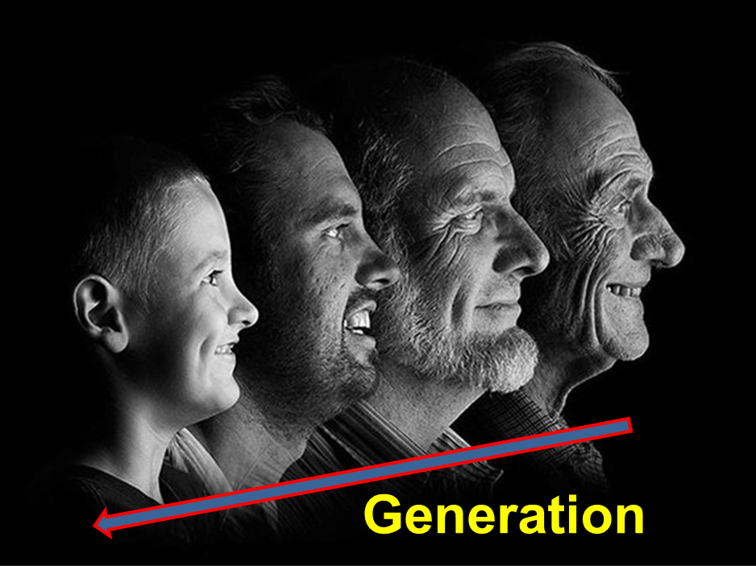
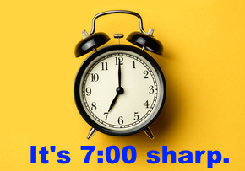
Vocabulary:
- explain (v)
accept (v)
pass down (p.v)
generation (n)
spot on (exp)
sharp (adj.)
table manner (exp)
presentation (n)
mention (v)
social (adj.) => society (n)
: giải thích
: chấp nhận
: truyền lại
: thế hệ
đúng, chính xác
: đúng giờ
: phép tắc ăn uống
: thuyết trình
: đề cập
: (thuộc) về xã hội

Slide 11
Checking vocabulary:
- explain /ɪksˈpleɪn/ (v)
accept / əˈsept / (v)
pass down /ˈpaːs daʊn/ (p.v)
generation /ˌdʒenəˈreɪʃn/ (n)
spot on /spɒt ɔn/(exp)
sharp / ʃɑːp / (a)
- table manner /ˈteɪbl ˈmænə(r)/ (exp)
: giải thích
: chấp nhận
: truyền lại
: thế hệ
= totally correct
: đúng, chính xác
: phép tắc ăn uống

Slide 12

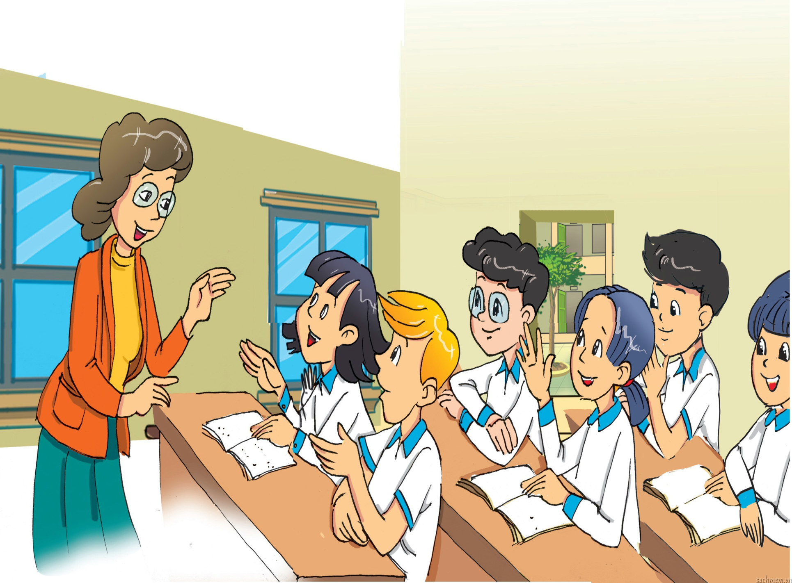

Slide 13

A lesson on customs and traditional
Teacher: Today we’re going to learn about customs and traditions. Do you think they’re the same?
Mi: I think they’re different, but it’s hard to explain how.
Nick: In my opinion, a custom is something that has become an accepted way of doing things. And a tradition is something we do that is special and is passed down through the generations.
Teacher: Yes, spot on! Give me an example of a custom.
Mai: My family has this custom of eating dinner at 7 p.m. sharp.
Teacher: Really?
Mai: Yes, we have to be at the dinner table on time.
Teacher: That’s interesting! How about a tradition, Phong?
Phong: We have a family tradition of visiting the pagoda on the first day of every lunar month.
Nick: You’re kidding!
Phong: No, no. We’ve followed this tradition for generations.
Teacher: You’ve mentioned family, but what about social customs and traditions, Nick?
Nick: Well, in the UK there are lots of customs for table manners. For example, we have to use a knife and fork at dinner. Then, there’s a British tradition of having afternoon tea at 4 p.m.
Teacher: Sounds lovely! Now, for homework, you should find information about a custom or tradition. You’re doing mini presentations next week...

Slide 14
1.a. Find a word or phrase that means:
1. agreed
accepted
2. grandparents, parents, and children
generations
3. totally correct
spot on
4. exactly on time
sharp
5. relating to human society
social
6. a polite way of eating at the dinner table
table manners

Slide 15
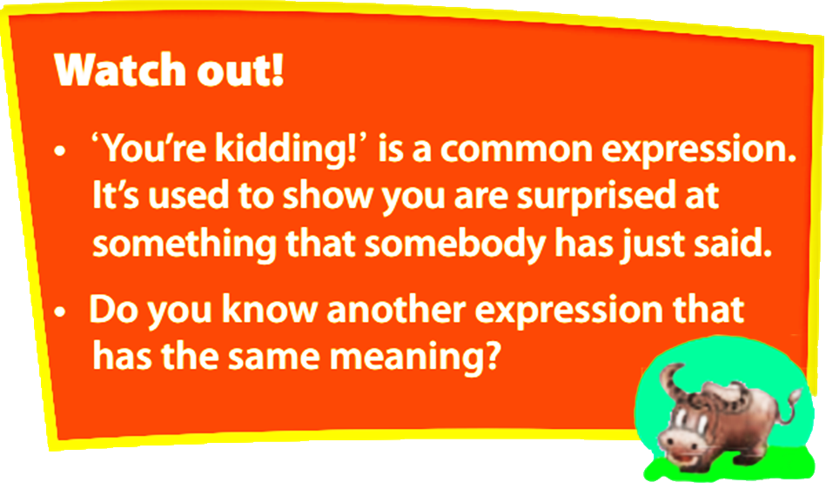
You are joking!
You must be joking!

Slide 16
1.b. Tick (✓) true (T) or false (F).
T F
1. Nick’s explanation of customs and
traditions is correct.
2. Only families have customs and
traditions.
3. In the UK there’s a tradition of having afternoon tea.
4. In the UK there is no accepted way of behaving at the dinner table.
✓
✓
There are also social ones
✓
There are a lot of customs for table manners in the UK.
✓

Slide 17
1.c. Answer the following questions.
1. What is Mai’s family custom?
It’s eating dinner at 7 p.m. sharp.
2. How does Nick feel when Phong talks about one of his family traditions?
He’s surprised.
3. What is the similarity between a custom and a tradition?
They both refer to doing something that develops over time.
4. What is the diﬀerence between them?
A custom is something accepted. A tradition is something special and is passed down through the generations.
5. What should the students do for homework?
They should find information about a custom or tradition.

Slide 18
1.d. Find these sentences in the conversation and fill in the missing words.
What do you think these sentences mean?
1. We ________ be at the dinner table on time.
2. You _______ find information about a custom or tradition.
have to
It’s an obligation – you have no choice
should
It’s a suggestion or advice – it would be best to follow it

Slide 19
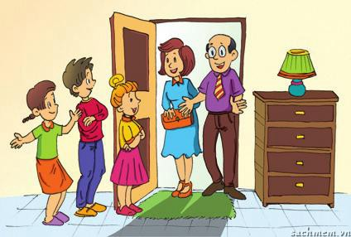
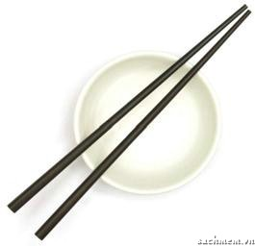
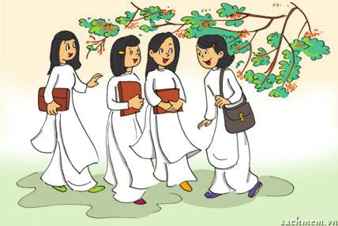
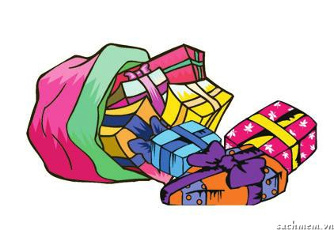
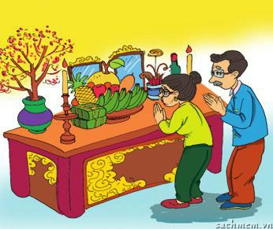
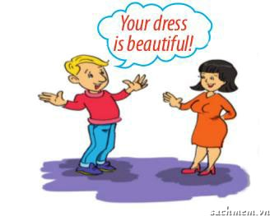
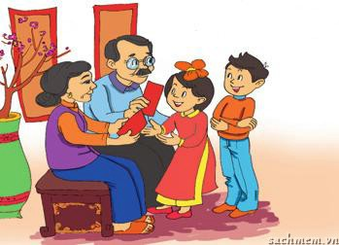
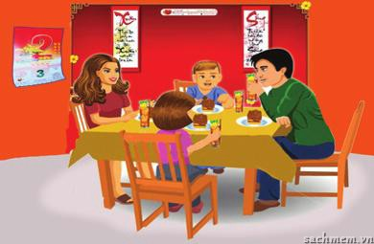
2.a. Match the pictures .
g
1. | smiling to accept a compliment
2. | worshipping ancestors
3. | wrapping gifts in colourful paper
4. | having lunch together on the second day of Tet
5. | placing the chopsticks on top of the rice bowl when finishing a meal
6. | children in the family standing in a row to greet guests
7. | wearing ao dai on special ocassions
8. | giving children lucky money at Tet
a.
e.
c
f
h
b.
f.
e
c.
g.
a
b
d.
h.
d

Slide 20
2. b. C (custom) or T (Tradition)
c
1. | smiling to accept a compliment
2. | worshipping ancestors
3. | wrapping gifts in colourful paper
4. | having lunch together on the second day of Tet
5. | placing the chopsticks on top of the rice bowl when finishing a meal
6. | children in the family standing in a row to greet guests
7. | wearing ao dai on special ocassions
8. | giving children lucky money at Tet
a.
e.
c/t
c
t
b.
f.
c
c.
g.
c
t
d.
h.
c/t

Slide 21
GAMES: CUSTOMS AND TRADITIONS EXPERTS

Slide 22
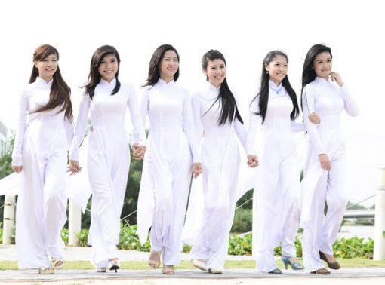
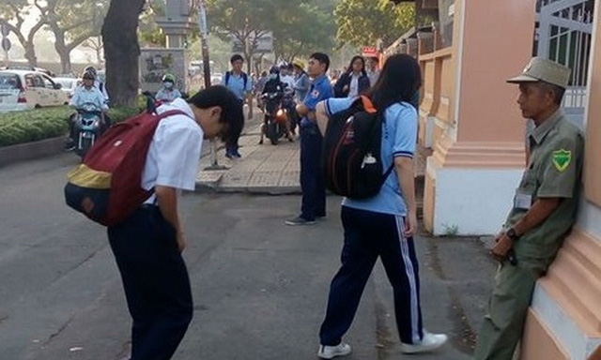
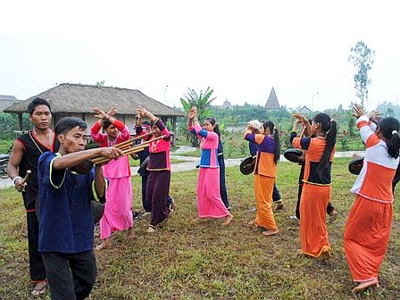
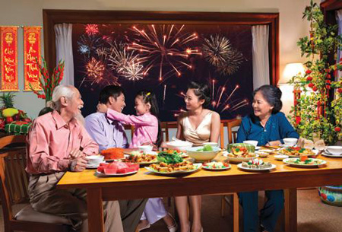
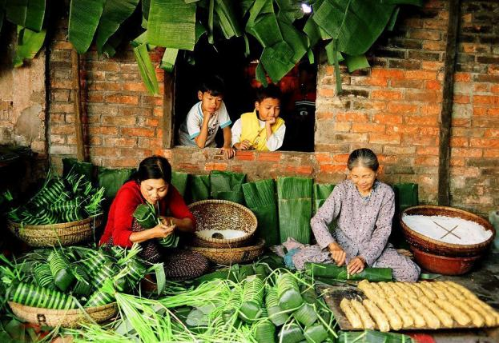

Slide 23


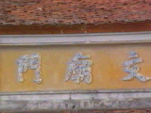
HOMEWORK
- Learn the new words by heart.
- Practice the dialogue again.
- Prepare for: Unit 4: A closer look 1.
+

