Slide 1


Slide 2
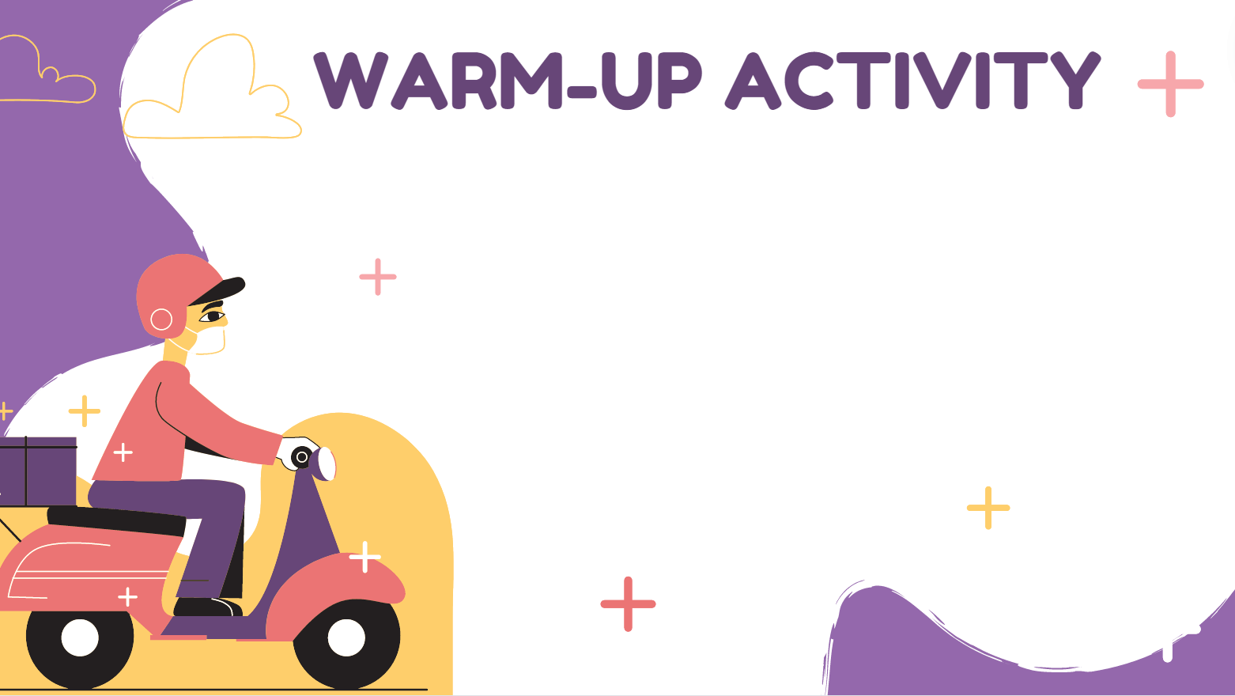
JUMBLED WORD
Ten words with incorrect order
Reorder letters to make a meaningful word
1 correct answer = 1 point

Slide 3
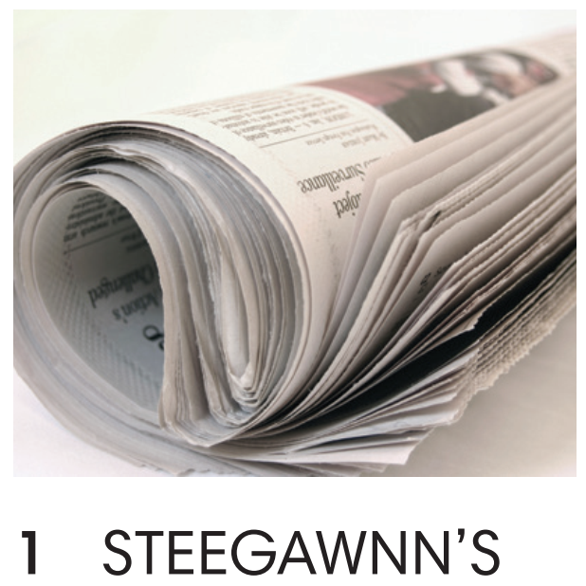

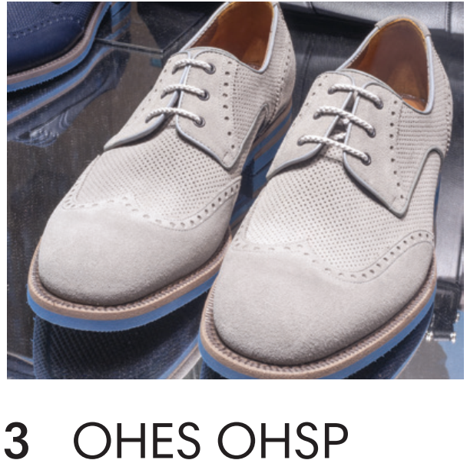
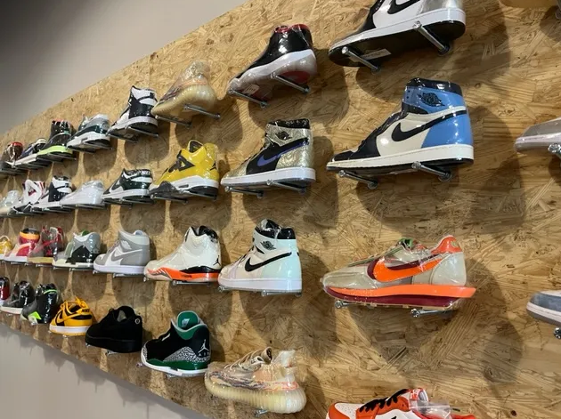
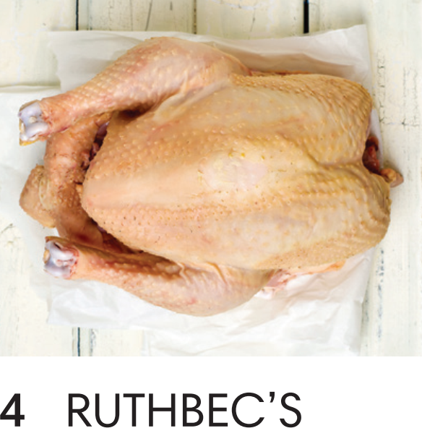
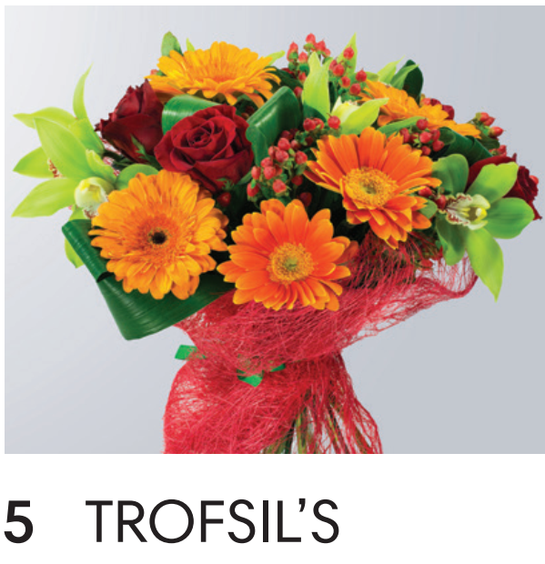
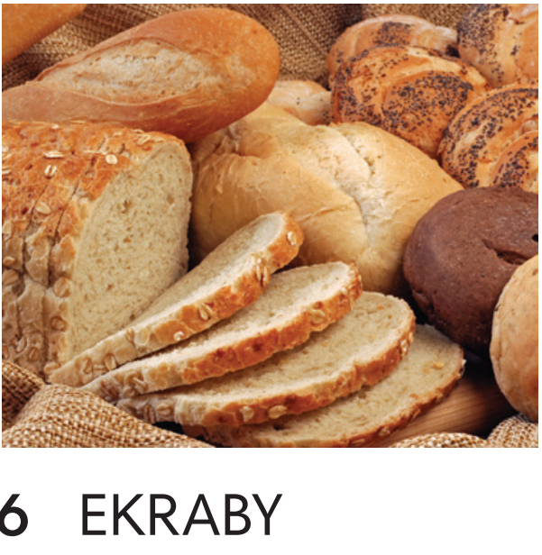
newsagent’s
bookshop
shoe shop
butcher’s
florist’s
bakery

Slide 4
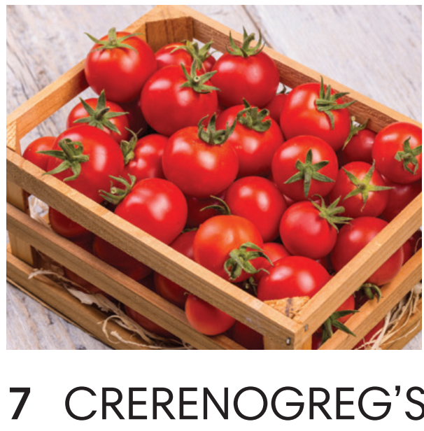
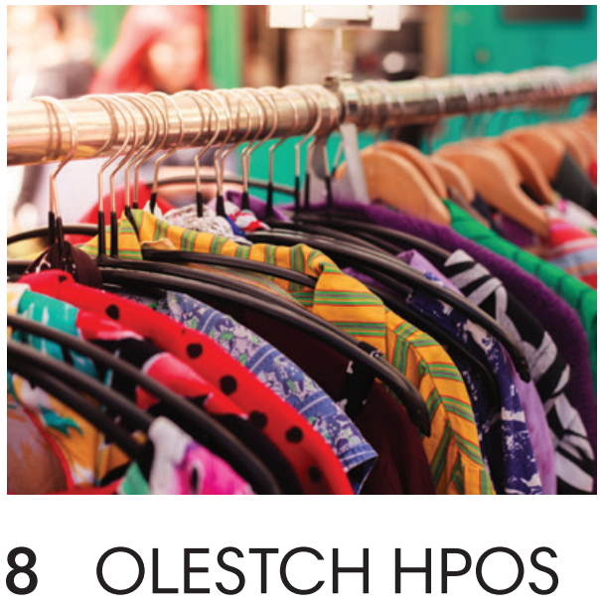
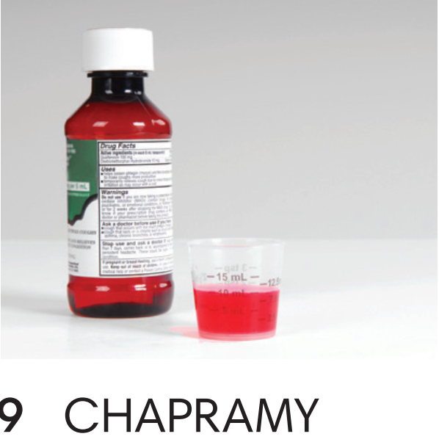
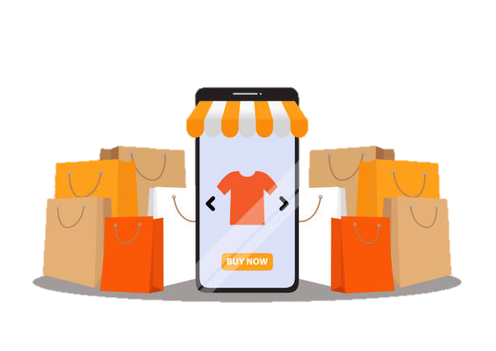
greengrocer’s
clothes shop
pharmacy

Slide 5
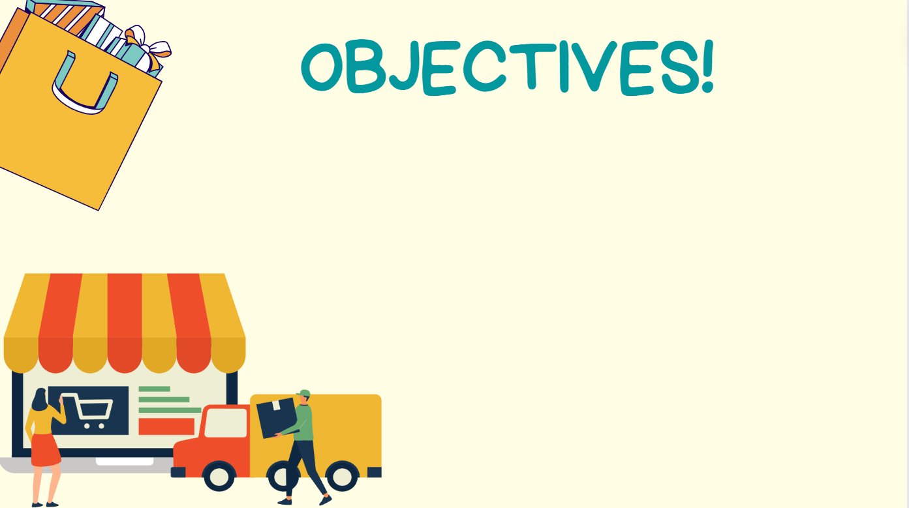


Use lexical items related to the topic “shopping around”
Shop for clothes and other things
Identify the difference between “ONE” and “ONES”

Slide 6


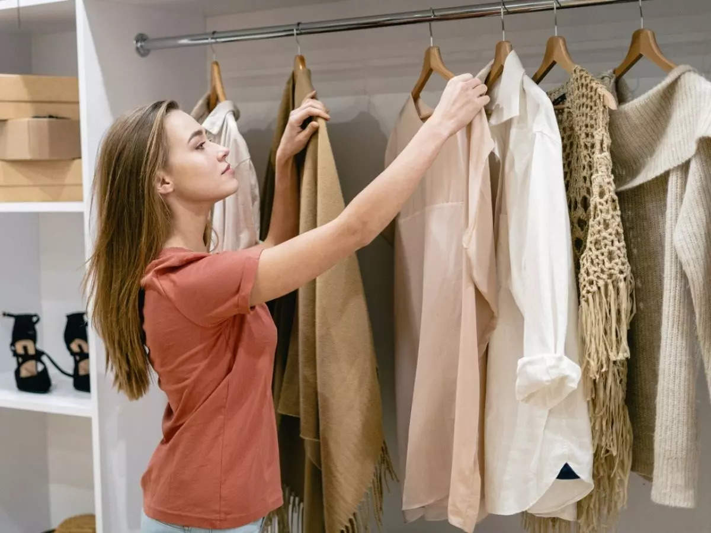
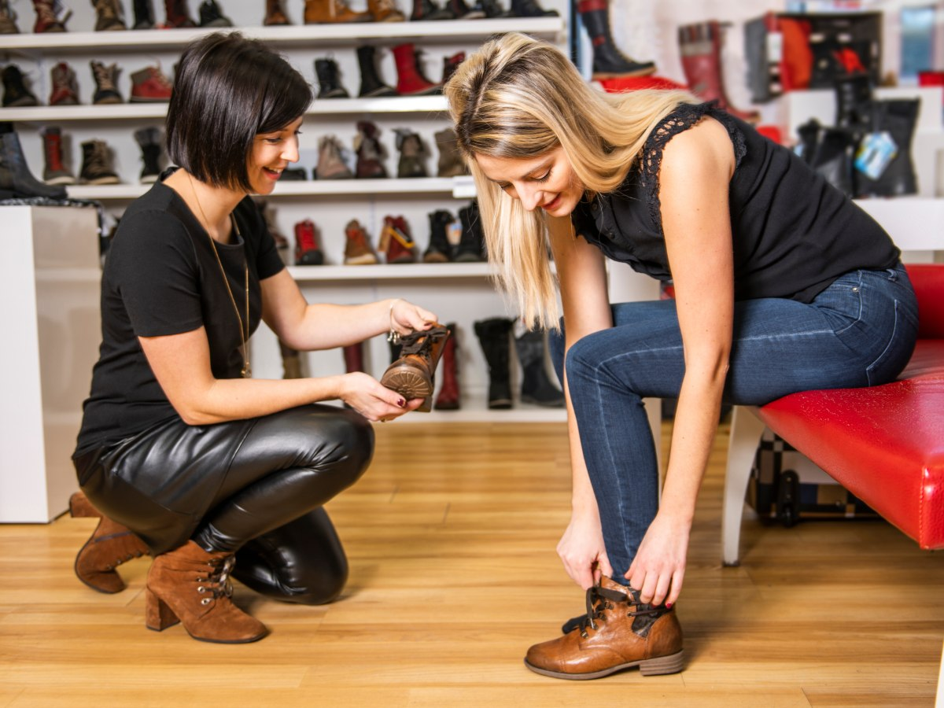
VOCABULARY
to put on a piece of clothing
to see if it fits and how it looks
try something on
/traɪ ˈsʌmθɪŋ ɒn/
thử đồ

Slide 7
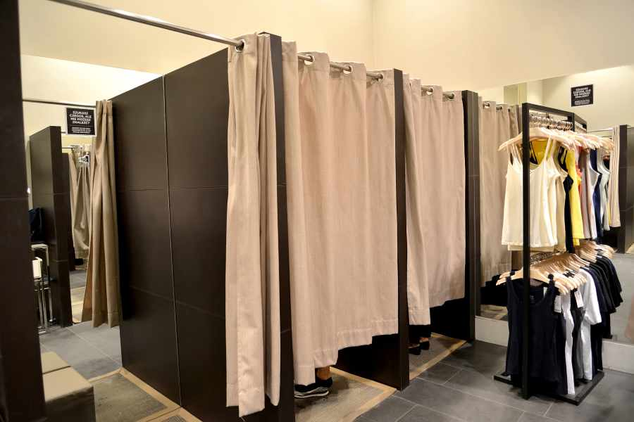
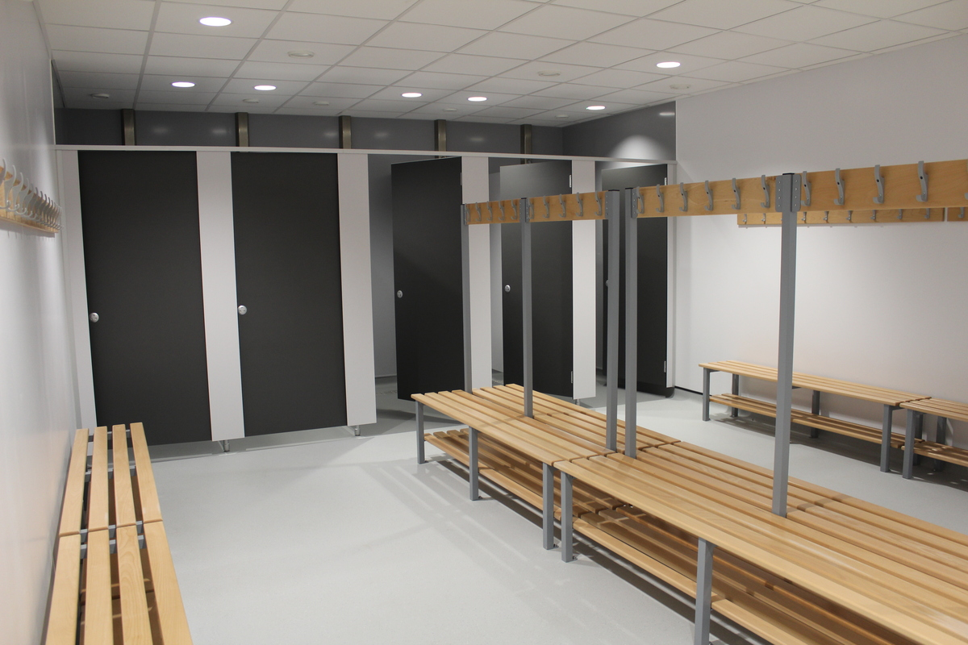
VOCABULARY
changing room (n)
a room for changing clothes in
/ˈtʃeɪndʒɪŋ ruːm/
phòng thay đồ, thử đồ

Slide 8
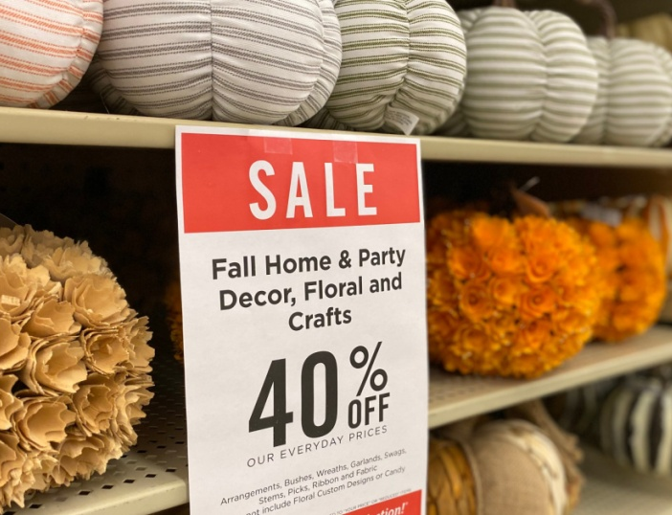
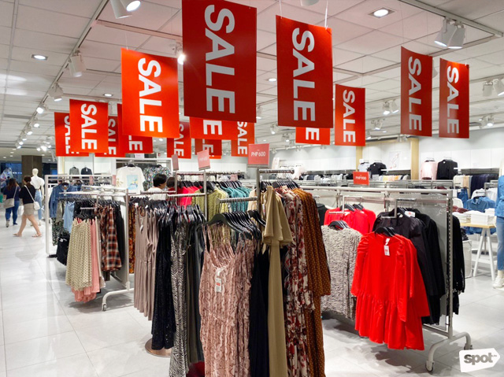
VOCABULARY
on sale
available to be bought,
especially in a shop
/ɒn seɪl/
còn hàng, có hàng

Slide 9

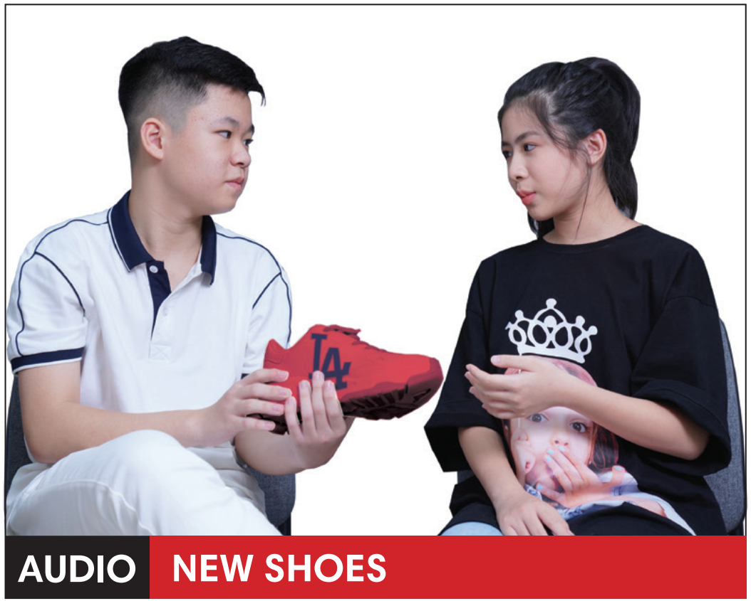
Shop Assistant (SA) : Can I help you?
Nam : Yes, I'm looking for a pair of trainers.
SA : These ones are on sale.
Nam : How much are they?
SA : Four hundred thousand dong.
Mai : That's a good price, Nam. You should get them.
Nam : Can I try them on, please?
SA : Of course. What size are you?
Nam : Thirty-seven.
Two minutes later
Nam : Oh! They're too small ... Excuse me! Have you got them in a bigger size?
SA : I think so... Just a second ... Here you are.

Slide 10


Exercise 1 (SB p.76) – Listening 7.07
Is Nam going to buy the red trainers? Listen and check.
Just a second!
I’m fed up!
Đợi một lát! Đợi một chút!
Đợi một lát! Đợi một chút!
Tôi chán quá rồi!
Shop Assistant (SA) : Can I help you?
Nam : Yes, I'm looking for a pair of trainers.
SA : These ones are on sale.
Nam : How much are they?
SA : Four hundred thousand dong.
Mai : That's a good price, Nam. You should get them.
Nam : Can I try them on, please?
SA : Of course. What size are you?
Nam : Thirty-seven.
Two minutes later
Nam : Oh! They're too small ... Excuse me! Have you got them in a bigger size?
SA : I think so... Just a second ... Here you are.

Slide 11
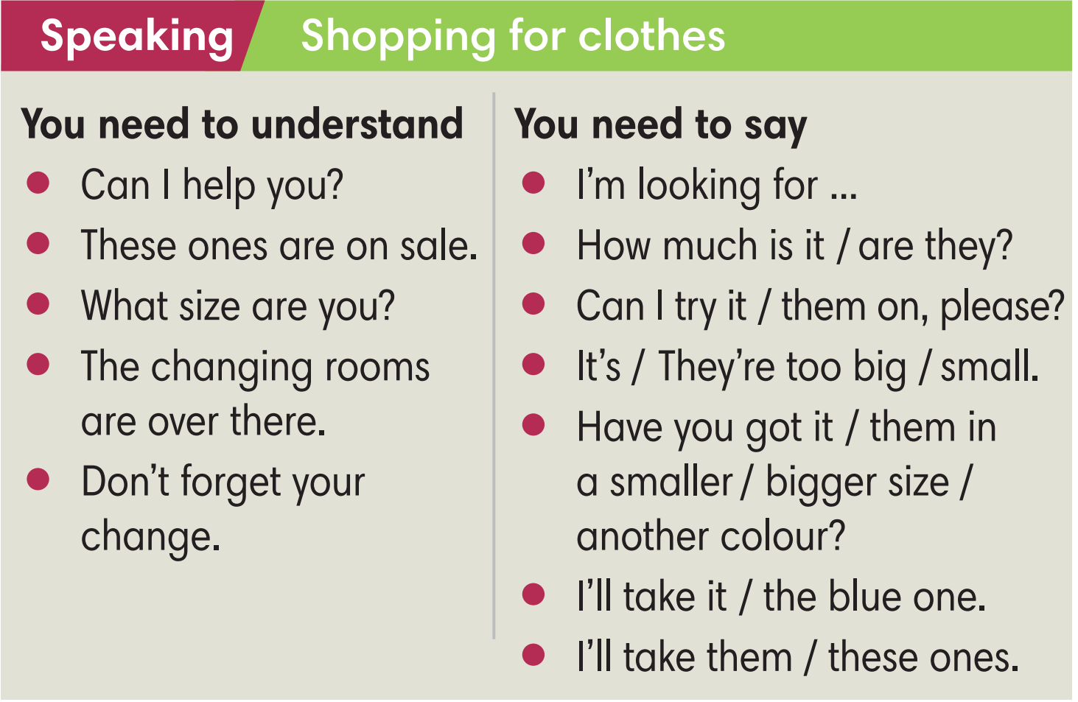
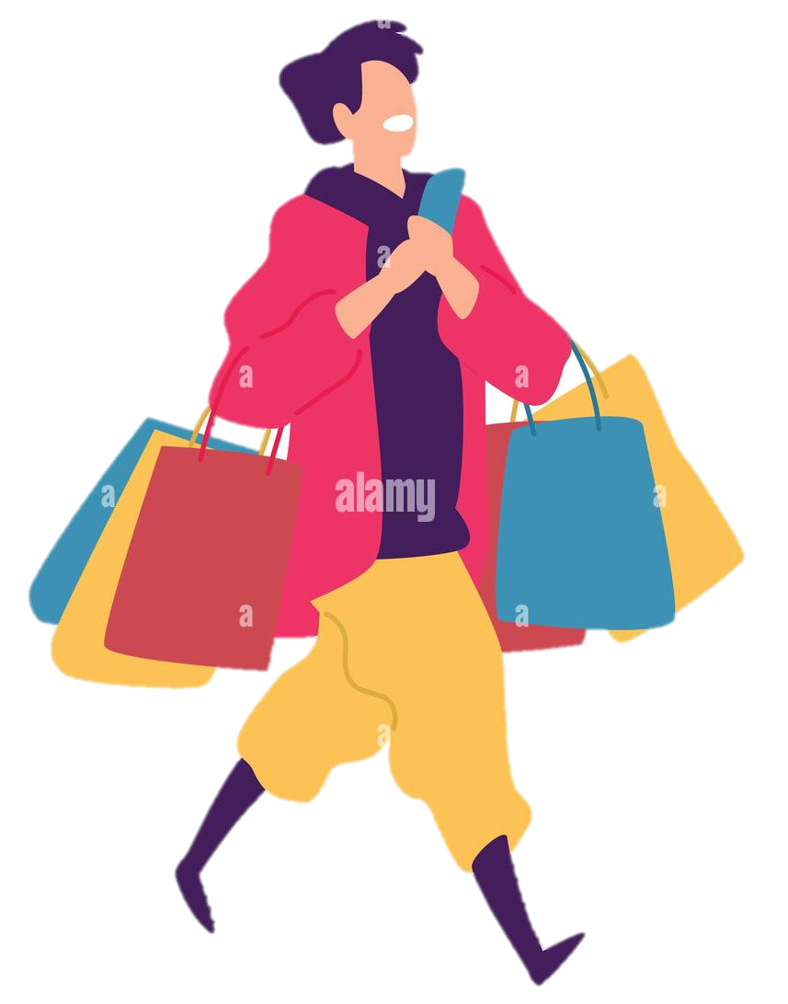

Exercise 2 (SB p.76)
In pairs, underline eight phrases that are in the dialogue.

Slide 12
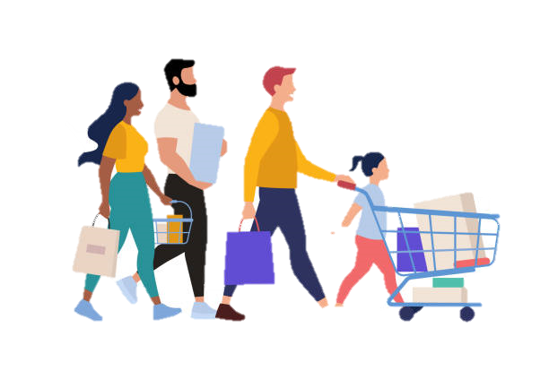
Exercise 2 (SB p.76)
In pairs, underline eight phrases that are in the dialogue.
Shop Assistant (SA) : Can I help you?
Nam : Yes, I'm looking for a pair of trainers.
SA : These ones are on sale.
Nam : How much are they?
SA : Four hundred thousand dong.
Mai : That's a good price, Nam. You should get them.
Nam : Can I try them on, please?
SA : Of course. What size are you?
Nam : Thirty-seven.
Two minutes later
Nam : Oh! They're too small ... Excuse me!
Have you got them in a bigger size?
SA : I think so... Just a second ... Here you are.

Slide 13
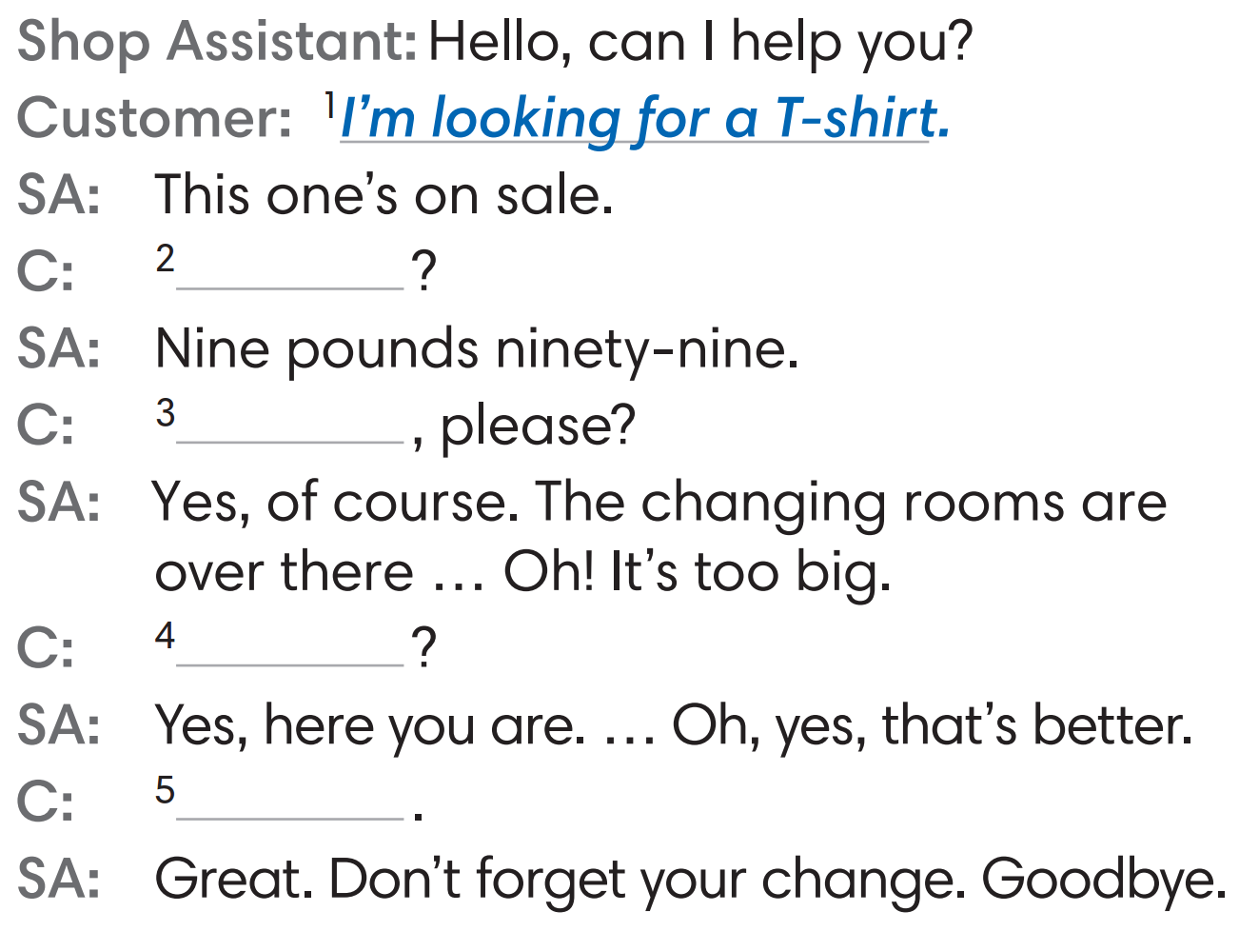

Exercise 3 (SB p.76) – Listening 7.08
Complete the dialogue with the phrases from the Speaking box. Listen and check.
(2) How much is it?
(3) Can I try it on, please?
(4) Have you got it in a smaller size?
(5) I'll take it.

Slide 14
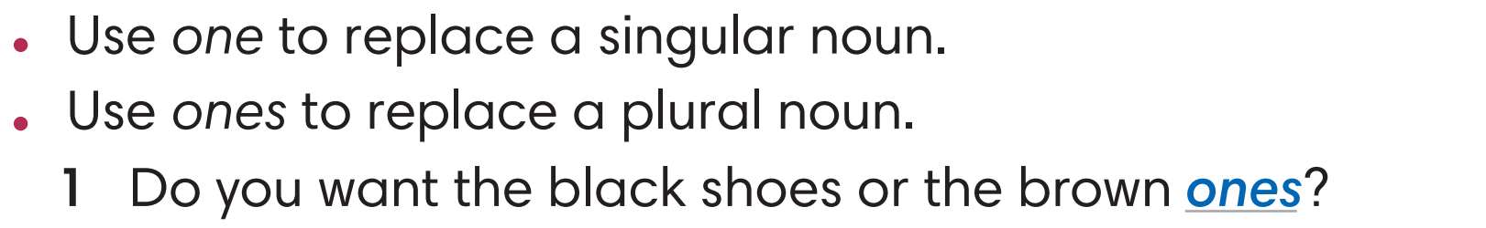

Exercise 4 (SB p.76) - Complete the sentences with one or ones.
A plural noun
ONE
2. This belt is too small. Have you got a bigger ________ ?
3. I'll take the pink shirt but I don't want the green ________.
4. My headphones aren't as good as these _________.
A singular noun
ONE
A singular noun
ONES
A plural noun

Slide 15

Exercise 5 (SB p.76) - In pairs, imagine you buy and sell the things below.
Student A is the customer, and Student B is the shop assistant.
Then change roles. Use the Speaking box to help you.
A : Good morning! Can I help you?
A hat | A pair of jeans | A coat/ a jacket
A : Good morning! Can I help you?
B : Yes, I'm looking for a hat.
B : Yes, I'm looking for ...
A : How about this? The blue one.
B : I don’t like blue? Have you got different colours?
A : Yes, of course. We have green, yellow, and purple ones. Which colour do you like?
B : The purple one would be the best.
A : Ok. That’s great. Here you are. Don’t forget your change.
B : Thank you. Goodbye.
A : Goodbye

Slide 16
Exercise 5 (SB p.76) - In pairs, imagine you buy and sell the things below.
Student A is the customer, and Student B is the shop assistant.
Then change roles. Use the Speaking box to help you.
A : Good morning! Can I help you?
A : Good morning! Can I help you?
B : Yes, I'm looking for a pair of jeans .
B : Yes, I'm looking for a jacket.
A : Would you like short or long ones?
A : These ones are on sale.
B : I need it for school so it’s should be long.
B : How much is it?
A : It’s 8 pounds.
A : Yeah, I see. We have green, blue, and gray ones. Which colour do you like?
B : I want to try it in size M.
A : Here you are. The changing rooms are there.
B : The gray ones would be the best. Can I try it on?
B : It’s too small. Have you got a bigger size?
A : Yes, of course. The changing rooms are over there.
A : Let me check. Hmm yes, we have. Here you are.
B : Thank you. I’ll take them.
B: This one really fits me. I’ll take it.
A : Here you are. Goodbye.
A: Thank you.

Slide 17
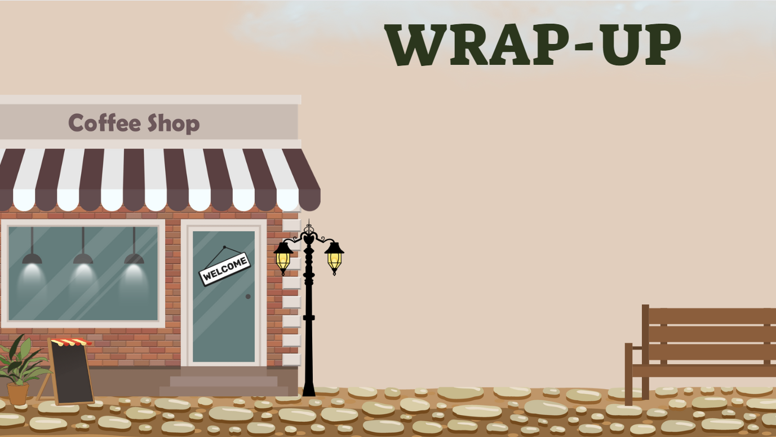
Consolidate what students
have learnt in the lesson

Slide 18

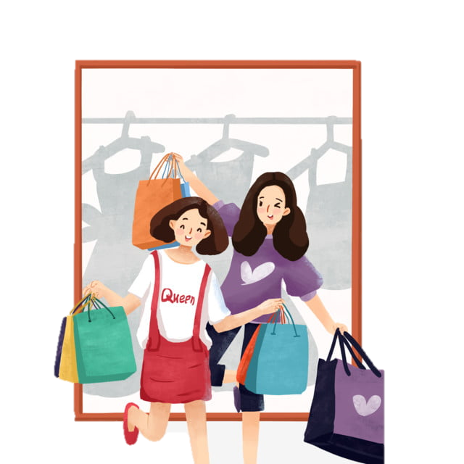
VOCABULARY REVIEW
try something on | /traɪ ˈsʌmθɪŋ ɒn/ | to put on a piece of clothing to see if it fits and how it looks | thử đồ
changing room (n) | /ˈtʃeɪndʒɪŋ ruːm/ | a room for changing clothes in | phòng thay đồ
on sale | /ɒn seɪl/ | available to be bought, especially in a shop | còn hàng, có hàng

Slide 19
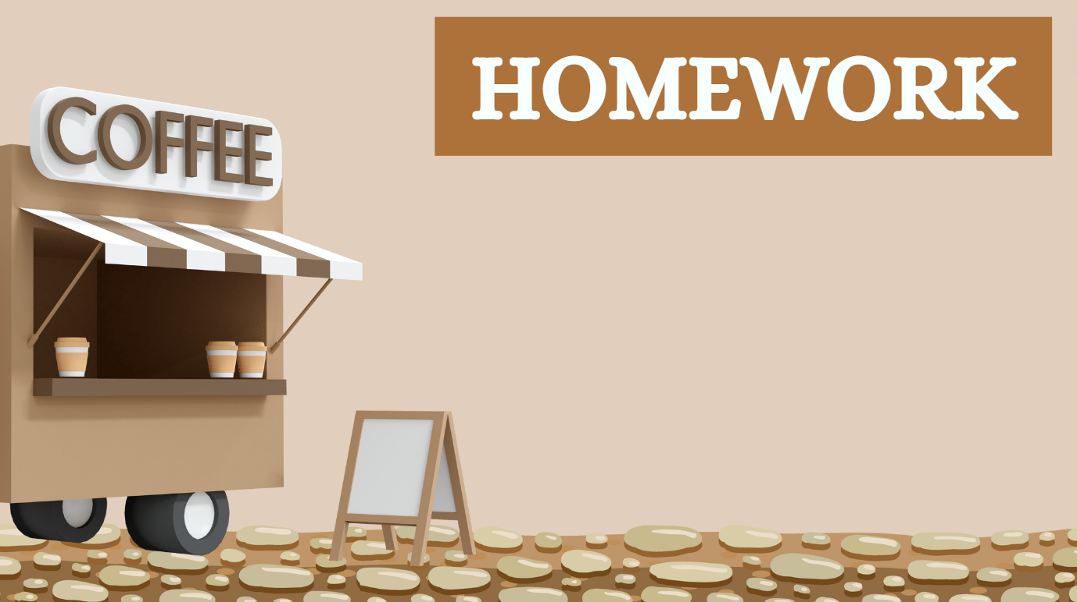
01. Learn the vocabulary by heart
02. Do the exercises in workbook
(page 65)
03. Prepare for Unit 7
Lesson 7 – Writing

Slide 20


