Slide 1


Slide 2

GUESSING GAME
01. Watch a video
02. Guess the name of place
03. 5 seconds = 1 picture
04. 1 correct answer = 1 point

Slide 3


Slide 4
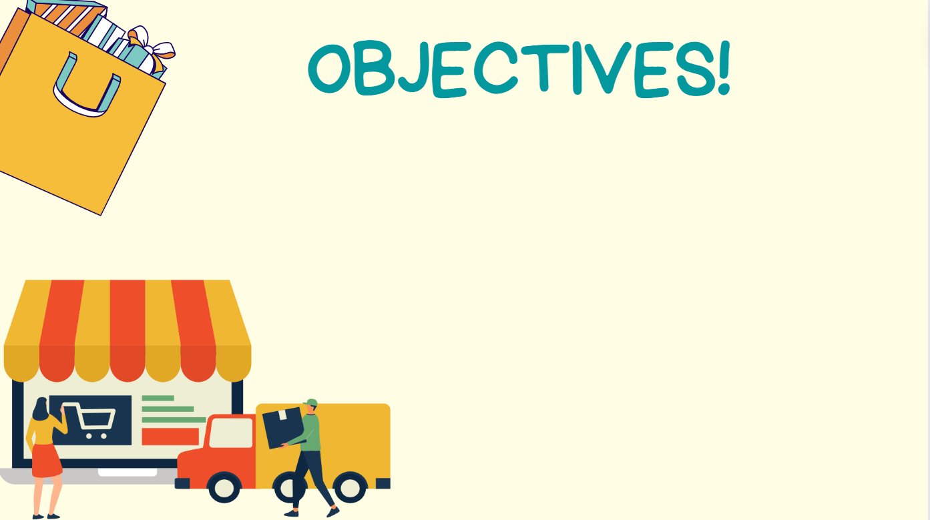


01. Use lexical items related to the topic “shopping around”
02. Use “Although, despite, in spite of” to show contrast
03. Talk about family’s shopping habits

Slide 5
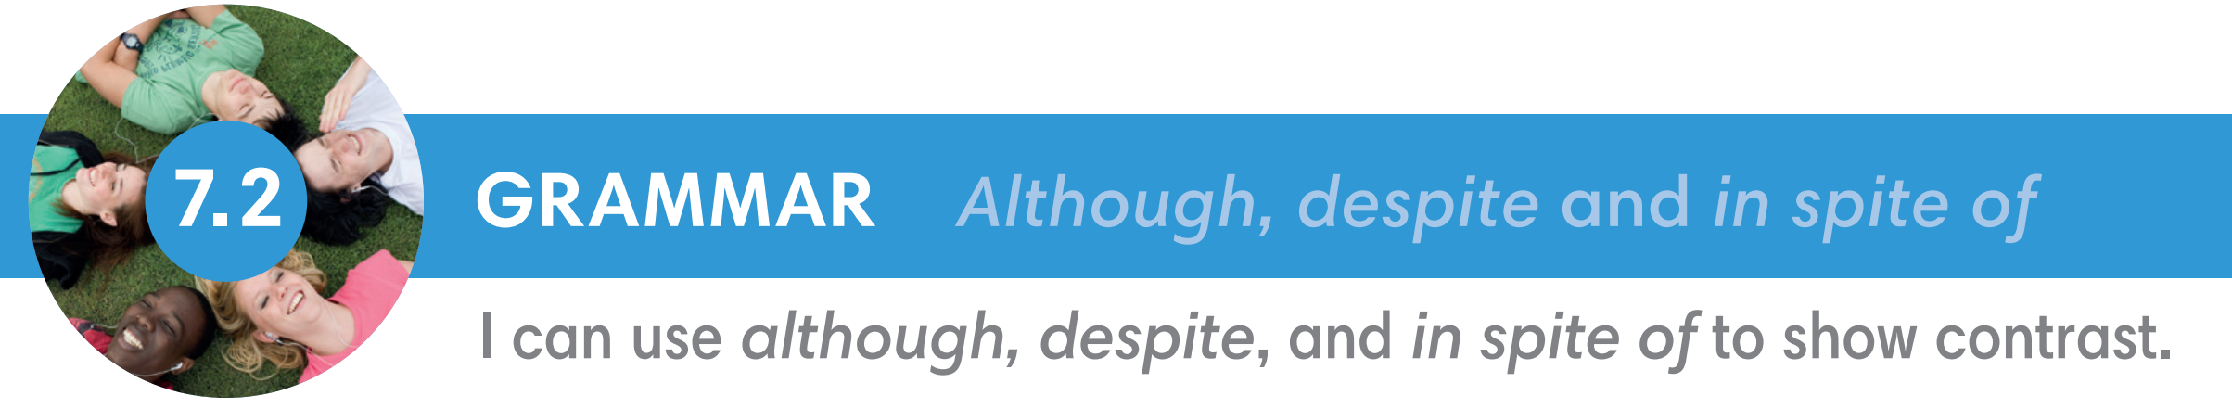
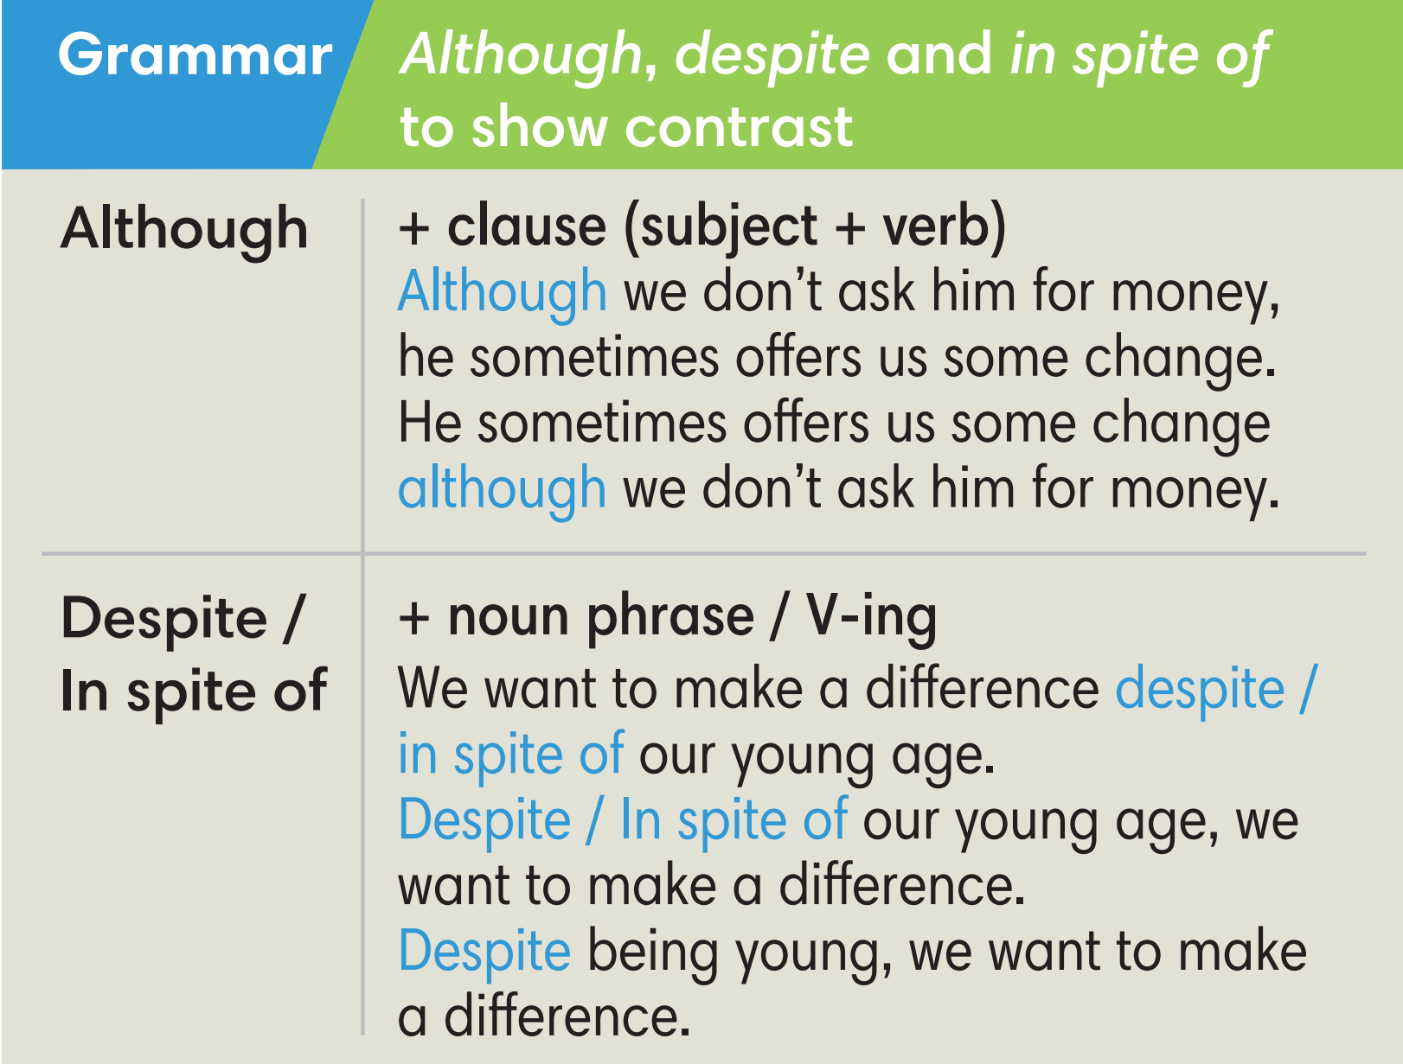

Slide 6





VOCABULARY
to have an effect on somebody/something
make a difference (n)
/meɪk ə ˈdɪfrəns/
Tạo ra sự khác biệt

Slide 7
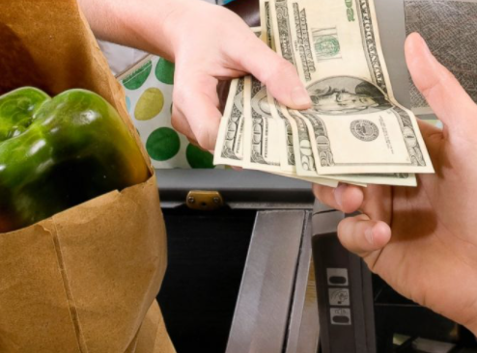
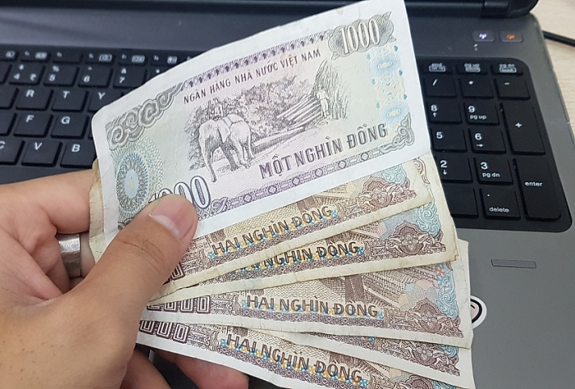
VOCABULARY
the money that you get back when you have paid for something
change (n)
/tʃeɪndʒ/
Tiền lẻ, tiền thừa

Slide 8
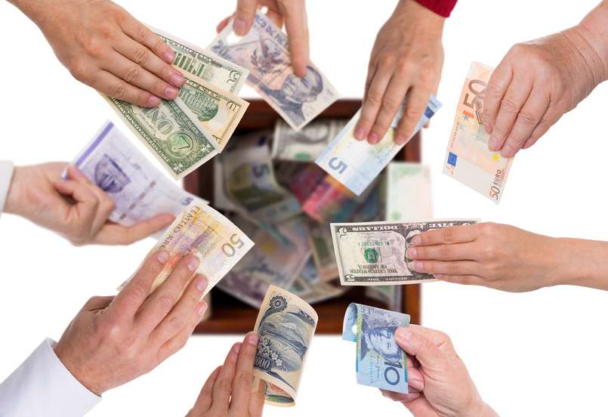

VOCABULARY
to collect money
for a special purpose
raise money (v)
/reɪz ˈmʌni/
Gây quỹ, quyên góp tiền

Slide 9


VOCABULARY
an act of trying to do something, especially something difficult
attempt (n)
/əˈtempt/
Sự cố gắng, nỗ lực
/ˈefət/
= effort (n)

Slide 10
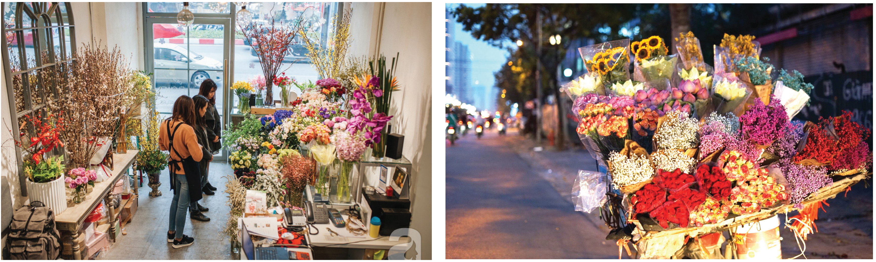
Exercise 1 (SB p.72) - Work in pairs. Look at the pictures.
Which one is your favourite place to buy flowers?
from a florist’s/ floral shop
from a street vendor

Slide 11
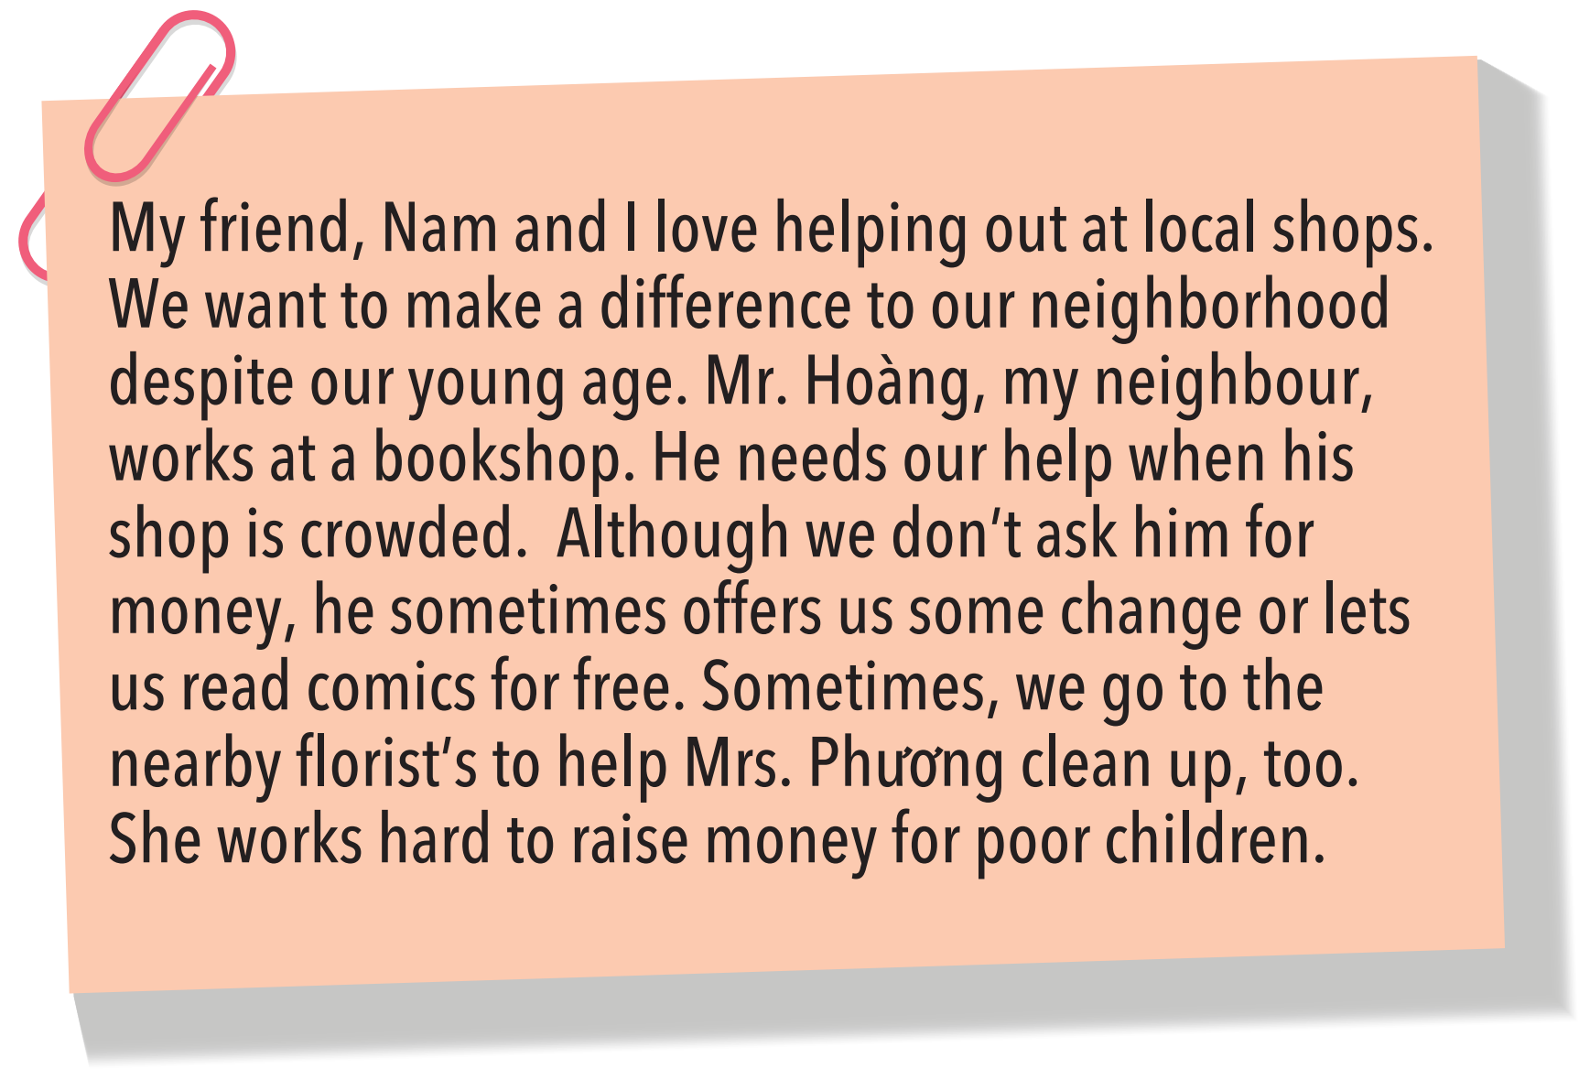
Exercise 2 (SB p.72) - Read the text below.
Underline although and despite. Answer the questions below.

Slide 12
Exercise 2 (SB p.72) - Read the text below.
Underline although and despite. Answer the questions below.
Exercise 2 (SB p.72) - Read the text below.
Underline although and despite. Answer the questions below.
My friend, Nam and I love helping out at local shops. We want to make a difference to our neighborhood despite our young age. Mr. Hoàng, my neighbour, works at a bookshop. He needs our help when his shop is crowded. Although we don’t ask him for money, he sometimes offers us some change or lets us read comics for free. Sometimes, we go to the nearby florist’s to help Mrs.Phương clean up, too. She works hard to raise money for poor children.
1 What does Mr. Hoàng sometimes offer the kids?
Mr.Hoàng sometimes offers the kids some change and lets them read comics for free.
2 Why does Mrs. Phương work hard?
She raises money for poor children.

Slide 13
Thể hiện sự tương phản
Mặc dù
Although + mệnh đề
Despite
In spite of +
danh từ / V.ing
Mặc dù

Slide 14
Exercise 3 (SB p.72) - Study the Grammar box.
Complete the sentences below, using although and despite / in spite of.
____________my father was late for work, he stopped to buy a newspaper at the newsagent's.
The shopping centre will be closed__________ its owner's attempt to rebuild it.
_________my mum's efforts, she still spends more money on clothes than she expected.
Living in the city is expensive___________some people can earn more money.
The shoe shop only sells a few pairs of shoes each day_________ its special offers at this time of the year.

Slide 15
Exercise 3 (SB p.72) - Study the Grammar box.
Complete the sentences below, using although and despite / in spite of.
Although
____________ my father was late for work, he stopped to buy
a newspaper at the newsagent's.
2. The shopping centre will be closed ____________________
its owner's attempt to rebuild it.
Clause (Subject + Verb)
despite / in spite of
Noun phrase

Slide 16
Despite / In spite of
3. ____________________my mum's efforts, she still spends
more money on clothes than she expected.
4. Living in the city is expensive _________________ some people
can earn more money.
5. The shoe shop only sells a few pairs of shoes each day
___________________ its special offers at this time of the year.
Noun phrase
although
Clause (Subject + Verb)
despite / in spite of
Noun phrase

Slide 17
Exercise 3 (SB p.72) - Study the Grammar box.
Complete the sentences below, using although and despite / in spite of.
____________my father was late for work, he stopped to buy a newspaper at the newsagent's.
The shopping centre will be closed _________________ its owner's attempt to rebuild it.
_________________ my mum's efforts, she still spends more money on clothes than she expected.
Living in the city is expensive ____________ some people can earn more money.
The shoe shop only sells a few pairs of shoes each day __________________ its special offers at this time of the year.
Although
despite/ in spite of
despite/ in spite of
although
despite/ in spite of

Slide 18

Exercise 4 (SB p.72)
In pairs, use your own ideas to complete the following sentences.
1 I don't like going to the butcher's, although .............................................................
2 The bakery is very crowded despite .............................................................................
3 Despite her old age, ..........................................................................................................
4 Although the greengrocer was very friendly, ............................................................
it’s pretty close to my house.
the high prices.
she still works very hard everyday.
it is so crowded during the day.

Slide 19
Exercise 5 (SB p.72) - In groups of four, talk about the shopping habits
of your family. Use although and despite.
My mum often goes to the butcher's every morning to buy some meat. Although she wakes up early, she often goes there when it is already crowded ...
A: Although my dad have to work very early he usually goes to bakery at 6a.m in the morning to buy me some fresh bread. I usually eat bread with eggs for breakfast.
B: Despite weak eyesight, my grandmother always goes to newsagent’s eveyday to buy some newspaper.
C: Although the clothes shop is very crowded at the weekend, my sister still go there to buy some discount clothes.
D: My mother goes to greengrocer’s to buy organic ingredients despite high prices.

Slide 20
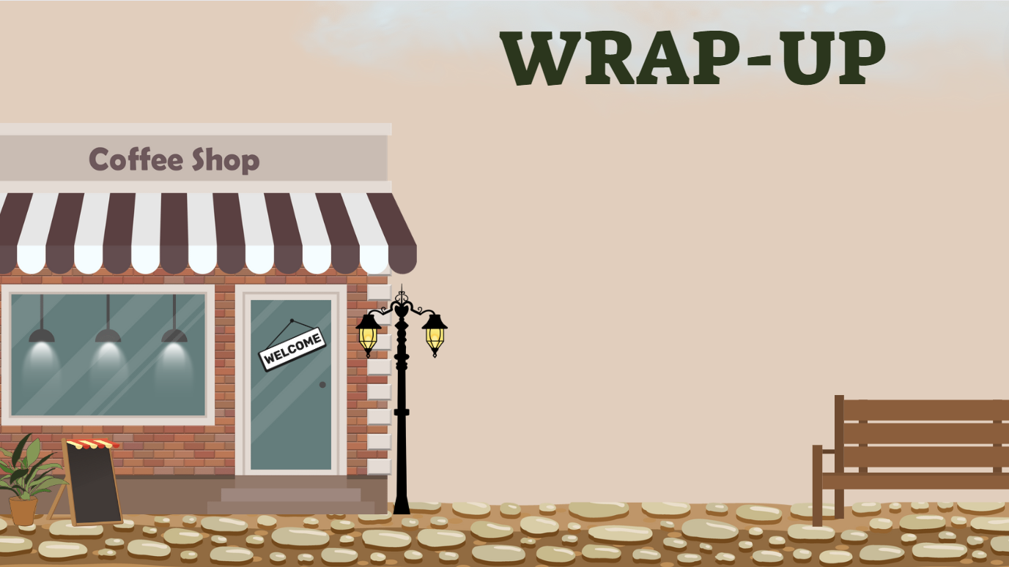
Consolidate what students
have learnt in the lesson

Slide 21

VOCABULARY REVIEW
make a difference (n) | /meɪk ə ˈdɪfrəns/ | to have an effect on somebody/something | tạo ra sự khác biệt
change (n) | /tʃeɪndʒ/ | the money that you get back when you have paid for something | tiền thừa, tiền lẻ
raise money (v) | /reɪz ˈmʌni/ | to collect money for a special purpose | gây quỹ, quyên góp tiền
attempt (n) Effort (n) | /əˈtempt/ /ˈefət/ | an act of trying to do something, especially something difficult | nỗ lực, cố gắng

Slide 22

01. Learn the vocabulary by heart
02. Do the exercises in workbook
(page 61)
02. Prepare for Unit 7
Lesson 3 – Reading + vocabulary

Slide 23


