Slide 1


Slide 2

STOP THE BUS
Three topics.
Show a letter from the alphabet.
Find a word for each topic that starts with this letter.
Say “stop the bus” to get a word for each topic.

Slide 3
 | NAME OF PLACES | FOOD / DRINKS | ADJECTIVES
P
Pharmacy
Pizza
Pretty
B
Bakery
Bread
Big / bad
H
Hospital
Hotdog
Hot / Huge
C
Clothes shop
Cake / Candy
Cheap / cute
S
Supermarket
Sushi / soda
Small / Slow
F
Florist’s
Fish / Fries
Far / Fantastic
N
Newsagent’s
Noodles / Nut
Near / New
M
Museum
Meat / Milk
Mean
T
Toy store
Tea
Tall / Thin

Slide 4
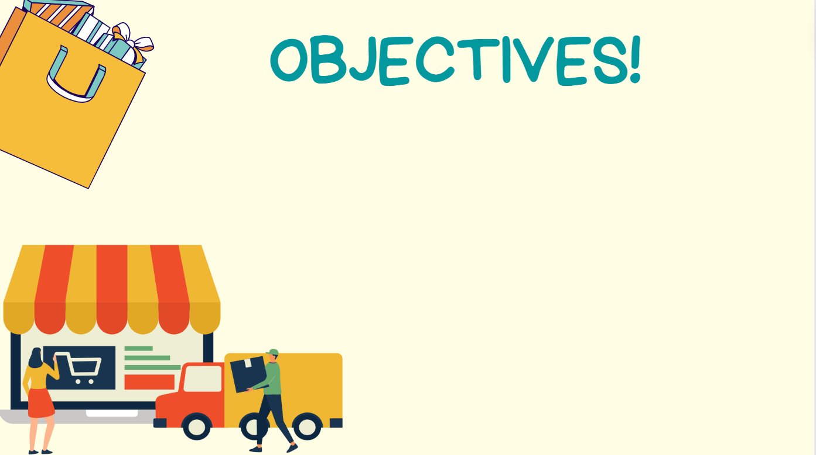


Use lexical items related to the topic “shopping around”
Write notes and messages to make arrangements

Slide 5



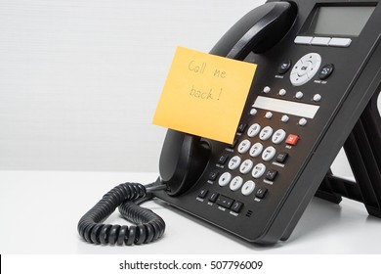
VOCABULARY
a written/ spoken piece of
information that you send to sb
leave a message
/liːv ə ˈmesɪdʒ/
để lại lời nhắn

Slide 6

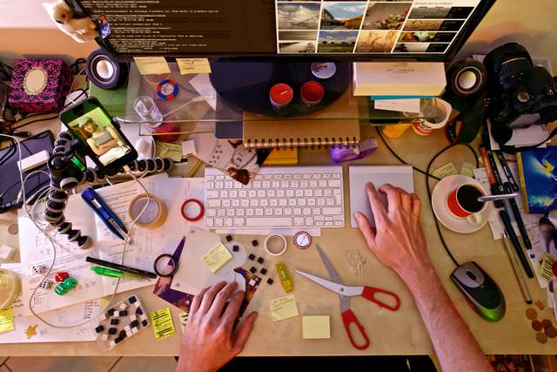
VOCABULARY
to make all the arrangements
for something to happen
organize (v)
/ˈɔːɡənaɪz/
tổ chức, sắp xếp

Slide 7


VOCABULARY
a spoken/ written request
to sb to go somewhere
invitation (n)
/ˌɪnvɪˈteɪʃn/
lời mời

Slide 8
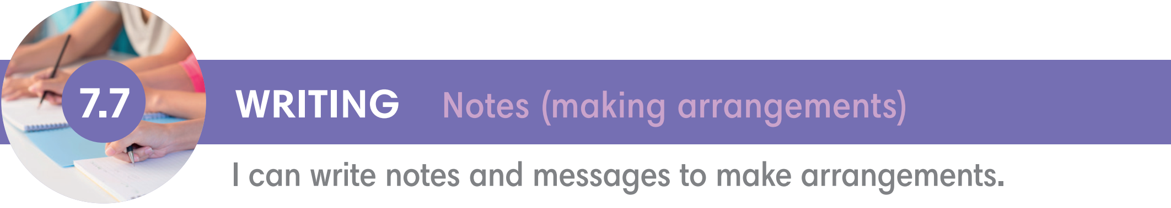
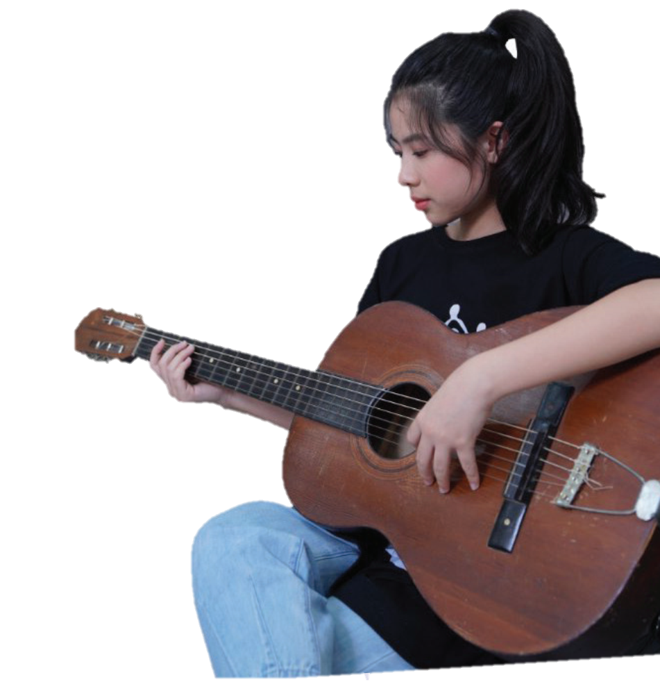
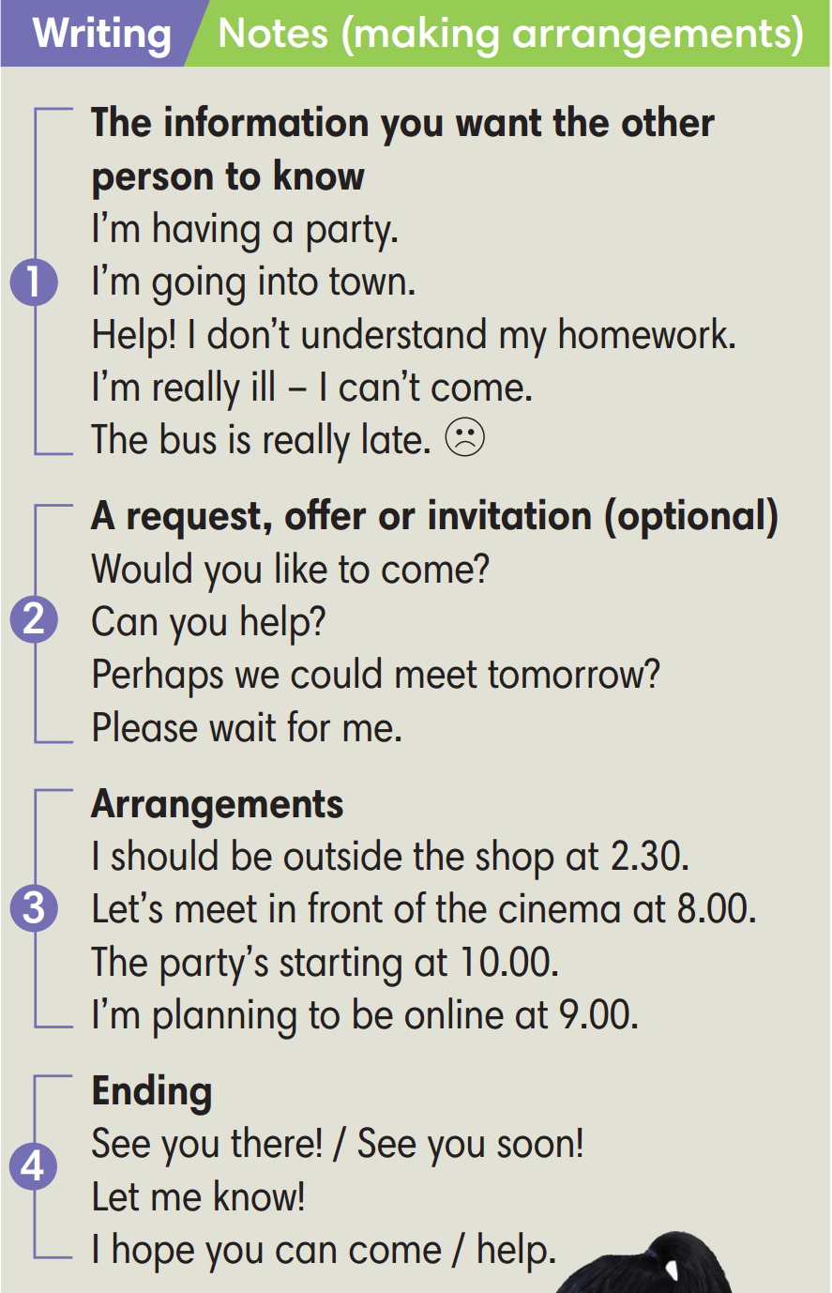

Slide 9

Exercise 1 (SB p.77)
Work in pairs. Choose the best format a-d for your messages in situations 1-4.
1. You're working on a school project and your bedroom is very untidy. You leave a message to ask your mum not to tidy up your papers.
a. a note on a piece of paper
2. You're meeting a friend but your bus is late. You want to let him/her know.
b. an update on Facebook
c. a text or message sent via /ˈvaɪə/your phone
3. It's your birthday next week and you decide to invite all of your friends to a party.
4. You need to tell your trainer that you're ill and can't go to judo classes next week.
d. an email

Slide 10
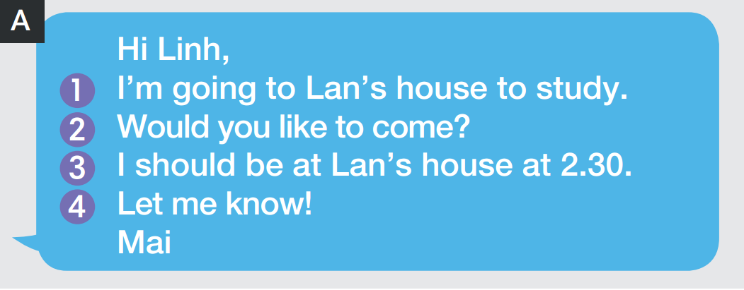
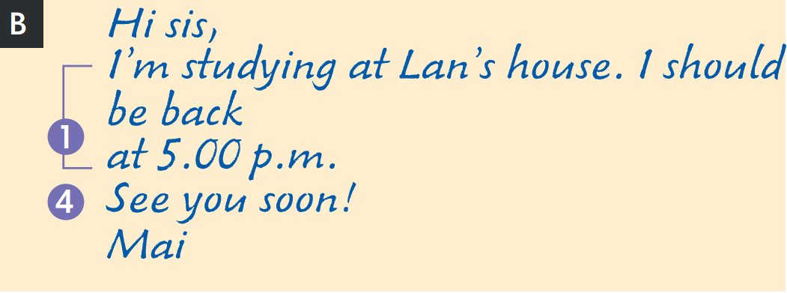
Exercise 2 (SB p.77) - Read two messages from Mai.
Which one includes an invitation? Which one only gives information?
includes an invitation
gives information

Slide 11
Exercise 3 (SB p.77)
Underline the phrases in the Writing box which are in Mai's messages.

Slide 12

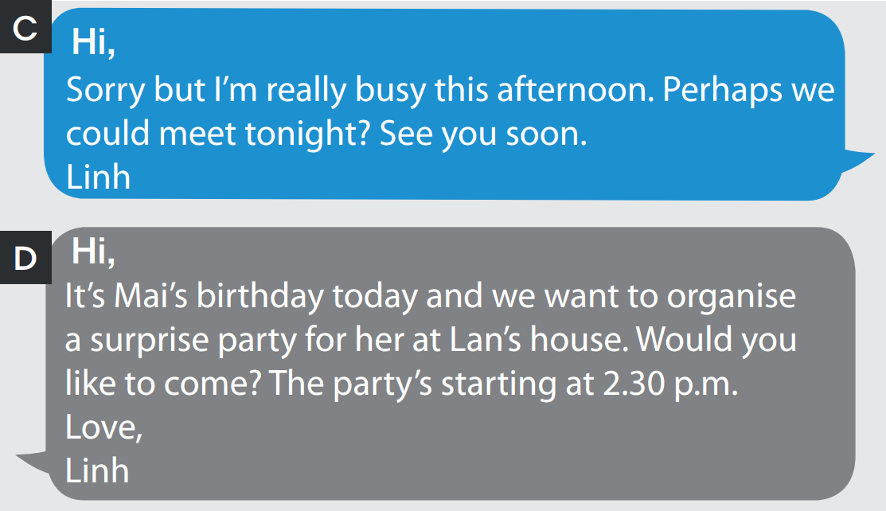
Exercise 4 (SB p.77) - Read two messages from Linh. Which message is a
reply to Mai's invitation? What surprises are Mai's friends planning for her?
What surprises are Mai's friends planning for her?
message is a reply to Mai's invitation
Linh and Mai's friends are planning a surprise party for her.

Slide 13
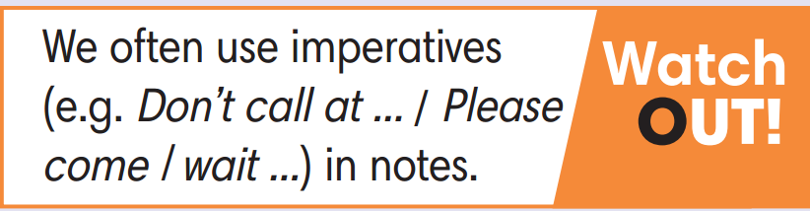
Exercise 5 (SB p.77) - Write a note to a friend:
1. 2. Say you want to see a film at home this weekend and ask your friend if he/she would like to come.
3. Suggest a time.
4. End your message.
Hi Trang,
1.2. I’m going to invite friends to come over my house to watch a film this weekend. Would you like to come?
3. We will begin at 8.00 p.m.
4. Hope to hear from you soon.
Love,
Rose

Slide 14
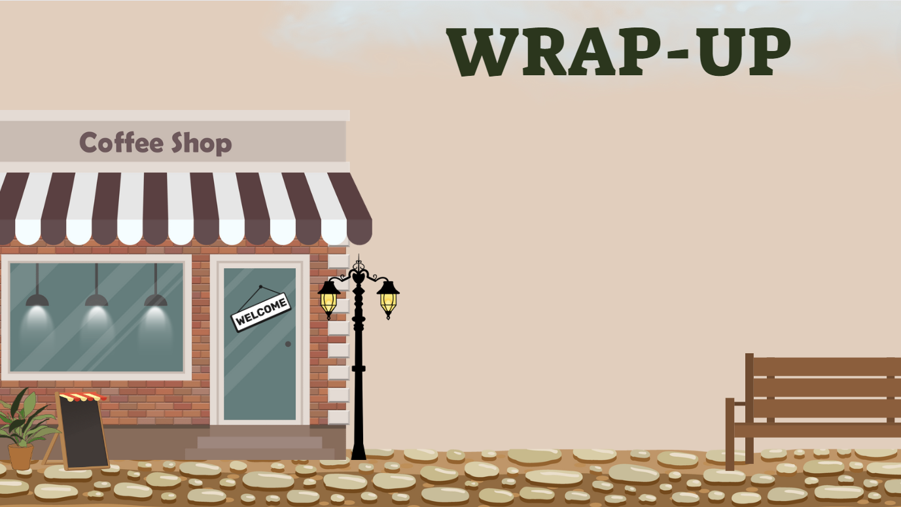
Consolidate what students
have learnt in the lesson

Slide 15

VOCABULARY REVIEW
leave a message | /liːv ə ˈmesɪdʒ/ | a written / spoken piece of information that you send to sb | để lại lời nhắn
organize (v) | /ˈɔːɡənaɪz/ | to make all the arrangements for something to happen | tổ chức, sắp xếp
invitation (n) | /ˌɪnvɪˈteɪʃn/ | a spoken / written request to sb to go somewhere | lời mời

Slide 16
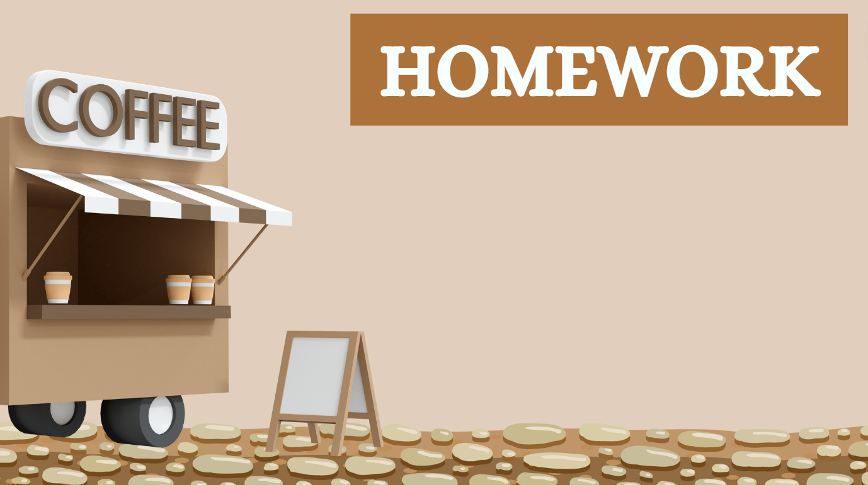
01. Learn the vocabulary by heart
02. Do the exercises in workbook
(page 66)
03. Prepare for Unit 7
Lesson 8 Vocabulary in action

Slide 17


