Slide 1


Slide 2
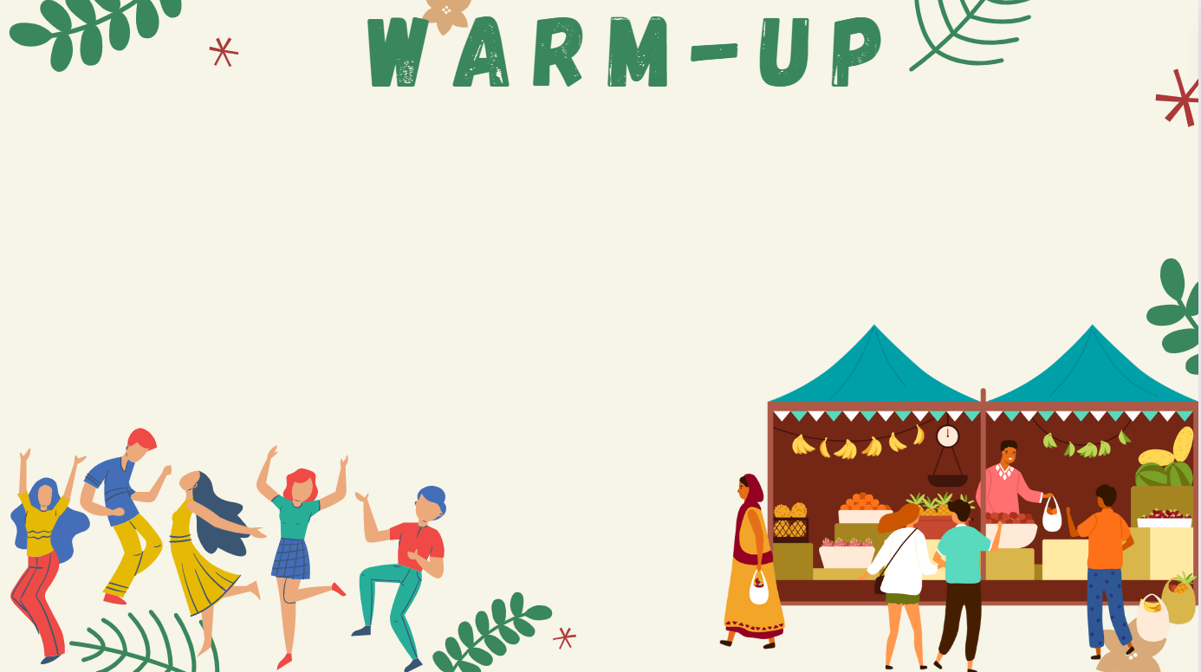


JUMBLED WORD
8 words with incorrect order
5 seconds for each word
Rearrange letters to make a correct word

Slide 3



TIME UP!
NUMBER 1
/ˈkʌstəm/
U
T
C
O
S
M

Slide 4
TIME UP!
NUMBER 2
/ˈkʌltʃər/
L
U
C
T
R
U
E

Slide 5
TIME UP!
NUMBER 3
/ˈkɒstjuːm/
U
M
C
T
S
E
O

Slide 6
TIME UP!
NUMBER 4
/ˈkɑːnɪvl/
A
I
C
L
N
V
R
A

Slide 7
TIME UP!
NUMBER 5
/ˈfaɪəwɜːk/
E
R
K
F
W
R
I
O

Slide 8
TIME UP!
NUMBER 6
/ˈhɑːvɪst/
A
E
H
S
V
R
T

Slide 9
TIME UP!
NUMBER 7
/pəˈreɪd/
R
P
A
E
A
D

Slide 10
TIME UP!
NUMBER 8
/ˈænsestər/
E
C
T
A
S
R
N
O

Slide 11
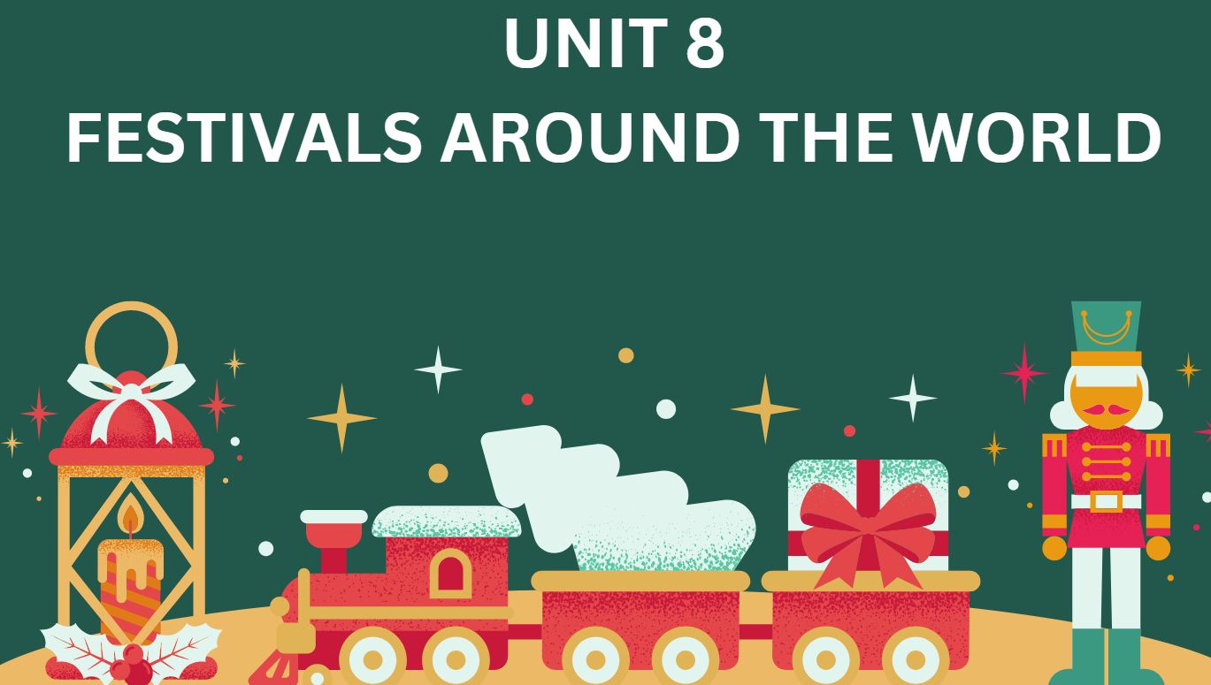
LESSON 8.4 - GRAMMAR 2
(SB page 84)

Slide 12

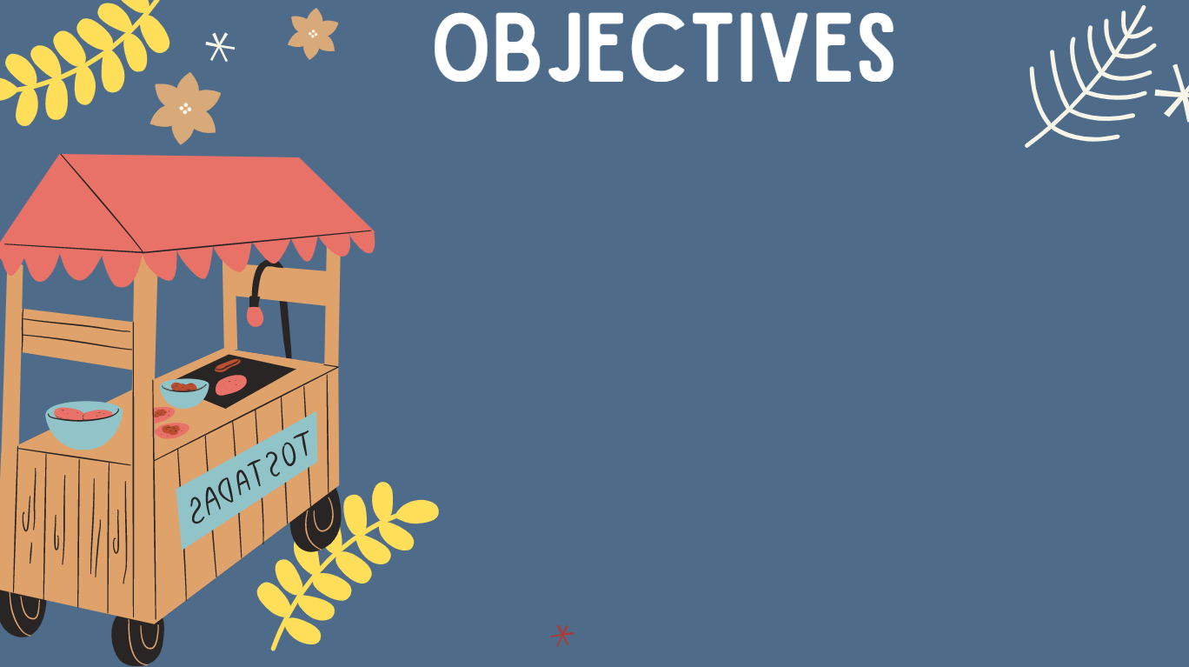
01. Use lexical items related to the topic “Festivals around the world”
02. Contrast ideas using “however” and “nevertheless”
03. Talk about your thought on a festival

Slide 13
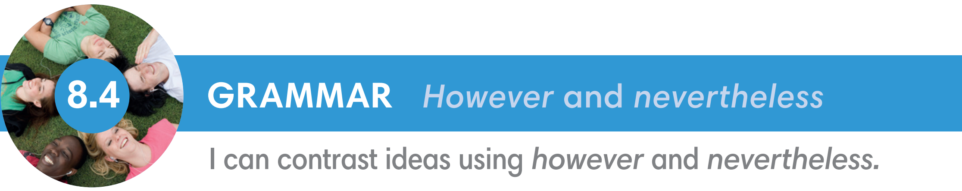
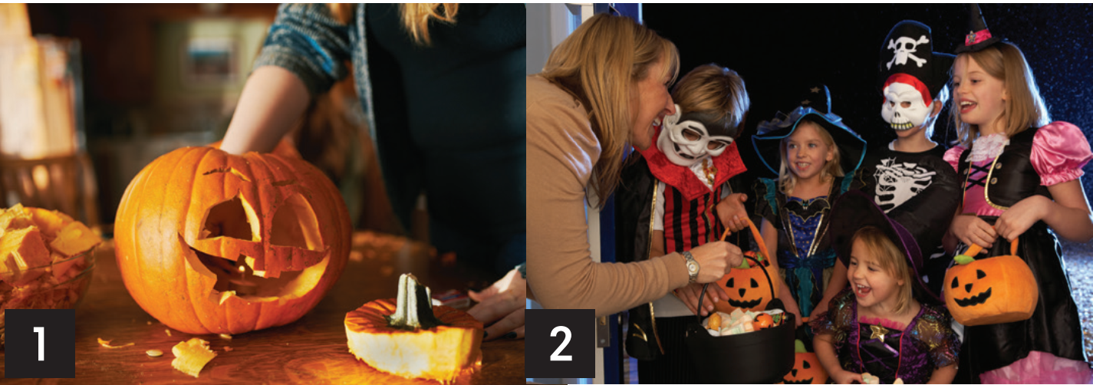
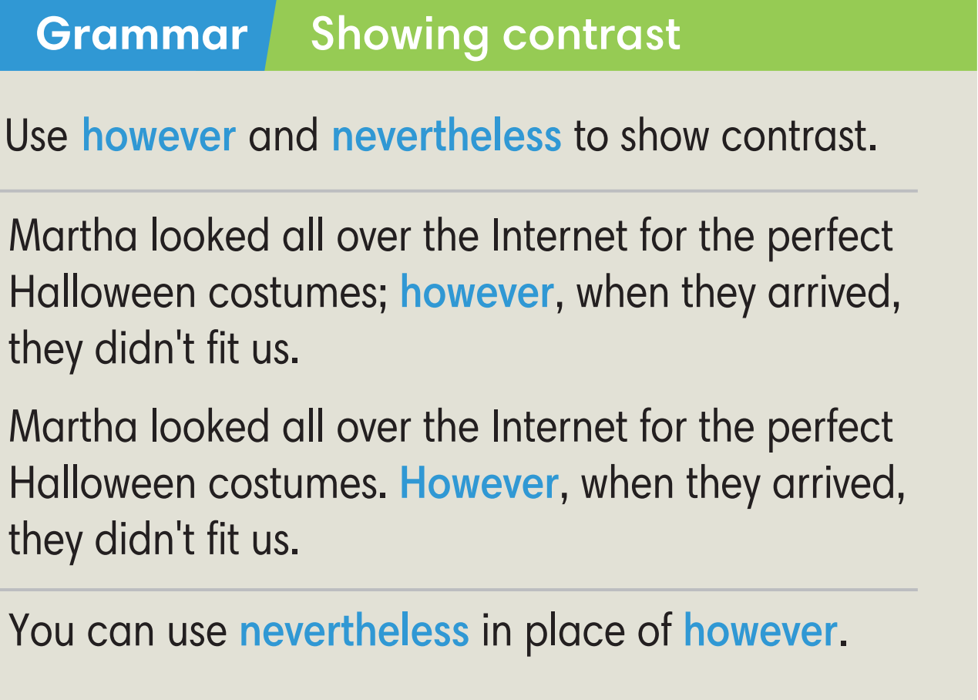
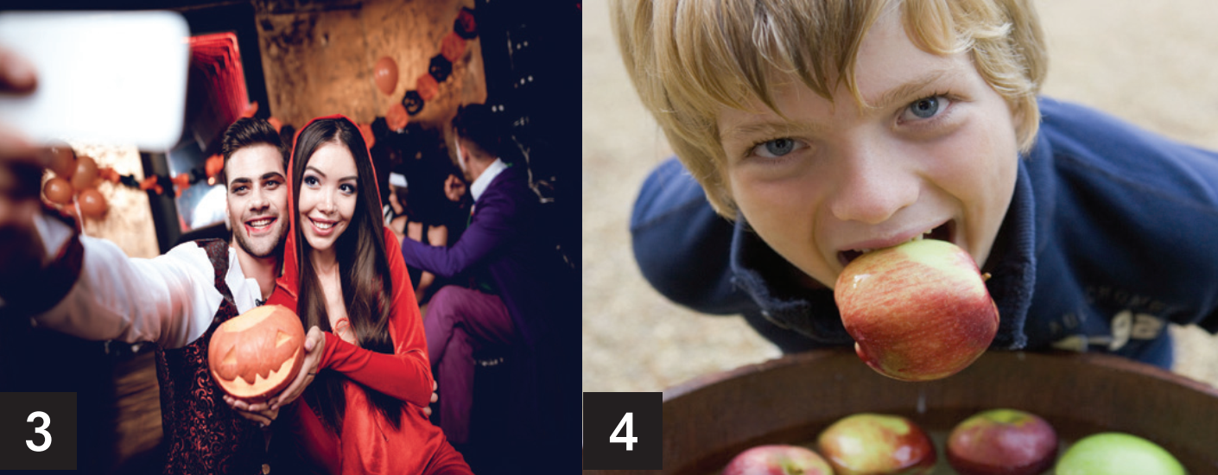

Slide 14
Exercise 1 (SB p.84)
Read the email and label the photos with the bold words.
Hi Betty,
Last year, Halloween didn't work out too well for Martha and me. First, Martha looked all over the Internet for the perfect Halloween costumes. However, when they arrived, they didn't fit us. They looked pretty awful.
The day before Halloween, I really got into carving my jack-o'-lantern. However, it didn't come out too well. In fact, it was a complete disaster. Martha's came out much better.
On Halloween night, we went to a costume party. A couple of people laughed at our costumes, but we didn't mind. At the party, we bobbed for apples. I got two, but poor Martha didn't get any. She just got a wet face.
Later that night, we went trick-or-treating with some friends from school. It was cold and rained a lot, but we had a good time. We got lots of candies.
Bob

Slide 15
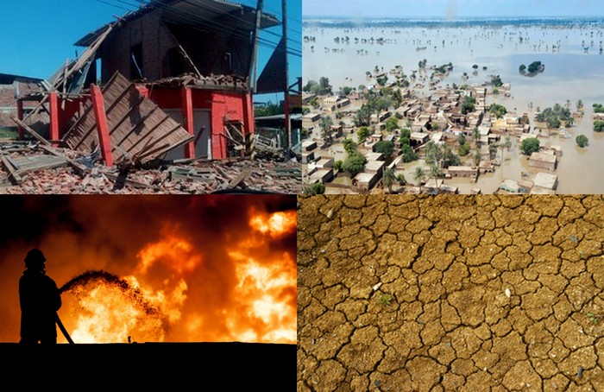
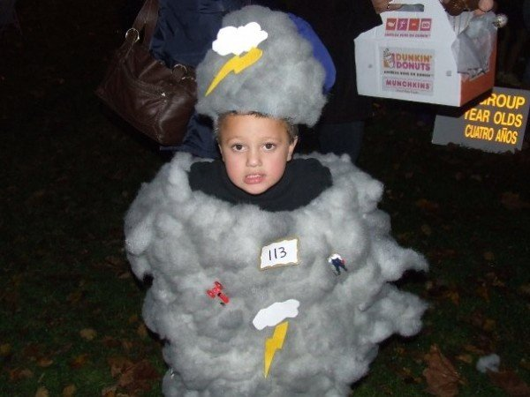
VOCABULARY
Disaster (n)
a complete failure
/dɪˈzɑːstər/
Thảm họa, thất bại

Slide 16
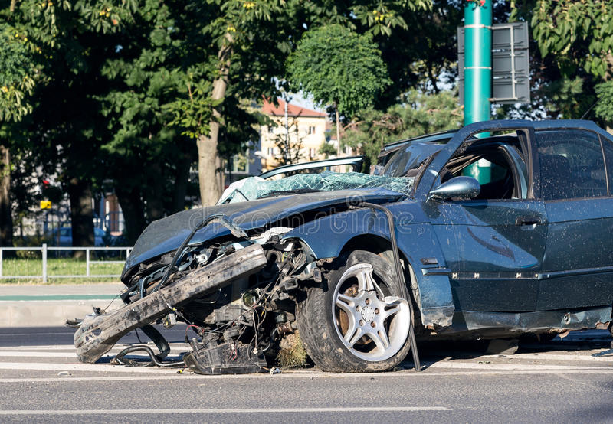
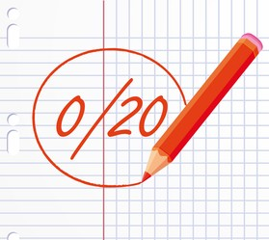
VOCABULARY
awful (adj)
very bad or terrible
/ˈɔːfl/
tồi tệ, kinh khủng

Slide 17
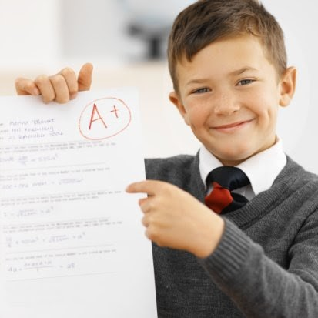
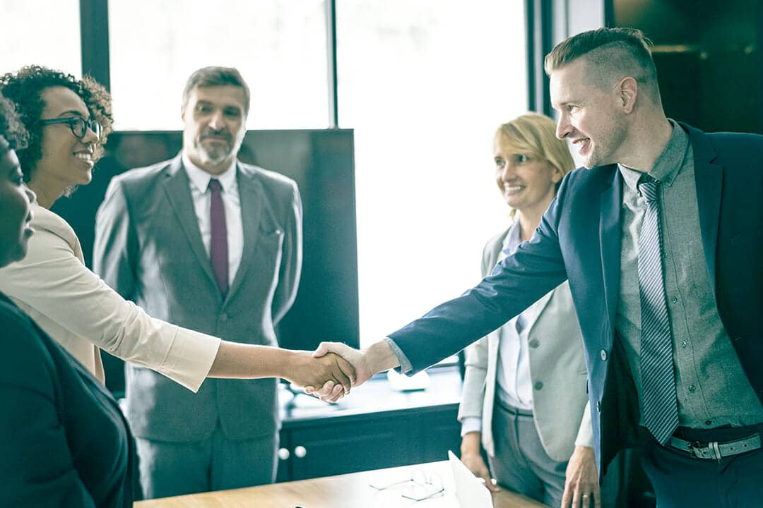
VOCABULARY
work out well (v)
to develop in a successful way
/wɜːk aʊt wel/
diễn ra tốt đẹp

Slide 18
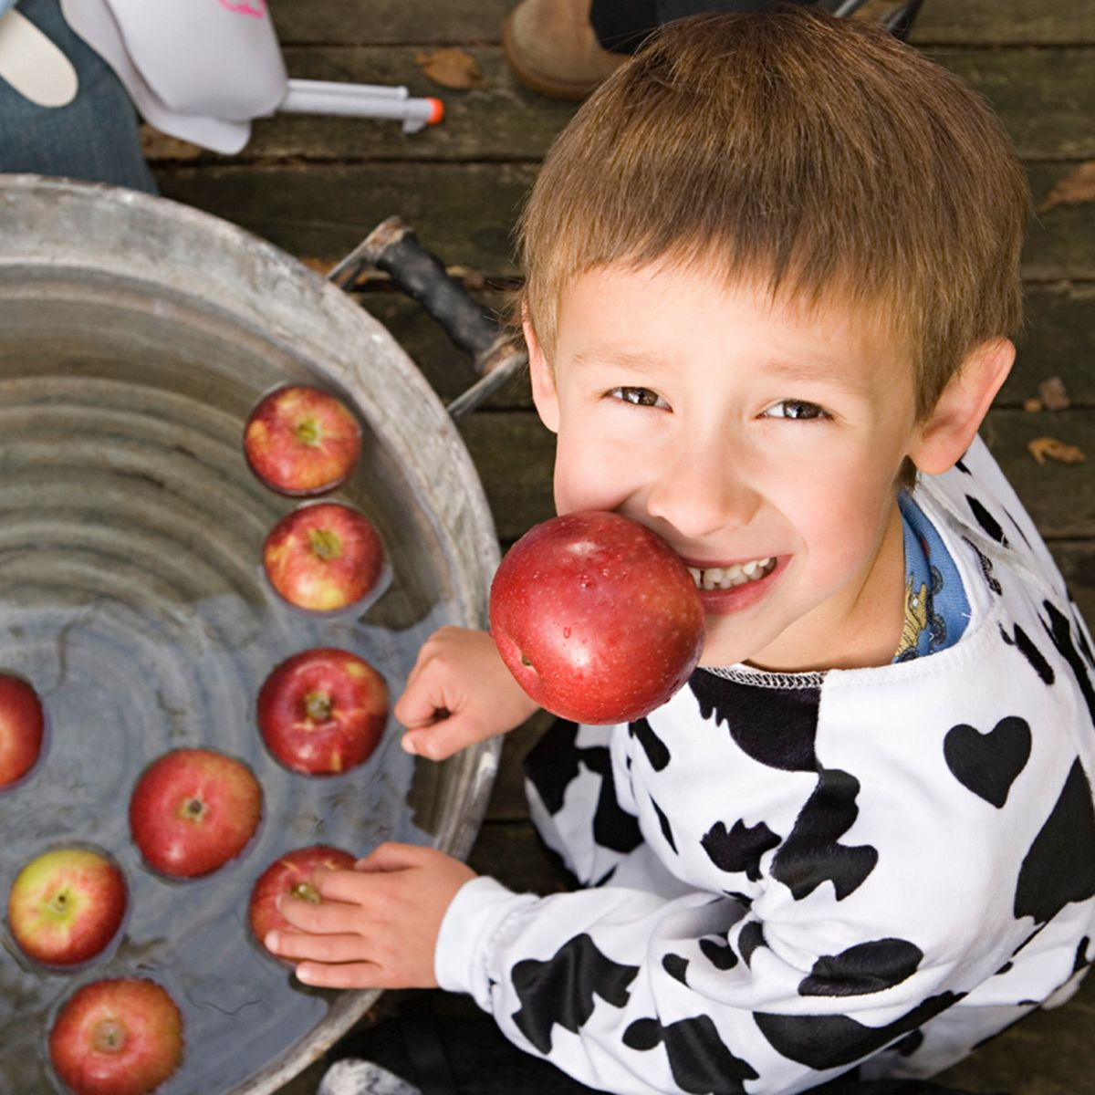
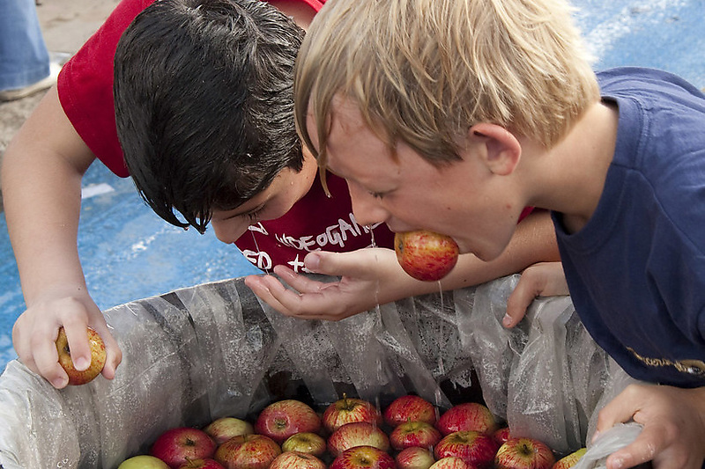
VOCABULARY
to move or make something move quickly up and down, especially in water
bob (v)
/bɒb/
đớp (thức ăn)

Slide 19
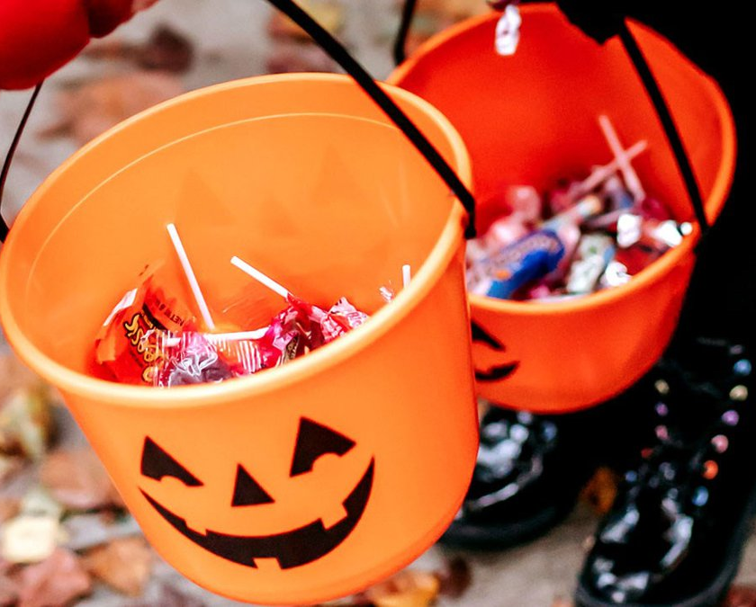
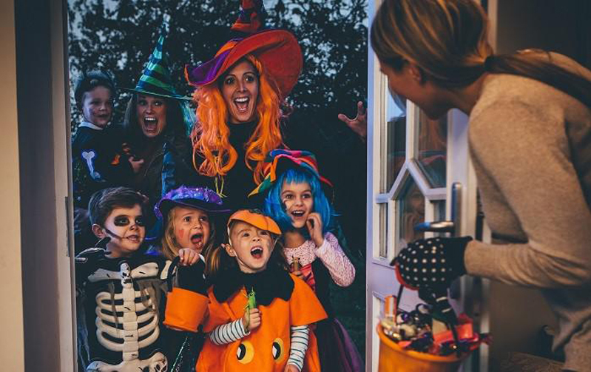
VOCABULARY
trick-or-treating
An activity for children in Halloween
/ˌtrɪk.ɔːˈtriː.tɪŋ/
trò trick-or-treat

Slide 20
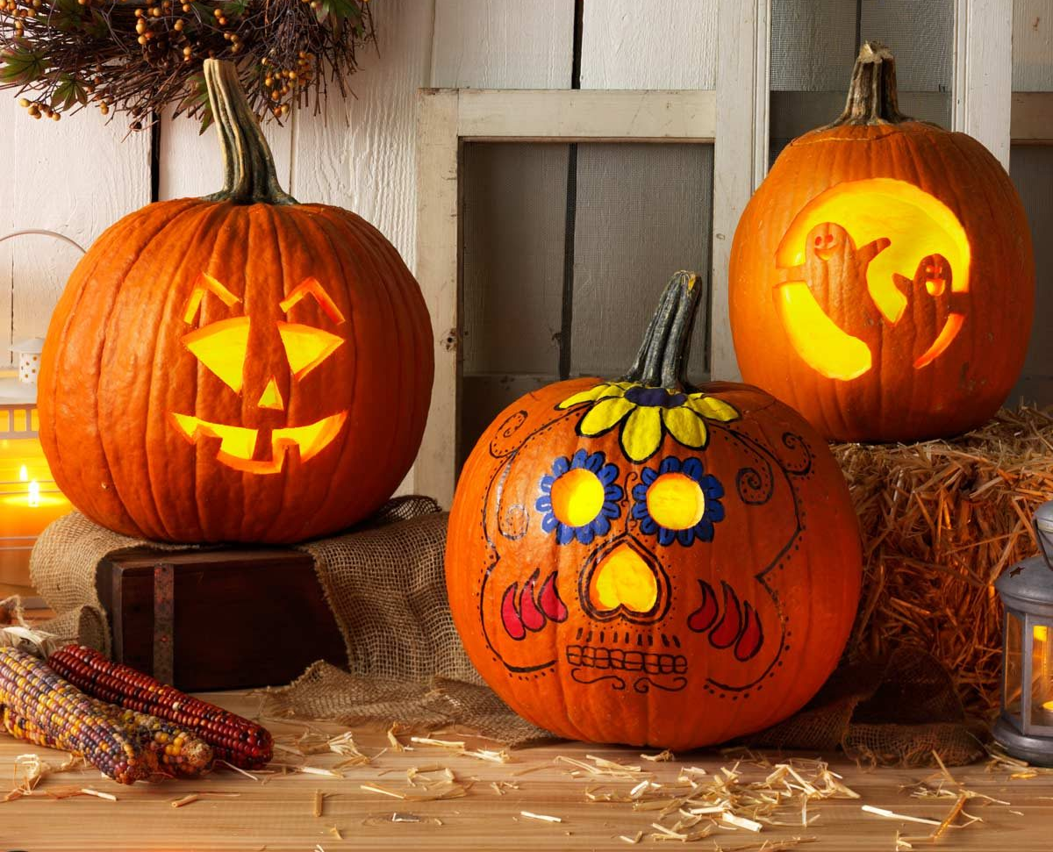
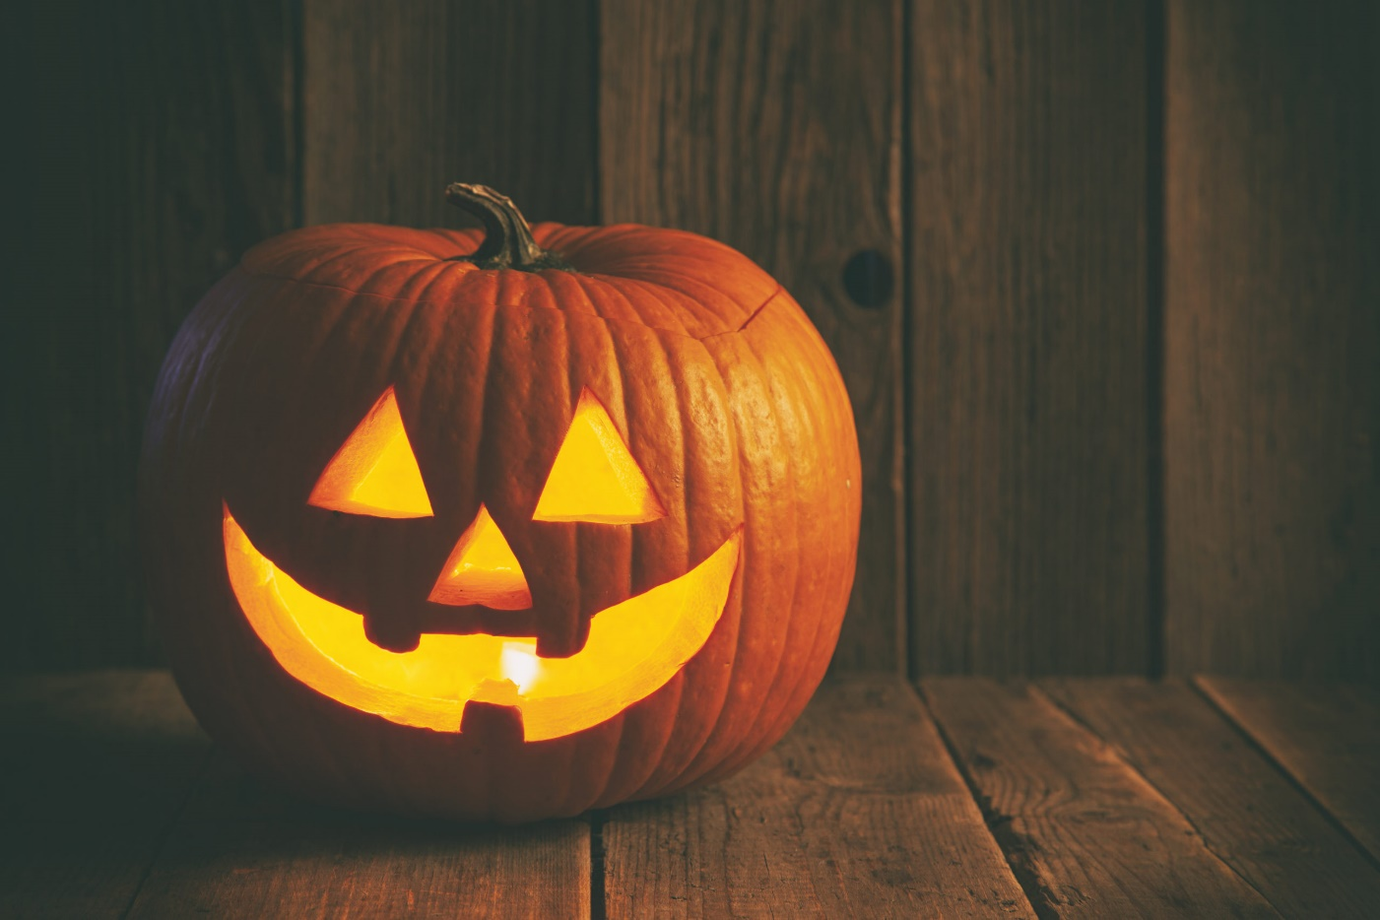
VOCABULARY
a light made from a hollow pumpkin like person's face, inside is a candle
jack-o'-lantern
/ˌdʒæk.əˈlæn.tən/
đèn bí ngô

Slide 21
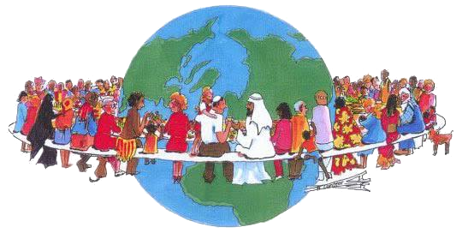
VOCABULARY
customary (adj)
An adjective of custom
/ˈkʌstəməri/
thuộc về phong tục

Slide 22
Exercise 1 (SB p.84)
Read the email and label the photos with the bold words.
Hi Betty,
Last year, Halloween didn't work out too well for Martha and me. First, Martha looked all over the Internet for the perfect Halloween costumes. However, when they arrived, they didn't fit us. They looked pretty awful.
The day before Halloween, I really got into carving my jack-o'-lantern. However, it didn't come out too well. In fact, it was a complete disaster. Martha's came out much better.
On Halloween night, we went to a costume party. A couple of people laughed at our costumes, but we didn't mind. At the party, we bobbed for apples. I got two, but poor Martha didn't get any. She just got a wet face.
Later that night, we went trick-or-treating with some friends from school. It was cold and rained a lot, but we had a good time. We got lots of candies.
Bob

Slide 23
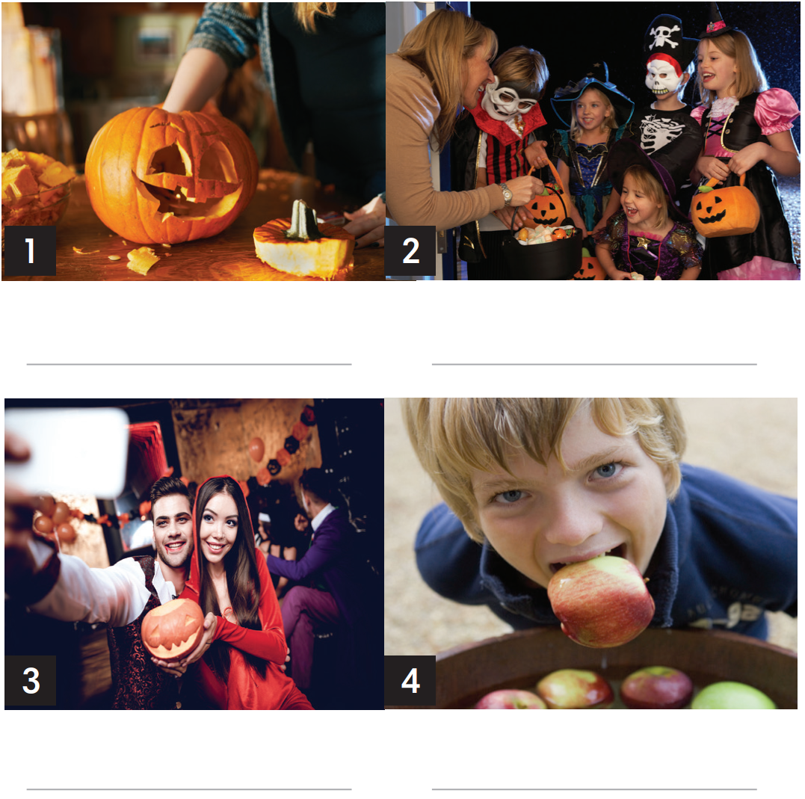
Exercise 1 (SB p.84)
Read the email and label the photos with the bold words.
jack-o'-lantern
costume party
bobbed for apples
trick-or-treating

Slide 24
Exercise 2 (SB p.84)
Find more expressions used to compare ideas in Exercise 1
Thể hiện sự tương phản
HOWEVER
/haʊˈevər/
NEVERTHELESS
/ˌnevəðəˈles/
This usually comes at the beginning of a sentence, and is followed by a comma

Slide 25
Exercise 2 (SB p.84)
Find more expressions used to compare ideas in Exercise 1
Hi Betty,
Last year, Halloween didn't work out too well for Martha and me. First, Martha looked all over the Internet for the perfect Halloween costumes. However, when they arrived, they didn't fit us. They looked pretty awful.
The day before Halloween, I really got into carving my jack-o'-lantern. However, it didn't come out too well. In fact, it was a complete disaster. Martha's came out much better.
On Halloween night, we went to a costume party. A couple of people laughed at our costumes, but we didn't mind. At the party, we bobbed for apples. I got two, but poor Martha didn't get any. She just got a wet face.
Later that night, we went trick-or-treating with some friends from school. It was cold and rained a lot, but we had a good time. We got lots of candies.
Bob

Slide 26
Exercise 3 (SB p.84) – Listening 8.02 - Make one sentence from two.
Use the word(s) in brackets in your sentences. Listen and check
1. My grandfather passed on some traditional stories to my aunt. She forgot them. (however)
→..............................................................................................................................................
2. They held an interesting ceremony in Osaka. Not many tourists came. (nevertheless)
→..............................................................................................................................................
3. Many relatives came home for Christmas. I didn't enjoy the celebration very much. (however)
→..............................................................................................................................................
4. It rained. The fireworks display was great. (nevertheless).
→..............................................................................................................................................
My grandfather passed on some traditional stories to my aunt
; however,
she forgot them.
They held an interesting ceremony in Osaka
; nevertheless,
not many tourists came.
My many relatives came home for Christmas
; however,
I didn’t enjoy the celebration very much.
It rained
; nevertheless,
the fireworks display was great.

Slide 27
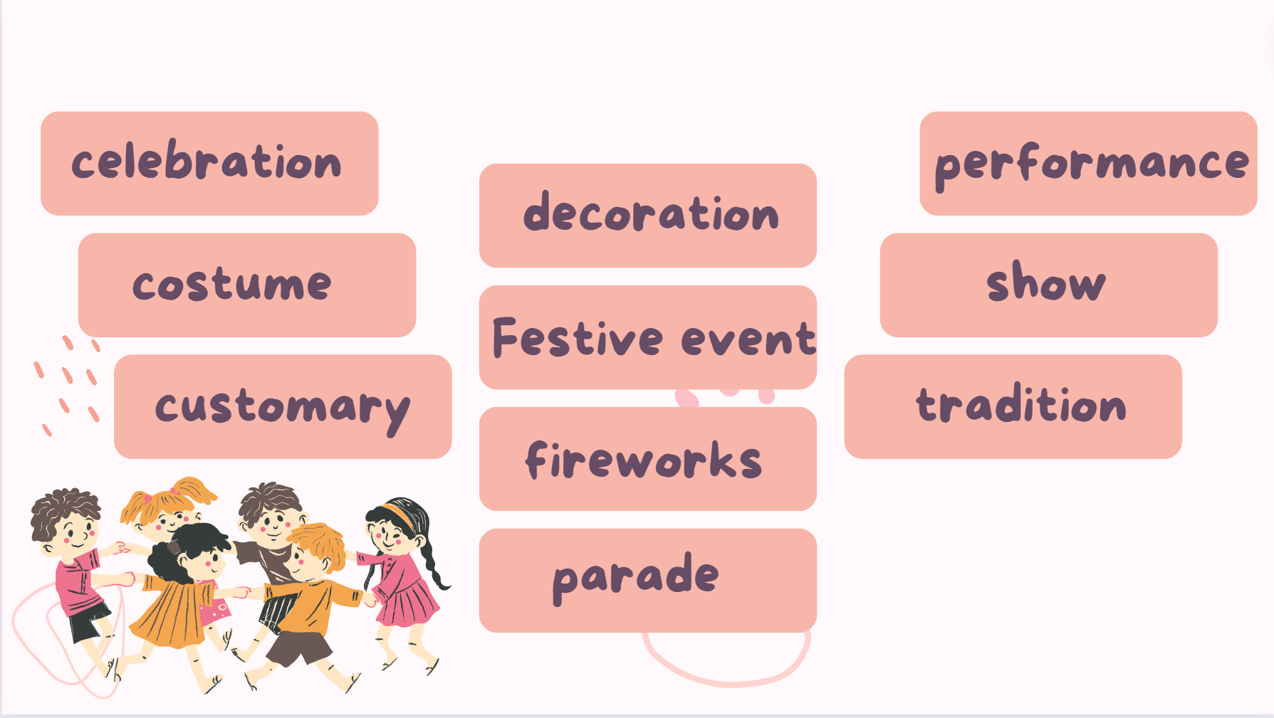
Exercise 4 (SB p.84) - In pairs, compare your thoughts on a festival
you both know of. Tell the class about it. You can use some of these words.

Slide 28
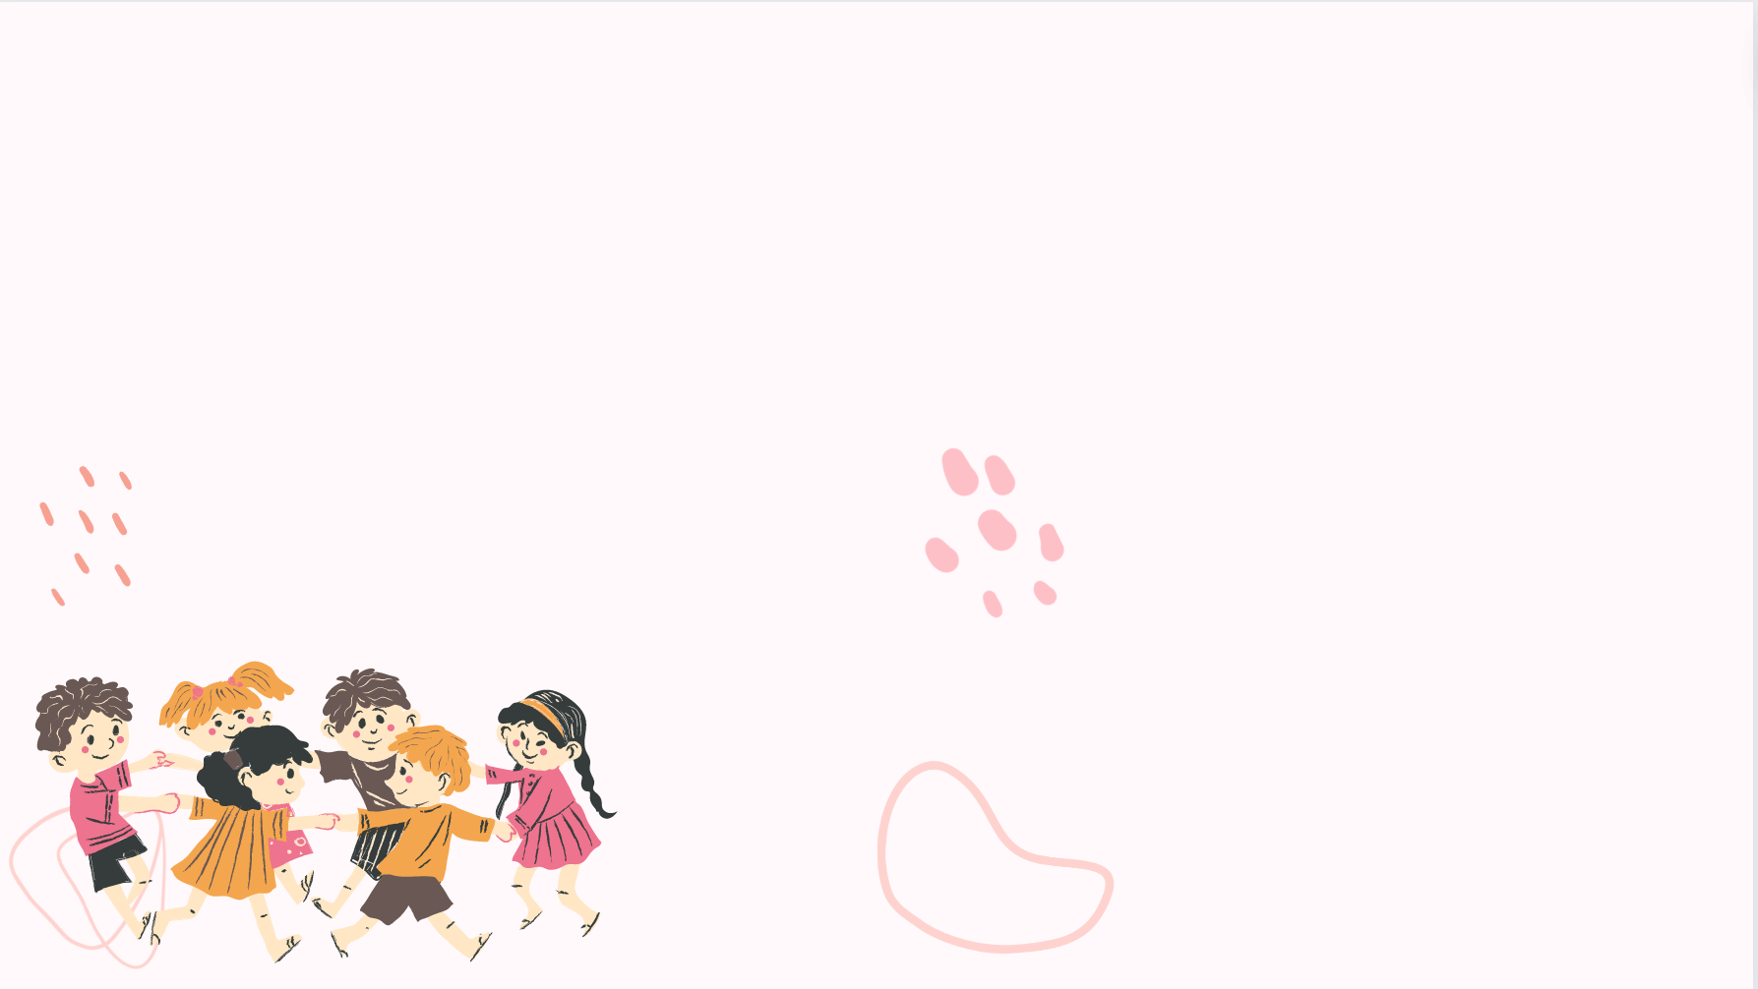
Exercise 4 (SB p.84) - In pairs, compare your thoughts on a festival
you both know of. Tell the class about it. You can use some of these words.
A: I love the celebration of the Lunar New Year’s Festival because this festive event is an opportunity for me to gather around my family and do some traditional activities such as house decoration, watching fireworks,... I like to spend quality time with my family and reserve these traditions.
B: I also love this festive event but my activities are quite different from yours. At this festival, I usually watch a music performance called countdown music night. I like the crowded atmosphere there when people countdown until a new year begins. It’s very cozy and exciting.

Slide 29
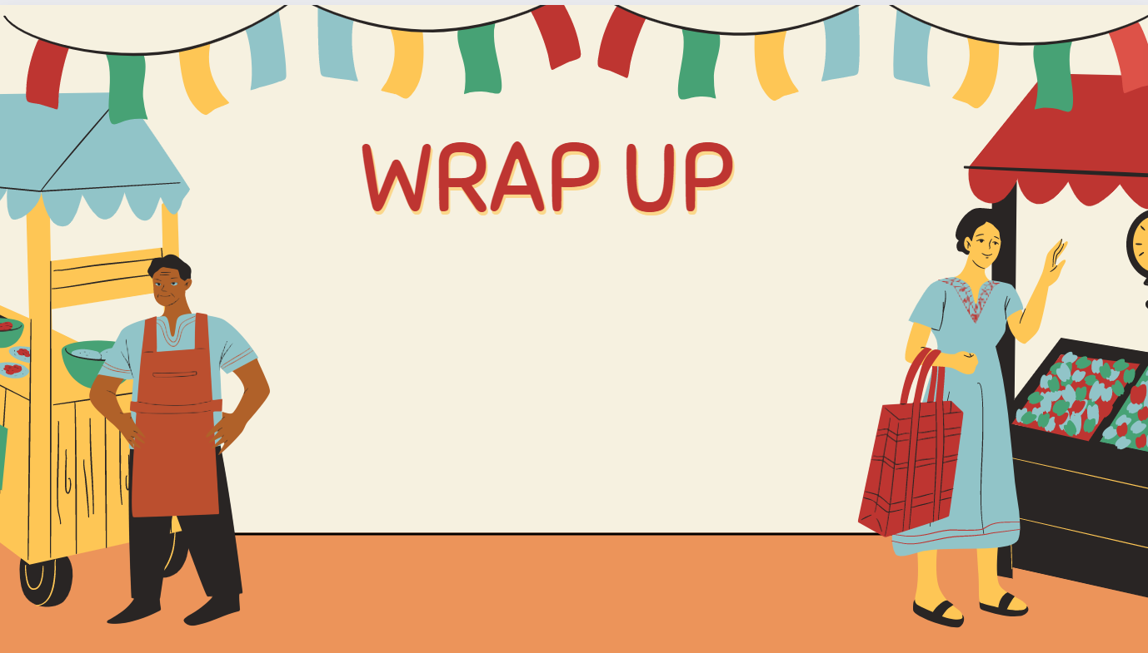
Consolidate what students
have learnt in the lesson

Slide 30

VOCABULARY REVIEW
disaster (n) | /dɪˈzɑːstər/ | a complete failure | thảm họa, thất bại
awful (adj) | /ˈɔːfl/ | very bad or terrible | tồi tệ, kinh khủng
work out well (v) | /wɜːk aʊt wel/ | to develop in a successful way | diễn ra tốt đẹp
bob (v) | /bɒb/ | to move or make something move quickly up and down, especially in water | đớp, ăn
trick-or-treating | /ˌtrɪk.ɔːˈtriː.tɪŋ/ | an activity for children in halloween | trò trick or treat
jack-o'-lantern | /ˌdʒæk.əˈlæn.tən/ | a light made from a hollow pumpkin like person's face, inside is a candle | đèn bí ngô
customary (adj) | /ˈkʌstəməri/ | an adjective of custom | thuộc về phong tục

Slide 31
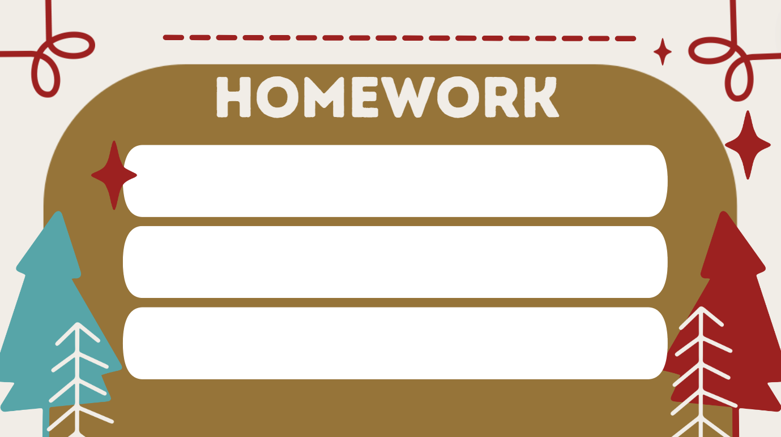
01. Learn the vocabulary by heart
02. Do the exercises in workbook (page 72)
03. Prepare for Unit 8. Lesson 5

Slide 32


