Slide 1
UNIT 2 – IT’S DELICIOUS
Lesson 2.2 Grammar
(SB page 22)

Slide 2

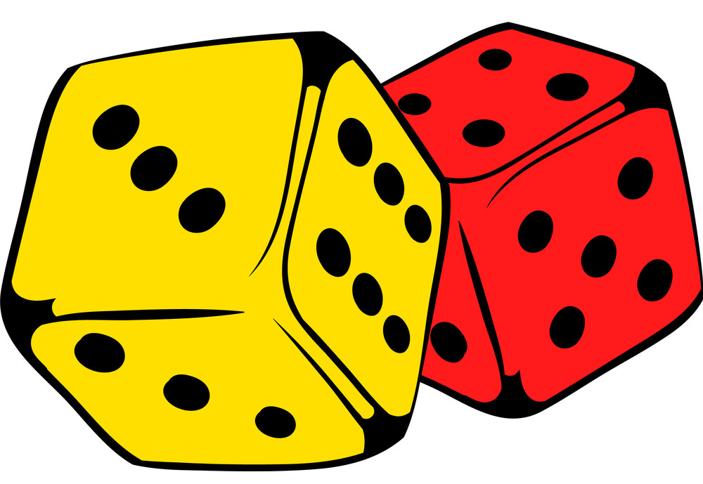
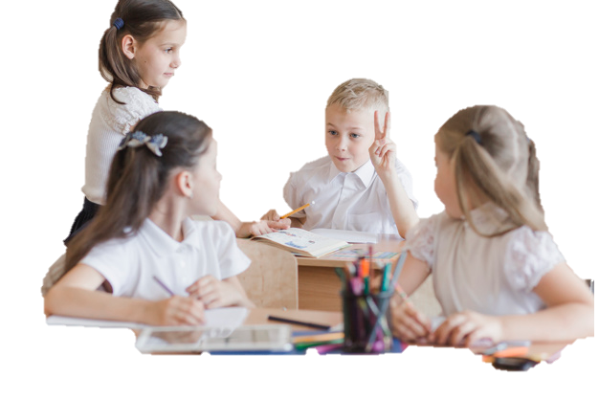
GAME: NAME IT!
B
TT puts Ss into groups of 4 and gives each group pieces of paper.
T explains that T is going to say a letter of the alphabet and Ss think of a food or drink word that starts with this letter.
Each group will write their word on the paper and raise it.
The first correct group wins a point.
breakfast, bread, ….

Slide 3

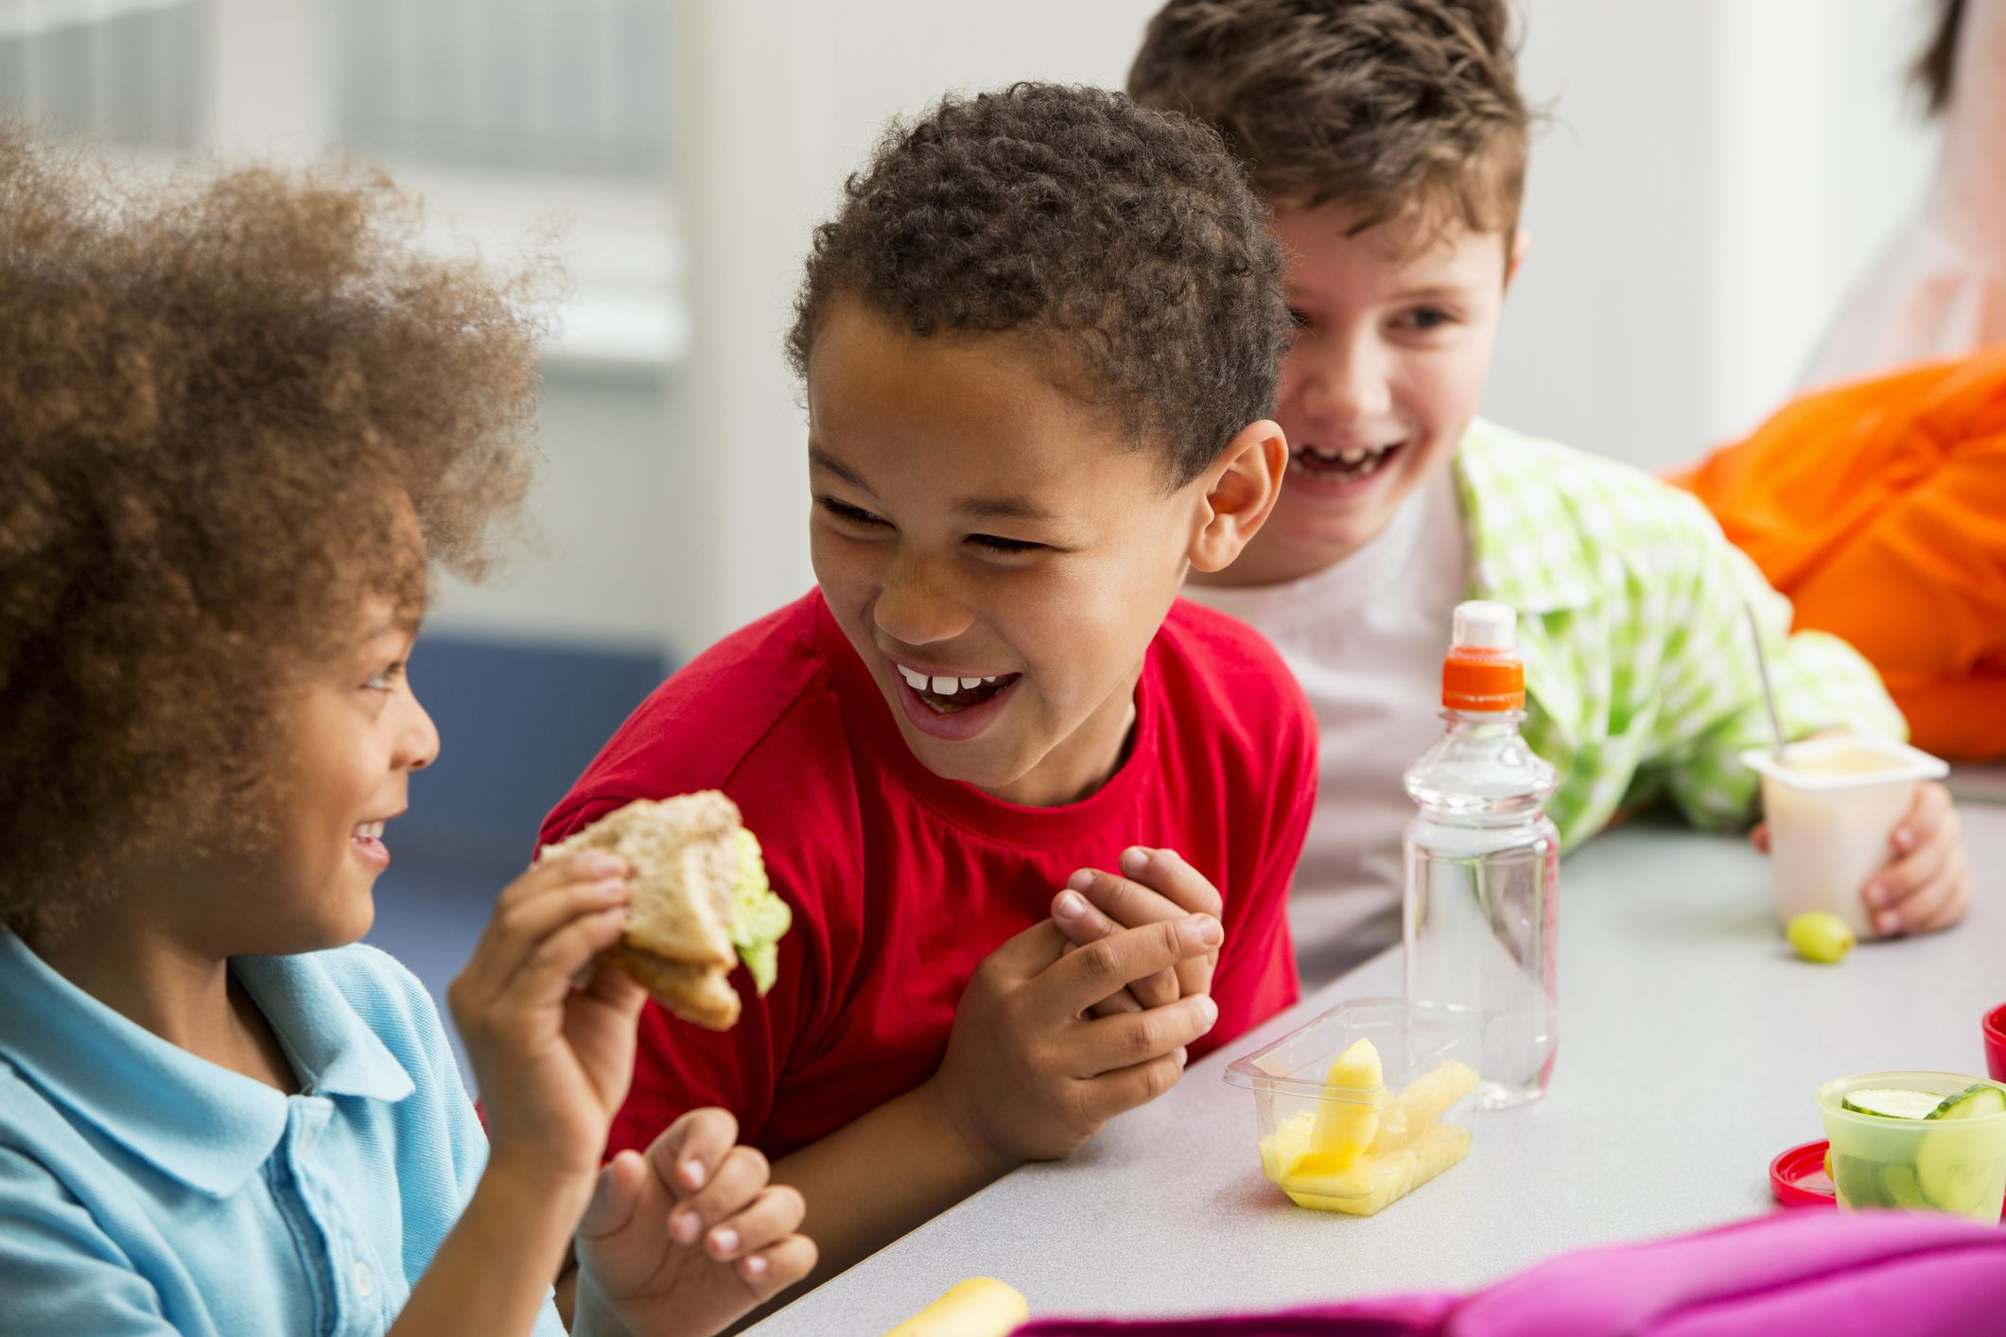
Objective
I can use there is/ there are to talk about places to eat in town.

Slide 4
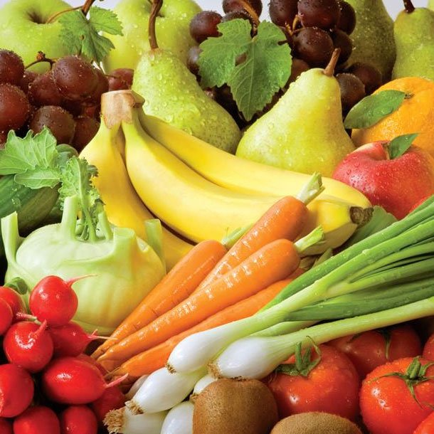
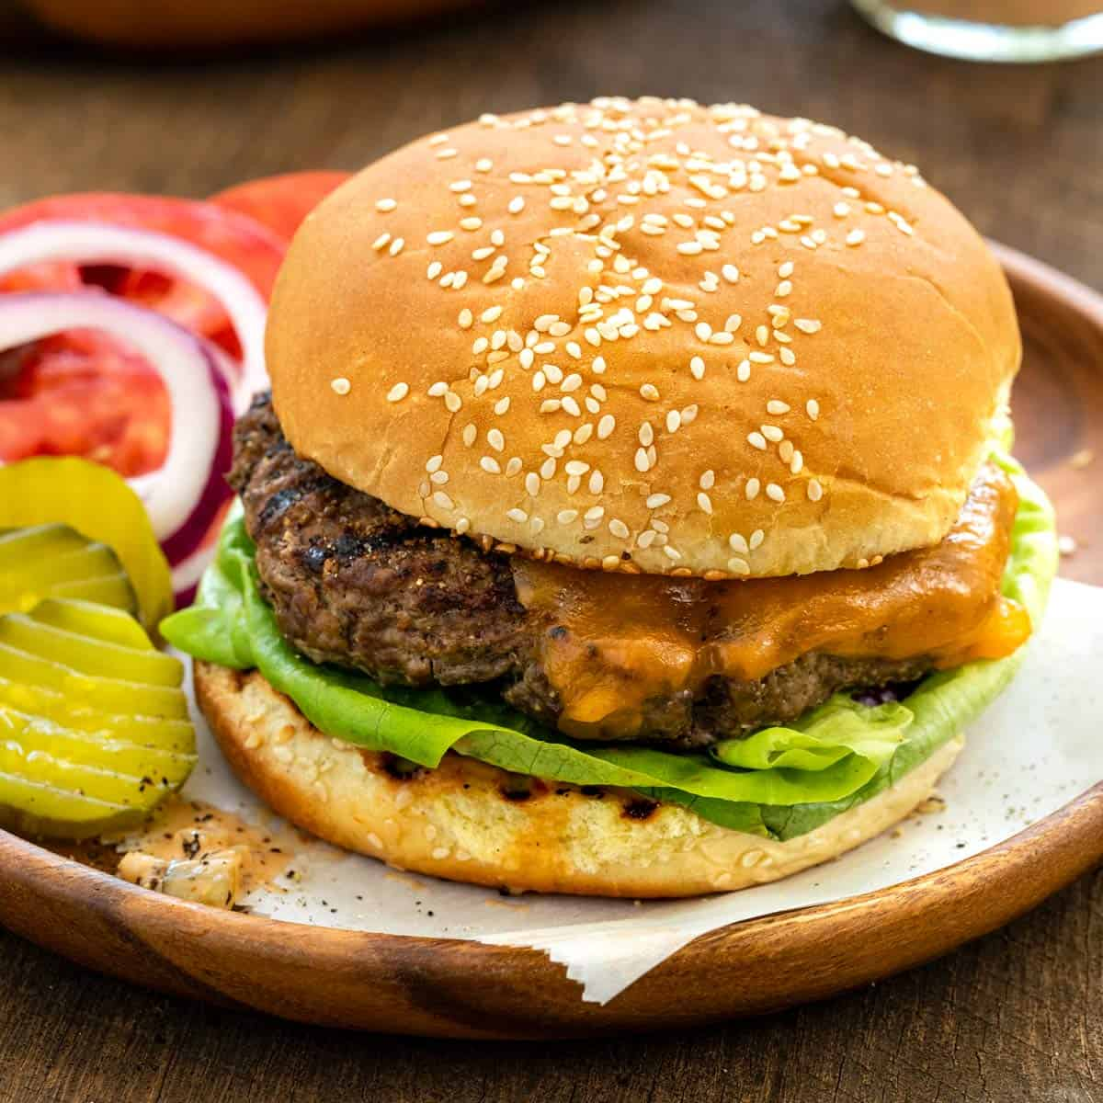

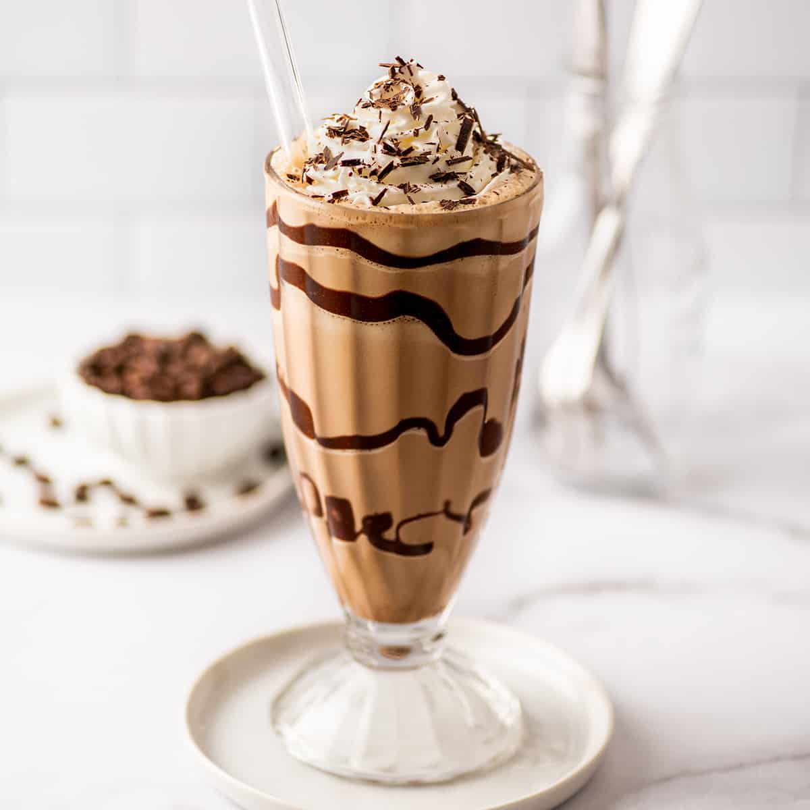
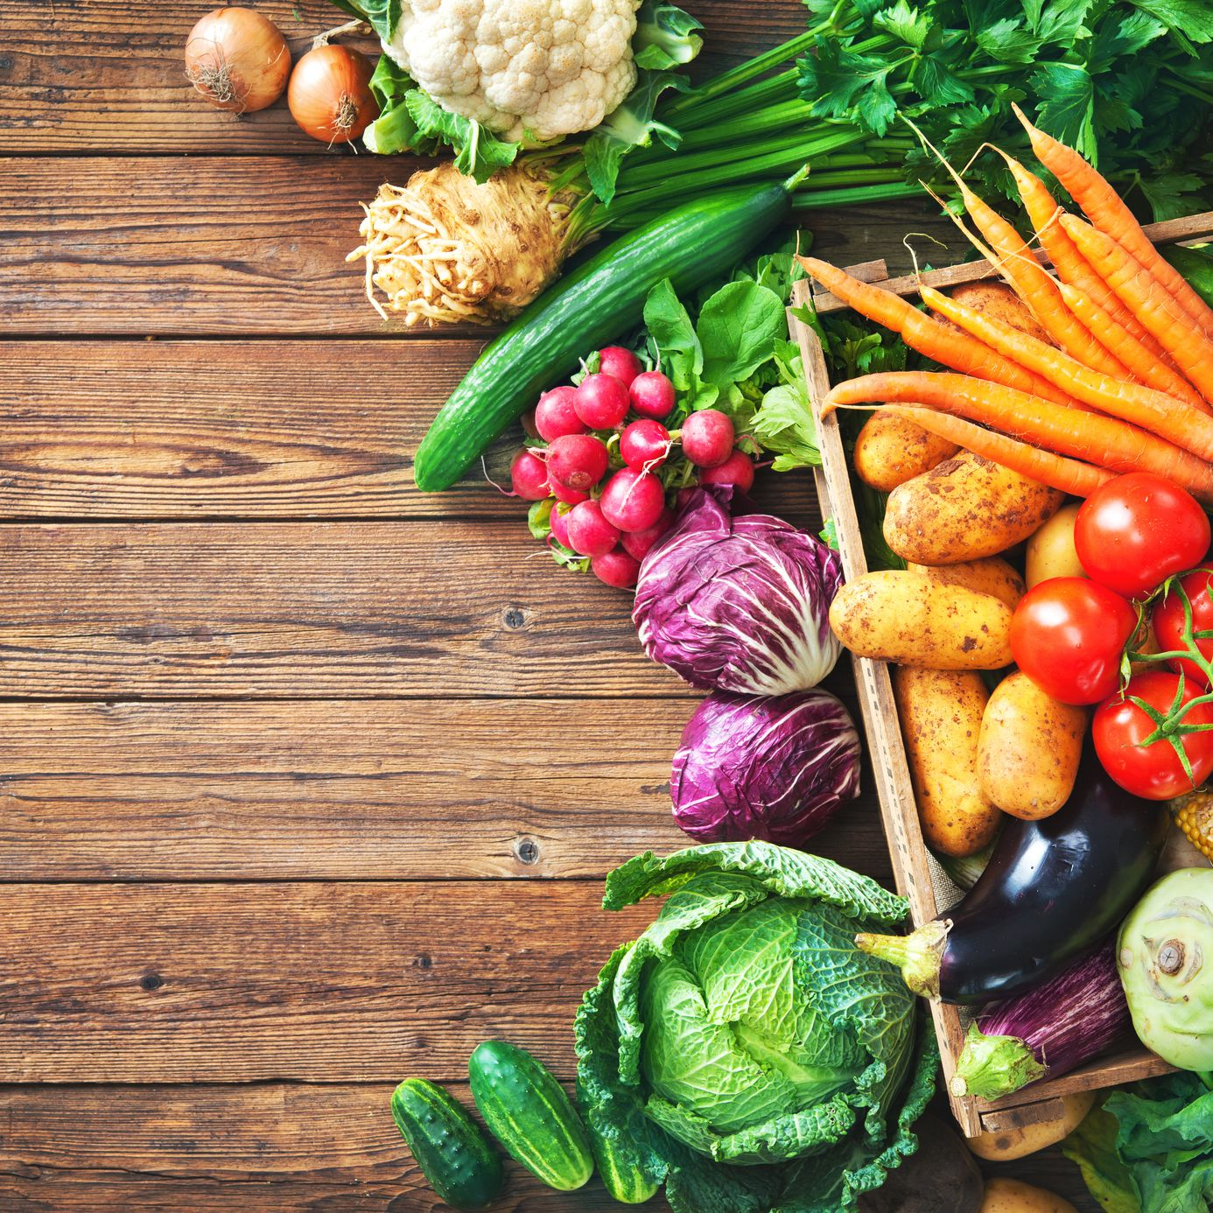
Is/Are … your favourite food?
What is your favourite place to eat or drink?

Slide 5

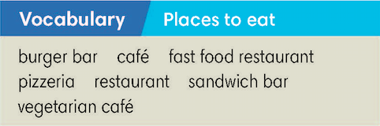
Exercise 1 - SB page 22
Study the Vocabulary box. Have you got these places in your country? Vote for your favourite place to eat.

Slide 6
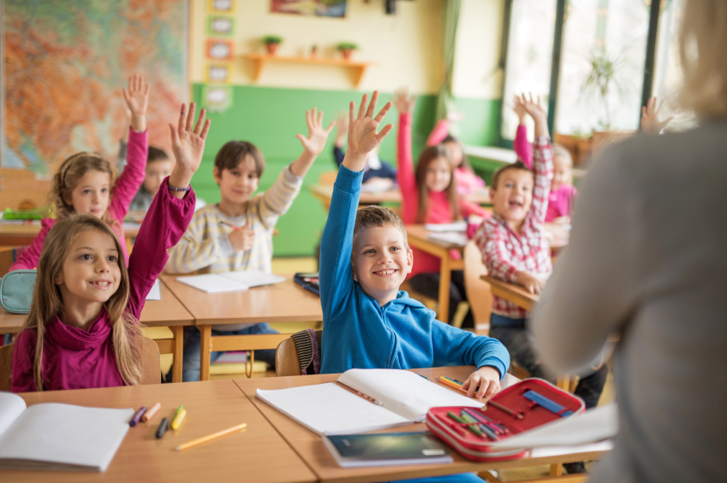
CLASS VOTE
What’s your favourite place to eat?

Slide 7
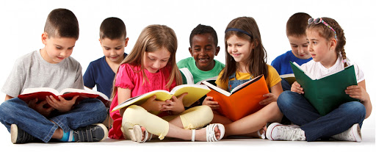
You’re going to read a short paragraph about a market in London.
Read and circle the places you’ve read in the Vocabulary box.

Slide 8
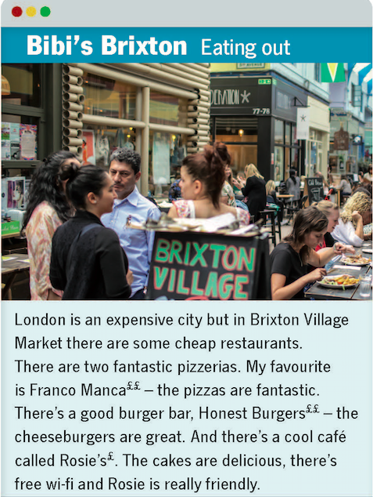
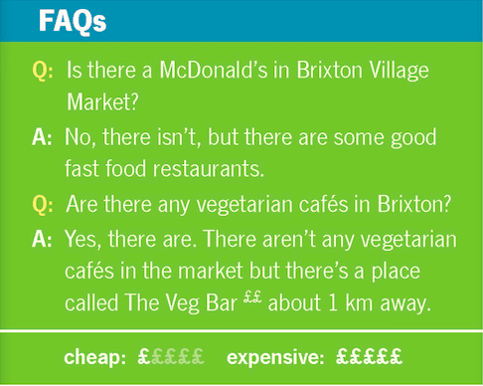

Exercise 2 - SB page 22
Click on the key to display the answer

Slide 9

GRAMMAR
THERE IS
THERE ARE
Meaning
have something
Usage
there is + singular N
there are + plural N
(+) There’s a sandwich bar.
(-) There isn’t a pizzeria.
(?) Is there an Italian restaurant?
Yes, there is.
No, there isn’t.
(+) There are some burgers bars
(-) There aren’t any burgers bars.
(?) Are there any cafés?
Yes, there are.
No, there aren’t.
Form

Slide 10
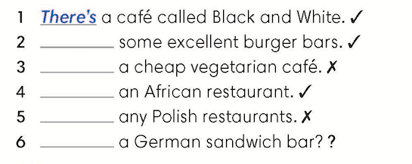
Exercise 3 - SB page 22
Complete the sentences about restaurants in Brixton with the correct form of there is/ there are.
There are
There isn’t
There’s
There aren’t
Is there
Click on the key to display the answer

Slide 11
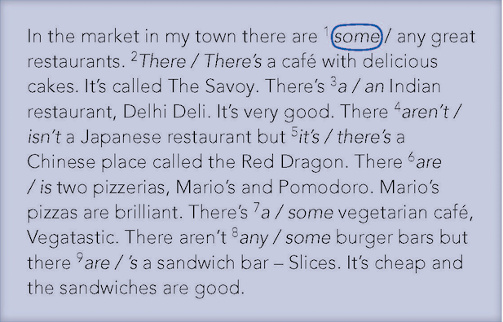
Exercise 4 - SB page 22
Read the description of the market and choose the correct option. Listen and check.

Slide 12
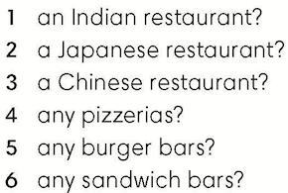
Exercise 5 - SB page 22
Is there an Indian restaurant?
In pairs, ask and answer questions about the text using the words below.
Yes, there is.

Slide 13


