Slide 1
UNIT 3 – EVERY DAY
Lesson 3.3 Reading & Vocabulary
(SB page 33)

Slide 2


CHAIN GAME
Create timetable schedule for Sam.
Sam gets up at 6
o’clock every morning
…
Notes:
Students work in 4 big groups.
Teacher shows a sentence about a student named Lan: “Lan gets up at 6 o’clock every morning.”
Students create timetable schedule for Lan.
Each student in the group will add one sentence and write it down.
The groups with the most correct sentences will be the winner.

Slide 3

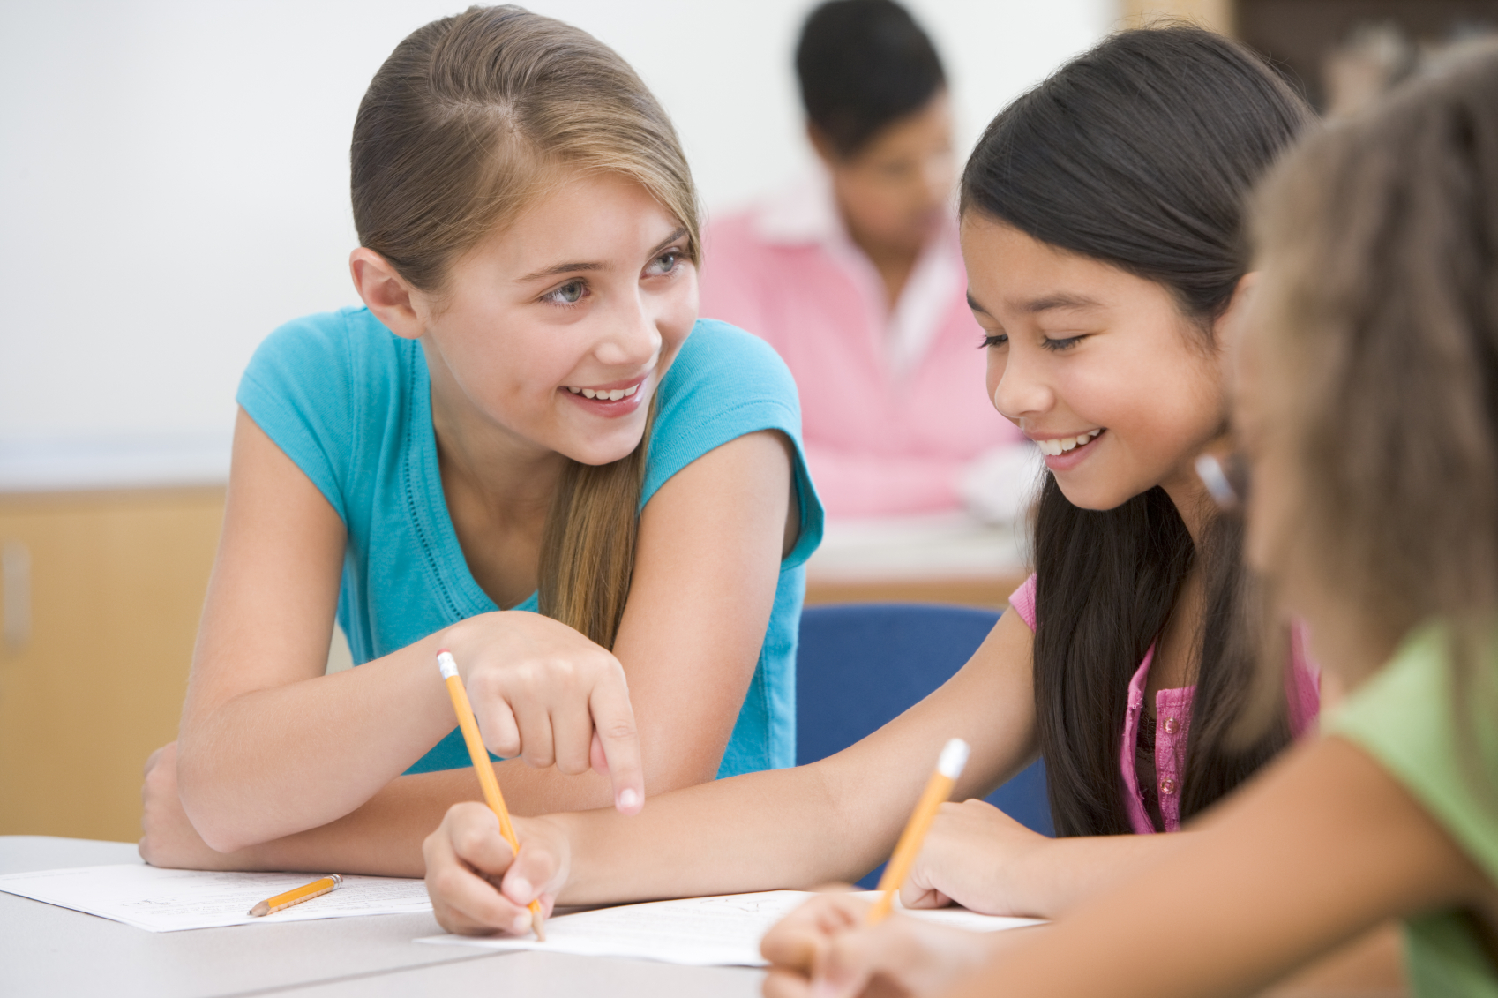
Objectives
I can find specific details and main ideas in an article and talk about free time activities.

Slide 4
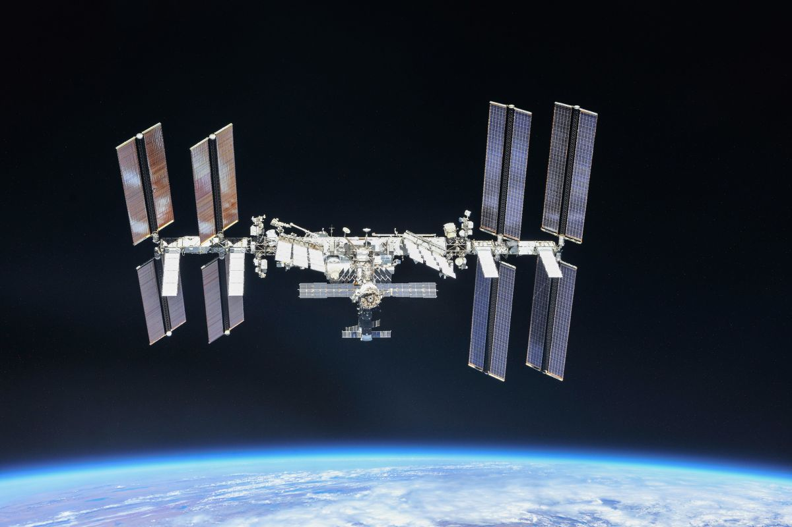
1
2
3
SPACE STATION
4
5
6

Slide 5


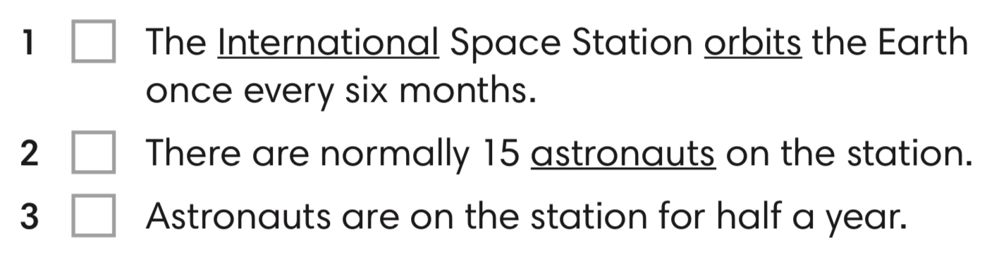
Exercise 1 - SB page 33
Do you know the underlined words?
Click on the question mark to display the definitions

Slide 6
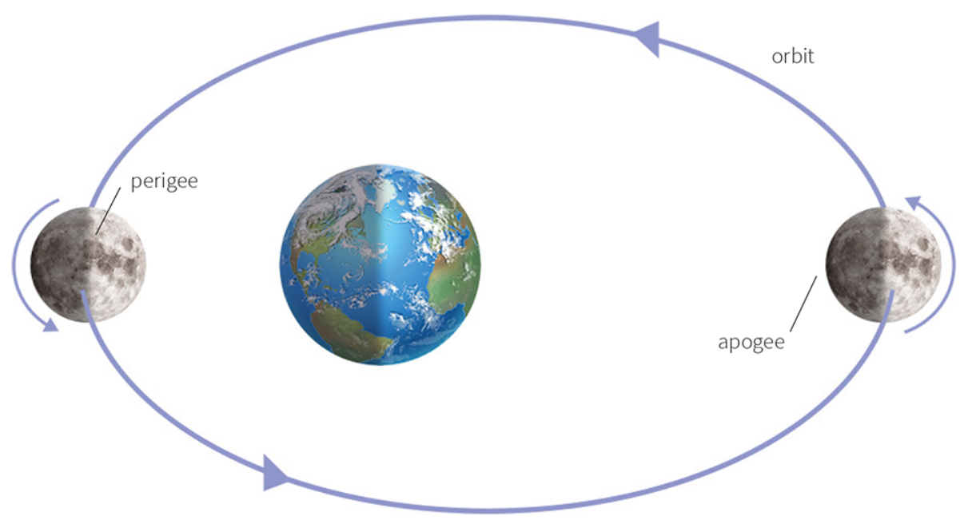
international (adj)
/ˌɪntəˈnæʃnəl/
connected with or involving two or more countries
astronaut (n)
/ˈæstrənɔːt/
a person whose job involves travelling and working in a spacecraft
orbit (n)
/ˈɔːbɪt/
curved path followed by a planet or an object as it moves around another planet, star, moon, etc.

Slide 7
Exercise 1 - SB page 33
In pairs, tick the sentences you think are true.
Click on the question mark to display the definitions

Slide 8
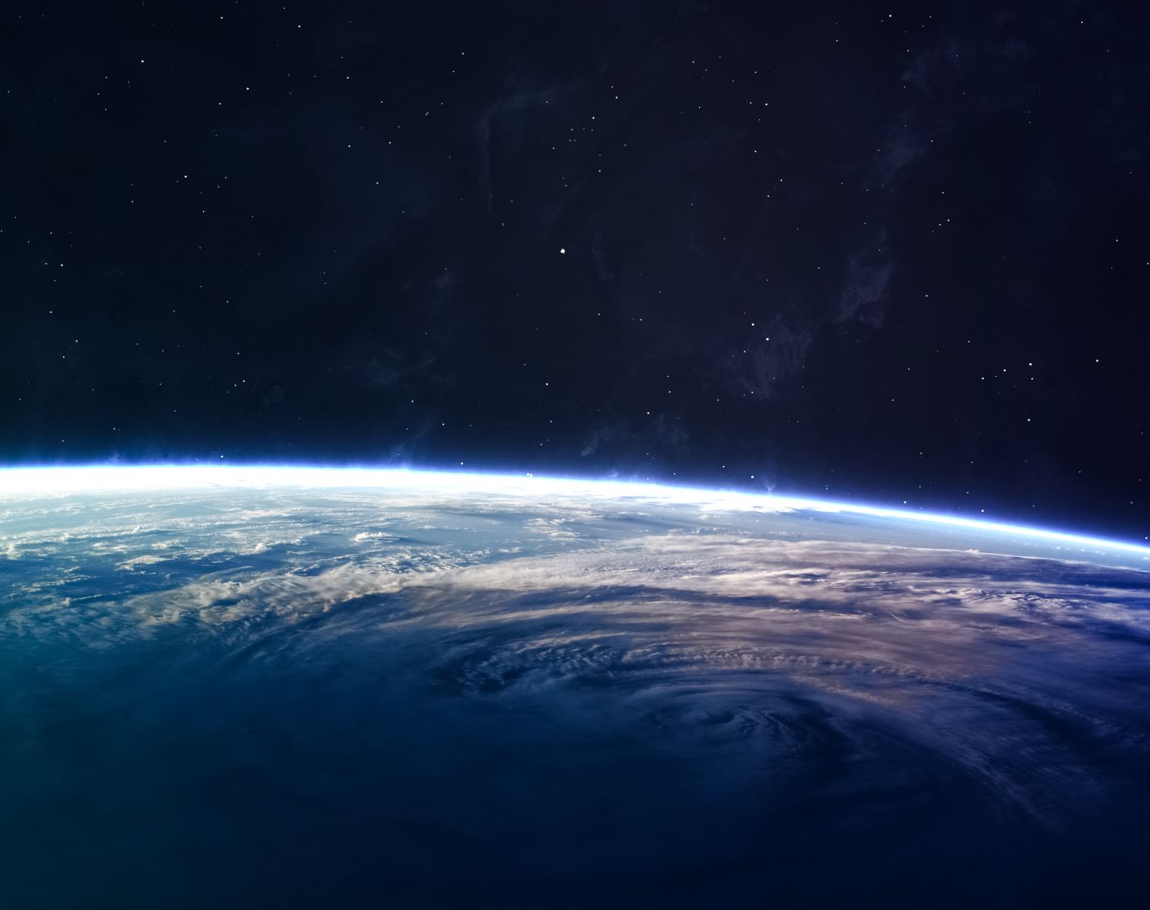
What do you know about the International Space Station?

Slide 9
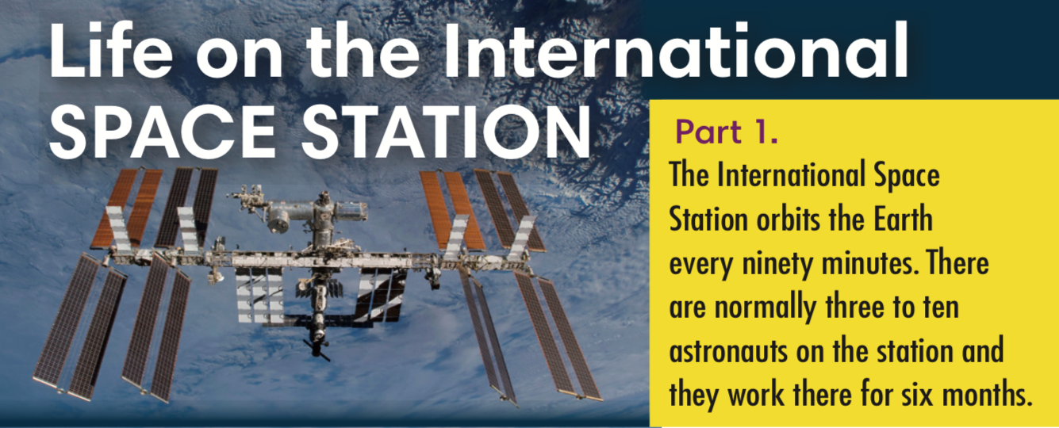

Exercise 2 - SB page 33
Read Part 1 of the text and check your answer to Exercise 1.
F
T
T
Click on the key to display the answer

Slide 10

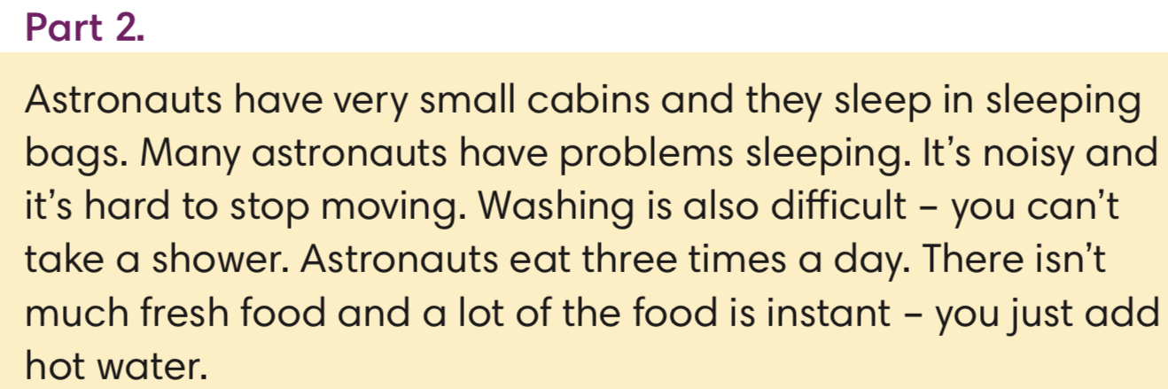

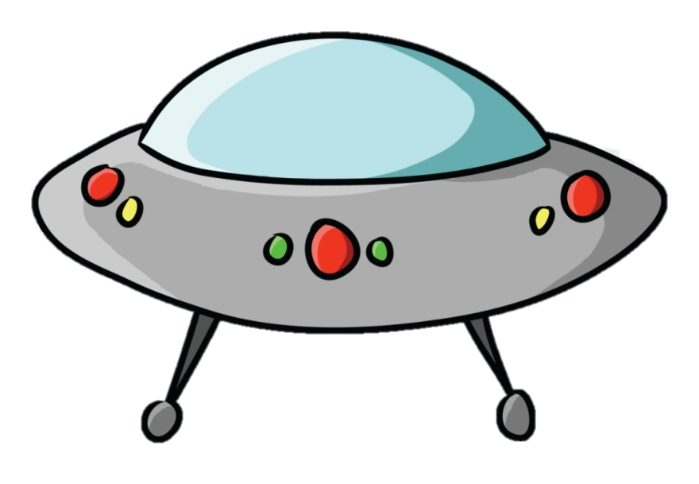

Let’s play: Planet to the rescues!!
What’s the heading for the text below?
Click on the key to display the answer

Slide 11
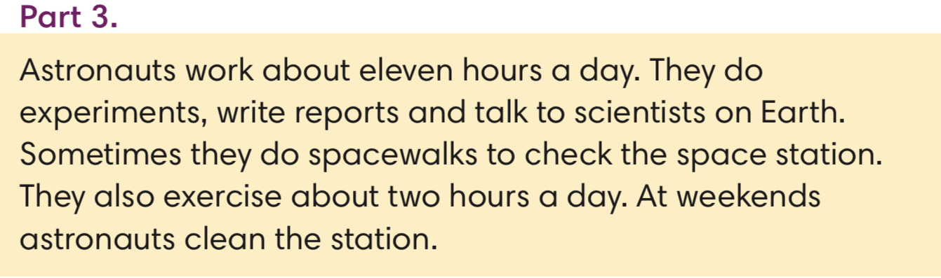
Let’s play: Planet to the rescues!!
What’s the heading for the text below?
Click on the key to display the answer

Slide 12
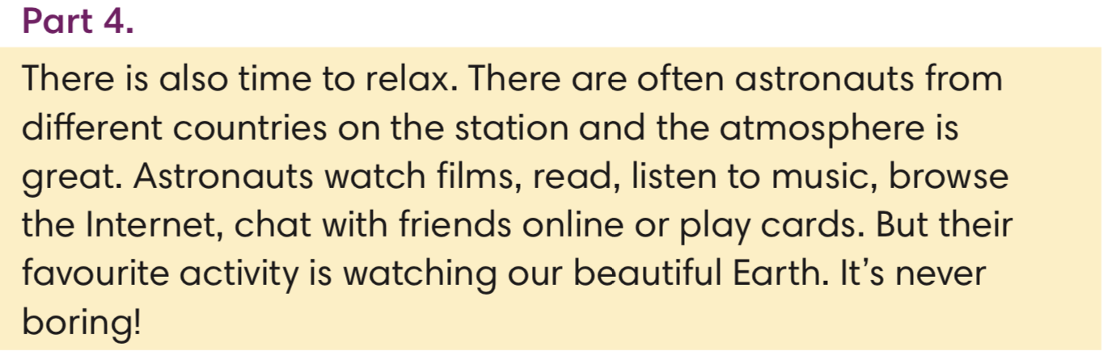
Let’s play: Planet to the rescues!!
What’s the heading for the text below?
Part 4
Click on the key to display the answer

Slide 13
Exercise 4 - SB page 33
Which facts about life on the International Space Station are surprising to you?
Examples:
They can browse the Internet. Because I don’t think they can access Internet from the Space.
They can’t take a shower. Because …
They work 11 hours a day. Because …

Slide 14
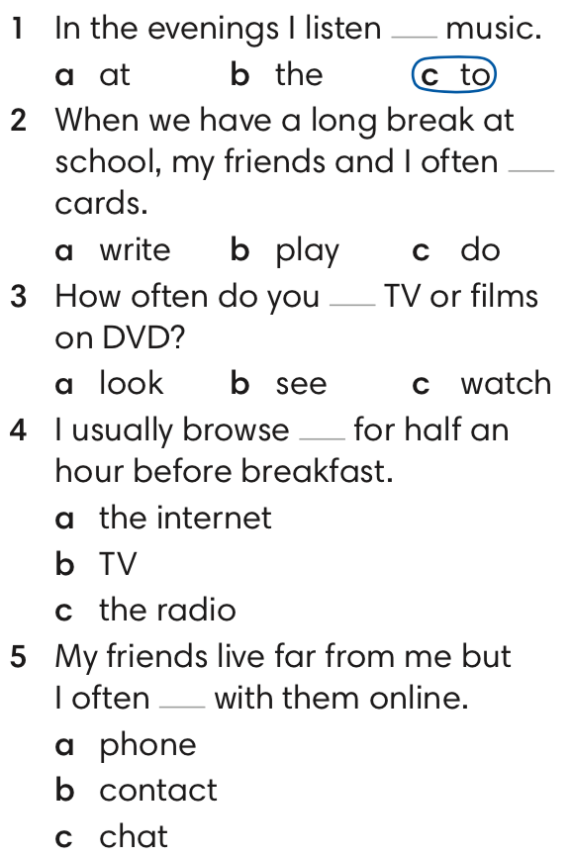
Exercise 5 - SB page 33
Choose the correct answers.
Click on the key to display the answer

Slide 15
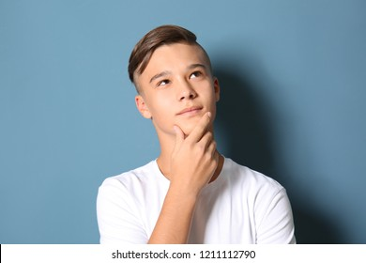
Exercise 6 - PB page 33
Talk about your daily activities with your partners. Then report.
Nam often browses the Internet.
He sometimes reads but he never plays cards.
Notes:
Add ảnh

Slide 16

Notes:
Thiếu 1 game chữa bài

