Slide 1


Slide 2
Game:“Matching”?
A | B
1. Become | a. Thought
2. Begin | b. Wrote
3. Buy | c. Became
4. Sell | d. Understood
5. Think | e. Bought
6. Understand | f. Began
7. Write | i. Sold
KEY
1=> c
2=> f
3=> e
4=> i
5=> a
6=> d
7=> b

Slide 3
UNIT 7 – THE TIME MACHINE
Period 65 Lesson 7.2: Grammar 1

Slide 4


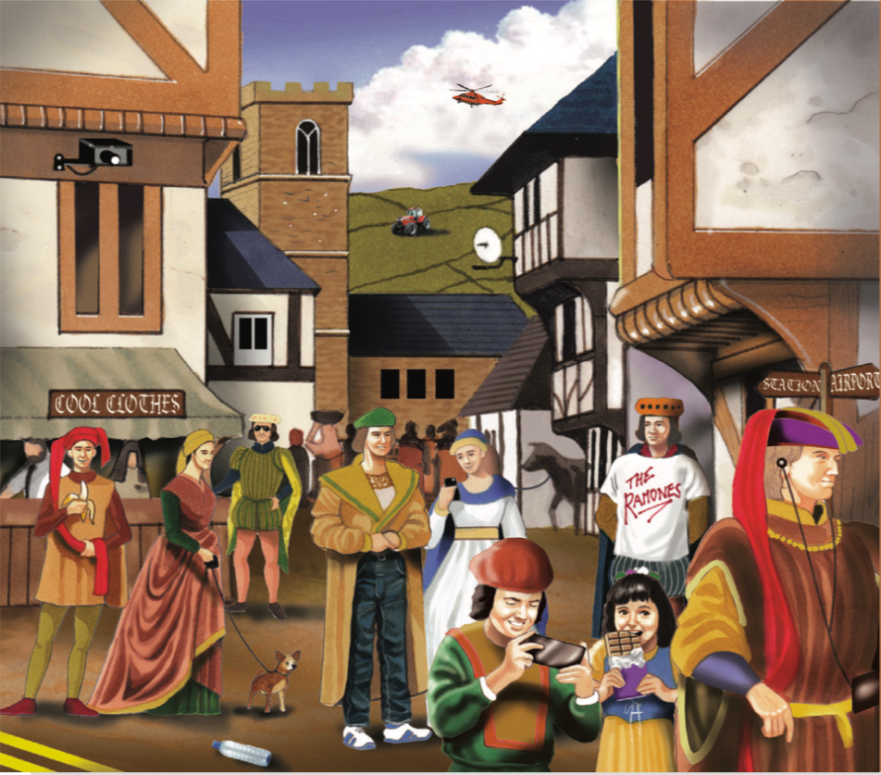
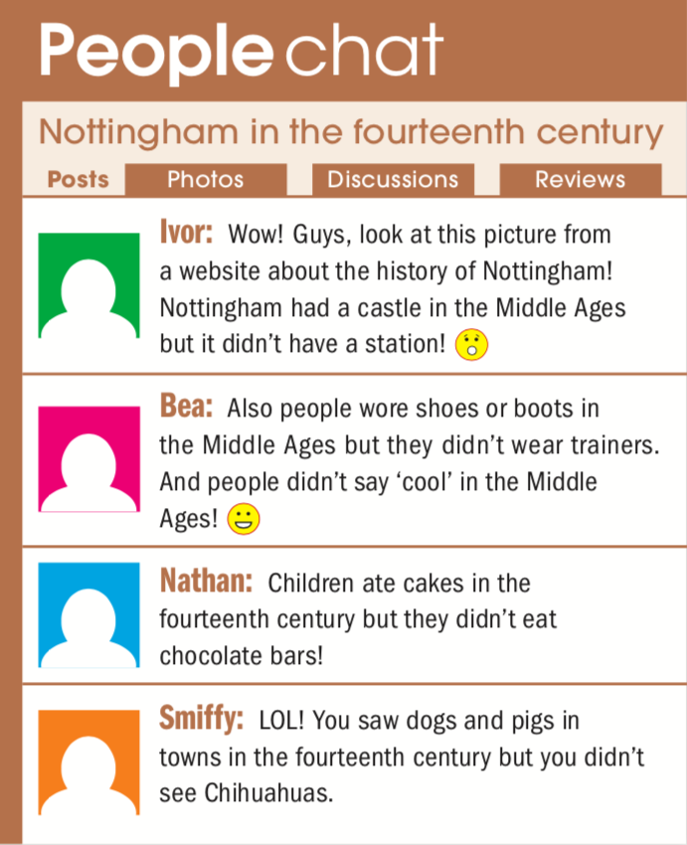
Exercise 1 (SB page 72)
Click on the key to display the answers

Slide 5
I. Grammar: Past simple negative.
Ex 1: It didn’t have a station.
Ex 2: They didn’t wear trainers.
* Form:
S + didn’t + V(if) + (O)

Slide 6
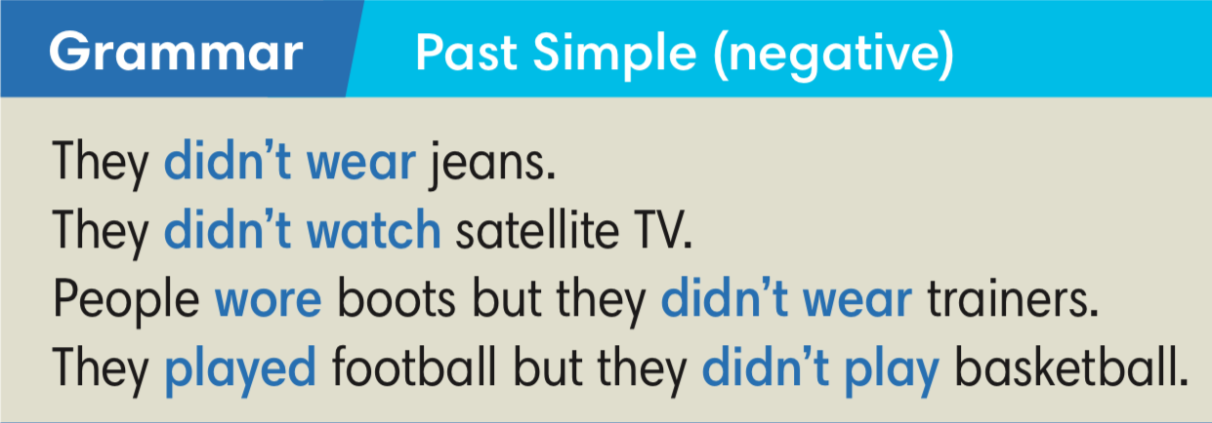
Exercise 2 (SB page 72)
Study the Grammar box. Find more examples of Past Simple negatives in the comments.
Click on the key to display the answers
Notes:
Game EXERCISE 4

Slide 7
Find 11 more mistakes!
1. jeans
6. satellite dish
2. camera
7. sunglasses
3. tractor
8. phones
4. helicopter
9. Ramones T-shirt
5. plastic bottle
10. earphones
11. banana

Slide 8
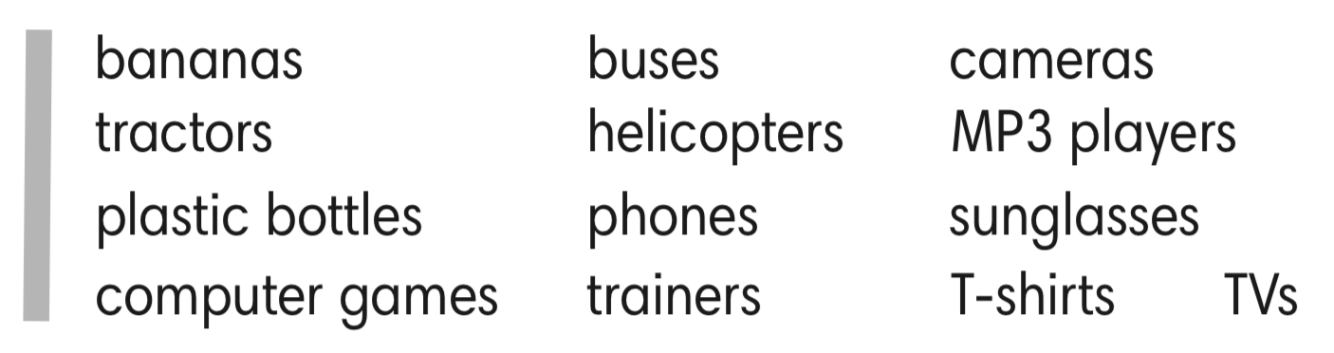
Exercise 3 (SB page 72)
In groups of 4, make more sentences about the mistakes in the picture. Use some ideas bellow to help you.
1. They didn’t use plastic bottles

Slide 9

TIME FOR
FUN
HAMSTER GAME
Give the correct form of verbs in Active Voice or Passive Voice.
Type the answer in the chat box.
Get the points from the hamster.
Notes:
Exercise 4 SB p.72

Slide 10



Complete the sentences with the Past Simple forms of the verbs in brackets.
1
8
2
Question 2
7
3
Ola ____________ (have) a shower this morning but she ____________ her hair.
had
6
4
didn’t wash
5
had / didn’t wash

Slide 11

Complete the sentences with the Past Simple forms of the verbs in brackets.
1
2
8
2
Question 3
7
3
Last night Dan ________ (go) to bed early but he _____________
(not sleep) well.
went
didn’t sleep
6
4
5
went / didn’t sleep

Slide 12

Complete the sentences with the Past Simple forms of the verbs in brackets.
1
8
2
Question 4
7
3
We ________ (work) hard yesterday but we __________(not feel) tired.
worked
6
4
didn’t feel
5
worked / didn’t feel

Slide 13

Complete the sentences with the Past Simple forms of the verbs in brackets.
1
8
2
Question 5
7
3
They ________ (come) to the party on Saturday but they ____________ (not stay) long.
came
6
4
didn’t stay
5
came / didn’t stay

Slide 14

Complete the sentences with the Past Simple forms of the verbs in brackets.
1
8
2
Question 6
7
3
Marion ________ (tell) me what to do but I ___________________ (understand).
told
6
4
didn’t understand
5
told / didn’t understand

Slide 15

Complete the sentences with the Past Simple forms of the verbs in brackets.
1
8
2
Question 7
7
3
I ________ (want) to go to the concert but I ___________ (not have) enough money for a ticket.
wanted
6
4
didn’t have
5
wanted / didn’t have

Slide 16

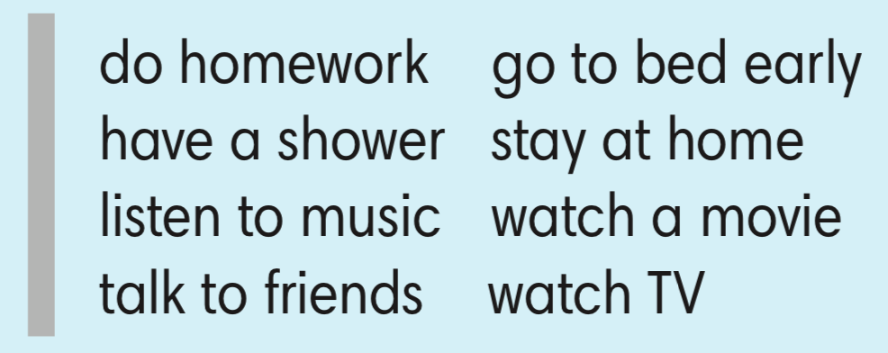
Exercise 5 (SB page 72)
In pairs, talk about what you did/ didn’t do last night.
Use the ideas below or your own.
Last night I did homework.
I didn’t watch a movie.
Really? I didn’t do homework. I went to bed early.

Slide 17


