Slide 1
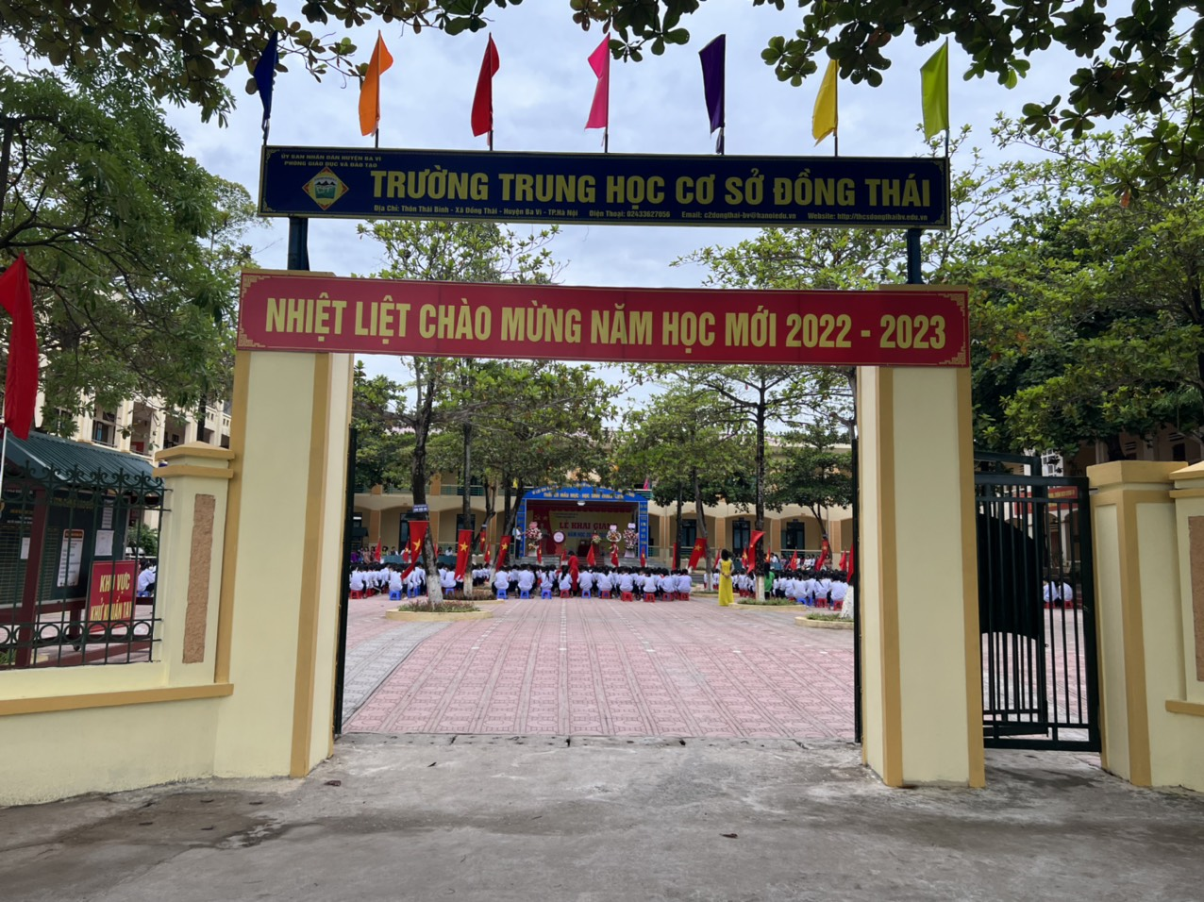

Slide 2
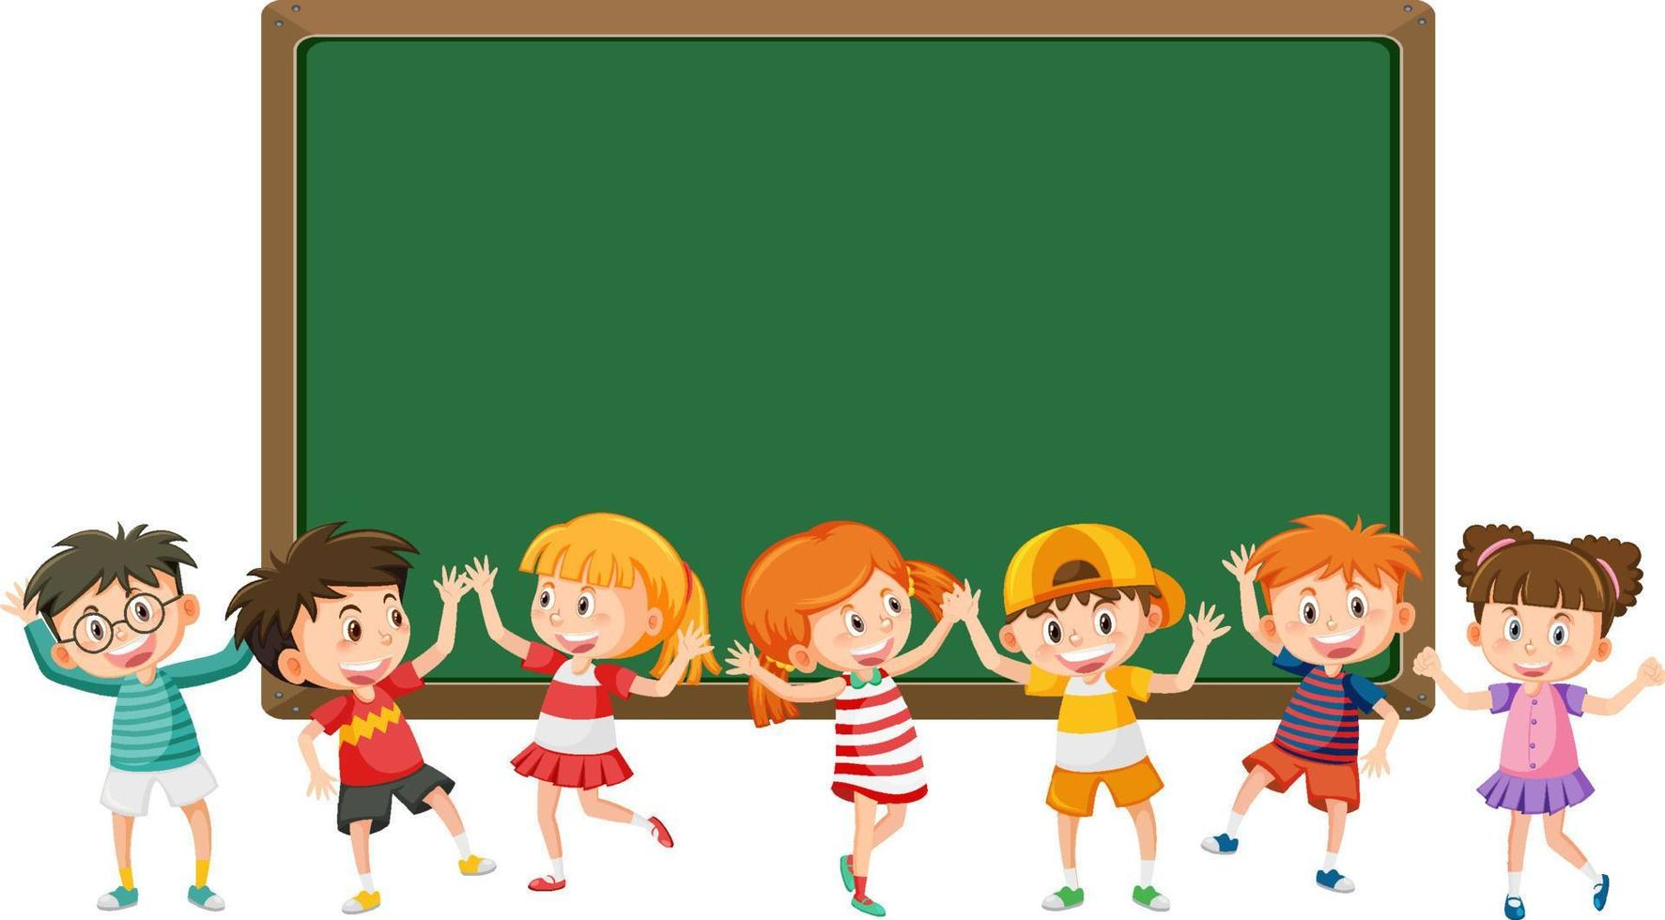
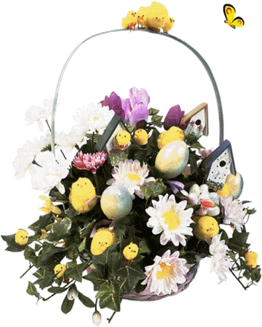
Warmly welcome teachers and students
to our English class!
Teacher: Phùng Thị Nhàn
Class: 8G

Slide 3
Guessing words
Warm – up:
1
C
U
S
T
O
M
2
T
R
A
D
I
T
I
O
N

Slide 4
4
OUR CUSTOMS
AND TRADITIONS
Unit
Period 27: Lesson 1: GETTING STARTED
In this Unit, we will study about our customs and traditions.

Slide 5
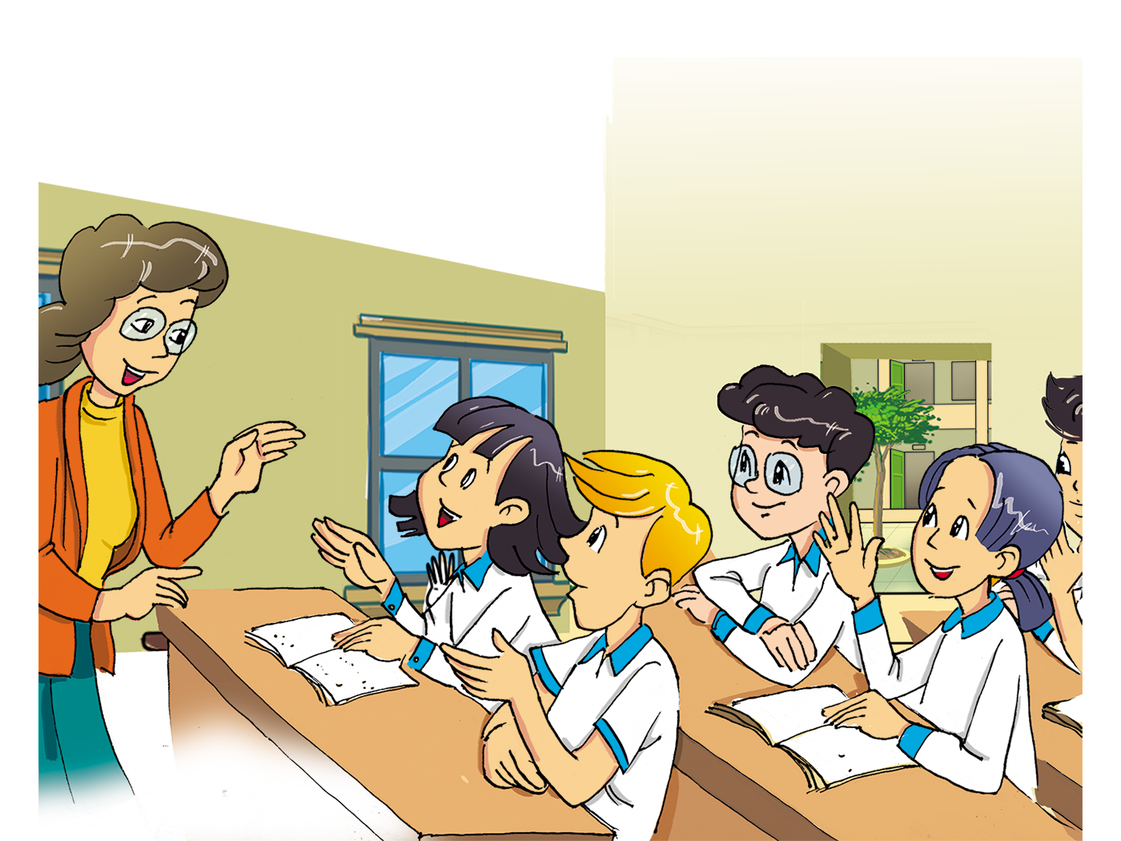
A lesson on customs and traditions

Slide 6
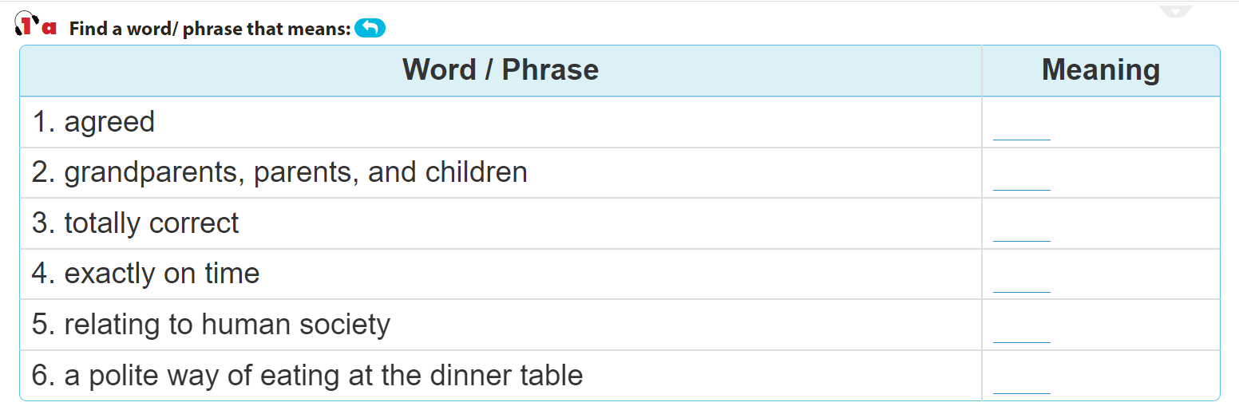
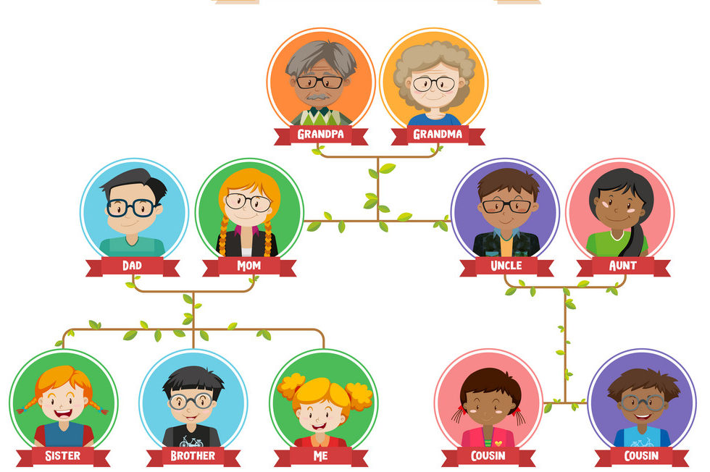
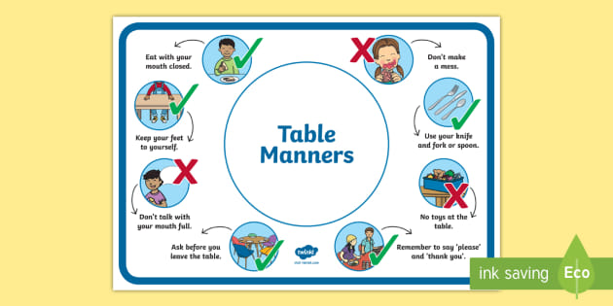
I. Vocabulary
Task 1a. (Page 39)
Accepted (adj)
/əkˈsep.tid/
Được chấp nhận.
Generations (n)
RULES
Các thế hệ.
/ˌdʒenəˈreɪʃnz/
Spot on (adj)
/spɒt ɒn/
Hoàn toàn đúng.
Sharp (adv)
/ʃɑːp/
Chính xác, đúng giờ.
Social (adj)
/ˈsəʊʃl/
Thuộc về xã hội.
Table manners (n)
/ˈteɪbl ˈmænə(r)z/
Các quy tắc ăn uống.

Slide 7
II. True/False statements
Task 1b. (Page 39)
T
F
1. Nick’s explanation of customs and traditions is correct.
2. Only families have customs and tradition.
3. In the UK there’s a tradition of having afternoon tea.
4. In the UK there is no accepted way of behaving at the dinner table.





Slide 8
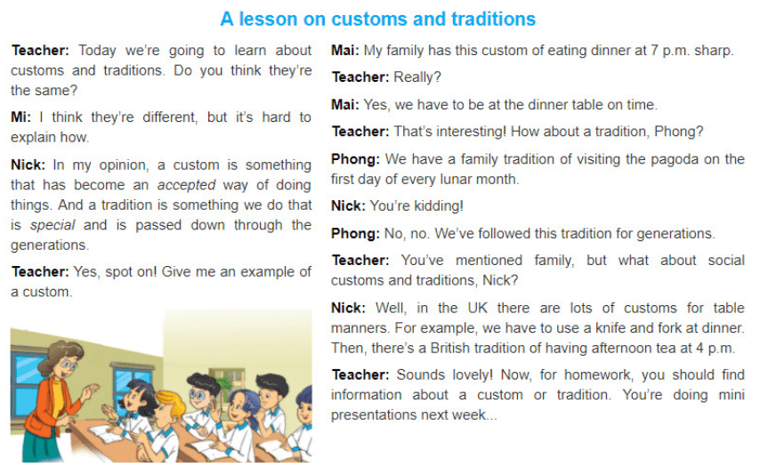


Slide 9
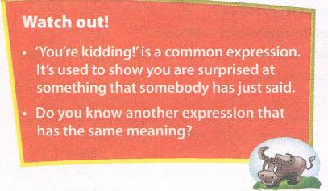
- Expression:
“You’re kidding!”:
bạn đang đùa đó thôi!
- Some similar expressions:
You must be kidding!/ You’re joking!/You must be joking! No way! …

Slide 10
Task 1d. Find these sentences in the conversation and fill in the missing words.
1. We ________ be at the dinner table on time.
2. You ________ find information about a custom or tradition.
What do you think sentences mean?
-have to: It’s an obligation – you have no choice.
-should: It’s a suggestion or an advice – it would be best to follow it.
have to
should

Slide 11
III. Answer the questions
Task 1c. (Page 39)
c. Answer the following questions.
1. What is Mai’s family custom?
2. How does Nick feel when Phong talks about one of his family
traditions?
3. What is the similarity between a custom and a tradition?
4. What is the difference between them?
5. What should the students do for homework?

Slide 12
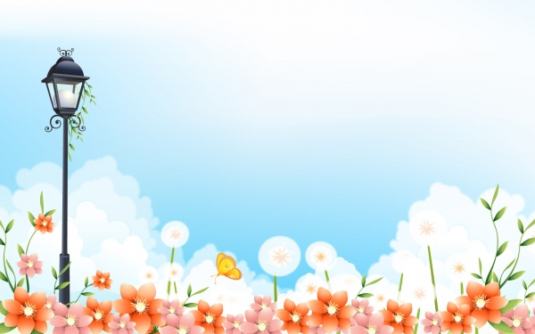


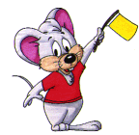
3
1
2
LUCKY
NUMBER

Slide 13
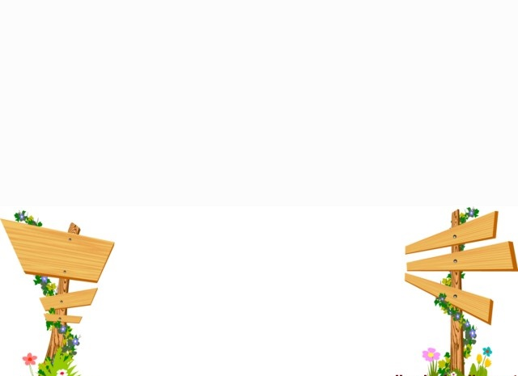
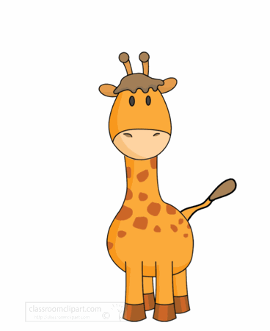
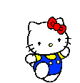
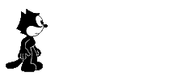
2
3
1
4
5
6
END

Slide 14





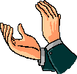

LUCKY NUMBER

Slide 15
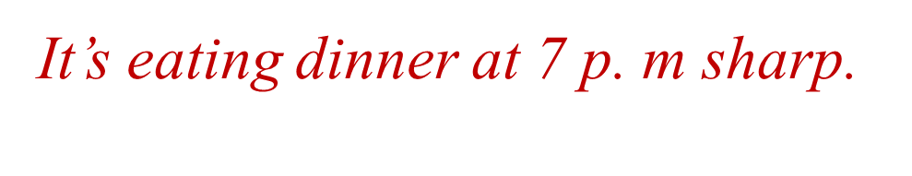
1. What is Mai’s family custom?

Slide 16
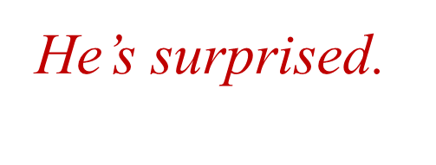
2. How does Nick feel when Phong talks about one of his family traditions?

Slide 17
3. What is the similarity between a custom and a tradition?
They both refer to doing something that develops over time.

Slide 18
4. What is the difference between them?
A custom is something accepted. A tradition is something special and is passed down through the generations.

Slide 19
5. What should the students do for homework?
They should find information about a custom or tradition.

Slide 20
IV. Production
Task 2a.b. (Page 39)

Slide 21
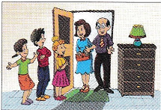
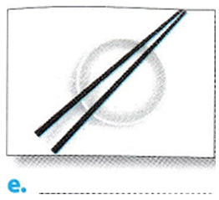
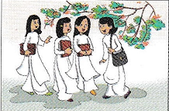
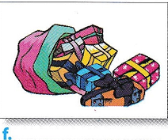
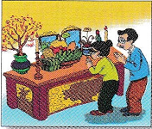
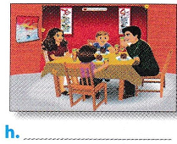
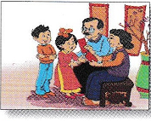
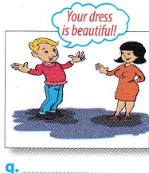
2 a. Match the pictures with the customs and traditions in the box.
1. Smiling to accept a compliment
2. Worshipping ancestors
3. Wrapping gifts in colour paper
4. Having lunch together on the
second day of Tet
5. Placing the chopsticks on top of the
rice bowl when finishing a meal
6. Children in the family standing in a
row to greet guests
7. Wearing ao dai on special occasions
8. Giving children lucky money at Tet
a. __
e. __
- 6
- 5
- 7
f. __
b. __
- 3
c. __
g. __
- 2
- 4
- 8
h. __
d. __
- 1

Slide 22
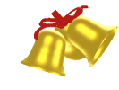
RING THE GOLDEN BELL
RING THE GOLDEN BELL
Let’s
Play!

Slide 23
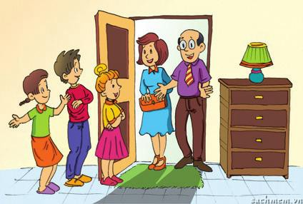
RING THE GOLDEN BELL
RING THE GOLDEN BELL
C
0
1
2
3
4
5
Children in the family standing in a row to greet guests.

Slide 24
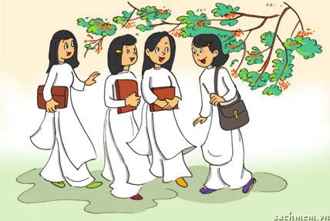
RING THE GOLDEN BELL
RING THE GOLDEN BELL
T
0
1
2
3
4
5
Wearing Ao Dai on special occasions.

Slide 25
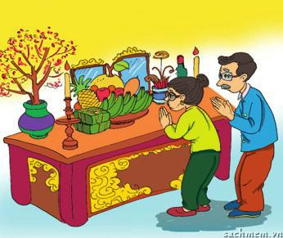
RING THE GOLDEN BELL
RING THE GOLDEN BELL
C or T
0
1
2
3
4
5
Worshipping ancestors

Slide 26
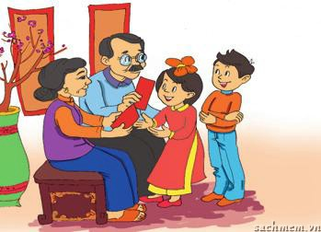
RING THE GOLDEN BELL
RING THE GOLDEN BELL
C or T
0
1
2
3
4
Giving children lucky money at Tet.
5

Slide 27
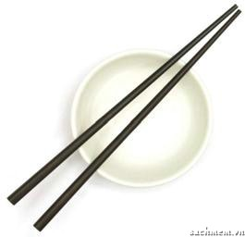
RING THE GOLDEN BELL
RING THE GOLDEN BELL
C
Placing the chopsticks on top of the rice bowl when finishing a meal.
0
1
2
3
4
5

Slide 28
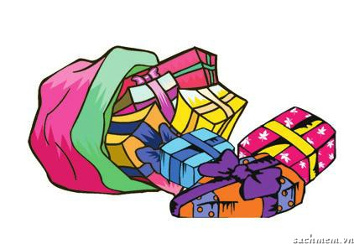
RING THE GOLDEN BELL
RING THE GOLDEN BELL
C
Wrapping gifts in colour paper.
0
1
2
3
4
5

Slide 29
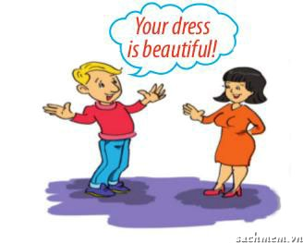
RING THE GOLDEN BELL
RING THE GOLDEN BELL
C
0
1
2
3
4
Smiling to accept a compliment.
5

Slide 30
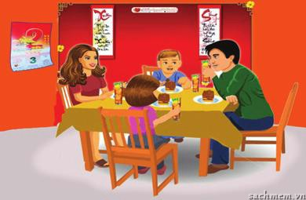
RING THE GOLDEN BELL
RING THE GOLDEN BELL
T
Having lunch together on the second day of Tet.
0
1
2
3
4
5

Slide 31
HOME PROJECT DISPLAY
3. GAME: CUSTOMS AND TRADITION EXPERTS
1. Work in groups.
2. Write down as many local customs
and tradition as you can think of.
3. Present your list to the other groups.
4. The group with the most ideas are the experts!

Slide 32

HOMEWORK
- Learn by heart vocabulary.
- Collect some pictures, video clips about your local customs and traditions.
- Prepare lesson 2: A closer look 1.

Slide 33
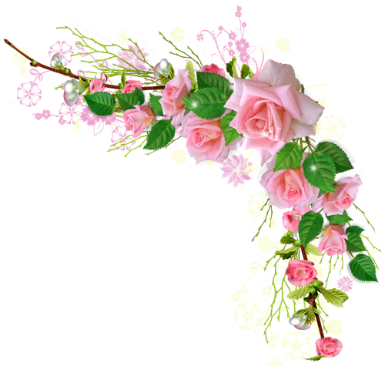



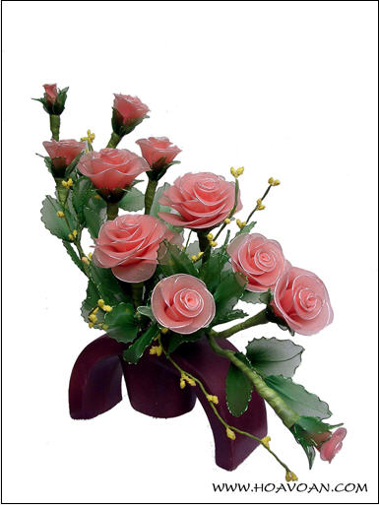
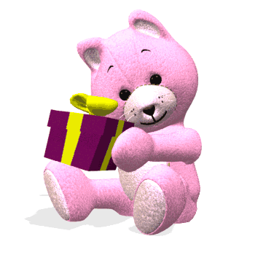
Thank you for your attention!

