Slide 1
UNIT 4 – love to learn
Lesson 4.1 Vocabulary
(SB page 40 – 41)

Slide 2
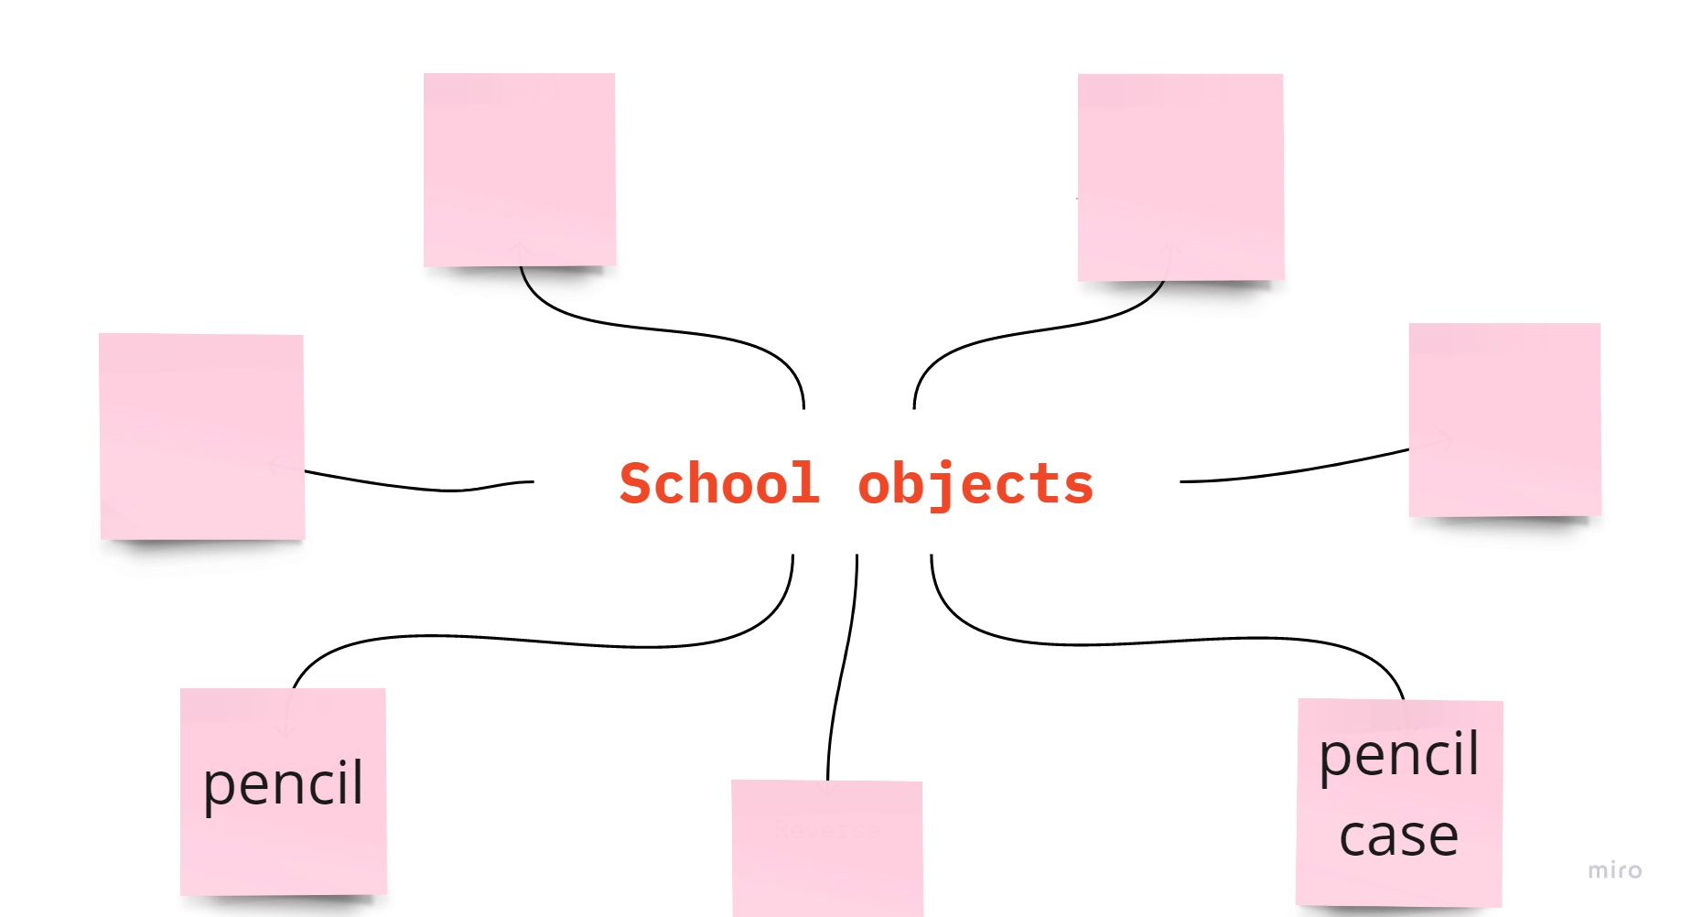
Brainstorming
Work in groups of 3.
List all the words about classroom objects.

Slide 3



Objectives
I can talk about classroom objects and school subjects.

Slide 4


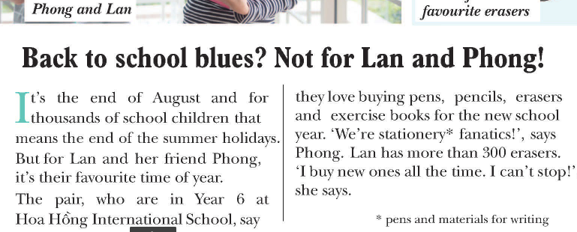
Exercise 1 (SB page 40)
Read the text and find four classroom objects.
Click on the key icon to display the answers

Slide 5
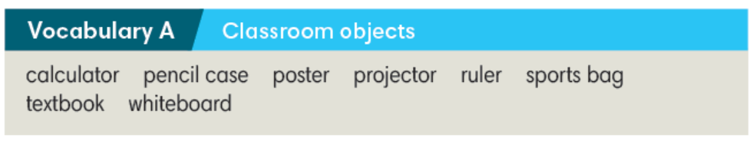
Exercise 1 (SB page 40)
Add four classroom objects to the list.
eraser
exercise book
pen
pencil

Slide 6
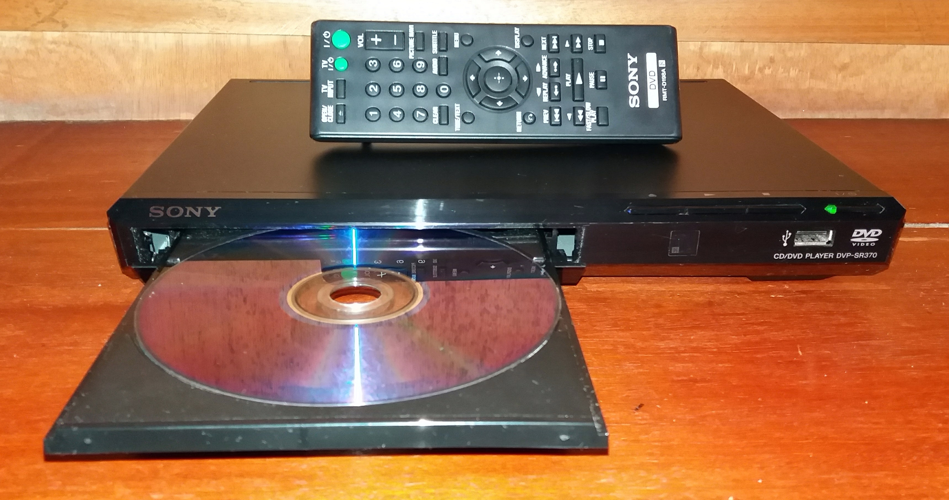


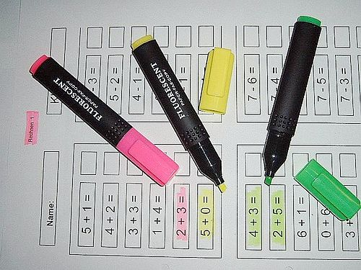
Exercise 1 (SB page 40)
Work in pairs. Find more words about classroom objects in two minutes.
DVD player
clock
crayons
highlight pens

Slide 7

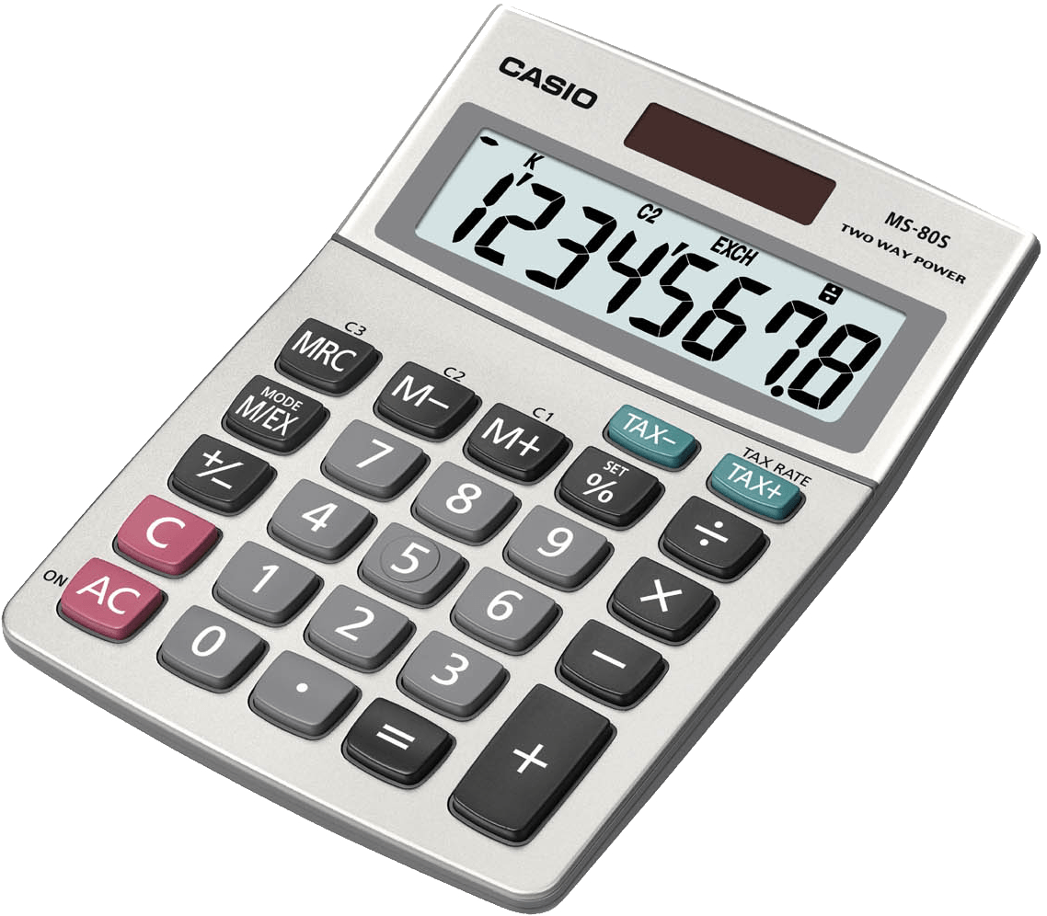


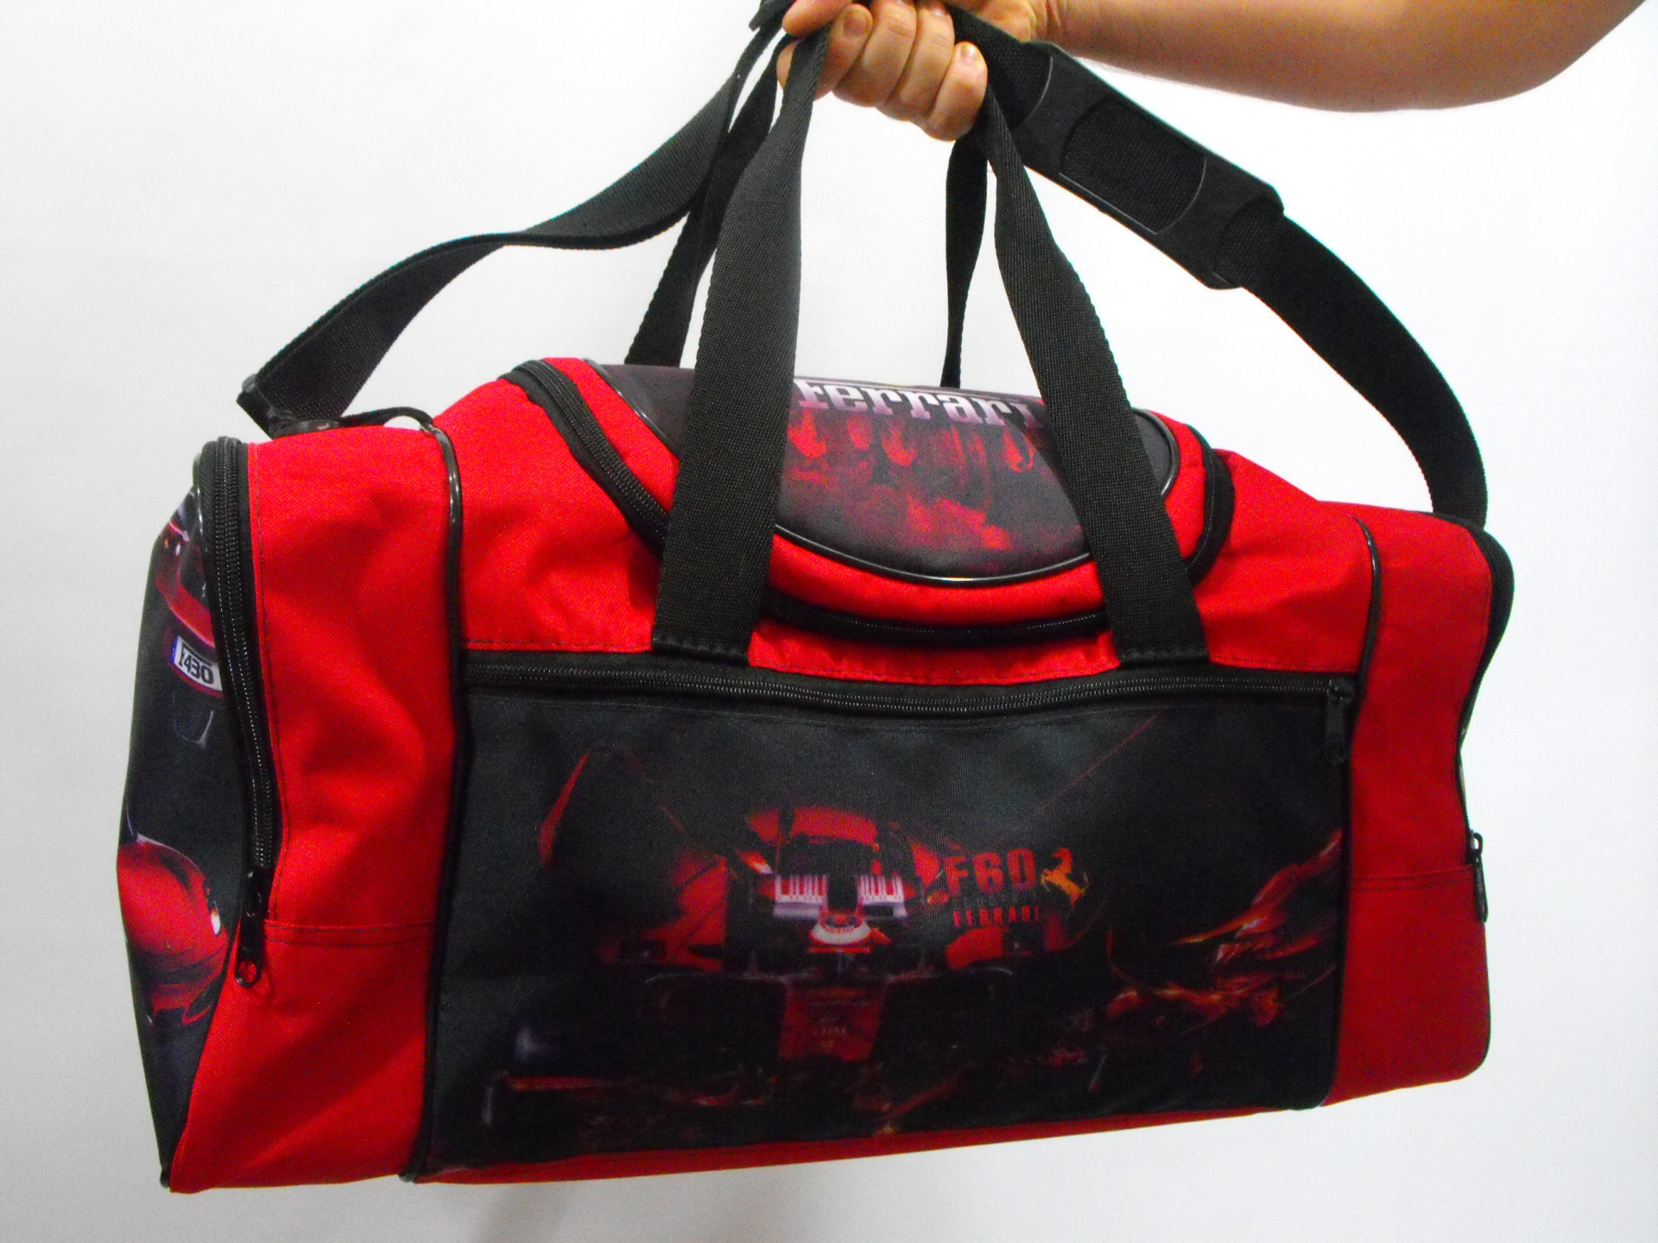
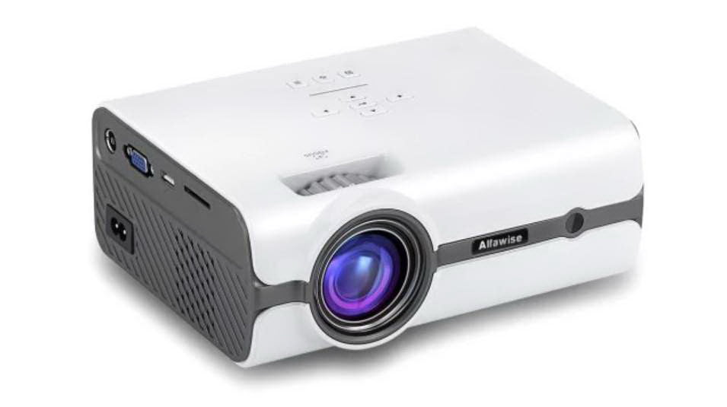
Exercise 2 (SB page 40)
Listen to five dialogues and write the classroom objects you hear.
1. calculator
2. ruler
3. textbook
4. sports bag
5. projector

Slide 8
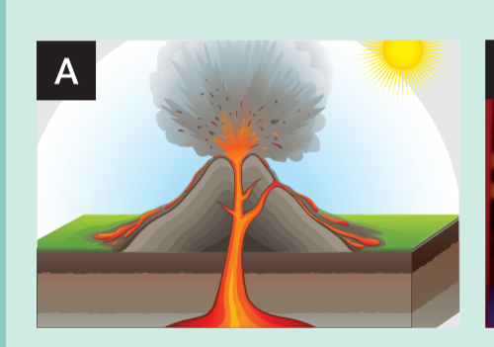
Exercise 3 (SB page 40 – 41)
In pairs, match the words with photos A-L.
Geography – | PE – | Maths –
Chemistry – | Art – | History –
Biology – | Music – | Physics –
Information Technology (IT) – |  | English –
A

Slide 9
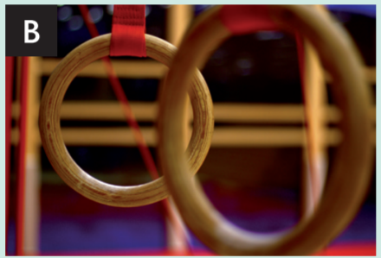
Exercise 3 (SB page 40 – 41)
In pairs, match the words with photos A-L.
Geography – | PE – | Maths –
Chemistry – | Art – | History –
Biology – | Music – | Physics –
Information Technology (IT) – |  | English –
A
B

Slide 10

Exercise 3 (SB page 40 – 41)
In pairs, match the words with photos A-L.
Geography – | PE – | Maths –
Chemistry – | Art – | History –
Biology – | Music – | Physics –
Information Technology (IT) – |  | English –
A
B
C

Slide 11
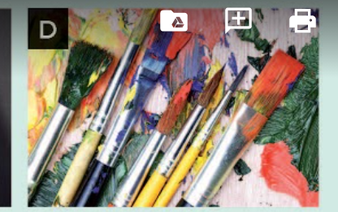
Exercise 3 (SB page 40 – 41)
In pairs, match the words with photos A-L.
Geography – | PE – | Maths –
Chemistry – | English – | Music –
Biology – | History – | Physics –
Information Technology (IT) – |  | Art –
A
B
C
D

Slide 12

Exercise 3 (SB page 40 – 41)
In pairs, match the words with photos A-L.
Geography – | PE – | Maths –
Chemistry – | English – | Music –
Biology – | History – | Physics –
Information Technology (IT) – |  | Art –
A
B
C
E
D

Slide 13

Exercise 3 (SB page 40 – 41)
In pairs, match the words with photos A-L.
Geography – | PE – | Maths –
Chemistry – | English – | Music –
Biology – | History – | Physics –
Information Technology (IT) – |  | Art –
A
B
C
E
F
D

Slide 14
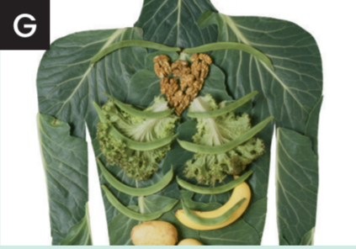
Exercise 3 (SB page 40 – 41)
In pairs, match the words with photos A-L.
Geography – | PE – | Maths –
Chemistry – | English – | Music –
Biology – | History – | Physics –
Information Technology (IT) – |  | Art –
A
B
C
E
G
F
D

Slide 15
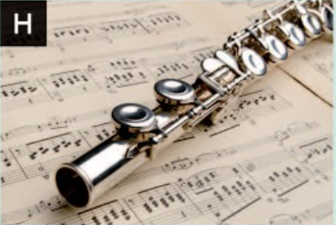
Exercise 3 (SB page 40 – 41)
In pairs, match the words with photos A-L.
Geography – | PE – | Maths –
Chemistry – | English – | Music –
Biology – | History – | Physics –
Information Technology (IT) – |  | Art –
A
B
C
E
H
G
F
D

Slide 16
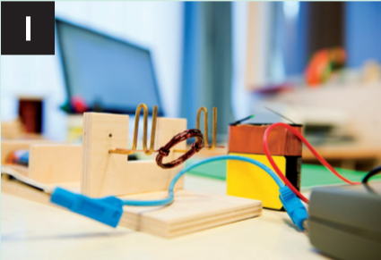
Exercise 3 (SB page 40 – 41)
In pairs, match the words with photos A-L.
Geography – | PE – | Maths –
Chemistry – | English – | Music –
Biology – | History – | Physics –
Information Technology (IT) – |  | Art –
A
B
C
E
H
G
F
I
D

Slide 17

Exercise 3 (SB page 40 – 41)
In pairs, match the words with photos A-L.
Geography – | PE – | Maths –
Chemistry – | English – | Music –
Biology – | History – | Physics –
Information Technology (IT) – |  | Art –
A
B
C
E
H
G
F
I
D
J

Slide 18

Exercise 3 (SB page 40 – 41)
In pairs, match the words with photos A-L.
Geography – | PE – | Maths –
Chemistry – | English – | Music –
Biology – | History – | Physics –
Information Technology (IT) – |  | Art –
A
B
C
E
K
H
G
F
I
D
J

Slide 19
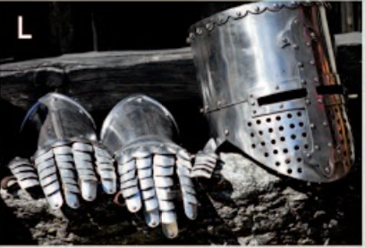
Exercise 3 (SB page 40 – 41)
In pairs, match the words with photos A-L.
Geography – | PE – | Maths –
Chemistry – | English – | Music –
Biology – | History – | Physics –
Information Technology (IT) – |  | Art –
A
B
C
E
K
H
G
F
I
& L
D
J

Slide 20

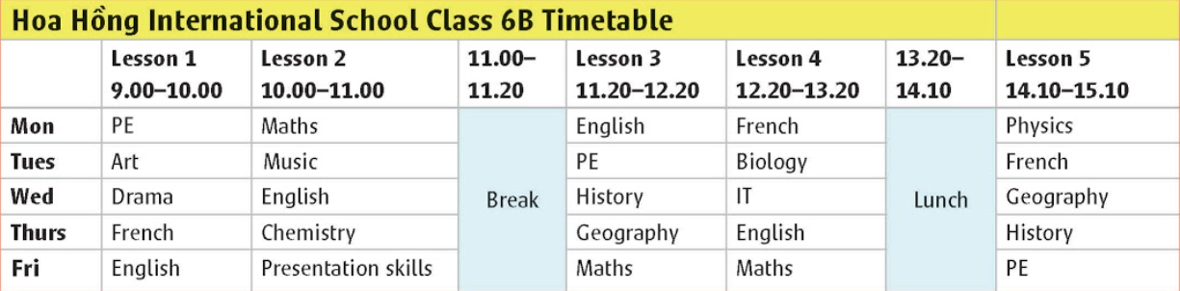
How many subjects are there?
How many days do students go to school?

Slide 21

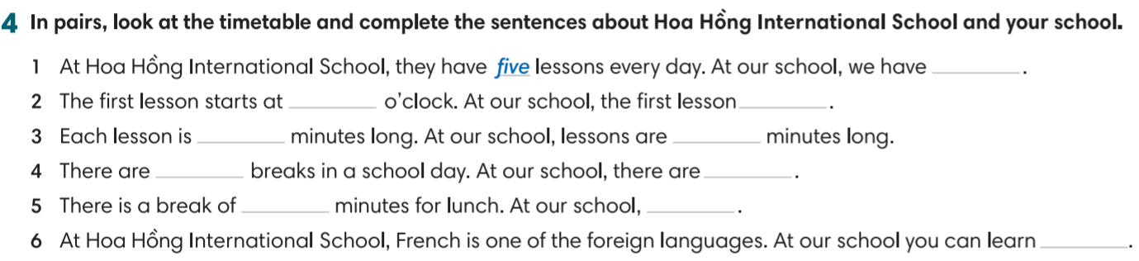
Exercise 4 (SB page 41)
Complete the sentences about Hoa Hong International School and your school.
nine
sixty
two
fifty

Slide 22
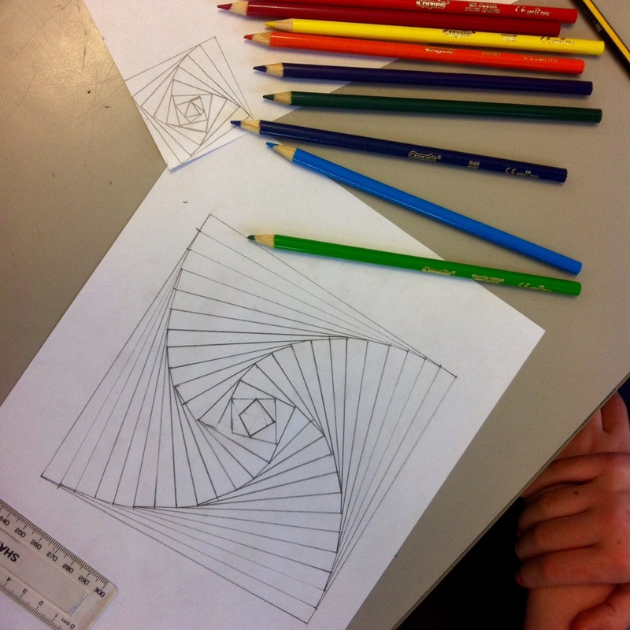

Exercise 5 (SB page 41)
In pairs, talk about days you like/don’t like at school. Say why.
I like Mondays because …
I don’t like Tuesdays because …

Slide 23


