Slide 1


Slide 2



Welcome to our class
English 9
Teacher: Phung Thị Kim Sinh

Slide 3
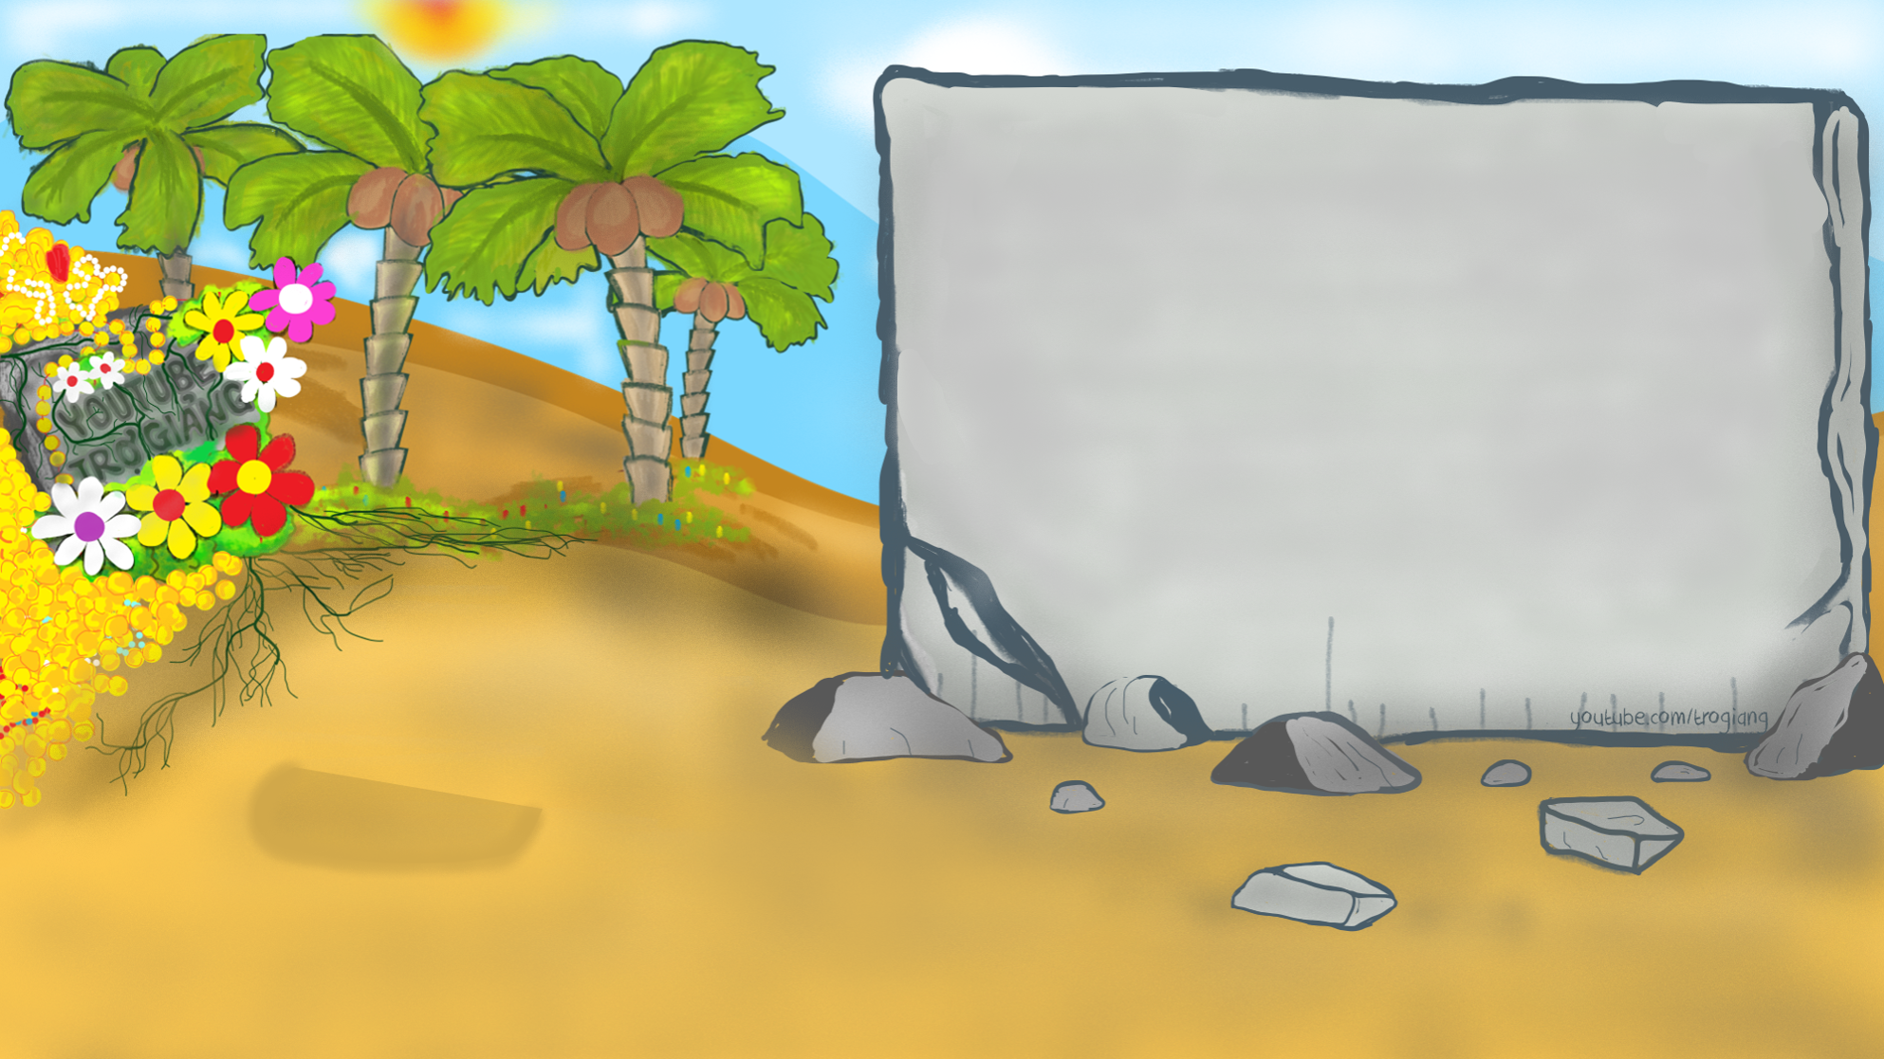













TRÒ CHƠI
TÌM MẬT MÃ

Slide 4

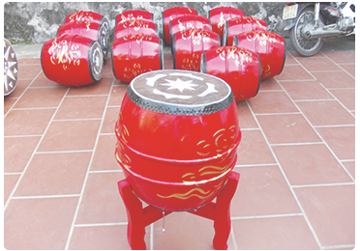


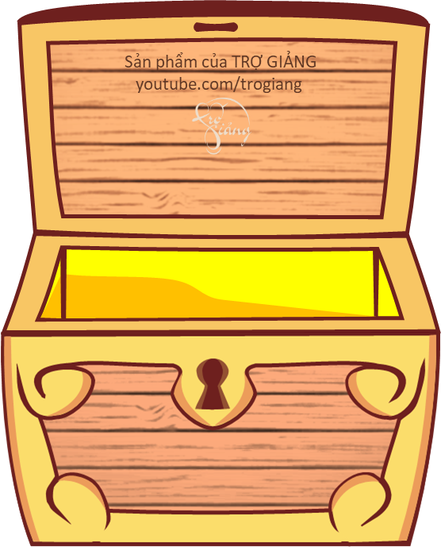







1. Please choose the correct name for under picture?
Drums
Drums
Paint
Lantern
Pottery

Slide 5
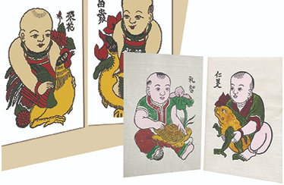


2. Please choose the correct name for under picture?
Paintings
Lantern
Pottery
Paintings
Silk

Slide 6
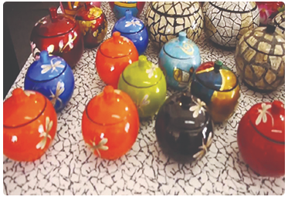

3. Please choose the correct name for under picture?
Lacquerware
Silk
Lacquerware
Lantern
Pottery

Slide 7
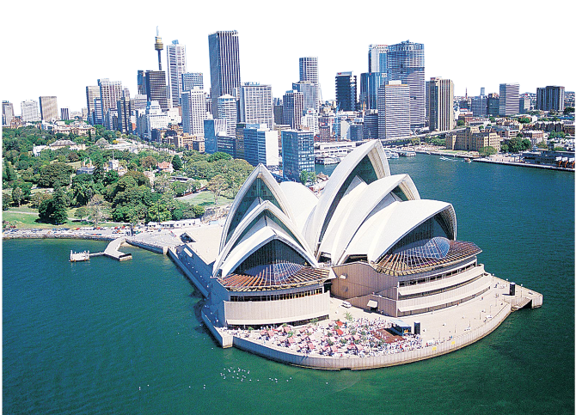

4. Please choose the correct name for under picture?
Sydney Opera House
Pottery
Paint
Lantern
Sydney Opera House

Slide 8
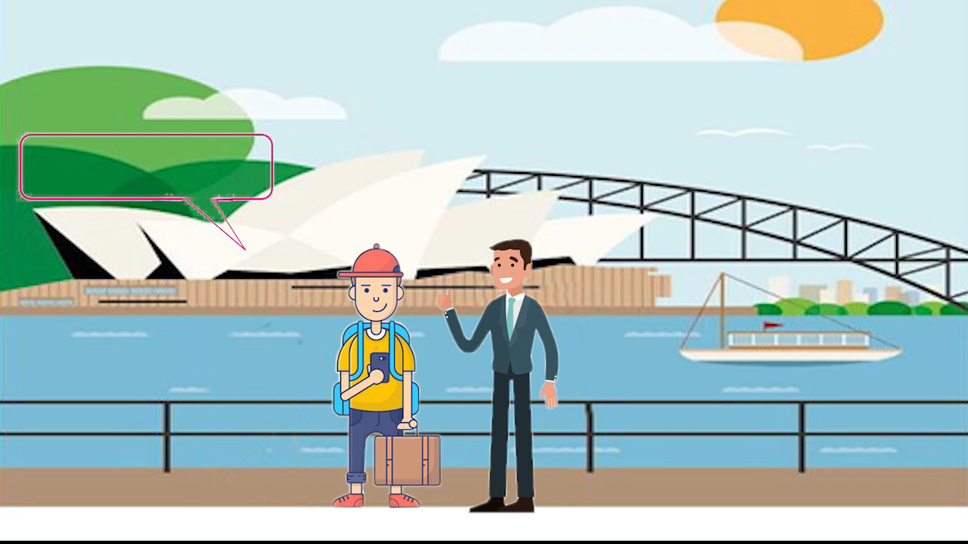

Slide 9

UNIT 2: City life
Getting started

Slide 10

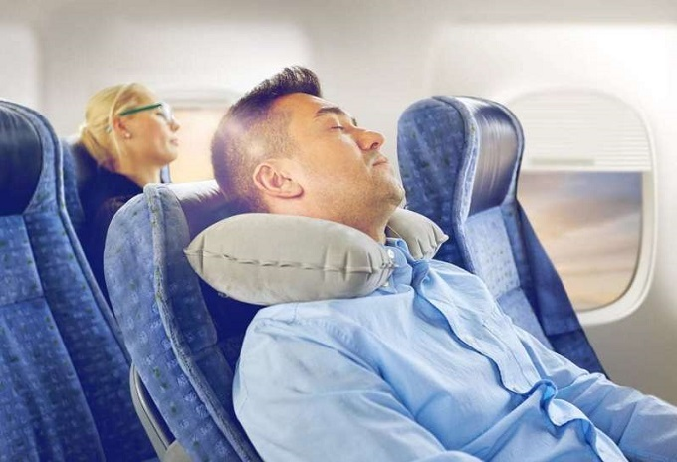

VOCABULARY
jet lag (n)
/ˈdʒet ˌlæɡ/
Sự mệt mỏi sau chuyến bay dài

Slide 11

VOCABULARY
reliable(adj)
/rɪˈlaɪ.ə.bəl/
Đáng tin cậy

Slide 12
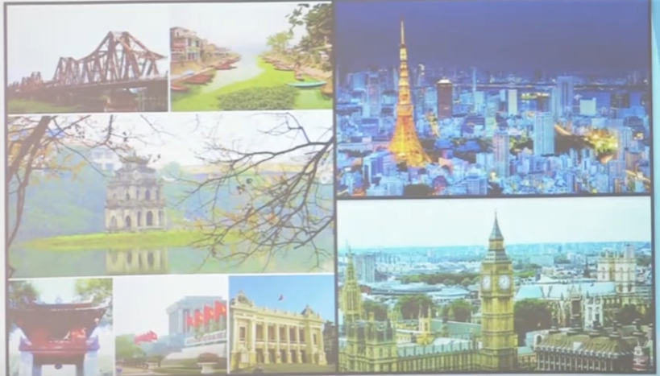
VOCABULARY
Metropolitan (adj)
/ˌmet.rəˈpɒl.ɪ.tən/
Thuộc về thủ đô

Slide 13
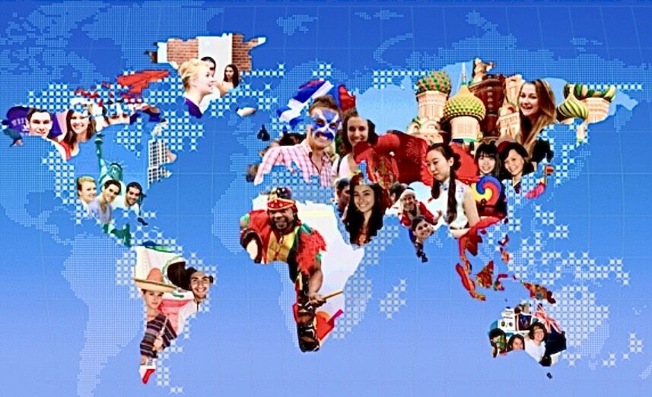
VOCABULARY
multicultural (adj)
/ˌmʌl.tiˈkʌl.tʃər.əl/
Đa văn hóa

Slide 14

VOCABULARY
fabulous (adj)
/ˈfæb.jə.ləs/
Tuyệt vời

Slide 15
1b. Find the word in the conversation to match these definitions.
1. tiredness from traveling across different tome zones
2. an attraction
3. that can be trusted
4. belonging to a very large city
5. including people of different races, religons, languages, and traditions
jet lag
a feature
reliable
metropolitan
multicultural

Slide 16

1a. Complete the sentences with information from the conversation.
1. It is Duong's first _________ to Sydney.
2. In Paul's opinion, Sydney is not _________ an city.
3. Sydney Harbour is a _________ attraction of Sydney.
4. The shopping is good because of the ________ of things.
5. Duong thinks Sydney may be a good place to _________.
visit
ancient
natural
variety
study

Slide 17

Lucky Number Game

Slide 18

1
2
3
4
5
6

Slide 19



Lucky number.
Congratulation !

Slide 20


1. Where did Paul grow up?
- He grew up in Sydney.

Slide 21

2. What is the biggest city in Australia?
- Sydney is

Slide 22

3. How is the public transport in Sydney?
- It is convenient and reliable.

Slide 23

4. Why is there a great variety of things and foods in Sydney?
- Because it is a metropolitan and multicultural city.

Slide 24

5. When was the first university built in Sydney?
- In 1850.

Slide 25
1d. Think of other ways to say these expressions from the conversation.
1. "How's it going?"
-> How are you? / How are things? / How are you doing?
2. "Getting over the jet lag?"
-> (Are you) recovering from the jet lag?
3. "I slept pretty well"
-> I slept quite well.
4. "No worries"
-> No problem./ / Nevermind. / Don’t bother..

Slide 26
2. Replace the word(s) in italics with one of the words from the box.
crowded – international – local – urban – neighboring
There is not a lot of world news in this newspaper.
I do my shopping in the neighborhood shops, not in the town centre.
At weekends the city centre is always packed with people.
My friend's family has just moved to a nearby town.
5. There is far too much pollution nowadays in city areas.
international
local
crowded
neighbouring
urban

Slide 27
3. Work in pairs to do the quiz.
CITY QUIZ
1. Which city is the oldest?
Ha Noi B. Hue C. Can Tho
2. Which city is in Oceania?
Baghdad B. Amsterdam C. Canberra
3. Which city is the best-known city in North America?
Chicago B. Vancouver C. New York
4. Which city is in Africa?
Luanda B. Athens C. Buenos Aires
5. Which city has the World Heritage status?
Bac Giang B. Vinh C. Hoi An
6. Which is a capital city?
A. Rio B. Moscow C. Osaka

Slide 28
LESSON END

Slide 29
HOME WORK
Learn by heart the new words
Practice the dialogue.
Redo exercise 1c/ page 17
Prepare U2- A closer look 1

Slide 30
Thank for your attention!

