Slide 1


WELCOME TO OUR CLASS!!!

Slide 2
UNIT 1: MY NEW SCHOOL
LESSON 1: GETTING STARTED
1
Listen and read

Slide 3

A special day
1
Listen and read
Duy: Yes! I have new books, and we have new subjects to study.
Phong: And a new uniform, Duy! You look smart!
Duy: Thanks, Phong. We always look smart in our uniforms.
Phong: Let me put on my uniform. Then we can go.
(Loud knock)
Phong: Hi, Vy.
Vy: Hi, Phong. Are you ready?
Phong: Just a minute.
Vy: Oh, this is Duy, my new friend.
Phong: Hi, Duy. Nice to meet you.
Duy: Hi, Phong. I live near here, and we go to the same school!
Phong: Good. Hmm, your school bag looks heavy.

Slide 4
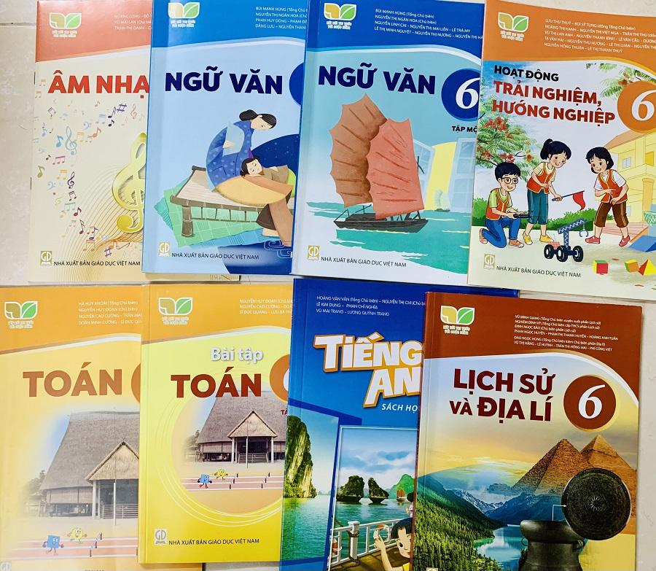
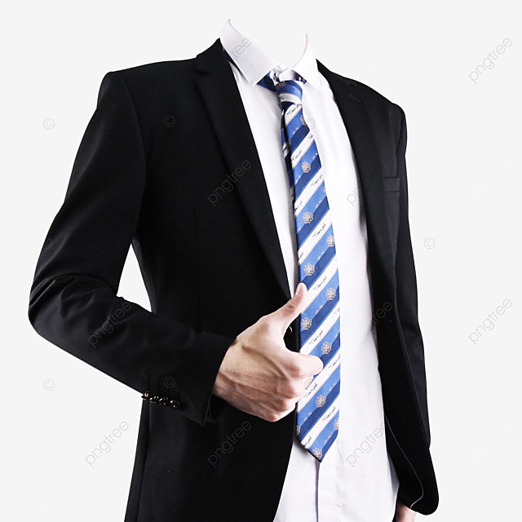
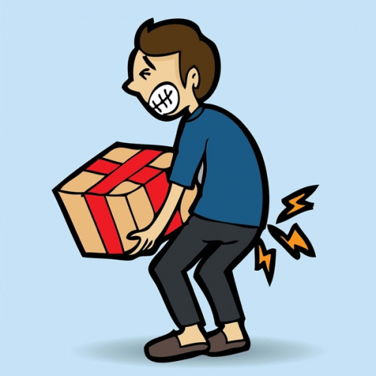
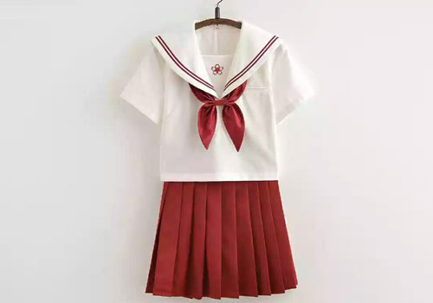
VOCABULARY
- Heavy:
nặng nề
- Subject:
môn học
- Uniform:
đồng phục
- Smart:
lịch sự, lịch lãm

Slide 5
Read the conversation again and tick True or False
2
 | T | F
Vy, Phong, and Duy go to the same school.
Duy is Phong’s friend.
Phong says Duy looks smart in his uniform.
They have new subjects to study.
Phong is wearing a school uniform.
√
√
√
√
√

Slide 6
Write ONE word from the box in each gap
3
go
subjects
has
wear
uniforms
1. Students ____ their uniforms on Monday.
2. Vy ____ a new friend, Duy.
3. -Do Phong, Vy, and Duy ____ to the same school?
-Yes, they do.
4. Students always look smart in their ________.
5. -What _______ do you like to study?
- I like to study English and history.

Slide 7
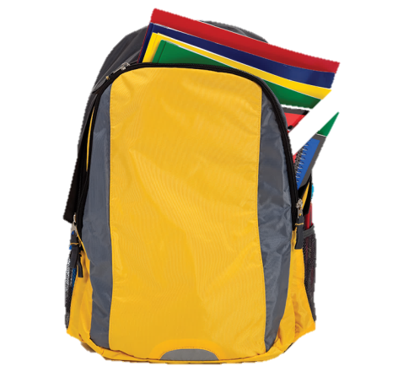
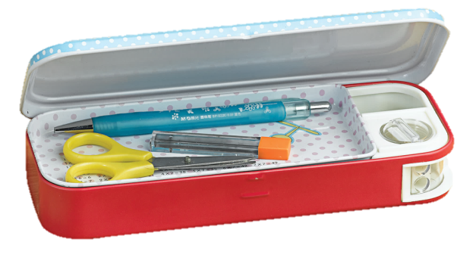
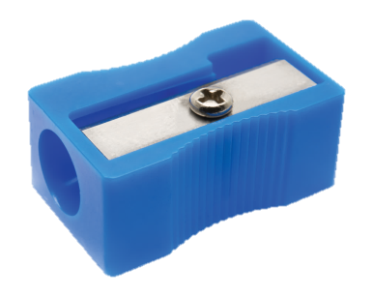
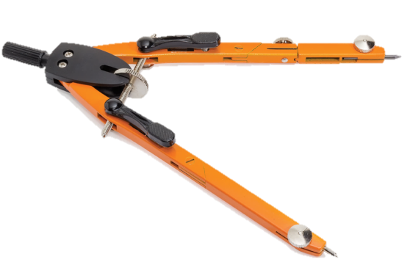
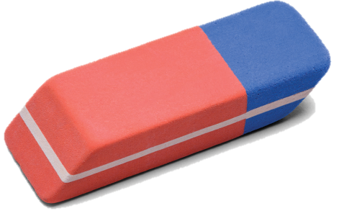
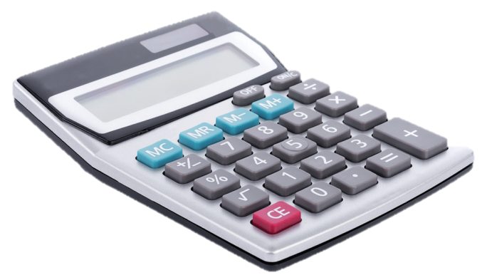
Match the words with the school things. Then listen and repeat.
4
School bag
Pencil sharpener
Pencil case
Compass
Rubber
Calculator

Slide 8
Look around the class. Write the name of the things you see in your notebook.
5
EX: I see pens, pencils, compass, pencil sharpeners, rubbers, calculators, pencil cases, school bags, rulers, books,.........
PLAY
END

Slide 9
LUCKY STAR
1
2
3
4
5
6
END

Slide 10

☺QUESTION☺
1. Calculator means: ..........?
A. Máy tính
B. Com-pa
C. Cây thước
D. Cục tẩy

Slide 11

☺QUESTION☺
2. Is this a rubber?
A. No, this is
B. Yes, I do
C. Yes, that is
D. No, this isn’t

Slide 12
LUCKY STAR!

Slide 13
☺QUESTION☺
3. What is this?
A. Calculator
B. Compass
C. Ruler
D. Rubber

Slide 14
☺QUESTION☺
4. Do Phong, Vy and Duy go to the same school?
A. No, they don’t
B. Yes, he does
C. Yes, they do
D. No, he doesn’t

Slide 15
LUCKY STAR!

Slide 16


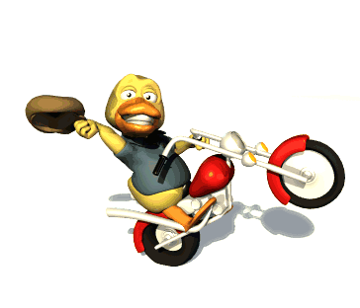

GOOD BYE!!!!!!
SEE YOU NEXT LESSON

