Slide 1

Unit 1: Free time
Lesson 1.2: Grammar
Page 5

Slide 2
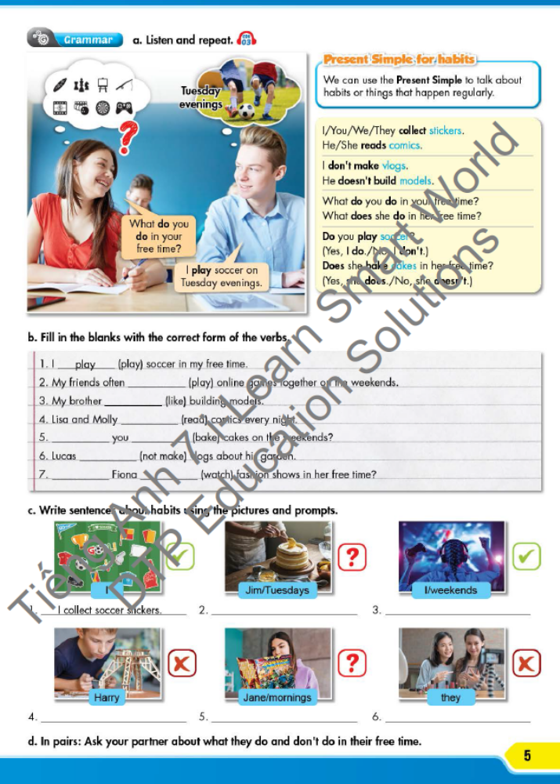


LESSON OUTLINE
Consolidation

Slide 3
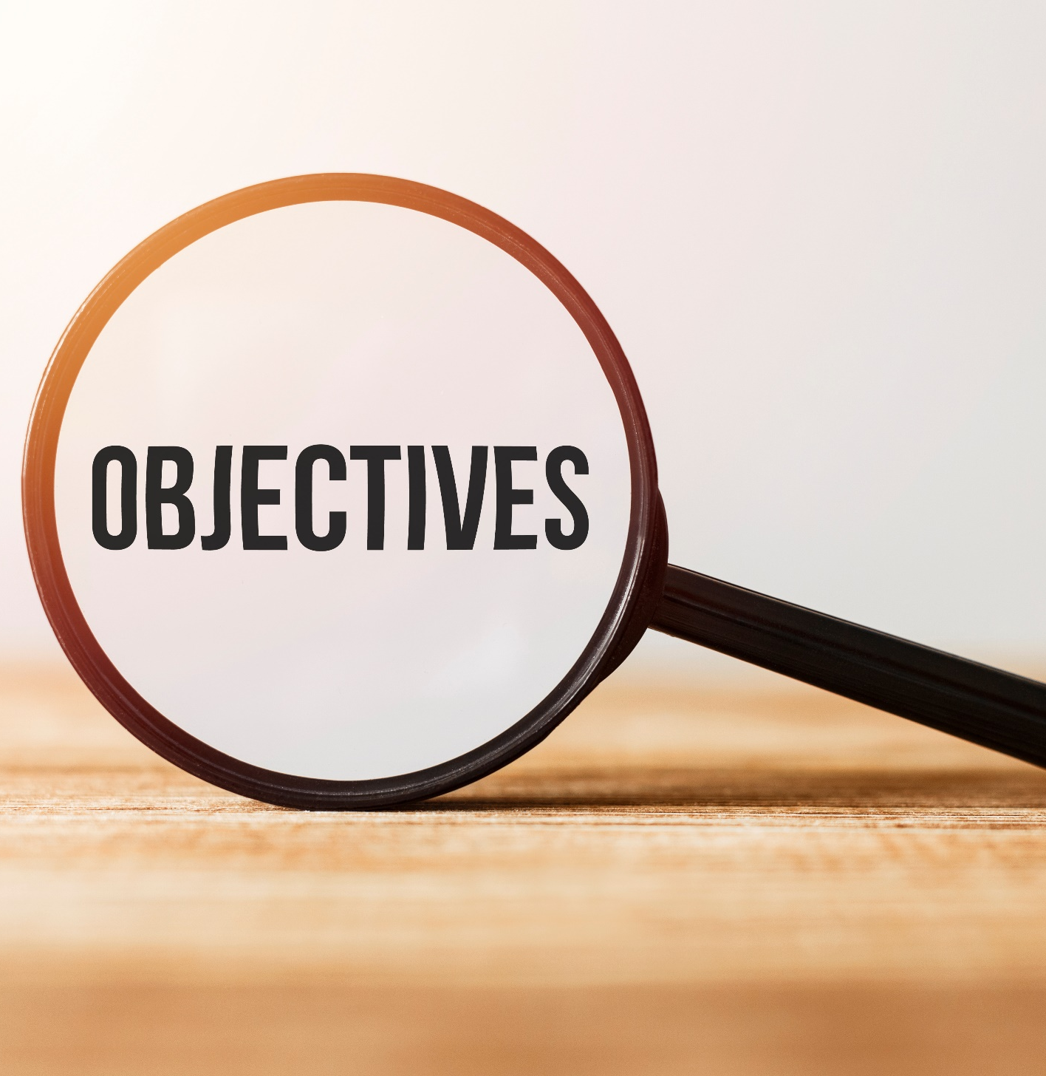
By the end of this lesson, students will be able to…
- use the Present Simple correctly.
- write simple sentences about habits.

Slide 4

WARM UP

Slide 5
Unit 1
Lesson 1
JUMBLED WORDS
Rearrange the letters to make meaningful words.
1. bbohy
2. deloms
3. moiccs
4. lonnie
5. bouYutre

Slide 6
Unit 1
Lesson 1
JUMBLED WORDS
Rearrange the letters to make meaningful words.
1. bbohy
2. deloms
3. moiccs
4. lonnie
5. bouYutre
1. hobby
2. models
3. comics
4. online
5. Youtuber
ANSWER

Slide 7

PRESENTATION
Present Simple

Slide 8
1.I always watch TV after I finish my exercises.
2.We go to the library every Saturday.
3.My father often has a cup of coffee every morning.

Slide 9
Lead in
1. What tense do we use in those sentences?
Present simple.
2. What do we Present Simple for?
→ To talk about habits or things that happen regularly.

Slide 10
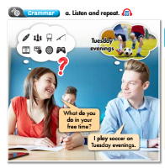
Presentation
How many people are there?
→ There are two.
What are they talking about?
→ They are talking about free time activities
What are you going to do?
→ Listen and repeat.

Slide 11
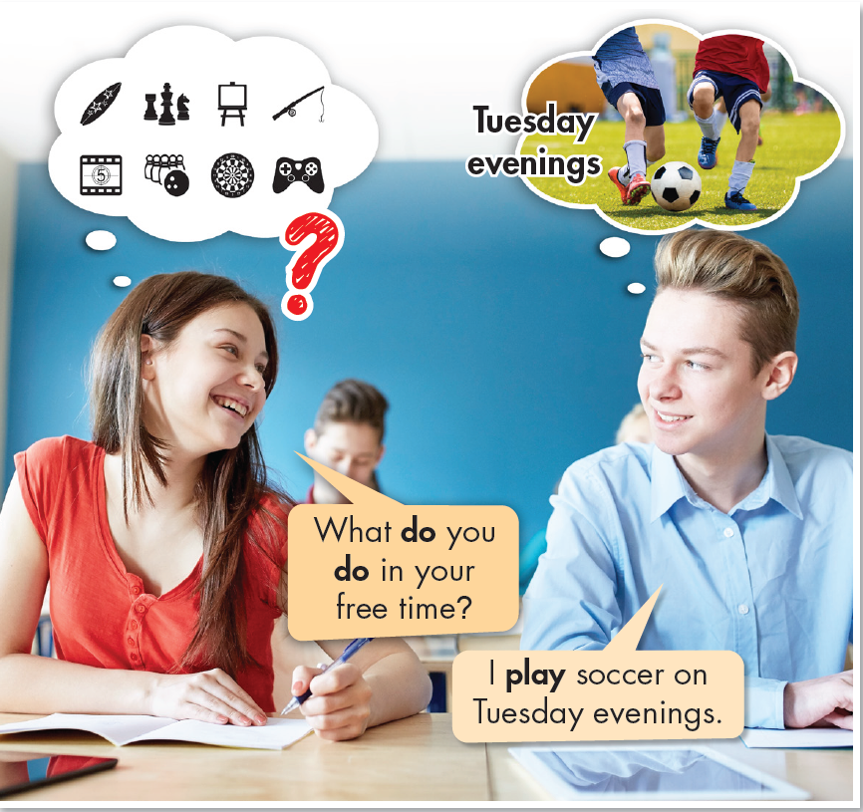

Unit 1

Slide 12
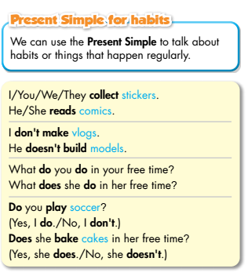
Unit 1
Form:
What is the form of present simple with “normal verb”?
To be:
What is the form of present simple with “to be”?
What is the use of present simple?
(+) S + am / is / are + … (-) S + am / is / are + not + … (?) Am / Is / Are + S + …?
Normal verb:
(+) S + V/ V_{s/es} (-) S + don’t / doesn’t + V _{bare infinitive} (?) Do / Does + S + V _{bare infinitive} ?
Use: We can use the Present Simple to talk about habits or things that happen regularly.

Slide 13

PRACTICE

Slide 14
Practice
b. Fill in the blanks with the correct form of the verbs.
1. I ___________ (play) soccer in my free time.
2. My friends often ___________ (play) online games together on the weekends.
3. My brother ___________ (like) building models.
4. Lisa and Molly ___________ (read) comics every night.
5. ___________ you ___________ (bake) cakes on the weekends?
6. Lucas ___________ (not make) vlogs about his garden.
7. ___________ Fiona ___________ (watch) fashion shows in her free time?
How many sentences are there?
→ There are seven.
What are you going to do?
Fill in the blanks with the
correct form of the verbs.

Slide 15
b. Fill in the blanks with the correct form of the verbs.
1. I ___________ (play) soccer in my free time.
2. My friends often ___________ (play) online games together on the weekends.
3. My brother ___________ (like) building models.
4. Lisa and Molly ___________ (read) comics every night.
5. ___________ you ___________ (bake) cakes on the weekends?
6. Lucas ___________ (not make) vlogs about his garden.
7. ___________ Fiona ___________ (watch) fashion shows in her free time?
play
play
likes
read
Do
bake
doesn’t make
Does
watch

Slide 16
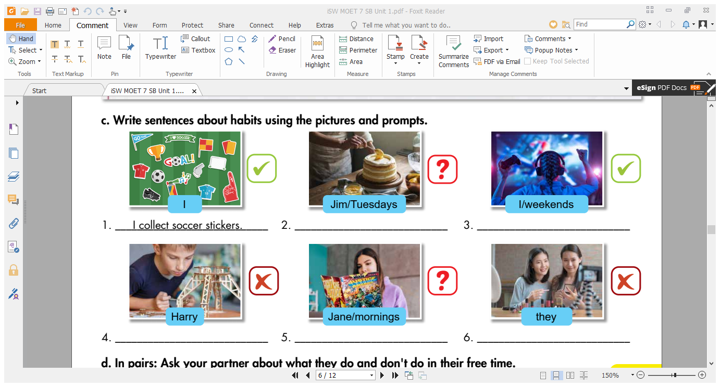
Practice
How many pictures are there?
→ There are six.
What are these?
→ They are prompts.
What are you going to do?
Write sentences about habits
using the pictures and prompts.

Slide 17
Unit 1
bake cakes
play online games
build models
read comics
make vlogs

Slide 18
Write sentences about habits using the prompts.
1. I/ collect/ soccer stickers/.
→ I collect soccer stickers.
2. Jim/ bake cakes/ Tuesday/ ?
→ Does Jim bake cakes on Tuesday?
3. I/ play online games/ weekends/.
→ I play online games on the weekend.

Slide 19
Write sentences about habits using the prompts.
4. Harry/ not/ build models.
→ Harry doesn’t build models.
5. Jane/ read comics/ mornings/?
→ Does Jane read comics in the mornings?
6. They/ not make vlogs/.
→ They don’t make vlogs.

Slide 20
Unscramble the sentences
Extra Practice
WB, page 3
4. plays/on/Molly/weekends./soccer/the
Molly plays soccer on the weekends.
5. her/in/What/your/does/free/sister/do/time?
What does your sister do in her free time?

Slide 21
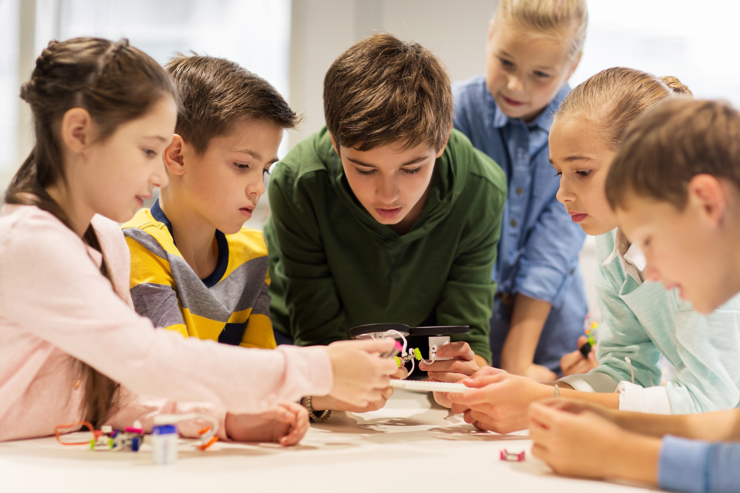
PRODUCTION

Slide 22
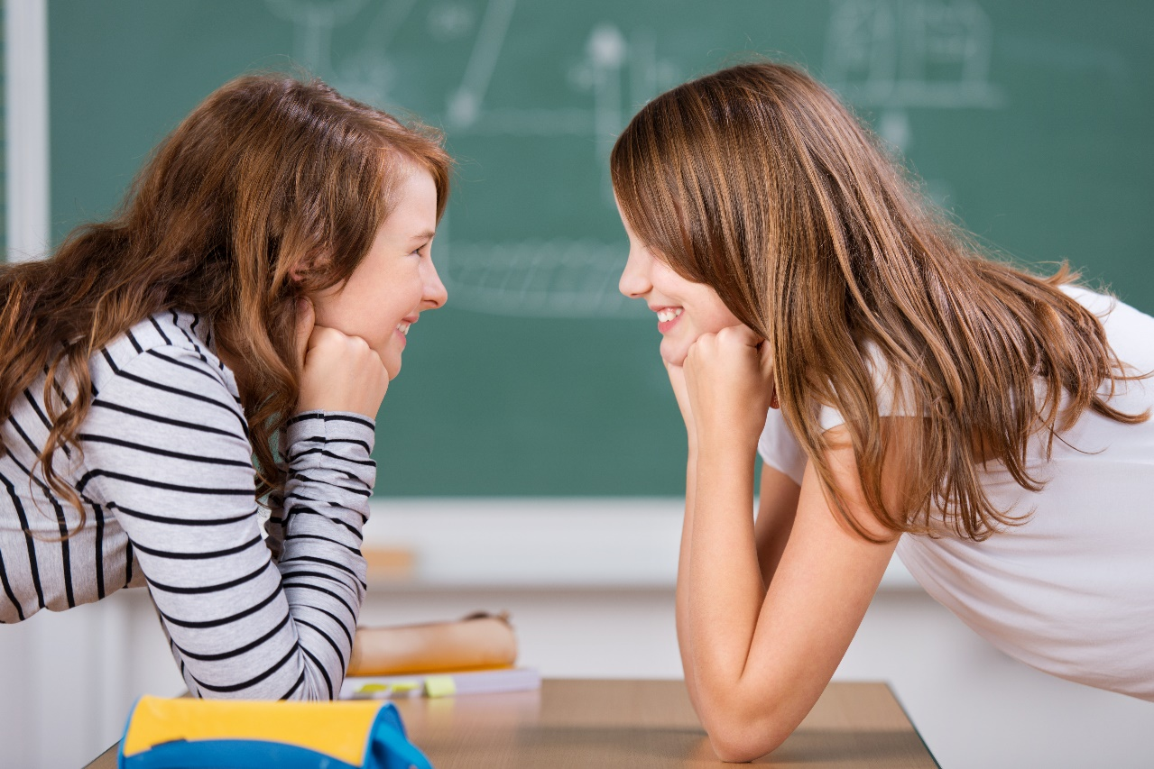
Unit 1
d. In pairs. Ask your partner about what they do and don’t do in their
free time.
What are they doing?
→ They are talking.
Do you think what they are talking about?
They are talking about what they do
and don’t do in their free time?
What are you going to do?
→ Work in pairs and talk about things we do and don’t do in our free time.

Slide 23

Unit 1
Hi Jenny. What do you do in your free time?
Work in pairs. Ask your partner about what you do and
don’t do in your free time.
I read comic books. How about you?
I build models. What don’t you do in your free time?
I don’t collect soccer stickers. And you?
I don’t bake cakes.

Slide 24
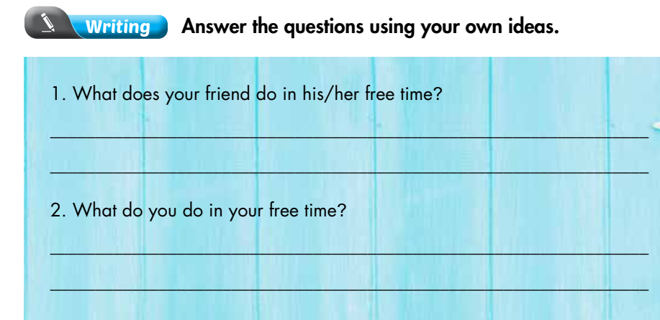
Extra Practice
WB, page 3

Slide 25

CONSOLIDATION

Slide 26
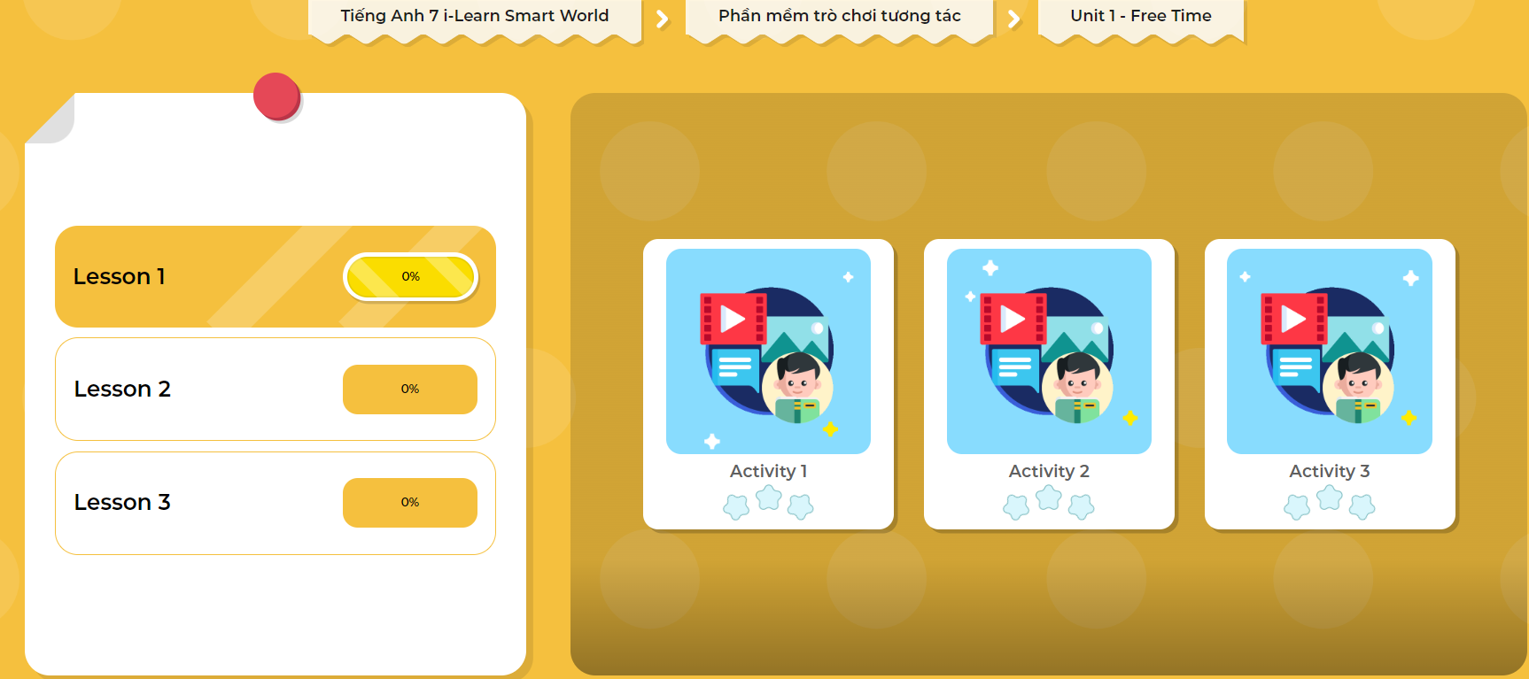
Extra Practice
DHA App
Let’s play!
Click here to play the game

Slide 27
Work in groups: Talk about what you do and don’t do in your free time. Use the grammar point:
  Present Simple

Slide 28
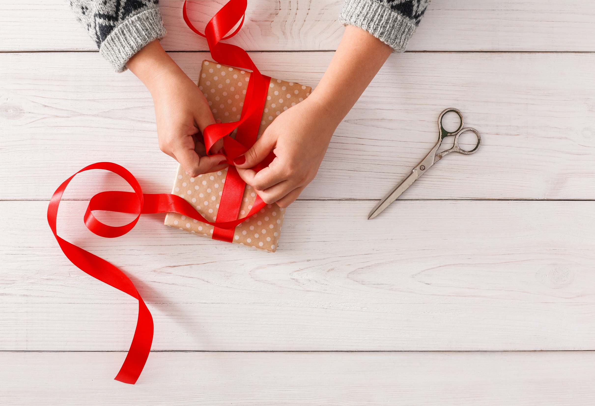
WRAP-UP

Slide 29
Today’s lesson
* Grammar:
- Use Present Simple to talk about habits or things that happen regularly.
* Speaking & Writing:
- Talk and write about what you do and don’t do in your free time.

Slide 30
Homework
Practice making sentences using Present Simple.
Do the exercise on page 5 WB (Writing)
Complete the grammar notes in Tiếng Anh 7 i-Learn Smart World Notebook on page 5.
Prepare the next lesson (page 6 SB).
Play the consolidation games in Tiếng Anh 7 i-Learn Smart World DHA App on www.eduhome.com.vn

Slide 31
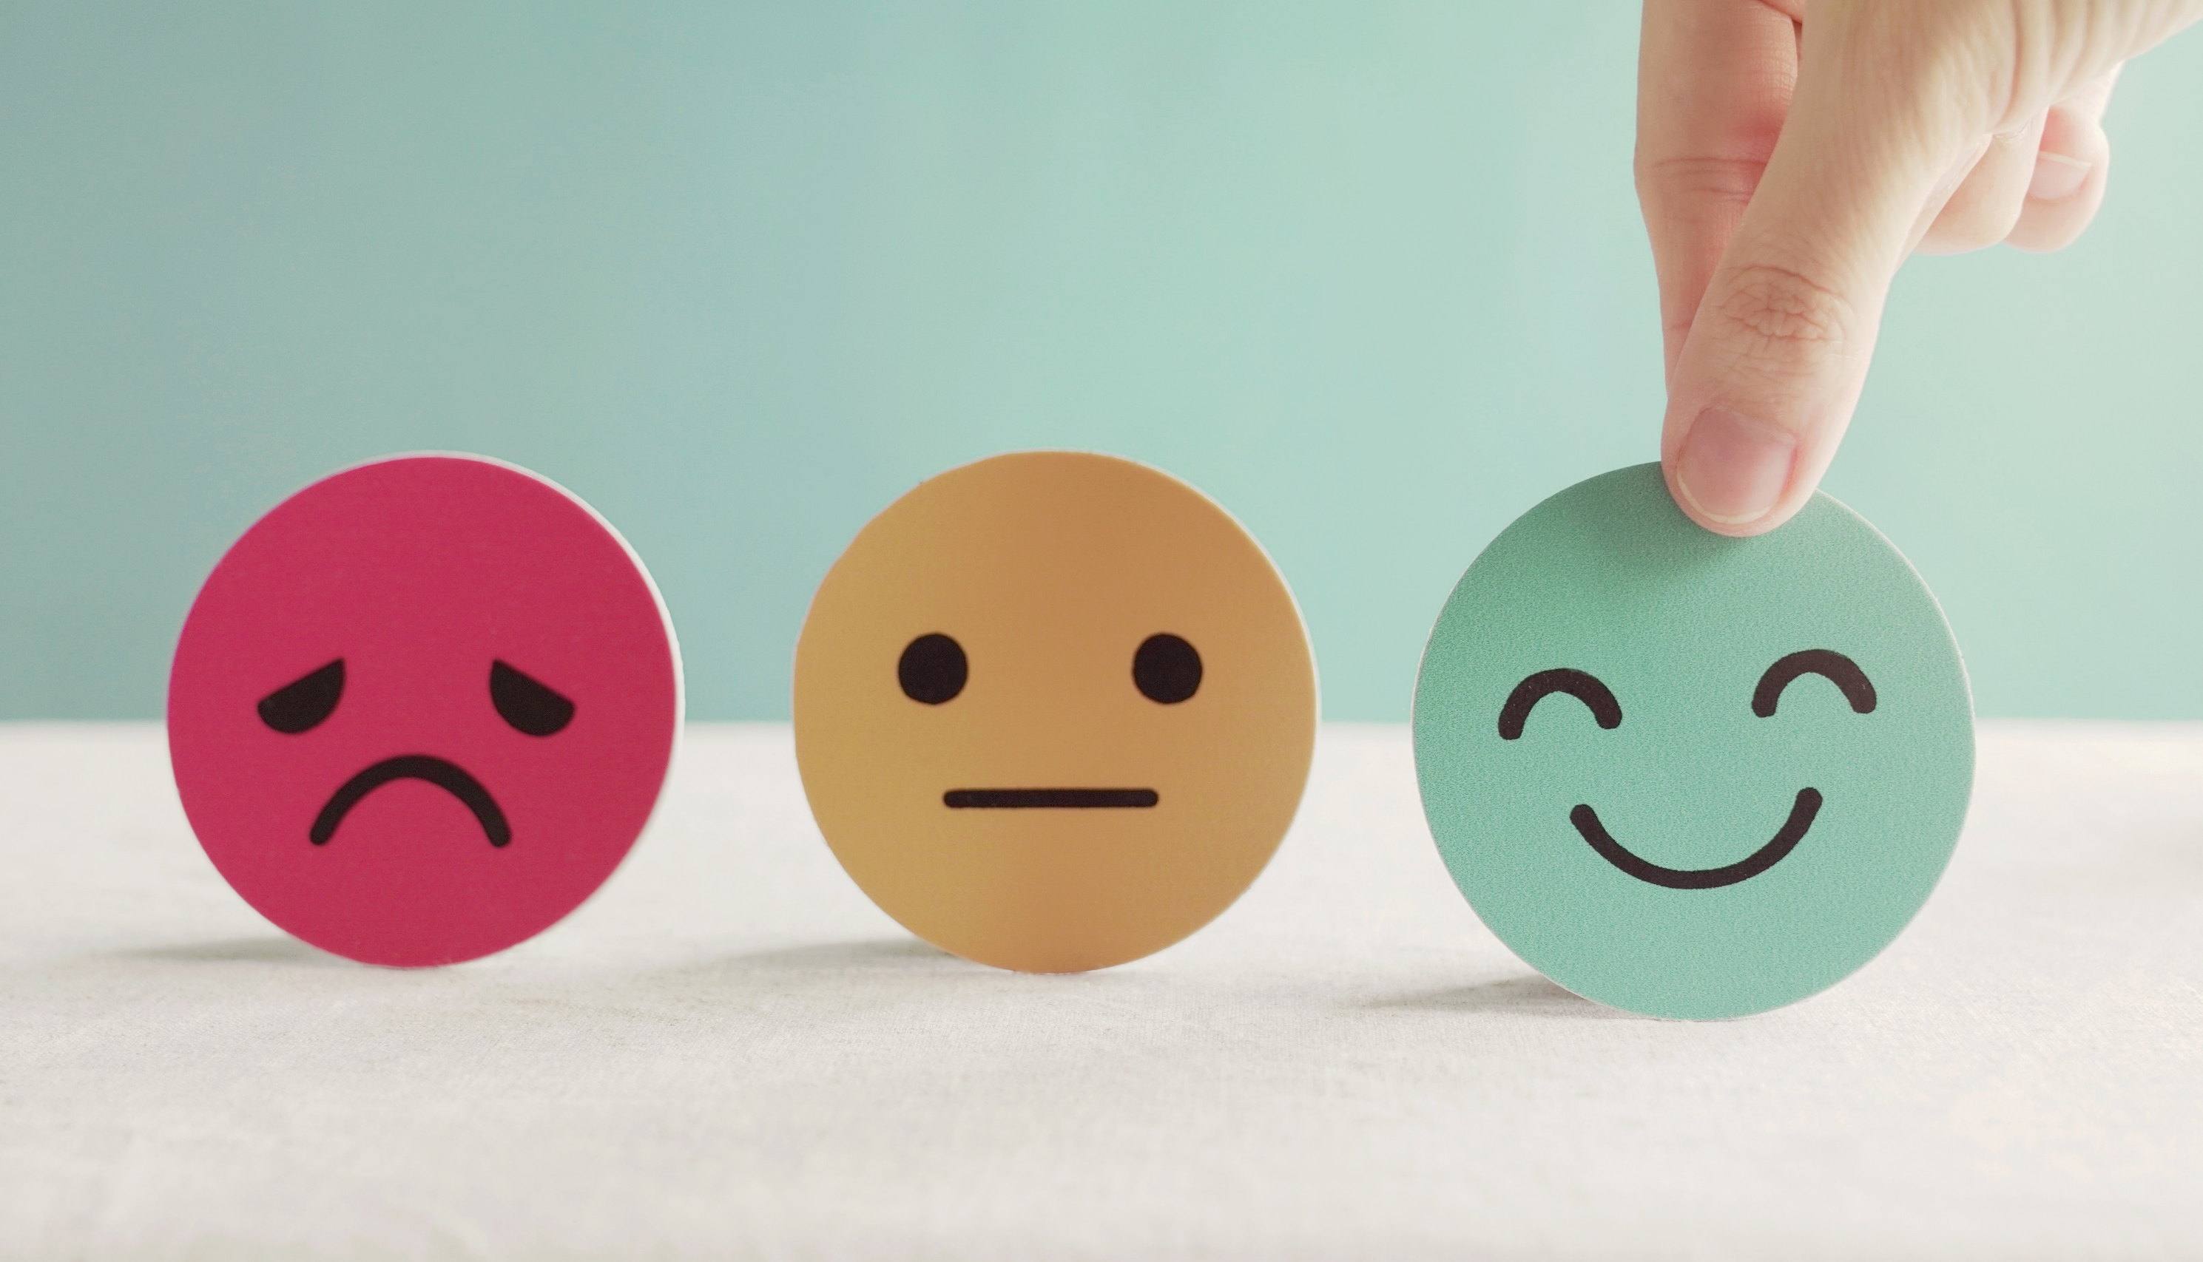
Lesson 3
Stay positive and have a nice day!

