Slide 1
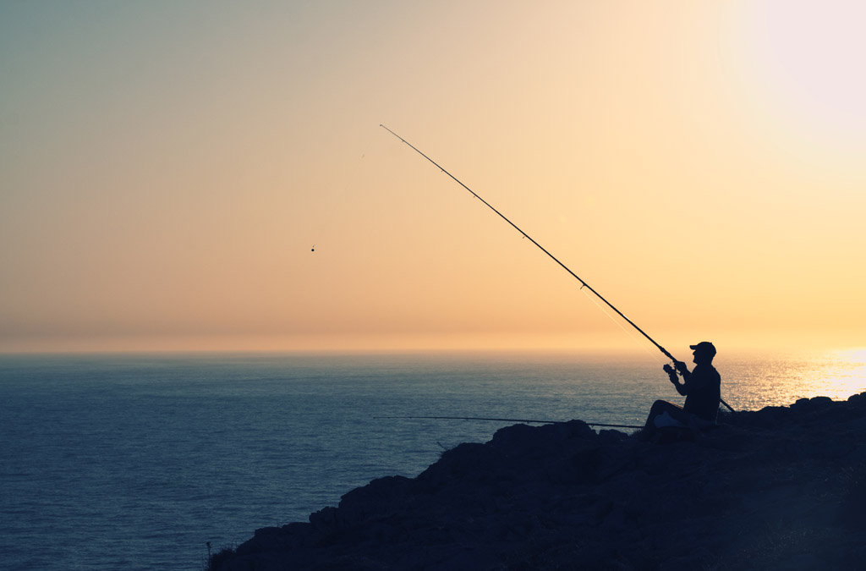

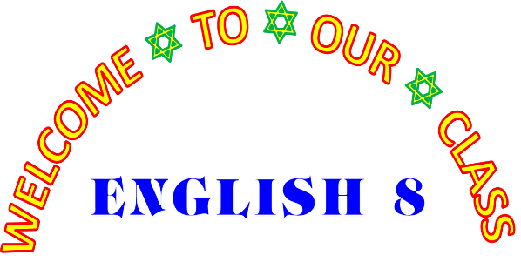


Slide 2
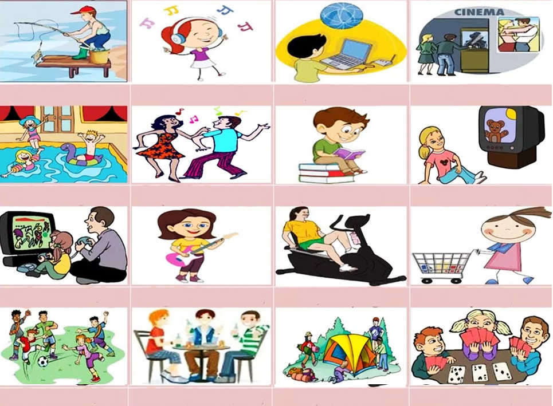
LEISURE ACTIVITIES
Go fishing
Listen to music
Surf the Internet
Go to the cinema
Go swimming
Go dancing
Read books
Watch TV
Play video games
Play an instrument
Do exercises
Go shopping
Play/do sports
Hang out with friends
Go camping
Play cards

Slide 3
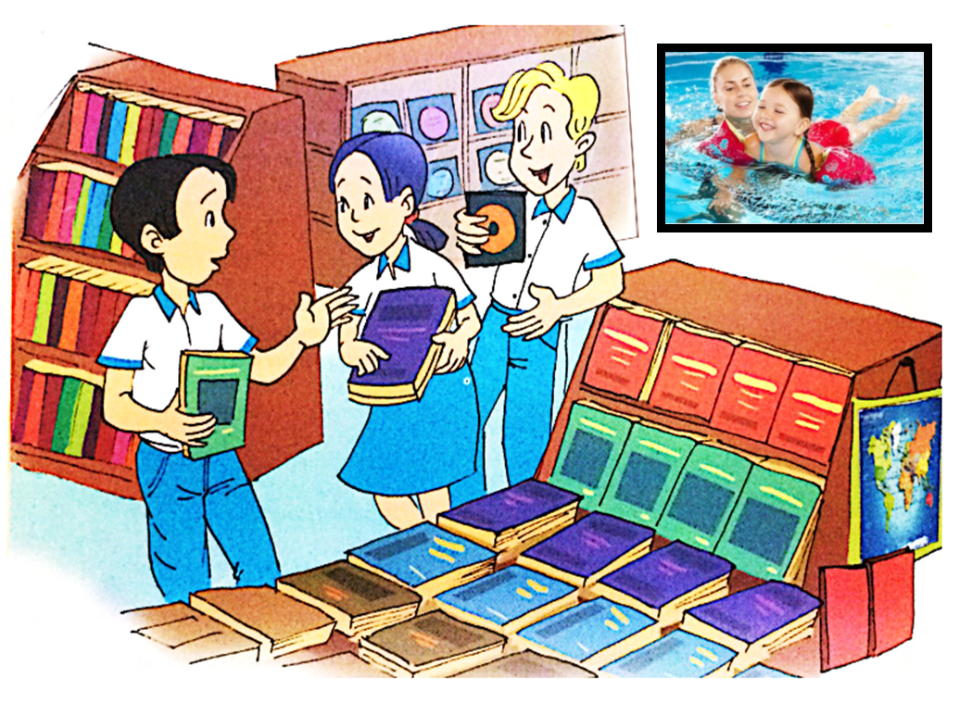
Nick
Mai
Phuc
3. What do they like doing in their free time?
2. What are they holding in their hands?
1. WHERE ARE MAI, PHUC AND NICK?

Slide 4
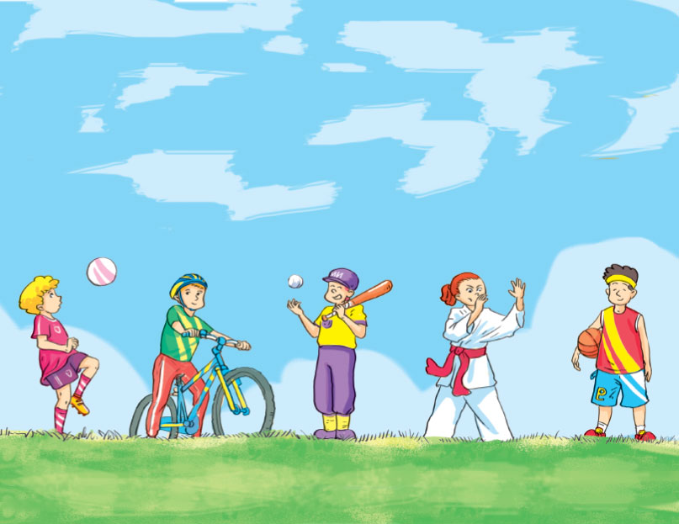
UNIT 1: LEISURE ACTIVITIES
Lesson 1: Getting started

Slide 5
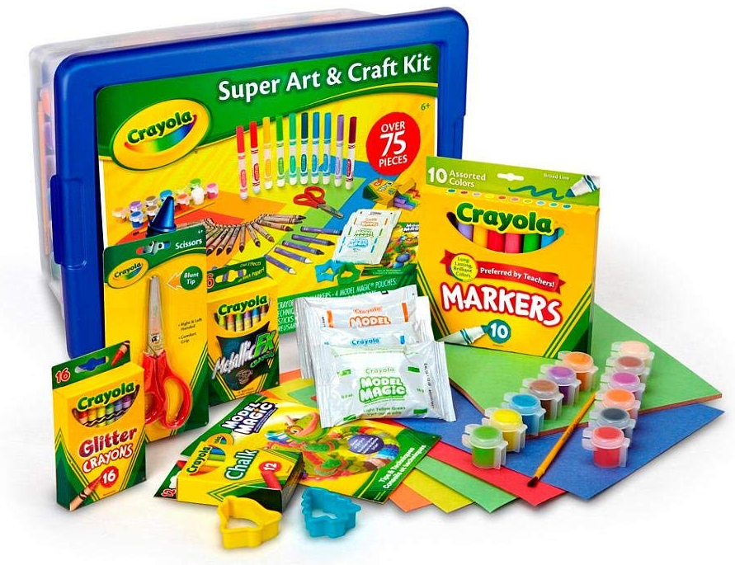
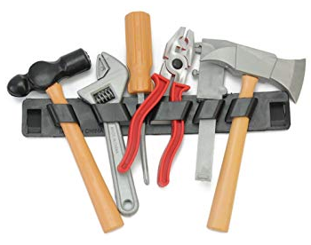
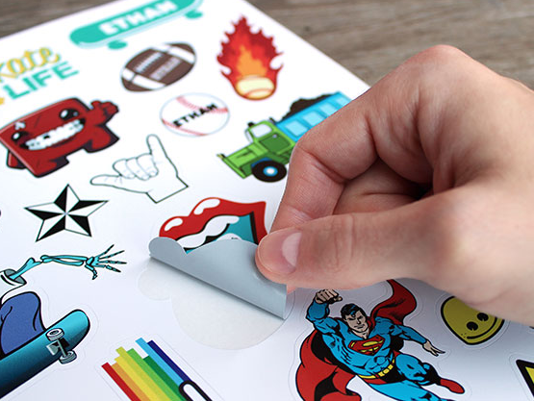
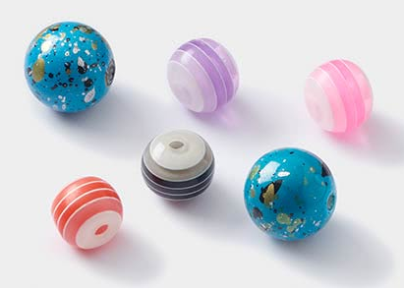
* Vocabulary:
- check out(v)
guide(n)
trick(n)
craft kit(v)
bead(n)
sticker(n)
- improve(v)
tool(n)
- kiểm tra, xem
- hướng dẫn
- mẹo, trò lừa
- bộ đồ thủ công
- hạt, hột (tròn)
- giấy dán, hình dán
cải thiện
công cụ, dụng cụ
- it’s right up my street !(exp)
Hợp ý mình mà.

Slide 6
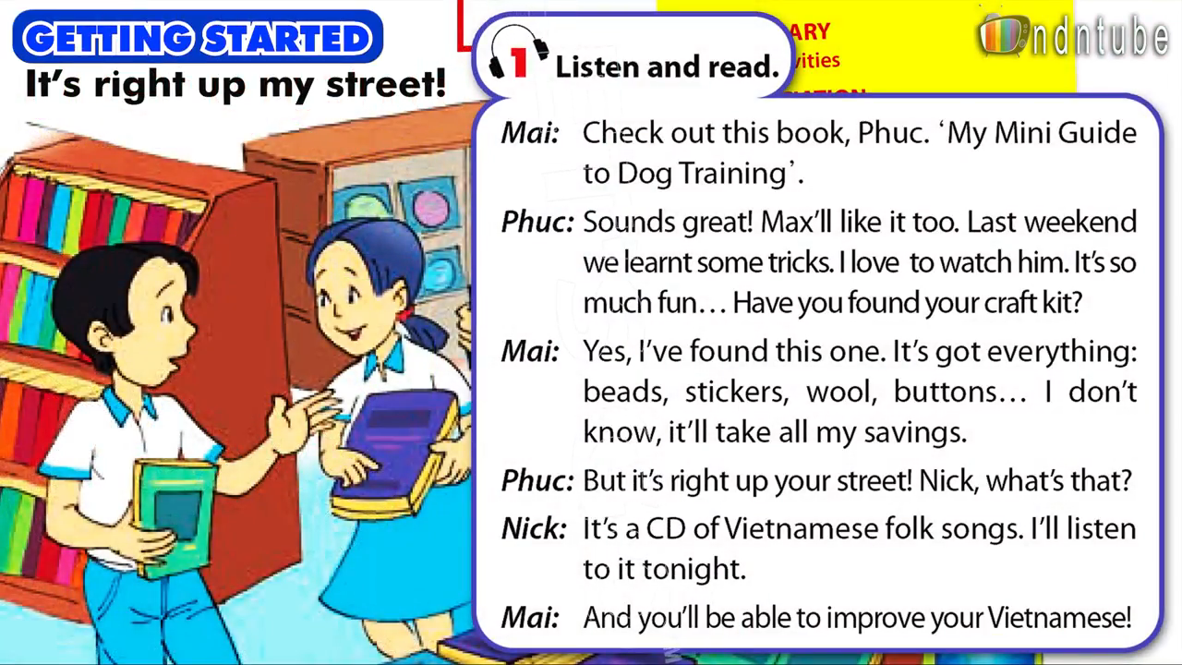
1. Listen and read:

Slide 7
a. Circle the correct answer.
Phuc, Mai, and Nick are in a library / bookstore / sports club.
2. Phuc is looking for a book / dog / craft kit.
3. Max is Phuc’s cat / goldfish / dog.
4. Mai has found a book / CD / craft kit for herself.
5. Nick’s CD is of folk music / pop music / rock music.
6. Nick is trying to learn Vietnamese / Japanese / English.

Slide 8
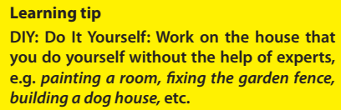
b. Tick ( ) the boxes.
✓
 | Phuc | Mai | Nick
1. pet training
2. making crafts
3. reading
4. listening to music
5. learning languages
6. playing sports
7. helping parents with DIY projects
✓
✓
✓
✓
✓
✓
✓
✓
DIY
✓
✓

Slide 9
c. Answer the questions.
Before answering the questions, look at these notes
- To check out something means to examine something or get more information about it in order to be certain that it is suitable (or true, or safe).
- If something is right up your street, it is the type of thing that you are interested in or that you enjoy doing.

Slide 10
What does Mai mean when she says ‘Check out this book’?
She means Phuc should examine this book.
2. What does Phuc mean when he says ‘It’s right up your street!’?
He means that it is the thing that Mai enjoys.

Slide 11

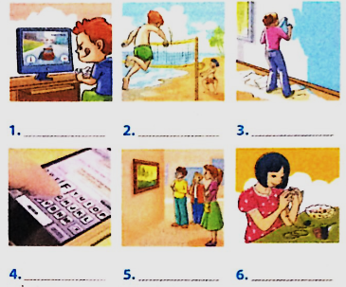
2. Find words/ phrases. Then listen to check.
playing beach games
texting
playing football
visiting museums
making crafts
doing DIY
playing computer games

Slide 12
relaxing
3. Complete the following sentences.
good
fun
satisfied
exciting
boring
You do leisure activities in your free time and they make you feel _______________.
2. You can do _______________ activities such as yoga, or _______________ ones such as mountain biking or skateboarding.
3. Hobbies such as making crafts or collecting things are _______________.
4. You can surf the Internet but some people say this is _______________.
5. You can spend time with family and friends, or
become a volunteer for the community. This will make you feel _______________.

Slide 13


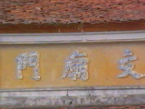
+
C. Homework:
- Learn the new words by heart.
- Practice the dialogue again.
- Do exercises B1 in workbook (page 3).
- Prepare for Unit 1: A closer look 1.

Slide 14

THANKS FOR YOUR ATTENTION!
Goodbye!
See you again!

